Slide 1
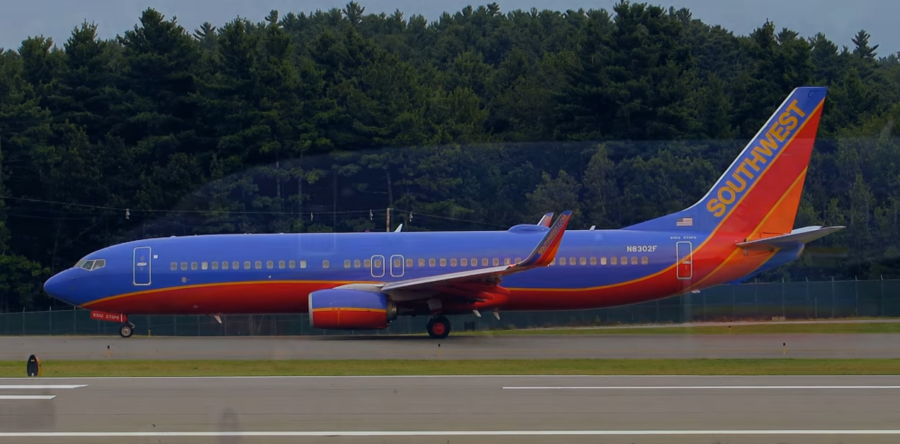
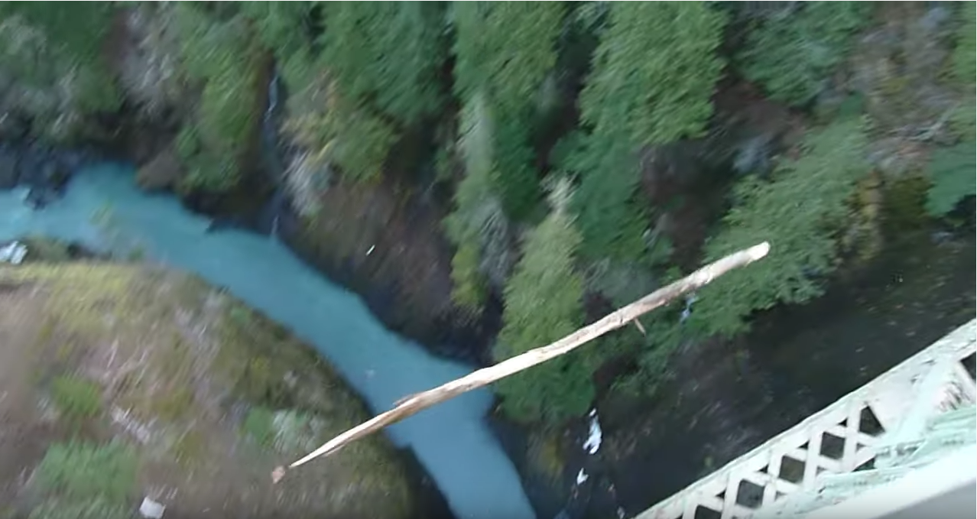
Motion in 1-Dimension
Examples of various types of motion illustrating translational, rotational, and vibrational.
https://www.youtube.com/watch?v=E-4uyXruTxs
https://www.youtube.com/watch?v=E-4uyXruTxs
https://www.youtube.com/watch?v=bUS8aCmytZE
https://www.youtube.com/watch?v=bUS8aCmytZE

Slide 2
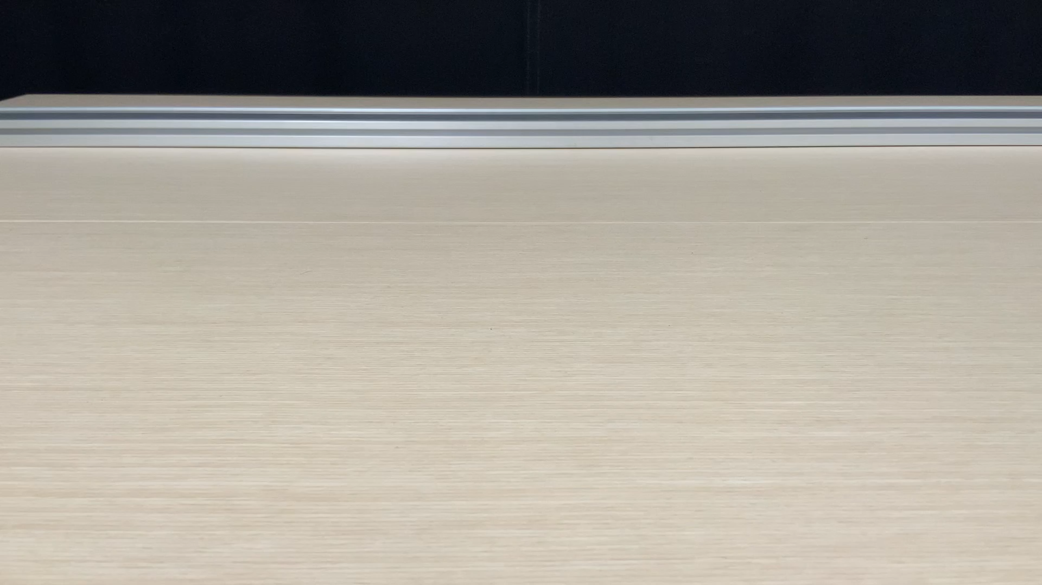


Motion in 1D
- Position vs. time
Here’s a video showing a cart moving in one dimeson.
$$−x$$
$$+x$$
Some “data”
t (s) | x (m)
0 | 12
1 | 17.1
2 | 12.4
3 | -2.1
4 | -26.4
Origin
The cart is at specific locations at every instant of time and what we’d like is to be able to describe the position of the cart as a function of time and from this describe the complete motion of the cart.

Slide 3

















Motion in 1D
- Motion Graphs
B
A
C
BA
$${∆x}_{BA}$$
$${∆x}_{CB}$$
$$a_{CBA}$$
$${∆v}_{CBA}$$
$${∆t}_{BA}$$
$${∆x}_{DC}$$
CB
$${∆t}_{CB}$$
D
$$a_{DCB}$$
$${∆v}_{DCB}$$
$${∆t}_{DC}$$
$${∆t}_{CBA}$$
DC
$${∆x}_{ED}$$
$$a_{EDC}$$
$${∆v}_{EDC}$$
E
$${∆t}_{DCB}$$
ED
$${∆t}_{ED}$$
$${∆t}_{EDC}$$
CBA
DCB
EDC

Slide 4
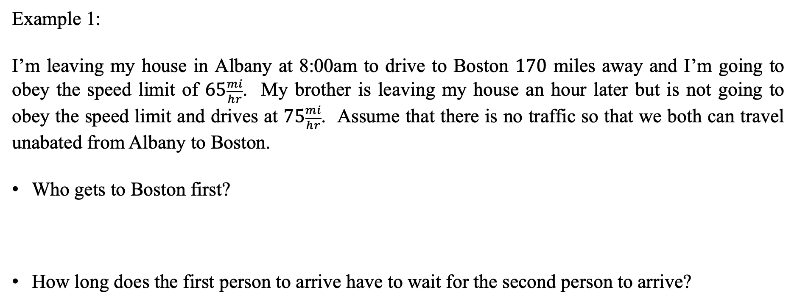
Motion in 1D with Constant Acceleration
- Uniform Motion (Constant Speed)
Example 1:
I’m leaving my house in Albany at 8:00am to drive to Boston $170$ miles away and I’m going to obey the speed limit of $65\frac{mi}{hr}$. My brother is leaving my house an hour later but is not going to obey the speed limit and drives at $75\frac{mi}{hr}$. Assume that there is no traffic so that we both can travel unabated from Albany to Boston.
Who gets to Boston first?
How long does the first person to arrive have to wait for the second person to arrive?

Slide 5
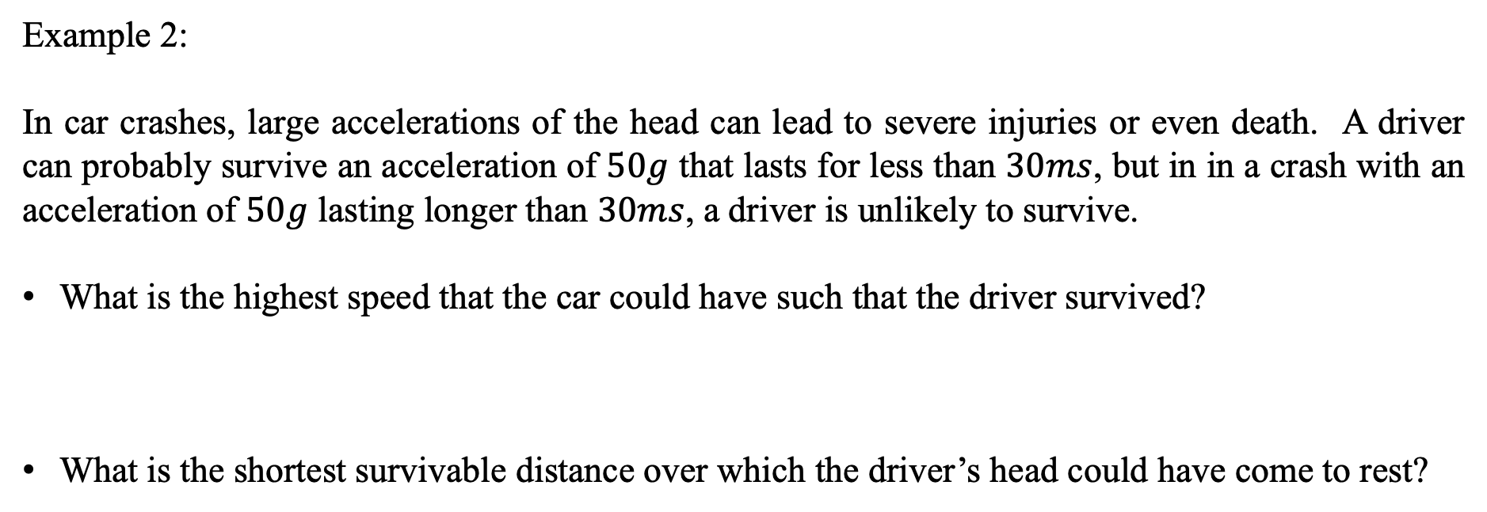
Motion in 1D with Constant Acceleration
- Uniform Motion (Constant Speed)
Example 2:
In car crashes, large accelerations of the head can lead to severe injuries or even death. A driver can probably survive an acceleration of $50g$ that lasts for less than $30ms$, but in in a crash with an acceleration of $50g$ lasting longer than $30ms$, a driver is unlikely to survive.
What is the highest speed that the car could have such that the driver survived?
What is the shortest survivable distance over which the driver’s head could have come to rest?

Slide 6
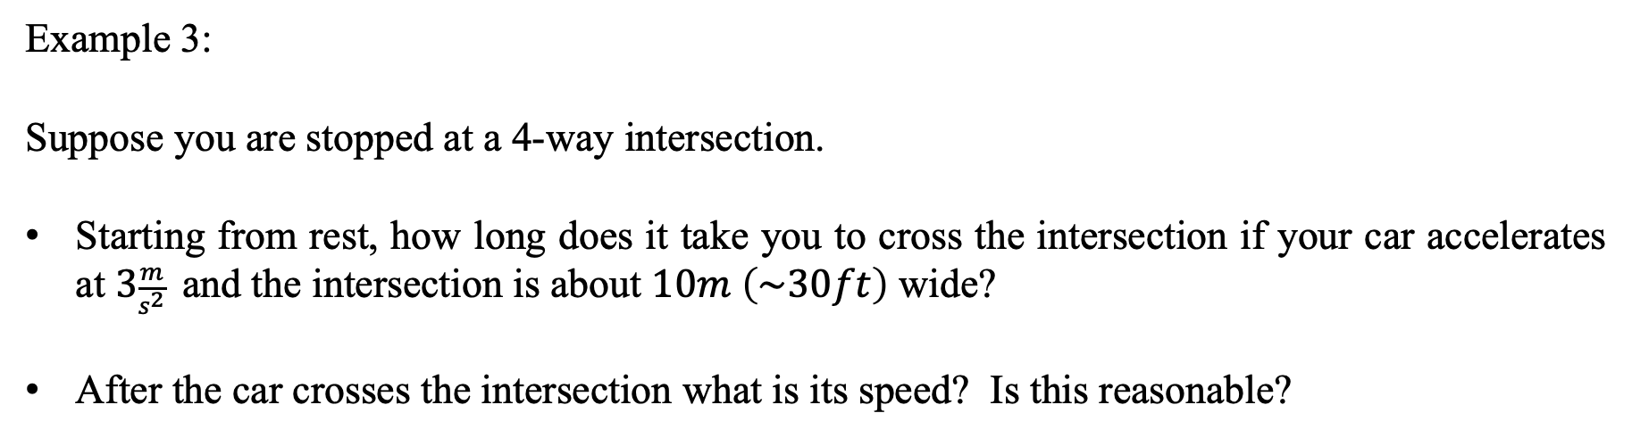
Motion in 1D with Constant Acceleration
- Problems
Example 3:
Suppose you are stopped at a 4-way intersection.
Starting from rest, how long does it take you to cross the intersection if your car accelerates at $3\frac{m}{s^{2}}$ and the intersection is about $10m \left(\sim 30ft\right)$ wide?
After the car crosses the intersection what is its speed? Is this reasonable?

Slide 7
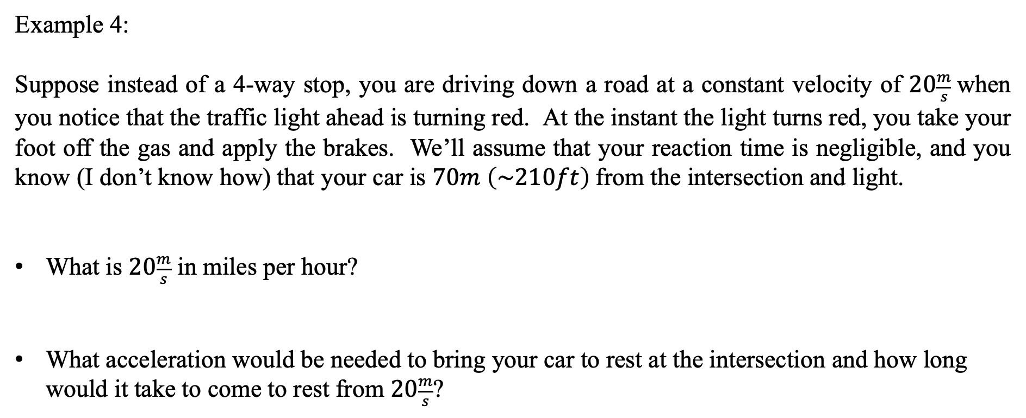
Motion in 1D with Constant Acceleration
- Problems
Example 4:
Suppose instead of a 4-way stop, you are driving down a road at a constant velocity of $20\frac{m}{s}$when you notice that the traffic light ahead is turning red. At the instant the light turns red, you take your foot off the gas and apply the brakes. We’ll assume that your reaction time is negligible, and you know (I don’t know how) that your car is $70m \left(\sim 210ft\right)$from the intersection and light.
What is $20\frac{m}{s}$ in miles per hour?
What acceleration would be needed to bring your car to rest at the intersection and how long would it take to come to rest from $20\frac{m}{s}$?

Slide 8
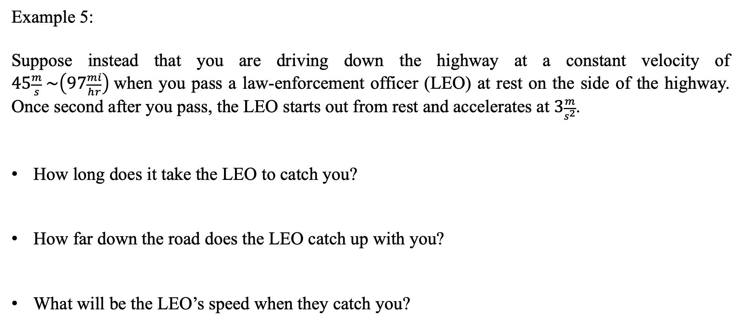
Motion in 1D with Constant Acceleration
- Problems
Example 5:
Suppose instead that you are driving down the highway at a constant velocity of $45\frac{m}{s} \sim \left(97\frac{mi}{hr}\right)$when you pass a law-enforcement officer (LEO) at rest on the side of the highway. Once second after you pass, the LEO starts out from rest and accelerates at $3\frac{m}{s^{2}}$.
How long does it take the LEO to catch you?
How far down the road does the LEO catch up with you?
What will be the LEO’s speed when they catch you?

Slide 9
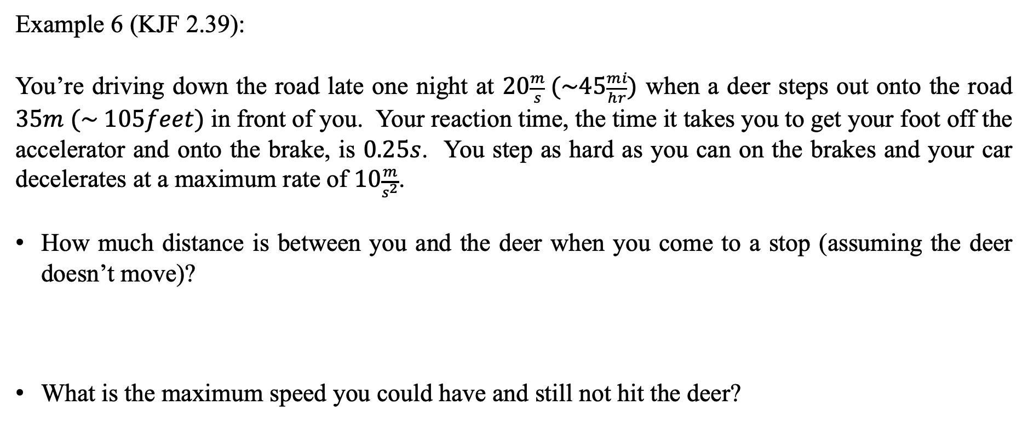
Motion in 1D with Constant Acceleration
- Problems
Example 6 (KJF 2.39):
You’re driving down the road late one night at $20\frac{m}{s} (\sim 45\frac{mi}{hr})$ when a deer steps out onto the road $35m (\sim 105feet)$ in front of you. Your reaction time, the time it takes you to get your foot off the accelerator and onto the brake, is $0.25s$. You step as hard as you can on the brakes and your car decelerates at a maximum rate of $10\frac{m}{s^{2}}$.
How much distance is between you and the deer when you come to a stop (assuming the deer doesn’t move)?
What is the maximum speed you could have and still not hit the deer?

Slide 10
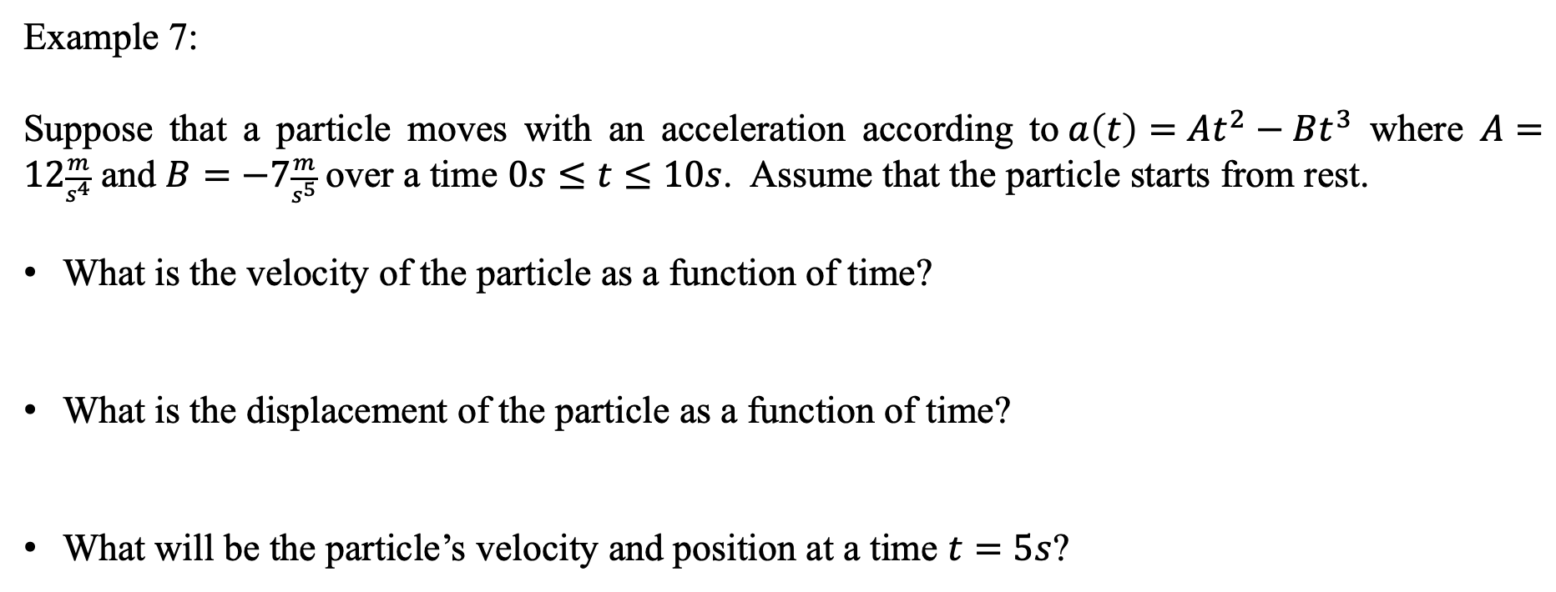
Motion in 1D with Constant Acceleration
- Problems
Example 7:
Suppose that a particle moves with an acceleration according to$a\left(t\right)=At^{2}−Bt^{3}$ where $A=12\frac{m}{s^{4}}$ and $B=−7\frac{m}{s^{5}}$over a time $0s≤t≤10s$. Assume that the particle starts from rest.
What is the velocity of the particle as a function of time?
What is the displacement of the particle as a function of time?
What will be the particle’s velocity and position at a time $t=5s$?

