Slide 1
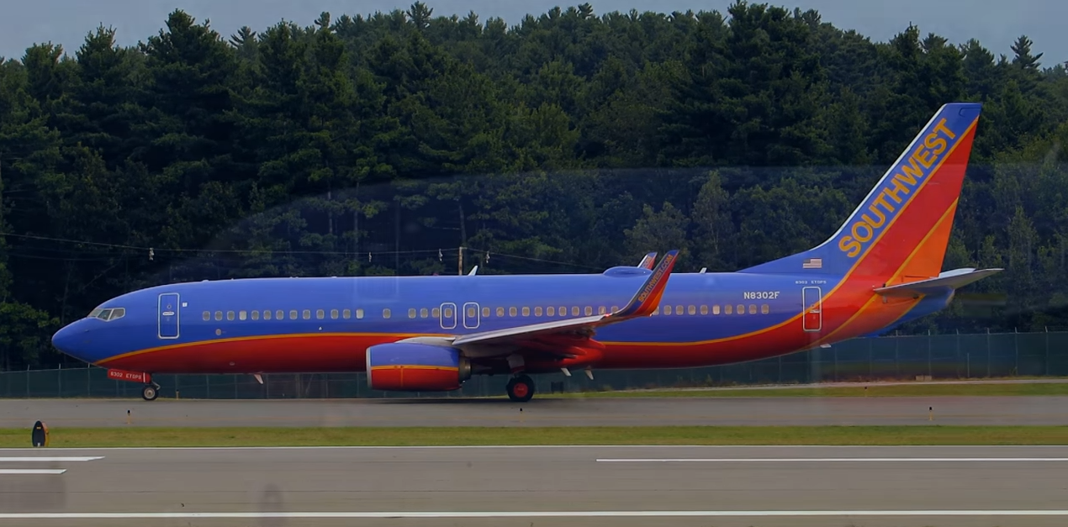
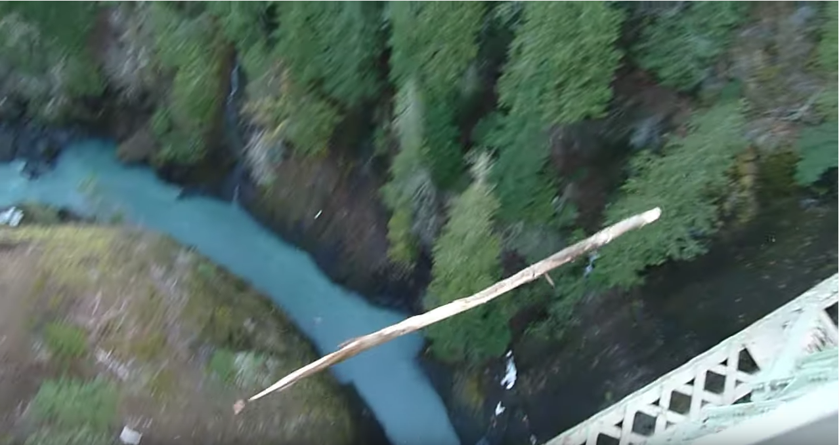
Motion in 1-Dimension
https://www.youtube.com/watch?v=E-4uyXruTxs
https://www.youtube.com/watch?v=bUS8aCmytZE

Slide 2
Motion in 1D
- Position vs. time
Here’s a video showing a cart moving in one dimeson.
$$−x$$
$$+x$$
Some “data”
t (s) | x (m)
0 | 12
1 | 17.1
2 | 12.4
3 | -2.1
4 | -26.4
Origin
The cart is at specific locations at every instant of time and what we’d like is to be able to describe the position of the cart as a function of time and from this describe the complete motion of the cart.

Slide 3
Motion in 1D
- Motion Graphs
B
A
C
BA
$${∆x}_{BA}$$
$${∆x}_{CB}$$
$${∆t}_{BA}$$
$$a_{CBA}$$
CB
$${∆v}_{CBA}$$
$${∆t}_{CB}$$
D
$${∆x}_{DC}$$
$$a_{DCB}$$
$${∆v}_{DCB}$$
$${∆t}_{DC}$$
$${∆t}_{CBA}$$
DC
$${∆x}_{ED}$$
$$a_{EDC}$$
$${∆v}_{EDC}$$
E
$${∆t}_{DCB}$$
ED
$${∆t}_{ED}$$
$${∆t}_{EDC}$$
CBA
DCB
EDC

Slide 4
Motion in 1D with constant acceleration
- Problems
Example 1:
Suppose you are stopped at a 4-way intersection.
Starting from rest, how long does it take you to cross the intersection if your car accelerates at $3\frac{m}{s^{2}}$ and the intersection is about $10m \left(\sim 30ft\right)$ wide?
After the car crosses the intersection what is its speed? Is this reasonable?

Slide 5
Motion in 1D with constant acceleration
- Problems
Example 2:
Suppose instead of a 4-way stop, you are driving down a road at a constant velocity of $20\frac{m}{s}$when you notice that the traffic light ahead is turning red. At the instant the light turns red, you take your foot off the gas and apply the brakes. Assuming that your reaction time is negligible, and you know (I don’t know how) that your car is $70m \left(\sim 210ft\right)$from the intersection and light.
What is $20\frac{m}{s}$ in miles per hour?
What acceleration would be needed to bring your car to rest at the intersection and how long would it take to come to rest from $20\frac{m}{s}$?

Slide 6
Motion in 1D with constant acceleration
- Problems
Example 3:
Suppose instead that you are driving down the highway at a constant velocity of $45\frac{m}{s} \sim \left(97\frac{mi}{hr}\right)$when you pass a law-enforcement officer (LEO) at rest on the side of the highway. Once second after you pass, the LEO starts out from rest and accelerates at $3\frac{m}{s^{2}}$.
How long does it take the LEO to catch you?
How far down the road does the LEO catch up with you?
What will be the LEO’s speed when they catch you?

Slide 7
Motion in 1D with constant acceleration
- Problems
Example 4:
Suppose a ball of mass $m=0.5kg$ dropped from rest from a roof (located a height $h=45m$ above the ground).
How long does it take the ball to reach the ground? This is called the time-of-flight of the projectile.
What is the speed of the ball just before it hits the ground? Do this in two ways using both the time-dependent and time-independent equations of motion.

