Slide 1
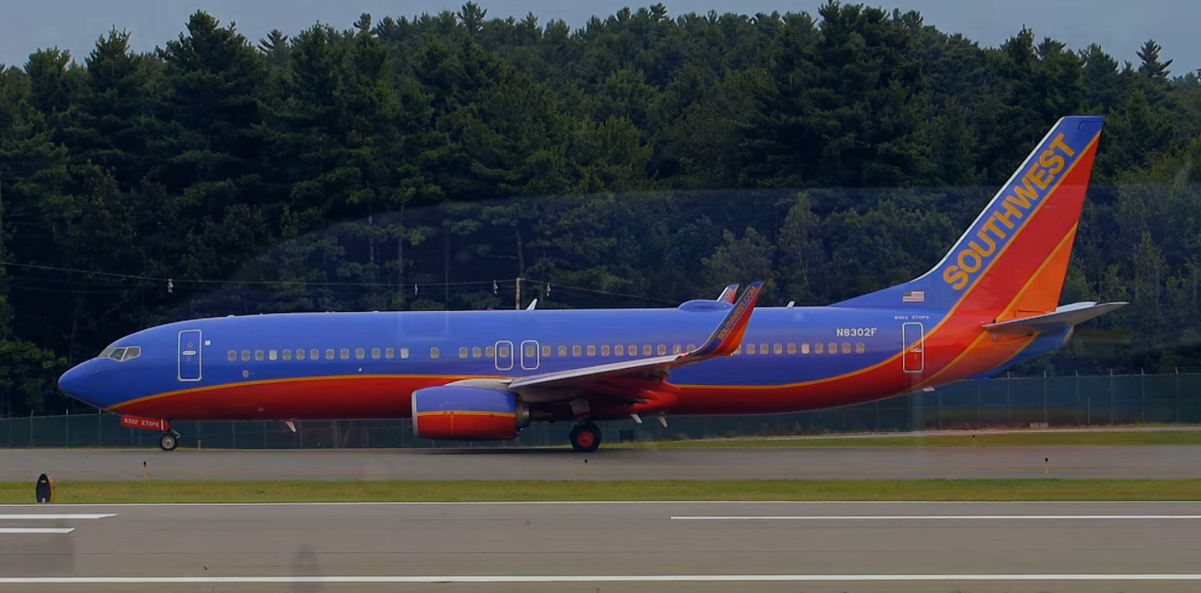
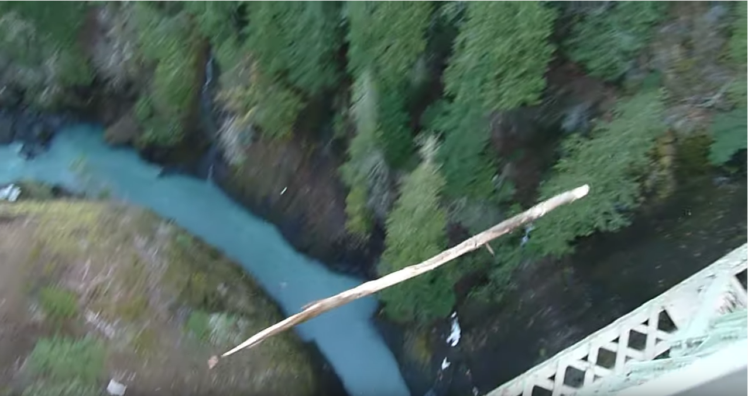
Motion in 1-Dimension
Examples of various types of motion illustrating translational, rotational, and vibrational.
https://www.youtube.com/watch?v=E-4uyXruTxs
https://www.youtube.com/watch?v=E-4uyXruTxs
https://www.youtube.com/watch?v=bUS8aCmytZE
https://www.youtube.com/watch?v=bUS8aCmytZE

Slide 2
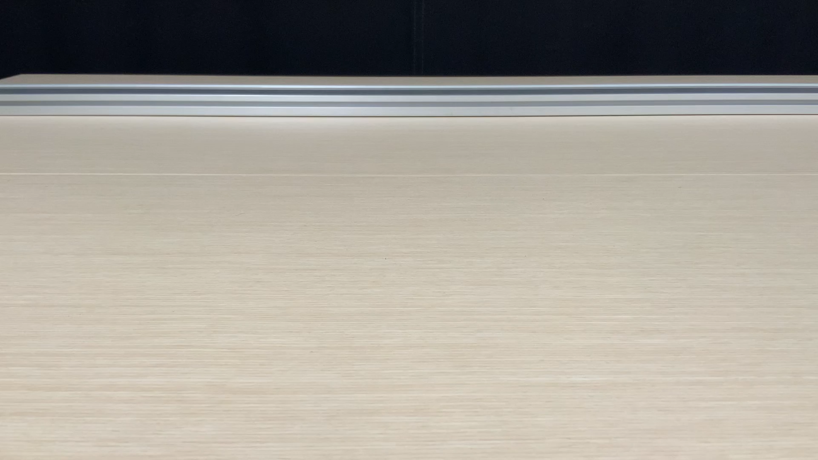


Motion in 1D
- Position vs. time
Here’s a video showing a cart moving in one dimeson.
$$−x$$
$$+x$$
Some “data”
t (s) | x (m)
0 | 12
1 | 17.1
2 | 12.4
3 | -2.1
4 | -26.4
Origin
The cart is at specific locations at every instant of time and what we’d like is to be able to describe the position of the cart as a function of time and from this describe the complete motion of the cart.

Slide 3

















Motion in 1D
- Motion Graphs
B
A
C
BA
$${∆x}_{BA}$$
$${∆x}_{CB}$$
$$a_{CBA}$$
$${∆v}_{CBA}$$
$${∆t}_{BA}$$
$${∆x}_{DC}$$
CB
$${∆t}_{CB}$$
D
$$a_{DCB}$$
$${∆v}_{DCB}$$
$${∆t}_{DC}$$
$${∆t}_{CBA}$$
DC
$${∆x}_{ED}$$
$$a_{EDC}$$
$${∆v}_{EDC}$$
E
$${∆t}_{DCB}$$
ED
$${∆t}_{ED}$$
$${∆t}_{EDC}$$
CBA
DCB
EDC

Slide 4
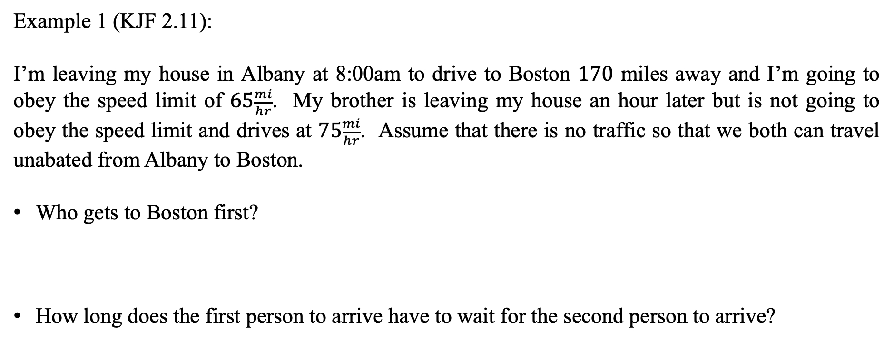
Motion in 1D with Constant Acceleration
- Uniform Motion (Constant Speed)
Example 1 (KJF 2.11):
I’m leaving my house in Albany at 8:00am to drive to Boston $170$ miles away and I’m going to obey the speed limit of $65\frac{mi}{hr}$. My brother is leaving my house an hour later but is not going to obey the speed limit and drives at $75\frac{mi}{hr}$. Assume that there is no traffic so that we both can travel unabated from Albany to Boston.
Who gets to Boston first?
How long does the first person to arrive have to wait for the second person to arrive?

Slide 5
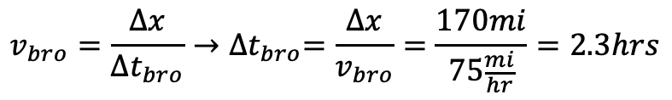
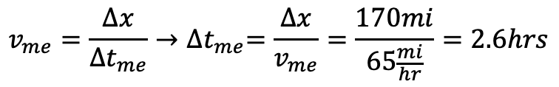
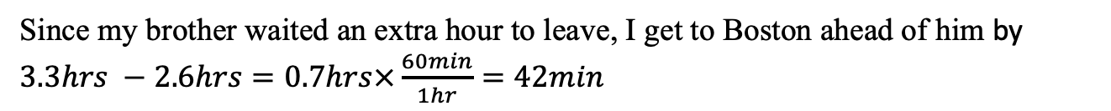


Motion in 1D with Constant Acceleration
- Uniform Motion (Constant Speed)
Example 1 (KJF 2.11) Solution:
Who gets to Boston first?
How long does the first person to arrive have to wait for the second person to arrive?
$$v_{me}=\frac{∆x}{∆t_{me}}→{∆t}_{me}=\frac{∆x}{v_{me}}=\frac{170mi}{65\frac{mi}{hr}}=2.6hrs$$
$$v_{bro}=\frac{∆x}{∆t_{bro}}→{∆t}_{bro}=\frac{∆x}{v_{bro}}=\frac{170mi}{75\frac{mi}{hr}}=2.3hrs$$
$$t_{me}=2.6hrs$$
$$t_{bro}=2.3hrs+1hr=3.3hrs$$
Since my brother waited an extra hour to leave, I get to Boston ahead of him by $3.3hrs −2.6hrs=0.7hrs×\frac{60min}{1hr}=42min$

Slide 6
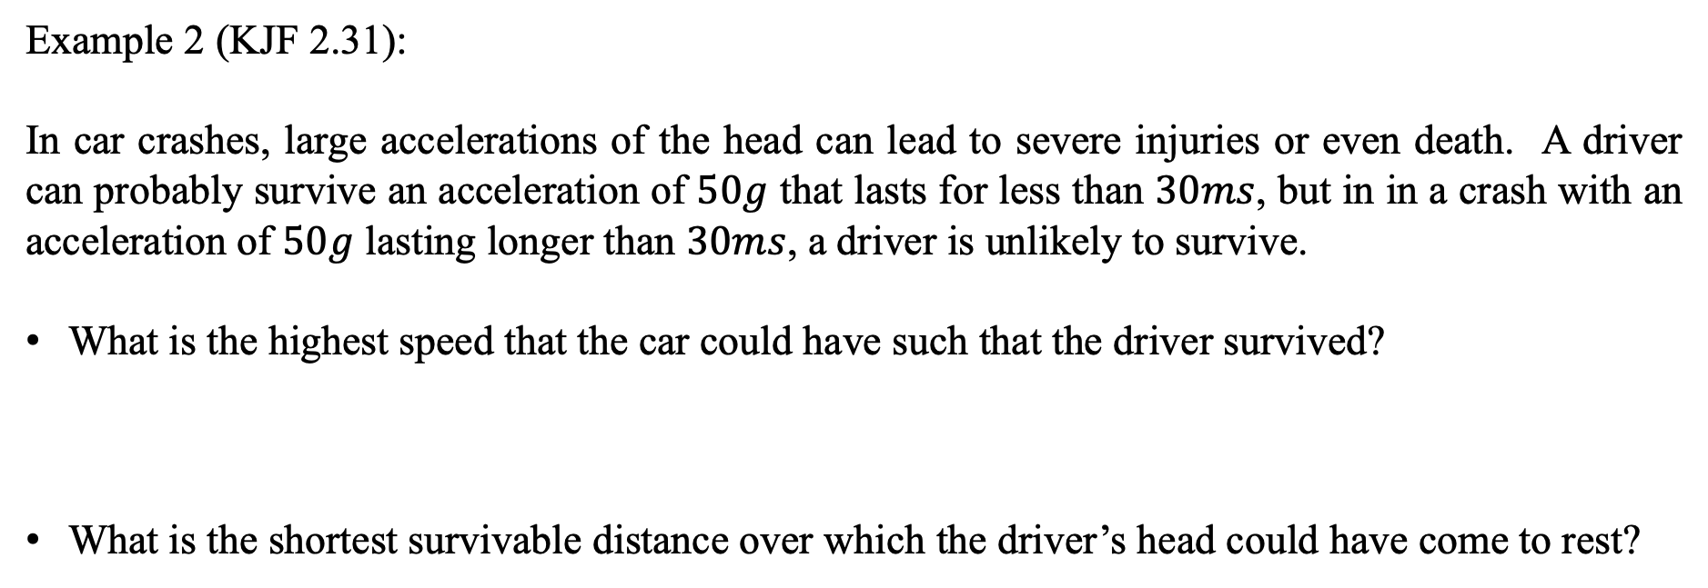
Motion in 1D with Constant Acceleration
- Uniform Motion (Constant Acceleration)
Example 2 (KJF 2.31):
In car crashes, large accelerations of the head can lead to severe injuries or even death. A driver can probably survive an acceleration of $50g$ that lasts for less than $30ms$, but in in a crash with an acceleration of $50g$ lasting longer than $30ms$, a driver is unlikely to survive.
What is the highest speed that the car could have such that the driver survived?
What is the shortest survivable distance over which the driver’s head could have come to rest?

Slide 7
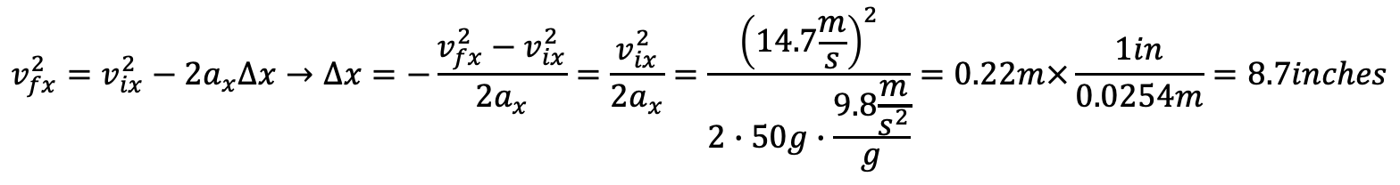
Motion in 1D with Constant Acceleration
- Uniform Motion (Constant Speed)
Example 2 (KJF 2.31) Solution:
What is the highest speed that the car could have such that the driver survived?
What is the shortest survivable distance over which the driver’s head could have come to rest?
$$v_{fx}=v_{ix}−a_{x}t→v_{ix}=a_{x}t=50g∙\frac{9.8\frac{m}{s^{2}}}{g}∙30×{10}^{−3}s=14.7\frac{m}{s}×\frac{1mi}{1600m}×\frac{3600s}{1hr}=33\frac{mi}{hr}$$
$$v_{fx}^{2}=v_{ix}^{2}−2a_{x}∆x→∆x=−\frac{v_{fx}^{2}−v_{ix}^{2}}{2a_{x}}=\frac{v_{ix}^{2}}{2a_{x}}=\frac{{\left(14.7\frac{m}{s}\right)}^{2}}{2∙50g∙\frac{9.8\frac{m}{s^{2}}}{g}}=0.22m×\frac{1in}{0.0254m}=8.7inches$$

Slide 8
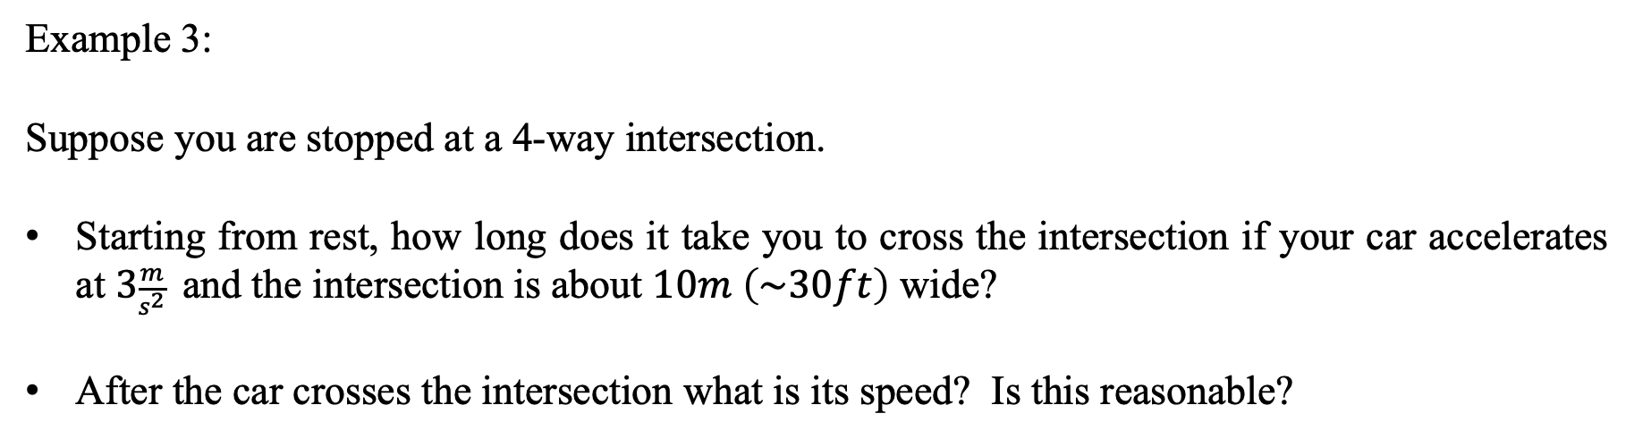
Motion in 1D with Constant Acceleration
- Problems
Example 3:
Suppose you are stopped at a 4-way intersection.
Starting from rest, how long does it take you to cross the intersection if your car accelerates at $3\frac{m}{s^{2}}$ and the intersection is about $10m \left(\sim 30ft\right)$ wide?
After the car crosses the intersection what is its speed? Is this reasonable?

Slide 9
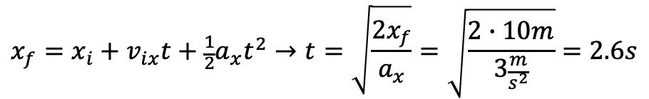
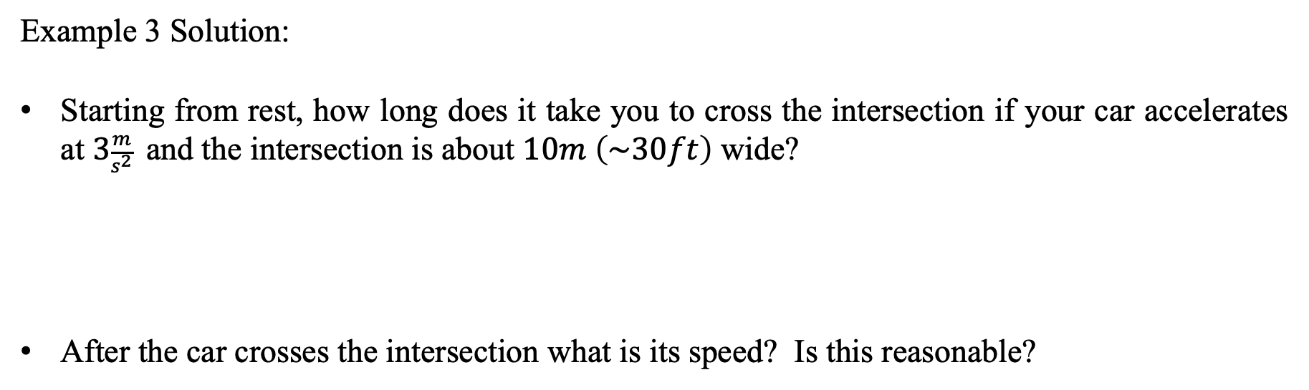
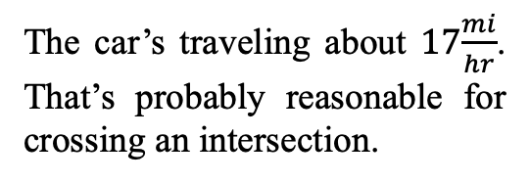
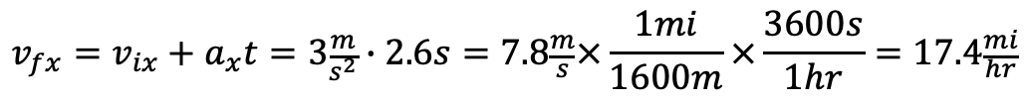
Motion in 1D with Constant Acceleration
- Problems
Example 3 Solution:
Starting from rest, how long does it take you to cross the intersection if your car accelerates at $3\frac{m}{s^{2}}$ and the intersection is about $10m \left(\sim 30ft\right)$ wide?
After the car crosses the intersection what is its speed? Is this reasonable?
$$x_{f}=x_{i}+v_{ix}t+\frac{1}{2}a_{x}t^{2}→t=\sqrt{\frac{2x_{f}}{a_{x}}}=\sqrt{\frac{2∙10m}{3\frac{m}{s^{2}}}}=2.6s$$
The car’s traveling about $17\frac{mi}{hr}$. That’s probably reasonable for crossing an intersection.
$$v_{fx}=v_{ix}+a_{x}t=3\frac{m}{s^{2}}∙2.6s=7.8\frac{m}{s}×\frac{1mi}{1600m}×\frac{3600s}{1hr}=17.4\frac{mi}{hr}$$

Slide 10
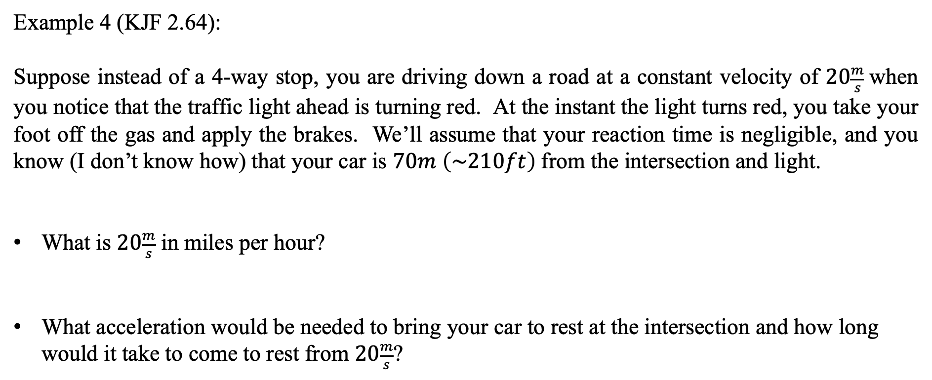
Motion in 1D with Constant Acceleration
- Problems
Example 4 (KJF 2.64):
Suppose instead of a 4-way stop, you are driving down a road at a constant velocity of $20\frac{m}{s}$when you notice that the traffic light ahead is turning red. At the instant the light turns red, you take your foot off the gas and apply the brakes. We’ll assume that your reaction time is negligible, and you know (I don’t know how) that your car is $70m \left(\sim 210ft\right)$from the intersection and light.
What is $20\frac{m}{s}$ in miles per hour?
What acceleration would be needed to bring your car to rest at the intersection and how long would it take to come to rest from $20\frac{m}{s}$?

Slide 11
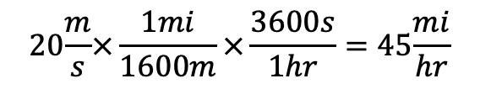
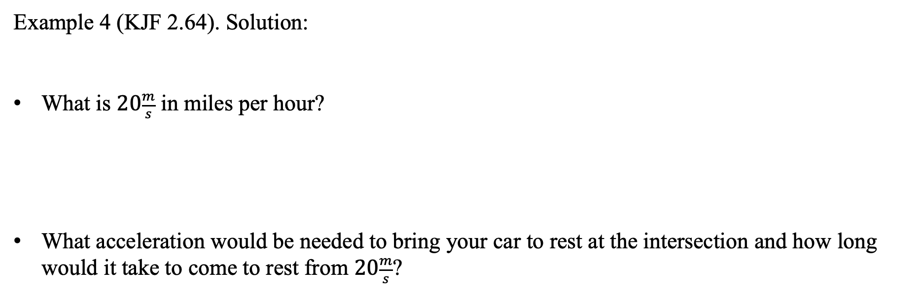
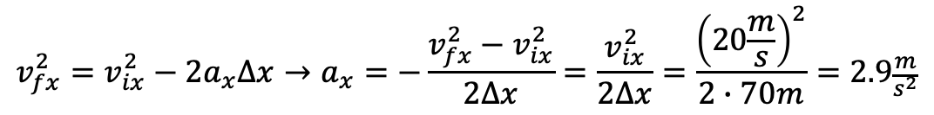
Motion in 1D with Constant Acceleration
- Problems
Example 4 (KJF 2.64). Solution:
What is $20\frac{m}{s}$ in miles per hour?
What acceleration would be needed to bring your car to rest at the intersection and how long would it take to come to rest from $20\frac{m}{s}$?
$$20\frac{m}{s}×\frac{1mi}{1600m}×\frac{3600s}{1hr}=45\frac{mi}{hr}$$
$$v_{fx}^{2}=v_{ix}^{2}−2a_{x}∆x→a_{x}=−\frac{v_{fx}^{2}−v_{ix}^{2}}{2∆x}=\frac{v_{ix}^{2}}{2∆x}=\frac{{\left(20\frac{m}{s}\right)}^{2}}{2∙70m}=2.9\frac{m}{s^{2}}$$

Slide 12
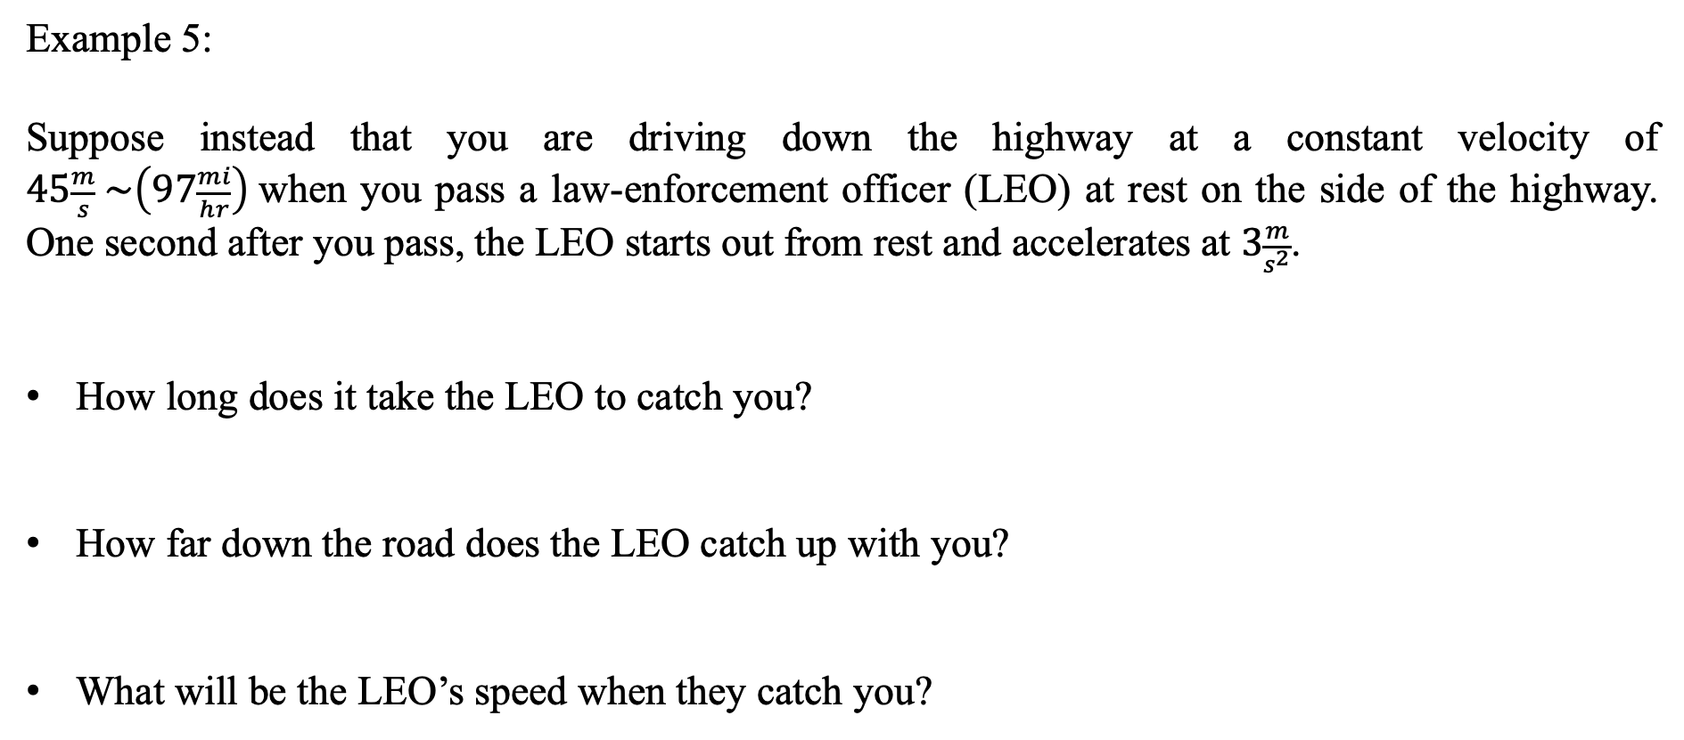
Motion in 1D with Constant Acceleration
- Problems
Example 5:
Suppose instead that you are driving down the highway at a constant velocity of $45\frac{m}{s} \sim \left(97\frac{mi}{hr}\right)$when you pass a law-enforcement officer (LEO) at rest on the side of the highway. One second after you pass, the LEO starts out from rest and accelerates at $3\frac{m}{s^{2}}$.
How long does it take the LEO to catch you?
How far down the road does the LEO catch up with you?
What will be the LEO’s speed when they catch you?

Slide 13
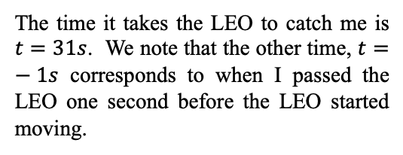
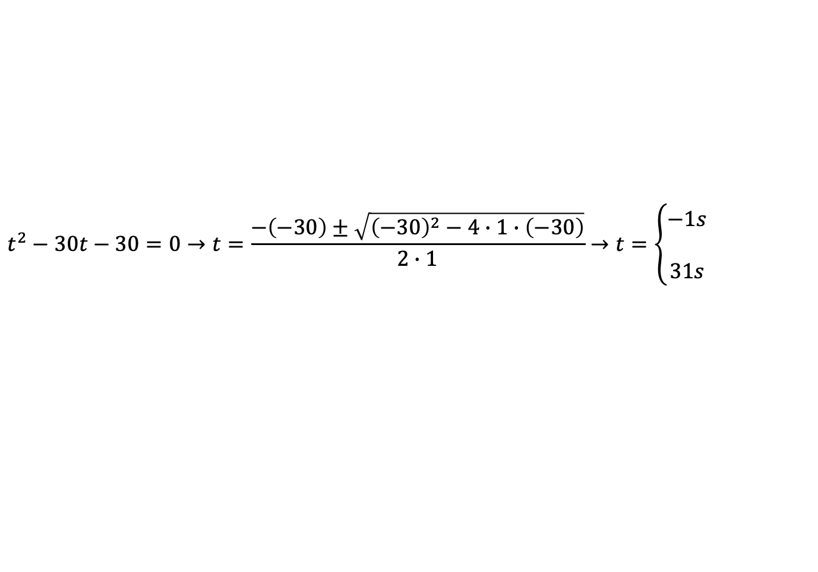
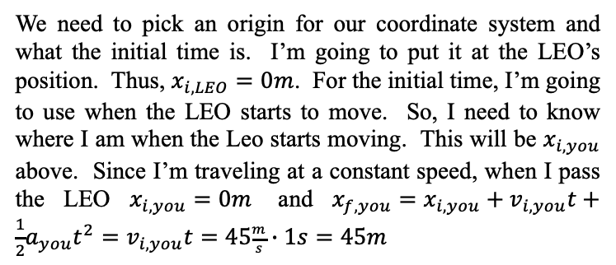
Motion in 1D with Constant Acceleration
- Problems
Example 5 Solution:
How long does it take the LEO to catch you?
We need to pick an origin for our coordinate system and what the initial time is. I’m going to put it at the LEO’s position. Thus, $x_{i,LEO}=0m$. For the initial time, I’m going to use when the LEO starts to move. So, I need to know where I am when the Leo starts moving. This will be $x_{i,you}$ above. Since I’m traveling at a constant speed, when I pass the LEO $x_{i,you}=0m$ and $x_{f,you}=x_{i,you}+v_{i,you}t+\frac{1}{2}a_{you}t^{2}=v_{i,you}t=45\frac{m}{s}∙1s=45m$
$$x_{f,LEO}=x_{i,LEO}+v_{i,LEO}t+\frac{1}{2}a_{LEO}t^{2}=\frac{1}{2}a_{LEO}t^{2}=\frac{1}{2}\left(3\frac{m}{s^{2}}\right)t^{2}$$
$$x_{f,you}=x_{i,you}+v_{i,you}t+\frac{1}{2}a_{you}t^{2}=x_{i,you}+v_{i,you}t=45m+45\frac{m}{s}∙t$$
When the LEO catches me, we have to be at the same final position at the same time. Therefore, $x_{f,LEO}=x_{f,you}$.
$$x_{f,LEO}=x_{f,you}→\frac{1}{2}a_{LEO}t^{2}=x_{i,you}+v_{i,you}t→\frac{1}{2}\left(3\frac{m}{s^{2}}\right)t^{2}=45m+45\frac{m}{s}∙t$$
The time it takes the LEO to catch me is $t=31s$. We note that the other time, $t=−1s$ corresponds to when I passed the LEO one second before the LEO started moving.
$$t^{2}−30t−30=0→t=\frac{−\left(−30\right)±\sqrt{{\left(−30\right)}^{2}−4∙1∙\left(−30\right)}}{2∙1}→t=\left\{\begin{matrix}−1s \\ \\ 31s\end{matrix}\right.$$

Slide 14
Motion in 1D with Constant Acceleration
- Problems
Example 5 Solution:
How far down the road does the LEO catch up with you?
What will be the LEO’s speed when they catch you?
$$x_{f,LEO}=x_{i,LEO}+v_{i,LEO}t+\frac{1}{2}a_{LEO}t^{2}=\frac{1}{2}a_{LEO}t^{2}=\frac{1}{2}\left(3\frac{m}{s^{2}}\right)t^{2}=\frac{1}{2}\left(3\frac{m}{s^{2}}\right){\left(31s\right)}^{2}=1441.5m$$
$$x_{f,you}=x_{i,you}+v_{i,you}t+\frac{1}{2}a_{you}t^{2}=x_{i,you}+v_{i,you}t=45m+45\frac{m}{s}∙t=45m+45\frac{m}{s}∙31s=1440m$$
The difference is due to rounding of the time from the quadratic equation.
$$v_{f,LEo}=v_{i,LEO}+a_{LEO}t=a_{LEO}t=3\frac{m}{s^{2}}∙31s=93\frac{m}{s}×\frac{1mi}{1600m}×\frac{3600s}{1hr}\sim 210\frac{mi}{hr}$$
This seems a bit excessive for the LEO to try to catch me, but that’s ok.

Slide 15
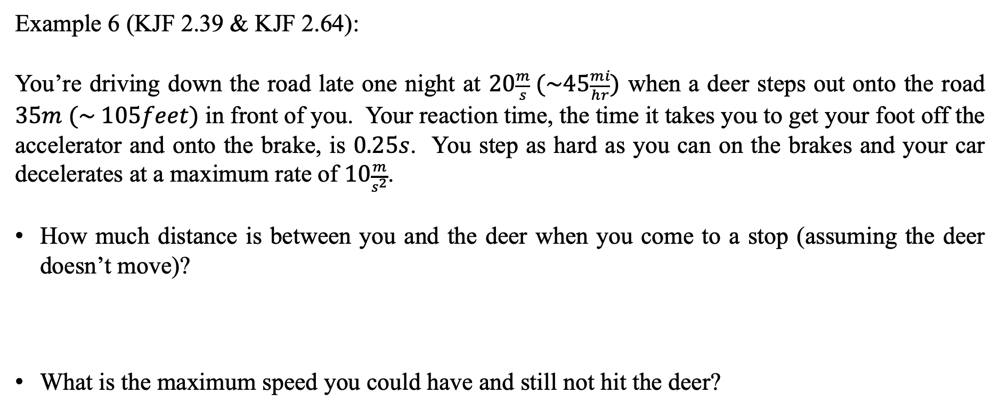
Motion in 1D with Constant Acceleration
- Problems
Example 6 (KJF 2.39 & KJF 2.64):
You’re driving down the road late one night at $20\frac{m}{s} (\sim 45\frac{mi}{hr})$ when a deer steps out onto the road $35m (\sim 105feet)$ in front of you. Your reaction time, the time it takes you to get your foot off the accelerator and onto the brake, is $0.25s$. You step as hard as you can on the brakes and your car decelerates at a maximum rate of $10\frac{m}{s^{2}}$.
How much distance is between you and the deer when you come to a stop (assuming the deer doesn’t move)?
What is the maximum speed you could have and still not hit the deer?

Slide 16
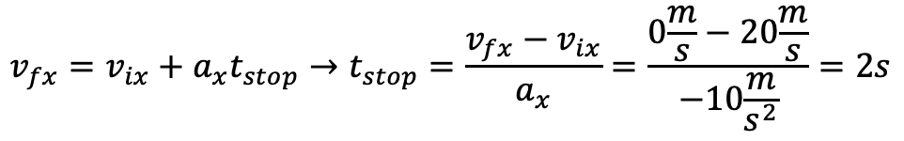
Motion in 1D with Constant Acceleration
- Problems
Example 6 (KJF 2.39 & KJF 2.64) Solution:
How much distance is between you and the deer when you come to a stop (assuming the deer doesn’t move)?
$$x_{total}=x_{react}+x_{stop}=v_{ix}t_{react}+v_{ix}t_{stop}+\frac{1}{2}a_{x}t_{stop}^{2}$$
The total distance traveled by you is the distance traveled in the time it takes you to react (assuming your car travels at a constant speed during this reaction time) plus the distance it takes you to come to rest after you put on the brakes.
$$x_{total}=\left(20\frac{m}{s}∙0.25s\right)+20\frac{m}{s}∙2s−\frac{1}{2}∙10\frac{m}{s^{2}}{\left(2s\right)}^{2}=25m$$
$$∆x=x_{deer}−x_{you}=35m−25m=10m$$
To find the time it takes you to stop your car after the brakes are applied, we know the initial and final velocities and the acceleration needed, so we can use our time dependent velocity equation to determine the stopping time.
$$v_{fx}=v_{ix}+a_{x}t_{stop}→t_{stop}=\frac{v_{fx}−v_{ix}}{a_{x}}=\frac{0\frac{m}{s}−20\frac{m}{s}}{−10\frac{m}{s^{2}}}=2s$$

Slide 17

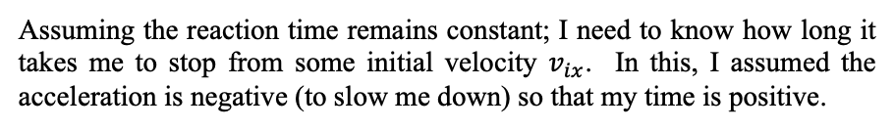
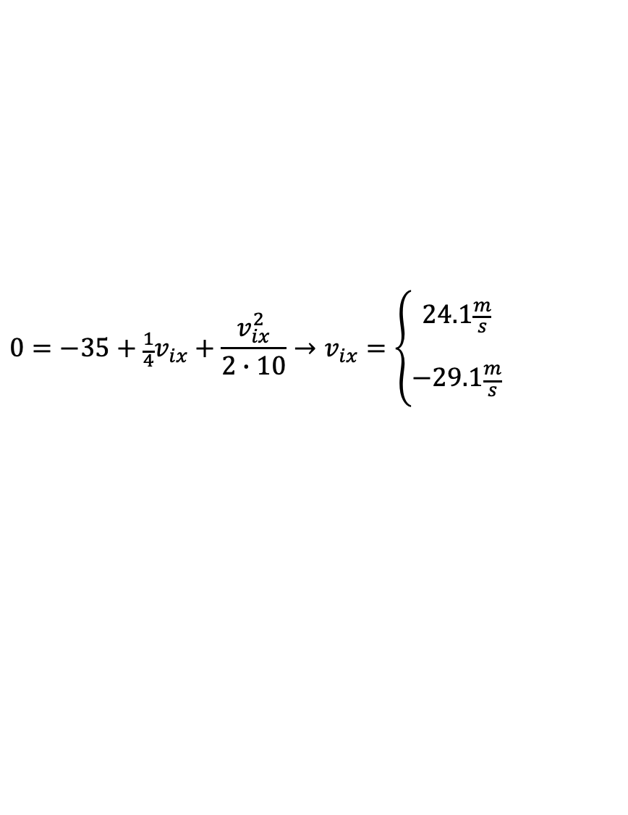

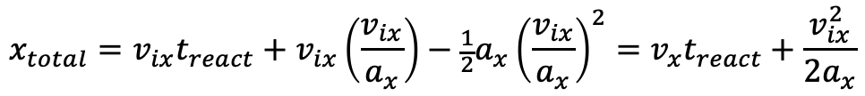
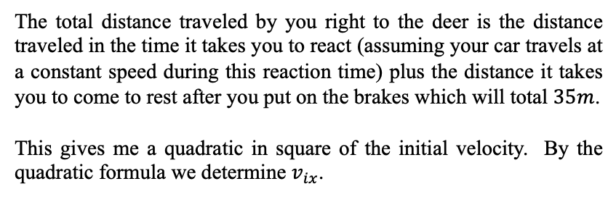
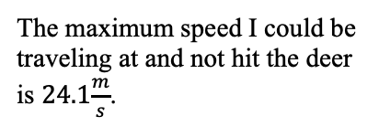
Motion in 1D with Constant Acceleration
- Problems
Example 6 (KJF 2.39 & KJF 2.64) Solution:
What is the maximum speed you could have and still not hit the deer?
$$v_{fx}=v_{ix}+a_{x}t_{stop}→t_{stop}=\frac{v_{fx}−v_{ix}}{a_{x}}=\frac{v_{ix}}{a_{x}}$$
Assuming the reaction time remains constant; I need to know how long it takes me to stop from some initial velocity $v_{ix}$. In this, I assumed the acceleration is negative (to slow me down) so that my time is positive.
$$x_{total}=x_{react}+x_{stop}=v_{ix}t_{react}+v_{ix}t_{stop}+\frac{1}{2}a_{x}t_{stop}^{2}$$
The total distance traveled by you right to the deer is the distance traveled in the time it takes you to react (assuming your car travels at a constant speed during this reaction time) plus the distance it takes you to come to rest after you put on the brakes which will total $35m$.
This gives me a quadratic in square of the initial velocity. By the quadratic formula we determine $v_{ix}$.
$$x_{total}=v_{ix}t_{react}+v_{ix}\left(\frac{v_{ix}}{a_{x}}\right)−\frac{1}{2}a_{x}{\left(\frac{v_{ix}}{a_{x}}\right)}^{2}=v_{x}t_{react}+\frac{v_{ix}^{2}}{2a_{x}}$$
$$0=−35+\frac{1}{4}v_{ix}+\frac{v_{ix}^{2}}{2∙10}→v_{ix}=\left\{\begin{matrix}24.1\frac{m}{s} \\ \\ −29.1\frac{m}{s}\end{matrix}\right.$$
The maximum speed I could be traveling at and not hit the deer is $24.1\frac{m}{s}$.
$$v_{ix}=24.1\frac{m}{s}$$

