Slide 1
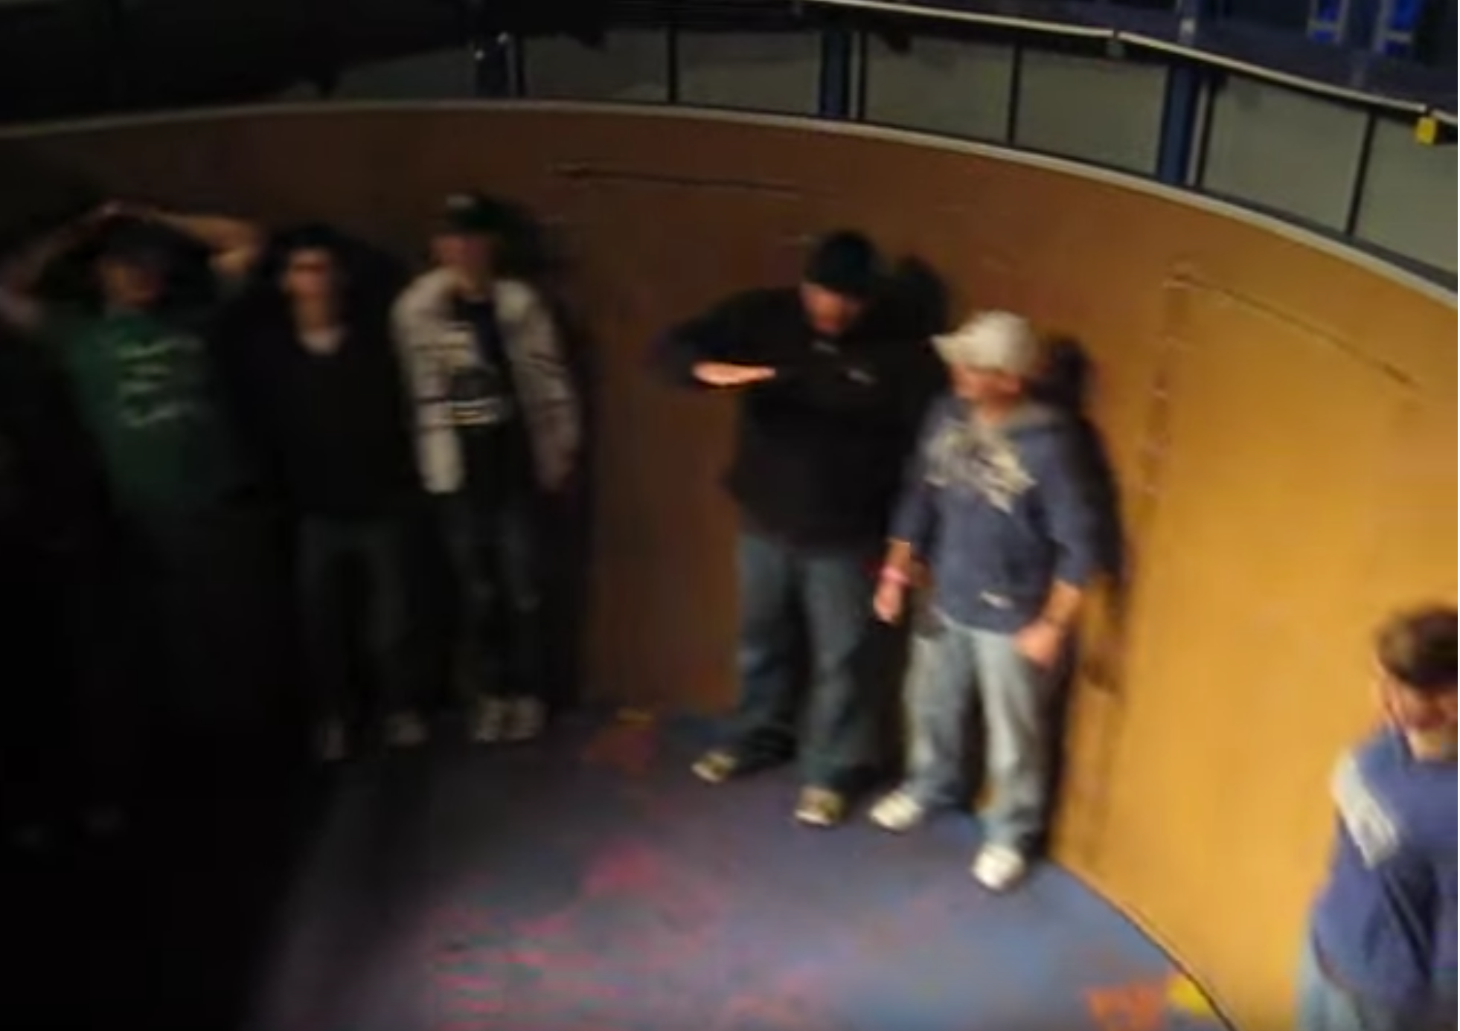
The moon revolves around the Earth in a nearly circular orbit at a distance of $r=3.8×{10}^{8}m$ . It takes the moon approximately 27 days (~ one month) for the moon to revolve about the Earth. What is the orbital speed of the moon and what is the mass of the Earth?
The Rotor is an amusement park thrill ride where one stands against a wall on the inside of a large ($r=10m$) cylinder. The ride starts from rest and when the riders reach a particular speed the floor drops out and the riders stay pinned to the wall. If the coefficient of friction is $μ=0.2$, what is the speed of the riders at which they stay pinned to the wall and what is the magnitude of the normal force from the wall on the riders? What does your result not depend on and what does this imply?
https://www.youtube.com/watch?v=uz_DkRs92pM

Slide 2
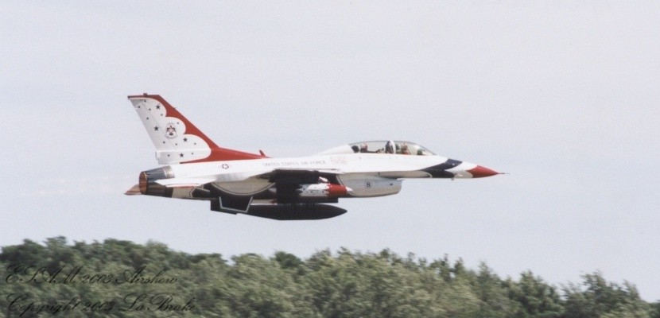
An F-16 executes a vertical loop-the-loop of radius $r=2.8km (\sim 1.7mi)$ at a constant speed of $225\frac{m}{s} (\sim 500\frac{mi}{hr})$. What force does the seat exert on the pilot at the bottom and top of the loop in terms of the weight of the pilot? What minimum speed would the plane need to traverse the loop so that the pilot would feel weightless?

