Slide 1
Circular Motion
$${\vec{v}}_{f}$$
$$dθ$$
$${−\vec{v}}_{i}$$
$$∆\vec{v}$$
$$ds$$
$$dθ$$
$${\vec{v}}_{f}$$
$$r$$
$${−\vec{v}}_{i}$$
$$ds$$
$${\vec{v}}_{i}$$
$$90−dθ$$
$$∆\vec{v}$$
$$dθ$$
$$dθ$$
$$r$$

Slide 2
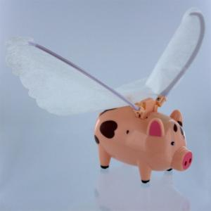
Circular Motion
Example 1:
Consider the flying pig of mass $m=250g$ suspended from the ceiling by a string of length $l=1.25m$. When turned on, the pig flies in a circle of radius $R$ and the string makes an angle of $θ={12}^{0}$ measured with respect to the vertical.
What is the tension in the wire connecting the pig to the ceiling?
What is the speed of the flying pig?
What is the period of motion of the flying pig? That is, now long does it take the flying pig to make one trip around the circle?
For a demo of the pig in flight, check out this YouTube link: https://www.youtube.com/watch?time_continue=8&v=VwiaI9hR7FQ&feature=emb_logo
$$θ$$
$$l$$
$$R$$
Flying Pig: https://www.wardsci.com/store/product/20912786/flying-pig

Slide 3
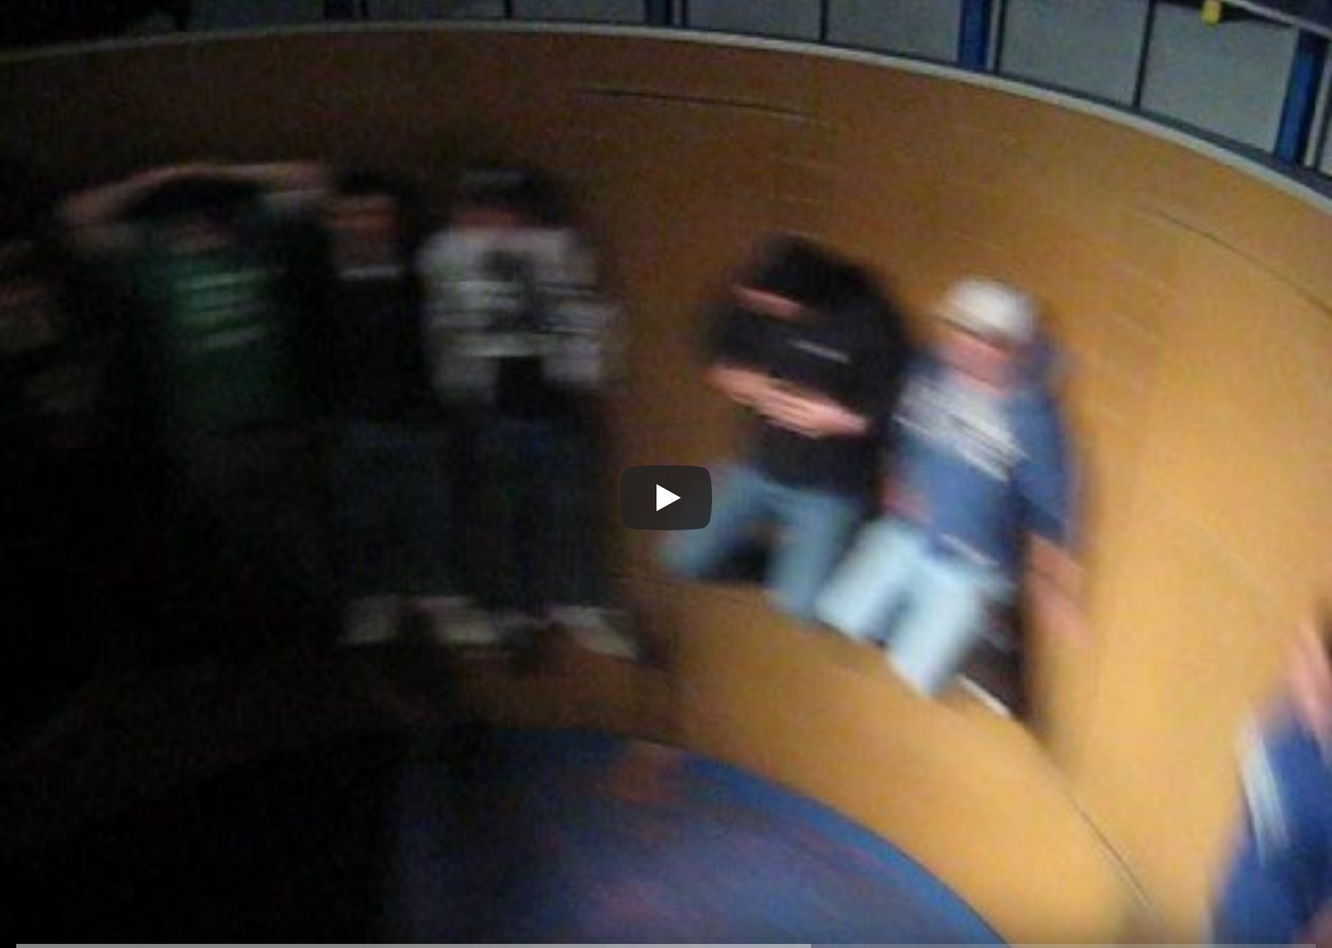
Circular Motion
Example 2:
The Rotor is an amusement park thrill ride where one stands against a wall on the inside of a large ($r=5m$) cylinder.
The ride starts from rest and when the riders reach a particular speed the floor drops out and the riders stay pinned to the wall due to friction.
If the coefficient of friction is $μ=0.2$, what is the speed of the riders at which they stay pinned to the wall and what is the magnitude of the normal force from the wall on the riders?
What does your result not depend on and what does this imply?
How long does it take a rider to make one complete revolution in the ride?
https://www.youtube.com/watch?v=uz_DkRs92pM

Slide 4
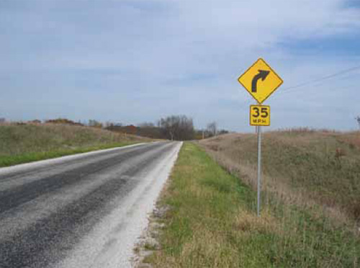
Circular Motion
Example 3:
There are signs that are posted all over America's roadways alerting you to all sorts of things, like speed limits, distances to exits, tourist attractions, and the like.
Suppose that you are driving down a level road when you see a sign like the one on the right. How does the department of transportation for your state know what speed limit to post on the sign? That is, how do you determine the posted speed that you should take the curve at?
Roadways are about $24ft$ wide (about $12ft$ per lane), and a typical curve is about in $200ft$ diameter ($100ft$ in radius). This is about $30m$.
How fast should I mark the road sign for you to safely negotiate the corner? Assume that the coefficient of friction between rubber and asphalt is $μ=0.7$ for a dry road and $μ=0.3$ for a wet road.
https://safety.fhwa.dot.gov/speedmgt/ref_mats/fhwasa10001/

Slide 5
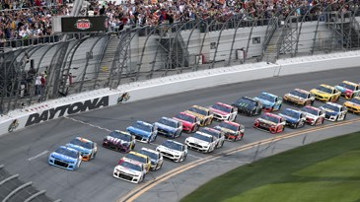
Circular Motion
Example 4:
In order to not have to rely on friction to help you negotiate a curve, racetracks bank the ends of the tracks.
This ultimately allows you to go faster around the track.
This effect can be seen in the sport of NASCAR in which cars drive at speeds approaching $200\frac{mi}{hr}$ for hundreds of miles.
What force(s) is(are) responsible for you taking the turns at a high rate of speed if it is not friction?
If your race car takes a turn at a speed of $150\frac{mi}{hr}$, what is the radius of curvature of the track?
Tracks are banked at various angles by the designer of the track. For example, Daytona has a bank angle of ${31}^{0}.$
https://www.ajc.com/sports/racing/rains-delay-end-daytona-500-until-monday/Ctvg7ozshchtRxGVsfjpYK/

Slide 6
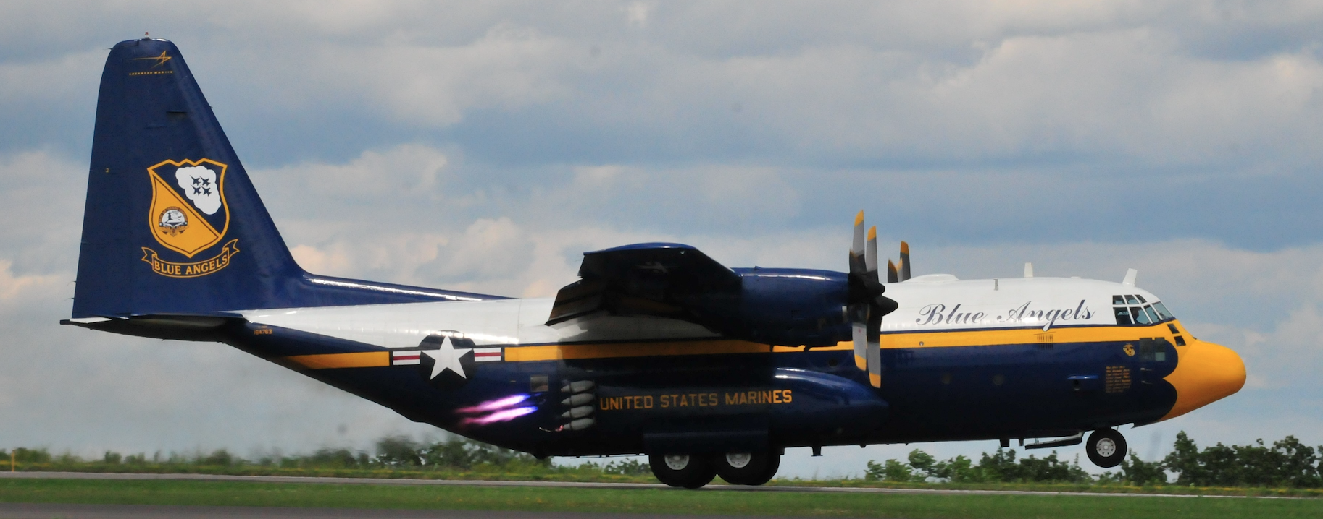
Circular Motion
Example 5:
The US Navy’s flight demonstration team, the Blue Angels, has a transport aircraft affectionately called “Fat Albert.” Suppose that the pilots of Fat Albert perform a maneuver for the airshow attendees where they fly the plane in a horizontal circle of radius $R=1600m (\sim 1mi)$ at a constant speed of $75\frac{m}{s} \left(\sim 165\frac{mi}{hr}\right)$ by tilting the wings of the airplane by an angle 𝜙 measured with respect to the vertical. When the plane flies, airflow over the wings of the plane generates a lifting force $F_{Lift}$ that is always perpendicular to the wings of the plane.
At what angle 𝜙 measured with respect to the vertical did the pilots tilt the plane?
In terms of the weight of the plane, what is the magnitude of the lift force $F_{Lift}$generated by the airflow over the wings?
$${\vec{F}}_{Lift}$$
$$φ$$
Photo: Fat Albert., S. LaBrake

Slide 7
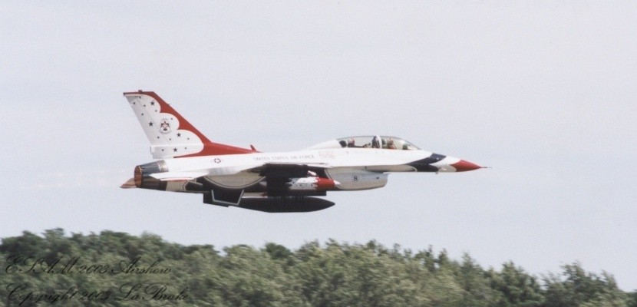
Circular Motion
Example 6:
An F-16 executes a vertical loop-the-loop of radius $r=2.8km (\sim 1.7mi)$ at a constant speed of $225\frac{m}{s} (\sim 500\frac{mi}{hr})$.
What force does the seat exert on the pilot at the bottom and top of the loop in terms of the weight of the pilot?
What minimum speed would the plane need to traverse the loop so that the pilot would feel weightless?
Photo: Thunderbird 7, S. LaBrake

