Slide 1


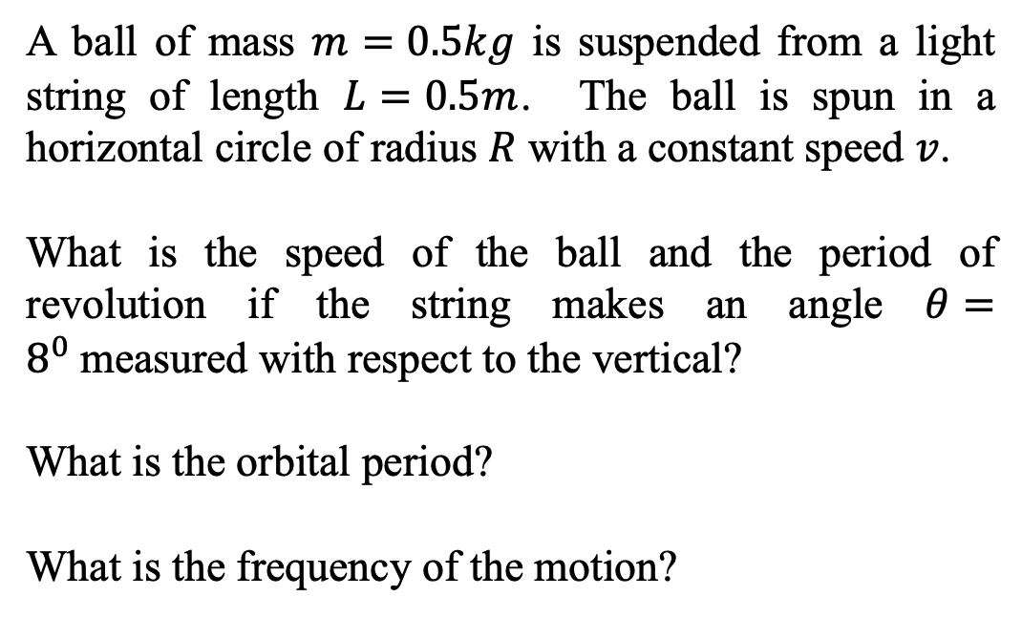

Circular Motion – the conical pendulum
A ball of mass $m=0.5kg$ is suspended from a light string of length $L=0.5m$. The ball is spun in a horizontal circle of radius $R$ with a constant speed $v$.
What is the speed of the ball and the period of revolution if the string makes an angle $θ=8^{0}$measured with respect to the vertical?
What is the orbital period?
What is the frequency of the motion?
$$θ$$
$$m$$
$$R$$

Slide 2


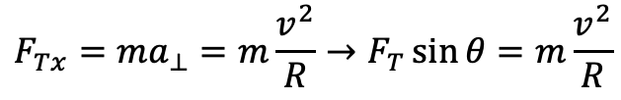
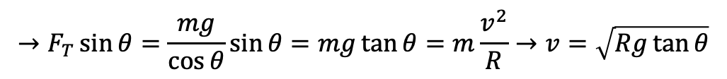

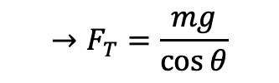
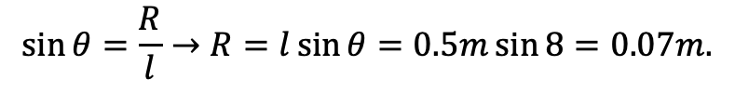


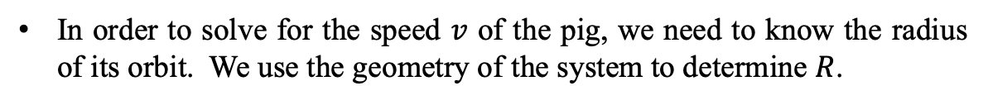
Circular Motion – The Conical Pendulum - Solution
Forces in the x-direction
The centripetal force is caused the the horizontal component of the tension force. It’s not an additional force in the problem.
$$F_{Tx}=ma_{⊥}=m\frac{v^{2}}{R}→F_{T}\sin{θ}=m\frac{v^{2}}{R}$$
$$θ$$
Forces in the y-direction
$$0$$
The vertical acceleration has to vanish. If there was a change in motion vertically then the angle would change and then the speed of the pig would not be constant.
$$F_{Ty}−F_{W}=F_{T}\cos{θ}−mg=ma_{y}=0$$
$$→F_{T}=\frac{mg}{\cos{θ}}$$
$${\vec{F}}_{T}$$
$$F_{Ty}$$
$$→F_{T}\sin{θ}=\frac{mg}{\cos{θ}}\sin{θ}=mg\tan{θ}=m\frac{v^{2}}{R}→v=\sqrt{Rg\tan{θ}}$$
$$F_{Tx}$$
$$m$$
$$R$$
In order to solve for the speed $v$ of the pig, we need to know the radius of its orbit. We use the geometry of the system to determine $R$.
$${\vec{F}}_{W}$$
$$\sin{θ}=\frac{R}{l}→R=l\sin{θ}=0.5m\sin{8}=0.07m.$$

Slide 3
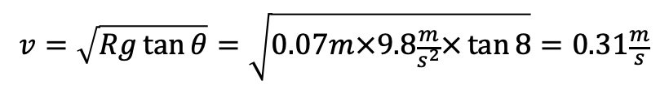
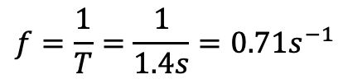

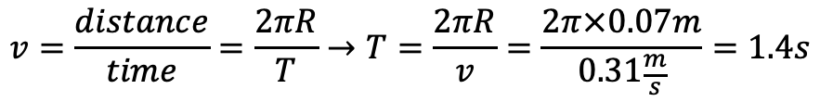
Circular Motion – The Conical Pendulum - Solution
The speed $v$ of the ball is then:
$$v=\sqrt{Rg\tan{θ}}=\sqrt{0.07m×9.8\frac{m}{s^{2}}×\tan{8}}=0.31\frac{m}{s}$$
$$θ$$
The period $T$ (or time for one revolution) of the ball is then:
$$v=\frac{distance}{time}=\frac{2πR}{T}→T=\frac{2πR}{v}=\frac{2π×0.07m}{0.31\frac{m}{s}}=1.4s$$
$${\vec{F}}_{T}$$
$$F_{Ty}$$
The frequency $f$ (or the number of revolutions per second) of the ball is then:
$$f=\frac{1}{T}=\frac{1}{1.4s}=0.71s^{−1}$$
$$F_{Tx}$$
$$m$$
$$R$$
$${\vec{F}}_{W}$$

Slide 4
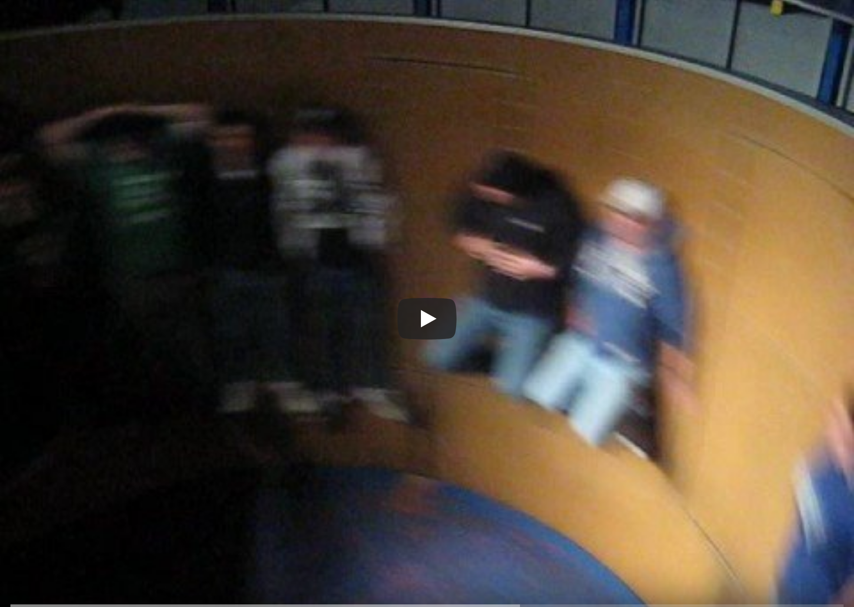
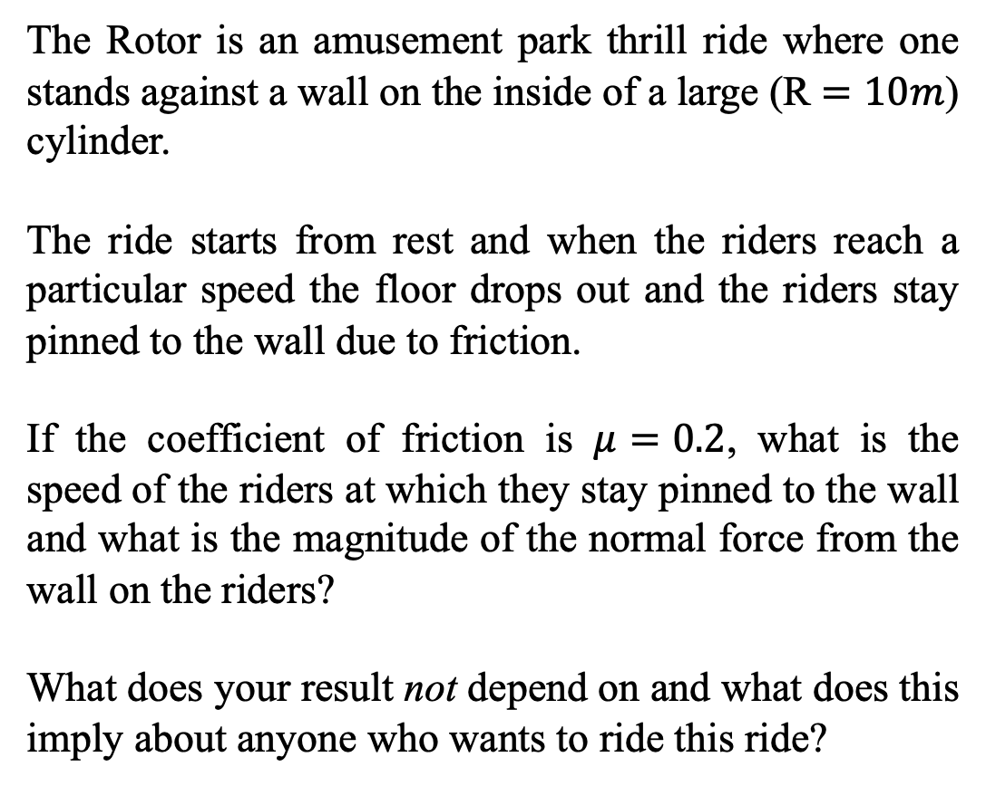
Circular Motion – The Rotor; an amusement park thrill ride
The Rotor is an amusement park thrill ride where one stands against a wall on the inside of a large (R $=10m$) cylinder.
The ride starts from rest and when the riders reach a particular speed the floor drops out and the riders stay pinned to the wall due to friction.
If the coefficient of friction is $μ=0.2$, what is the speed of the riders at which they stay pinned to the wall and what is the magnitude of the normal force from the wall on the riders?
What does your result not depend on and what does this imply about anyone who wants to ride this ride?
https://www.youtube.com/watch?v=uz_DkRs92pM

Slide 5

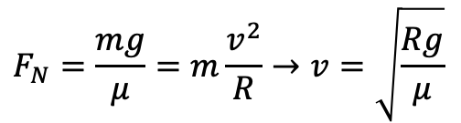



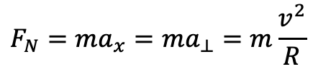


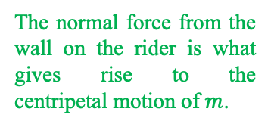


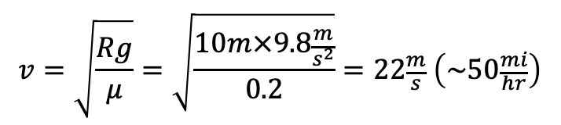
Circular Motion – The Rotor- Solution
Forces in the x-direction:
The normal force from the wall on the rider is what gives rise to the centripetal motion of $m$.
$$F_{N}=ma_{x}=ma_{⊥}=m\frac{v^{2}}{R}$$
$$R$$
Forces in the y-direction:
$$y$$
$${\vec{F}}_{fr}$$
$$0$$
$$x$$
$$F_{fr}−F_{W}={μF}_{N}−mg=ma_{y}=0→F_{N}=\frac{mg}{μ}$$
$$m$$
$$F_{N}=\frac{mg}{μ}=m\frac{v^{2}}{R}→v=\sqrt{\frac{Rg}{μ}}$$
$${\vec{F}}_{N}$$
$$v=\sqrt{\frac{Rg}{μ}}=\sqrt{\frac{10m×9.8\frac{m}{s^{2}}}{0.2}}=22\frac{m}{s} \left(\sim 50\frac{mi}{hr}\right)$$
$${\vec{F}}_{W}$$
In this expression for the speed notice that the result does not depend on the mass of the rider. This of course means that anyone can ride at any time. Which seems reasonable.

Slide 6
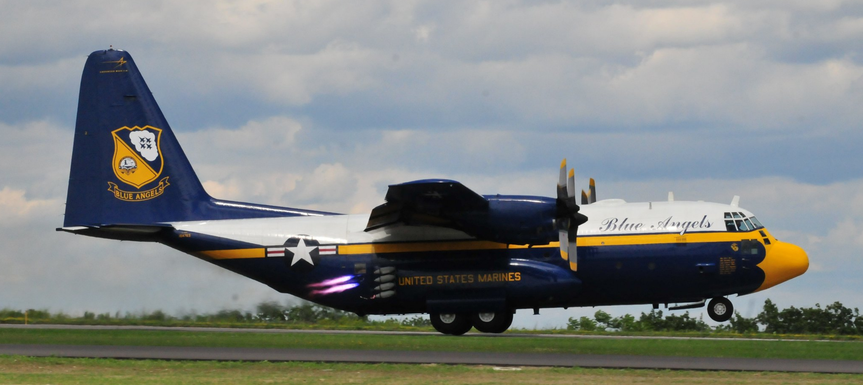
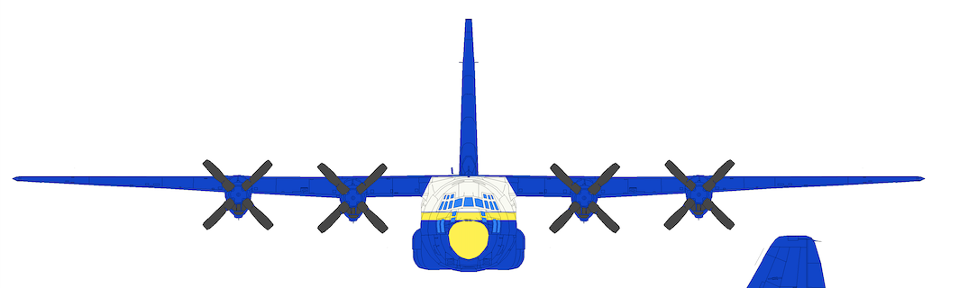
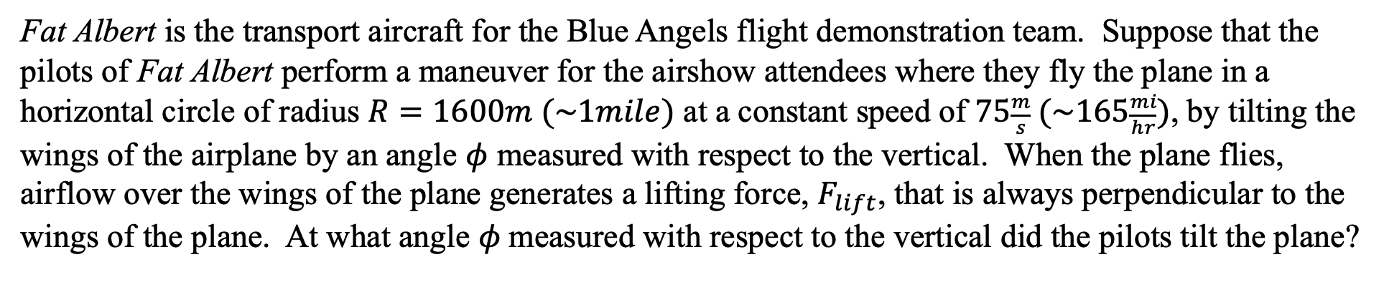
Circular Motion – A Banked Airplane
Fat Albert is the transport aircraft for the Blue Angels flight demonstration team. Suppose that the pilots of Fat Albert perform a maneuver for the airshow attendees where they fly the plane in a horizontal circle of radius $R=1600m (\sim 1mile)$ at a constant speed of $75\frac{m}{s} (\sim 165\frac{mi}{hr})$, by tilting the wings of the airplane by an angle $φ$ measured with respect to the vertical. When the plane flies, airflow over the wings of the plane generates a lifting force, $F_{lift}$, that is always perpendicular to the wings of the plane. At what angle $φ$measured with respect to the vertical did the pilots tilt the plane?
$${\vec{F}}_{Lift}$$
$$φ$$
Photo: S. LaBrake
FLift
FLift
ϕ
ϕ

Slide 7
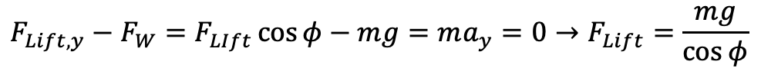
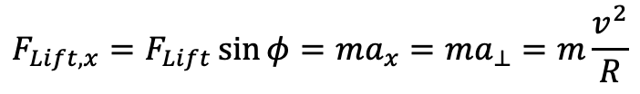

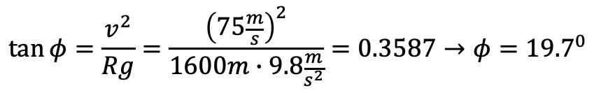
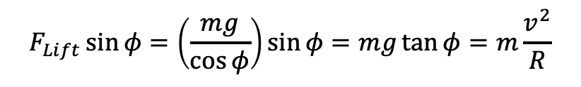
Circular Motion – A Banked Airplane - Solution
Forces in the x-direction:
$$F_{Lift,x}=F_{Lift}\sin{φ}=ma_{x}=ma_{⊥}=m\frac{v^{2}}{R}$$
$${\vec{F}}_{Lift}$$
$$φ$$
Forces in the y-direction:
$$0$$
$$F_{Lift,y}−F_{W}=F_{LIft}\cos{φ}−mg=ma_{y}=0→F_{Lift}=\frac{mg}{\cos{φ}}$$
$${\vec{F}}_{W}$$
$$F_{Lift}\sin{φ}=\left(\frac{mg}{\cos{φ}}\right)\sin{φ}=mg\tan{φ}=m\frac{v^{2}}{R}$$
$$\tan{φ}=\frac{v^{2}}{Rg}=\frac{{\left(75\frac{m}{s}\right)}^{2}}{1600m∙9.8\frac{m}{s^{2}}}=0.3587→φ={19.7}^{0}$$

Slide 8
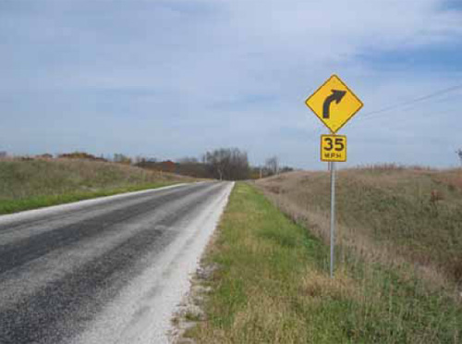
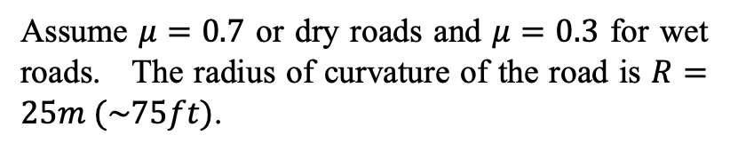
Circular Motion – A Curve In The Road
There are signs that are posted all over America's roadways alerting you to all sorts of things, like speed limits, distances to exits, tourist attractions, and the like.
Suppose that you are driving down a level road when you see a sign like the one on the right.
How does the department of transportation for your state know what speed limit to post on the sign?
That is, how do you determine the posted speed that you should take the curve at?
https://safety.fhwa.dot.gov/speedmgt/ref_mats/fhwasa10001/
Assume $μ=0.7$ or dry roads and $μ=0.3$ for wet roads. The radius of curvature of the road is $R=25m (\sim 75ft)$.

Slide 9
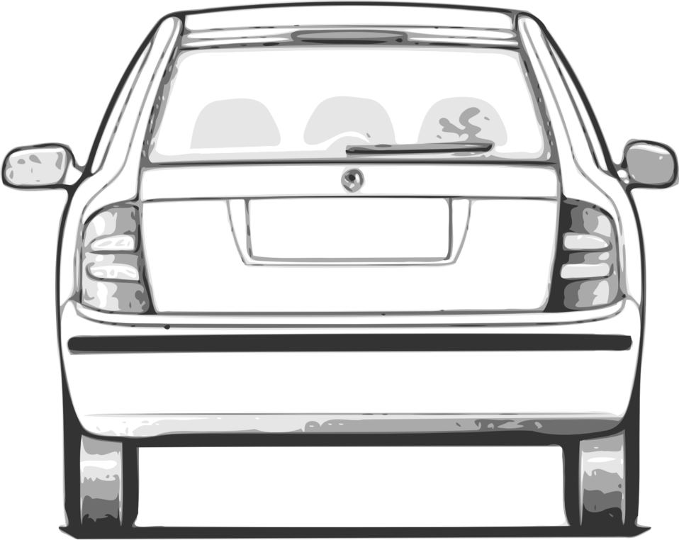
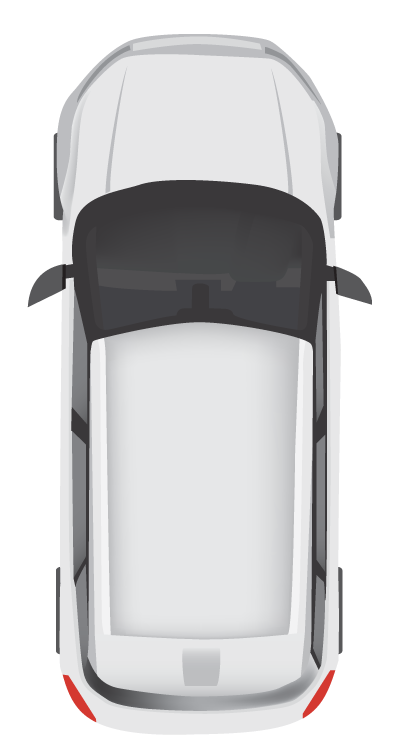


Circular Motion – A Curve In The Road
Face-on view
Top-down view
$$R$$
? mph
$$R$$

Slide 10

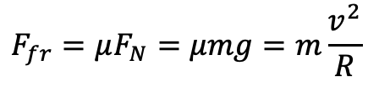





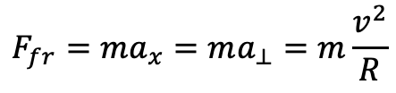



Circular Motion – A Curve In The Road - Solution
Face on view
$${\vec{F}}_{N}$$
Forces in the x-direction
$$F_{fr}=ma_{x}=ma_{⊥}=m\frac{v^{2}}{R}$$
? mph
Forces in the y-direction
$$R$$
$$0$$
$$F_{N}−F_{W}=ma_{y}=0→F_{N}=F_{W}=mg$$
$$F_{fr}=μF_{N}=μmg=m\frac{v^{2}}{R}$$
This seems reasonable. As the coefficient of friction increases you should be able to go faster, friction can hold on to you.
The bigger the radius of the circle the gentler the turn and thus the faster you can go.
$${\vec{F}}_{W}$$
Top overhead view
$$v=\sqrt{μRg}$$
$$R$$
For a dry road
$$v=\sqrt{μRg}=\sqrt{0.7×25m×9.8\frac{m}{s^{2}}}=13.1\frac{m}{s}=29.5\frac{mi}{hr}$$
For a wet road
$${\vec{F}}_{fr}$$
$$v=\sqrt{μRg}=\sqrt{0.3×25m×9.8\frac{m}{s^{2}}}=8.6\frac{m}{s}=19.3\frac{mi}{hr}$$
Maybe I’d pick $25\frac{mi}{hr}$ as something in between that’s safe.

Slide 11
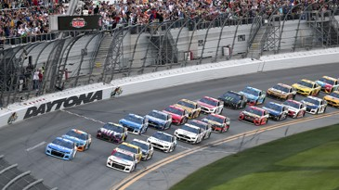
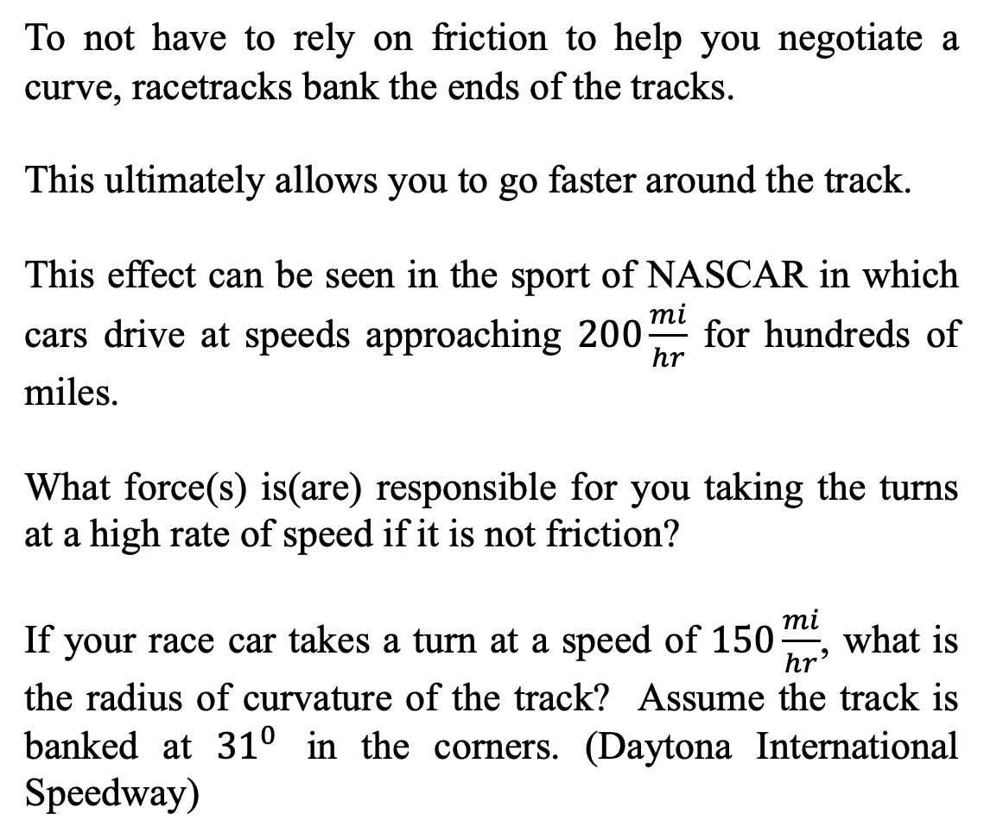
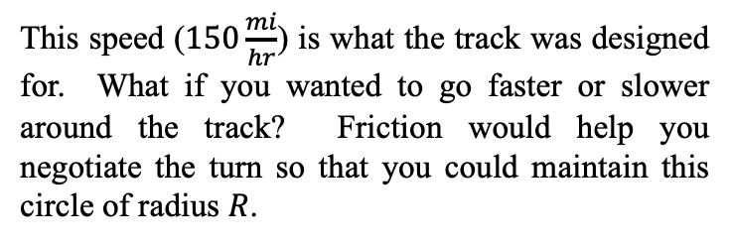
Circular Motion – A Banked Roadway
To not have to rely on friction to help you negotiate a curve, racetracks bank the ends of the tracks.
This ultimately allows you to go faster around the track.
This effect can be seen in the sport of NASCAR in which cars drive at speeds approaching $200\frac{mi}{hr}$ for hundreds of miles.
What force(s) is(are) responsible for you taking the turns at a high rate of speed if it is not friction?
If your race car takes a turn at a speed of $150\frac{mi}{hr}$, what is the radius of curvature of the track? Assume the track is banked at ${31}^{0}$ in the corners. (Daytona International Speedway)
https://www.ajc.com/sports/racing/rains-delay-end-daytona-500-until-monday/Ctvg7ozshchtRxGVsfjpYK/
This speed ($150\frac{mi}{hr}$) is what the track was designed for. What if you wanted to go faster or slower around the track? Friction would help you negotiate the turn so that you could maintain this circle of radius $R$.

Slide 12






Circular Motion – A Banked Roadway
$$y$$
$$x$$
$$R$$
$$R$$
$$θ$$
$$θ$$
https://www.ajc.com/sports/racing/rains-delay-end-daytona-500-until-monday/Ctvg7ozshchtRxGVsfjpYK/

Slide 13



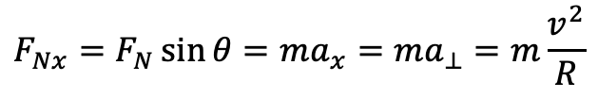
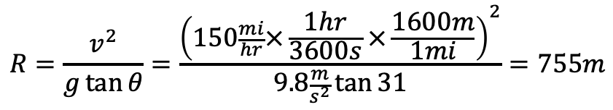

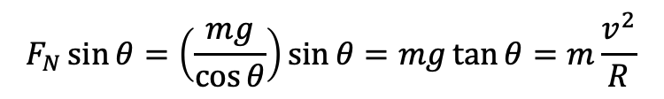


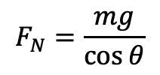




Circular Motion – A Banked Roadway - Solution
Forces in the x-direction
$$y$$
$$F_{Nx}$$
$${\vec{F}}_{N}$$
$$F_{Nx}=F_{N}\sin{θ}=ma_{x}=ma_{⊥}=m\frac{v^{2}}{R}$$
$$F_{Ny}$$
$$θ$$
Forces in the y-direction
$$x$$
$$0$$
$$R$$
$$F_{Ny}−F_{W}=F_{N}\cos{θ}−mg=ma_{y}=0$$
$${\vec{F}}_{W}$$
$$θ$$
$$F_{N}=\frac{mg}{\cos{θ}}$$
$$R=\frac{v^{2}}{g\tan{θ}}=\frac{{\left(150\frac{mi}{hr}×\frac{1hr}{3600s}×\frac{1600m}{1mi}\right)}^{2}}{9.8\frac{m}{s^{2}}\tan{31}}=755m$$
$$F_{N}\sin{θ}=\left(\frac{mg}{\cos{θ}}\right)\sin{θ}=mg\tan{θ}=m\frac{v^{2}}{R}$$
This radius of curvature corresponds to a circle with a radius of about 0.5 miles. Given the size of these tracks this doesn’t seem wholly unreasonable.

Slide 14
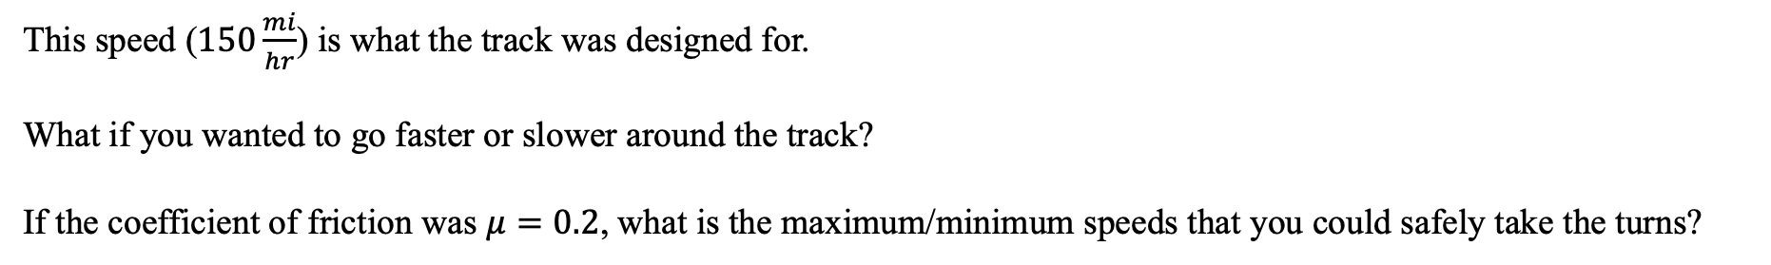
Circular Motion – A Banked Roadway
This speed ($150\frac{mi}{hr}$) is what the track was designed for.
What if you wanted to go faster or slower around the track?
If the coefficient of friction was $μ=0.2$, what is the maximum/minimum speeds that you could safely take the turns?
$$y$$
$$x$$
$$R$$
$$R$$
$$θ$$
$$θ$$
https://www.ajc.com/sports/racing/rains-delay-end-daytona-500-until-monday/Ctvg7ozshchtRxGVsfjpYK/

Slide 15

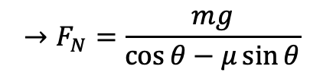


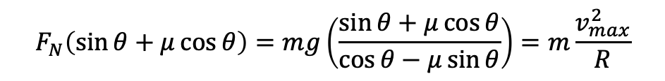

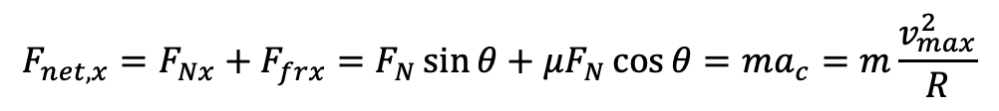
Circular Motion – A Banked Roadway - Solution
To take the corner at a high rate of speed, the car would tend to slide up the track to a larger radius. To keep the radius fixed, we need friction to point down the track to help us take the corner.
$$y$$
$$F_{Nx}$$
$${\vec{F}}_{N}$$
$$F_{net,y}=F_{Ny}−F_{W}−F_{Fry}=F_{N}\cos{θ}−mg−μF_{N}\sin{θ}=ma_{y}=0$$
$$F_{Ny}$$
$$→F_{N}=\frac{mg}{\cos{θ}−μ\sin{θ}}$$
$$θ$$
$$F_{frx}$$
$$x$$
$$F_{net,x}=F_{Nx}+F_{frx}=F_{N}\sin{θ}+μF_{N}\cos{θ}=ma_{c}=m\frac{v_{max}^{2}}{R}$$
$$θ$$
$$R$$
$$F_{fry}$$
$${\vec{F}}_{fr}$$
$${\vec{F}}_{W}$$
$$θ$$
$$F_{N}\left(\sin{θ}+μ\cos{θ}\right)=mg\left(\frac{\sin{θ}+μ\cos{θ}}{\cos{θ}−μ\sin{θ}}\right)=m\frac{v_{max}^{2}}{R}$$
$$→v_{max}=\sqrt{Rg\left(\frac{\sin{θ}+μ\cos{θ}}{\cos{θ}−μ\sin{θ}}\right)}=\sqrt{755m∙9.8\frac{m}{s^{2}}∙\left(\frac{\sin{31}+0.2\cos{31}}{\cos{31}−0.2\sin{31}}\right)}=82.1\frac{m}{s} (\sim 185\frac{mi}{hr})$$

Slide 16

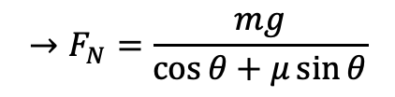


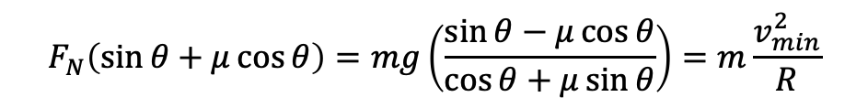

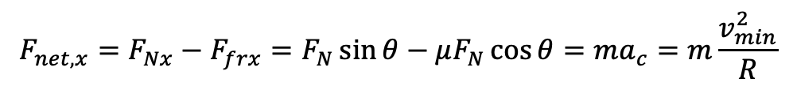
Circular Motion – A Banked Roadway - Solution
To take the corner at a low rate of speed, the car would tend to slide down the track to a larger radius. To keep the radius fixed, we need friction to point up the track to help us take the corner.
$$y$$
$$F_{Nx}$$
$${\vec{F}}_{N}$$
$$F_{net,y}=F_{Ny}−F_{W}+F_{Fry}=F_{N}\cos{θ}−mg+μF_{N}\sin{θ}=ma_{y}=0$$
$$F_{Ny}$$
$$→F_{N}=\frac{mg}{\cos{θ}+μ\sin{θ}}$$
$${\vec{F}}_{fr}$$
$$θ$$
$$F_{fry}$$
$$x$$
$$θ$$
$$F_{net,x}=F_{Nx}−F_{frx}=F_{N}\sin{θ}−μF_{N}\cos{θ}=ma_{c}=m\frac{v_{min}^{2}}{R}$$
$$F_{frx}$$
$$R$$
$${\vec{F}}_{W}$$
$$θ$$
$$F_{N}\left(\sin{θ}+μ\cos{θ}\right)=mg\left(\frac{\sin{θ}−μ\cos{θ}}{\cos{θ}+μ\sin{θ}}\right)=m\frac{v_{min}^{2}}{R}$$
$$→v_{min}=\sqrt{Rg\left(\frac{\sin{θ}−μ\cos{θ}}{\cos{θ}+μ\sin{θ}}\right)}=\sqrt{755m∙9.8\frac{m}{s^{2}}∙\left(\frac{\sin{31}−0.2\cos{31}}{\cos{31}+0.2\sin{31}}\right)}=51.5\frac{m}{s} (\sim 116\frac{mi}{hr})$$

Slide 17
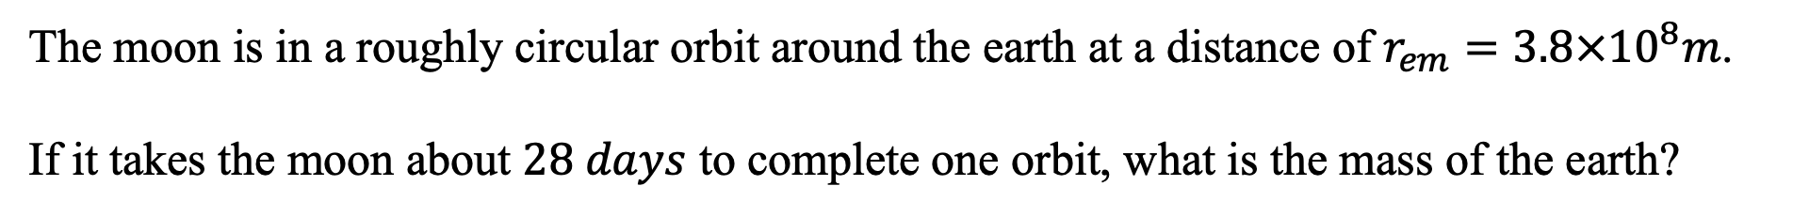
Circular Motion – The Earth-Moon System
The moon is in a roughly circular orbit around the earth at a distance of $r_{em}=3.8×{10}^{8}m$.
If it takes the moon about $28 days$ to complete one orbit, what is the mass of the earth?

Slide 18
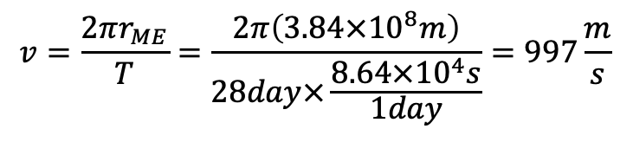
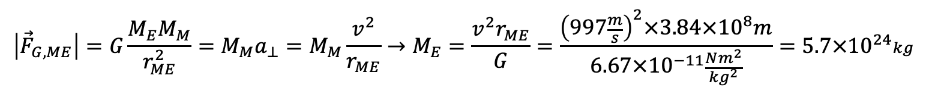
Circular Motion – The Earth-Moon System- Solution
The constant speed of the of the moon in orbit about the earth is given by the distance the moon travels (the circumference of the circle) divided by the time to travel once time around the circle, the period.
$$v=\frac{2πr_{ME}}{T}=\frac{2π\left(3.84×{10}^{8}m\right)}{28day×\frac{8.64×{10}^{4}s}{1day}}=997\frac{m}{s}$$
Gravity is what causes the moon to deviate from its straight-line motion and orbit about the sun and thus it’s the centripetal force. The gravitational force on the moon due to the earth points from the moon to the earth. Using Newton’s law of gravity, we can determine the mass of the central body, the earth.
$$\left|{\vec{F}}_{G,ME}\right|=G\frac{M_{E}M_{M}}{r_{ME}^{2}}=M_{M}a_{⊥}=M_{M}\frac{v^{2}}{r_{ME}}→M_{E}=\frac{v^{2}r_{ME}}{G}=\frac{{\left(997\frac{m}{s}\right)}^{2}×3.84×{10}^{8}m}{6.67×{10}^{−11}\frac{Nm^{2}}{{kg}^{2}}}=5.7×{10}^{24}kg$$
This is, by the way, how we determine masses in the universe. We watch one object orbit about a second object (the central body) and use Newton’s law of gravity to determine the mass of the central body.

