Slide 1


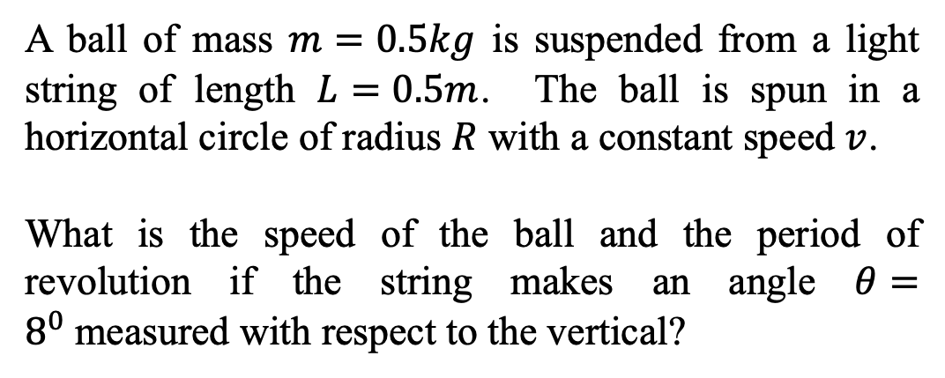

Circular Motion – the conical pendulum
$$θ$$
A ball of mass $m=0.5kg$ is suspended from a light string of length $L=0.5m$. The ball is spun in a horizontal circle of radius $R$ with a constant speed $v$.
What is the speed of the ball and the period of revolution if the string makes an angle $θ=8^{0}$measured with respect to the vertical?
$$m$$
$$R$$

Slide 2
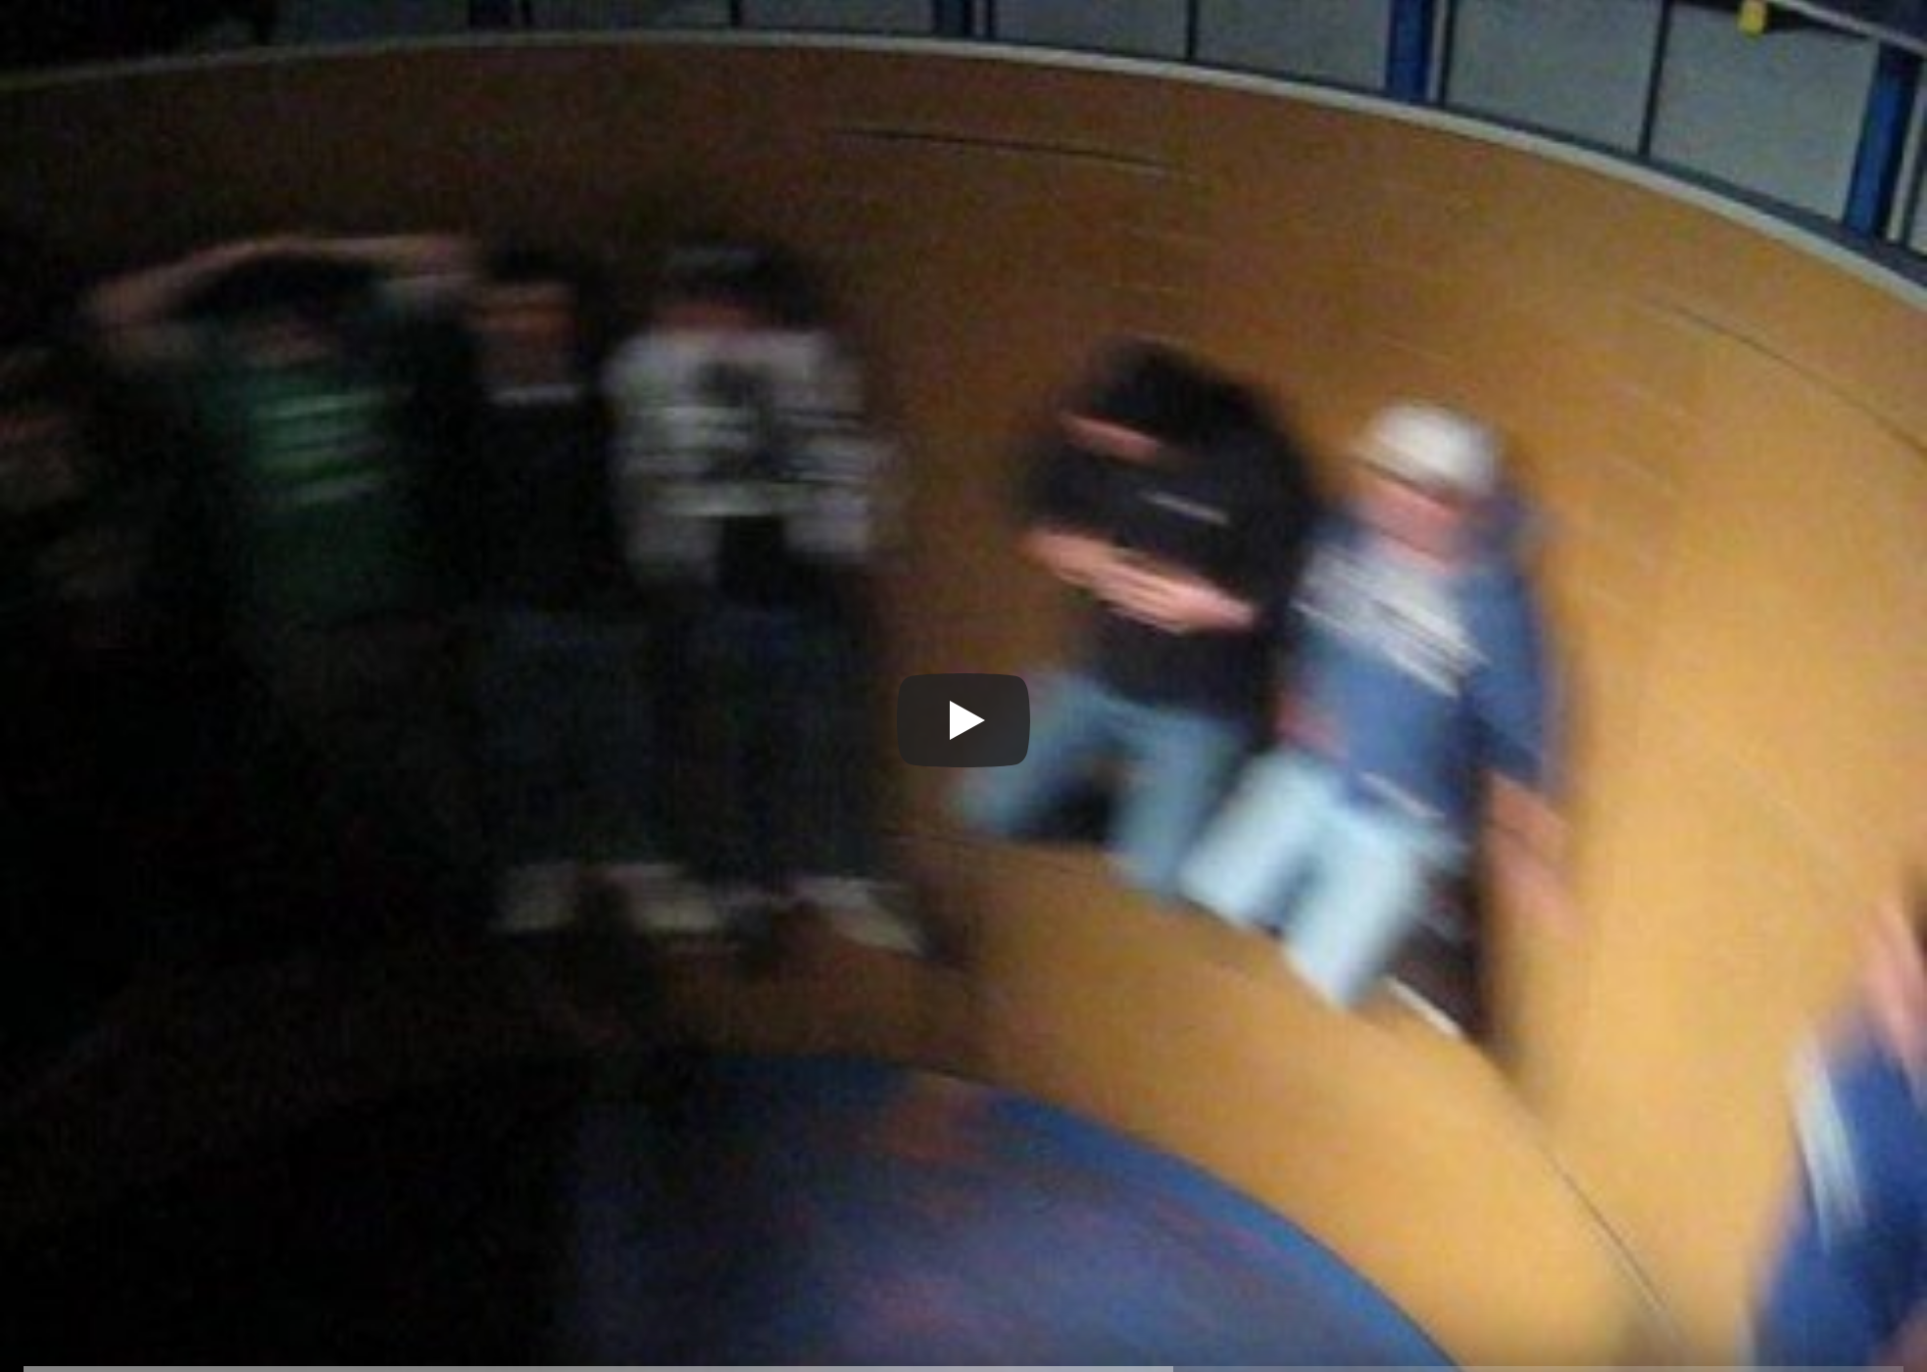
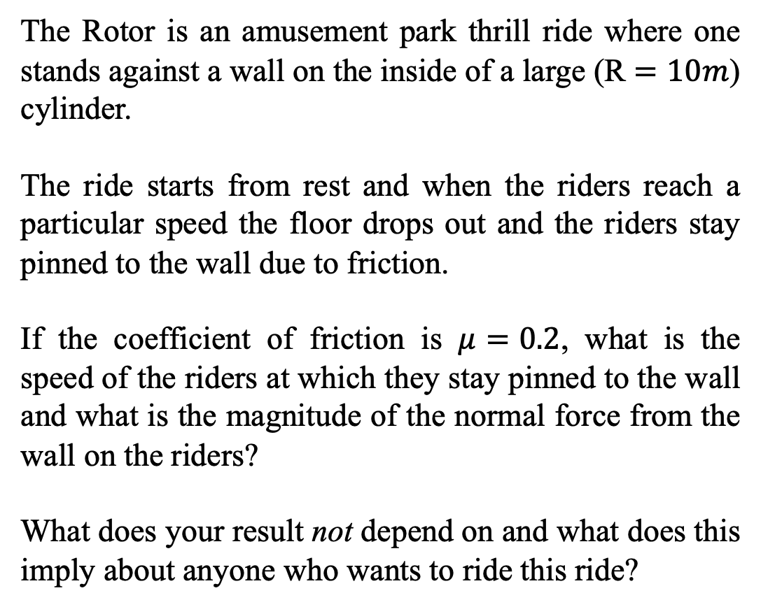
Circular Motion – the rotor; an amusement park thrill ride
The Rotor is an amusement park thrill ride where one stands against a wall on the inside of a large (R $=10m$) cylinder.
The ride starts from rest and when the riders reach a particular speed the floor drops out and the riders stay pinned to the wall due to friction.
If the coefficient of friction is $μ=0.2$, what is the speed of the riders at which they stay pinned to the wall and what is the magnitude of the normal force from the wall on the riders?
What does your result not depend on and what does this imply about anyone who wants to ride this ride?
https://www.youtube.com/watch?v=uz_DkRs92pM

Slide 3
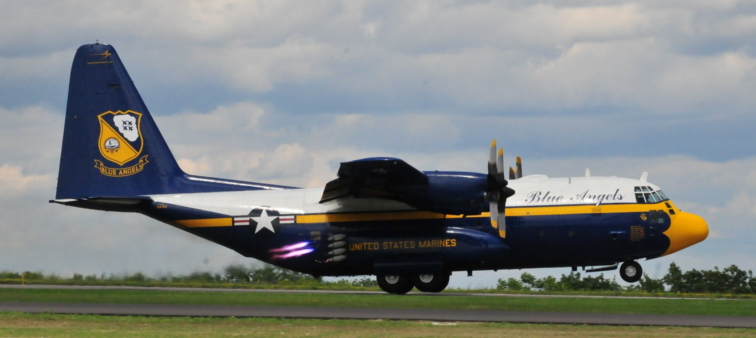
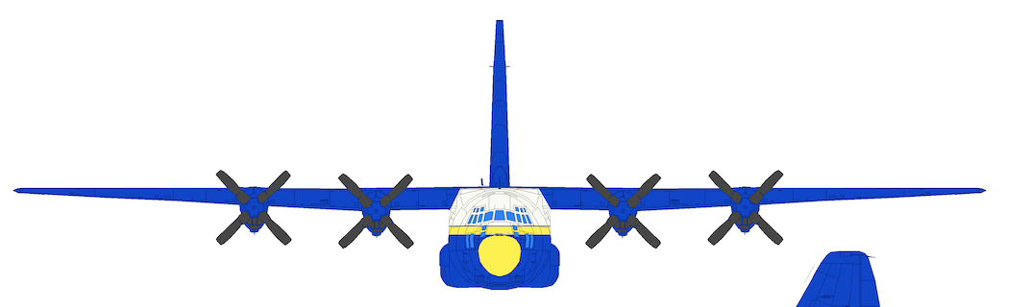
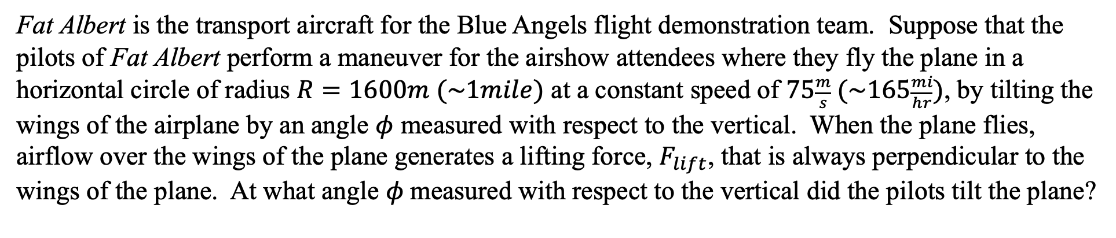
Circular Motion – a banked airplane
Fat Albert is the transport aircraft for the Blue Angels flight demonstration team. Suppose that the pilots of Fat Albert perform a maneuver for the airshow attendees where they fly the plane in a horizontal circle of radius $R=1600m (\sim 1mile)$ at a constant speed of $75\frac{m}{s} (\sim 165\frac{mi}{hr})$, by tilting the wings of the airplane by an angle $φ$ measured with respect to the vertical. When the plane flies, airflow over the wings of the plane generates a lifting force, $F_{lift}$, that is always perpendicular to the wings of the plane. At what angle $φ$measured with respect to the vertical did the pilots tilt the plane?
$${\vec{F}}_{Lift}$$
$$φ$$
Photo: S. LaBrake
FLift
FLift
ϕ
ϕ

Slide 4
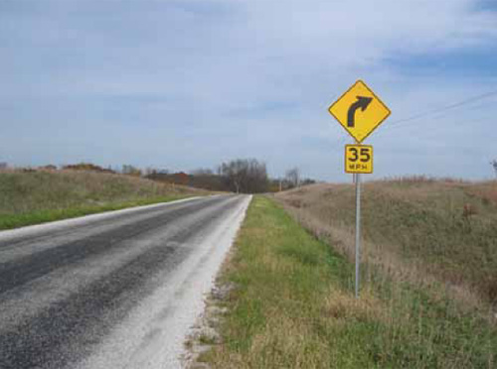
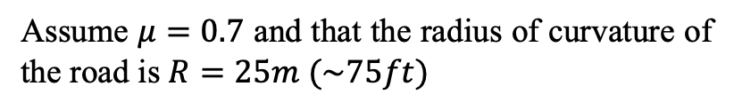
Circular Motion – a curve in the road
There are signs that are posted all over America's roadways alerting you to all sorts of things, like speed limits, distances to exits, tourist attractions, and the like.
Suppose that you are driving down a level road when you see a sign like the one on the right.
How does the department of transportation for your state know what speed limit to post on the sign?
That is, how do you determine the posted speed that you should take the curve at?
https://safety.fhwa.dot.gov/speedmgt/ref_mats/fhwasa10001/
Assume $μ=0.7$ and that the radius of curvature of the road is $R=25m (\sim 75ft)$

Slide 5
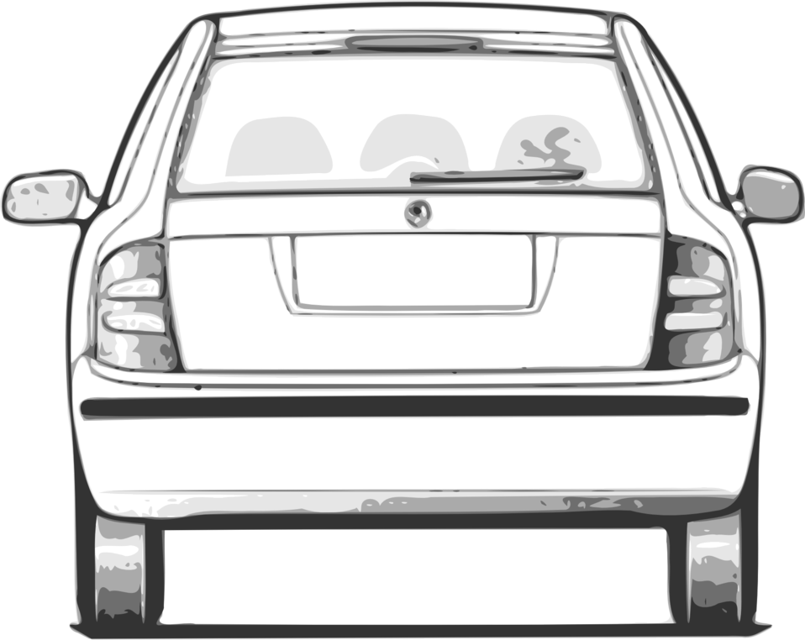
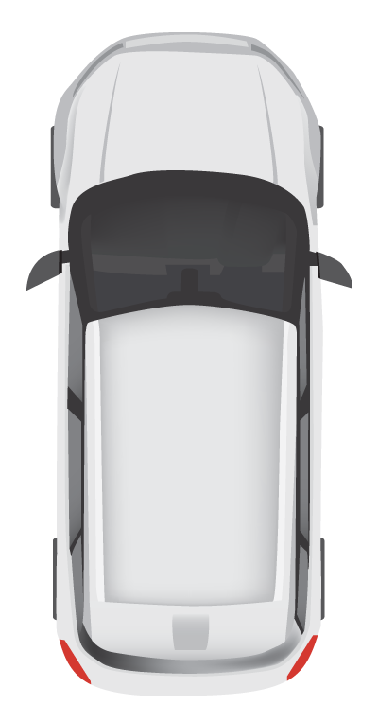


Circular Motion – a curve in the road
Face-on view
Top-down view
$$R$$
? mph
$$R$$

Slide 6
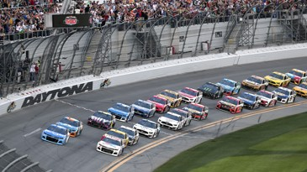
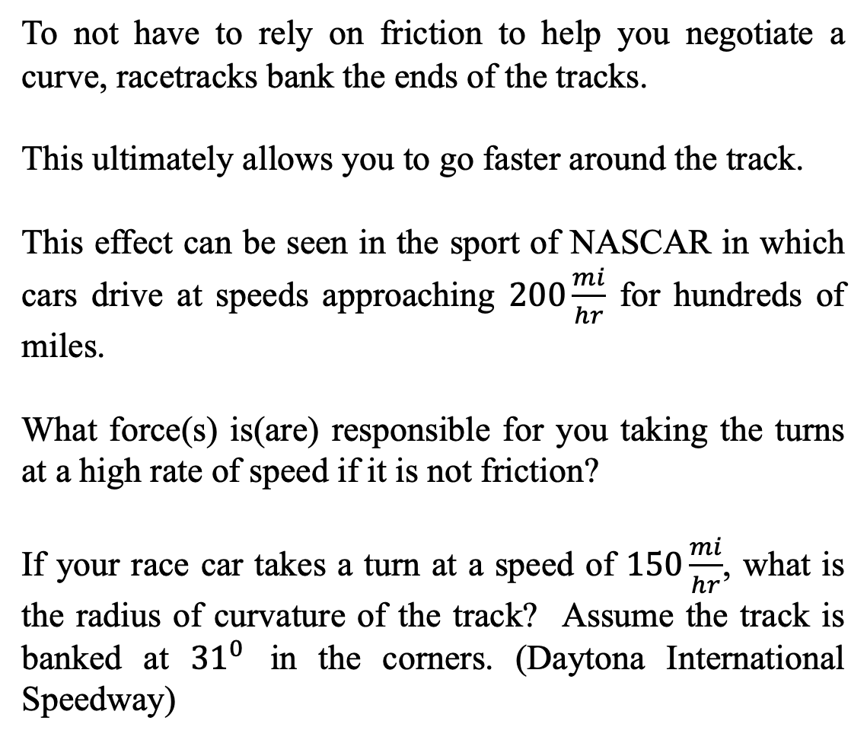
Circular Motion – a banked roadway
To not have to rely on friction to help you negotiate a curve, racetracks bank the ends of the tracks.
This ultimately allows you to go faster around the track.
This effect can be seen in the sport of NASCAR in which cars drive at speeds approaching $200\frac{mi}{hr}$ for hundreds of miles.
What force(s) is(are) responsible for you taking the turns at a high rate of speed if it is not friction?
If your race car takes a turn at a speed of $150\frac{mi}{hr}$, what is the radius of curvature of the track? Assume the track is banked at ${31}^{0}$ in the corners. (Daytona International Speedway)
https://www.ajc.com/sports/racing/rains-delay-end-daytona-500-until-monday/Ctvg7ozshchtRxGVsfjpYK/

Slide 7






Circular Motion – a banked roadway
$$y$$
$$x$$
$$R$$
$$R$$
$$θ$$
$$θ$$
https://www.ajc.com/sports/racing/rains-delay-end-daytona-500-until-monday/Ctvg7ozshchtRxGVsfjpYK/

