Slide 1
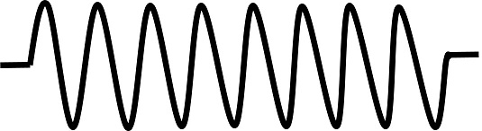


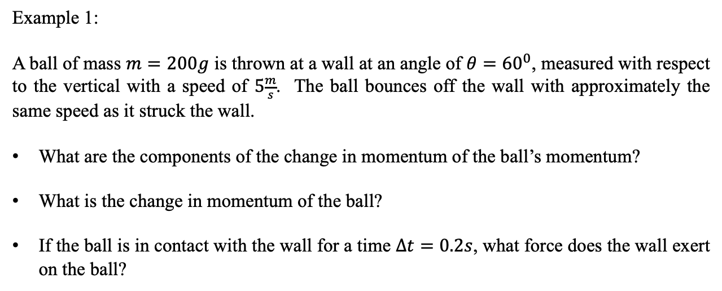





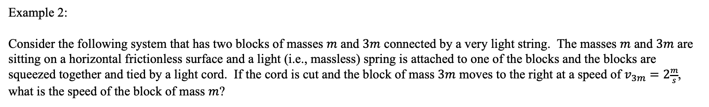



Momentum and Collisions
Example 1:
A ball of mass $m=200g$ is thrown at a wall at an angle of $θ={60}^{0}$, measured with respect to the vertical with a speed of $5\frac{m}{s}$. The ball bounces off the wall with approximately the same speed as it struck the wall.
What are the components of the change in momentum of the ball’s momentum?
What is the change in momentum of the ball?
If the ball is in contact with the wall for a time $∆t=0.2s$, what force does the wall exert on the ball?
$$m$$
$$v_{i}$$
$$θ$$
$$θ$$
$$v_{i}$$
$$m$$
Example 2:
Consider the following system that has two blocks of masses $m$ and $3m$ connected by a very light string. The masses $m$ and $3m$ are sitting on a horizontal frictionless surface and a light (i.e., massless) spring is attached to one of the blocks and the blocks are squeezed together and tied by a light cord. If the cord is cut and the block of mass $3m$ moves to the right at a speed of $v_{3m}=2\frac{m}{s}$, what is the speed of the block of mass $m$?
$$v_{m}$$
$$v_{3m}$$
$$m$$
$$3m$$
$$m$$
$$3m$$

Slide 2
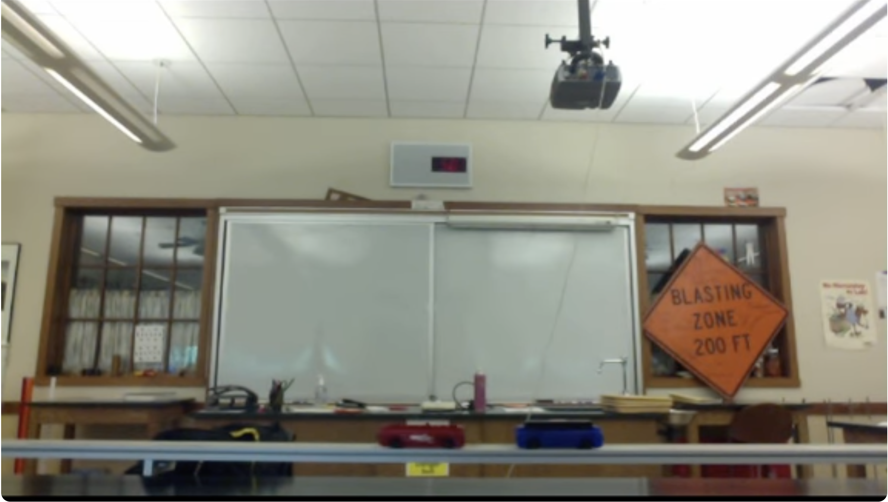
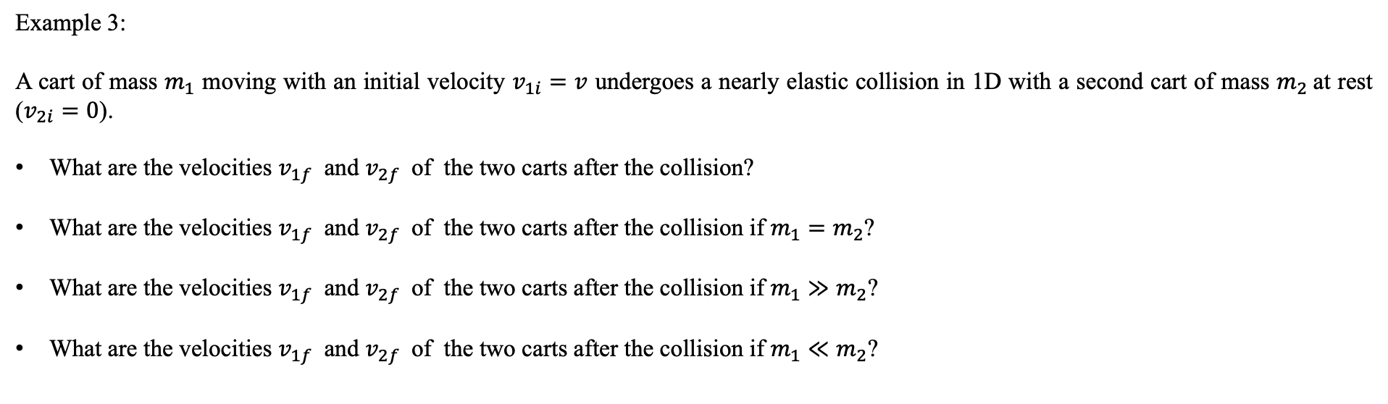
Momentum and Collisions
Example 3:
A cart of mass $m_{1}$ moving with an initial velocity $v_{1i}=v$ undergoes a nearly elastic collision in 1D with a second cart of mass $m_{2}$at rest ($v_{2i}=0$).
What are the velocities $v_{1f}$ and $v_{2f}$ of the two carts after the collision?
What are the velocities $v_{1f}$ and $v_{2f}$ of the two carts after the collision if $m_{1}=m_{2}$?
What are the velocities $v_{1f}$ and $v_{2f}$ of the two carts after the collision if $m_{1}≫m_{2}$?
What are the velocities $v_{1f}$ and $v_{2f}$ of the two carts after the collision if $m_{1}≪m_{2}$?
https://www.youtube.com/watch?v=YhLztPNEcaQ

Slide 3
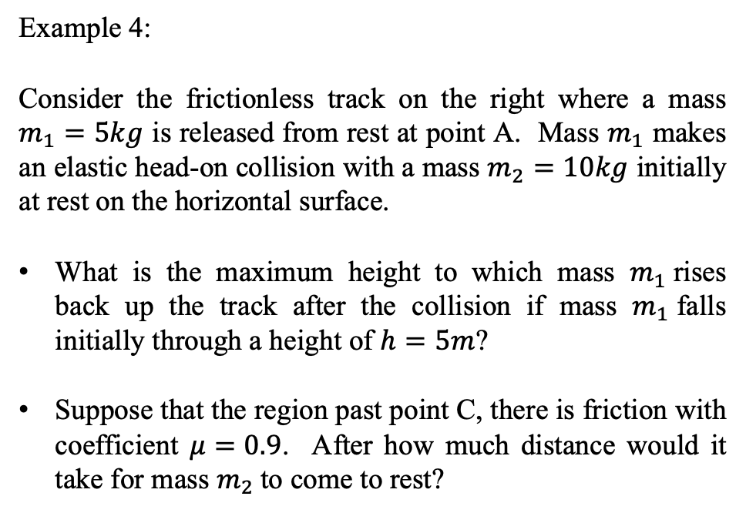
Momentum and Collisions
Example 4:
Consider the frictionless track on the right where a mass $m_{1}=5kg$ is released from rest at point A. Mass $m_{1}$ makes an elastic head-on collision with a mass $m_{2}=10kg$ initially at rest on the horizontal surface.
What is the maximum height to which mass $m_{1}$rises back up the track after the collision if mass $m_{1}$falls initially through a height of $h=5m$?
Suppose that the region past point C, there is friction with coefficient $μ=0.9$. After how much distance would it take for mass $m_{2}$to come to rest?
$$m_{1}$$
A
$$m_{2}$$
B
C

Slide 4
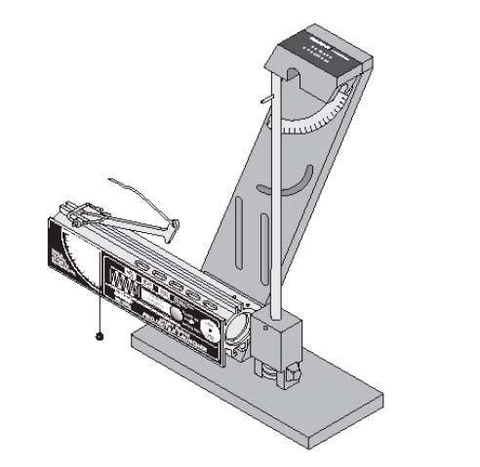
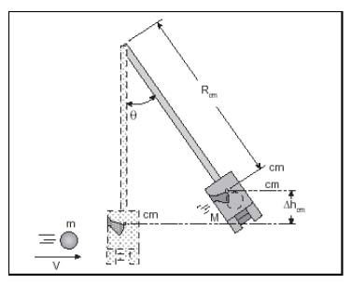
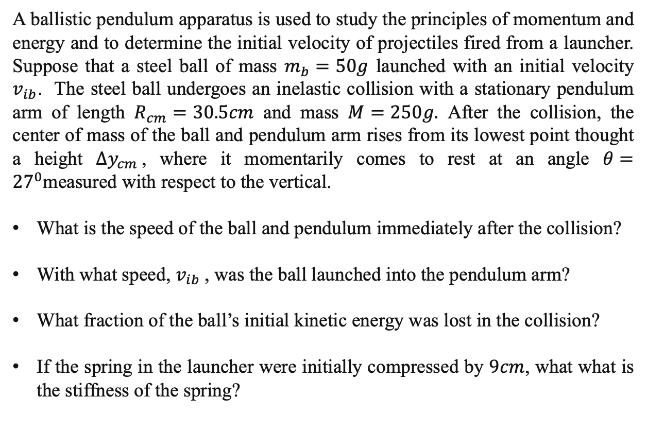
Momentum and Collisions
Example 5:
A ballistic pendulum apparatus is used to study the principles of momentum and energy and to determine the initial velocity of projectiles fired from a launcher. Suppose that a steel ball of mass $m_{b}=50g$ launched with an initial velocity $v_{ib}$. The steel ball undergoes an inelastic collision with a stationary pendulum arm of length $R_{cm}=30.5cm$ and mass $M=250g.$ After the collision, the center of mass of the ball and pendulum arm rises from its lowest point thought a height $∆y_{cm}$, where it momentarily comes to rest at an angle $θ={27}^{0}$measured with respect to the vertical.
What is the speed of the ball and pendulum immediately after the collision?
With what speed, $v_{ib}$, was the ball launched into the pendulum arm?
What fraction of the ball’s initial kinetic energy was lost in the collision?
If the spring in the launcher were initially compressed by $9cm$, what what is the stiffness of the spring?
$$R_{cm}$$
$$m_{b}$$
$$∆y_{cm}$$
$$v_{ib}$$

Slide 5
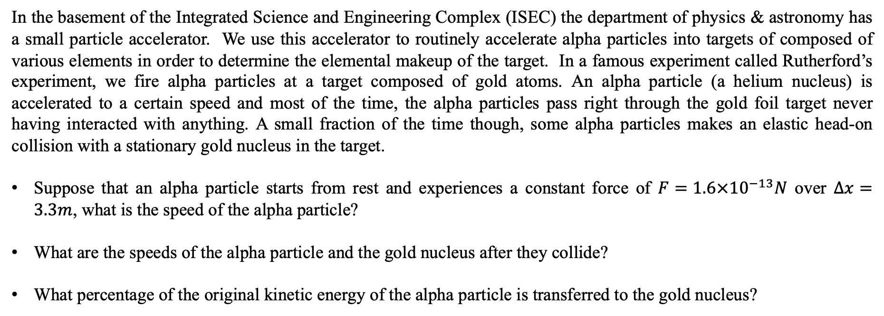
Momentum and Collisions
Example 6:
In the basement of the Integrated Science and Engineering Complex (ISEC) the department of physics & astronomy has a small particle accelerator. We use this accelerator to routinely accelerate alpha particles into targets of composed of various elements in order to determine the elemental makeup of the target. In a famous experiment called Rutherford’s experiment, we fire alpha particles at a target composed of gold atoms. An alpha particle (a helium nucleus) is accelerated to a certain speed and most of the time, the alpha particles pass right through the gold foil target never having interacted with anything. A small fraction of the time though, some alpha particles makes an elastic head-on collision with a stationary gold nucleus in the target.
Suppose that an alpha particle starts from rest and experiences a constant force of $F=1.6×{10}^{−13}N$ over $∆x=3.3m$, what is the speed of the alpha particle?
What are the speeds of the alpha particle and the gold nucleus after they collide?
What percentage of the original kinetic energy of the alpha particle is transferred to the gold nucleus?

Slide 6
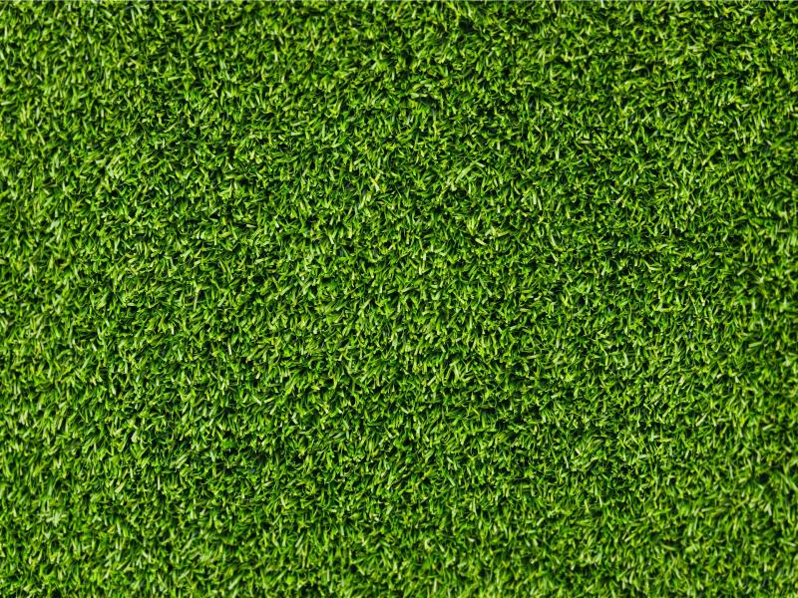
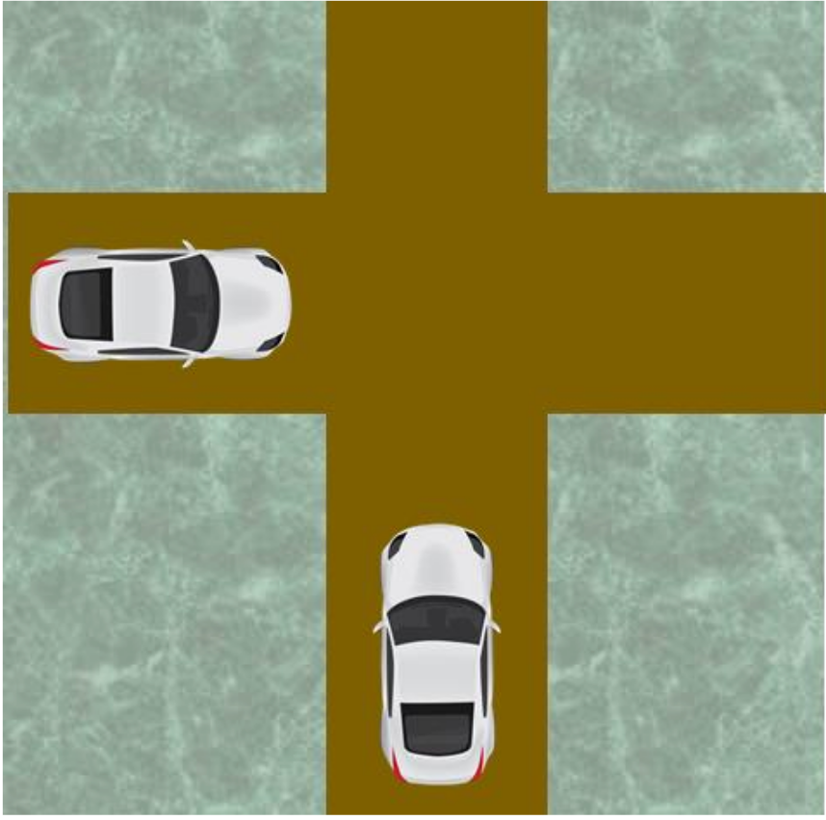
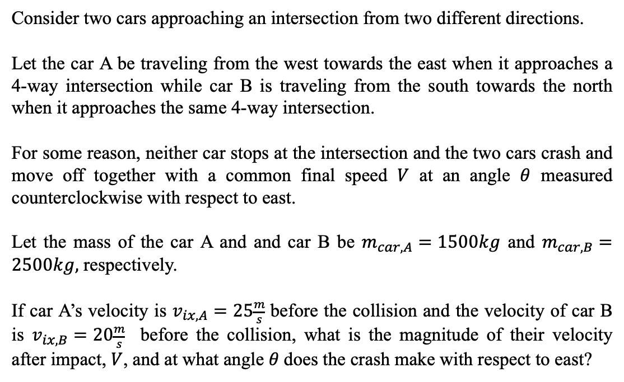
Momentum and Collisions
- Inelastic Collisions in 2D
Example 7:
Consider two cars approaching an intersection from two different directions.
Let the car A be traveling from the west towards the east when it approaches a 4-way intersection while car B is traveling from the south towards the north when it approaches the same 4-way intersection.
For some reason, neither car stops at the intersection and the two cars crash and move off together with a common final speed $V$ at an angle $θ$ measured counterclockwise with respect to east.
Let the mass of the car A and and car B be $m_{car,A}=1500kg$ and $m_{car,B}=2500kg,$ respectively.
If car A’s velocity is $v_{ix,A}=25\frac{m}{s}$ before the collision and the velocity of car B is $v_{ix,B}=20\frac{m}{s}$ before the collision, what is the magnitude of their velocity after impact, $V$, and at what angle $θ$does the crash make with respect to east?
A
B

Slide 7
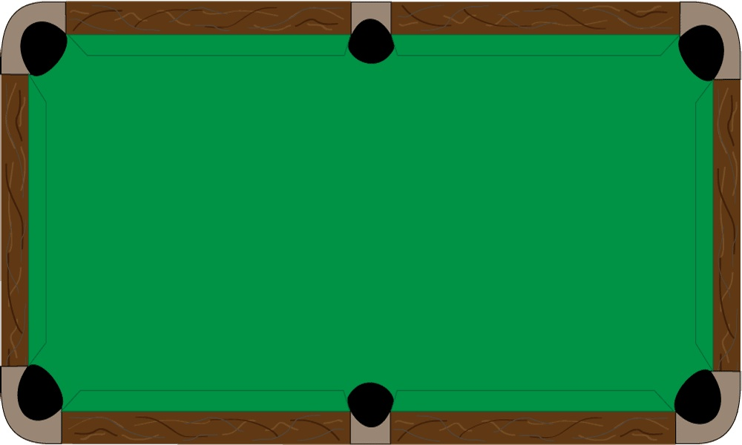

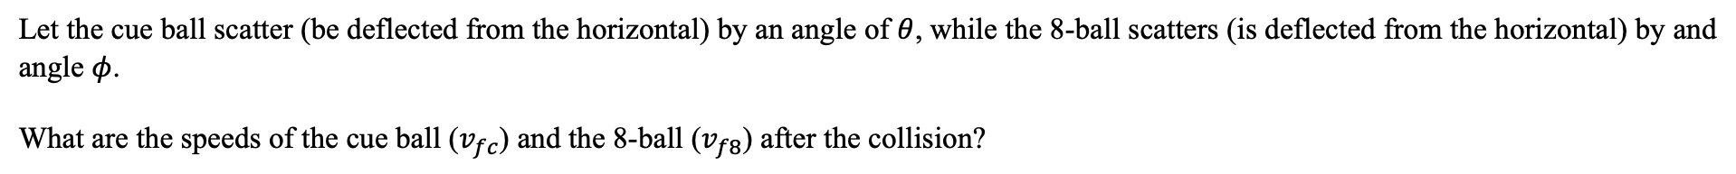


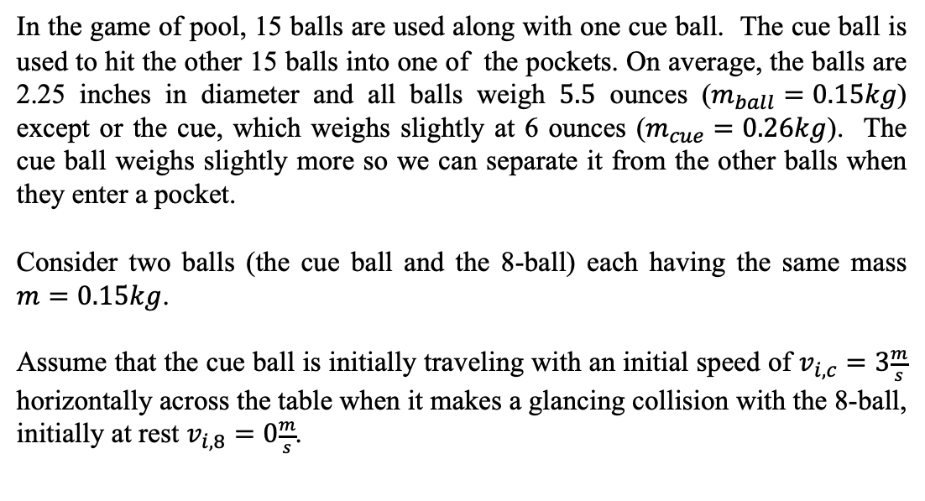





Momentum and Collisions
- Elastic Collisions in 2D
$$y$$
$$v_{ic}$$
Example 7:
$$x$$
$$v_{i8}=0$$
In the game of pool, 15 balls are used along with one cue ball. The cue ball is used to hit the other 15 balls into one of the pockets. On average, the balls are 2.25 inches in diameter and all balls weigh $5.5$ ounces ($m_{ball}=0.15kg$) except or the cue, which weighs slightly at 6 ounces ($m_{cue}=0.26kg$). The cue ball weighs slightly more so we can separate it from the other balls when they enter a pocket.
Consider two balls (the cue ball and the 8-ball) each having the same mass $m=0.15kg$.
Assume that the cue ball is initially traveling with an initial speed of $v_{i,c}=3\frac{m}{s}$ horizontally across the table when it makes a glancing collision with the 8-ball, initially at rest $v_{i,8}=0\frac{m}{s}$.
$$v_{fc}$$
Before the collision.
$$y$$
$$v_{f8}$$
$$φ$$
$$θ$$
$$x$$
$$v_{fc}$$
After the collision.
Let the cue ball scatter (be deflected from the horizontal) by an angle of $θ$, while the 8-ball scatters (is deflected from the horizontal) by and angle $φ$.
What are the speeds of the cue ball ($v_{fc}$) and the 8-ball ($v_{f8}$) after the collision?

Slide 8
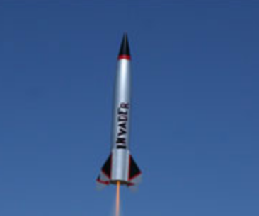



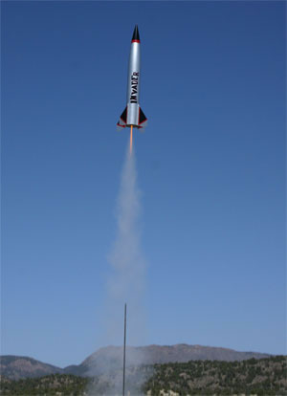



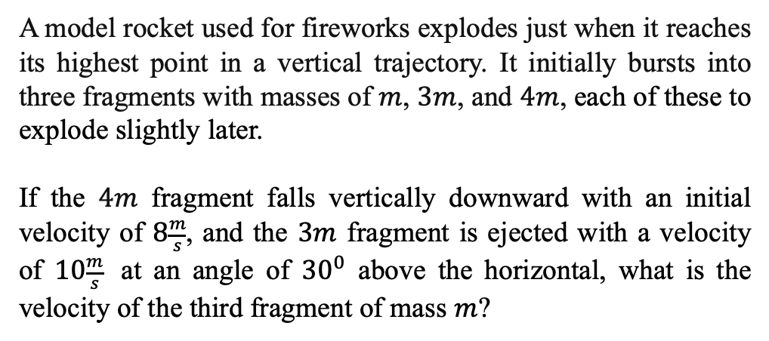



Momentum and Collisions
$$y$$
Example 9:
$$v_{3m}$$
$$θ$$
$$v_{m}$$
A model rocket used for fireworks explodes just when it reaches its highest point in a vertical trajectory. It initially bursts into three fragments with masses of $m$, $3m$, and $4m$, each of these to explode slightly later.
If the $4m$ fragment falls vertically downward with an initial velocity of $8\frac{m}{s}$, and the $3m$ fragment is ejected with a velocity of $10\frac{m}{s}$ at an angle of ${30}^{0}$ above the horizontal, what is the velocity of the third fragment of mass $m$?
$$φ$$
$$x$$
$$v_{4m}$$
https://www.toysperiod.com/blog/scale-models/model-rockets-from-history-of-rocketry-to-building-your-own/

Slide 9
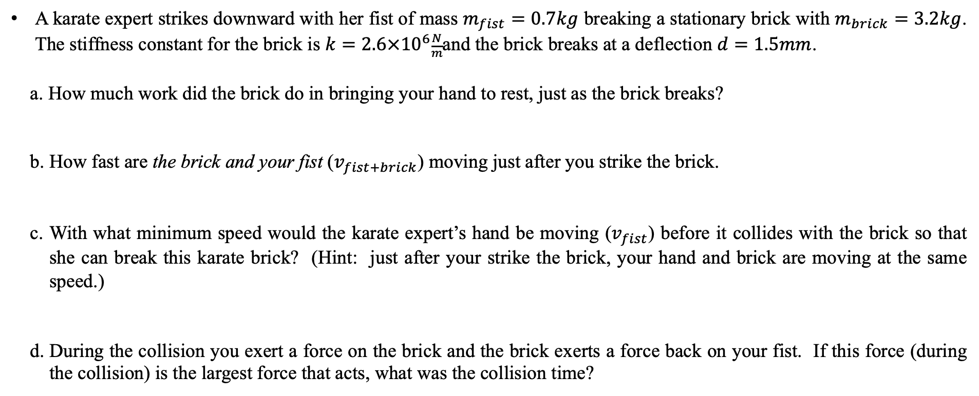
Momentum and Collisions
Example 10:
A karate expert strikes downward with her fist of mass $m_{fist}=0.7kg$ breaking a stationary brick with $m_{brick}=3.2kg$. The stiffness constant for the brick is $k=2.6×{10}^{6}\frac{N}{m}$and the brick breaks at a deflection $d=1.5mm$.
a. How much work did the brick do in bringing your hand to rest, just as the brick breaks?
b. How fast are the brick and your fist ($v_{fist+brick}$) moving just after you strike the brick.
c. With what minimum speed would the karate expert’s hand be moving ($v_{fist}$) before it collides with the brick so that she can break this karate brick? (Hint: just after your strike the brick, your hand and brick are moving at the same speed.)
d. During the collision you exert a force on the brick and the brick exerts a force back on your fist. If this force (during the collision) is the largest force that acts, what was the collision time?

