Slide 1

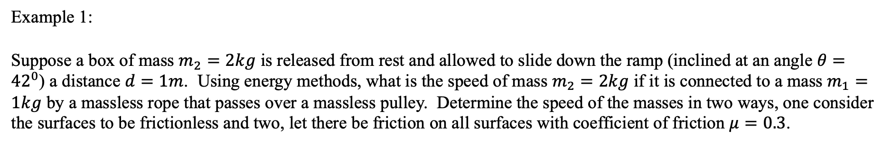


Conservation of Energy
Example 1:
Suppose a box of mass $m_{2}=2kg$ is released from rest and allowed to slide down the ramp (inclined at an angle $θ={42}^{0}$) a distance $d=1m$. Using energy methods, what is the speed of mass $m_{2}=2kg$ if it is connected to a mass $m_{1}=1kg$ by a massless rope that passes over a massless pulley. Determine the speed of the masses in two ways, one consider the surfaces to be frictionless and two, let there be friction on all surfaces with coefficient of friction $μ=0.3$.
$$m_{1}$$
$$m_{2}$$
$$θ$$

Slide 2









Conservation of Energy
Example 1 Solution:
Assuming that that there is no friction on any of the surfaces, we’ll apply conservation of energy.
$$m_{1}$$
$$∆E=∆K+∆U_{g}+∆U_{s}=0$$
$$m_{2}$$
$$0$$
$$0$$
$$∆E=∆K_{1}+∆U_{g1}+∆K_{2}+∆U_{g2}+∆U_{s}=0$$
Mass $m_{1}$ does not change height and there are no springs in the problem so let $∆U_{g1}=0$ and $∆U_{s}=0$ .
$$θ$$
$$0$$
$$0$$
$$0$$
$$∆E=\left(\frac{1}{2}m_{1}v_{1f}^{2}−\frac{1}{2}m_{1}v_{1i}^{2}\right)+\left(\frac{1}{2}m_{2}v_{2f}^{2}−\frac{1}{2}m_{2}v_{2i}^{2}\right)+\left(m_{2}gy_{2f}−m_{2}gy_{2i}\right)=0$$
$K$ and $U_{g}$ for $m_{1}$
$K$ and $U_{g}$ for $m_{2}$
$∆E=$ $\frac{1}{2}m_{1}v_{1f}^{2}+\frac{1}{2}m_{1}v_{1f}^{2}−m_{2}gy_{2i}=0$
The gravitational potential energy of mass $m_{2}$ decreases (it falls) and the kinetic energies of masses $m_{1}$ and $m_{2}$ both increase as a result of mass $m_{2}$ falling.

Slide 3


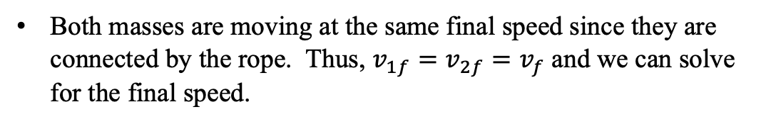
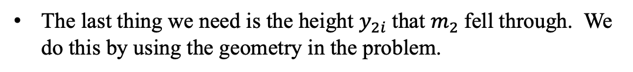

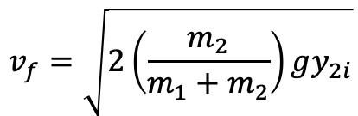


Conservation of Energy
Example 1 Solution continued:
Both masses are moving at the same final speed since they are connected by the rope. Thus, $v_{1f}=v_{2f}=v_{f}$ and we can solve for the final speed.
$$m_{1}$$
$∆E=$ $\frac{1}{2}m_{1}v_{1f}^{2}+\frac{1}{2}m_{2}v_{2f}^{2}−m_{2}gy_{2i}=0$
$$m_{2}$$
$$d$$
$$\frac{1}{2}\left(m_{1}+m_{2}\right)v_{f}^{2}=m_{2}gy_{2i}$$
$$y_{2i}$$
$$v_{f}=\sqrt{2\left(\frac{m_{2}}{m_{1}+m_{2}}\right)gy_{2i}}$$
$$θ$$
The last thing we need is the height $y_{2i}$that $m_{2}$fell through. We do this by using the geometry in the problem.
$$\sin{θ}=\frac{y_{2i}}{d}→y_{2i}=d\sin{θ}$$
$$v_{f}=\sqrt{2\left(\frac{m_{2}}{m_{1}+m_{2}}\right)gy_{2i}}=\sqrt{2\left(\frac{m_{2}}{m_{1}+m_{2}}\right)gd\sin{θ}}=\sqrt{2\left(\frac{2kg}{1kg+2kg}\right)×9.8\frac{m}{s^{2}}×1m\sin{42}}=2.96\frac{m}{s}$$
The value seems reasonable. The acceleration ($\frac{m_{2}}{m_{1}+m_{2}}g\sin{θ}$) is less than $g$and the speed is less than the case without friction.

Slide 4



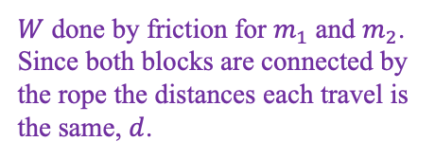
Conservation of Energy
Example 1 Solution continued:
If there is friction on all of the surfaces, we’ll apply conservation of energy, but we need to calculate the work done done on both surfaces due to friction.
$$m_{1}$$
$$∆E=∆K+∆U_{g}+∆U_{s}=−F_{fr}d$$
$$m_{2}$$
$$d$$
$$0$$
$$0$$
$$∆E=∆K_{1}+∆U_{g1}+∆K_{2}+∆U_{g2}+∆U_{s}=−F_{fr1}d−F_{fr2}d$$
$$y_{2i}$$
Mass $m_{1}$ does not change height and there are no springs in the problem so let $∆U_{g1}=0$ and $∆U_{s}=0$ .
$$θ$$
$$0$$
$$0$$
$$0$$
$$∆E=\left(\frac{1}{2}m_{1}v_{1f}^{2}−\frac{1}{2}m_{1}v_{1i}^{2}\right)+\left(\frac{1}{2}m_{2}v_{2f}^{2}−\frac{1}{2}m_{2}v_{2i}^{2}\right)+\left(m_{2}gy_{2f}−m_{2}gy_{2i}\right)=−μm_{1}gd−μm_{2}g\cos{θ}d$$
$K$ and $U_{g}$ for $m_{1}$
$K$ and $U_{g}$ for $m_{2}$
$W$ done by friction for $m_{1}$ and $m_{2}$. Since both blocks are connected by the rope the distances each travel is the same, $d$.
$∆E=$ $\frac{1}{2}m_{1}v_{1f}^{2}+\frac{1}{2}m_{2}v_{2f}^{2}−m_{2}gy_{2i}=−μgd\left(m_{1}+m_{2}\cos{θ}\right)$
The gravitational potential energy of mass $m_{2}$ decreases (it falls) and the kinetic energies of masses $m_{1}$ and $m_{2}$ increase as a result of mass $m_{2}$ falling but not to the same extent as the case without friction.

Slide 5


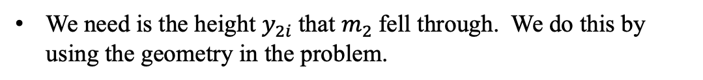

Conservation of Energy
Example 1 Solution continued:
$$m_{1}$$
Both masses are moving at the same final speed since they are connected by the rope. Thus, $v_{1f}=v_{2f}=v_{f}$ and we can solve for the final speed.
$$m_{2}$$
$$d$$
$∆E=$ $\frac{1}{2}m_{1}v_{f}^{2}+\frac{1}{2}m_{2}v_{f}^{2}−m_{2}gy_{2i}=−μgx_{f}\left(m_{1}+m_{2}\cos{θ}\right)$
$$y_{2i}$$
$$θ$$
We need is the height $y_{2i}$that $m_{2}$fell through. We do this by using the geometry in the problem.
$$\sin{θ}=\frac{y_{2i}}{d}→y_{2i}=d\sin{θ}$$
$∆E=$ $\frac{1}{2}\left(m_{1}+m_{2}\right)v_{f}^{2}+−m_{2}gd\sin{θ}=−μgd\left(m_{1}+m_{2}\cos{θ}\right)$
$$v_{f}=\sqrt{\frac{2gd\left(m_{2}\sin{θ}−μ\left(m_{1}+m_{2}\cos{θ}\right)\right)}{m_{1}+m_{2}}}=\sqrt{\frac{2×9.8×1m\left(\left(2kg\sin{42}\right)−0.3\left(1kg+2kg\cos{42}\right)\right)}{1kg+2kg}}=1.97\frac{m}{s}$$
The value seems reasonable. The acceleration ($\frac{m_{2}\sin{θ}−μ\left(m_{1}+m_{2}\cos{θ}\right)}{m_{1}+m_{2}}g$) is less than $g$and the speed is less than the case without friction.

Slide 6
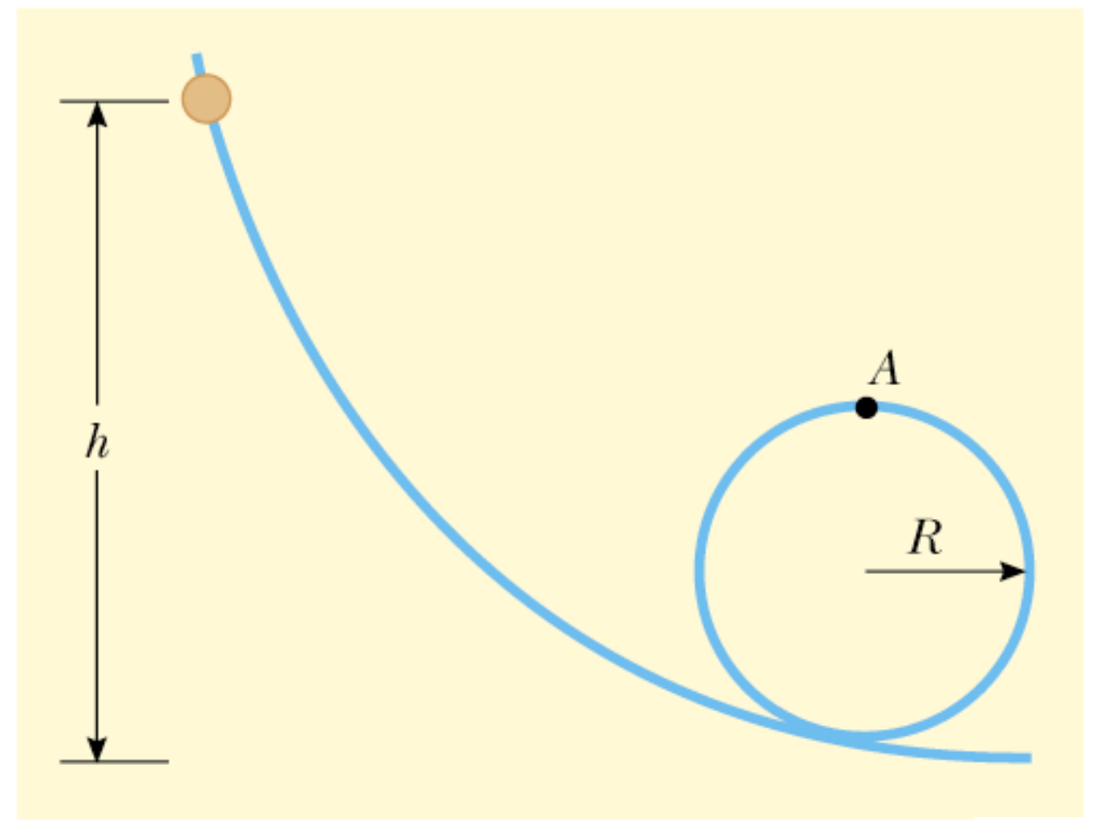
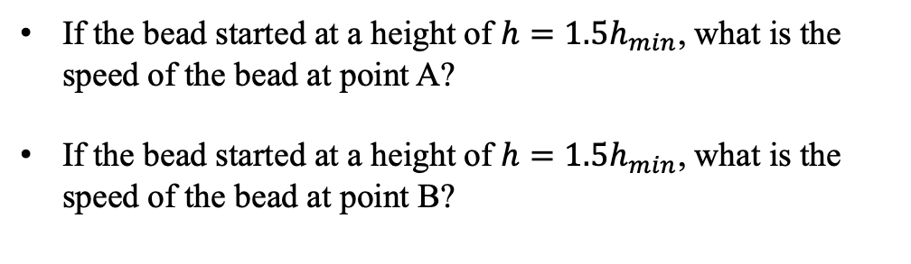
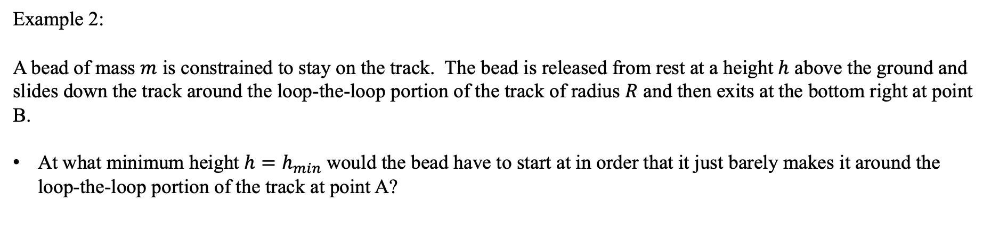
Conservation of Energy
Example 2:
A bead of mass $m$ is constrained to stay on the track. The bead is released from rest at a height $h$ above the ground and slides down the track around the loop-the-loop portion of the track of radius $R$ and then exits at the bottom right at point B.
At what minimum height $h=h_{min}$would the bead have to start at in order that it just barely makes it around the loop-the-loop portion of the track at point A?
If the bead started at a height of $h=1.5h_{min}$, what is the speed of the bead at point A?
If the bead started at a height of $h=1.5h_{min}$, what is the speed of the bead at point B?
B

Slide 7

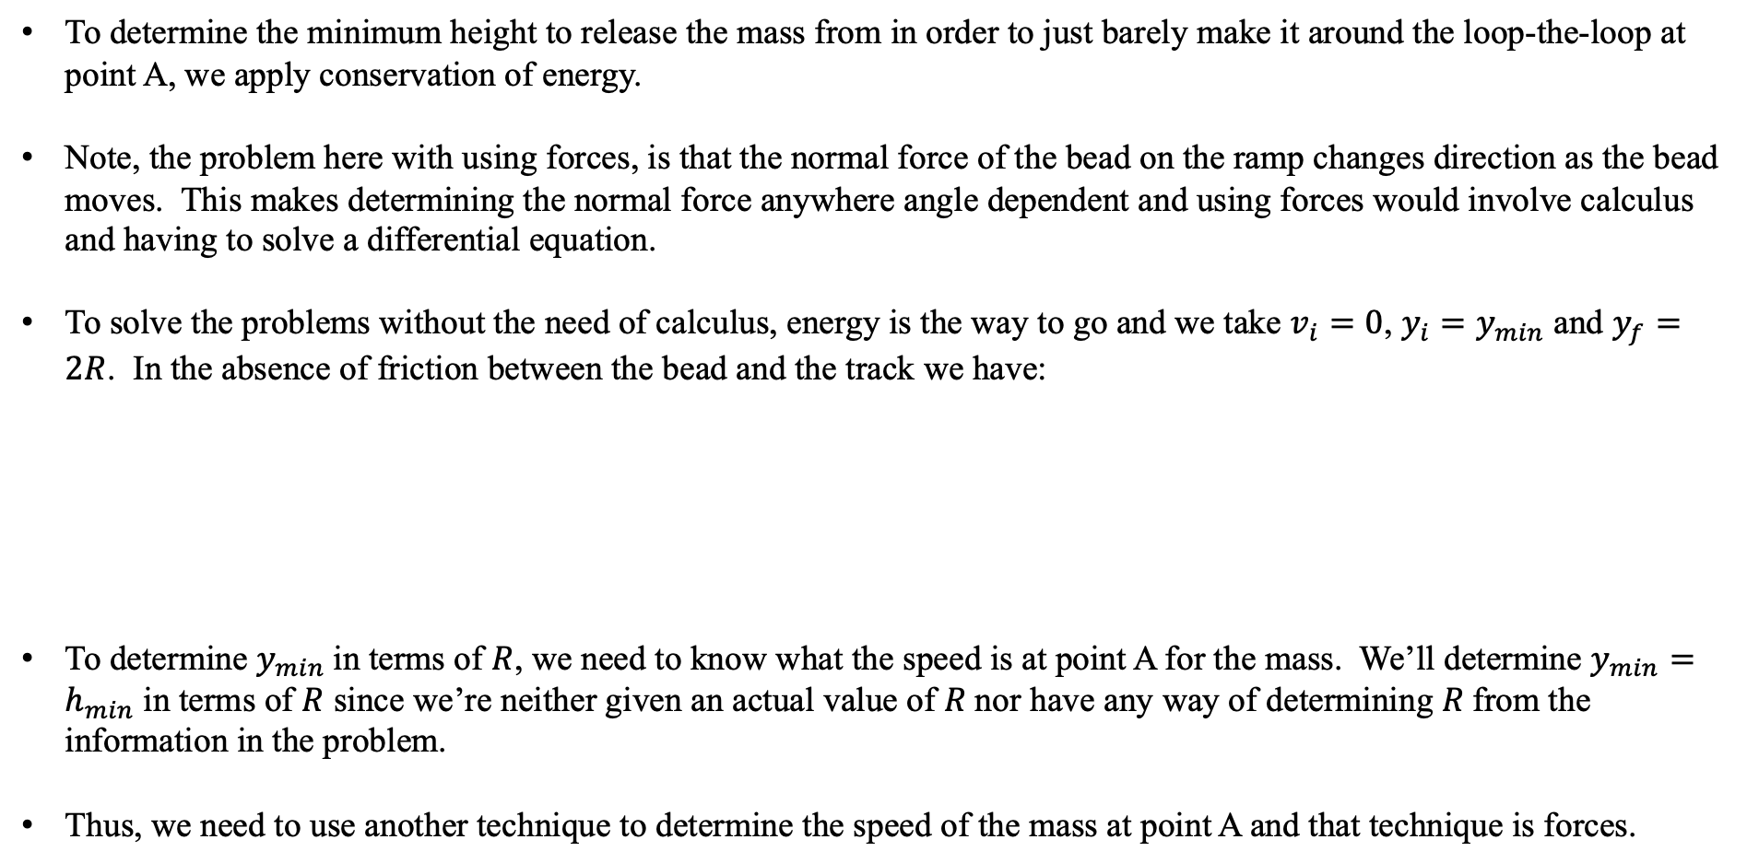


Conservation of Energy
Example 2 Solution:
To determine the minimum height to release the mass from in order to just barely make it around the loop-the-loop at point A, we apply conservation of energy.
Note, the problem here with using forces, is that the normal force of the bead on the ramp changes direction as the bead moves. This makes determining the normal force anywhere angle dependent and using forces would involve calculus and having to solve a differential equation.
To solve the problems without the need of calculus, energy is the way to go and we take $v_{i}=0$, $y_{i}=y_{min}$ and $y_{f}=2R$. In the absence of friction between the bead and the track we have:
To determine $y_{min}$in terms of $R$, we need to know what the speed is at point A for the mass. We’ll determine $y_{min}=h_{min}$ in terms of $R$ since we’re neither given an actual value of $R$nor have any way of determining $R$from the information in the problem.
Thus, we need to use another technique to determine the speed of the mass at point A and that technique is forces.
$$0$$
$$∆E=∆K+∆U_{g}+∆U_{s}=0$$
$$0$$
$$\left(\frac{1}{2}mv_{f}^{2}−\frac{1}{2}mv_{i}^{2}\right)+\left(mgy_{f}−mgy_{i}\right)=0→\frac{1}{2}mv_{f}^{2}+2Rmg−mgy_{min}=0$$

Slide 8



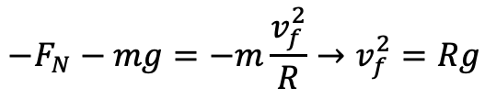
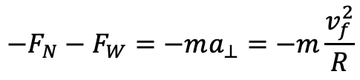

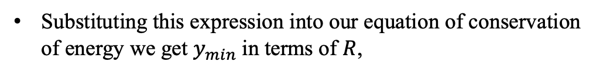
Conservation of Energy
Example 2 Solution continued:
Assuming that the positive y-direction is vertically upwards, we have by Newton’s laws of motion at point A:
$${\vec{F}}_{N}$$
$${\vec{F}}_{W}$$
$$R$$
$$−F_{N}−F_{W}=−ma_{⊥}=−m\frac{v_{f}^{2}}{R}$$
The condition for the bead to just barely hang is when the normal force vanishes. If the normal force vanishes then the bead is no longer in contact with the track.
$$−F_{N}−mg=−m\frac{v_{f}^{2}}{R}→v_{f}^{2}=Rg$$
$$0$$
Substituting this expression into our equation of conservation of energy we get $y_{min}$in terms of $R$,
$$\frac{1}{2}mv_{f}^{2}+2Rmg−mgy_{min}=\frac{1}{2}mRg+2MRg−mgy_{min}=0→y_{min}=2.5R$$

Slide 9


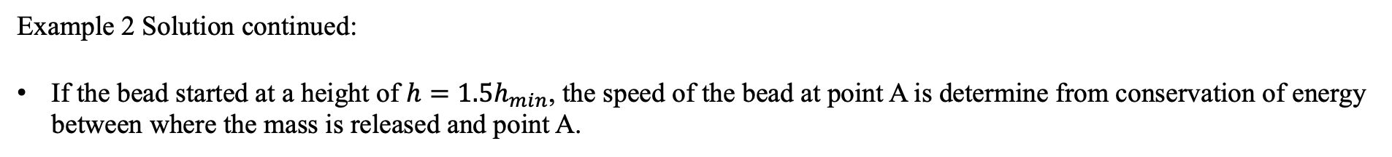


Conservation of Energy
Example 2 Solution continued:
If the bead started at a height of $h=1.5h_{min}$, the speed of the bead at point A is determine from conservation of energy between where the mass is released and point A.
$$0$$
$$∆E=∆K+∆U_{g}+∆U_{s}=0$$
$$0$$
$$\left(\frac{1}{2}mv_{f}^{2}−\frac{1}{2}mv_{i}^{2}\right)+\left(mgy_{f}−mgy_{i}\right)=0→\frac{1}{2}mv_{fA}^{2}+mg\left(2R\right)−mg\left(1.5×2.5R\right)=0$$
$$v_{f}=\sqrt{3.5Rg}$$
The work done on the mass by gravity changes the kinetic energy of the mass which in turn also leads to a change in gravitational potential energy of the mass. We can calculate either change. From the change in gravitational potential energy of the mass
Notice the work done is positive as expected since the mass is moving faster at the bottom than it was at rest.
$$0$$
$$W=−∆U_{g}=−\left(mgy_{fB}−mgy_{iA}\right)=mgy_{iA}=3.75mgR$$
B

Slide 10
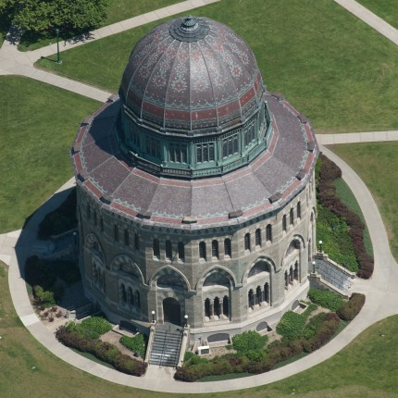
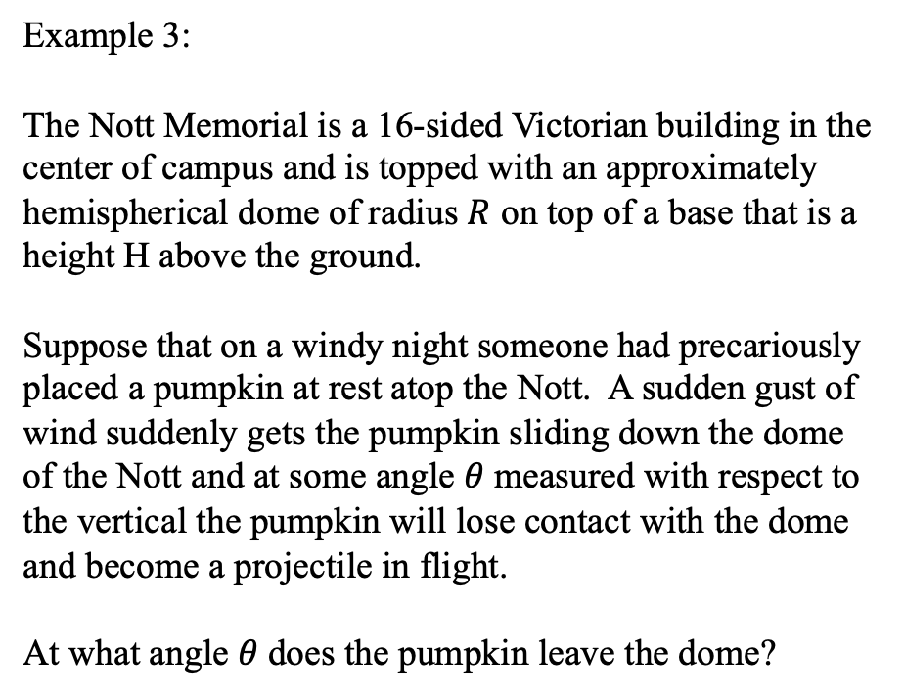
Conservation of Energy
Example 3:
The Nott Memorial is a 16-sided Victorian building in the center of campus and is topped with an approximately hemispherical dome of radius $R$ on top of a base that is a height H above the ground.
Suppose that on a windy night someone had precariously placed a pumpkin at rest atop the Nott. A sudden gust of wind suddenly gets the pumpkin sliding down the dome of the Nott and at some angle $θ$measured with respect to the vertical the pumpkin will lose contact with the dome and become a projectile in flight.
At what angle $θ$does the pumpkin leave the dome?
https://commodorebuilders.com/2014/03/24/union-college-nott-memorial/

Slide 11
Conservation of Energy
Example 3 solution:
Let’s model the Nott Memorial as a square base of height $H$ and a hemispherical roof of radius $R$. The pumpkin has mass $m$ and starts from rest ($v_{i}=0$). There are no springs in the problem, so $∆U_{s}=0$.
To determine the angle $θ$ at which the pumpkin leaves the roof, let’s start with conservation of energy.
Assuming there is no friction between the pumpkin and the dome of the Nott, the pumpkin will slide down the dome and not roll.
$$m$$
$$∆y$$
$$m$$
$$0$$
$$θ$$
$$R$$
$$∆E=∆K+∆U_{g}+∆U_{s}=0$$
$$θ$$
$$0$$
$$∆E=\left(\frac{1}{2}mv_{f}^{2}−\frac{1}{2}mv_{i}^{2}\right)+\left(mgy_{f}−mgy_{i}\right)=0$$
$$y_{i}$$
$$y_{f}$$
$$∆E=\frac{1}{2}mv_{f}^{2}+\left(mg\left(H+R\cos{θ}\right)−mg\left(H+R\right)\right)=0$$
$$H$$
These two terms (when multiplied by $mg$ subtract and what matters is simply $∆y$, the height the pumpkin actually fell through.
$$∆E=\frac{1}{2}mv_{f}^{2}+mgR\left(\cos{θ}−1\right)=0$$

Slide 12
Conservation of Energy
Example 3 solution continued:
$$∆E=\frac{1}{2}mv_{f}^{2}+mgR\left(\cos{θ}−1\right)=0$$
This is the equation we get from conservation of energy.
It will allow us to solve for $θ$, but unfortunately we have another unknown in the problem.
That is, what is the speed of the pumpkin $v_{f}$ when it leaves the surface of the dome?
To determine this, let’s look at the motion of the pumpkin.
The speed of course is not constant, but is increasing with increasing $θ$. The velocity of the pumpkin is changing in magnitude and direction. This is a hard problem to solve.
However, this looks like a mass $m$ moving in a circle of radius $R$. So, let’s try looking at the forces on the pumpkin just before it leaves the surface of the dome.
$$m$$
$$∆y$$
$$m$$
$$θ$$
$$R$$
$$θ$$
$$y_{i}$$
$$y_{f}$$
$$H$$

Slide 13
Conservation of Energy
Example 3 solution continued:
Let’s zoom in on a small section of the dome just before the pumpkin leaves.
This piece of the dome looks locally flat (like a mass on an incline) even though the dome is actually curved.
Assuming a tilted-coordinate system and applying Newton’s laws of motion perpendicular to the incline we have:
$$m$$
$$∆y$$
$$m$$
$$θ$$
$$R$$
$$θ$$
$$y_{i}$$
$$y_{f}$$
$${\vec{F}}_{N}$$
$$H$$
$$F_{N}−F_{Wy}=F_{N}−mg\cos{θ}=ma_{y}=−m\frac{v_{f}^{2}}{R}$$
$$θ$$
$${\vec{F}}_{W}$$
Applying Newton’s laws of motion parallel to the incline will tell us how the speed of the pumpkin is changing. Unfortunately it’s changing with angle and this is a calculus problem. Let’s ignore that as it doesn’t help us at all.

Slide 14
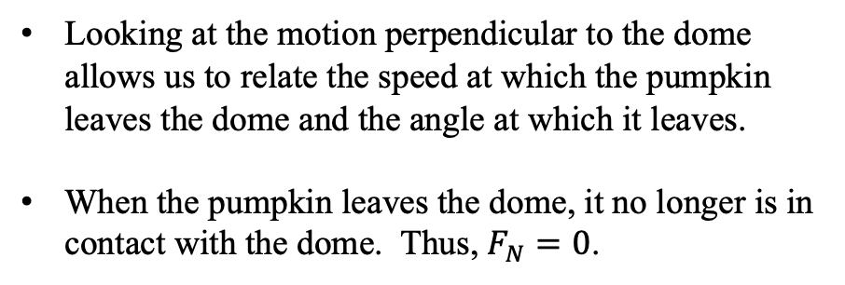
Conservation of Energy
Example 3 solution continued:
$$m$$
Looking at the motion perpendicular to the dome allows us to relate the speed at which the pumpkin leaves the dome and the angle at which it leaves.
When the pumpkin leaves the dome, it no longer is in contact with the dome. Thus, $F_{N}=0$.
$$∆y$$
$$m$$
$$θ$$
$$R$$
$$θ$$
$$y_{i}$$
$$0$$
$$y_{f}$$
$$F_{N}−mg\cos{θ}=−m\frac{v_{f}^{2}}{R}$$
$${\vec{F}}_{N}$$
$$H$$
$$θ$$
$${\vec{F}}_{W}$$
$$v_{f}^{2}=Rg\cos{θ}$$
Sometimes we need to couple Newton’s laws of motion and energy to solve a problem.

Slide 15
Conservation of Energy
Example 3 solution continued:
Returning to our statement of conservation of energy we can now determine the angle at which the pumpkin leaves the dome.
$$m$$
$$∆y$$
$$m$$
$$∆E=\frac{1}{2}mv_{f}^{2}+mgR\left(\cos{θ}−1\right)=0$$
$$θ$$
$$R$$
$$θ$$
$$\frac{1}{2}m\left(Rg\cos{θ}\right)+mgR\left(\cos{θ}−1\right)=0$$
$$\cos{θ}=\frac{2}{3}$$
$$y_{i}$$
$$y_{f}$$
$${\vec{F}}_{N}$$
$$H$$
$$θ=\cos^{−1}\left(\frac{2}{3}\right)={48.2}^{0}$$
$$θ$$
$${\vec{F}}_{W}$$
The pumpkin leaves at about ${48}^{0}$with respect to the vertical when it slides. What happens if it rolls? We’ll come back and visit this problem again when we get to rotational motion.
This result doesn’t depend on the size of the pumpkin or on the size of the dome.

Slide 16
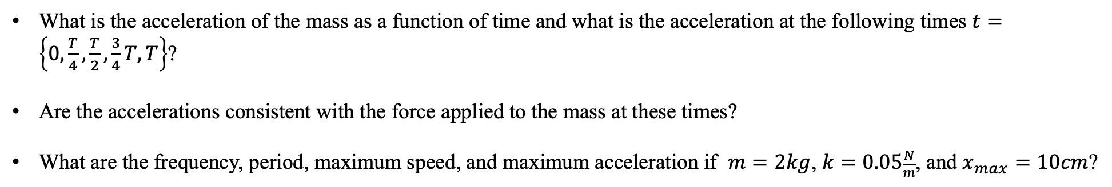
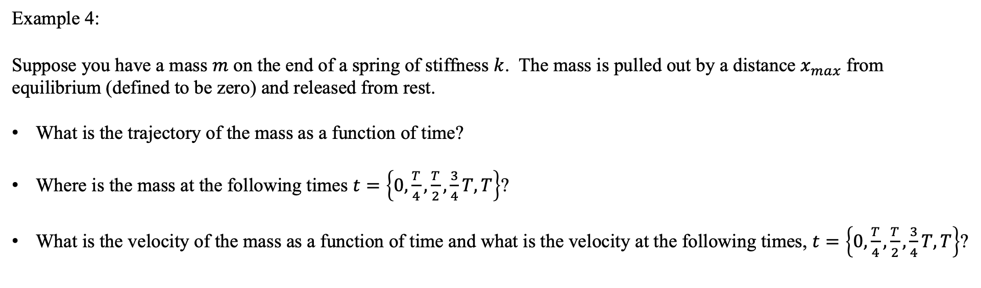
Motion of a Mass on a Spring
Example 4:
Suppose you have a mass $m$ on the end of a spring of stiffness $k$. The mass is pulled out by a distance $x_{max}$ from equilibrium (defined to be zero) and released from rest.
What is the trajectory of the mass as a function of time?
Where is the mass at the following times $t=\left\{0,\frac{T}{4},\frac{T}{2},\frac{3}{4}T,T\right\}$?
What is the velocity of the mass as a function of time and what is the velocity at the following times, $t=\left\{0,\frac{T}{4},\frac{T}{2},\frac{3}{4}T,T\right\}$?
What is the acceleration of the mass as a function of time and what is the acceleration at the following times $t=\left\{0,\frac{T}{4},\frac{T}{2},\frac{3}{4}T,T\right\}$?
Are the accelerations consistent with the force applied to the mass at these times?
What are the frequency, period, maximum speed, and maximum acceleration if $m=2kg$, $k=0.05\frac{N}{m}$, and $x_{max}=10cm$?

Slide 17
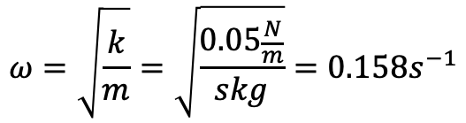

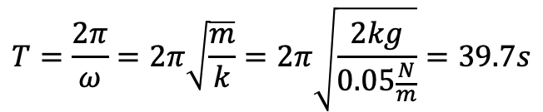
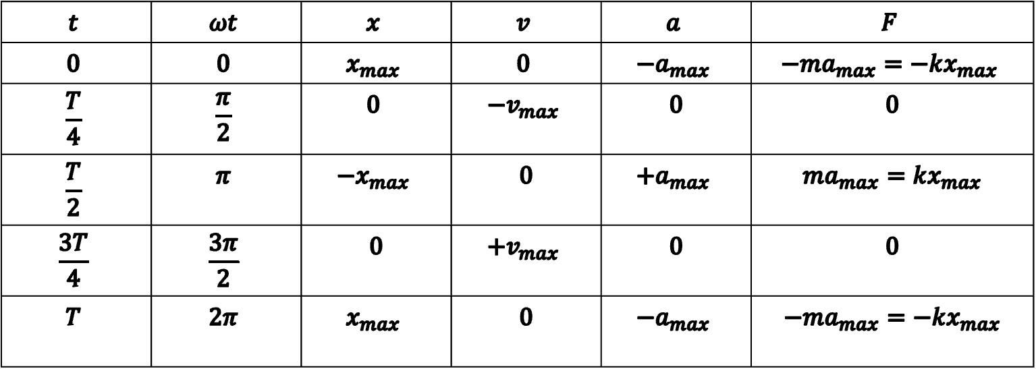

Example 4 Solutions:
$$t$$ | $$ωt$$ | $$x$$ | $$v$$ | $$a$$ | $$F$$
$$0$$ | $$0$$ | $$x_{max}$$ | $$0$$ | $$−a_{max}$$ | $$−ma_{max}=−kx_{max}$$
$$\frac{T}{4}$$ | $$\frac{π}{2}$$ | $$0$$ | $$−v_{max}$$ | $$0$$ | $$0$$
$$\frac{T}{2}$$ | $$π$$ | $${−x}_{max}$$ | $$0$$ | $${+a}_{max}$$ | $$ma_{max}=kx_{max}$$
$$\frac{3T}{4}$$ | $$\frac{3π}{2}$$ | $$0$$ | $$+v_{max}$$ | $$0$$ | $$0$$
$$T$$ | $$2π$$ | $$x_{max}$$ | $$0$$ | $$−a_{max}$$ | $$−ma_{max}=−kx_{max}$$
$$ω=\sqrt{\frac{k}{m}}=\sqrt{\frac{0.05\frac{N}{m}}{skg}}=0.158s^{−1}$$
$$T=\frac{2π}{ω}=2π\sqrt{\frac{m}{k}}=2π\sqrt{\frac{2kg}{0.05\frac{N}{m}}}=39.7s$$
$$x\left(t\right)=x_{max}\cos{ωt}=x_{max}\cos{\frac{2π}{T}t}$$
$$v\left(t\right)=−x_{max}ω\sin{ωt}=−v_{max}\sin{\frac{2π}{T}t}$$
$$v_{max}=x_{max}ω=0.1m∙0.158s^{−1}=0.0158\frac{m}{s}$$
$$a\left(t\right)=−x_{max}ω^{2}\cos{ωt}=−a_{max}\cos{\frac{2π}{T}t}$$
$$a_{max}=x_{max}ω^{2}=0.1m∙{\left(0.158s^{−1}\right)}^{2}=0.0025\frac{m}{s^{2}}$$
$$F\left(t\right)=ma\left(t\right)=−kx\left(t\right)$$

Slide 18
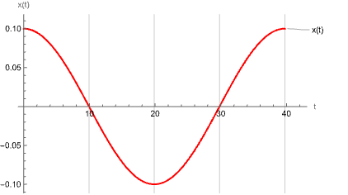
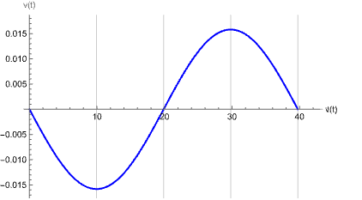
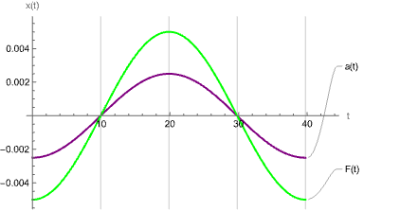
Motion of a Mass on a Spring

Slide 19
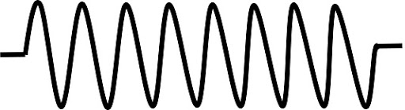

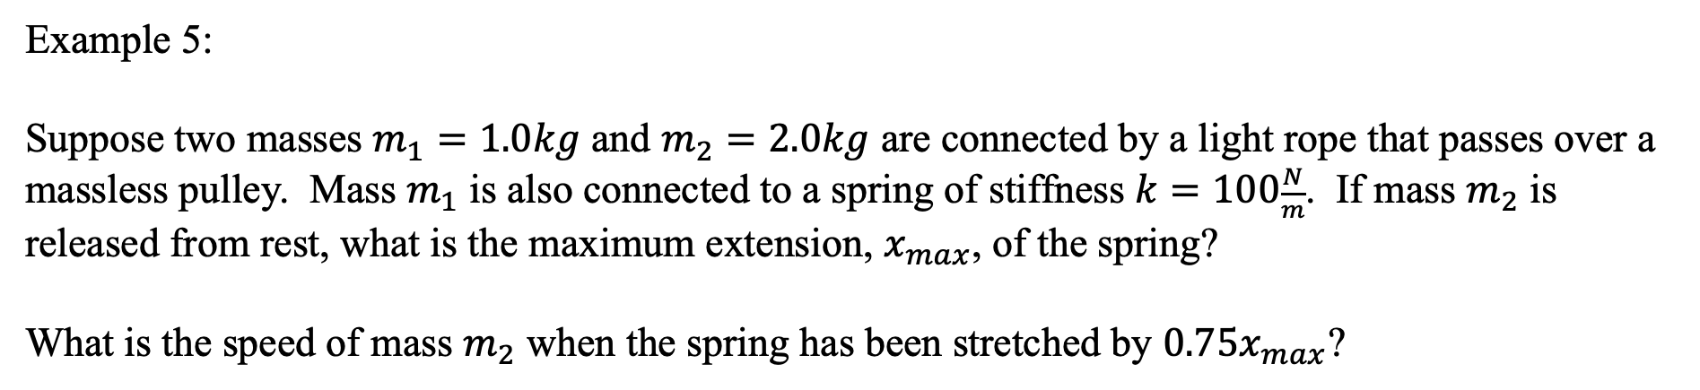


Conservation of Energy
Example 5:
Suppose two masses $m_{1}=1.0kg$ and $m_{2}=2.0kg$ are connected by a light rope that passes over a massless pulley. Mass $m_{1}$ is also connected to a spring of stiffness $k=100\frac{N}{m}$. If mass $m_{2}$ is released from rest, what is the maximum extension, $x_{max}$, of the spring?
What is the speed of mass $m_{2}$ when the spring has been stretched by $0.75x_{max}$?
$$k$$
$$m_{1}$$
$$m_{2}$$

Slide 20
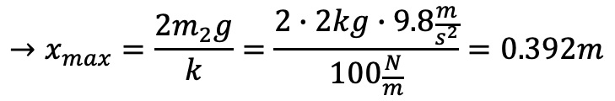

Example 5 Solution:
What is the maximum extension, $x_{max}$, of the spring?
$$∆E=W_{fr}=∆K_{T}+∆U_{g}+∆U_{s}=∆K_{1}+∆U_{g1}+∆K_{2}+∆U_{g2}+∆U_{s}$$
$$0=0+0+0+\left(m_{2}gy_{2f}−m_{2}gy_{2i}\right)+\left(\frac{1}{2}kx_{f}^{2}−\frac{1}{2}kx_{i}^{2}\right)=−m_{2}gx_{f}+\frac{1}{2}kx_{f}^{2}=\left(−m_{2}g+\frac{1}{2}kx\right)x$$
$$→x_{min}=0m$$
$$→x_{max}=\frac{2m_{2}g}{k}=\frac{2∙2kg∙9.8\frac{m}{s^{2}}}{100\frac{N}{m}}=0.392m$$

Slide 21
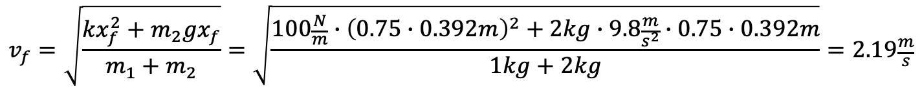

Example 5 Solution:
What is the speed of mass $m_{2}$ when the spring has been stretched by $0.75x_{max}$?
$$∆E=W_{fr}=∆K_{T}+∆U_{g}+∆U_{s}=∆K_{1}+∆U_{g1}+∆K_{2}+∆U_{g2}+∆U_{s}$$
$$0=\left(\frac{1}{2}m_{1}v_{f}^{2}−\frac{1}{2}m_{1}v_{i}^{2}\right)+0+\left({\frac{1}{2}m}_{2}v_{f}^{2}−\frac{1}{2}m_{2}v_{i}^{2}\right)+\left(m_{2}gy_{2f}−m_{2}gy_{2i}\right)+\left(\frac{1}{2}kx_{f}^{2}−\frac{1}{2}kx_{i}^{2}\right)$$
$$0=\frac{1}{2}\left(m_{1}+m_{2}\right)v_{f}^{2}−m_{2}gx_{f}−\frac{1}{2}kx_{f}^{2}$$
$$v_{f}=\sqrt{\frac{kx_{f}^{2}+m_{2}gx_{f}}{m_{1}+m_{2}}}=\sqrt{\frac{100\frac{N}{m}∙{\left(0.75∙0.392m\right)}^{2}+2kg∙9.8\frac{m}{s^{2}}∙0.75∙0.392m}{1kg+2kg}}=2.19\frac{m}{s}$$

Slide 22


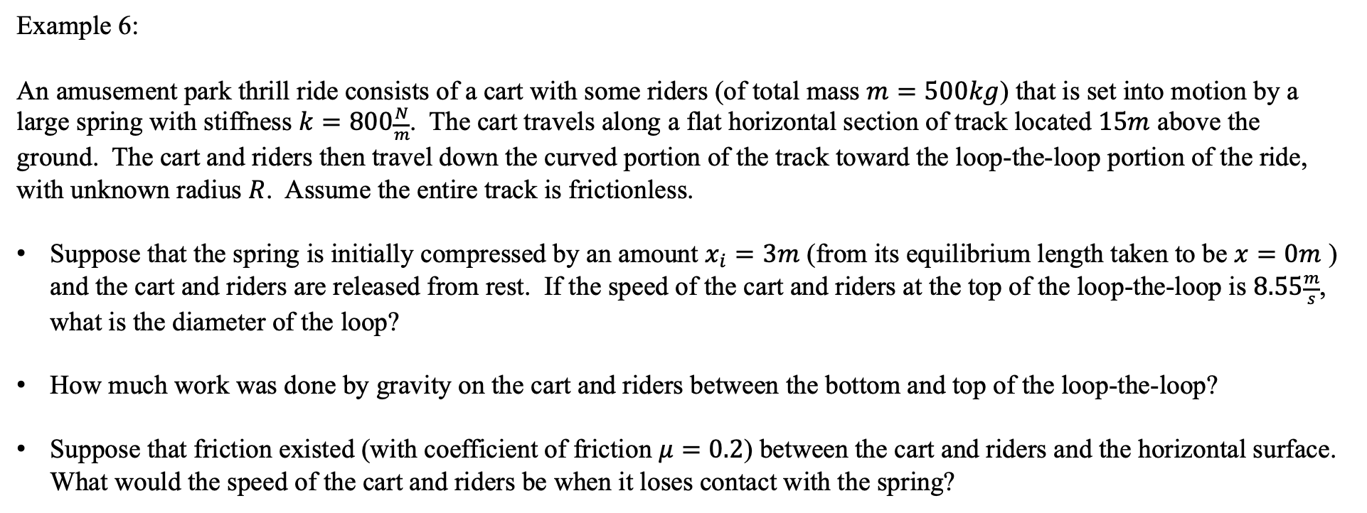



Conservation of Energy
Example 6:
An amusement park thrill ride consists of a cart with some riders (of total mass $m=500kg$) that is set into motion by a large spring with stiffness $k=800\frac{N}{m}$. The cart travels along a flat horizontal section of track located $15m$ above the ground. The cart and riders then travel down the curved portion of the track toward the loop-the-loop portion of the ride, with unknown radius $R$. Assume the entire track is frictionless.
Suppose that the spring is initially compressed by an amount $x_{i}=3m$ (from its equilibrium length taken to be $x=0m$ ) and the cart and riders are released from rest. If the speed of the cart and riders at the top of the loop-the-loop is $8.55\frac{m}{s}$, what is the diameter of the loop?
How much work was done by gravity on the cart and riders between the bottom and top of the loop-the-loop?
Suppose that friction existed (with coefficient of friction $μ=0.2$) between the cart and riders and the horizontal surface. What would the speed of the cart and riders be when it loses contact with the spring?
$$k$$
$$m$$
$$∆y=15m$$
$$R$$

Slide 23




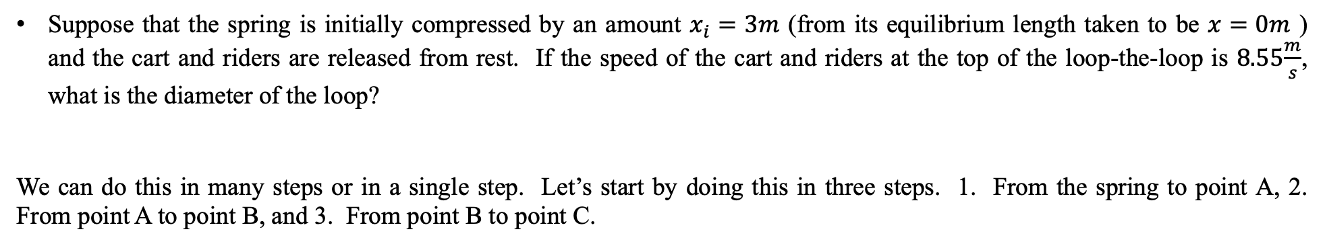
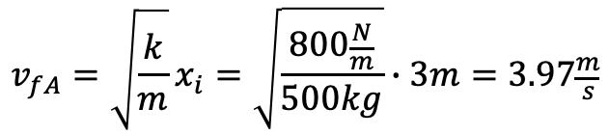
Example 6 Solutions:
Suppose that the spring is initially compressed by an amount $x_{i}=3m$ (from its equilibrium length taken to be $x=0m$ ) and the cart and riders are released from rest. If the speed of the cart and riders at the top of the loop-the-loop is $8.55\frac{m}{s}$, what is the diameter of the loop?
We can do this in many steps or in a single step. Let’s start by doing this in three steps. 1. From the spring to point A, 2. From point A to point B, and 3. From point B to point C.
1. From the spring to point A
$$∆E=W_{fr}=∆K_{T}+∆U_{g}+∆U_{s}$$
$$0=\left(\frac{1}{2}mv_{fA}^{2}−\frac{1}{2}mv_{i}^{2}\right)+0+\left(\frac{1}{2}kx_{f}^{2}−\frac{1}{2}kx_{i}^{2}\right)=\frac{1}{2}mv_{fA}^{2}−\frac{1}{2}kx_{i}^{2}$$
$$v_{fA}=\sqrt{\frac{k}{m}}x_{i}=\sqrt{\frac{800\frac{N}{m}}{500kg}}∙3m=3.97\frac{m}{s}$$
$$k$$
$$A$$
$$m$$
$$C$$
$$∆y=15m$$
$$R$$
$$B$$

Slide 24


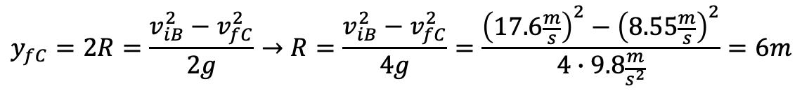
Example 6 Solutions:
2. From point A to point B:
$$∆E=W_{fr}=0=∆K_{T}+∆U_{g}+∆U_{s}$$
$$0=\left(\frac{1}{2}mv_{fB}^{2}−\frac{1}{2}mv_{iA}^{2}\right)+\left(mgy_{fB}−mgy_{iA}\right)$$
$$v_{fB}=\sqrt{v_{iA}^{2}+2gy_{iA}}=\sqrt{{\left(3.97\frac{m}{s}\right)}^{2}+2∙9.8\frac{m}{s^{2}}∙15m}=17.6\frac{m}{s}$$
3. From point B to point C.
$$∆E=W_{fr}=0=∆K_{T}+∆U_{g}+∆U_{s}$$
$$0=\left(\frac{1}{2}mv_{fC}^{2}−\frac{1}{2}mv_{iB}^{2}\right)+\left(mgy_{fC}−mgy_{iB}\right)$$
$$y_{fC}=2R=\frac{v_{iB}^{2}−v_{fC}^{2}}{2g}→R=\frac{v_{iB}^{2}−v_{fC}^{2}}{4g}=\frac{{\left(17.6\frac{m}{s}\right)}^{2}−{\left(8.55\frac{m}{s}\right)}^{2}}{4∙9.8\frac{m}{s^{2}}}=6m$$

Slide 25
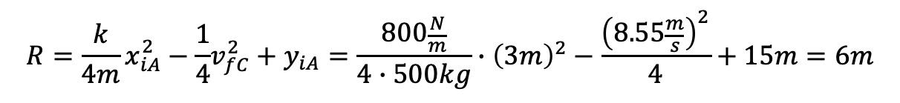
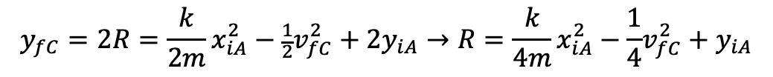
Example 6 Solutions:
As one step from compressing the spring to the top of the loop:
$$∆E=W_{fr}=0=∆K_{T}+∆U_{g}+∆U_{s}$$
$$0=\left(\frac{1}{2}mv_{fC}^{2}−0\right)+\left(mgy_{fC}−mgy_{iA}\right)+\left(0−\frac{1}{2}kx_{iA}^{2}\right)$$
$$y_{fC}=2R=\frac{k}{2m}x_{iA}^{2}−\frac{1}{2}v_{fC}^{2}+2y_{iA}→R=\frac{k}{4m}x_{iA}^{2}−\frac{1}{4}v_{fC}^{2}+y_{iA}$$
$$R=\frac{k}{4m}x_{iA}^{2}−\frac{1}{4}v_{fC}^{2}+y_{iA}=\frac{800\frac{N}{m}}{4∙500kg}∙{\left(3m\right)}^{2}−\frac{{\left(8.55\frac{m}{s}\right)}^{2}}{4}+15m=6m$$

Slide 26
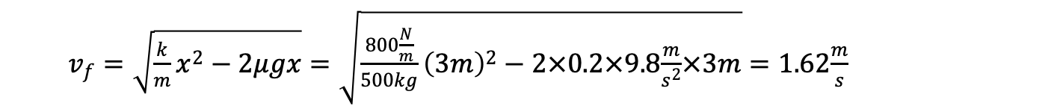

Example 6 Solutions:
How much work was done by gravity on the cart and riders between the bottom and top of the loop-the-loop?
$$W_{g}=−∆U_{g}=−\left(2Rmg−0\right)=−2×6m×500kg×9.8\frac{m}{s^{2}}=−58800J$$
$$W_{g}=∆K=\left(\frac{1}{2}mv_{fC}^{2}−\frac{1}{2}mv_{iB}^{2}\right)=\frac{1}{2}∙500kg∙\left({\left(8.55\frac{m}{s}\right)}^{2}−{\left(17.6\right)\frac{m}{s}}^{2}\right)=−58800J$$
$W_{g}=F_{g}∆x\cos{φ}=mg∙2R∙\cos{180}=−2Rmg=−58800J$
Suppose that friction existed (with coefficient of friction $μ=0.2$) between the cart and riders and the horizontal surface. What would the speed of the cart and riders be when it loses contact with the spring?
$$∆E=W_{fr}=∆K_{T}+∆U_{g}+∆U_{s}$$
$W_{fr}=F_{fr}∆x\cos{φ}=μF_{N}x\cos{180}=−μmgx=\left(\frac{1}{2}mv_{f}^{2}−0\right)+\left(0−\frac{1}{2}kx_{i}^{2}\right)$
$v_{f}=\sqrt{\frac{k}{m}x^{2}−2μgx}=\sqrt{\frac{800\frac{N}{m}}{500kg}{\left(3m\right)}^{2}−2×0.2×9.8\frac{m}{s^{2}}×3m}=1.62\frac{m}{s}$

Slide 27
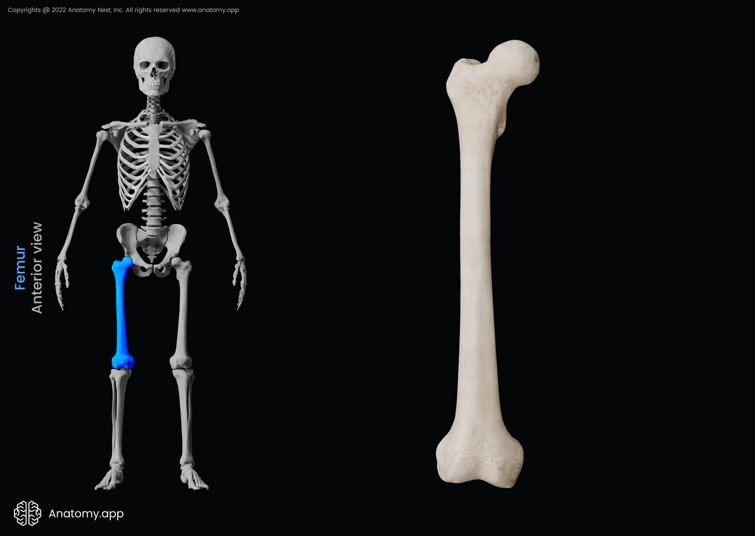

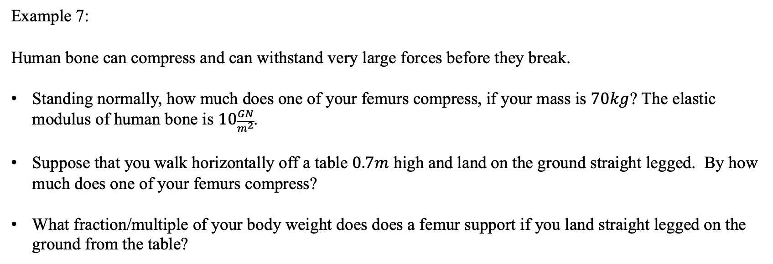

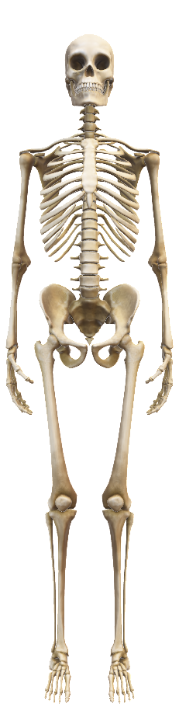
Example 7:
Human bone can compress and can withstand very large forces before they break.
Standing normally, how much does one of your femurs compress, if your mass is $70kg$? The elastic modulus of human bone is $10\frac{GN}{m^{2}}$.
Suppose that you walk horizontally off a table $0.7m$ high and land on the ground straight legged. By how much does one of your femurs compress?
What fraction/multiple of your body weight does does a femur support if you land straight legged on the ground from the table?
$$40cm \sim 16”$$
$$2.6cm\sim 1”$$
https://anatomy.app/encyclopedia/femur

Slide 28
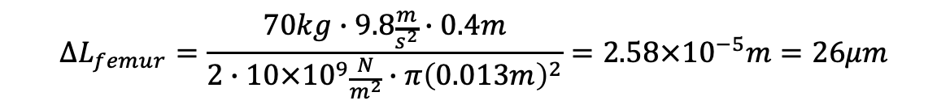
Example 7 Solutions:
Standing normally, how much does one of your femurs compress?
$$Stress=E∙strain→\frac{F}{A_{femur}}=E\frac{∆L_{femur}}{L_{femur}}→{∆L}_{femur}=\frac{FL_{femur}}{A_{femur}E}=\frac{F_{N}L_{femur}}{2EA_{femur}}=\frac{F_{W}L_{femur}}{2EA_{femur}}=\frac{mgL_{femur}}{2EA_{femur}}$$
$$∆L_{femur}=\frac{70kg∙9.8\frac{m}{s^{2}}∙0.4m}{2∙10×{10}^{9}\frac{N}{m^{2}}∙π{\left(0.013m\right)}^{2}}=2.58×{10}^{−5}m=26μm$$

Slide 29

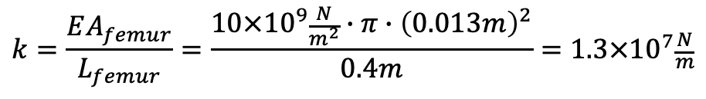
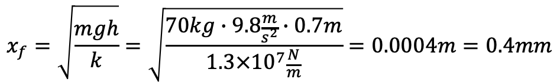
Example 7 Solutions:
Suppose that you walk horizontally off a table $0.7m$ high and land on the ground straight legged. By how much does one of your femurs compress?
$$∆E=W_{fr}=∆K_{T}+∆U_{g}+∆U_{s}$$
$$0=0+\left(mgy_{f}−mgy_{i}\right)+\left(\frac{1}{2}kx_{f}^{2}−\frac{1}{2}kx_{i}^{2}\right)+\left(\frac{1}{2}kx_{f}^{2}−\frac{1}{2}kx_{i}^{2}\right)=−mgh+kx_{f}^{2}$$
$$Stress=E∙strain→\frac{F}{A_{femur}}=E\frac{∆L_{femur}}{L_{femur}}→F=\left(\frac{EA_{femur}}{L_{femur}}\right){∆L}_{femur}→F=k∆L$$
$$k=\frac{EA_{femur}}{L_{femur}}=\frac{10×{10}^{9}\frac{N}{m^{2}}∙π∙{\left(0.013m\right)}^{2}}{0.4m}=1.3×{10}^{7}\frac{N}{m}$$
$$x_{f}=\sqrt{\frac{mgh}{k}}=\sqrt{\frac{70kg∙9.8\frac{m}{s^{2}}∙0.7m}{1.3×{10}^{7}\frac{N}{m}}}=0.0004m=0.4mm$$

Slide 30
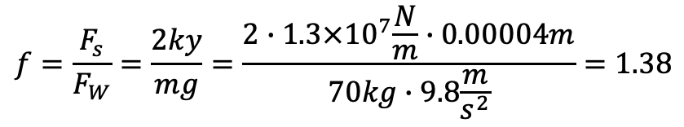
Example 7 Solutions:
What fraction/multiple of your body weight does does a femur support if you land straight legged on the ground from the table?
$$f=\frac{F_{s}}{F_{W}}=\frac{2ky}{mg}=\frac{2∙1.3×{10}^{7}\frac{N}{m}∙0.00004m}{70kg∙9.8\frac{m}{s^{2}}}=1.38$$

Slide 31

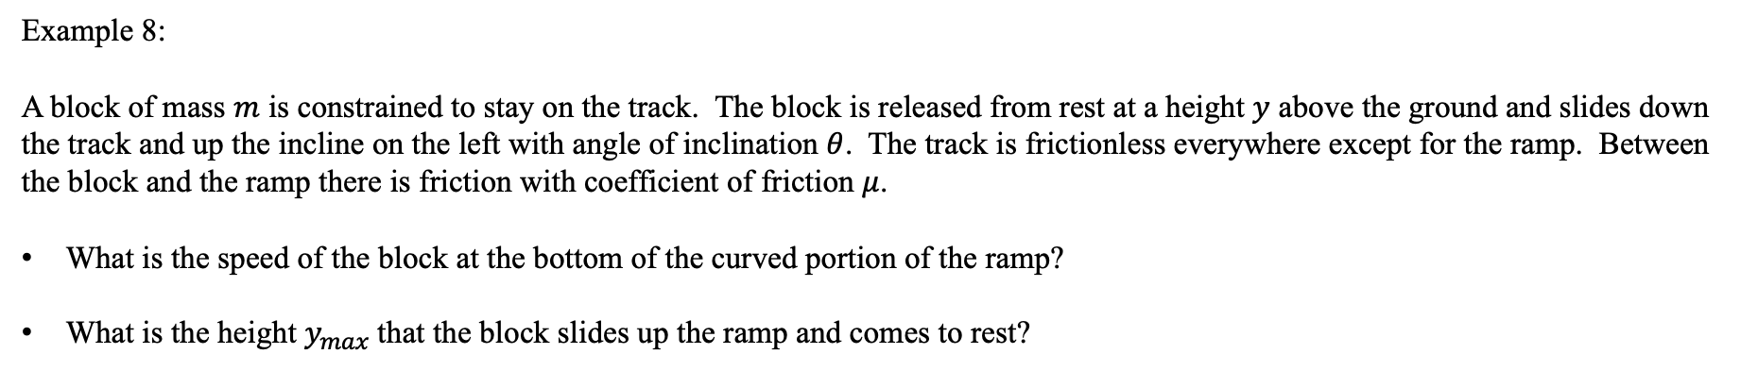



Conservation of Energy
Example 8:
A block of mass $m$ is constrained to stay on the track. The block is released from rest at a height $y$ above the ground and slides down the track and up the incline on the left with angle of inclination $θ$. The track is frictionless everywhere except for the ramp. Between the block and the ramp there is friction with coefficient of friction $μ$.
What is the speed of the block at the bottom of the curved portion of the ramp?
What is the height $y_{max}$that the block slides up the ramp and comes to rest?
$$m$$
$$y$$
$$y_{max}$$
$$θ$$

Slide 32




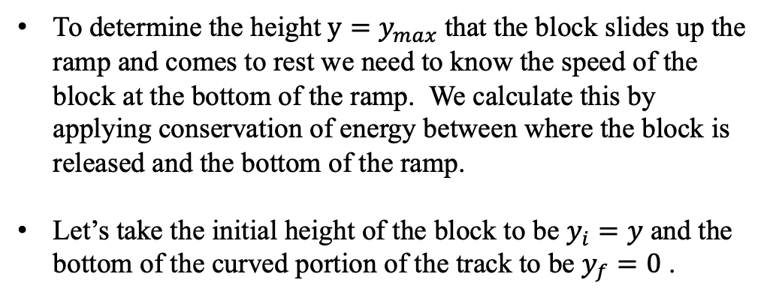




Conservation of Energy
Example 8 Solution:
To determine the height $y=y_{max}$that the block slides up the ramp and comes to rest we need to know the speed of the block at the bottom of the ramp. We calculate this by applying conservation of energy between where the block is released and the bottom of the ramp.
Let’s take the initial height of the block to be $y_{i}=y$ and the bottom of the curved portion of the track to be $y_{f}=0$ .
$$m$$
$$y$$
$$0$$
$$∆E=∆K+∆U_{g}+∆U_{s}=0$$
$$y_{max}$$
$$θ$$
$$m$$
$$0$$
$$0$$
$$\left(\frac{1}{2}mv_{f}^{2}−\frac{1}{2}mv_{i}^{2}\right)+\left(mgy_{f}−mgy_{i}\right)=0$$
$$v_{f}=\sqrt{2gy}$$
$$v_{f}=\sqrt{2gy}$$
The block slides across the horizontal surface at the same speed it reached the bottom of the curved portion since there is no friction in the system so far.

Slide 33





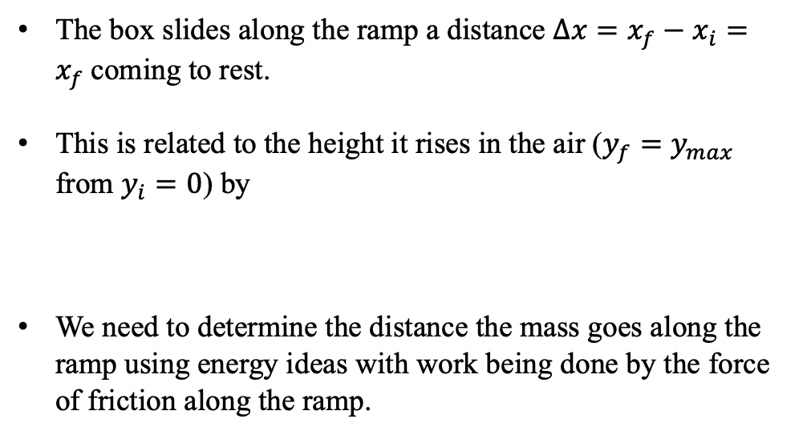
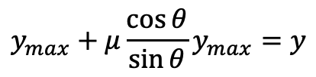




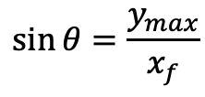


Conservation of Energy
Example 8 Solution continued:
The box slides along the ramp a distance $∆x=x_{f}−x_{i}=x_{f}$coming to rest.
This is related to the height it rises in the air ($y_{f}=y_{max}$ from $y_{i}=0$) by
We need to determine the distance the mass goes along the ramp using energy ideas with work being done by the force of friction along the ramp.
$$m$$
$$y$$
$$\sin{θ}=\frac{y_{max}}{x_{f}}$$
$$∆x$$
$$y_{max}$$
$$m$$
$$θ$$
$$v_{f}=\sqrt{2gy}$$
$$0$$
$$∆E=∆K+∆U_{g}+∆U_{s}=−F_{fr}∆x=−μF_{N}x_{f}$$
$$0$$
$$0$$
$$\left(\frac{1}{2}mv_{f}^{2}−\frac{1}{2}mv_{i}^{2}\right)+\left(mgy_{f}−mgy_{i}\right)=−μF_{N}x_{f}$$
$$y_{max}+μ\frac{\cos{θ}}{\sin{θ}}y_{max}=y$$
$$y_{max}=\frac{y}{1+μ\cot{θ}}$$
$$−\frac{1}{2}m\left(2gy\right)+mgy_{max}=−μmg\cos{θ}x_{f}$$

Slide 34
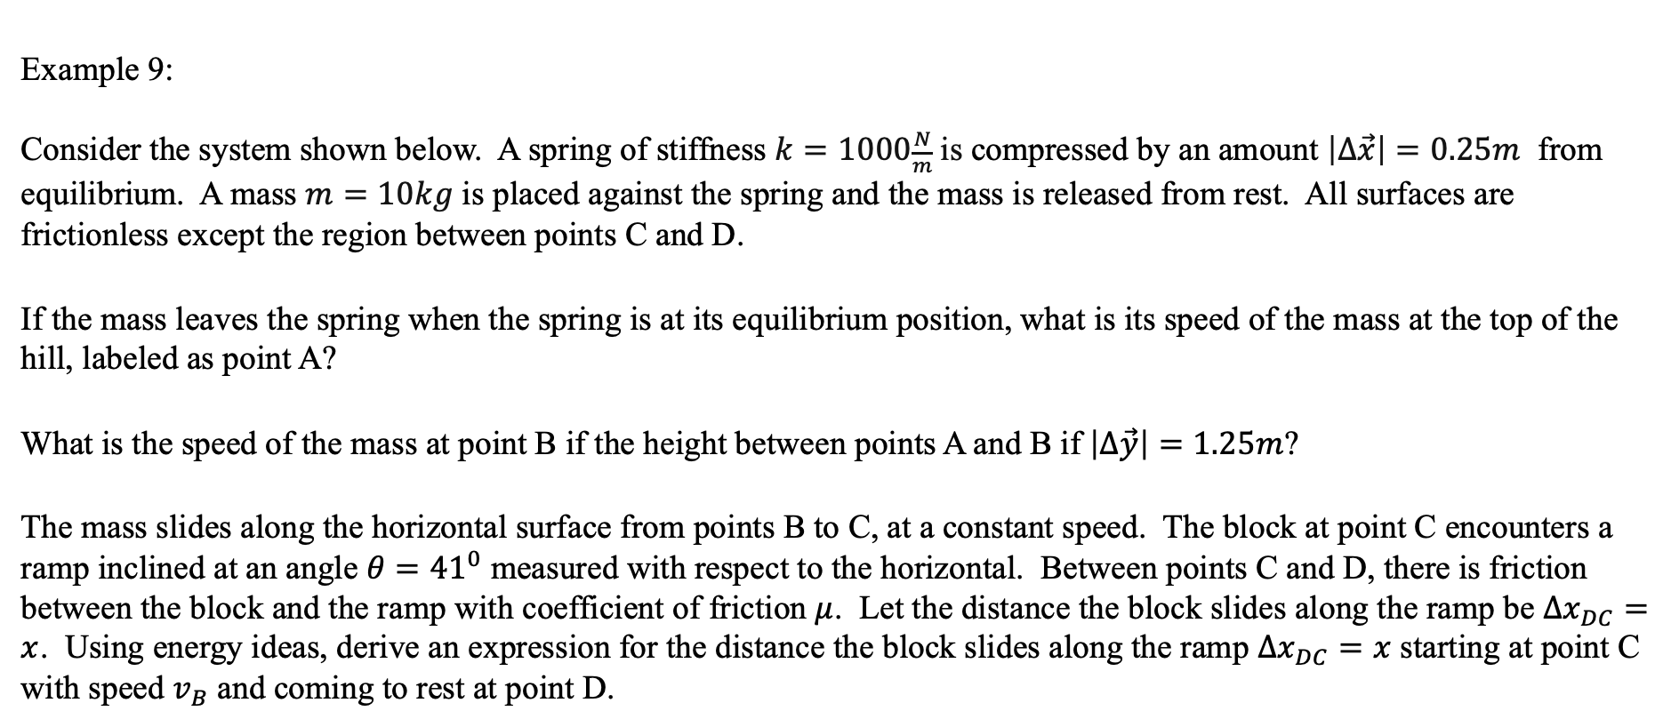


Conservation of Energy
Example 9:
Consider the system shown below. A spring of stiffness $k=1000\frac{N}{m}$ is compressed by an amount $\left|∆\vec{x}\right|=0.25m$ from equilibrium. A mass $m=10kg$ is placed against the spring and the mass is released from rest. All surfaces are frictionless except the region between points C and D.
If the mass leaves the spring when the spring is at its equilibrium position, what is its speed of the mass at the top of the hill, labeled as point A?
What is the speed of the mass at point B if the height between points A and B if $\left|∆\vec{y}\right|=1.25m$?
The mass slides along the horizontal surface from points B to C, at a constant speed. The block at point C encounters a ramp inclined at an angle $θ={41}^{0}$ measured with respect to the horizontal. Between points C and D, there is friction between the block and the ramp with coefficient of friction $μ$. Let the distance the block slides along the ramp be $∆x_{DC}=x$. Using energy ideas, derive an expression for the distance the block slides along the ramp $∆x_{DC}=x$ starting at point C with speed $v_{B}$ and coming to rest at point D.
$$k$$
$$m$$
A
D
Δx
Δy
B
C
θ

Slide 35
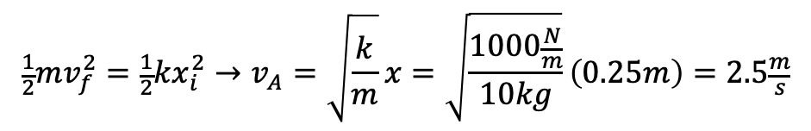






Conservation of Energy
Example 7 Solution:
To determine the speed of the mass when it loses contact with the spring (at its equilibrium point ($x_{f}=0$) since the mass is not permanently attached) we use conservation of energy.
The speed of the mass when it leaves the spring is also the speed of the mass at the top of the hill, labeled as point A since there is no friction on the horizontal surface and the spring is initially compressed (from equilibrium) by $x_{i}=\left|∆\vec{x}\right|$.
As the mass is being accelerated by the spring from rest to its final speed, the mass does not change height. Thus $∆U_{g}=0$.
$$0$$
$$∆E=∆K+∆U_{g}+∆U_{s}$$
$$0$$
$$0$$
$$\left(\frac{1}{2}mv_{f}^{2}−\frac{1}{2}mv_{i}^{2}\right)+\left(\frac{1}{2}kx_{f}^{2}−\frac{1}{2}kx_{i}^{2}\right)=0$$
The mass gains kinetic energy.
The spring loses elastic potential energy.
$$\frac{1}{2}mv_{f}^{2}=\frac{1}{2}kx_{i}^{2}→v_{A}=\sqrt{\frac{k}{m}}x=\sqrt{\frac{1000\frac{N}{m}}{10kg}}\left(0.25m\right)=2.5\frac{m}{s}$$

Slide 36




Conservation of Energy
Example 7 Solution continued:
To determine the speed of the mass at point B we apply conservation of energy between point A at the top of the hill and point B at the bottom of the hill. Again, there is no friction (or springs) on this portion of the track.
This seems reasonable. Gravity does work on the mass from point A to point B and the mass loses gravitational potential energy and gains kinetic energy.
Thus the mass should go faster at the bottom of the hill?
Notice forces would be hard to apply here since there are big curves between points A and B. Thus the component of the weight parallel to the track changes angle as the mass slides along the track. In other words, the force may not be constant and difficult to determine.
$$0$$
$$∆E=∆K+∆U_{g}+∆U_{s}=0$$
$$0$$
$$\left(\frac{1}{2}mv_{fB}^{2}−\frac{1}{2}mv_{iA}^{2}\right)+\left(mgy_{fB}−mgy_{iA}\right)=0$$
$$v_{fB}=\sqrt{v_{iA}^{2}+2gy_{iA}}=\sqrt{{\left(2.5\frac{m}{s}\right)}^{2}+\left(2×9.8\frac{m}{s^{2}}×1.25m\right)}=5.6\frac{m}{s}$$
$$k$$
$$m$$
A
D
Δx
Δy
B
C
θ

Slide 37







Conservation of Energy
Example 7 Solution continued:
In order to derive an expression for the distance the block slides along the ramp $∆x_{DC}=x$ starting at point C with speed $v_{B}$ and coming to rest at point D, we use conservation of energy and the work done by friction on the mass along the ramp.
$$0$$
$$∆E=∆K+∆U_{g}+∆U_{s}=−F_{fr}∆x=−μF_{N}x$$
$$0$$
$$0$$
$$\left(\frac{1}{2}mv_{fD}^{2}−\frac{1}{2}mv_{iC}^{2}\right)+\left(mgy_{fD}−mgy_{iC}\right)=−μF_{N}x$$
The box slides along the ramp a distance $∆x=x_{fD}−x_{iC}=x$ before coming to rest.
This is related to the height it rises in the air ($y_{fD}=y_{D}$ from $y_{iC}=0$) by
$$\sin{θ}=\frac{y_{D}}{x}$$
$$k$$
$$m$$
A
$$m$$
D
Δx
Δy
$$y_{D}$$
B
C
θ

Slide 38








Conservation of Energy
Example 7 Solution continued:
Let’s put what we have together in our statement of conservation of energy knowing that $v_{iC}=v_{fB}$, since there is no friction along the horizontal surface.
$$0$$
$$0$$
$\left(\frac{1}{2}mv_{fD}^{2}−\frac{1}{2}mv_{iC}^{2}\right)+\left(mg\left(x\sin{θ}\right)−mgy_{iC}\right)=−μF_{N}x=$ $−μ\left(mg\cos{θ}\right)x$
$$−\frac{1}{2}mv_{iB}^{2}+mgx\sin{θ}=−μxmg\cos{θ}$$
$$x=\frac{v_{iB}^{2}}{2g\left(\sin{θ+μ\cos{θ}}\right)}$$
Mass loses kinetic energy as it rises due to friction and an increase in height.
The loss of kinetic energy goes into an increase in height and an increase in gravitational potential energy.
$$k$$
$$m$$
A
$$m$$
D
Δx
Δy
$$y_{D}$$
B
C
θ
Note also, if the system was only the mass, gravity and friction would be external to the system and the work done by gravity and friction ($−mgx\sin{θ}−μxmg\cos{θ}$) would change the kinetic energy of the system ($−\frac{1}{2}mv_{iB}^{2}$).
This seems reasonable. If friction was not present, $μ=0,$ the denominator would get smaller and thus $x$ larger and the block would go farther up the ramp. Also, if $μ=0$, this would be the same expression you’d get if you through the block straight up in the air and asked how high the block went, $y$.

Slide 39





Conservation of Energy
Example 7 Solution continued:
Suppose that $μ=0.7$ and that the ramp is inclined at an angle of $θ={41}^{0}$. How high and far along the ramp does the block go?
The distance along the ramp:
The height in the air:
$$x=\frac{v_{iB}^{2}}{2g\left(\sin{θ+μ\cos{θ}}\right)}=\frac{{\left(5.6\frac{m}{s}\right)}^{2}}{2×9.8\frac{m}{s^{2}}\left(\sin{41}+0.7\cos{41}\right)}=1.35m$$
$$\sin{θ}=\frac{y_{D}}{x}→y_{D}=x\sin{θ}=1.35m\sin{41}=0.886m=88.6cm$$
$$k$$
$$m$$
A
$$m$$
D
Δx
Δy
$$y_{D}$$
B
C
θ

