Slide 1

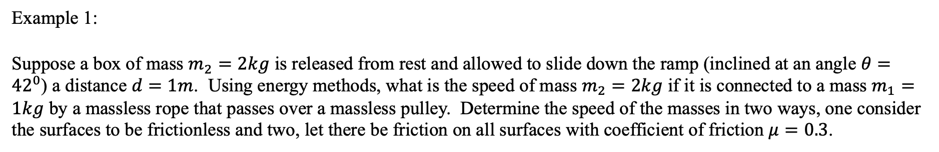


Conservation of Energy
Example 1:
Suppose a box of mass $m_{2}=2kg$ is released from rest and allowed to slide down the ramp (inclined at an angle $θ={42}^{0}$) a distance $d=1m$. Using energy methods, what is the speed of mass $m_{2}=2kg$ if it is connected to a mass $m_{1}=1kg$ by a massless rope that passes over a massless pulley. Determine the speed of the masses in two ways, one consider the surfaces to be frictionless and two, let there be friction on all surfaces with coefficient of friction $μ=0.3$.
$$m_{1}$$
$$m_{2}$$
$$θ$$

Slide 2
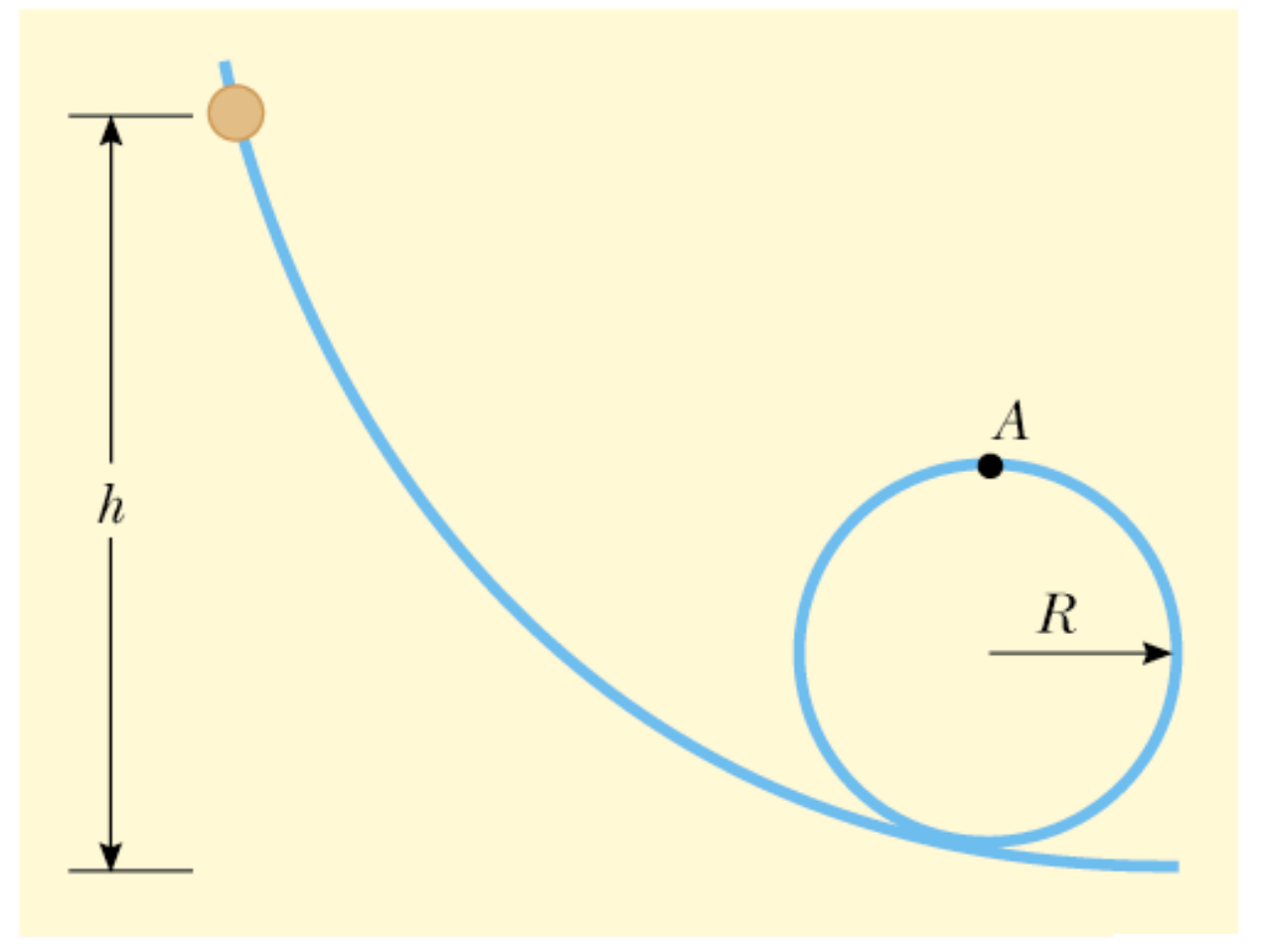
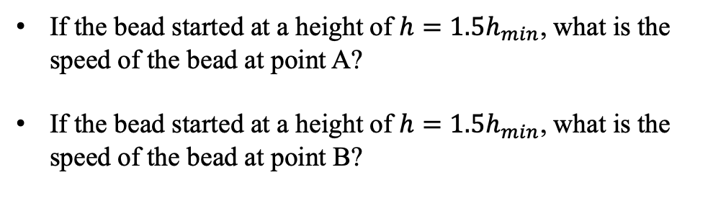
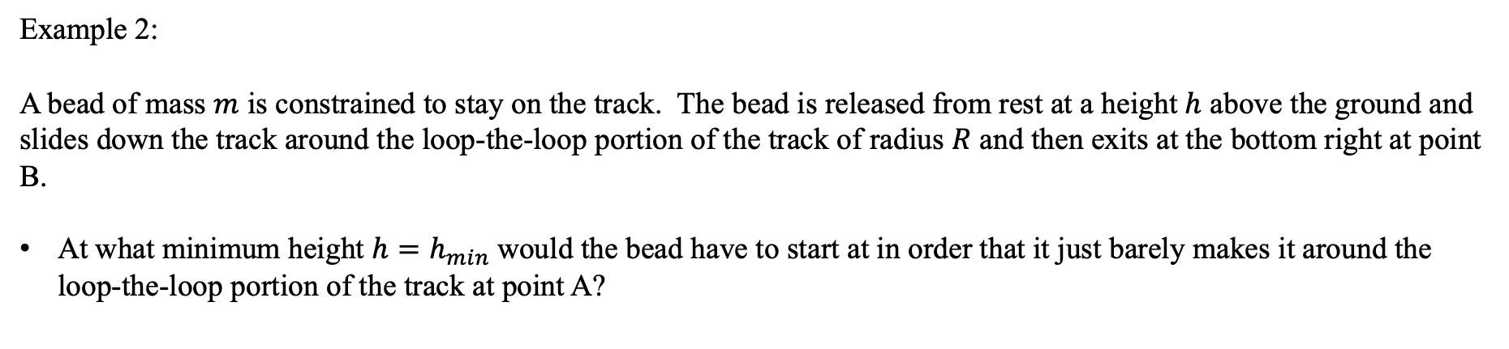
Conservation of Energy
Example 2:
A bead of mass $m$ is constrained to stay on the track. The bead is released from rest at a height $h$ above the ground and slides down the track around the loop-the-loop portion of the track of radius $R$ and then exits at the bottom right at point B.
At what minimum height $h=h_{min}$would the bead have to start at in order that it just barely makes it around the loop-the-loop portion of the track at point A?
If the bead started at a height of $h=1.5h_{min}$, what is the speed of the bead at point A?
If the bead started at a height of $h=1.5h_{min}$, what is the speed of the bead at point B?
B

Slide 3

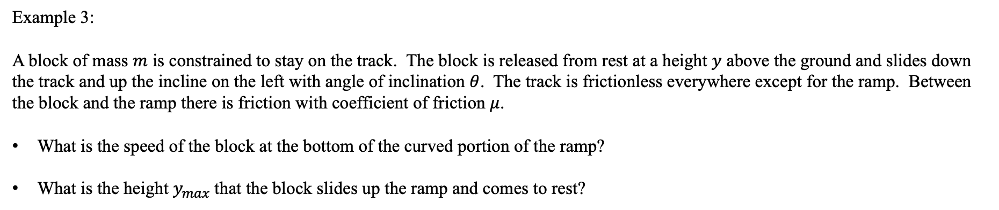



Conservation of Energy
Example 3:
A block of mass $m$ is constrained to stay on the track. The block is released from rest at a height $y$ above the ground and slides down the track and up the incline on the left with angle of inclination $θ$. The track is frictionless everywhere except for the ramp. Between the block and the ramp there is friction with coefficient of friction $μ$.
What is the speed of the block at the bottom of the curved portion of the ramp?
What is the height $y_{max}$that the block slides up the ramp and comes to rest?
$$m$$
$$y$$
$$y_{max}$$
$$θ$$

Slide 4
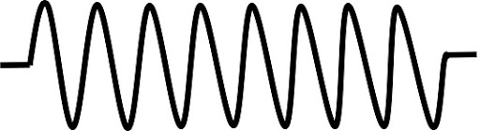

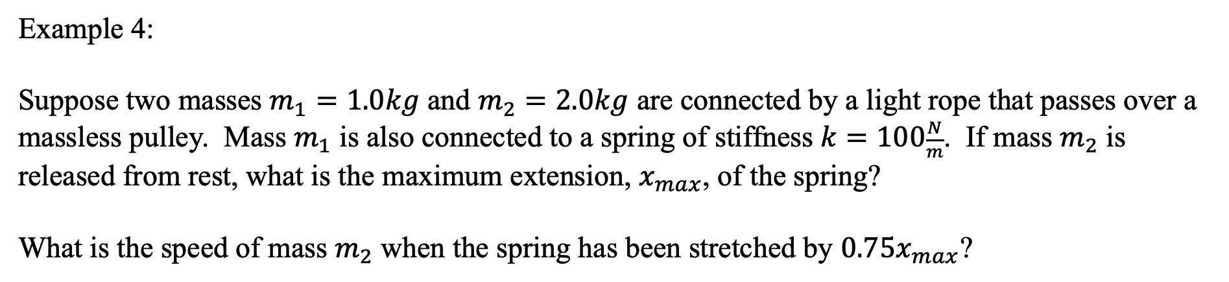


Conservation of Energy
Example 4:
Suppose two masses $m_{1}=1.0kg$ and $m_{2}=2.0kg$ are connected by a light rope that passes over a massless pulley. Mass $m_{1}$ is also connected to a spring of stiffness $k=100\frac{N}{m}$. If mass $m_{2}$ is released from rest, what is the maximum extension, $x_{max}$, of the spring?
What is the speed of mass $m_{2}$ when the spring has been stretched by $0.75x_{max}$?
$$k$$
$$m_{1}$$
$$m_{2}$$

Slide 5

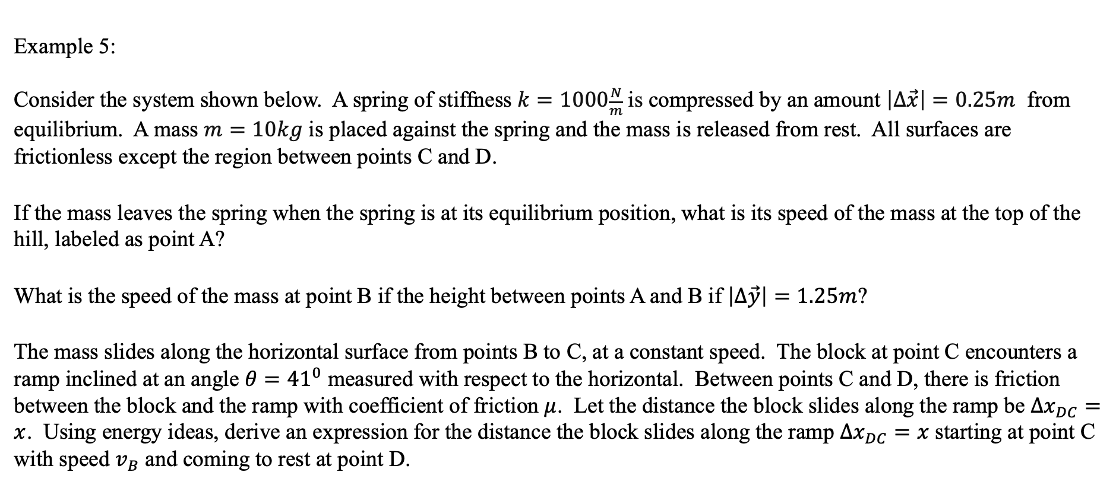


Conservation of Energy
Example 5:
Consider the system shown below. A spring of stiffness $k=1000\frac{N}{m}$ is compressed by an amount $\left|∆\vec{x}\right|=0.25m$ from equilibrium. A mass $m=10kg$ is placed against the spring and the mass is released from rest. All surfaces are frictionless except the region between points C and D.
If the mass leaves the spring when the spring is at its equilibrium position, what is its speed of the mass at the top of the hill, labeled as point A?
What is the speed of the mass at point B if the height between points A and B if $\left|∆\vec{y}\right|=1.25m$?
The mass slides along the horizontal surface from points B to C, at a constant speed. The block at point C encounters a ramp inclined at an angle $θ={41}^{0}$ measured with respect to the horizontal. Between points C and D, there is friction between the block and the ramp with coefficient of friction $μ$. Let the distance the block slides along the ramp be $∆x_{DC}=x$. Using energy ideas, derive an expression for the distance the block slides along the ramp $∆x_{DC}=x$ starting at point C with speed $v_{B}$ and coming to rest at point D.
$$k$$
$$m$$
A
D
Δx
Δy
B
C
θ

Slide 6

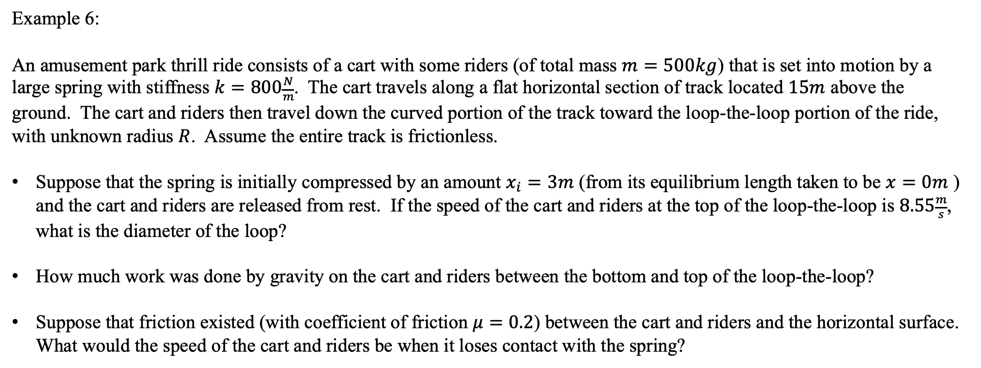



Conservation of Energy
Example 6:
An amusement park thrill ride consists of a cart with some riders (of total mass $m=500kg$) that is set into motion by a large spring with stiffness $k=800\frac{N}{m}$. The cart travels along a flat horizontal section of track located $15m$ above the ground. The cart and riders then travel down the curved portion of the track toward the loop-the-loop portion of the ride, with unknown radius $R$. Assume the entire track is frictionless.
Suppose that the spring is initially compressed by an amount $x_{i}=3m$ (from its equilibrium length taken to be $x=0m$ ) and the cart and riders are released from rest. If the speed of the cart and riders at the top of the loop-the-loop is $8.55\frac{m}{s}$, what is the diameter of the loop?
How much work was done by gravity on the cart and riders between the bottom and top of the loop-the-loop?
Suppose that friction existed (with coefficient of friction $μ=0.2$) between the cart and riders and the horizontal surface. What would the speed of the cart and riders be when it loses contact with the spring?
$$k$$
$$m$$
$$∆y=15m$$
$$R$$

Slide 7
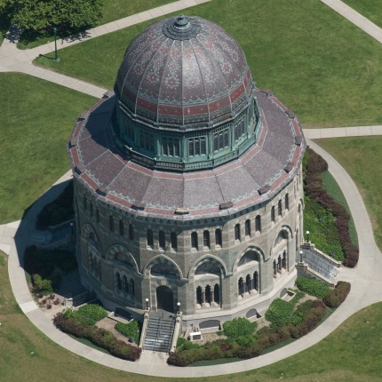
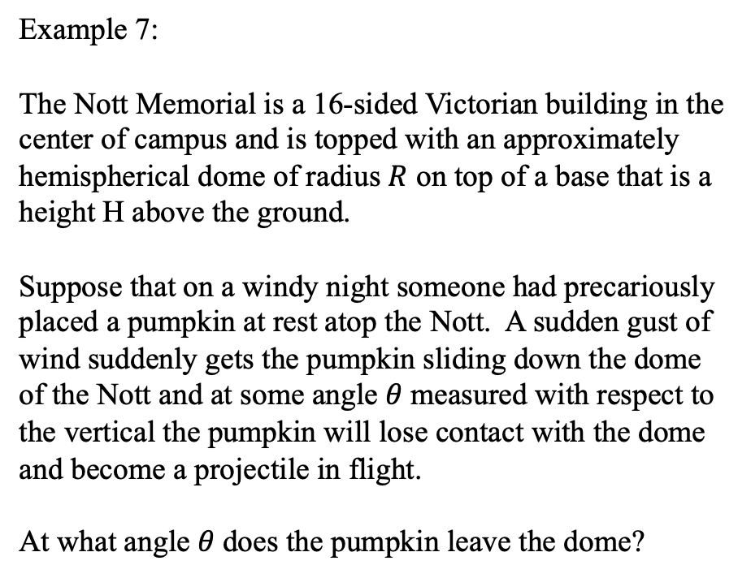
Conservation of Energy
Example 7:
The Nott Memorial is a 16-sided Victorian building in the center of campus and is topped with an approximately hemispherical dome of radius $R$ on top of a base that is a height H above the ground.
Suppose that on a windy night someone had precariously placed a pumpkin at rest atop the Nott. A sudden gust of wind suddenly gets the pumpkin sliding down the dome of the Nott and at some angle $θ$measured with respect to the vertical the pumpkin will lose contact with the dome and become a projectile in flight.
At what angle $θ$does the pumpkin leave the dome?
https://commodorebuilders.com/2014/03/24/union-college-nott-memorial/

Slide 8
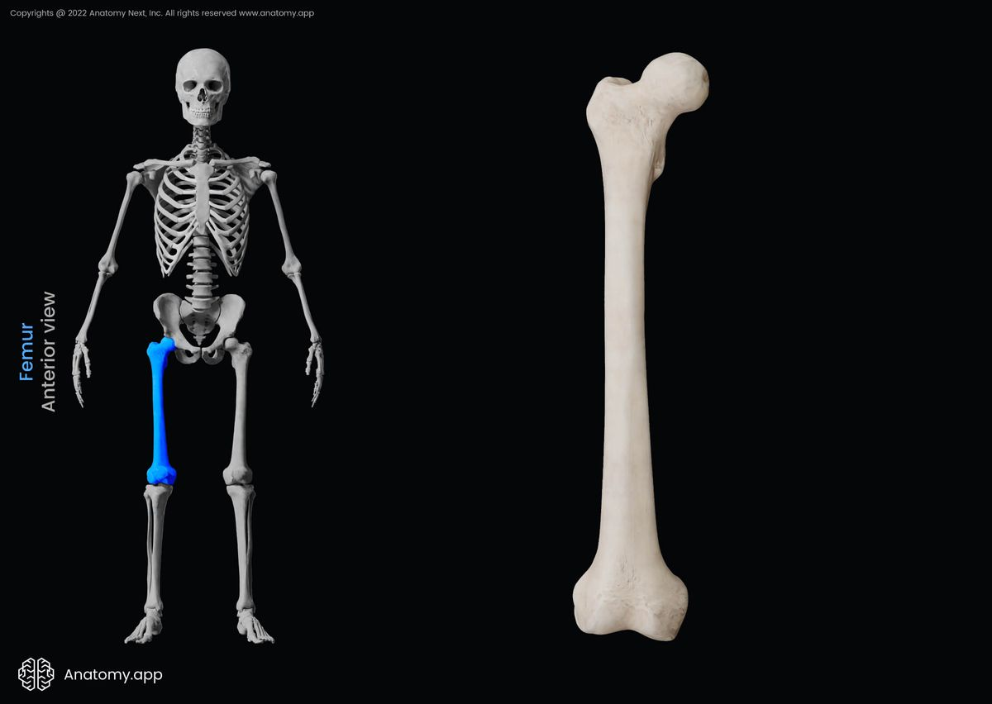

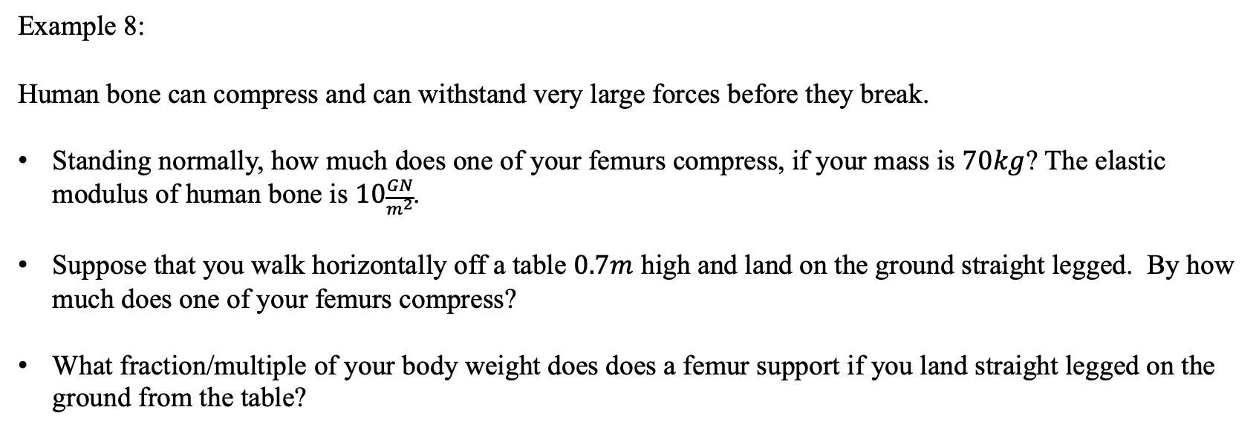

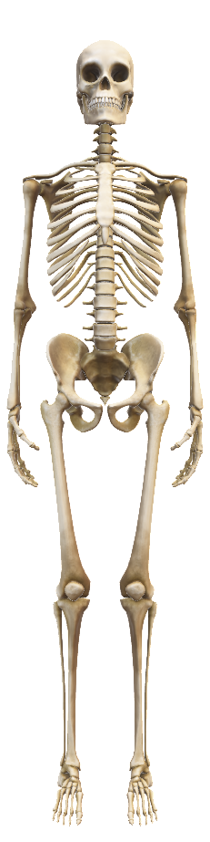
Example 8:
Human bone can compress and can withstand very large forces before they break.
Standing normally, how much does one of your femurs compress, if your mass is $70kg$? The elastic modulus of human bone is $10\frac{GN}{m^{2}}$.
Suppose that you walk horizontally off a table $0.7m$ high and land on the ground straight legged. By how much does one of your femurs compress?
What fraction/multiple of your body weight does does a femur support if you land straight legged on the ground from the table?
$$40cm \sim 16”$$
$$2.6cm\sim 1”$$
https://anatomy.app/encyclopedia/femur

