Slide 1
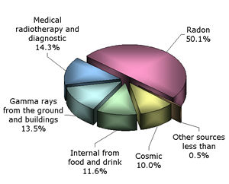
Physics 300 Experiment #3: Environmental Radioactivity
We’re surrounded by radioactivity everyday.
Some sources are natural and some sources are anthropogenic (human made.)
We’re going to investigate some sources of natural radioactivity found in the environment.
From studying these sources you’ll determine a method for calibration of a gamma ray detector and associated software and learn how a gamma ray detector functions.
Then we’ll determine the half life of two radioactive samples: ¹³⁷Ba and ⁴⁰K.
http://www.npl.co.uk/educate-explore/factsheets/ionising-radiation/
Background image: http://facstaff.gpc.edu/~pgore/PhysicalScience/atom-with-electrons.gif

Slide 2
Why is studying radioactivity important?
What’s my dosage? How much radiation am I exposed to?
Is it dangerous?
Will it make me sick or kill me.
More practical – what are the sources?
How long will these sources be around?
How do I determine how active a source is?
Can I control the radioactivity for a common good?
Useful measurements that can be made from radioactivity?

Slide 3
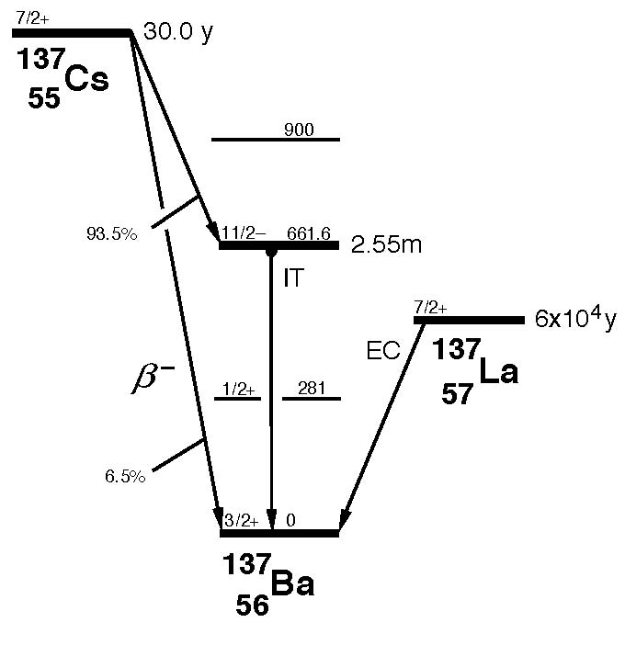
Radioactive Decays
Alpha Decay
Beta-Plus Decay
Beta-Minus Decay
Gamma Decay
Energy
Atomic Mass

Slide 4
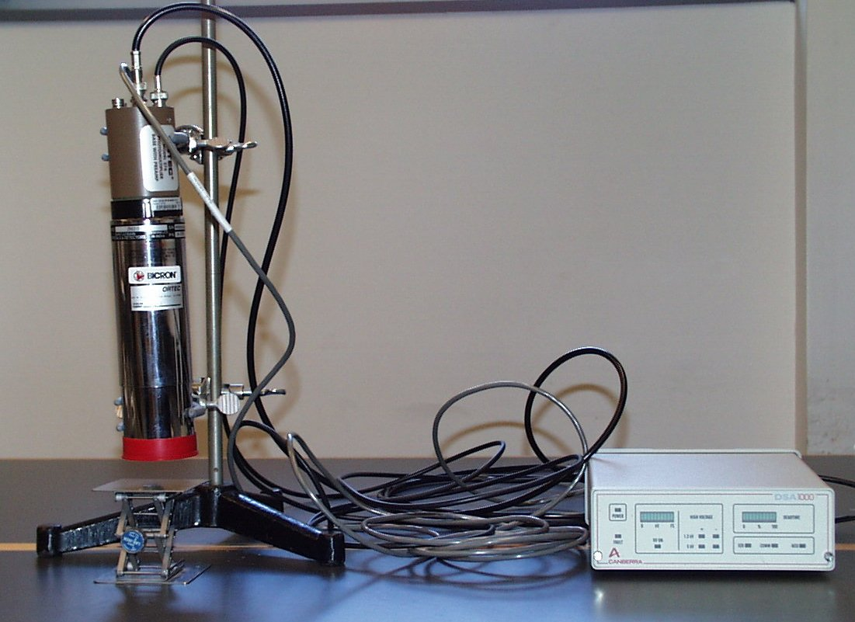
Gamma Ray Detectors
Sodium Iodide (NaI) detectors are a type of detector that’s called a scintillation detector.
A gamma ray interacting with a scintillator produces a pulse of light, which is converted to an electric pulse by a photomultiplier tube.
The photomultiplier consists of a photocathode, a focusing electrode and photoreceptors that multiply the number of electrons striking
them several times each.
The collected light at the end of the detector is a measure of the gamma ray’s energy.
http://physics.lafayette.edu/wp-content/blogs.dir/48/files/facilities-gallery/scintillation-detector.jpg

Slide 5
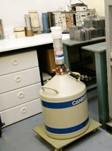
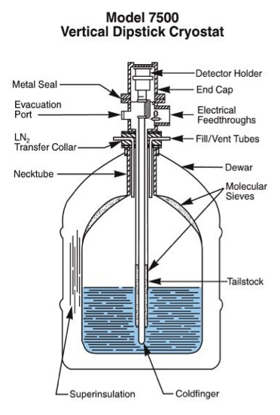
Gamma Ray Detectors
Canberra Model GC1017 that is a Ge crystal and it is cooled by liquid nitrogen.
A fraction of gamma rays that are incident from a radioactive source placed on the detector actually interact with the detector, many pass on through.
When a gamma ray does interact with the detector it will ionize electrons in the germanium giving up its energy to the electron it liberates.
This electron will in turn ionize more germanium atoms producing many electrons.
A strong electric field put across the crystal collects the electrons and the number of electrons counted is a measure of the incident gamma ray’s energy.
The signals heights that are detected are in general small and need to be analyzed by a pre-amplifier.
http://www.port.ac.uk/departments/academic/sees/analyticalfacilities/gammaray/
Schematic of the Canberra Model 7500 series gamma ray detector. Our particular detector, the GC1017 Ge(Li) is virtually identical.

Slide 6
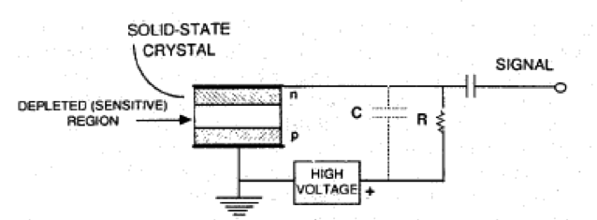
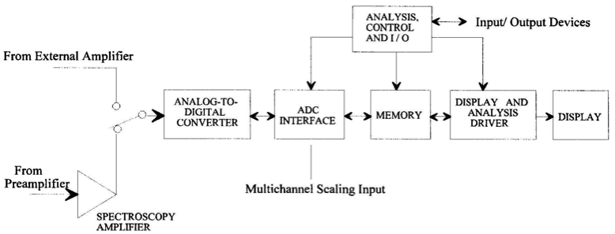
Gamma Ray Detectors
The signals from the pre-amplifier are sent to an analyzer and then to a multi- channel analyzer (MCA) that is operated in pulse-height or PHA mode.
In PHA mode, the input pulses are sorted into channels according to their amplitude.
Schematic of the germanium crystal with voltage bias from the high-voltage power supply. Ionization by an incident gamma ray in the depleted region produces electrons that are collected and this produces the signal that is sent to the preamplifier.
The PHA measures the height of an incident pulse and converts this into a voltage peak.
Maximum height of the pulse is assigned a channel number
The amplitude normally in the 0-10 V range is digitized and the resulting digital value is used as the address of a memory location corresponding to a given channel.
Schematic of the Multi-Channel Analyzer assembly. The detector signals from the pre-amplifier are fed into an amplifier and then converted from analog to digital signals and sent to the MCA and displayed on the computer screen.

Slide 7
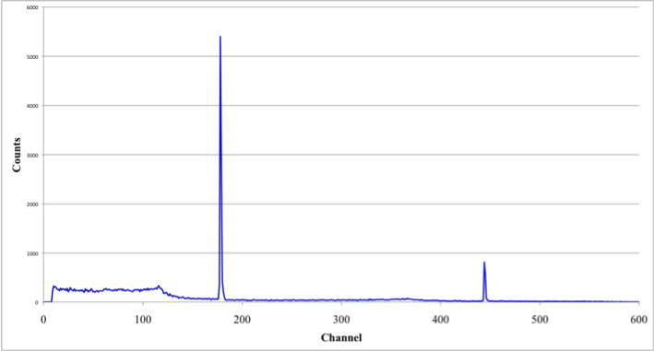
Gamma Ray Spectroscopy and Energy Calibration
Example of the gamma ray emission spectrum of an unknown radioactive sample.
From this particular source (²²Na) and several other standards (⁵⁷Co, ¹³⁷Cs, and ¹³³Ba) we can determine, from the channel number of the photopeaks and the energy of the radioactive decay, the detector calibration curve.
We will use this calibration curve to turn the x-axis from channel into energy.

Slide 8
Radioactive Decay Law
The radioactive decay law gives us a way to determine the change in the number of radioactive nuclei, their mass or the activity of a sample as a function of time.
The activity is defined as the number of radioactive decays per unit time and is given in units of the Curie or the Becquerel, where
The radioactive decay law is determined from solving the equation below for the number of radioactive atoms left after a time t.
This equation can be written in terms of the activity, where the activity is defined by
λ is called the decay constant and has units of inverse time and the value depends on the radioactive decay. It is related to the half-life of the sample.

Slide 9
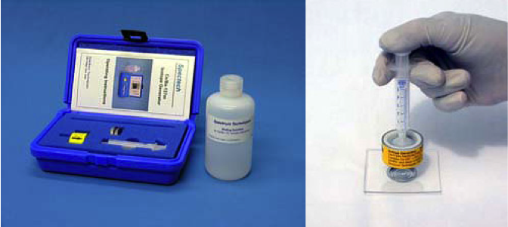
Determination of the half-life of ¹³⁷Ba
Energy
Cs/Ba isotope generator kit on the left. The cow is shown on the right with the syringe of the acid solution attached. The cow is milked into a pan for use in an experiment from Pasco. http://www.pasco.com/prodCatalog/SN/SN-7995_isotope-generator-kit-barium-137-m/#overviewTab
Atomic Mass
¹³⁷Cs decays by beta-minus decay to a metastable state of ¹³⁷Ba.
The barium state is relatively short lived and ¹³⁷Ba decays by the emission of a 0.662MeV gamma ray and it’s this decay we’ll detect to determine the half life of the metastable ¹³⁷Ba by measuring the activity of the sample as a function of time.

Slide 10
Radioactivity in the Environment
- Naturally occurring sources in Food
Bananas contain the radionuclide ⁴⁰K
This is a naturally occurring isotope of the element potassium
Potassium is essential in muscle function and concentrates in the muscles.
These nuts concentrate ²²⁶Ra from the soil
These nuts are probably the most radioactive foodstuff we consume
Yet the radioactivity is so low that it is difficult to measure it
From 0.2 to 7 pCi/g

Slide 11
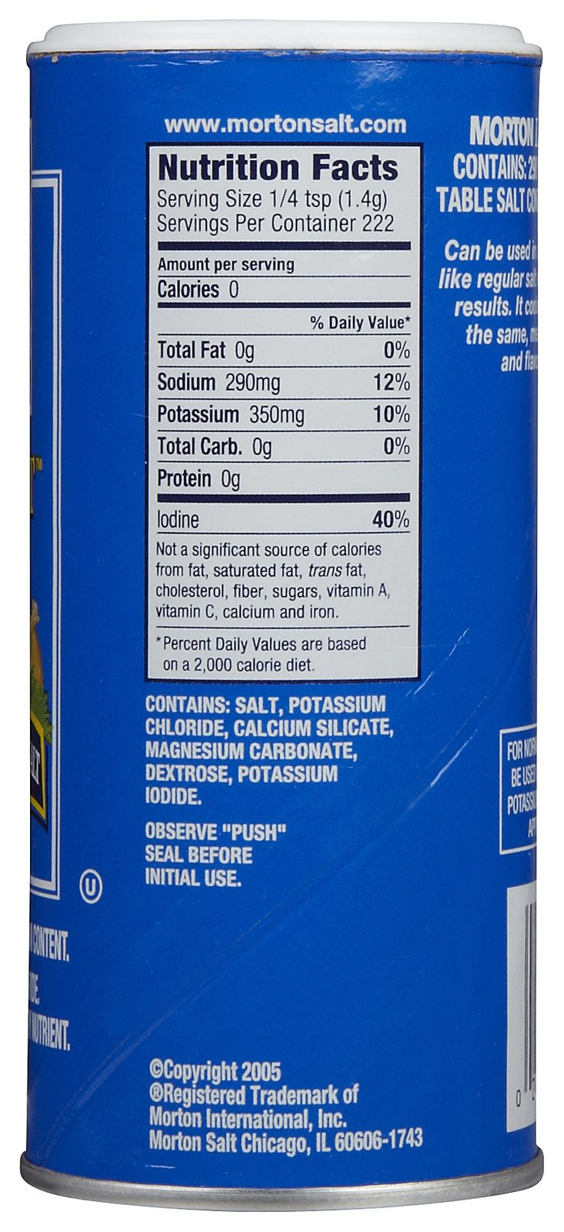
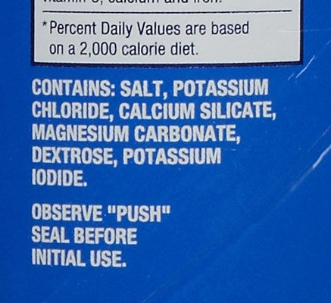
Environmental Radioactivity
- Salt Substitute as a source of ⁴⁰K
Some individuals cannot use regular salt (NaCl) to season their food
They use KCl instead
KCl is radioactive because of the ⁴⁰Kthat is present in the salt substitute
Activity about 450 pCi/g
⁴⁰K is radioactive and decays by gamma emission.
⁴⁰K has a very long half-life (billions of years.)
Can be use to date the age of rocks found on Earth to determine the age of the Earth (the method is called potassium-argon dating.)
Can also be used to determine the approximates age of the solar system by studying meteorites.
http://www.soap.com/p/morton-salt-lite-salt-11-oz-2-pk-313955

Slide 12
Experimental Procedure
Record spectra for the standards and generate a Energy versus Channel graph to determine the energy calibration.
Run the ¹³⁷Ba sample and from the activity as a function of time determine the half-life of ¹³⁷Ba.
Using known masses of KCl determine the half-life of ⁴⁰K.
Lab Report is due on or before noon on Friday, May 3, 2013.
Late lab reports loose 10 points per day, including weekends.

