Slide 1
FE Example #1
A baseball of mass $m_{b}=150g (\sim 5 ounces)$ is hit by a bat that is horizontally swung $1m$ off the ground. The ball leaves the end of the bat with a speed of $34\frac{m}{s} (\sim 75\frac{mi}{hr})$ at an angle $θ={36}^{0}$, measured with respect to the horizontal.
If the outfield wall is $400ft (\sim 130m)$ away and has a height $h=5m$ measured from ground level, will the player have hit a homerun?
If the player hits a home run with what velocity will the ball clear the outfield wall?
At what height above the wall will the ball clear the outfield wall if the player hits a home run.
If the player does not hit a home run, by how much does the player miss the outfield wall, measured horizontally across the ground?
What’s the highest point the baseball reaches above the ground?
What’s the time of flight of the baseball if the player does not hit a home run? If the player does hit a home run, what is the time of flight until the ball just clears the outfield wall?

Slide 2
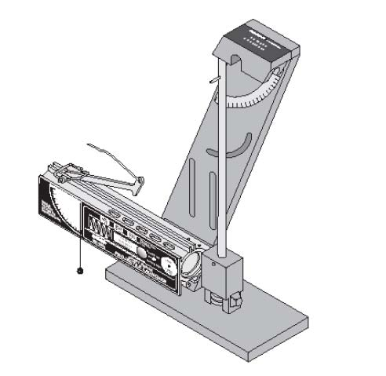
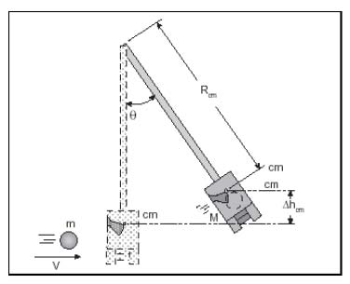
FE Example #2
A ballistic pendulum apparatus is used to study the principles of momentum and energy and to determine the initial velocity of projectiles fired from a launcher. Suppose that a steel ball of mass $m_{b}=50g$ launched with an initial velocity $v_{ib}$. The steel ball undergoes an inelastic collision with a stationary pendulum arm of length $R_{cm}=30.5cm$ and mass $M=250g.$ After the collision, the center of mass of the ball and pendulum arm rises from its lowest point thought a height $∆h_{cm}$, where it momentarily comes to rest at an angle $θ={27}^{0}$measured with respect to the vertical.
What is the speed of the ball and pendulum immediately after the collision?
With what speed, $v_{ib}$, was the ball launched into the pendulum arm?
What fraction of the ball’s initial kinetic energy was lost in the collision?
If the spring in the launcher were initially compressed by $9cm$, what what is the stiffness of the spring?
$$R_{cm}$$
$$m_{b}$$
$$∆y_{cm}$$
$$v_{ib}$$

Slide 3
FE Example #3
A sled of mass $m=100kg$ is at rest at the top of a tall snowy hill of height $h=50m$. The cart starts to slide down the hill. What is the speed of the sled at the bottom of the hill?
The hill is part of an obstacle course and when the sled gets to the bottom of the hill it encounters a loop-the-loop that makes up part of the track. If the bottom of the loop-the-loop is at ground level, what is the normal force on the sled at the top of the loop-the-loop if the loop-the-loop is a circle of radius $R=10m$?
How much work was done by gravity on the sled from the bottom to the top of the loop-the-loop?
After the sled exits the loop-the-loop it slides across the horizontal ground until it encounters a spring of stiffness $k$ and under the spring a patch of friction exists. What is the stiffness of the spring if the cart needs to be brought to rest over a distance of $7m$? Assume the coefficient of kinetic friction is $μ_{k}=0.75$.

Slide 4
FE Example #4
A box of mass $m_{1}$ is at rest on a horizontal surface. This box is connected to a second box of mass $m_{2}$ by a light string that passes over a pulley of mass $m_{p}$and radius $r_{p}$. The box of mass $m_{2}$hangs vertically at rest.
If the system is released from rest, what is the acceleration of the system? Assume friction (with coefficient of kinetic friction $μ_{k}$) exists on the horizontal surface that mass $m_{1}$slides.
What is the speed of mass $m_{1}$ after it has slid a distance $d$? Do this by forces/torques and by conservation of energy.
What coefficient of kinetic friction would be needed so the box of mass $m_{2}$falls at a constant speed?

Slide 5
FE Example #5
A bar of mass $m_{b}=50kg$ and length $L=2m$ is attached to the side of a building by a cable as shown below.
What is the tension in the cable if $θ={15}^{0}$ and the cable is attached at a point $75\%$ of the length of the bar?
What is the reaction force (magnitude and direction) on the attachment point at the building?
Suppose the cable breaks, what is the initial angular acceleration of the system?
When the bar is horizontal what is its rotational speed?
When the bar is horizontal, what is the translational speed of the center-of-mass?
$$θ$$
$$2θ$$

