Slide 1
Final Exam Type Problems
Spring 2026
The problems that follow are meant to be representative of the major topics covered on the final exam that you should know from taking the course. These may or may not cover everything tested on the problems on the final exam but are designed to give you practice on multi-part questions of the types of things that you could expect to see on the final exam.

Slide 2
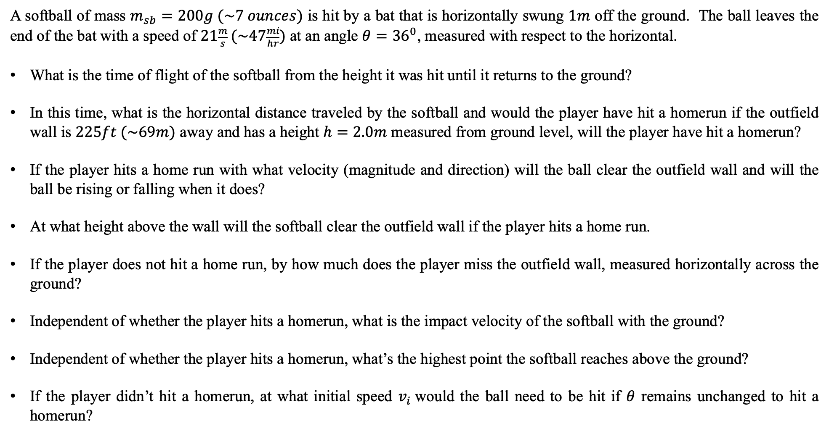
Final Exam Example #1
– 2D Projectile Motion, Equations of Motion & Vectors
A softball of mass $m_{sb}=200g (\sim 7 ounces)$ is hit by a bat that is horizontally swung $1m$ off the ground. The ball leaves the end of the bat with a speed of $21\frac{m}{s} (\sim 47\frac{mi}{hr})$ at an angle $θ={36}^{0}$, measured with respect to the horizontal.
What is the time of flight of the softball from the height it was hit until it returns to the ground?
In this time, what is the horizontal distance traveled by the softball and would the player have hit a homerun if the outfield wall is $225ft (\sim 69m)$ away and has a height $h=2.0m$ measured from ground level, will the player have hit a homerun?
If the player hits a home run with what velocity (magnitude and direction) will the ball clear the outfield wall and will the ball be rising or falling when it does?
At what height above the wall will the softball clear the outfield wall if the player hits a home run.
If the player does not hit a home run, by how much does the player miss the outfield wall, measured horizontally across the ground?
Independent of whether the player hits a homerun, what is the impact velocity of the softball with the ground?
Independent of whether the player hits a homerun, what’s the highest point the softball reaches above the ground?
If the player didn’t hit a homerun, at what initial speed $v_{i}$would the ball need to be hit if $θ$ remains unchanged to hit a homerun?

Slide 3
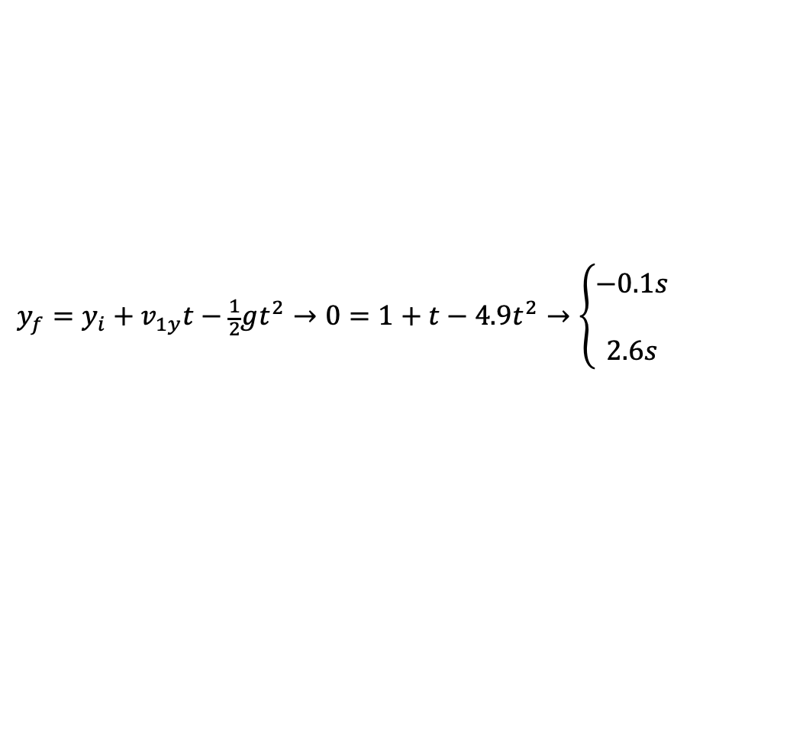

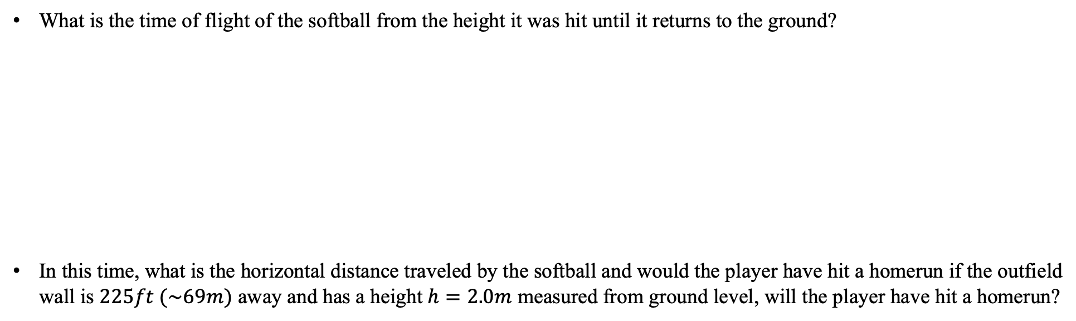


Final Exam Example #1 - Solutions
What is the time of flight of the softball from the height it was hit until it returns to the ground?
In this time, what is the horizontal distance traveled by the softball and would the player have hit a homerun if the outfield wall is $225ft (\sim 69m)$ away and has a height $h=2.0m$ measured from ground level, will the player have hit a homerun?
$$v_{ix}=v_{i}\cos{θ}=21\frac{m}{s}\cos{36}=17\frac{m}{s}$$
$$v_{iy}=v_{i}\sin{θ}=21\frac{m}{s}\sin{36}=12.3\frac{m}{2}$$
$$y_{f}=y_{i}+v_{1y}t−\frac{1}{2}gt^{2}→0=1+t−4.9t^{2}→\left\{\begin{matrix}−0.1s \\ \\ 2.6s\end{matrix}\right.$$
$$x_{f}=x_{i}+v_{1x}t+\frac{1}{2}a_{x}t^{2}→x_{f}=v_{ix}t=17\frac{m}{s}∙2.6s=44.2m$$
If the player does not hit a home run, by how much does the player miss the outfield wall, measured horizontally across the ground?
$$∆x=69m−44.2m=24.8m$$

Slide 4
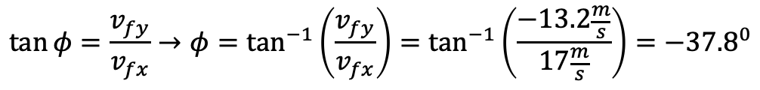
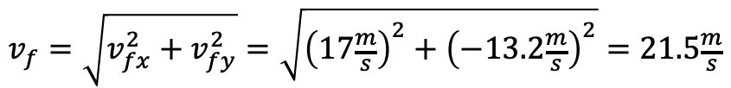
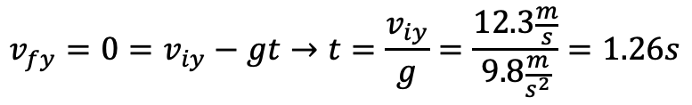

Final Exam Example #1 - Solutions
Independent of whether the player hits a homerun, what is the impact velocity of the softball with the ground?
Independent of whether the player hits a homerun, what’s the highest point the softball reaches above the ground?
Method 1
Method 2
$$v_{f}=\sqrt{v_{fx}^{2}+v_{fy}^{2}}=\sqrt{{\left(17\frac{m}{s}\right)}^{2}+{\left(−13.2\frac{m}{s}\right)}^{2}}=21.5\frac{m}{s}$$
$$v_{fx}=v_{ix}+a_{x}t→v_{fx}=v_{ix}=17\frac{m}{s}$$
$$v_{fy}=v_{iy}+a_{y}t=12.3\frac{m}{s}−\left(9.8\frac{m}{s^{2}}∙2.6s\right)=−13.2\frac{m}{s}$$
$$\tan{φ}=\frac{v_{fy}}{v_{fx}}→φ=\tan^{−1}\left(\frac{v_{fy}}{v_{fx}}\right)=\tan^{−1}\left(\frac{−13.2\frac{m}{s}}{17\frac{m}{s}}\right)=−{37.8}^{0}$$
$$v_{fy}=0=v_{iy}−gt→t=\frac{v_{iy}}{g}=\frac{12.3\frac{m}{s}}{9.8\frac{m}{s^{2}}}=1.26s$$
$$y_{f}=y_{i}+v_{1y}t−\frac{1}{2}gt^{2}=1m+\left(12.3\frac{m}{s}∙1.26s\right)−\frac{1}{2}\left(9.8\frac{m}{s^{2}}\right){\left(1.26s\right)}^{2}=8.7m$$
$$v_{fy}^{2}=0=v_{iy}^{2}−2g∆y→∆y=y_{f}−y_{i}=\frac{v_{iy}^{2}}{2g}→y_{f}=y_{i}+\frac{v_{iy}^{2}}{2g}=1m+\frac{{\left(12.3\frac{m}{s}\right)}^{2}}{2∙9.8\frac{m}{s^{2}}}=8.7m$$

Slide 5
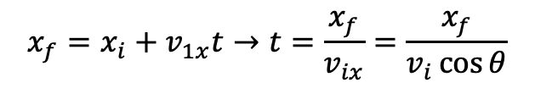
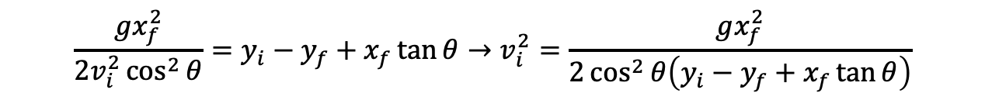
Final Exam Example #1 - Solutions
If the player didn’t hit a homerun, at what initial speed $v_{i}$would the ball need to be hit if $θ$ remains unchanged to hit a homerun?
$$x_{f}=x_{i}+v_{1x}t→t=\frac{x_{f}}{v_{ix}}=\frac{x_{f}}{v_{i}\cos{θ}}$$
$$y_{f}=y_{i}+v_{1y}t−\frac{1}{2}gt^{2}=y_{i}+v_{i}\sin{θ}\left(\frac{x_{f}}{v_{i}\cos{θ}}\right)−\frac{1}{2}g{\left(\frac{x_{f}}{v_{i}\cos{θ}}\right)}^{2}→y_{f}=y_{i}+x_{f}\tan{θ}−\frac{gx_{f}^{2}}{2v_{i}^{2}\cos^{2}{θ}}$$
$$\frac{gx_{f}^{2}}{2v_{i}^{2}\cos^{2}{θ}}=y_{i}−y_{f}+x_{f}\tan{θ}→v_{i}^{2}=\frac{gx_{f}^{2}}{2\cos^{2}{θ\left(y_{i}−y_{f}+x_{f}\tan{θ}\right)}}$$
$$v_{i}^{2}=\frac{gx_{f}^{2}}{2\cos^{2}{θ\left(y_{i}−y_{f}+x_{f}\tan{θ}\right)}}=\frac{9.8\frac{m}{s^{2}}{\left(69m\right)}^{2}}{2\cos^{2}{36}\left(1m−2m+69m\tan{36}\right)}→v_{i}=25.9\frac{m}{2}$$

Slide 6
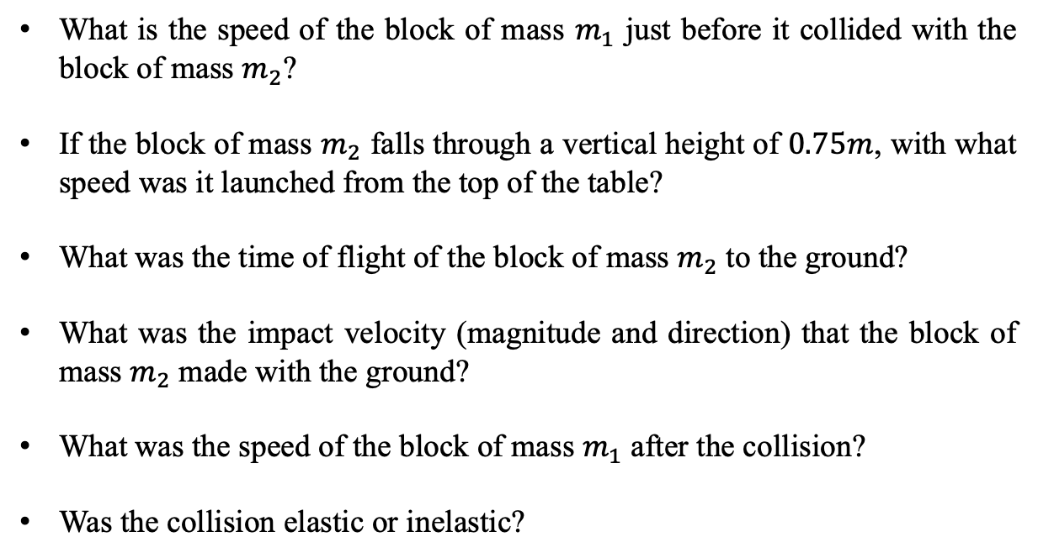
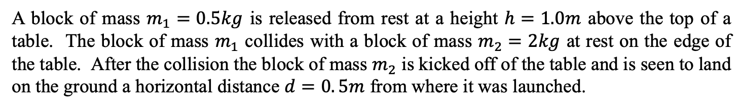



Final Exam Example #2
– Conservation of Energy, Collisions, 2D Projectile Motion, Equations of Motion & Vectors
A block of mass $m_{1}=0.5kg$ is released from rest at a height $h=1.0m$ above the top of a table. The block of mass $m_{1}$ collides with a block of mass $m_{2}=2kg$ at rest on the edge of the table. After the collision the block of mass $m_{2}$ is kicked off of the table and is seen to land on the ground a horizontal distance $d=0. 5m$ from where it was launched.
$$m_{1}$$
What is the speed of the block of mass $m_{1}$ just before it collided with the block of mass $m_{2}$?
If the block of mass $m_{2}$ falls through a vertical height of $0.75m$, with what speed was it launched from the top of the table?
What was the time of flight of the block of mass $m_{2}$ to the ground?
What was the impact velocity (magnitude and direction) that the block of mass $m_{2}$ made with the ground?
What was the speed of the block of mass $m_{1}$ after the collision?
Was the collision elastic or inelastic?
$$h$$
$$m_{2}$$

Slide 7
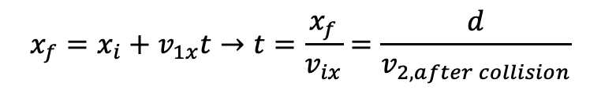
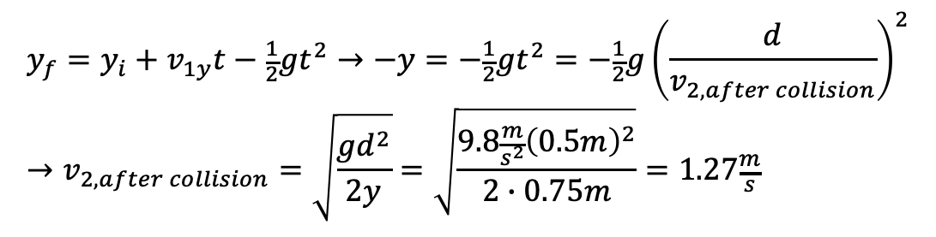
Final Exam Example #2 - Solution
What is the speed of the block of mass $m_{1}$ just before it collided with the block of mass $m_{2}$?
$$∆E=0=∆K_{T}+∆K_{R}+∆U_{g}+∆U_{s}=∆K_{T}+∆U_{g}=\left(\frac{1}{2}m_{1}v_{1f}^{2}−\frac{1}{2}m_{1}v_{1i}^{2}\right)+\left(m_{1}gy_{if}−m_{1}gy_{1i}\right)$$
$$\frac{1}{2}m_{1}v_{1f}^{2}=m_{1}gy_{1i}→v_{1f}=v_{1,horizontal}=\sqrt{2gh}=\sqrt{2∙9.8\frac{m}{s^{2}}∙1m}=4.4\frac{m}{s}$$
If the block of mass $m_{2}$ falls through a vertical height of $0.75m$, with what speed was it launched from the top of the table?
$$x_{f}=x_{i}+v_{1x}t→t=\frac{x_{f}}{v_{ix}}=\frac{d}{v_{2,after collision}}$$
$$y_{f}=y_{i}+v_{1y}t−\frac{1}{2}gt^{2}→−y=−\frac{1}{2}gt^{2}=−\frac{1}{2}g{\left(\frac{d}{v_{2,after collision}}\right)}^{2}→v_{2,after collision}=\sqrt{\frac{gd^{2}}{2y}}=\sqrt{\frac{9.8\frac{m}{s^{2}}{\left(0.5m\right)}^{2}}{2∙0.75m}}=1.27\frac{m}{s}$$

Slide 8
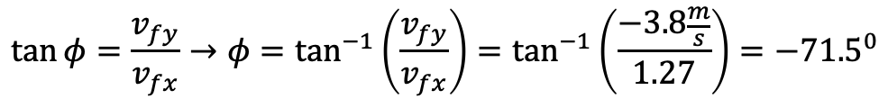
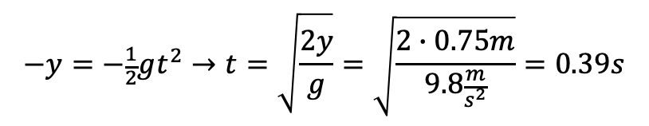
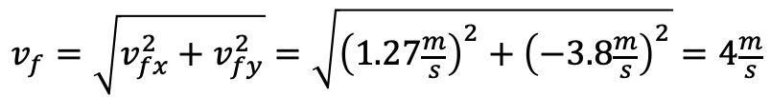

Final Exam Example #2 - Solution
What was the time of flight of the block of mass $m_{2}$ to the ground?
$$−y=−\frac{1}{2}gt^{2}→t=\sqrt{\frac{2y}{g}}=\sqrt{\frac{2∙0.75m}{9.8\frac{m}{s^{2}}}}=0.39s$$
What was the impact velocity (magnitude and direction) that the block of mass $m_{2}$ made with the ground?
$$v_{fx}=v_{ix}+a_{x}t→v_{fx}=v_{ix}=1.27\frac{m}{s}$$
$$v_{fy}=v_{iy}+a_{y}t=−\left(9.8\frac{m}{s^{2}}∙0.39ss\right)=−3.8\frac{m}{s}$$
$$v_{f}=\sqrt{v_{fx}^{2}+v_{fy}^{2}}=\sqrt{{\left(1.27\frac{m}{s}\right)}^{2}+{\left(−3.8\frac{m}{s}\right)}^{2}}=4\frac{m}{s}$$
$$\tan{φ}=\frac{v_{fy}}{v_{fx}}→φ=\tan^{−1}\left(\frac{v_{fy}}{v_{fx}}\right)=\tan^{−1}\left(\frac{−3.8\frac{m}{s}}{1.27}\right)=−{71.5}^{0}$$

Slide 9

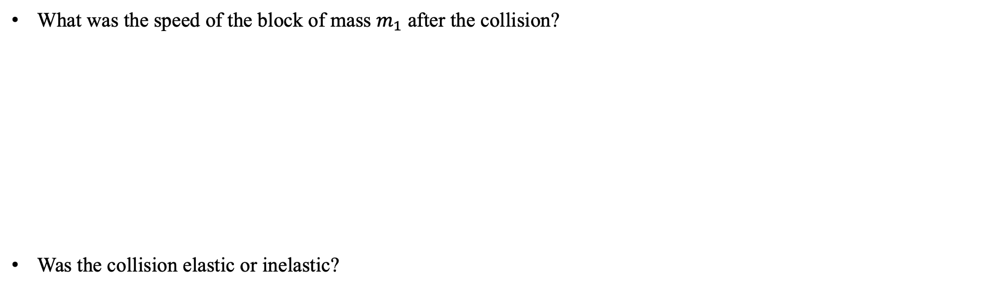
Final Exam Example #2 - Solution
What was the speed of the block of mass $m_{1}$ after the collision?
Was the collision elastic or inelastic?
$$∆p_{x}=0=p_{fx}−p_{ix}→p_{ix}=p_{fx}$$
$$m_{1}v_{1,horizontal}=m_{1}v_{1,after,collision}+m_{2}v_{2,after,collision}$$
$$→v_{1,after,collision}=\frac{m_{1}v_{1,horizontal}−m_{2}v_{2,after collision}}{m_{1}}=\frac{\left(0.5kg∙4.4\frac{m}{s}\right)−\left(2kg∙1.27\frac{m}{2}\right)}{0.5kg}=−0.68\frac{m}{s}$$
$$∆K=K_{f}−K_{i}=\left(\frac{1}{2}m_{1}v_{1ac}^{2}+\frac{1}{2}m_{2}v_{2ac}^{2}\right)−\frac{1}{2}m_{1}v_{1h}^{2}$$
$$∆K=\left(\frac{1}{2}\left(0.5kg\right){\left(−0.68\frac{m}{s}\right)}^{2}+\frac{1}{2}\left(2kg\right){\left(1.27\frac{m}{2}\right)}^{2}\right)−\frac{1}{2}\left(0.5kg\right){\left(4.4\frac{m}{s}\right)}^{2}=−3.11J$$
Since this is not zero, the collision is inelastic.

Slide 10
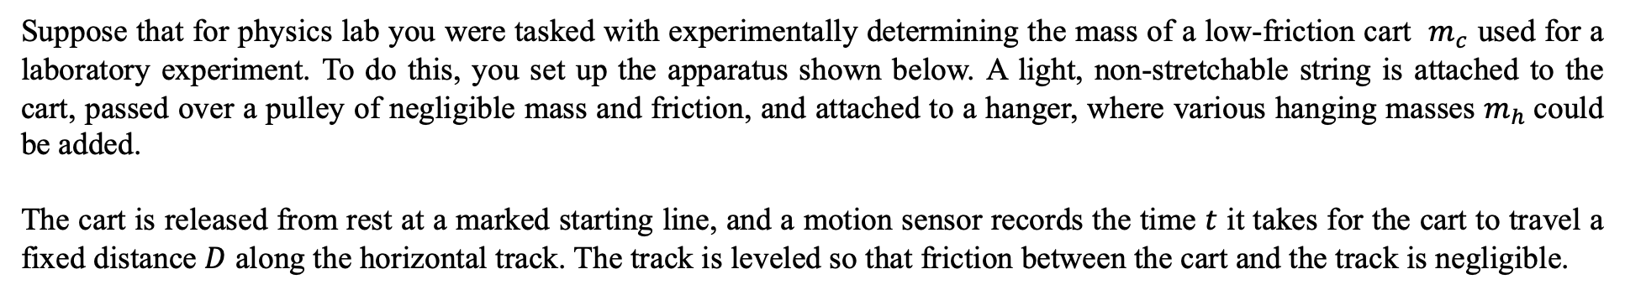



Final Exam Example #3
– Motion in 1D, constant Forces, Constat Acceleration, Equations of Motion, Data Analysis, and Uncertainty
Suppose that for physics lab you were tasked with experimentally determining the mass of a low-friction cart $m_{c}$ used for a laboratory experiment. To do this, you set up the apparatus shown below. A light, non-stretchable string is attached to the cart, passed over a pulley of negligible mass and friction, and attached to a hanger, where various hanging masses $m_{h}$could be added.
The cart is released from rest at a marked starting line, and a motion sensor records the time $t$ it takes for the cart to travel a fixed distance $D$ along the horizontal track. The track is leveled so that friction between the cart and the track is negligible.
$m_{c}$
$$D$$
$m_{h}$
From a carefully labeled free-body (force) diagram, what is the translational acceleration of the low-friction cart in terms of $m_{c}$, $m_{h}$, and $g$?

Slide 11
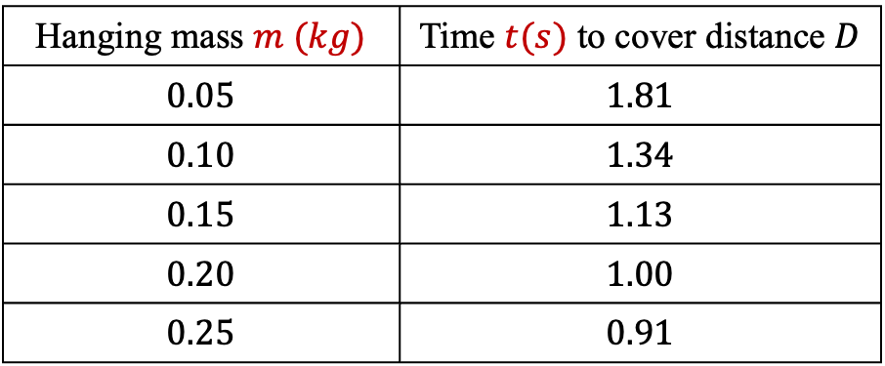

Final Exam Example #3
– Motion in 1D, constant Forces, Constant Acceleration, Equations of Motion, Data Analysis, and Uncertainty
Suppose that you wanted to determine the mass of the low-friction cart $m_{c}$, by taking data on the time $t$ it took to travel the horizontal distance $D$, and the translational acceleration of the system $a$. Derive an equation that would allow you to accomplish this and explain how you would determine the mass of the low-friction cart from your equation.
Suppose that you took the following data on the masses $m$ hung on the holder and the time $t$ it took the low-friction cart to cover the constant horizontal distance $D=1.2m$ from rest. What would you have to plot in order to determine the mass of the low-friction cart?
Hanging mass $m (kg)$ | Time $t(s)$ to cover distance $D$
$$0.05$$ | $$1.81$$
$$0.10$$ | $$1.34$$
$$0.15$$ | $$1.13$$
$$0.20$$ | $$1.00$$
$$0.25$$ | $$0.91$$

Slide 12




Final Exam Example #3
– Motion in 1D, constant Forces, Constant Acceleration, Equations of Motion, Data Analysis, and Uncertainty
Here’s the plot and from the plot, what is the mass $m_{c}$ of the low-friction cart?
Suppose you later discover that the string was not perfectly level, but was actually tilted slightly upward toward the pulley. Would the acceleration of the cart be greater than, less than, or equal to the acceleration on a perfectly level track? Explain your reasoning.
How would this tilt affect the mass of the low-friction cart? Would it be an overestimate, underestimate, or would it not affect the result at all? Explain your reasoning.
$$t^{2}=0.152m^{−1}+0.245$$
$$t^{2}\left(s^{2}\right)$$
$$m^{−1}\left({kg}^{−1}\right)$$

Slide 13

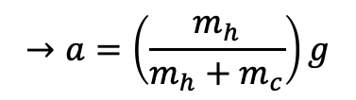


Final Exam Example #3 - Solutions
Suppose that you wanted to determine the mass of the low-friction cart $m_{c}$, by taking data on the time $t$ it took to travel the horizontal distance $D$, and the translational acceleration of the system $a$. Derive an equation that would allow you to accomplish this and explain how you would determine the mass of the low-friction cart from your equation.
For the cart parallel to the horizontal surface (to the right is the positive x-direction):
$$F_{T}=m_{c}a$$
For the hanging mass (vertically up is the positive y-direction)
$$F_{T}−m_{h}g=−m_{h}a$$
$$→m_{c}a−m_{h}g=−m_{h}a$$
$$→a=\left(\frac{m_{h}}{m_{h}+m_{c}}\right)g$$

Slide 14
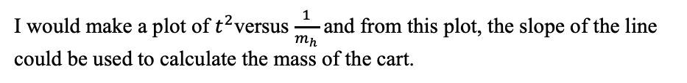
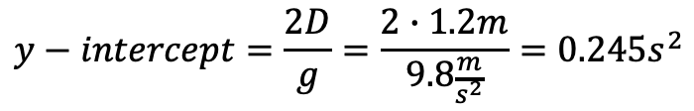
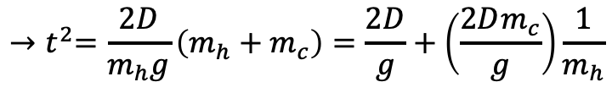
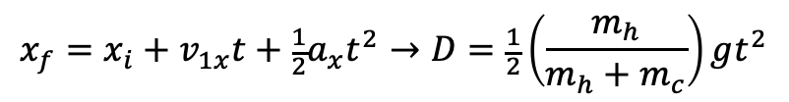
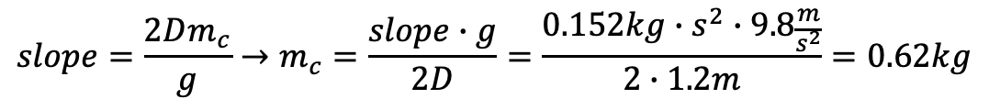
Final Exam Example #3 - Solutions
The horizontal distance $D$ traveled in time $t$ is given by the cart:
$$x_{f}=x_{i}+v_{1x}t+\frac{1}{2}a_{x}t^{2}→D=\frac{1}{2}\left(\frac{m_{h}}{m_{h}+m_{c}}\right)gt^{2}$$
$${→t}^{2}=\frac{2D}{m_{h}g}\left(m_{h}+m_{c}\right)=\frac{2D}{g}+\left(\frac{2Dm_{c}}{g}\right)\frac{1}{m_{h}}$$
I would make a plot of $t^{2}$versus $\frac{1}{m_{h}}$ and from this plot, the slope of the line could be used to calculate the mass of the cart.
$$slope=\frac{2Dm_{c}}{g}→m_{c}=\frac{slope∙g}{2D}=\frac{0.152kg∙s^{2}∙9.8\frac{m}{s^{2}}}{2∙1.2m}=0.62kg$$
We could also evaluate the y-intercept and in doing so, we see that it is the same value as is given on the graph.
$$y−intercept=\frac{2D}{g}=\frac{2∙1.2m}{9.8\frac{m}{s^{2}}}=0.245s^{2}$$

Slide 15
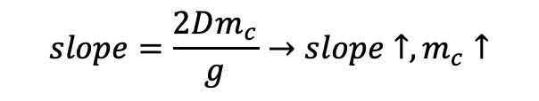
Final Exam Example #3 - Solutions
Suppose you later discover that the string was not perfectly level, but was actually tilted slightly upward toward the pulley. Would the acceleration of the cart be greater than, less than, or equal to the acceleration on a perfectly level track? Explain your reasoning.
How would this tilt affect the mass of the low-friction cart? Would it be an overestimate, underestimate, or would it not affect the result at all? Explain your reasoning.
$$F_{T}\cos{θ}=m_{c}a→\left(m_{h}g−m_{h}a\right)\cos{θ}=m_{c}a→a=\left(\frac{m_{h}\cos{θ}}{m_{h}\cos{θ}+m_{c}}\right)g$$
$$F_{T}−m_{h}g=−m_{h}a→F_{T}=m_{h}g−m_{h}a$$
To see what happens to the acceleration, let’s try some extremes. For $θ=0$ this reduces to our original equation. For $θ→90$, this gives $a→0$. So, the acceleration of the cart would be less than that if the string were level. We could also argue this from $F_{T}\cos{θ}$. As $θ↑$, $F_{T}↓$ and thus $a↓$.
Since the acceleration is smaller, it would take longer to cover the same distance for each given hanging mass. Thus, the slope would be larger and thus the mass would be larger. This would be an overestimation of the mass of the cart.
$$slope=\frac{2Dm_{c}}{g}→slope↑, m_{c}↑$$

Slide 16
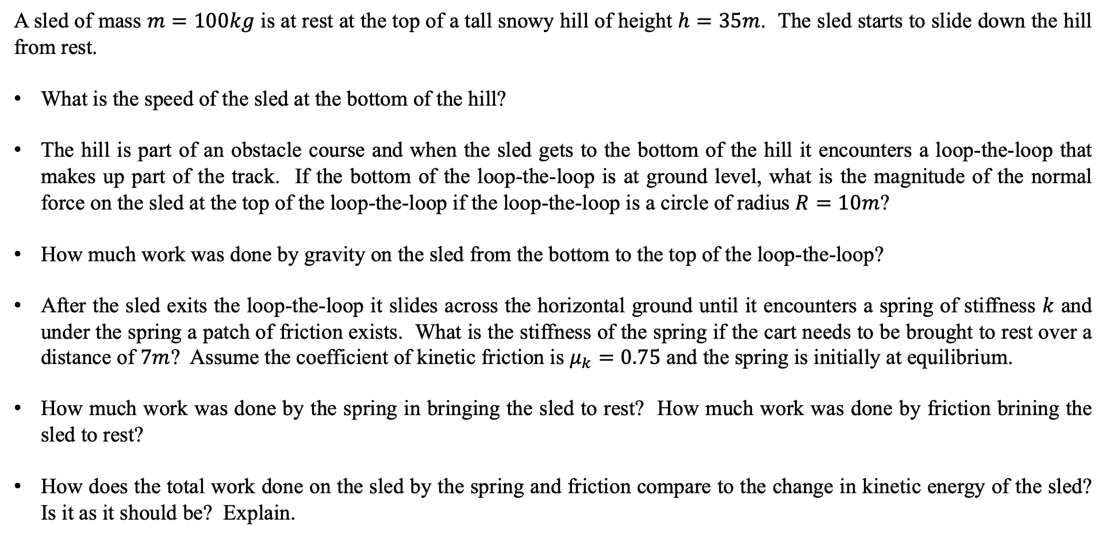
Final Exam Example #4
- Conservation of Energy, Circular Motion and Forces, Work, Frictional Work, Springs and Elastic Potential Energy, Work-Kinetic Energy Theorem
A sled of mass $m=100kg$ is at rest at the top of a tall snowy hill of height $h=35m$. The sled starts to slide down the hill from rest.
What is the speed of the sled at the bottom of the hill?
The hill is part of an obstacle course and when the sled gets to the bottom of the hill it encounters a loop-the-loop that makes up part of the track. If the bottom of the loop-the-loop is at ground level, what is the magnitude of the normal force on the sled at the top of the loop-the-loop if the loop-the-loop is a circle of radius $R=10m$?
How much work was done by gravity on the sled from the bottom to the top of the loop-the-loop?
After the sled exits the loop-the-loop it slides across the horizontal ground until it encounters a spring of stiffness $k$ and under the spring a patch of friction exists. What is the stiffness of the spring if the cart needs to be brought to rest over a distance of $7m$? Assume the coefficient of kinetic friction is $μ_{k}=0.75$ and the spring is initially at equilibrium.
How much work was done by the spring in bringing the sled to rest? How much work was done by friction brining the sled to rest?
How does the total work done on the sled by the spring and friction compare to the change in kinetic energy of the sled? Is it as it should be? Explain.

Slide 17
Final Exam Example #4 - Solution
What is the speed of the sled at the bottom of the hill?
$$∆E=0=∆K_{T}+∆K_{R}+∆U_{g}+∆U_{s}=∆K_{T}+∆U_{g}=\left(\frac{1}{2}mv_{bottom}^{2}−\frac{1}{2}mv_{top}^{2}\right)+\left(mgy_{bottom}−mgy_{top}\right)$$
$$\frac{1}{2}mv_{bottom}^{2}=mgy_{top}→v_{1,bottom}=\sqrt{2gh}=\sqrt{2∙9.8\frac{m}{s^{2}}∙35m}=26.2\frac{m}{s}$$
The hill is part of an obstacle course and when the sled gets to the bottom of the hill it encounters a loop-the-loop that makes up part of the track. If the bottom of the loop-the-loop is at ground level, what is the magnitude of the normal force on the sled at the top of the loop-the-loop if the loop-the-loop is a circle of radius $R=10m$?
$$∆E=0=∆K_{T}+∆K_{R}+∆U_{g}+∆U_{s}=∆K_{T}+∆U_{g}=\left(\frac{1}{2}mv_{top}^{2}−\frac{1}{2}mv_{bottom}^{2}\right)+\left(mgy_{top}−mgy_{bottom}\right)$$
$$v_{top}^{2}=v_{bottom}^{2}−2gy_{top}={\left(26.2\frac{m}{s}\right)}^{2}−2∙9.8\frac{m}{s^{2}}∙\left(2∙10m\right)=294.4\frac{m^{2}}{s^{2}}→v_{top}=17.2\frac{m}{s}$$
$$−F_{N}−mg=−m\frac{v_{top}^{2}}{R}→F_{N}=m\frac{v_{top}^{2}}{R}−mg=100kg\left(\frac{294.4\frac{m^{2}}{s^{2}}}{10m}−9.8\frac{m}{s^{2}}\right)=1964.4N$$

Slide 18
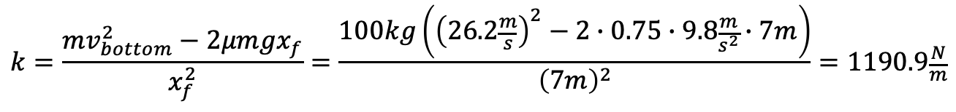
Final Exam Example #4 - Solution
How much work was done by gravity on the sled from the bottom to the top of the loop-the-loop?
  Method 1:
  Method 2:
  Method 3:
$$W=F∆y\cos{θ}=mg\left(2R\right)\cos{180}=−2Rmg=−2∙10m∙100kg∙9.8\frac{m}{s^{2}}=−19600J$$
$$W=−∆U_{g}=−\left(mgy_{top}=mgy_{bottom}\right)=−2Rmg=−19600J$$
$$W=∆K=\frac{1}{2}mv_{top}^{2}−\frac{1}{2}mv_{bottom}^{2}=\frac{1}{2}∙100kg\left({\left(17.2\frac{m}{s}\right)}^{2}−{\left(26.2\frac{m}{s}\right)}^{2}\right)=−19530J$$
After the sled exits the loop-the-loop it slides across the horizontal ground until it encounters a spring of stiffness $k$ and under the spring a patch of friction exists. What is the stiffness of the spring if the cart needs to be brought to rest over a distance of $7m$? Assume the coefficient of kinetic friction is $μ_{k}=0.75$ and the spring is initially at equilibrium.
$$∆E=W_{fr}=∆K_{T}+∆K_{R}+∆U_{g}+∆U_{s}→W_{fr}=∆K_{T}+∆U_{s}→F_{fr}∆x\cos{θ}=\left(\frac{1}{2}mv_{f}^{2}−\frac{1}{2}mv_{bottom}^{2}\right)+\left(\frac{1}{2}kx_{f}^{2}−\frac{1}{2}kx_{i}^{2}\right)$$
$$μF_{N}x_{f}\cos{180}=−μmgx_{f}=−\frac{1}{2}mv_{bottom}^{2}+\frac{1}{2}kx_{f}^{2}$$
$$k=\frac{mv_{bottom}^{2}−2μmgx_{f}}{x_{f}^{2}}=\frac{100kg\left({\left(26.2\frac{m}{s}\right)}^{2}−2∙0.75∙9.8\frac{m}{s^{2}}∙7m\right)}{{\left(7m\right)}^{2}}=1190.9\frac{N}{m}$$

Slide 19

Final Exam Example #4 - Solution
How much work was done by the spring in bringing the sled to rest? How much work was done by friction brining the sled to rest?
How does the total work done on the sled by the spring and friction compare to the change in kinetic energy of the sled? Is it as it should be? Explain.
$$W_{fr}=−μmgx_{f}=−0.75∙100kg∙9.8\frac{m}{s^{2}}∙7m=−5145J$$
$$W_{s}=−∆U_{s}=−\frac{1}{2}kx_{f}^{2}=\frac{1}{2}∙1190.9\frac{N}{m}{∙\left(7m\right)}^{2}=−29177J$$
$$W_{net}=W_{fr}+W_{s}=W_{fr}−∆U_{s}=∆K$$
$$W_{net}=W_{fr}+W_{s}=−5145J−29177J=−34322J$$
$$W_{net}=∆K=\frac{1}{2}mv_{f}^{2}−\frac{1}{2}mv_{bottom}^{2}=−\frac{1}{2}∙100kg∙{\left(26.2\frac{m}{s}\right)}^{2}=−34322J$$
The net work done is equal to the change in kinetic energy as it should be.

Slide 20
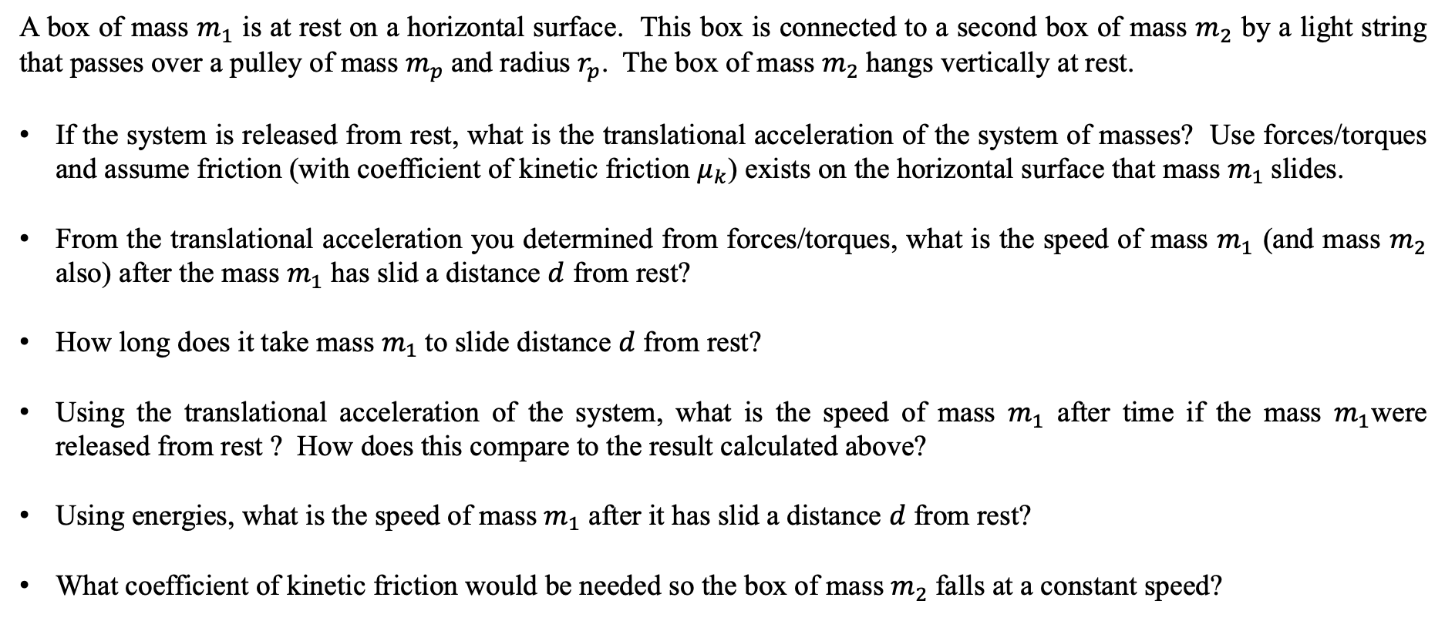
Final Exam Example #5
- Forces, Torques, Equations of Motion for Constant Acceleration, & Conservation of Energy
A box of mass $m_{1}$ is at rest on a horizontal surface. This box is connected to a second box of mass $m_{2}$ by a light string that passes over a pulley of mass $m_{p}$and radius $r_{p}$. The box of mass $m_{2}$hangs vertically at rest.
If the system is released from rest, what is the translational acceleration of the system of masses? Use forces/torques and assume friction (with coefficient of kinetic friction $μ_{k}$) exists on the horizontal surface that mass $m_{1}$slides.
From the translational acceleration you determined from forces/torques, what is the speed of mass $m_{1}$ (and mass $m_{2}$ also) after the mass $m_{1}$ has slid a distance $d$ from rest?
How long does it take mass $m_{1}$to slide distance $d$ from rest?
Using the translational acceleration of the system, what is the speed of mass $m_{1}$ after time if the mass $m_{1}$were released from rest ? How does this compare to the result calculated above?
Using energies, what is the speed of mass $m_{1}$ after it has slid a distance $d$ from rest?
What coefficient of kinetic friction would be needed so the box of mass $m_{2}$falls at a constant speed?

Slide 21
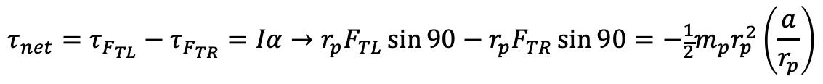
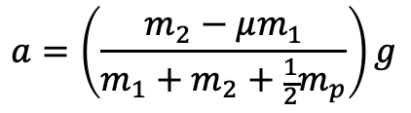
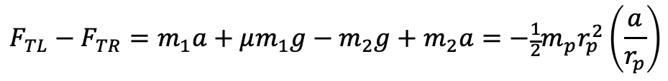
Final Exam Example #5 - Solution
If the system is released from rest, what is the translational acceleration of the system of masses? Use forces/torques and assume friction (with coefficient of kinetic friction $μ_{k}$) exists on the horizontal surface that mass $m_{1}$slides.
For mass $m_{1}$
$$F_{net,x}=F_{TL}−F_{fr}=m_{1}a→F_{TL}=m_{1}a+F_{fr}=m_{1}a+μF_{N}=m_{1}a+μm_{1}g$$
$$F_{net,y}=F_{N}−F_{W}=m_{1}a_{y}=0→F_{N}=F_{w}=m_{2}g$$
For mass $m_{2}$
$$F_{net,y}=F_{TR}−F_{W2}=−m_{2}a_{y}→F_{TR}=F_{W2}−m_{2}a=m_{2}g−m_{2}a$$
For the pulley
$$τ_{net}=τ_{F_{TL}}−τ_{F_{TR}}=Iα→r_{p}F_{TL}\sin{90}−r_{p}F_{TR}\sin{90}=−\frac{1}{2}m_{p}r_{p}^{2}\left(\frac{a}{r_{p}}\right)$$
$$F_{TL}−F_{TR}=m_{1}a+μm_{1}g−m_{2}g+m_{2}a=−\frac{1}{2}m_{p}r_{p}^{2}\left(\frac{a}{r_{p}}\right)$$
$$a=\left(\frac{m_{2}−μm_{1}}{m_{1}+m_{2}+\frac{1}{2}m_{p}}\right)g$$

Slide 22
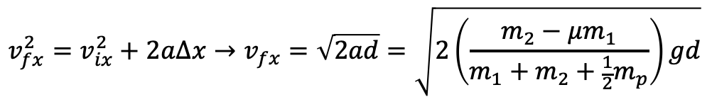
Final Exam Example #5 - Solution
From the translational acceleration you determined from forces/torques, what is the speed of mass $m_{1}$ (and mass $m_{2}$ also) after the mass $m_{1}$ has slid a distance $d$ from rest?
$$v_{fx}^{2}=v_{ix}^{2}+2a∆x→v_{fx}=\sqrt{2ad}=\sqrt{2\left(\frac{m_{2}−μm_{1}}{m_{1}+m_{2}+\frac{1}{2}m_{p}}\right)gd}$$
How long does it take mass $m_{1}$to slide distance $d$ from rest?
$$x_{f}=x_{i}+v_{ix}t+\frac{1}{2}a_{x}t^{2}→d=\frac{1}{2}\left(\frac{m_{2}−μm_{1}}{m_{1}+m_{2}+\frac{1}{2}m_{p}}\right)gt^{2}→t=\sqrt{\frac{2d}{g}\left(\frac{m_{1}+m_{2}+\frac{1}{2}m_{p}}{m_{2}−μm_{1}}\right)}$$
Using the translational acceleration of the system, what is the speed of mass $m_{1}$ after time if the mass $m_{1}$were released from rest ? How does this compare to the result calculated above?
$$v_{fx}=v_{ix}+a_{x}t=\left[\left(\frac{m_{2}−μm_{1}}{m_{1}+m_{2}+\frac{1}{2}m_{p}}\right)g\right]\sqrt{\frac{2d}{g}\left(\frac{m_{1}+m_{2}+\frac{1}{2}m_{p}}{m_{2}−μm_{1}}\right)}=\sqrt{2\left(\frac{m_{2}−μm_{1}}{m_{1}+m_{2}+\frac{1}{2}m_{p}}\right)gd}$$

Slide 23
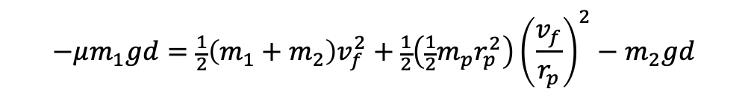
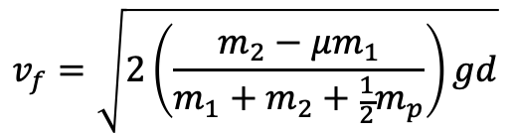

Final Exam Example #5 - Solution
Using energies, what is the speed of mass $m_{1}$ after it has slid a distance $d$ from rest?
$$∆E=W_{fr}=∆K_{T}+∆K_{R}+∆U_{g}+∆U_{s}=∆K_{T1}+∆K_{T2}+∆K_{Rp}+∆U_{g2}$$
$$μF_{N}d\cos{180}=−μm_{1}gd=\left(\frac{1}{2}m_{1}v_{1f}^{2}−\frac{1}{2}m_{1}v_{1i}^{2}\right)+\left(\frac{1}{2}m_{2}v_{2f}^{2}−\frac{1}{2}m_{2}v_{2i}^{2}\right)+\left(\frac{1}{2}Iω_{pf}^{2}−\frac{1}{2}Iω_{pi}^{2}\right)+\left(m_{2}gy_{2f}−m_{2}gy_{2i}\right)$$
$$−μm_{1}gd=\frac{1}{2}\left(m_{1}+m_{2}\right)v_{f}^{2}+\frac{1}{2}\left(\frac{1}{2}m_{p}r_{p}^{2}\right){\left(\frac{v_{f}}{r_{p}}\right)}^{2}−m_{2}gd$$
$$−μm_{1}gd=\frac{1}{2}\left(m_{1}+m_{2}+\frac{1}{2}m_{p}\right)v_{f}^{2}−m_{2}gd$$
$$v_{f}=\sqrt{2\left(\frac{m_{2}−μm_{1}}{m_{1}+m_{2}+\frac{1}{2}m_{p}}\right)gd}$$

Slide 24


Final Exam Example #5 - Solution
What coefficient of kinetic friction would be needed so the box of mass $m_{2}$falls at a constant speed?
For mass $m_{1}$
$$F_{net,x}=F_{TL}−F_{fr}=m_{1}a=0→F_{TL}=F_{fr}=μm_{1}g$$
For mass $m_{2}$
$$F_{net,y}=F_{TR}−F_{W2}=−m_{2}a_{y}=0→F_{TR}=F_{W2}=m_{2}g$$
For the pulley
$$τ_{net}=τ_{F_{TL}}−τ_{F_{TR}}=Iα=0→r_{p}F_{TL}\sin{90}=r_{p}F_{TR}\sin{90}→F_{TL}=F_{TR}$$
$$F_{TL}=F_{TR}→F_{fr}=F_{W2}→m_{2}g=μm_{1}g$$
$$μ=\frac{m_{2}}{m_{1}}$$

Slide 25

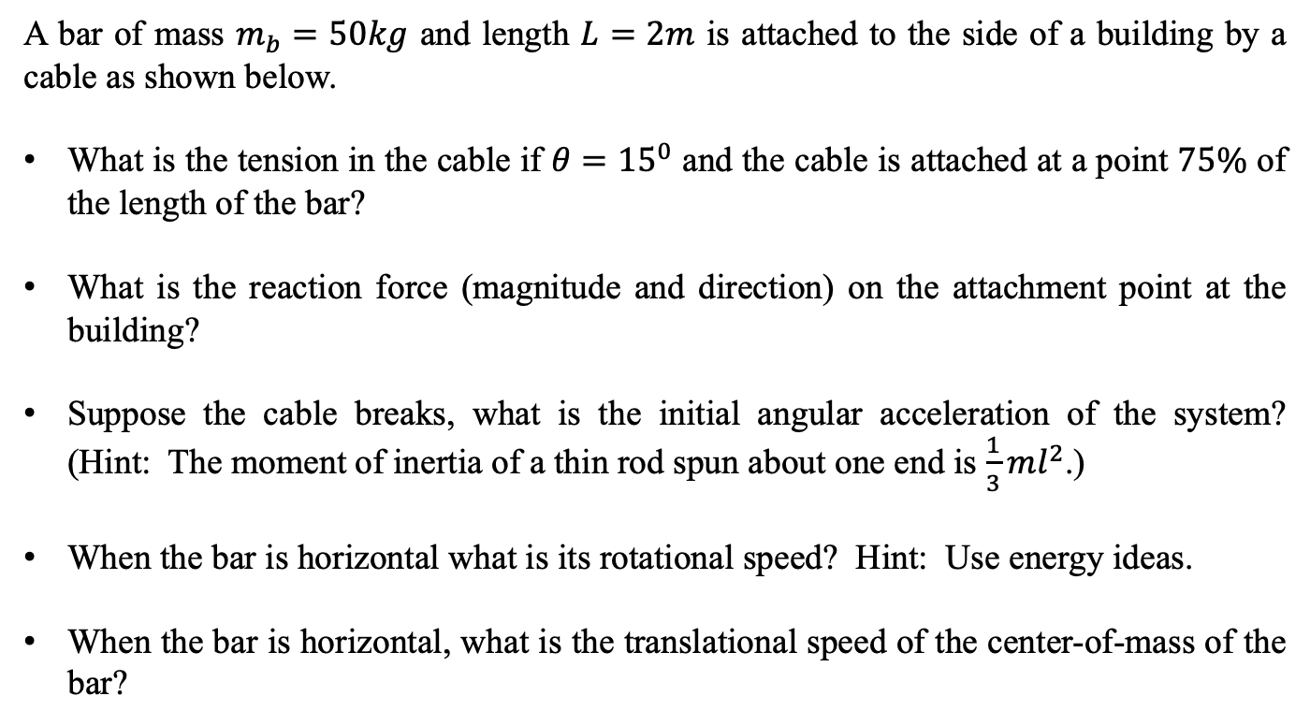

Final Exam Example #6
- Rotational and Translational Statics, Forces, Torques, Rotational Motion, Rotational Kinetic Energy, & Conservation of Energy
A bar of mass $m_{b}=50kg$ and length $L=2m$ is attached to the side of a building by a cable as shown below.
What is the tension in the cable if $θ={15}^{0}$ and the cable is attached at a point $75\%$ of the length of the bar?
What is the reaction force (magnitude and direction) on the attachment point at the building?
Suppose the cable breaks, what is the initial angular acceleration of the system? (Hint: The moment of inertia of a thin rod spun about one end is $\frac{1}{3}ml^{2}$.)
When the bar is horizontal what is its rotational speed? Hint: Use energy ideas.
When the bar is horizontal, what is the translational speed of the center-of-mass of the bar?
$$θ$$
$$2θ$$

Slide 26
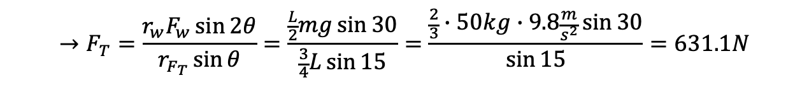
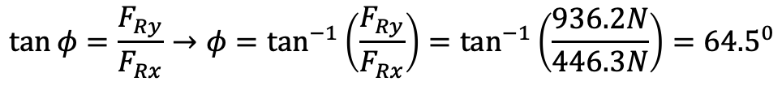
Final Exam Example #6 - Solution
What is the tension in the cable if $θ={15}^{0}$ and the cable is attached at a point $75\%$ of the length of the bar?
$$F_{net,x}=F_{Rx}−F_{Tx}=F_{Rx}−F_{T}\cos\left(90−3θ\right)=0→F_{Rx}=F_{T}\cos{45}$$
$$F_{net,y}=F_{Ry}−F_{w}−F_{Ty}=F_{Ry}−F_{W}−F_{T}\sin\left(90−3θ\right)=0→F_{Ry}=F_{w}+F_{T}\sin{45}$$
$$τ_{net}=−τ_{w}+τ_{F_{T}}=−r_{w}F_{w}\sin{2θ}+r_{F_{T}}F_{T}\sin{θ}=0$$
$$→F_{T}=\frac{r_{w}F_{w}\sin{2θ}}{r_{F_{T}}\sin{θ}}=\frac{\frac{L}{2}mg\sin{30}}{\frac{3}{4}L\sin{15}}=\frac{\frac{2}{3}∙50kg∙9.8\frac{m}{s^{2}}\sin{30}}{\sin{15}}=631.1N$$
$${→F}_{Rx}=F_{T}\cos{75}=631.1N∙\cos{45}=446.3N$$
$${→F}_{Ry}=F_{w}+F_{T}\sin{45}=50kg∙9.8\frac{m}{s^{2}}+631.1N∙\sin{45}=936.2N$$
$$F_{R}=\sqrt{F_{Rx}^{2}+F_{Ry}^{2}}=\sqrt{{\left(446.3N\right)}^{2}+{\left(936.2N\right)}^{2}}=1037.2N$$
$$\tan{φ}=\frac{F_{Ry}}{F_{Rx}}→φ=\tan^{−1}\left(\frac{F_{Ry}}{F_{Rx}}\right)=\tan^{−1}\left(\frac{936.2N}{446.3N}\right)={64.5}^{0}$$

Slide 27

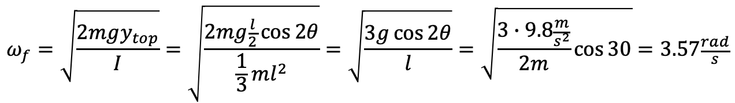
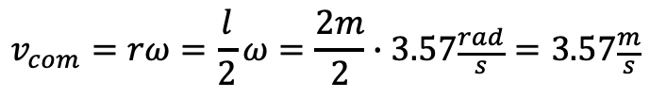
Final Exam Example #6 - Solution
Suppose the cable breaks, what is the initial angular acceleration of the system? (Hint: The moment of inertia of a thin rod spun about one end is $\frac{1}{3}ml^{2}$.)
When the bar is horizontal what is its rotational speed?
When the bar is horizontal, what is the translational speed of the center-of-mass of the bar?
$$τ_{net}=−τ_{w}=Iα=\frac{1}{3}ml^{2}α→α=−\frac{3τ_{w}}{ml^{2}}=−\frac{3\left(\frac{l}{2}mg\sin{2θ}\right)}{ml^{2}}=−\frac{3g}{2l}\sin{2θ}=−\frac{3∙9.8\frac{m}{s^{2}}}{2∙2m}\sin{30}=−3.68\frac{rad}{s^{2}}$$
$$∆E=0=∆K_{T}+∆K_{R}+∆U_{g}+∆U_{s}=∆K_{T}+∆U_{g}=\left(\frac{1}{2}Iω_{f}^{2}−\frac{1}{2}Iω_{i}^{2}\right)+\left(mgy_{bottom}−mgy_{top}\right)$$
$$ω_{f}=\sqrt{\frac{2mgy_{top}}{I}}=\sqrt{\frac{2mg\frac{l}{2}\cos{2θ}}{\frac{1}{3}ml^{2}}}=\sqrt{\frac{3g\cos{2θ}}{l}}=\sqrt{\frac{3∙9.8\frac{m}{s^{2}}}{2m}\cos{30}}=3.57\frac{rad}{s}$$
$$v_{com}=rω=\frac{l}{2}ω=\frac{2m}{2}∙3.57\frac{rad}{s}=3.57\frac{m}{s}$$
Just a comment: You either have to solve this problem by torques (which is an integral problem) or by using energy, which we did. You can’t use the rotational equations of motion because they are for constant angular acceleration. Here the angular acceleration changes with angle and is not constant.

Slide 28
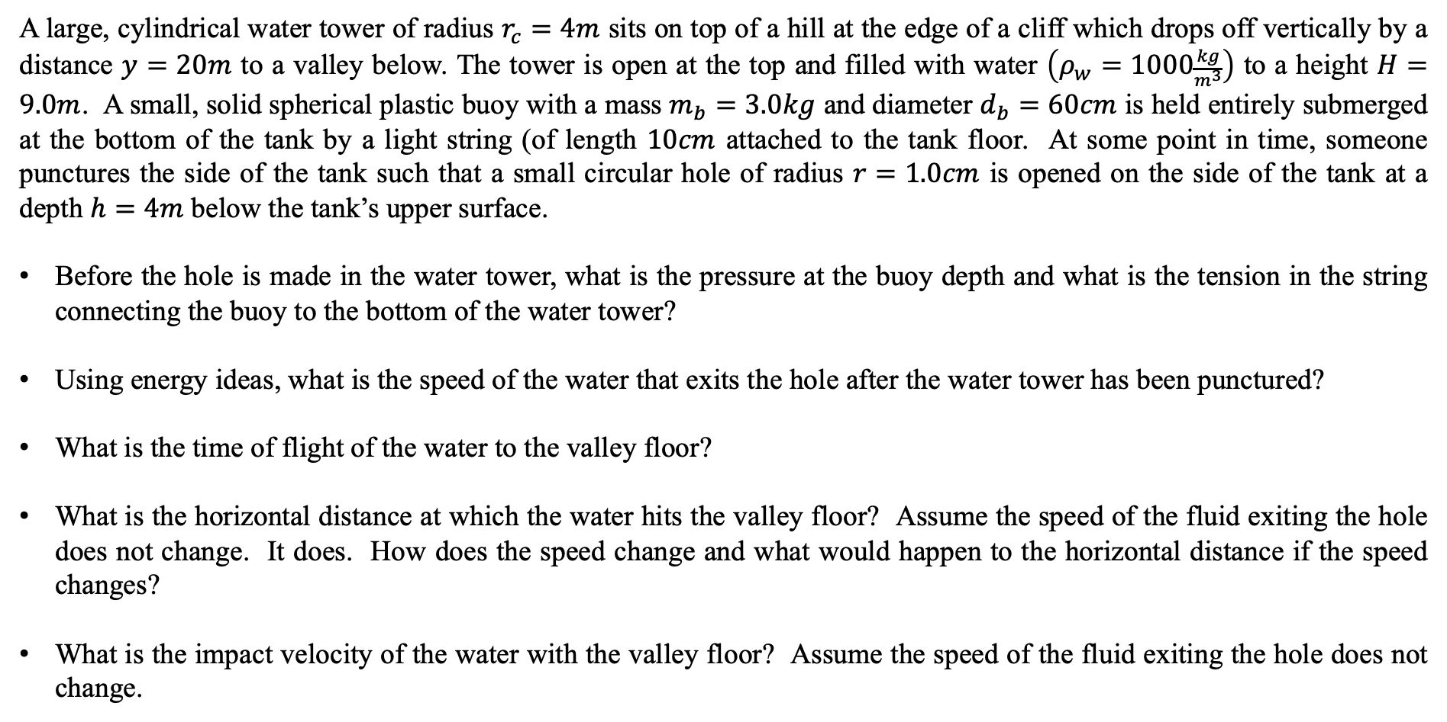
Final Exam Example #7
- Fluids, Fluid Pressure, Equation of Continuity, Bernoulli's Equation, Conservation of Energy, Kinetic and Gravitational Potential Energies, and Graphs
A large, cylindrical water tower of radius $r_{c}=4m$ sits on top of a hill at the edge of a cliff which drops off vertically by a distance $y=20m$ to a valley below. The tower is open at the top and filled with water $\left(ρ_{w}=1000\frac{kg}{m^{3}}\right)$ to a height $H=9.0m$. A small, solid spherical plastic buoy with a mass $m_{b}=3.0kg$ and diameter $d_{b}=60cm$ is held entirely submerged at the bottom of the tank by a light string (of length $10cm$ attached to the tank floor. At some point in time, someone punctures the side of the tank such that a small circular hole of radius $r=1.0cm$ is opened on the side of the tank at a depth $h=4m$ below the tank’s upper surface.
Before the hole is made in the water tower, what is the pressure at the buoy depth and what is the tension in the string connecting the buoy to the bottom of the water tower?
Using energy ideas, what is the speed of the water that exits the hole after the water tower has been punctured?
What is the time of flight of the water to the valley floor?
What is the horizontal distance at which the water hits the valley floor? Assume the speed of the fluid exiting the hole does not change. It does. How does the speed change and what would happen to the horizontal distance if the speed changes?
What is the impact velocity of the water with the valley floor? Assume the speed of the fluid exiting the hole does not change.

Slide 29
Final Exam Example #7
- Fluids, Fluid Pressure, Equation of Continuity, Bernoulli's Equation, Conservation of Energy, Kinetic and Gravitational Potential Energies, and Graphs
Suppose that at before the hole is made inside of the water tower, the string connecting the buoy to the water tower’s bottom is cut. What is the acceleration of the buoy toward the surface of the water tower? Assume fluid drag is negligible. It is not, but that’s a very hard problem to solve.
What is the kinetic energy change as a function of time if there is no fluid drag? What if there was viscous drag?
What is the potential energy as a function of time? How does it relate to the change in kinetic energy?

Slide 30
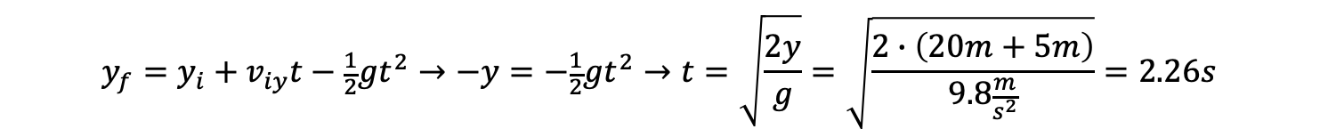
Final Exam Example #7 - Solution
Before the hole is made in the water tower, what is the pressure at the buoy depth and what is the tension in the string connecting the buoy to the bottom of the water tower?
$$P_{d}=P_{air}+ρgd=1.01×{10}^{5}\frac{N}{m^{2}}+1000\frac{kg}{m^{3}}∙9.8\frac{m}{s^{2}}∙\left(9m−0.1m\right)=1.88×{10}^{5}\frac{N}{m^{2}}$$
$$F_{net,y}=−F_{T}−F_{W}+F_{B}=0→F_{T}=F_{B}−F_{W}=ρgV−mg=1000\frac{kg}{m^{3}}∙9.8\frac{m}{s^{2}}∙\left(\frac{4}{3}π{\left(0.3m\right)}^{3}\right)−\left(3kg∙9.8\frac{m}{s^{2}}\right)=323.4N$$
Using energy ideas, what is the speed of the water that exits the hole after the water tower has been punctured?
$$∆E=0=∆K_{T}+∆K_{R}+∆U_{g}+∆U_{s}=∆K_{T}+∆U_{g}=\left(\frac{1}{2}mv_{side}^{2}−\frac{1}{2}mv_{top}^{2}\right)+\left(mgy_{bottom}−mgy_{top}\right)$$
$$v_{side}=\sqrt{2g\left(y_{top}−y_{bottom}\right)}=\sqrt{2∙9.8\frac{m}{s^{2}}∙\left(9m−4m\right)}=9.9\frac{m}{s}$$
What is the time of flight of the water to the valley floor?
$$y_{f}=y_{i}+v_{iy}t−\frac{1}{2}gt^{2}→−y=−\frac{1}{2}gt^{2}→t=\sqrt{\frac{2y}{g}}=\sqrt{\frac{2∙\left(20m+5m\right)}{9.8\frac{m}{s^{2}}}}=2.26s$$

Slide 31

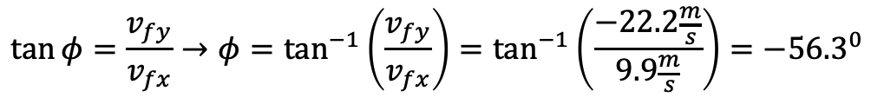
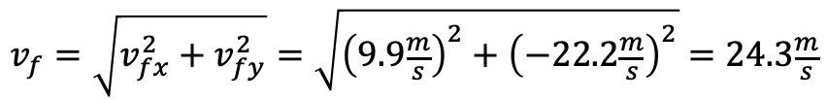
Final Exam Example #7 - Solution
What is the horizontal distance at which the water hits the valley floor? Assume the speed of the fluid exiting the hole does not change. It does. How does the speed change and what would happen to the horizontal distance if the speed changes?
What is the impact velocity of the water with the valley floor? Assume the speed of the fluid exiting the hole does not change.
$$x_{f}=x_{i}+v_{ix}t+\frac{1}{2}a_{x}t^{2}=v_{ix}t=9.9\frac{m}{s}∙2.26s=22.4m$$
As the heigh of the water decreases in the tower, the speed of the exiting fluid decreases by conservation of energy. Thus, the horizontal distance will decrease but the time of flight will remain the since that is determined by the vertical fall.
$$v_{f}=\sqrt{v_{fx}^{2}+v_{fy}^{2}}=\sqrt{{\left(9.9\frac{m}{s}\right)}^{2}+{\left(−22.2\frac{m}{s}\right)}^{2}}=24.3\frac{m}{s}$$
$$v_{fx}=v_{ix}+a_{x}t→v_{fx}=v_{ix}=9.9\frac{m}{s}$$
$$v_{fy}=v_{iy}+a_{y}t=−\left(9.8\frac{m}{s^{2}}∙2.26s\right)=−22.2\frac{m}{s}$$
$$\tan{φ}=\frac{v_{fy}}{v_{fx}}→φ=\tan^{−1}\left(\frac{v_{fy}}{v_{fx}}\right)=\tan^{−1}\left(\frac{−22.2\frac{m}{s}}{9.9\frac{m}{s}}\right)=−{56.3}^{0}$$

Slide 32
Final Exam Example #7 - Solution
Suppose that at before the hole is made inside of the water tower, the string connecting the buoy to the water tower’s bottom is cut. What is the acceleration of the buoy toward the surface of the water tower? Assume fluid drag is negligible. It is not, but that’s a very hard problem to solve.
What is the kinetic energy change as a function of time if there is no fluid drag? What if there was viscous drag?
What is the potential energy as a function of time? How does it relate to the change in kinetic energy?
$$F_{net}=F_{B}−F_{w}=ma_{y}→a_{y}=\frac{F_{B}−F_{w}}{m}=\frac{1000\frac{kg}{m^{3}}∙9.8\frac{m}{s^{2}}∙\left(\frac{4}{3}π{\left(0.3m\right)}^{3}\right)−3kg∙9.8\frac{m}{s^{2}}}{3kg}=107.8\frac{m}{s^{2}}$$
Since the buoy accelerates upwards from rest, its kinetic energy increases. If there were viscous drag, there may be a point at which the upward buoyant force will equal the downward weight. If this happens before the buoy reaches the surface, it will stop accelerating and move upward with a constant velocity.
Since the energy is constant and the kinetic energy increases, the potential energy must decrease. This seems counter intuitive, but as the buoy rises, the fluid that it displaces falls. This leads to a decreases in potential energy in the system.

