Slide 1
The Potential Barrier
- Calculations
Continuity of the wave function and its first derivative at the boundaries of the barrier.

Slide 2
The Potential Barrier
- Calculations
I want to calculate the transmission coefficient, so I’m going to calculate A as a function of F. Thus, I’m going to eliminate the coefficients C and D.
Now let’s add together equation 1 and equation 5.

Slide 3
The Potential Barrier
- Calculations
And from equation 4
Now let’s add and subtract equation7 and equation 2, where equation 2

Slide 4
The Potential Barrier
- Calculations
Adding equation 7 and equation 2:
Subtracting equation 2 from equation 7:

Slide 5
The Potential Barrier
- Calculations
Let’s substitute these two equations (equations 8 and 9) into equation 6 for the coefficients C and D:
And from here we could calculate the transmission coefficient, T, but let’s clean this up a bit.
So,

Slide 6
The Potential Barrier
- Calculations
Now equation 10 becomes:
What are those functions in parentheses on the right hand side?

Slide 7
The Potential Barrier
- Calculations
From a table of mathematical functions:
And finally we have something useful:

Slide 8
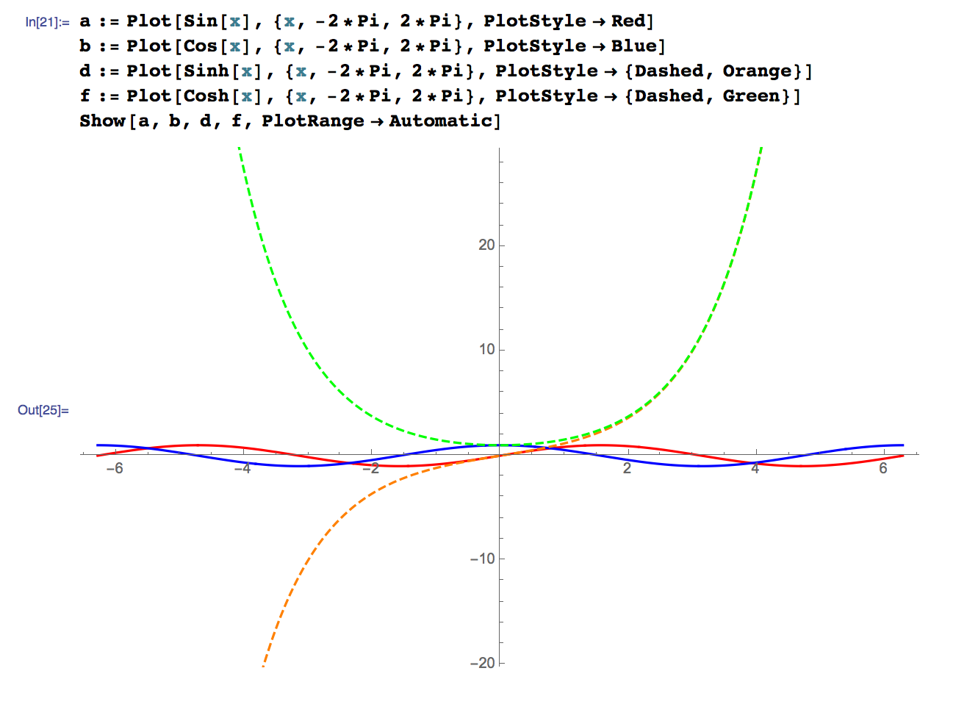
The Potential Barrier
- Calculations
The hyperbolic functions:

Slide 9
The Potential Barrier
- Calculations
The transmission coefficient:
Now when I multiply these two expressions together the terms involving the complex exponentials multiply to one.

Slide 10
The Potential Barrier
- Calculations
The transmission coefficient:
Now when I multiply these two expressions together the terms involving the complex exponentials multiply to one.

Slide 11
The Potential Barrier
- Calculations
The transmission coefficient:
And “lastly” from a table of mathematical formulas:
So that

Slide 12
The Potential Barrier
- Calculations
Let’s write the transmission coefficient in terms of the energies:
Start with the expression involving the k’s:
and

Slide 13
The Potential Barrier
- Calculations
The definitions of k and k’:
So that:

Slide 14
The Potential Barrier
- Calculations
Putting everything together we get the transmission coefficient:
And of course:

