Slide 1
MRI in Neurology How Physics Makes My life Easier
Richard Simmons, M.D.
Child Neurologist
Schenectady Neurological Consultants

Slide 2
Today’s Talk
Not about physics
Why MRI in Neurology
About MRI
Neuroanatomy Lesson
Examples of normal brain
Utility of different sequences
How MRI helps make diagnoses (the fun part)

Slide 3
MRI
In 1977, this technology was harnessed to produce the first human MRI scan
Commercial scanning began in the early 1980’s
MRI is now performed thousands of times daily across the world
Neurology is one of the top specialties using MRI

Slide 4
Why MRI in Neurology?
Ultrasound difficult with a thick skull
CT limited by skull thickness
The brain is composed of numerous structures of varying water/lipid/protein content
Vibrant, detailed pictures
NO RADIATION!

Slide 5
The Brain
Complex structure not easily visualized with surgical exploration
Deep structures, brainstem, cranial nerves
Subtle structures not easily visualized with the naked eye
Damage by exploration not easily repaired

Slide 6
Utility of MRI in Neurology
Multiple sequences allow for views of:
Anatomy
Pathology
Blood flow
Arterial
Venous

Slide 7
MRI Basics
Hydrogen Protons

Slide 8
In Magnetic Field

Slide 9
RF Pulse

Slide 10
Relaxation Time (T1)

Slide 11
Echo Sequences
Can use 180º RF pulse
Perform repeatedly
Measure time to 63% decay (T2 time)

Slide 12
So What?
Used to measure hydrogen concentration
Water in different environments processes differently
Data collected turned into grayscale image

Slide 13
NORMAL BRAIN

Slide 14
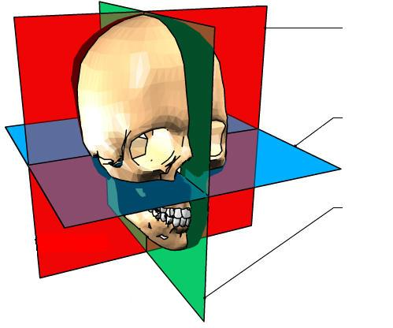
Coronal
Axial
Sagittal

Slide 15
Crash Course in Neuroanatomy

Slide 16
Neuroanatomy
Gray Matter (Neurons)
White Matter (Axons with myelin)
Cerebrospinal Fluid (CSF)

Slide 17
Neuroanatomy

Slide 18
Neuroanatomy

Slide 19
T1 – “Anatomy”
Presents the brain “as is”
Gray matter is gray
White matter is white
CSF is black

Slide 20
T1 Normal Brain

Slide 21
T2- “Pathology”
Presents the brain “inverted”
Gray matter is white
White matter is gray
CSF is bright white
Emphasizes water-containing areas with greater clarity than T1
Pathologic lesions frequently have increased water content (edema)

Slide 22
T2 Normal Brain

Slide 23
FLAIR
Fluid Attenuated Inversion Recovery
T2 sequence with CSF signal dropped
Allows better visualization of periventricular pathology
The sequence of choice for Multiple Sclerosis

Slide 24
FLAIR Normal Brain

Slide 25
DWI
Diffusion-Weighted Imaging
Evaluates diffusion of water molecules
Gold standard for evaluating areas of restricted diffusion (stroke)
Very little clinical use otherwise

Slide 26
DWI Normal Brain

Slide 27
Contrast
Gadolinium (Gd)
Rare-earth metal
Paramagnetic
Ideal for visualizing breakdown of the blood-brain barrier

Slide 28
Clinical Cases

Slide 29
Case 1: Weakness
6 year-old girl
Mild cognitive delay
Gross motor delays since birth
Now with primarily right-sided “clumsiness”

Slide 30
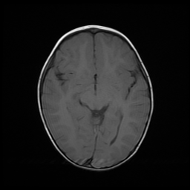
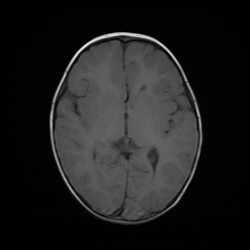
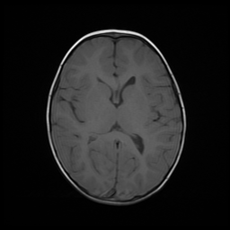
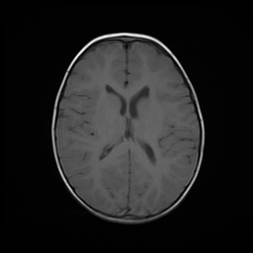
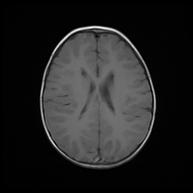

Slide 31
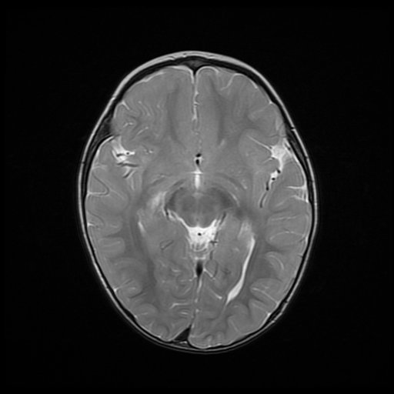
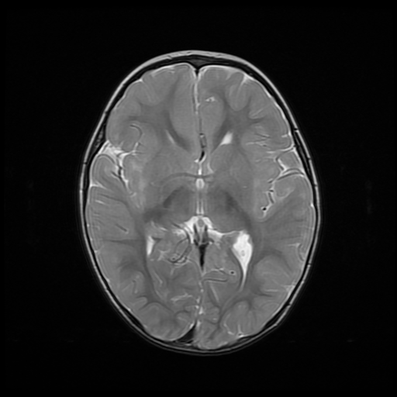
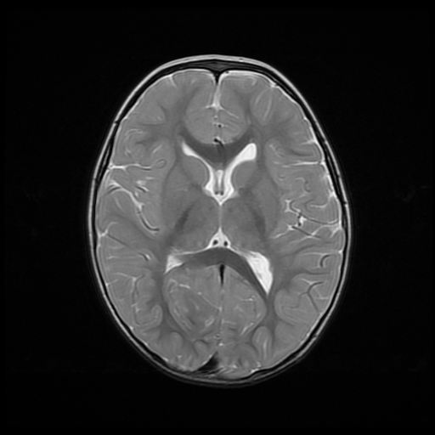
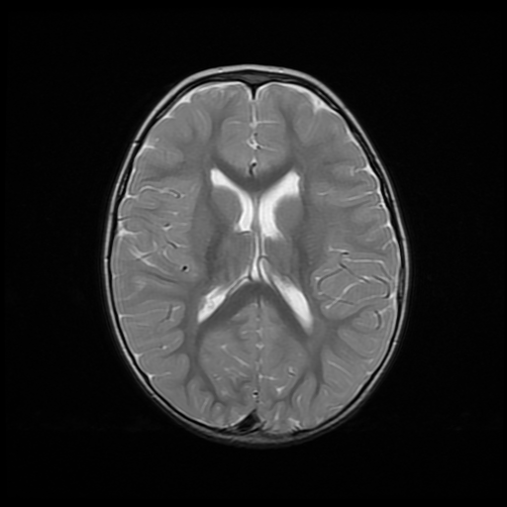
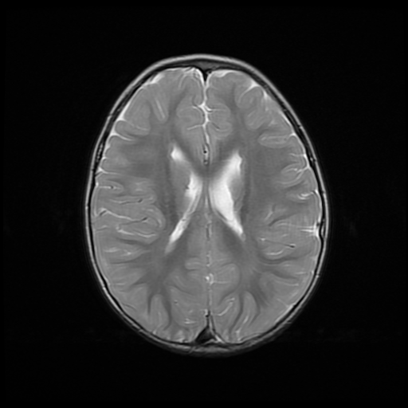
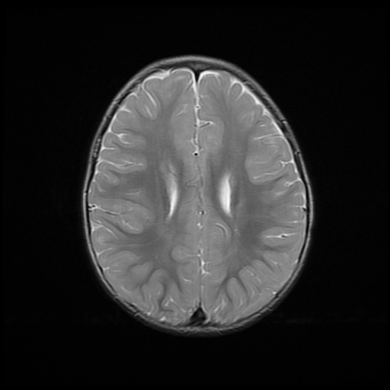

Slide 32
Case 2: Progressive Weakness
27 year old man
Intermittent loss of strength/sensation that nearly recovers each time
Over time has had progressive weakness of all extremities
Mild cognitive decline

Slide 33
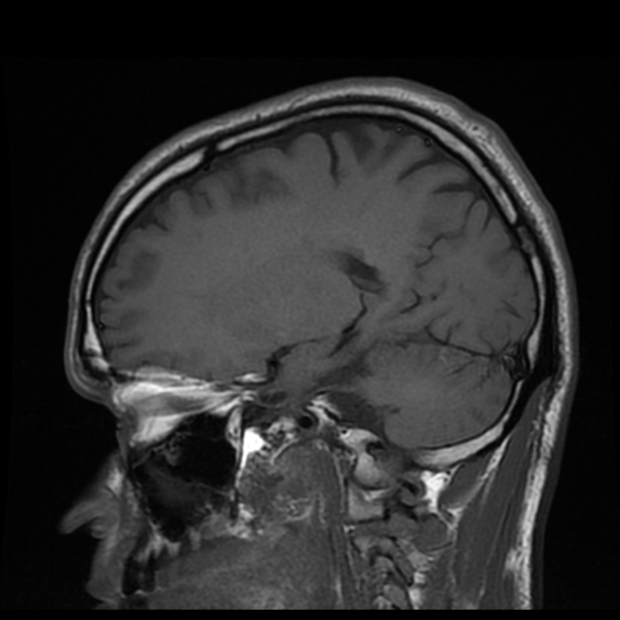
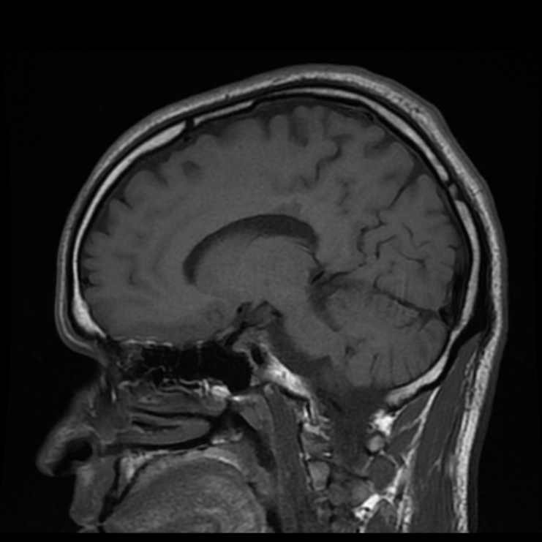
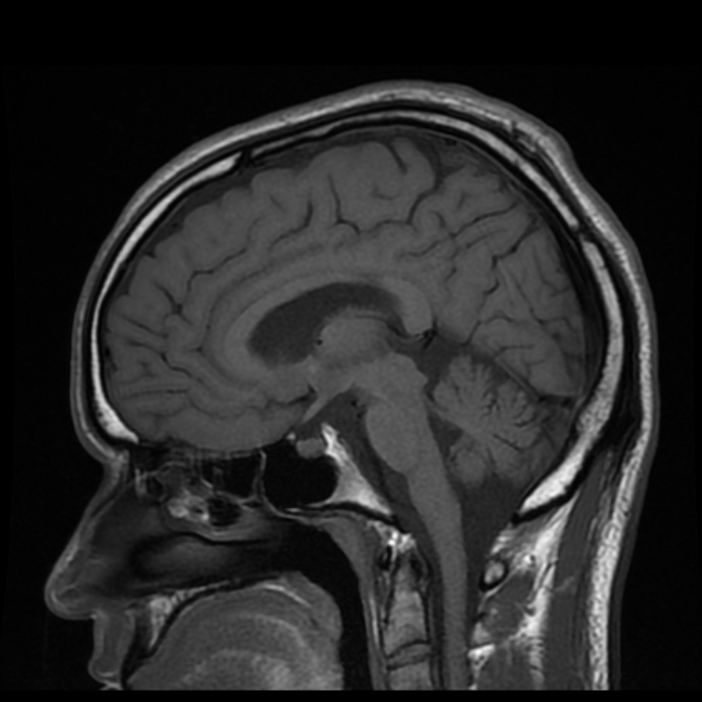
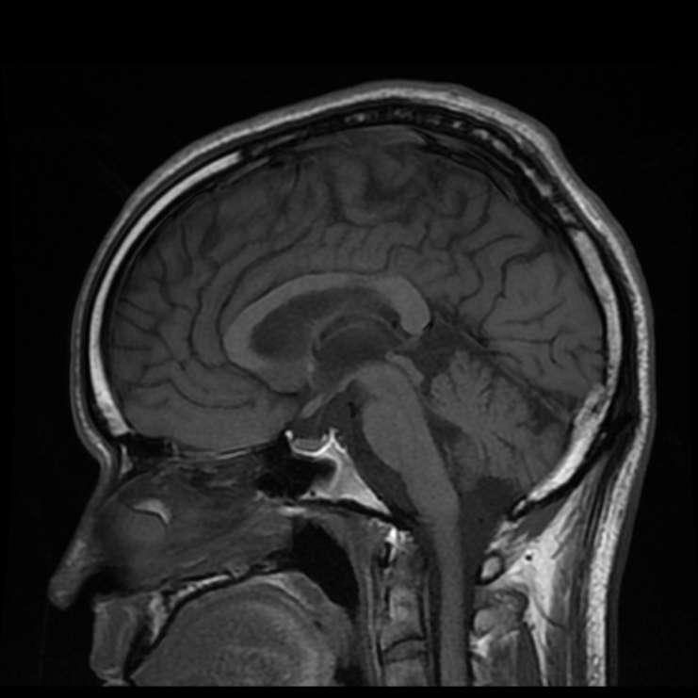
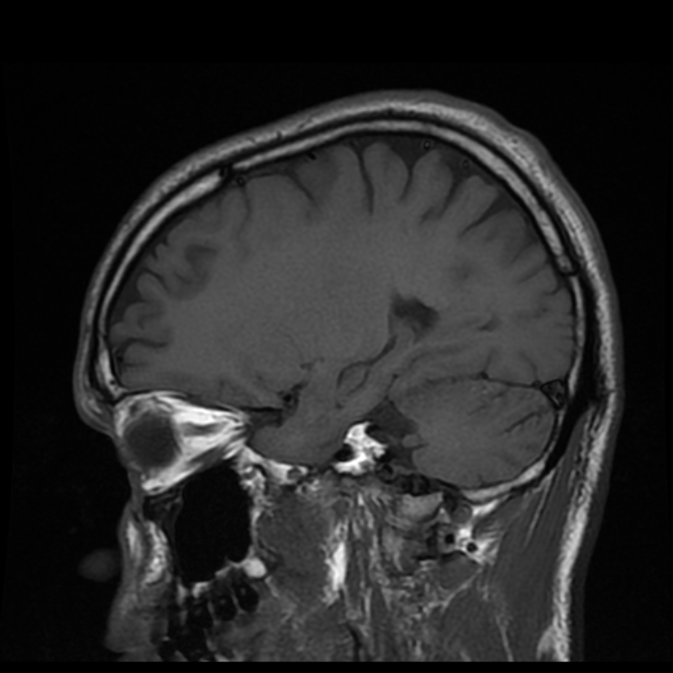

Slide 34
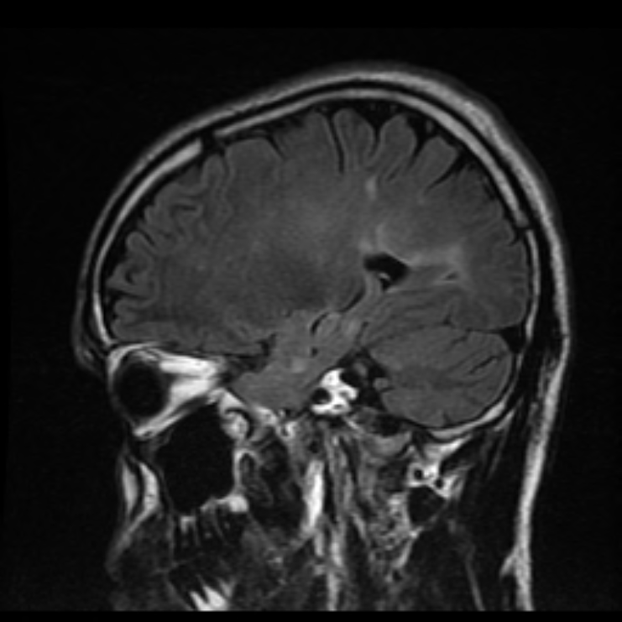
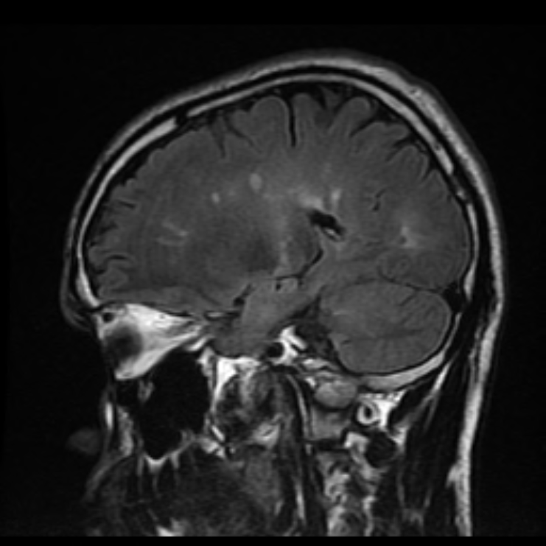
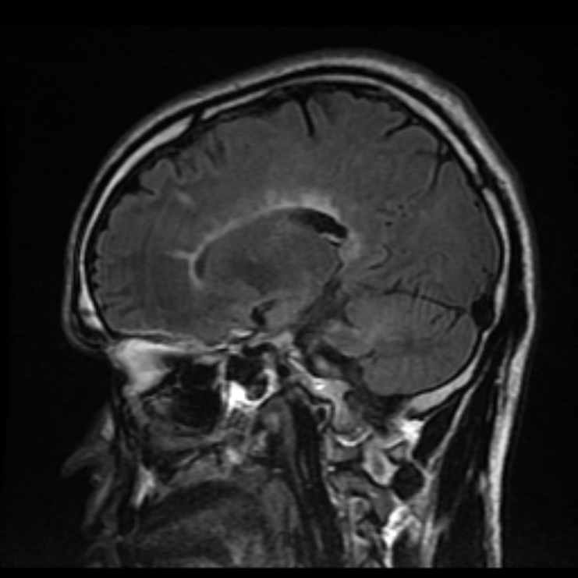
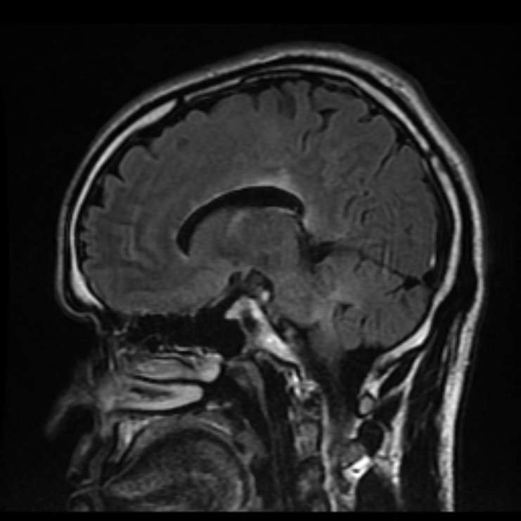
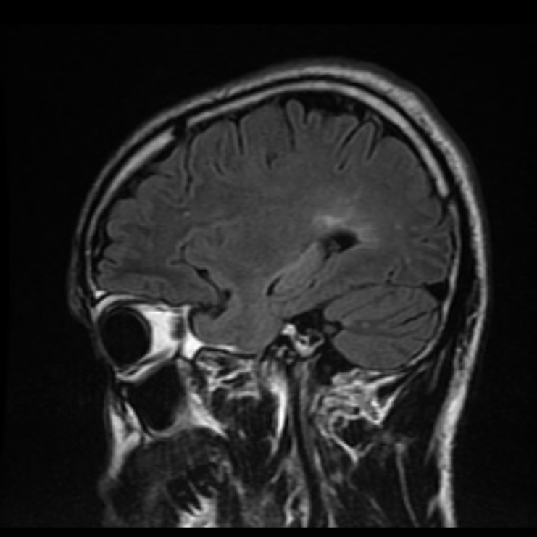

Slide 35
Case 3: Fall with Headache
5 year-old boy
Fell 5 feet from deck hitting head
CT in the ER was abnormal
Child was physically OK without neurological deficit
MRI to confirm CT findings

Slide 36
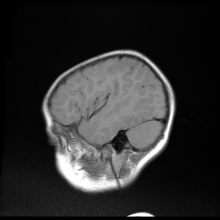
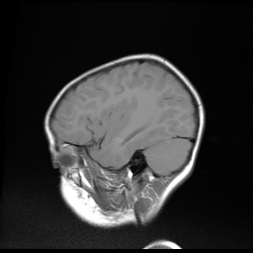
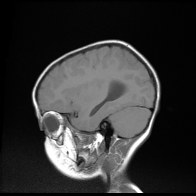
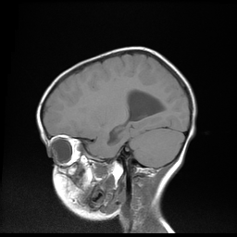
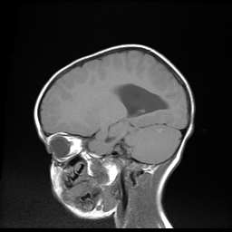
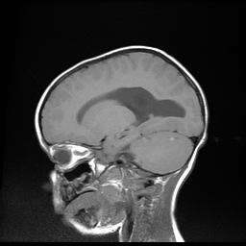
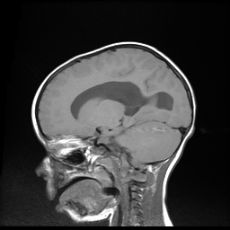
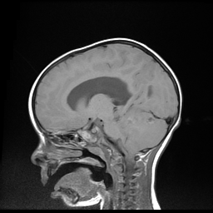
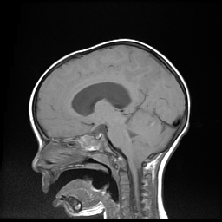

Slide 37
Case 4: Partial Seizure
17 year-old male
Had shaking of right arm for 3 minutes
Mild cognitive disability (IQ 85)
Mild weakness of right side face, arm, and leg
Mild asymmetry of limbs (circumference of right calf less than left calf)

Slide 38
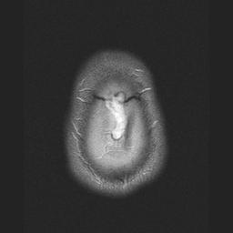
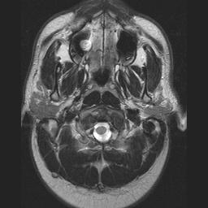
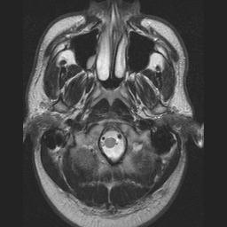
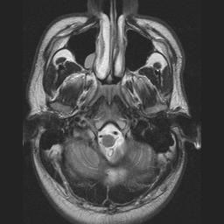
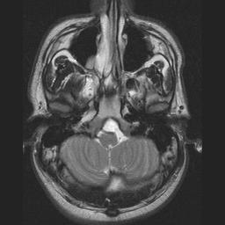
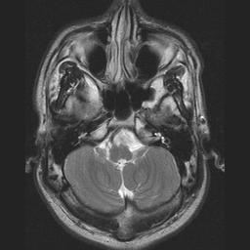
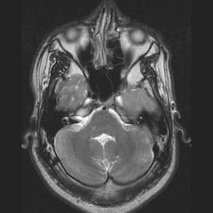
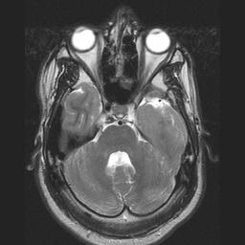
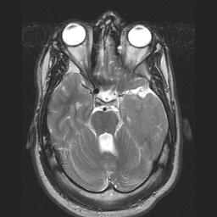
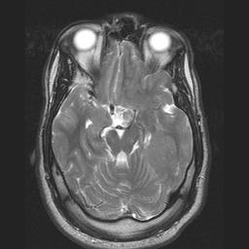
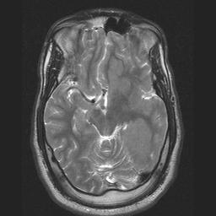
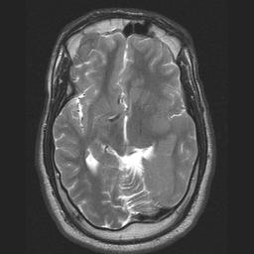
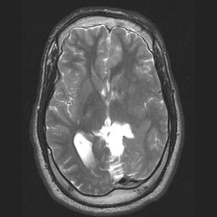
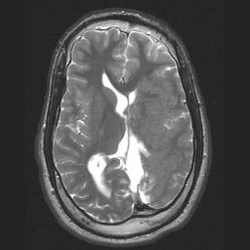
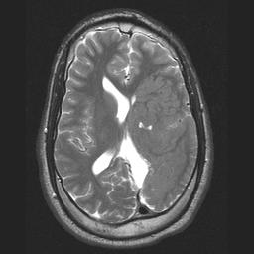
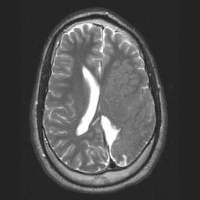
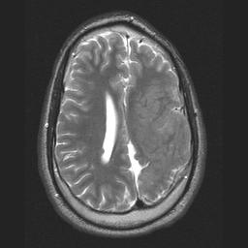
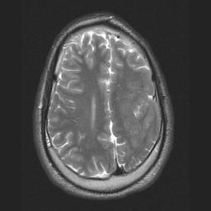
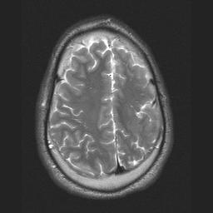

Slide 39
Case 5: New Headaches
11 year-old girl
1 month of daily headaches in the right frontal region
Moderate headaches that never really go away
Some episodes of staring off on a daily basis
EEG showed seizure activity in right frontal region

Slide 40
FLAIR Image
T1 Image after Gd

Slide 41
Case 6: Right-sided weakness
72 year-old man
Smoker and frequent alcohol use
High blood pressure
Sudden onset right-sided weakness and difficulty speaking

Slide 42
DWI
FLAIR

Slide 43
The Future
Diffusion Tensor Imaging
Water diffuses faster down axons than across axons
Can calculate this speed with DWI
Then create 3D images with directionality to show tracts

Slide 44
Questions?

