Slide 1
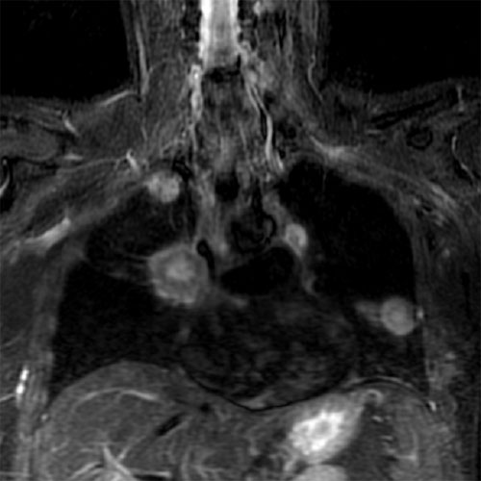
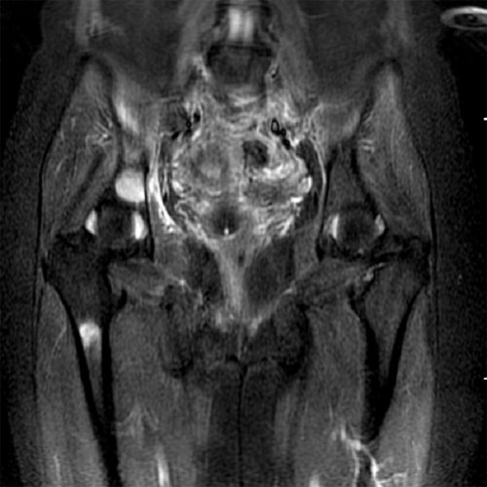
Magnetic Resonance Imaging
http://www.gehealthcare.com/euen/oncology/images/breast-health/onc_breast_pulmo_500.jpg
http://www.gehealthcare.com/euen/oncology/images/breast-health/onc_breast_bonemetasta_500.jpg
http://www.gehealthcare.com/euen/oncology/images/breast-health/onc_breast_wholemri.jpg
Background Image: http://www.ruf.rice.edu/~pomeran/images/brainmri.jpg

Slide 2
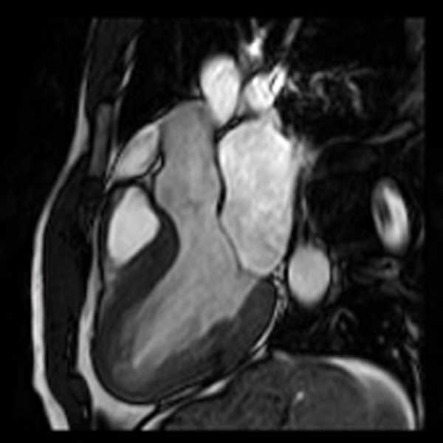
Magnetic Resonance Imaging
- Outline
Magnetism and precession of magnetic moments
Nuclear magnetic fields and nuclear magnetic moments
Spin orientation and spin state transitions & Larmor frequency
RF pulses & NMR signal
T1 & T2 relaxation
Spin echo formation
Contrast mechanisms
MRI scanners and imaging
http://dynamicheartphantom.com/cardiac.jpg

Slide 3
Magnetic Resonance Imaging
- Outline
NMRI or Nuclear Magnetic Resonance Imaging is composed of three main ideas
1. Magnetic moments of unpaired protons or neutrons and their interaction
with an applied magnetic field. → Nuclear Magnetic
2. A resonance is created in system (by an external RF source) and this resonance is what we will try to detect by Faraday’s law. → Resonance
3. We will use this information on the energy of the photons emitted to mathematically reconstruct an image. → Imaging

Slide 4
Magnetic Resonance Imaging
- Outline
Contributing factors to MRI imaging
Quantum properties of nuclear spins – produces a separation of magnetic moments into high and low energy states.
Radio frequency (RF) excitation properties – produce an emission of radiation at a particular frequency that will ultimately be used to image a particular
body feature.
Tissue relaxation properties and nuclear environment determines the RF signal that is emitted.
Changing magnetic field strength and gradients to probe the body.
Timing of gradients, RF pulses, and signal detection to get a complete data set that can be manipulated to view the body.

Slide 5
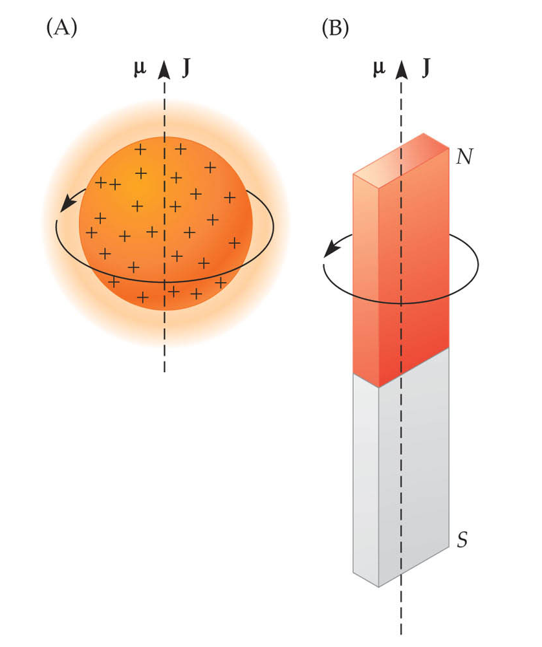
Magnetic Resonance Imaging
- MRI Basics
What kinds of nuclei can be used for NMR?
Nucleus needs to have 2 properties:
Spin
Charge
Nuclei are made of protons and neutrons
Both have spin ½
Protons have charge
Pairs of spins tend to cancel, so only atoms with an odd number of protons or neutrons have spin
Good nuclear choices for magnetic resonance are ¹H₁, ¹³C₆, ¹⁹F₉, ²³Na₁₁, ³¹P₁₅
An Introduction to MRI Physics and Analysis ,Michael Jay Schillaci, PhD

Slide 6
Magnetic Resonance Imaging
- MRI Basics
- Hydrogen atoms are best for MRI
Biological tissues are predominantly ¹²C₆, ¹⁶O₈, ¹H₁, and ¹⁴N₇
Hydrogen atom is the only major species that is sensitive to magnetic resonance.
Hydrogen is the most abundant atom in the body.
The majority of hydrogen is in water (H₂O).
Essentially all MRI is hydrogen (proton) imaging.
For most atoms, the net nuclear spin is zero.

Slide 7
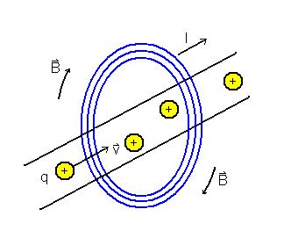
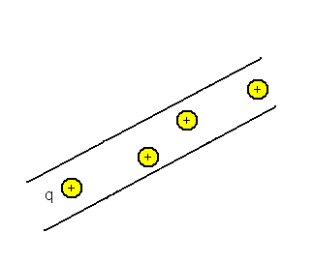
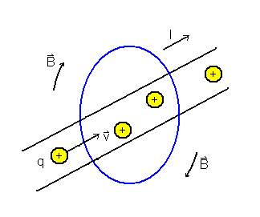
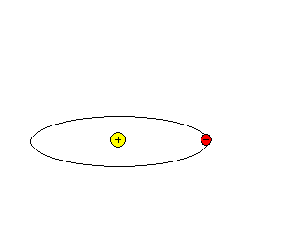
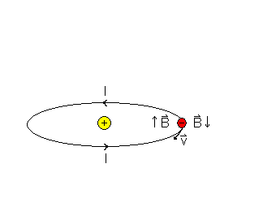
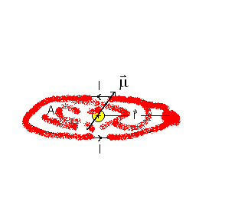
Magnetic Resonance Imaging
- MRI Basics
- Origins of Magnetism
Macroscopic View
- Current in wire
- Field is “around” wire
Depends on current
Depends on distance
Microscopic View
- Moment of an atom
- Field is “about” nucleus
Depends on material

Slide 8
Magnetic Resonance Imaging
- MRI Basics
- Magnetic Precession
The proton’s motion in the nucleus defines a small current loop and thus defines a magnetic moment.
Since the proton has a mass and it is in a small orbit, it also possesses an orbital angular momentum.
The total angular momentum is the vector sum of the orbital and spin angular momenta.
Spin is an intrinsic property of all atomic particles, much like mass.
Particles can either have their spin vector up (say for example, a counterclockwise
rotation) or down (a clockwise rotation.)
Placing the proton in an external magnetic field causes interactions between the angular momentum and magnetic moment vectors.

Slide 9
Magnetic Resonance Imaging
- MRI Basics
- Magnetic Precession
μ_{z}
The electric charge
of the proton creates a small current loop since the proton is constantly in motion and this generates a magnetic moment μ = current times the area of the loop.
The proton also has mass which generates an angular momentum
L when it is spinning.
L
, μ
An Introduction to MRI Physics and Analysis Michael Jay Schillaci, PhD
The proton “magnet” differs from the magnetic bar in that it
also possesses angular momentum caused by spinning.
In the presence of a static external magnetic field the protons try to align (or anti-align) with the applied field.

Slide 10
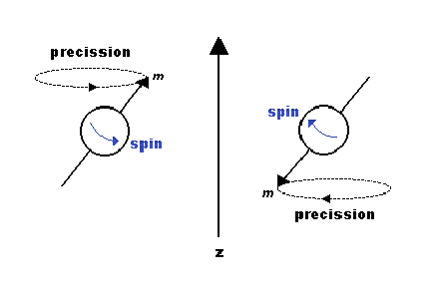
Magnetic Resonance Imaging
- MRI Basics
- Spin States
We have the magnetic moment, μ and the angular momentum, L, which are vectors, lying along the spin axis.
γ is called the gyromagnetic ratio and is a constant for a given nucleus.
There are two states for spin: Spin up & Spin down.
Protons & neutrons are filled in nuclear orbitals by spin to minimize the nuclear energy.

Slide 11
Magnetic Resonance Imaging
- MRI Basics
- A single isolated proton precesses in an external magnetic field
The proton precesses about an axis (on which
it spins) due to the external magnetic field, in a similar way that a spinning top precesses about a vertical axis due to the force of gravity.
If the spin were aligned exactly with the field then the top or the proton would not precess.
MRI is mainly concerned with the action of hydrogen, in
fat and in water, which absorb and re-emit radiofrequency (RF) energy at a specific frequency.
The charge causing the hydrogen (proton) to precess is like
a circulating current making each individual proton act like a bar magnet or dipole.
As there are normally equal numbers of proton spins pointing in every direction the protons spins cancel each other out and the net magnetic effect is zero.

Slide 12
Magnetic Resonance Imaging
- MRI Basics
- Separation of spins in an external field
A moving (spinning) charged particle generates its own little magnetic field.
- Such particles will tend to “line up” with external magnetic field lines
(think of iron filings around a magnet).
- This produces magnetic dipoles (little bar magnets) and two different energy states.
Spinning particles with mass have angular momentum.
- Angular momentum resists attempts to change the spin orientation
(think of a gyroscope)
www.simplyphysics.com
www.simplyphysics.com

Slide 13
Magnetic Resonance Imaging
- MRI Basics
- Magnetic precession of the proton
MRI uses a combination of electric and magnetic fields to manipulate the proton.
MR measures the net magnetization of atomic nuclei in the presence of magnetic fields.
The magnetization can be manipulated by changing the magnetic field environment.
Static magnetic fields don’t change (< 0.1 ppm / hr) and the main field (B_{o}) is static and (nearly) homogeneous.
Radio frequency (RF) fields are electromagnetic fields that oscillate at radio frequencies or tens of millions of cycles per second.
You could have magnetic field gradients, or fields that change gradually over space and can change quickly over time (thousands of times per second).

Slide 14
Magnetic Resonance Imaging
- MRI Basics
- RF Photon Energy, Absorption, Emission and Spin
Static Field “splits” states
- Zeeman effect splits high/low energy states
Another field, the RF Field (or oscillating field) perturbs and “rotates” the magnetic moments of the protons away from the external field.
The proton precesses about the magnetic field at a well defined frequency called the Larmor frequency and will emit radiation at a well defined energy (depending on the frequency.)
Spin down
B₀ = 1.0T
B₀
μ
Spin up
B₀
μ
An Introduction to MRI Physics and Analysis Michael Jay Schillaci, PhD
* For comparison: In the Earth’s magnetic field ( 0.00005 T ), hydrogen precesses at ~2100 Hz.
B₀
μ = γ J
An Introduction to MRI Physics and Analysis Michael Jay Schillaci, PhD

Slide 15
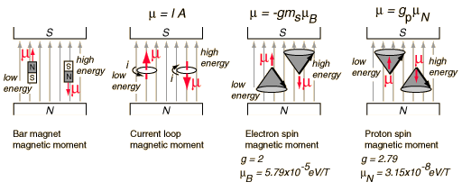
Magnetic Resonance Imaging
- MRI Basics
- Static magnetic field
http://hyperphysics.phy-astr.gsu.edu/hbase/nuclear/nmr.html#c1
In the presence of a static field the magnetic moment tries to align (or anti-align) with the applied field.
If the magnetic moment is aligned exactly with the applied field then the proton does not precess.
If the magnetic moment is not aligned exactly with the field then the proton precesses about the static field.
There are high and low energy states that are separated out by the static field.

Slide 16
Magnetic Resonance Imaging
- MRI Basics
- Connections
The precession of the proton spin in the magnetic field is the interaction which is used in proton NMR.
As a practical technique, a sample containing protons (hydrogen nuclei) is placed in a strong magnetic field to produce partial polarization of the protons.
A strong RF field is also imposed on the sample to excite some of the nuclear spins into their higher energy state.
When this strong RF signal is switched off, the spins tend to return to their lower state, producing a small amount of radiation at the Larmor frequency associated with that field.
The emission of radiation is associated with the "spin relaxation" of the protons from their excited state.
It induces a radio frequency signal in a detector coil which is amplified to display the NMR signal by Faraday’s Law.

Slide 17
Magnetic Resonance Imaging
- MRI Basics
- RF Photon Energy, Absorption, Emission and Spin
Radiation is absorbed
- Energy increases
Radiation is emitted
- Energy decreases
Higher
Lower
An Introduction to MRI Physics and Analysis Michael Jay Schillaci, PhD

Slide 18
Magnetic Resonance Imaging
- MRI Basics
- RF Photon Energy, Absorption, Emission and Spin
Β₀
μ
Energy Difference
Frequency
Equate differences
Β₀
μ
E = E_{up} – E_{down}
= μ_{z} B_{o} - (-μ_{z} B_{o} )
= 2 μ_{z} B_{o}
Larmor Equation
Only certain frequencies are absorbed or emitted by the proton.
These specific frequencies are called resonant frequencies.
E = hf₀ = 2 μ_{z} B_{o}

Slide 19
Magnetic Resonance Imaging
- MRI Basics
- RF Photon Energy, Absorption, Emission and Spin
Quantum Mechanics governs state transitions
Energy of transition
Planck’s constant
Energy values
X-Ray, CT
Excites Electrons
MRI
Excites Protons

Slide 20
MRI Scanner
An Introduction to MRI Physics and Analysis Michael Jay Schillaci, PhD

Slide 21
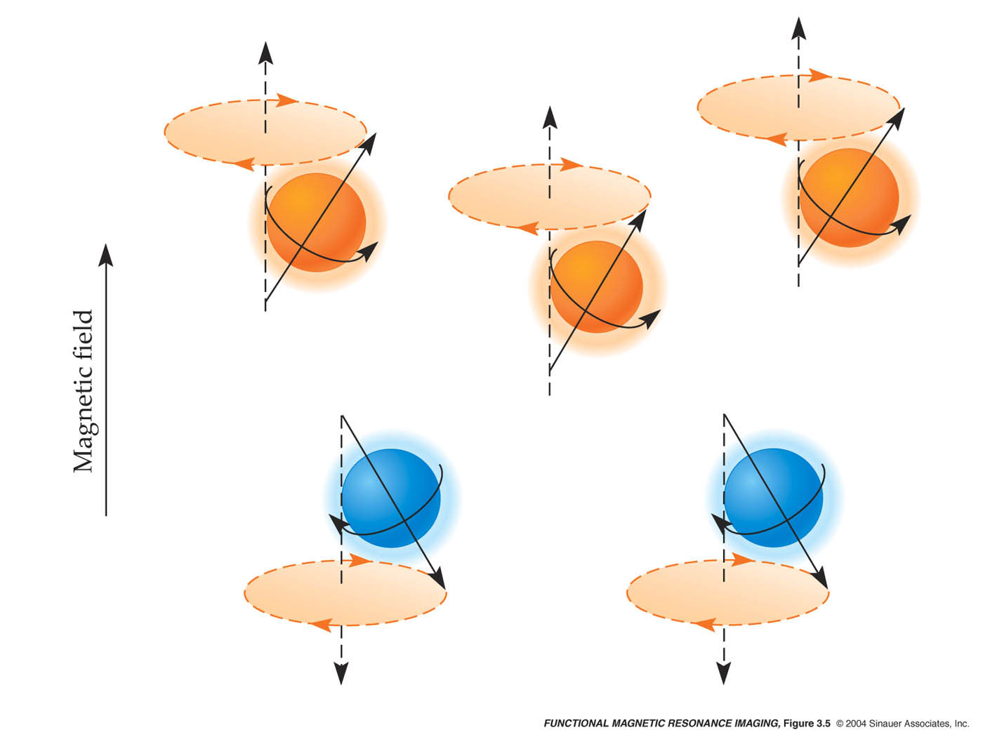
Producing a MRI Signal
Protons in no magnetic field
In a magnetic field, protons can take either high- or low-energy states
An Introduction to MRI Physics and Analysis Michael Jay Schillaci, PhD
In the absence of a strong magnetic field, the spins are oriented randomly.
Thus, there is no net magnetization (M).
An Introduction to MRI Physics and Analysis Michael Jay Schillaci, PhD
There is now a net magnetization (M).
Protons all precessing out of phase.

Slide 22
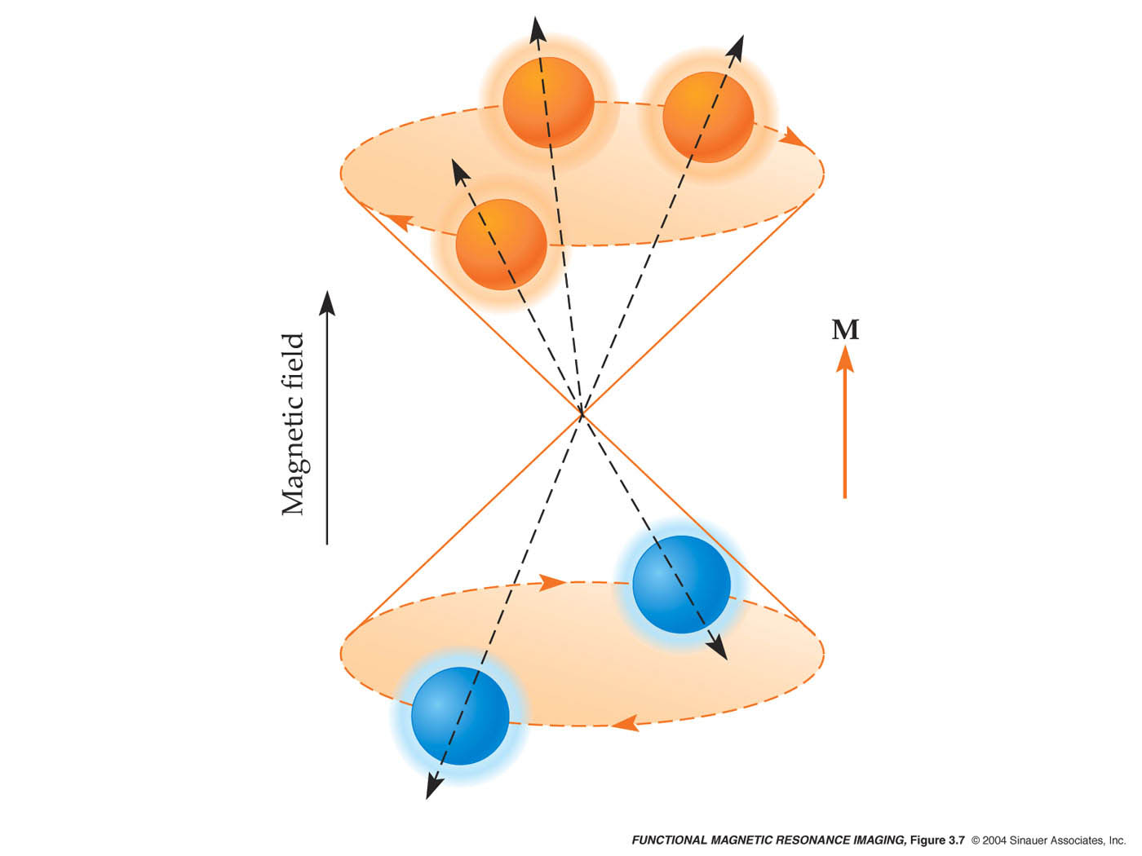
Producing a MRI Signal
An Introduction to MRI Physics and Analysis Michael Jay Schillaci, PhD
The difference between the numbers of protons in the high-energy and low-energy states results in a net magnetization (M) and gives rise to the Larmor Equation.
The net magnetization points along the static magnetic field.

Slide 23
Producing a MRI Signal
An oscillating RF signal is applied to the sample and nuclei can absorb energy of the
correct frequency. This excites the sample
This RF signal (which is small compared to the static field) is applied perpendicular to
the static magnetic field.
The net magnetic field creates a force on the magnetization and the magnetization vector begins to precess at the Larmor frequency.
MRI scanners usually use pulses of RF waves that can flip the dipole by 90⁰ or 180⁰.
When the RF field is off the protons relax back to their low energy states with an emission of RF energy and continue to precess at the resonant frequency about the static field.
The RF photons that can be detected and imaged (not trivial).

Slide 24
Producing a MRI Signal - Radiofrequency Coils
Defined by their function:
Transmit / receive coil (most common)
Transmit only coil (can only excite the system)
Receive only coil (can only receive MR signal)
Defined by geometry
Volume coil (low sensitivity but uniform coverage)
Surface coil (High sensitivity but limited coverage)
Phased-array coil (High sensitivity, near-uniform coverage)
Operate based on Faraday’s Law of Induction

Slide 25
Producing a MRI Signal
The strength of the RF signal produced by the protons (or any appropriate nuclei) is proportional to the number of protons (or nuclei) that are excited.
The applied pulse tips over the high energy states and causes an emission of a photon with at specific frequency that depends on the chemical environment of the proton.
RF field
The RF photons are detected by a field coil since there is a changing magnetic field through the coil.
These signals are used to form the MRI image.

Slide 26
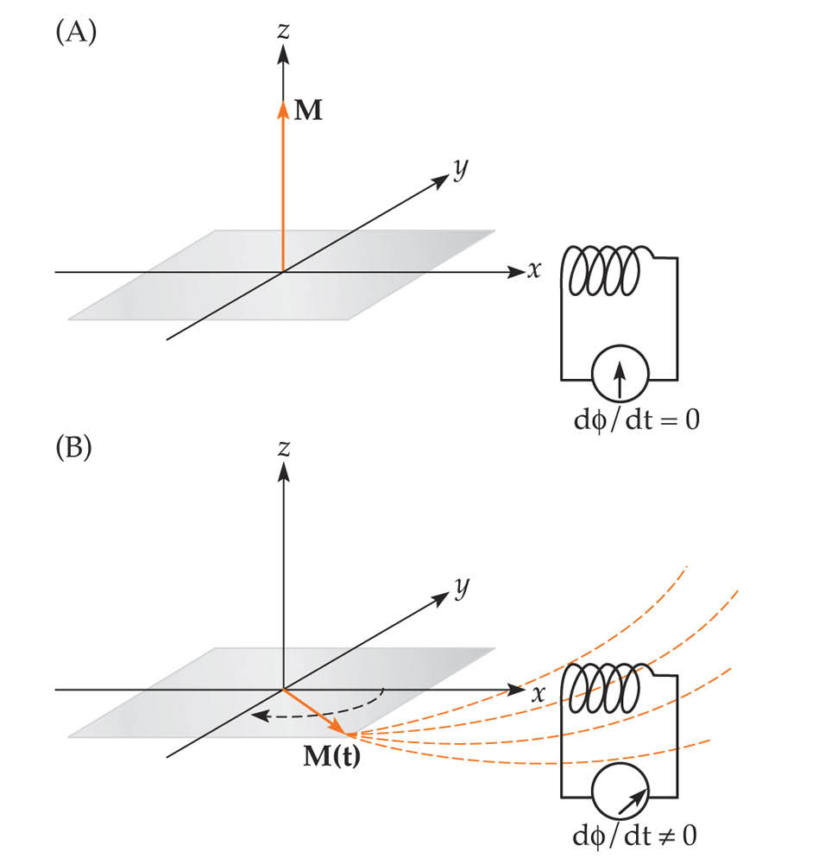
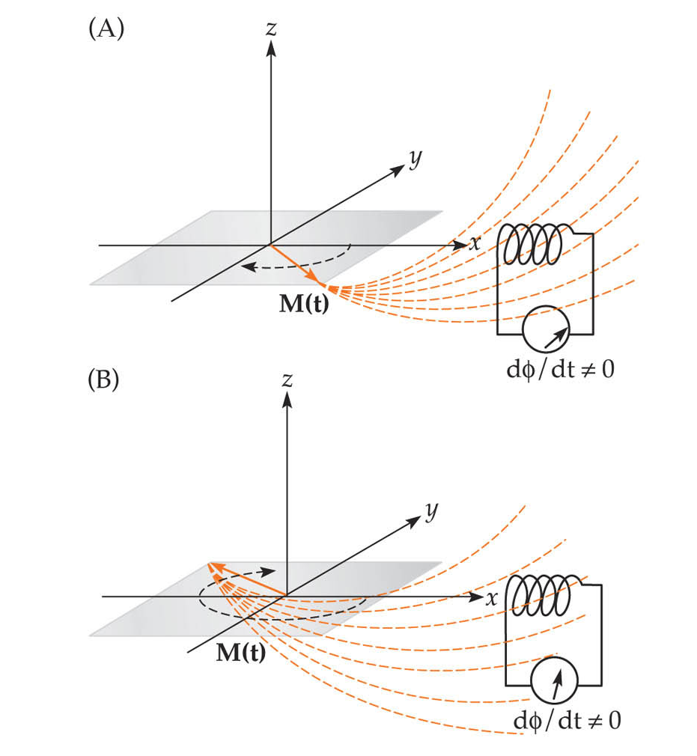
Origin of the MR Signal
Before Excitation
During Excitation (t_{o})
After Excitation
During Excitation (t₁)
An Introduction to MRI Physics and Analysis Michael Jay Schillaci, PhD
Excitation (or the absorption of a RF photon) tips the net magnetization (M) down into the transverse plane, where it can generate current in detector coils (i.e., via induction).
An Introduction to MRI Physics and Analysis Michael Jay Schillaci, PhD
The amount of current oscillates at the (Larmor) frequency of the net magnetization.
Notes:
fmri-fig-03-17-0.jpg

