Slide 1
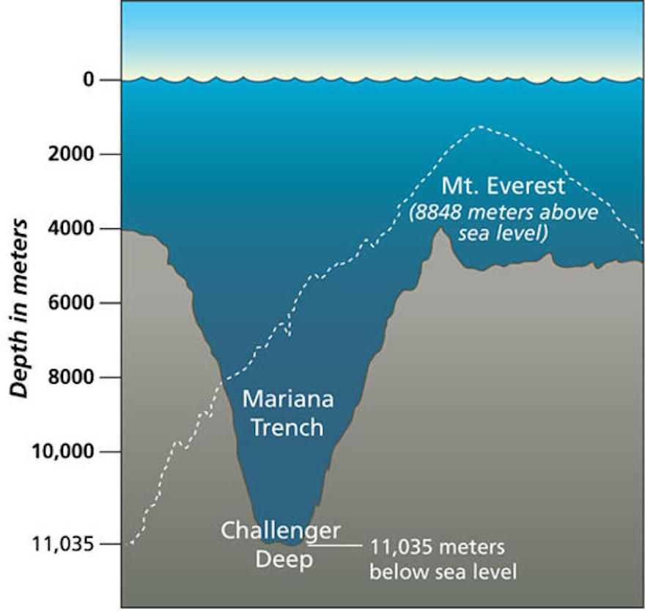
Fluids at Rest
Example 1:
The deepest point in the oceans of the world is called Challenger Deep and is in the pacific ocean ($ρ_{seawater}=1025\frac{kg}{m^{3}}$) at the southern most end of the Mariana trench. The depth of Challenger Deep is about $33,000ft \sim 11000m$.
What pressure would be recorded at this depth?
Example 2:
A person of mass $70kg$ stands at rest on a scale.
What does the scale read if we ignore the buoyant force on the person?
If a person can be modeled as a cylinder of height $2m$ and radius $0.2m$, what would the scale read? The density of air is $ρ_{air}=1.3\frac{kg}{m^{3}}$.
https://www.pinterest.com/pin/141793088246977612/

Slide 2
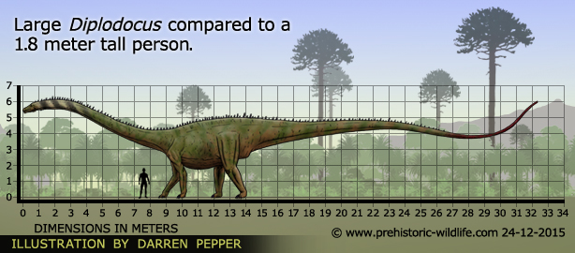
Fluids at Rest
Example 3
The dinosaur Diplodocus was enormous, with a long neck and tail and a mass that was large enough to test its leg strength. According to some scientists, Diplodocus waded in water, perhaps in water that was up to its head, so that it could use the water to help lighten the load on its legs. To check this idea, let’s take the density of Diplodocus to be $90\%$ of that of water ($ρ_{water}=1000\frac{kg}{m^{3}}$) and assume that the mass of Diplodocus was about $1.85×{10}^{4}kg (\sim 41,000lbs\sim 21tons)$.
If the dinosaur was submerged with $80\%$ of its body under water, what would be the dinosaurs apparent weight? That is, what fraction of the dinosaur's actual weight would be supported?
When it is $80\%$submerged its lungs would be about $4m$ below the surface of the water. At this depth, what would be the difference in pressure between the water and the dinosaur’s lungs?
If, for the dinosaur to breath, the maximum pressure difference needs to be $8000 \frac{N}{m^{2}}$ or less, could Diplodocus have breathed submerged in the water?
http://www.prehistoric-wildlife.com/species/d/diplodocus.html

Slide 3
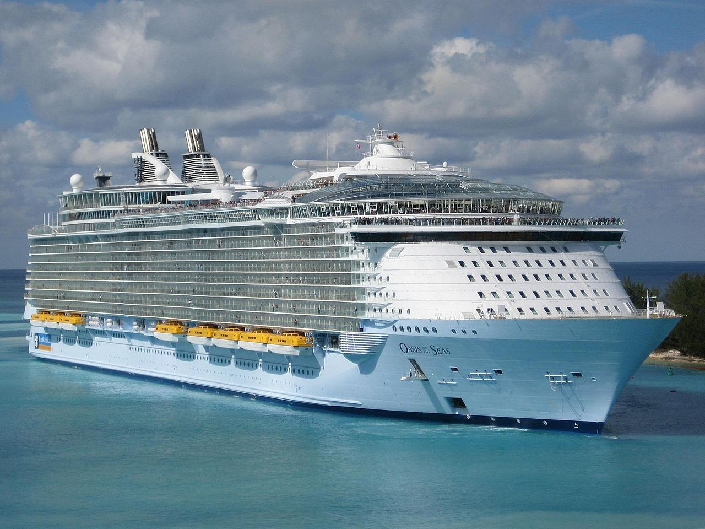
Fluids at Rest
Example 4
Royal Caribbean has some of the largest cruise ships in the world. Consider the Oasis class cruise ship the Oasis of the Seas docked at a port. The ship has a weight of $226838tons (\sim 2×{10}^{9}N)$, is $1184$ feet ($\sim 395m$) long, $208$ feet ($\sim 69m$) wide, $213$ feet ($\sim 71m$) tall and when empty has a maximum draft of $30feet \left(\sim 10m\right)$, where the draft is how deep the ship can comfortably sink into the water, or how much of the ship is below the water. This ship can accommodate $8461$ passengers ($6296$) and crew ($2165$).
Before any passengers and crew get on the ship, what is the draft of the ship?
Suppose that the ship scheduled to depart and that it is fully laden. How much deeper in the water will the ship sink if all passengers and crew get on the ship for a voyage?
https://en.wikipedia.org/wiki/Oasis_of_the_Seas#/media/File:Oasis_of_the_Seas.jpg
Oasis of the Seas information: https://www.tripsavvy.com/oasis-of-the-seas-royal-caribbean-992876

Slide 4
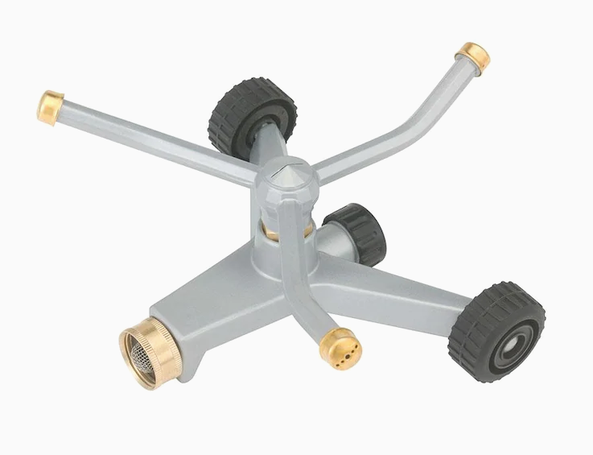
Fluids in Motion
Example 5:
A lawn sprinkler is being fed by a hose with a diameter of $0.019m (\sim \frac{3}{4}”)$. The flow rate for the water in the hose from a faucet at the house is $6.31×{10}^{−5}\frac{m^{3}}{s}$ and the water ultimately flows out of three cylindrical sprinkler heads each with a diameter of $0.0064m (\sim \frac{1}{4}”)$. In the figure, ignore the “gold” looking ends and assume the water exits through one circular opening at the end of each sprinkler head.
What is the speed of the water as it enters the sprinkler from the hose?
What is the speed of the water as it exits from one of the sprinkler heads?
The outflow from the sprinkler creates a torque about the center of the sprinkler and this distributes water to the lawn. If the water is turned on and the sprinkler spins at a final rate of $ω=61\frac{rev}{min}$after a time of $t=3s$, what is the radius of the sprinkler?
Sprinkler heads
Water in from faucet.
https://www.lowes.com/pd/Gilmour-Whirling-Heavy-Duty-692-sq-ft-Rotating-Sled-Lawn-Sprinkler/1000738722?cm_mmc=shp-_-c-_-prd-_-sol-_-google-_-lia-_--_-watering-_-1000738722-_-0&store_code=1740&placeholder=null&gclid=EAIaIQobChMIlL7M277F6QIVDNvACh1P5gIDEAQYBiABEgLUCvD_BwE&gclsrc=aw.ds

Slide 5
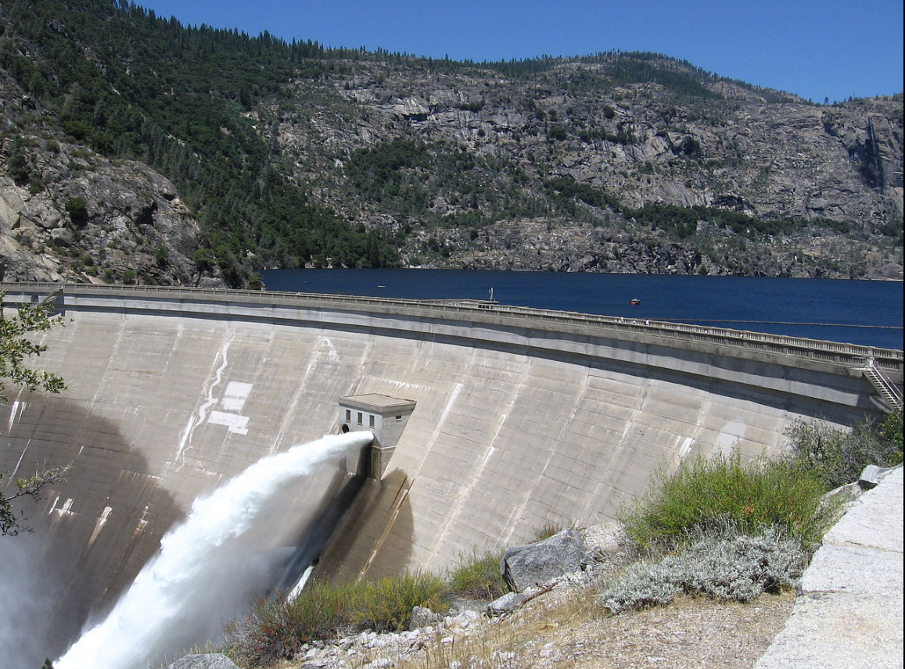
Fluids in Motion
Example 6:
Consider a dam, like the O’Shaughnessy Dam in California, shown on the right. The dam holds back a reservoir of water.
Let the reservoir have a cross-sectional area $A_{top}$ and someone opens a flood gate on the face of the dam at a depth $d$ below the surface of the water in the reservoir. The flood gate has an area $A_{fg}$defined by its radius $r_{fg}=1.7m (\sim 5ft)$.
What is the speed of the water flowing out of the floodgate on the side of the dam if $d=10m$?
https://en.wikipedia.org/wiki/O%27Shaughnessy_Dam_(California)

Slide 6
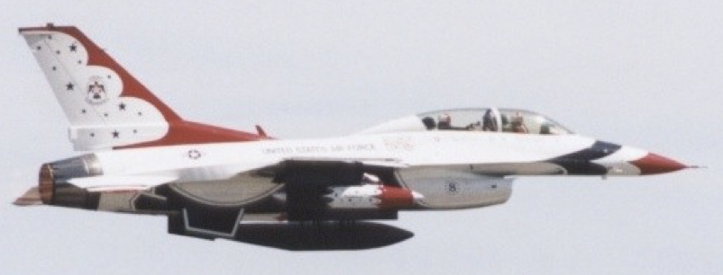
Fluids in Motion
Example 7:
Consider the airplane shown below. What is the aerodynamic lift produced on the wing if the wing has a surface area $A_{wing}=60m^{2}$ and the velocity of the airflow across the top and bottom of the wing are $340\frac{m}{s}$ and $290\frac{m}{s}$ respectively? The weight of the plane is $80kN$.

Slide 7
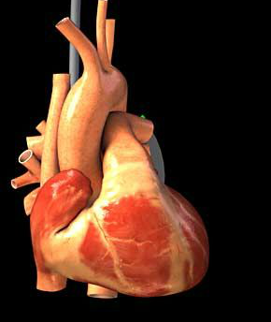
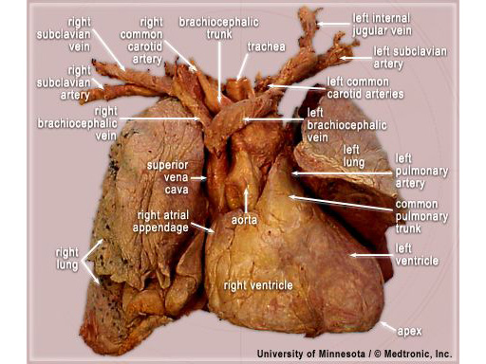
The Physics of the Body
- The Human Heart
The human heart is a dual suction/pressure pump that pulls in blood from the major systems of the body and pumps blood back out to those major systems through a closed loop.
A schematic on the left of the human heart and a cadaver dissection of the human heart and lungs on the right showing part of the circulatory system.
The atria of the heart provide suction to pull blood in from the systems of the body while the ventricles provide pumping to push the blood around to the systems of the body.
The function of the heart is to pump blood through the network of arteries and veins called the cardiovascular system.
Arteries carry oxygenated blood from the heart to the major systems of the body and veins carry oxygen poor blood back to the heart.

Slide 8
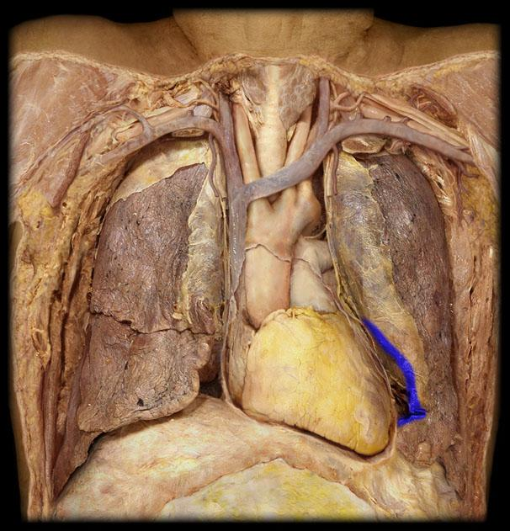
The Human Heart
Trachea
Brachiocephalic
veins
Carotid Arties
Anatomical view of a cadaver dissection of the thoracic (or chest) cavity.
This shows the major organs in the chest and upper abdomen of the human body.
SVC
Pulmonary Artery
Left Upper Lobe of the Lung
Right Upper Lobe of the Lung
Ascending Aorta & Aortic Arch
Middle Right Lobe of the Lung
Left Lower Lobe of the Lung
Right Lower Lobe of the Lung
Heart
Diaphragm

Slide 9
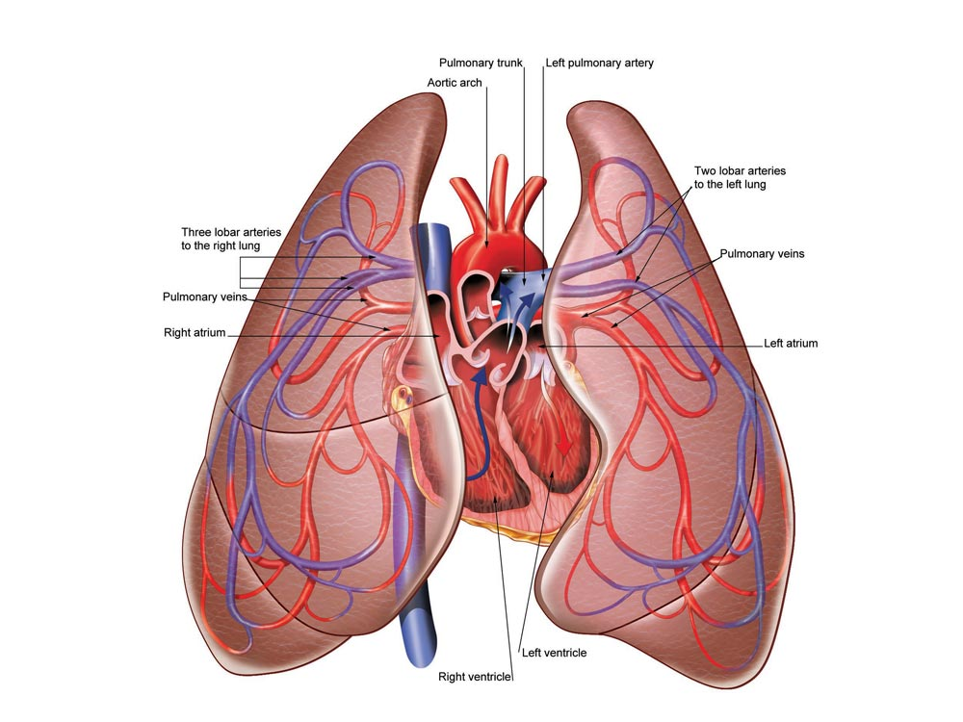
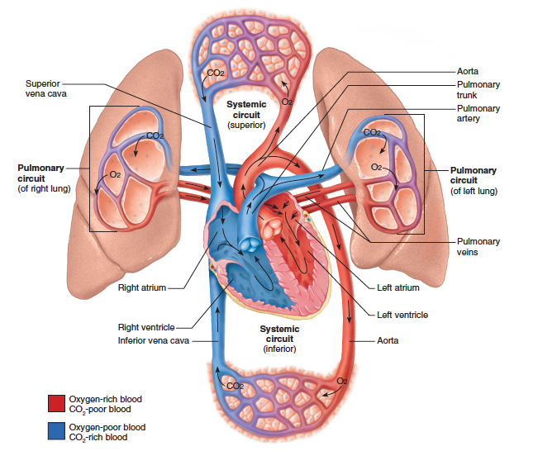
The Human Heart
Cartoon diagrams showing the major anatomical locations of the heart and lungs showing the relation to major arteries/veins.
http://www.stylepinner.com/human-anatomy-heart-and-lungs/aHVtYW4tYW5hdG9teS1oZWFydC1hbmQtbHVuZ3M/
https%3A%2F%2Fgrayson.instructure.com%2Fcourses%2F63%2Ffiles%2F745964%2Fdownload%3Fwrap%3D1&bvm
The heart and lungs form a closed loop system of which forms the basis for the circulatory system.

Slide 10
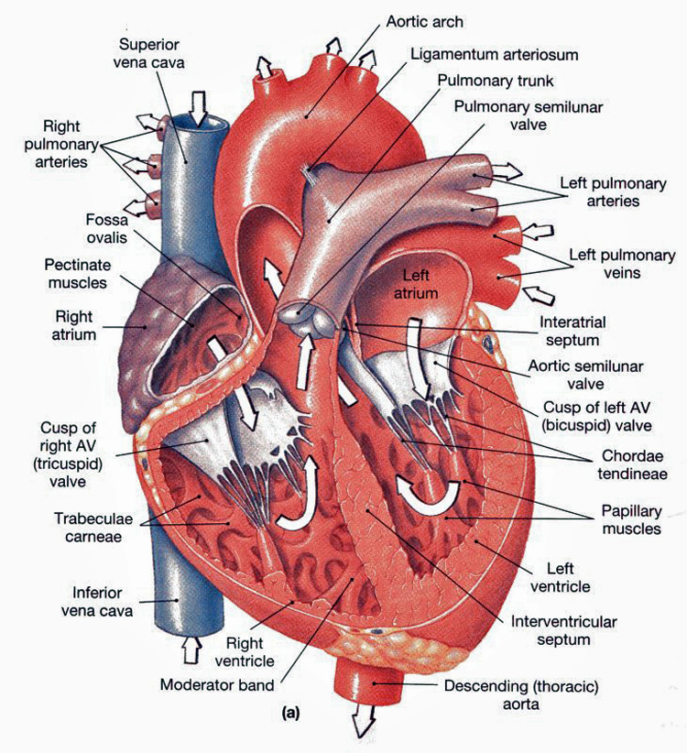
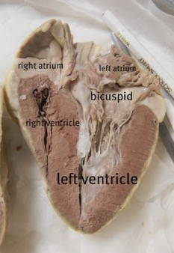
The Human Heart
Blood flows from the systems of the body into the right atrium where it is pushed into the right ventricle.
The blood that enters the right side of the heart from the superior (above) and inferior (below) vena cava is oxygen poor.
The blood is pumped from the right ventricle through the left and right pulmonary arteries to the lungs where carbon dioxide is exchanged for oxygen in the blood.
The oxygen rich blood is pulled into the left atria from the pulmonary veins and into the left ventricle.
The left ventricle pumps the blood out through the aorta which ascends and splits into the carotid arteries into the head, neck and face and descends into the femoral arteries in the legs.
The blood flows from the arteries to the veins by passing through capillary beds of the major organs.
Valves in between the atria and ventricles control the blood flow so that it flows in only one direction (no regurgitation from the ventricles back into the atria.)
http://anatomyandphysiologyi.com/heart-anatomy-chambers-vessels-valves/
https://www.biologycorner.com/anatomy/circulatory/heart/heart_dissection.html

Slide 11
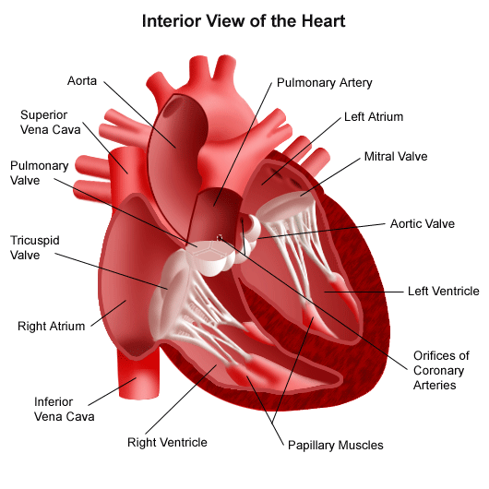
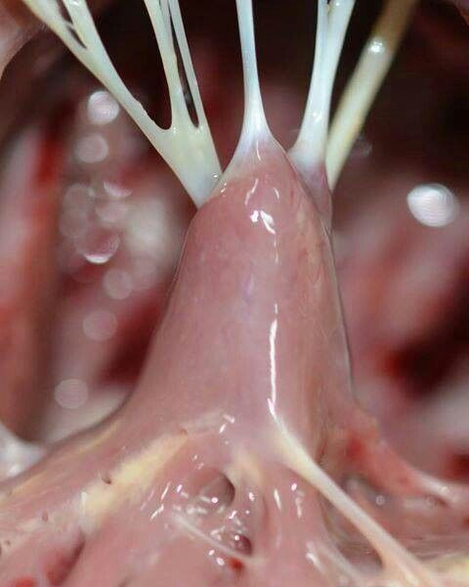
The Human Heart
The Chordae Tendineae (or heartstrings) are strong, fibrous strings attached to the leaflets (or cusps) of the heart on the ventricular side; i.e., the lower chamber.
These strings originate from small mounds of muscle tissue, the papillary muscles, which project inward from the walls of the ventricle.
The heartstrings anchor the valves and aid in their opening/closing.
http://vector.childrenshospital.org/2012/10/new-valves-for-babies-that-can-grow-with-them/

Slide 12
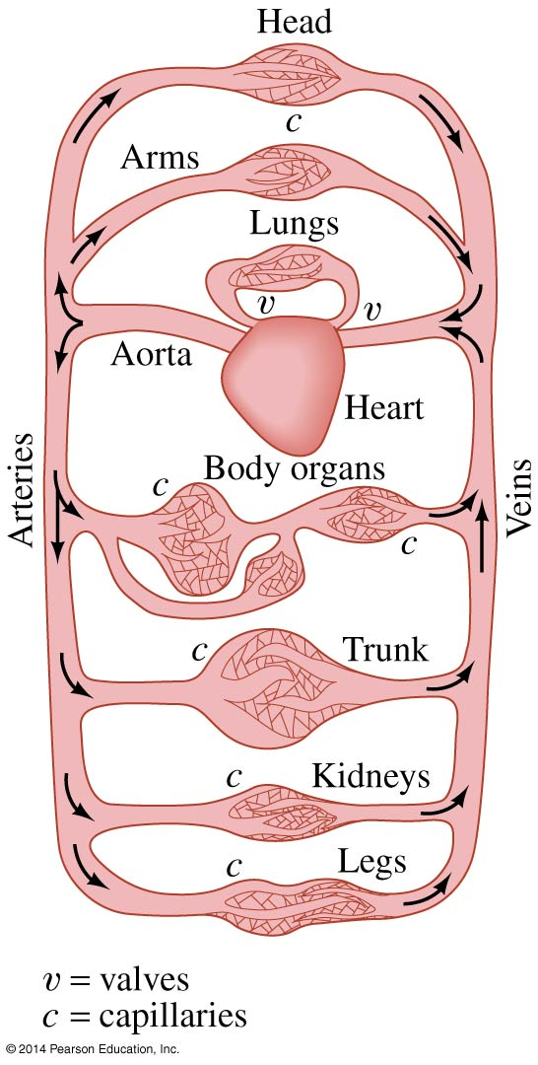
The Human Heart
Example 8:
Suppose that the aorta has an average radius of about $r_{aorta}=1.25cm$ and the typical average blood velocity $11\frac{cm}{s}$with an average density of $ρ_{blood}=1050\frac{kg}{m^{3}}$. The human circulatory system is a closed loop system, so the flow rate of blood out of the heart has to be the same as the flow rate of blood coming back to the heart.
What is the total flow rate of blood through the aorta?
What is the average blood velocity in the major arteries if the total cross-sectional area of the major arteries is $20{cm}^{2}$?
On the assumption that all the blood in the circulatory system goes through the capillaries, what is the total cross-sectional area of the capillaries if the average velocity of the blood in the capillaries is $0.03\frac{cm}{s}$?
If a typical capillary has a cross sectional area of $3×{10}^{−7}{cm}^{2}$, about how many capillaries are there in the human body?
If a capillary has an average length of $l=0.75mm$ what is the average time that a red blood cell spends in a capillary?

Slide 13
The Human Heart
Example 9:
The human heart can be modeled as a mechanical pump. The aorta is a large artery ($r_{aorta}=1.25cm$) that carries oxygenated blood ($ρ_{blood}=1050\frac{kg}{m^{3}}$) away from the heart to the systems of the body. A typical flow rate for blood out of the heart is $3×{10}^{−3}\frac{m^{3}}{min}$ and the heart does work (with every beat) at a rate of $0.5\frac{mJ}{s}$. A condition associated with arteries in the human body is Atherosclerosis . Atherosclerosis is a disease in which plaque builds up inside your
arteries. Arteries are blood vessels that carry oxygen-rich blood from your heart and other parts of your body. Plaque is made up of fat, cholesterol, calcium, and other substances found in the blood. Over time, plaque hardens and narrows your arteries. This limits the flow of oxygen-rich blood to your organs and other parts of your body. Atherosclerosis can lead to serious problems, including heart attack, stroke, or even death.
What is the expression for the energy per unit volume for blood flowing in the aorta?
What is the expression for the power produced by the heart in terms of the flow rate of blood out of the heart and the energy per unit volume of blood flowing in the aorta?
What is the radius of the opening of the blockage in the aorta?
What percent of the aorta is blocked?
Aortic diameter
Reduced aortic diameter
Blockage

Slide 14
The Human Heart
Mathew Kaye, MD
Jacobs School of Medicine and Biomedical Sciences at the University at Buffalo, Union College 2016

