Slide 1
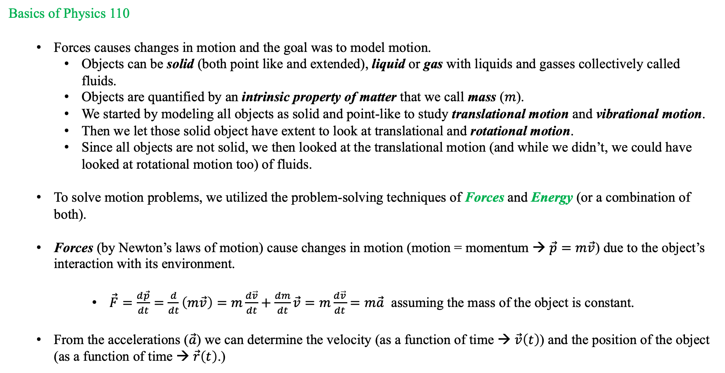
Introduction and Course Outline
Basics of Physics 110
  Forces causes changes in motion and the goal was to model motion.
    Objects can be solid (both point like and extended), liquid or gas with liquids and gasses collectively called fluids.
    Objects are quantified by an intrinsic property of matter that we call mass ($m$).
    We started by modeling all objects as solid and point-like to study translational motion and vibrational motion.
    Then we let those solid object have extent to look at translational and rotational motion.
    Since all objects are not solid, we then looked at the translational motion (and while we didn’t, we could have looked at rotational motion too) of fluids.
  To solve motion problems, we utilized the problem-solving techniques of Forces and Energy (or a combination of both).
  Forces (by Newton’s laws of motion) cause changes in motion (motion = momentum → $\vec{p}=m\vec{v}$) due to the object’s interaction with its environment.
      $\vec{F}=\frac{d\vec{p}}{dt}=\frac{d}{dt}\left(m\vec{v}\right)=m\frac{d\vec{v}}{dt}+\frac{dm}{dt}\vec{v}=m\frac{d\vec{v}}{dt}=m\vec{a}$ assuming the mass of the object is constant.
  From the accelerations ($\vec{a}$) we can determine the velocity (as a function of time → $\vec{v}\left(t\right)$) and the position of the object (as a function of time → $\vec{r}\left(t\right)$.)

Slide 2
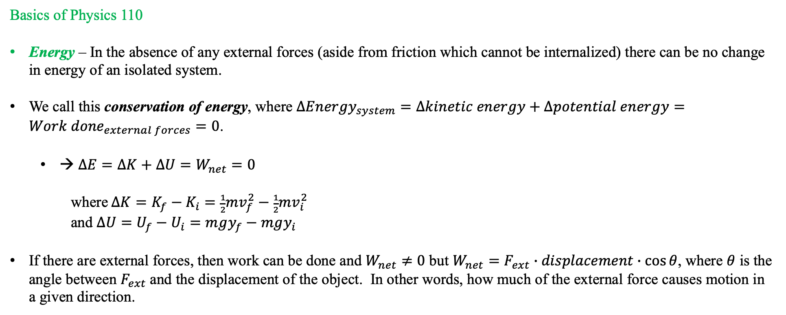
Introduction and Course Outline
Basics of Physics 110
Energy – In the absence of any external forces (aside from friction which cannot be internalized) there can be no change in energy of an isolated system.
We call this conservation of energy, where $∆{Energy}_{system}=∆kinetic energy+∆potential energy={Work done}_{external forces}=0$.
  → $∆E=∆K+∆U=W_{net}=0$
  where $∆K=K_{f}−K_{i}=\frac{1}{2}mv_{f}^{2}−\frac{1}{2}mv_{i}^{2}$
  and $∆U=U_{f}−U_{i}=mgy_{f}−mgy_{i}$
If there are external forces, then work can be done and $W_{net}≠0$ but $W_{net}=F_{ext}∙displacement∙\cos{θ}$, where $θ$ is the angle between $F_{ext}$and the displacement of the object. In other words, how much of the external force causes motion in a given direction.
So, now we can ask how does this help us with Physics 111?

Slide 3
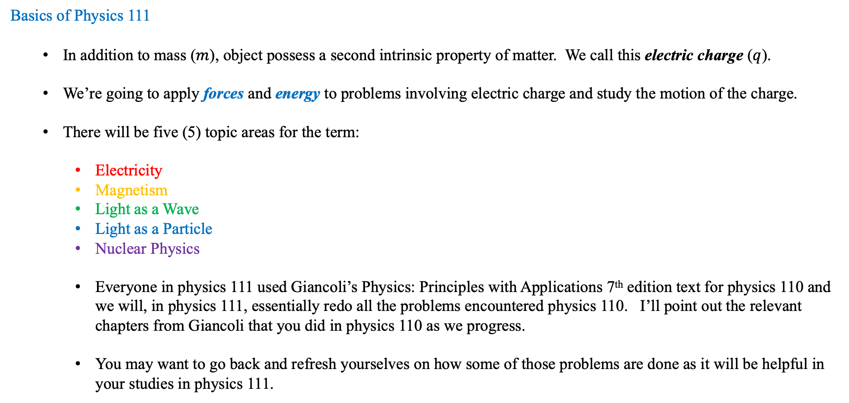
Introduction and Course Outline
Basics of Physics 111
  In addition to mass ($m$), object possess a second intrinsic property of matter. We call this electric charge ($q$).
  We’re going to apply forces and energy to problems involving electric charge and study the motion of the charge.
  There will be five (5) topic areas for the term:
    Electricity
    Magnetism
    Light as a Wave
    Light as a Particle
    Nuclear Physics
    Everyone in physics 111 used Giancoli’s Physics: Principles with Applications 7th edition text for physics 110 and we will, in physics 111, essentially redo all the problems encountered physics 110. I’ll point out the relevant chapters from Giancoli that you did in physics 110 as we progress.
    You may want to go back and refresh yourselves on how some of those problems are done as it will be helpful in your studies in physics 111.

Slide 4
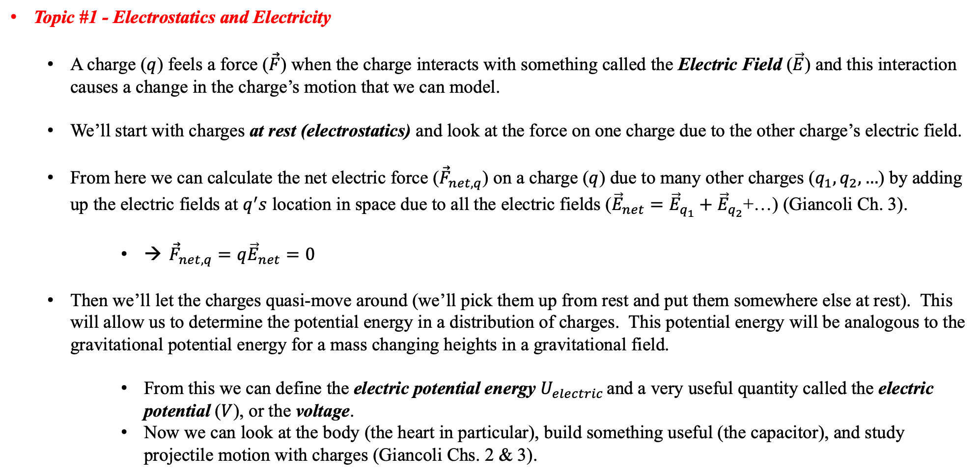
Introduction and Course Outline
Topic #1 - Electrostatics and Electricity
  A charge ($q$) feels a force ($\vec{F}$) when the charge interacts with something called the Electric Field ($\vec{E}$) and this interaction causes a change in the charge’s motion that we can model.
  We’ll start with charges at rest (electrostatics) and look at the force on one charge due to the other charge’s electric field.
  From here we can calculate the net electric force (${\vec{F}}_{net,q}$) on a charge ($q$) due to many other charges ($q_{1}, q_{2}, …$) by adding up the electric fields at $q^{′}s$ location in space due to all the electric fields (${\vec{E}}_{net}={\vec{E}}_{q_{1}}+{\vec{E}}_{q_{2}}$+…) (Giancoli Ch. 3).
      → ${\vec{F}}_{net,q}=q{\vec{E}}_{net}=0$
  Then we’ll let the charges quasi-move around (we’ll pick them up from rest and put them somewhere else at rest). This will allow us to determine the potential energy in a distribution of charges. This potential energy will be analogous to the gravitational potential energy for a mass changing heights in a gravitational field.
      From this we can define the electric potential energy $U_{electric }$and a very useful quantity called the electric potential ($V$), or the voltage.
      Now we can look at the body (the heart in particular), build something useful (the capacitor), and study projectile motion with charges (Giancoli Chs. 2 & 3).

Slide 5
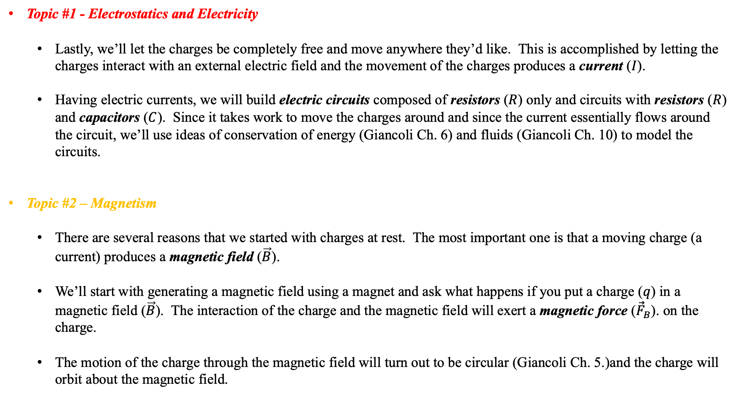
Introduction and Course Outline
Topic #1 - Electrostatics and Electricity
  Lastly, we’ll let the charges be completely free and move anywhere they’d like. This is accomplished by letting the charges interact with an external electric field and the movement of the charges produces a current ($I$).
  Having electric currents, we will build electric circuits composed of resistors ($R$) only and circuits with resistors ($R$) and capacitors ($C$). Since it takes work to move the charges around and since the current essentially flows around the circuit, we’ll use ideas of conservation of energy (Giancoli Ch. 6) and fluids (Giancoli Ch. 10) to model the circuits.
Topic #2 – Magnetism
  There are several reasons that we started with charges at rest. The most important one is that a moving charge (a current) produces a magnetic field ($\vec{B}$).
  We’ll start with generating a magnetic field using a magnet and ask what happens if you put a charge ($q$) in a magnetic field ($\vec{B}$). The interaction of the charge and the magnetic field will exert a magnetic force (${\vec{F}}_{B}$). on the charge.
  The motion of the charge through the magnetic field will turn out to be circular (Giancoli Ch. 5.)and the charge will orbit about the magnetic field.

Slide 6
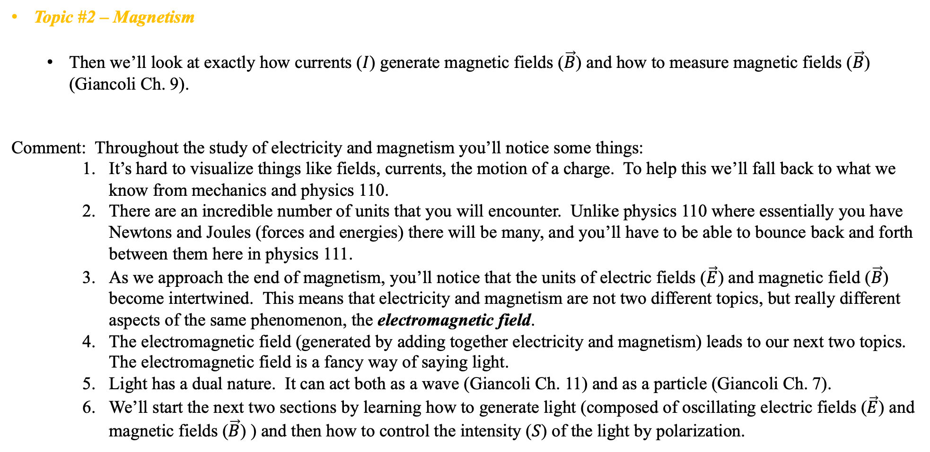
Introduction and Course Outline
Topic #2 – Magnetism
  Then we’ll look at exactly how currents ($I$) generate magnetic fields ($\vec{B}$) and how to measure magnetic fields ($\vec{B}$) (Giancoli Ch. 9).
Comment: Throughout the study of electricity and magnetism you’ll notice some things:
    It’s hard to visualize things like fields, currents, the motion of a charge. To help this we’ll fall back to what we know from mechanics and physics 110.
    There are an incredible number of units that you will encounter. Unlike physics 110 where essentially you have Newtons and Joules (forces and energies) there will be many, and you’ll have to be able to bounce back and forth between them here in physics 111.
    As we approach the end of magnetism, you’ll notice that the units of electric fields ($\vec{E}$) and magnetic field ($\vec{B}$) become intertwined. This means that electricity and magnetism are not two different topics, but really different aspects of the same phenomenon, the electromagnetic field.
    The electromagnetic field (generated by adding together electricity and magnetism) leads to our next two topics. The electromagnetic field is a fancy way of saying light.
    Light has a dual nature. It can act both as a wave (Giancoli Ch. 11) and as a particle (Giancoli Ch. 7).
    We’ll start the next two sections by learning how to generate light (composed of oscillating electric fields ($\vec{E}$) and magnetic fields ($\vec{B}$) ) and then how to control the intensity ($S$) of the light by polarization.

Slide 7
Introduction and Course Outline
Topic #3 – Light as a Wave
  Having generated light, we will let the light interact with a material. The interaction of the light with the material forces some of the light to be reflected and some to be transmitted (we call this refraction).
  We’ll develop a set of laws that govern reflection and refraction and then use these ideas to build a useful device called a lens.
  Then we will study two different types of lenses, called converging and diverging to see what kinds of images they both will produce.
  This will lead to studying the structure and function of the human eye as well as refractive errors of the eye (vision problems) and their corrections (glasses and contact lenses).
Topic #4 – Light as a Particle
  The study of light as a wave has been thoroughly investigated, starting in the middle ages. Everyone knew light was a wave.
  However, early in the twentieth century experiments involving light were conducted and the outcomes could not be explained using the ideas that light was a wave. A new way of thinking had to be developed. The particle of light.

Slide 8
Introduction and Course Outline
Topic #4 – Light as a Particle
  The particle nature of light we call a photon and when photons of light interact with matter (namely electrons in atoms) collisions can occur (Giancoli Ch. 7).
  We’ll then look at collisions between photons and matter and study photon collision effects called the photoelectric effect and the Compton effect.
  However, as we’ll see the interactions of photons with electrons could make the electrons travel at speeds approaching that of light.
  To accurately describe the motion of tiny objects traveling at very high rates of speed we’ll need to redo our description of classical mechanics, in particular energy and momentum. This is the idea of relativity.
  We’ll need to develop a new way of describing the energy and the momentum of a particle.
  These new ways of course must give us, in the limit that the speed of object gets small compared to the speed of light, the classical energy and momentum of a particle (Giancoli Chs. 6 & 7).

Slide 9
Introduction and Course Outline
Topic #5 – Nuclear Physics
  Since we’ve been looking at small things like electrons in atoms, let’s study the atom.
  First, we’ll look at building the atoms on the periodic table starting with helium and then ask what makes an atom stable.
  Then we’ll examine where the atoms found on earth come from and how they get there (stellar astrophysics).
  We’ll then examine what happens when atoms become unstable (nuclear energy, nuclear medicine and radioactive decay).
  And if there’s time, we’ll look at some novel uses of radioactivity in medicine, such as a PET scan.

