Slide 1
Introduction and Course Outline
  Welcome back to the winter term at Union and to Physics 111!
  This set of slides is to introduce you to this course, cover the syllabus, explain exactly we’ll be looking at this term as well as remind you of the topics and concepts that you need from Physics 110 (or Physics 120). All the underlined phrases are hyperlinks. Clicking on them will take you to that relevant course page on my website.
  This term we will be applying all those concepts and ideas developed in Phy110 (or Phy120) to the study of electricity, magnetism, light (both as a wave and as a particle), and nuclear physics.
  Class will meet every MWF from 8:00^{am} – 9:05^{am} and Th 8:00^{am} – 8:50^{am} and every Friday in which there is no exam scheduled, we will have a quiz. Quiz #1 will be on Friday, January 10, 2025.
  There will be two in-class exams this term. The first one will be on Friday, January 31, 2025 (week 4), and the second on Friday, February 28, 2025 (week 8).
  It is expected that you will make every effort to be at the scheduled exams. Makeup exams are rarely granted, except for exceptional circumstances, as determined solely by the instructor.
  Everyone in Phy111 must complete the laboratory sequence. Make sure you are signed up for one of the lab sections. It is the policy of the Physics & Astronomy department that you must pass lab, by earning a minimum of 70%, to pass the course. Therefore, if you do not pass the lab component of the course, it is an automatic failure, independent of your performance in the class. Lab will begin on Thursday, January 9, 2025 (week 1).

Slide 2
Introduction and Course Outline
Homework
The homework for the term is designed to be representative of the topics covered throughout the course. There maybe times we cover a topic in which there is no homework problem available or there may be times where homework problems assigned on topics that were not explicitly covered as they are extensions of what we’ve done in class.
The daily homework assignments are topic specific so expect that the homework will cover those topics from class and give you practice on only those type problems.
You should be aware that problems in science are not one-off problems that test one and only one topic or idea. Problems for the quizzes and exams will combine topics and the big picture for any quiz/exam problem will be the synthesis of these individual ideas/topics into a three-to-four-part problem. As such the quizzes and exams are generally compilations of the homework and are in general harder than the individual homework problems.
The homework for the term will be assigned and graded using Mastering Physics. To sign up please visit: https://mlm.pearson.com/enrollment/labrake68174. You will need the class ID register for the class: labrake68174
Homework assignments will open every MWF at 8:00^{am} and will nominally “close” at 12:00^{pm} the following class day. Variations of this schedule will occur during exam weeks when the homework assigned will close Wednesday night at 10:00^{pm}. No homework assignments will ever open on the Thursday class.
The homework assignments nominally close at noon. This is not a hard close and you may continue to work on the homework assignments after the nominal close time. However, to encourage you to complete them on time, there is a 2% penalty per day assessed for work completed past the close date/time that bottoms out at 50%.

Slide 3
Introduction and Course Outline
Textbook Reading Assignments
  Readings will generally be assigned every class, and you should check the homework webpage to see what the days reading assignment will be. These will also be announced in class.
  The readings listed should be done ideally before each class lecture so that you have some idea about what will be covered. You will get more out of the lecture if you have looked over (not necessarily understood) the material to be covered. This way you can also come to class with questions about the material being covered and more actively participate in the lecture.
Pre-Lecture Assignments:
  The pre-lecture assignments are designed to introduce you to the topic that will be covered in the days class. Ideally you should do the class days reading before attempting these assignments. These assignments should only take you 10 – 15 minutes to complete and no late assignments will be accepted.
  These assignments will generally have a video for you to watch and a few multiple-choice or short answer type questions. There will generally be a pre-lecture assignment due every MWF. These assignments will be given on Mastering Physics and will open 24 hours before the material will be covered in class and will close at 8:00^{am} when the class begins. There are no extensions or makeups for missed pre-lecture assignments.
Office Hours:
  Office hours for the term will be held in my office in ISEC 119.
    M: 11^{am} – 3^{pm}
    WF: 10:30^{am} – 11:30^{am}
    Sun: 9^{am} – 11^{am}

Slide 4
Introduction and Course Outline
Learning Objectives
This course aims to provide students with a strong foundation in the fundamental principles of physics and the skills necessary to apply these principles to solve problems and make informed decisions in their academic and professional pursuits. Specific course objectives are as follows:
Develop an understanding of the fundamental principles of physics and how they apply to other disciplines such as biology, chemistry, medicine and society.
Develop critical thinking and problem-solving skills that can be applied to physics and other disciplines such as biology, chemistry, medicine and society.
Apply mathematical tools to solve problems including algebraic manipulation and graphical analysis.
Develop effective laboratory skills and an ability to design and conduct experiments to test hypotheses.
Work collaboratively and communicate scientific ideas both verbally and in writing.
Appreciate the role of physics in modern society and its contribution to technology and innovation.
Let’s go look at what we’re going to cover this term.

Slide 5
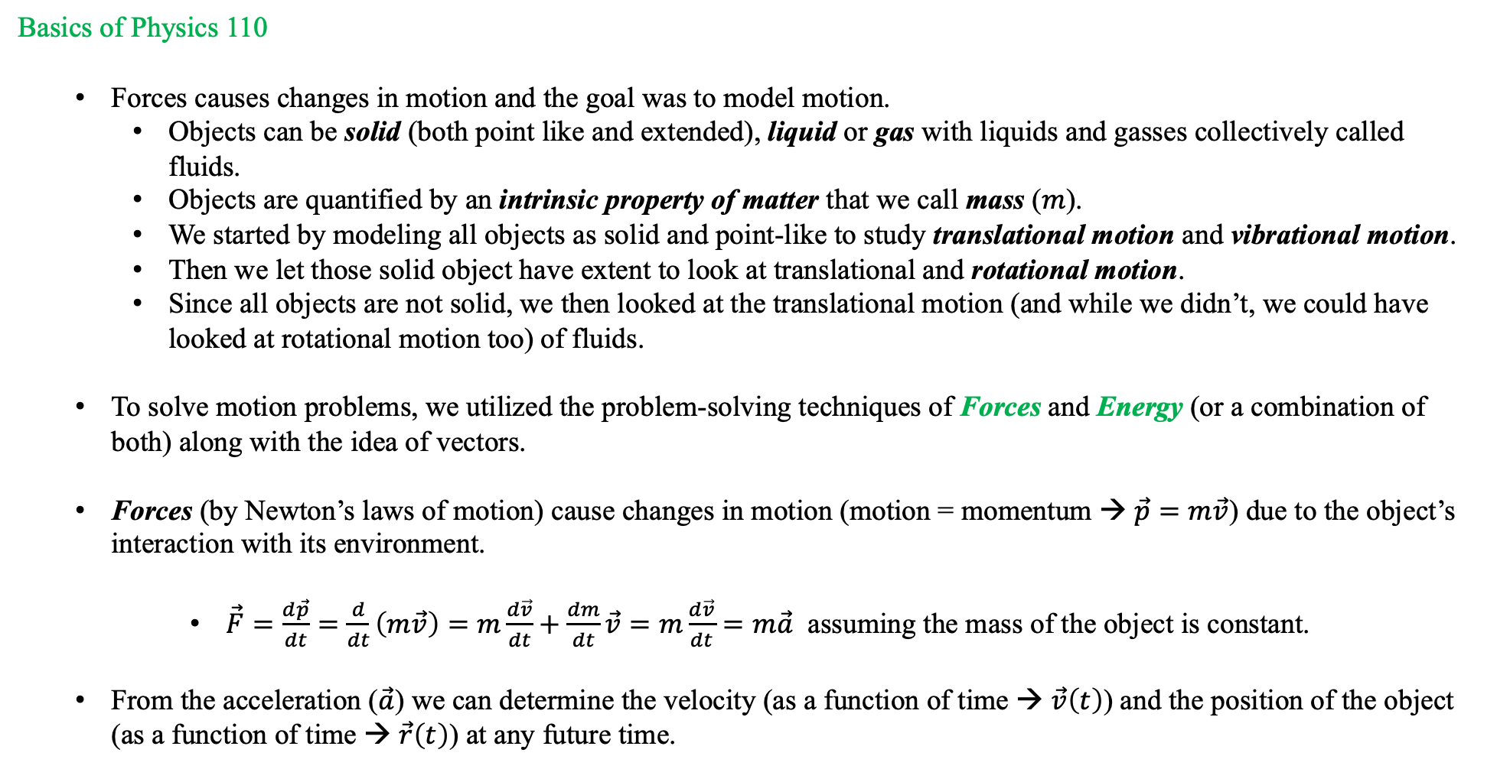
Introduction and Course Outline
Basics of Physics 110
  Forces causes changes in motion and the goal was to model motion.
    Objects can be solid (both point like and extended), liquid or gas with liquids and gasses collectively called fluids.
    Objects are quantified by an intrinsic property of matter that we call mass ($m$).
    We started by modeling all objects as solid and point-like to study translational motion and vibrational motion.
    Then we let those solid object have extent to look at translational and rotational motion.
    Since all objects are not solid, we then looked at the translational motion (and while we didn’t, we could have looked at rotational motion too) of fluids.
  To solve motion problems, we utilized the problem-solving techniques of Forces and Energy (or a combination of both) along with the idea of vectors.
  Forces (by Newton’s laws of motion) cause changes in motion (motion = momentum → $\vec{p}=m\vec{v}$) due to the object’s interaction with its environment.
      $\vec{F}=\frac{d\vec{p}}{dt}=\frac{d}{dt}\left(m\vec{v}\right)=m\frac{d\vec{v}}{dt}+\frac{dm}{dt}\vec{v}=m\frac{d\vec{v}}{dt}=m\vec{a}$ assuming the mass of the object is constant.
  From the acceleration ($\vec{a}$) we can determine the velocity (as a function of time → $\vec{v}\left(t\right)$) and the position of the object (as a function of time → $\vec{r}\left(t\right)$) at any future time.

Slide 6
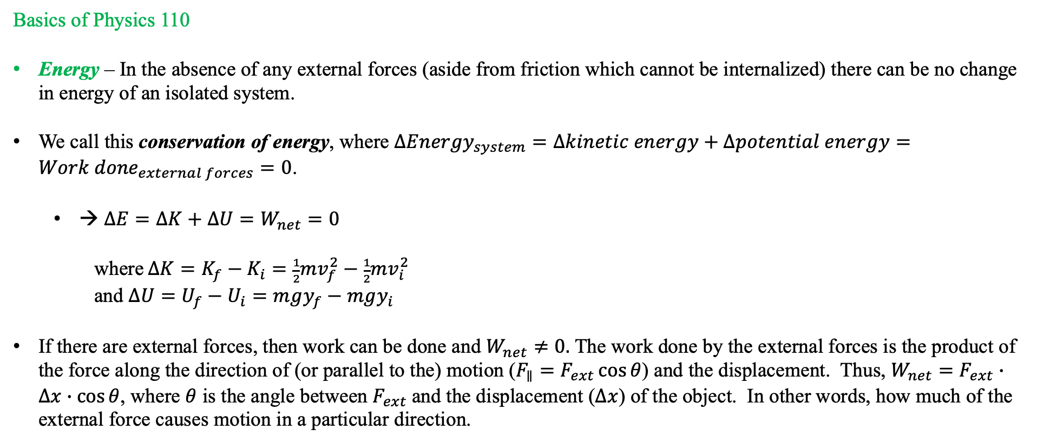
Introduction and Course Outline
Basics of Physics 110
Energy – In the absence of any external forces (aside from friction which cannot be internalized) there can be no change in energy of an isolated system.
We call this conservation of energy, where $∆{Energy}_{system}=∆kinetic energy+∆potential energy={Work done}_{external forces}=0$.
  → $∆E=∆K+∆U=W_{net}=0$
  where $∆K=K_{f}−K_{i}=\frac{1}{2}mv_{f}^{2}−\frac{1}{2}mv_{i}^{2}$
  and $∆U=U_{f}−U_{i}=mgy_{f}−mgy_{i}$
If there are external forces, then work can be done and $W_{net}≠0.$ The work done by the external forces is the product of the force along the direction of (or parallel to the) motion ($F_{∥}=F_{ext}\cos{θ}$) and the displacement. Thus, $W_{net}=F_{ext}∙∆x∙\cos{θ}$, where $θ$ is the angle between $F_{ext}$and the displacement ($∆x$) of the object. In other words, how much of the external force causes motion in a particular direction.
So, now we can ask how does this help us with Physics 111?

Slide 7
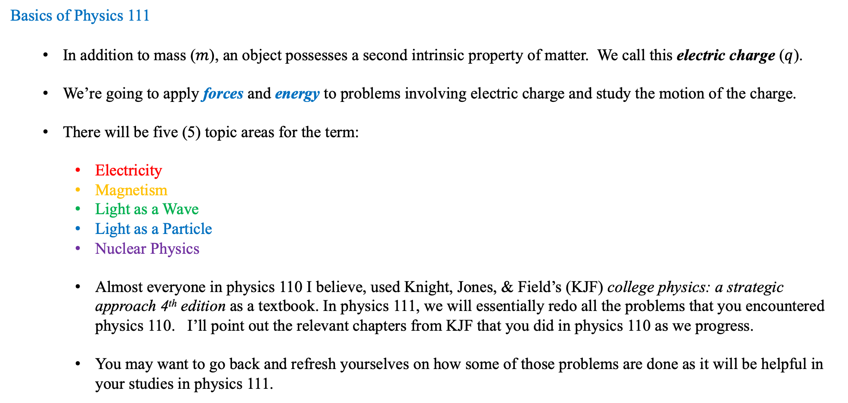
Introduction and Course Outline
Basics of Physics 111
  In addition to mass ($m$), an object possesses a second intrinsic property of matter. We call this electric charge ($q$).
  We’re going to apply forces and energy to problems involving electric charge and study the motion of the charge.
  There will be five (5) topic areas for the term:
    Electricity
    Magnetism
    Light as a Wave
    Light as a Particle
    Nuclear Physics
    Almost everyone in physics 110 I believe, used Knight, Jones, & Field’s (KJF) college physics: a strategic approach 4th edition as a textbook. In physics 111, we will essentially redo all the problems that you encountered physics 110. I’ll point out the relevant chapters from KJF that you did in physics 110 as we progress.
    You may want to go back and refresh yourselves on how some of those problems are done as it will be helpful in your studies in physics 111.

Slide 8
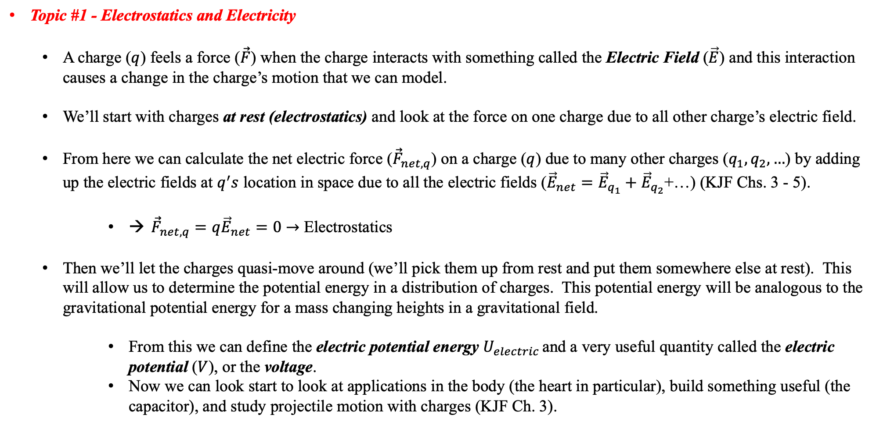
Introduction and Course Outline
Topic #1 - Electrostatics and Electricity
  A charge ($q$) feels a force ($\vec{F}$) when the charge interacts with something called the Electric Field ($\vec{E}$) and this interaction causes a change in the charge’s motion that we can model.
  We’ll start with charges at rest (electrostatics) and look at the force on one charge due to all other charge’s electric field.
  From here we can calculate the net electric force (${\vec{F}}_{net,q}$) on a charge ($q$) due to many other charges ($q_{1}, q_{2}, …$) by adding up the electric fields at $q^{′}s$ location in space due to all the electric fields (${\vec{E}}_{net}={\vec{E}}_{q_{1}}+{\vec{E}}_{q_{2}}$+…) (KJF Chs. 3 - 5).
      → ${\vec{F}}_{net,q}=q{\vec{E}}_{net}=0$ $→$ Electrostatics
  Then we’ll let the charges quasi-move around (we’ll pick them up from rest and put them somewhere else at rest). This will allow us to determine the potential energy in a distribution of charges. This potential energy will be analogous to the gravitational potential energy for a mass changing heights in a gravitational field.
      From this we can define the electric potential energy $U_{electric }$and a very useful quantity called the electric potential ($V$), or the voltage.
      Now we can look start to look at applications in the body (the heart in particular), build something useful (the capacitor), and study projectile motion with charges (KJF Ch. 3).

Slide 9
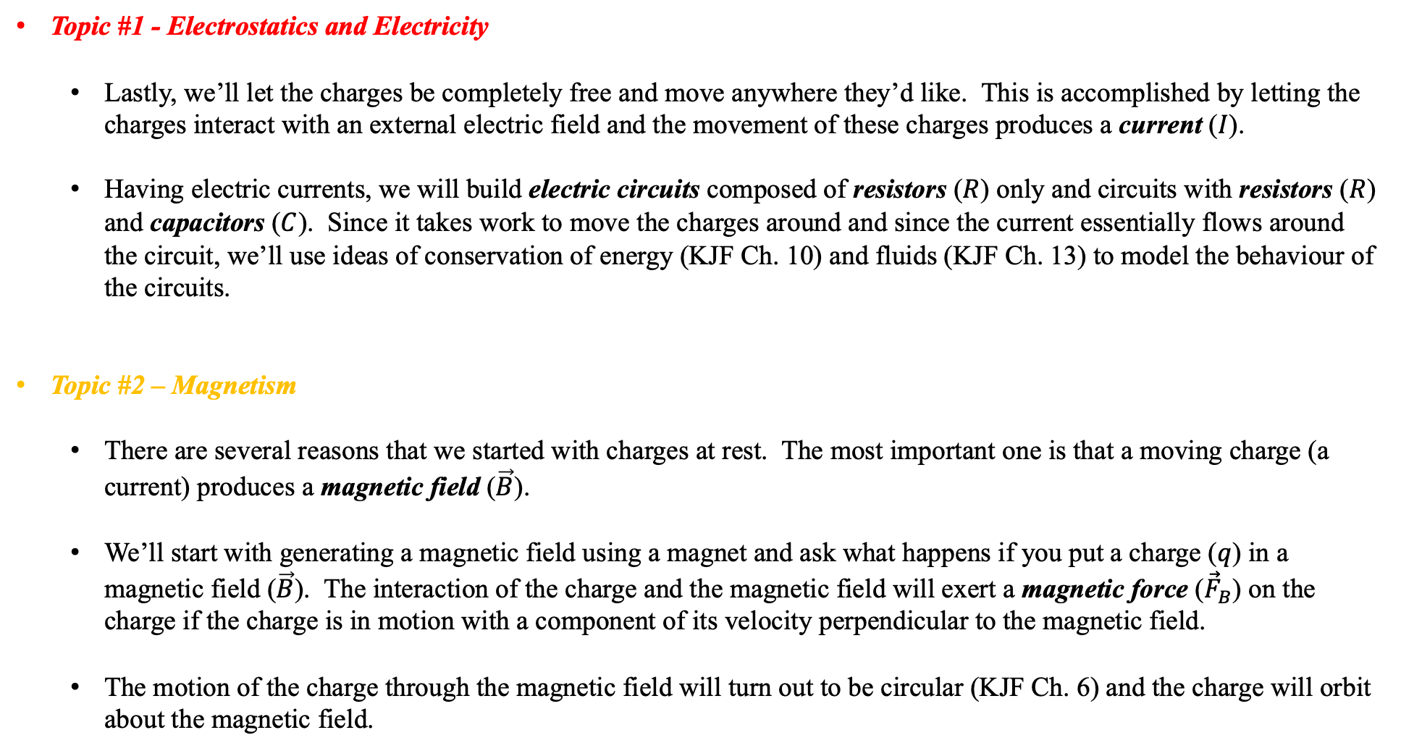
Introduction and Course Outline
Topic #1 - Electrostatics and Electricity
  Lastly, we’ll let the charges be completely free and move anywhere they’d like. This is accomplished by letting the charges interact with an external electric field and the movement of these charges produces a current ($I$).
  Having electric currents, we will build electric circuits composed of resistors ($R$) only and circuits with resistors ($R$) and capacitors ($C$). Since it takes work to move the charges around and since the current essentially flows around the circuit, we’ll use ideas of conservation of energy (KJF Ch. 10) and fluids (KJF Ch. 13) to model the behaviour of the circuits.
Topic #2 – Magnetism
  There are several reasons that we started with charges at rest. The most important one is that a moving charge (a current) produces a magnetic field ($\vec{B}$).
  We’ll start with generating a magnetic field using a magnet and ask what happens if you put a charge ($q$) in a magnetic field ($\vec{B}$). The interaction of the charge and the magnetic field will exert a magnetic force (${\vec{F}}_{B}$) on the charge if the charge is in motion with a component of its velocity perpendicular to the magnetic field.
  The motion of the charge through the magnetic field will turn out to be circular (KJF Ch. 6) and the charge will orbit about the magnetic field.

Slide 10
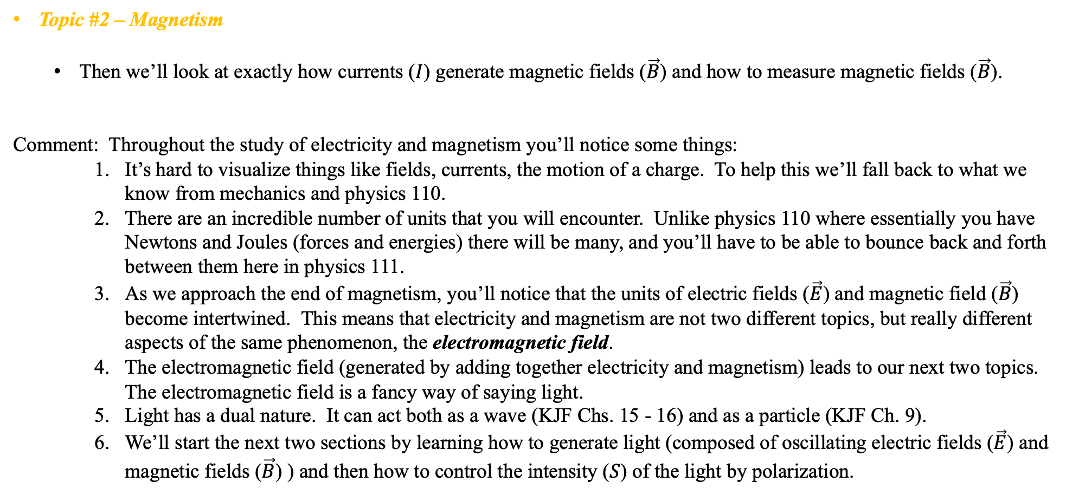
Introduction and Course Outline
Topic #2 – Magnetism
  Then we’ll look at exactly how currents ($I$) generate magnetic fields ($\vec{B}$) and how to measure magnetic fields ($\vec{B}$).
Comment: Throughout the study of electricity and magnetism you’ll notice some things:
    It’s hard to visualize things like fields, currents, the motion of a charge. To help this we’ll fall back to what we know from mechanics and physics 110.
    There are an incredible number of units that you will encounter. Unlike physics 110 where essentially you have Newtons and Joules (forces and energies) there will be many, and you’ll have to be able to bounce back and forth between them here in physics 111.
    As we approach the end of magnetism, you’ll notice that the units of electric fields ($\vec{E}$) and magnetic field ($\vec{B}$) become intertwined. This means that electricity and magnetism are not two different topics, but really different aspects of the same phenomenon, the electromagnetic field.
    The electromagnetic field (generated by adding together electricity and magnetism) leads to our next two topics. The electromagnetic field is a fancy way of saying light.
    Light has a dual nature. It can act both as a wave (KJF Chs. 15 - 16) and as a particle (KJF Ch. 9).
    We’ll start the next two sections by learning how to generate light (composed of oscillating electric fields ($\vec{E}$) and magnetic fields ($\vec{B}$) ) and then how to control the intensity ($S$) of the light by polarization.

Slide 11
Introduction and Course Outline
Topic #3 – Light as a Wave
  Having generated light, we will let the light interact with a material. The interaction of the light with the material forces some of the light to be reflected and some to be transmitted (we call this refraction).
  We’ll develop a set of laws that govern reflection and refraction and then use these ideas to build a useful device called a lens.
  Then we will study two different types of lenses, called converging and diverging to see what kinds of images they each produce.
  This will lead to studying the structure and function of the human eye as well as refractive errors of the eye (vision problems) and their corrections (glasses and contact lenses).
Topic #4 – Light as a Particle
  The study of light as a wave has been thoroughly investigated, starting in the middle ages. Everyone knew light was a wave.
  However, early in the twentieth century experiments involving light were conducted and the outcomes could not be explained using the ideas that light was a wave. A new way of thinking had to be developed. The particle of light.

Slide 12
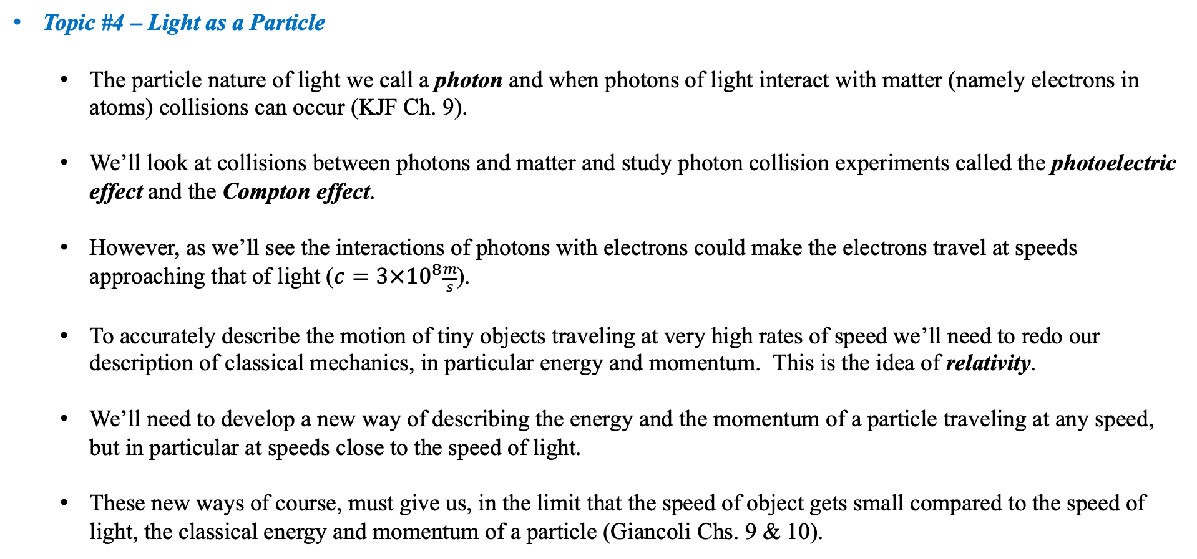
Introduction and Course Outline
Topic #4 – Light as a Particle
  The particle nature of light we call a photon and when photons of light interact with matter (namely electrons in atoms) collisions can occur (KJF Ch. 9).
  We’ll look at collisions between photons and matter and study photon collision experiments called the photoelectric effect and the Compton effect.
  However, as we’ll see the interactions of photons with electrons could make the electrons travel at speeds approaching that of light ($c=3×{10}^{8}\frac{m}{s}$).
  To accurately describe the motion of tiny objects traveling at very high rates of speed we’ll need to redo our description of classical mechanics, in particular energy and momentum. This is the idea of relativity.
  We’ll need to develop a new way of describing the energy and the momentum of a particle traveling at any speed, but in particular at speeds close to the speed of light.
  These new ways of course, must give us, in the limit that the speed of object gets small compared to the speed of light, the classical energy and momentum of a particle (Giancoli Chs. 9 & 10).

Slide 13
Introduction and Course Outline
Topic #5 – Nuclear Physics
  Since we’ve been looking at small things like electrons in atoms, let’s study the atom.
  First, we’ll look at building the atoms on the periodic table starting with helium and then ask what makes an atom stable.
  Then we’ll examine where the atoms found on earth come from and how they get there (stellar astrophysics).
  We’ll then examine what happens when atoms become unstable (nuclear energy, nuclear medicine and radioactive decay).
  And if there’s time, we’ll look at some novel uses of radioactivity in medicine, such as a PET scan.
You’re job between now and class:
Read this outline (which if you’re here, hopefully you’ve done) and refresh yourself on forces and energy in describing motion.
Sign up for mastering physics (the instructions are attached to the email.)
Have a very happy and fun start to the new year!

