Slide 1
Magnetic Resonance
Suppose that a spin ½ particle (a proton say) is at rest in an external magnetic field. A small transverse field is applied ot the sample. What is the Hamiltonian for the system? The magnetic fields are as below.
The Hamiltonian is given by, where,
The spin matrices are:

Slide 2
Magnetic Resonance
The Hamiltonian is:
Operating on a state we have:

Slide 3
Magnetic Resonance
This produces
These are a set of coupled differential equations.

Slide 4
Magnetic Resonance
The solutions are:
where

Slide 5
Magnetic Resonance
Now that we have the states we can calculate.
Suppose that a particle starts out in a spin up state at time t = 0.
What is the probability of a transition to a spin down state?
Where the initial conditions are:

Slide 6
Magnetic Resonance
Thus if you can hit the up state with a photon of the correct frequency then you can cause a spin flip transition from the lower energy state to higher energy state.
Thus:
So:

Slide 7
Magnetic Resonance Imaging
So, if you can hit the spin up state with a photon at the correct time (you have to tune the circuit to match when the probability is a maximum) then you can cause a resonance in the system.
If you can do this then you can keep pulsing the system at this frequency.
Unfortunately you have to determine this frequency to hit the sample at to cause the resonance, but in the end you can image protons in water in different magnetic environments, by Faraday’s law. The photons that are given off when the spins relax are a changing source of magnetic field through a coil of wire, the intensity of which is made proportional to a shade of grey.
These photons are radio-frequency photons and are non-ionizing forms of radiation.
What can we image?

Slide 8
Magnetic Resonance Imaging
An Introduction to MRI Physics and Analysis Michael Jay Schillaci, PhD

Slide 9
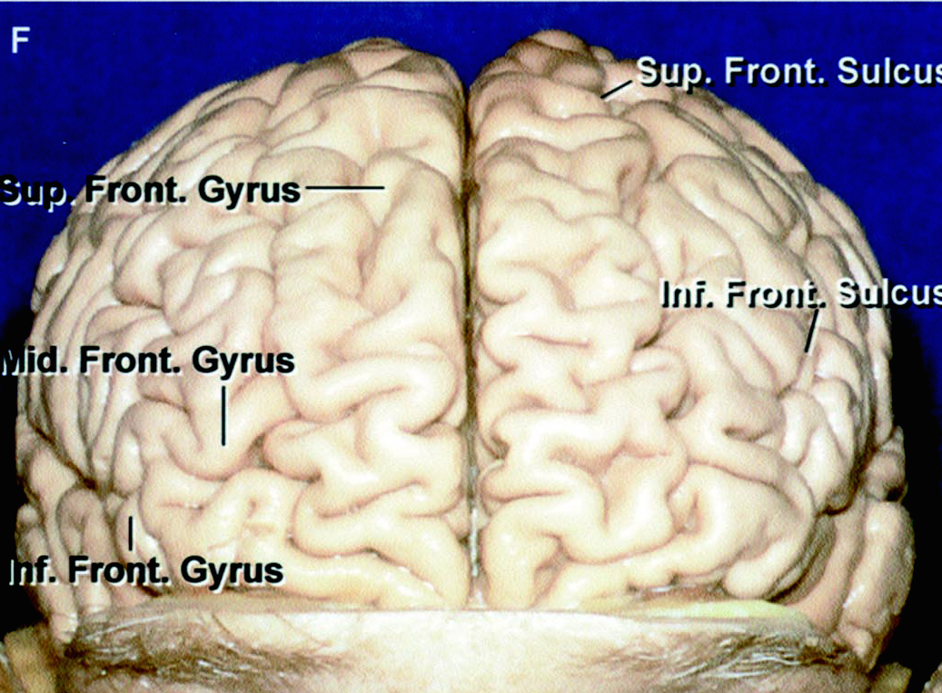
Imaging the Brain with MRI
- Anatomy
Alan L. Rhoton, Jr. MD, Dept. of Neurological Surgery, University of Florida: Special thanks to Allison Schacter for the images.

Slide 10
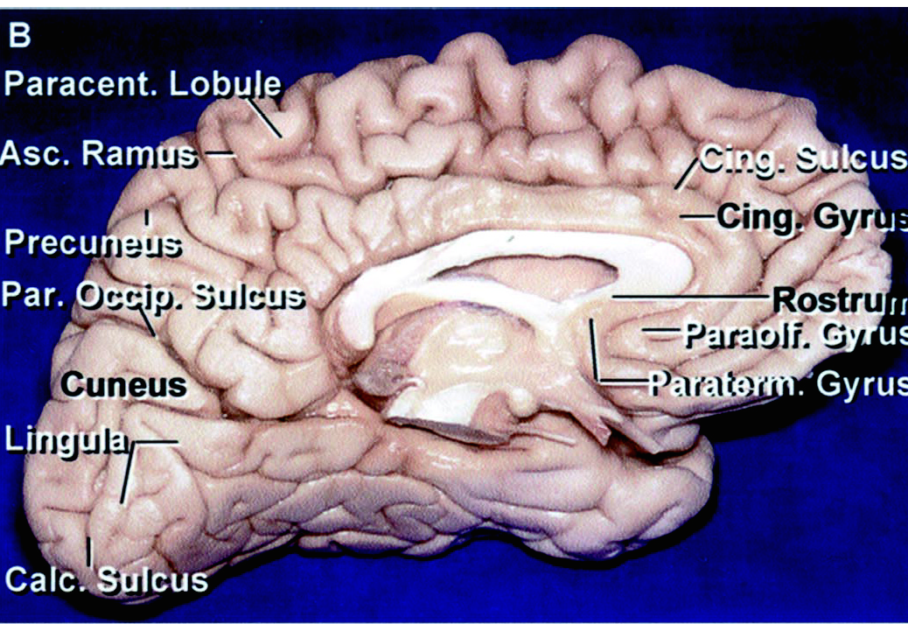
Imaging the Brain with MRI
- Anatomy
Alan L. Rhoton, Jr. MD, Dept. of Neurological Surgery, University of Florida
Notes:
Corpus callosum/the corpus callosum consists of about 200 millon axons that interconnect the two hemispheres. The primary function of the corpus callosum is to integrate motor, sensory, and cognitive performances between the cerebral cortex on one side of the brain to the same region on the other side.

Slide 11
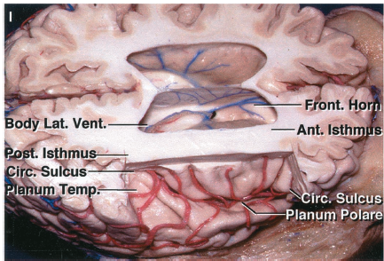
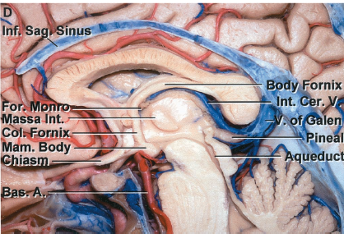
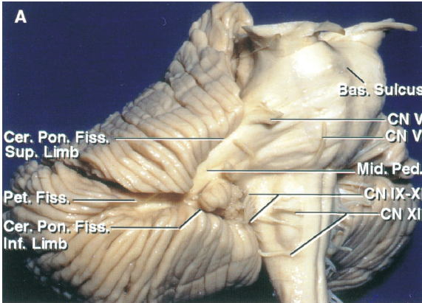
Imaging the Brain with MRI
- Anatomy
Alan L. Rhoton, Jr. MD, Dept. of Neurological Surgery, University of Florida
Alan L. Rhoton, Jr. MD, Dept. of Neurological Surgery, University of Florida
Alan L. Rhoton, Jr. MD, Dept. of Neurological Surgery, University of Florida
Notes:
Left occipital lobe/cerebellum and medulla

Slide 12
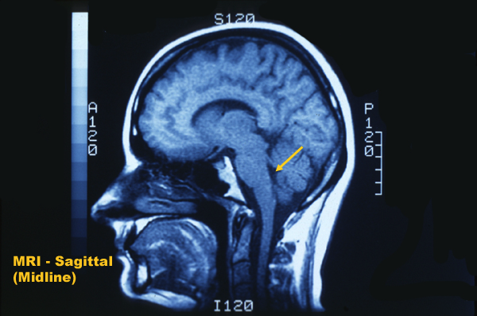
Imaging the Brain with MRI
- Anatomy – T1 weighted image
Hypothalamus
Thalamus
Corpus Callosum
Lateral Ventricle
4th Ventricle
Cerebellum
Skin &
Subcutaneous
Fat
(Dura Matta)
CSF
Skull Bone
Optic Nerve
Cisterna Magna
Trachea
Pons
http://www.neomed.edu/DEPTS/NEUR/atlas/Sagittal/MRI/Sagittal1/Sagittal1Frame.htm
Spinal Chord
Medulla Oblongata
Notes:
Corpus callosum/the corpus callosum consists of about 200 millon axons that interconnect the two hemispheres. The primary function of the corpus callosum is to integrate motor, sensory, and cognitive performances between the cerebral cortex on one side of the brain to the same region on the other side.

Slide 13
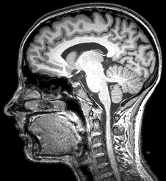
Imaging the Brain with MRI
An Introduction to MRI Physics and Analysis Michael Jay Schillaci, PhD

Slide 14
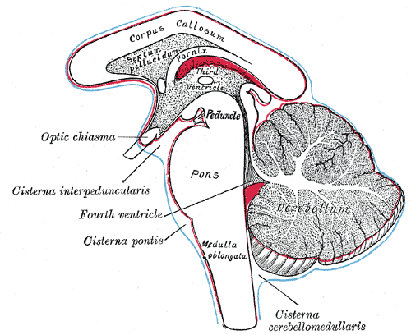
Imaging the Brain with MRI
- Cisterna Magna
http://www.neomed.edu/DEPTS/NEUR/atlas/Sagittal/MRI/Sagittal1/Sagittal1Frame.htm
http://education.yahoo.com/reference/gray/subjects/subject/193
Alan L. Rhoton, Jr. MD, Dept. of Neurological Surgery, University of Florida
Cerebrospinal fluid produced in the fourth ventricle drains into the cisterna magna via the lateral apertures and median aperture.
Cisterns are receptacles for holding liquid.

Slide 15
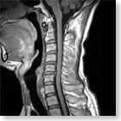
T1 Weighted Image (T1WI)
(Gray Matter Gray – White Matter White)
An Introduction to MRI Physics and Analysis Michael Jay Schillaci, PhD
http://www.gehealthcare.com/usen/mr/products/Profile/neuro_img_gal.html

Slide 16
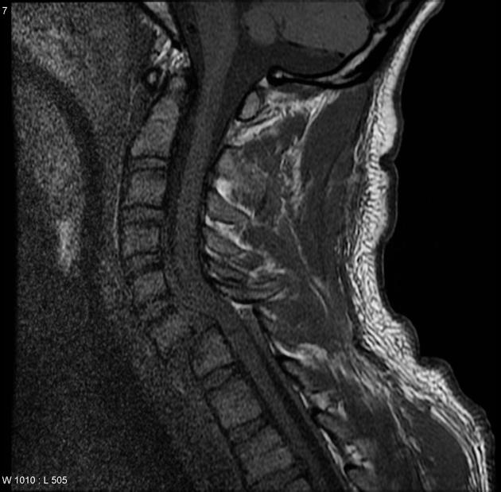
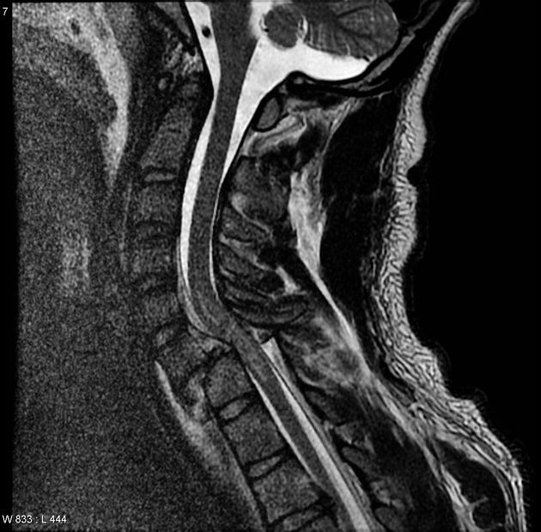
Imaging the Brain with MRI
https://radiopaedia.org/cases/cervical-fracture-dislocation

Slide 17
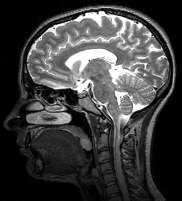
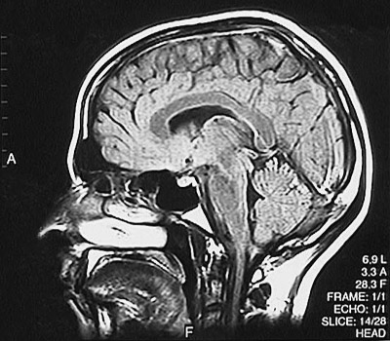
Magnetic Resonance Imaging
- Image Formation & Reconstruction Types
T1 Weighted Image (T1WI)
(Gray Matter Gray – White Matter White)
T2 Weighted Image (T2WI)
(White Matter Gray
Gray Matter White – CSF Contrast)
FLAIR
White Matter Gray
Gray Matte Whiter – CSF Removed
An Introduction to MRI Physics and Analysis Michael Jay Schillaci, PhD
http://library.med.utah.edu/WebPath/HISTHTML/NEURANAT/MRIFS06.html
T2 scans are almost the photographic negative of T1 scans. We make dark areas white and white areas dark to enhance fluid filled areas.
FLAIR – Fluid Attenuated Image Recovery – T2 image with CSF suppressed. Shows areas where fluid should not be.

