Slide 1
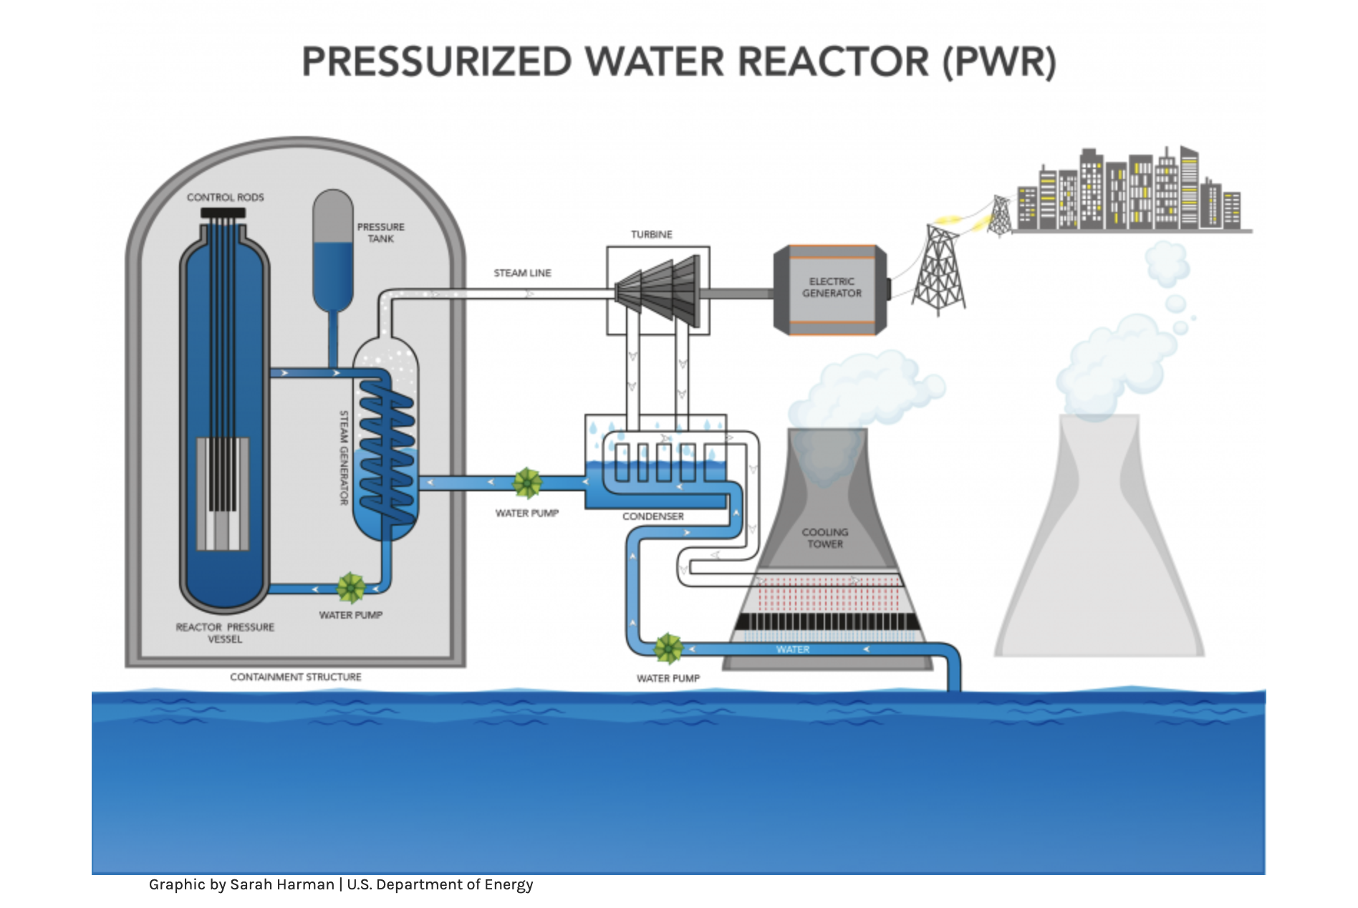
Nuclear Fission, Nuclear Energy and Nuclear Accidents
Fission is the splitting of a heavy unstable nucleus into generally two smaller pieces of almost equal mass. Usually, we need an external input to start the fission process and the splitting of these heavy nuclei releases a large amount of energy. This is the driving force behind nuclear energy generated from a nuclear reactor.
Chernobyl is located in eastern Ukraine and
the disaster was a result of a flawed reactor
design and untrained personnel. Water and
steam valves on the reactor were not opened
and the heat from the reactor was not
extracted and thus the reactor core eventually
melted releasing radioactive elements to the
environment.
$${}_{92}^{235}U+{}_{0}^{1}n→{}_{92}^{236}U→{}_{53}^{131}I+{}_{39}^{102}Y+3\left({}_{0}^{1}n\right)+Energy$$
https://www.energy.gov/ne/articles/nuclear-101-how-does-nuclear-reactor-work

Slide 2
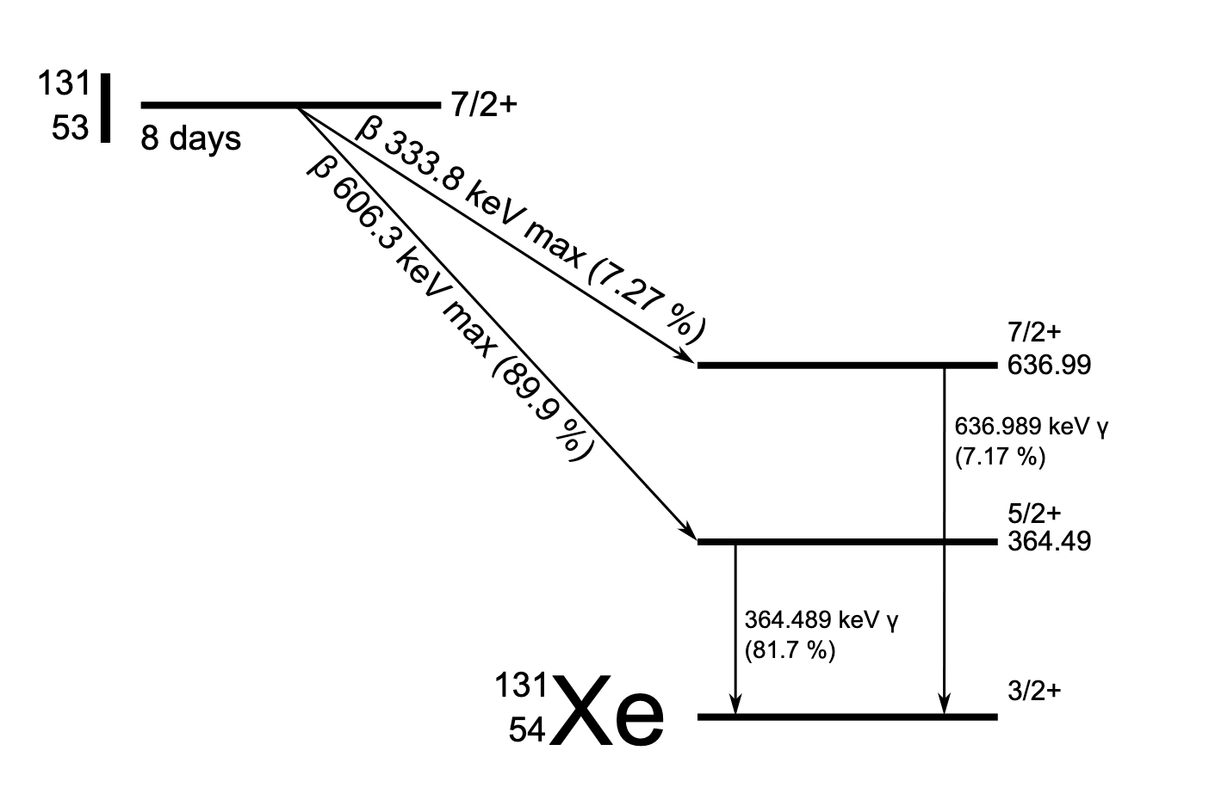
Radioactive Accident at Chernobyl
After the nuclear reactor accident in Chernobyl (in 1986), a large amount of the radioactive isotope ${}_{53}^{131}I$ was emitted, which was deposited on the soil and plants. Thus, the milk of cows that grazed on the contaminated land contained a higher level of ${}_{53}^{131}I$, and the milk could therefore be only used for cheese production instead of direct consumption. In the body, iodine uptake occurs in the thyroid. This isotope of iodine is particularly carcinogenic and in large quantities can lead to thyroid cancer.
In the radioactive decay of iodine, what daughter nucleus is produced?
What is the decay constant that characterizes the decay of ${}_{53}^{131}I$ if it has a half-life of 8 days and what is the storage time needed to decrease the ${}_{53}^{131}I$ content of the cheese to 5% of the original level?
https://en.wikipedia.org/wiki/Iodine-131#/media/File:Iodine-131-decay-scheme-simplified.svg

Slide 3
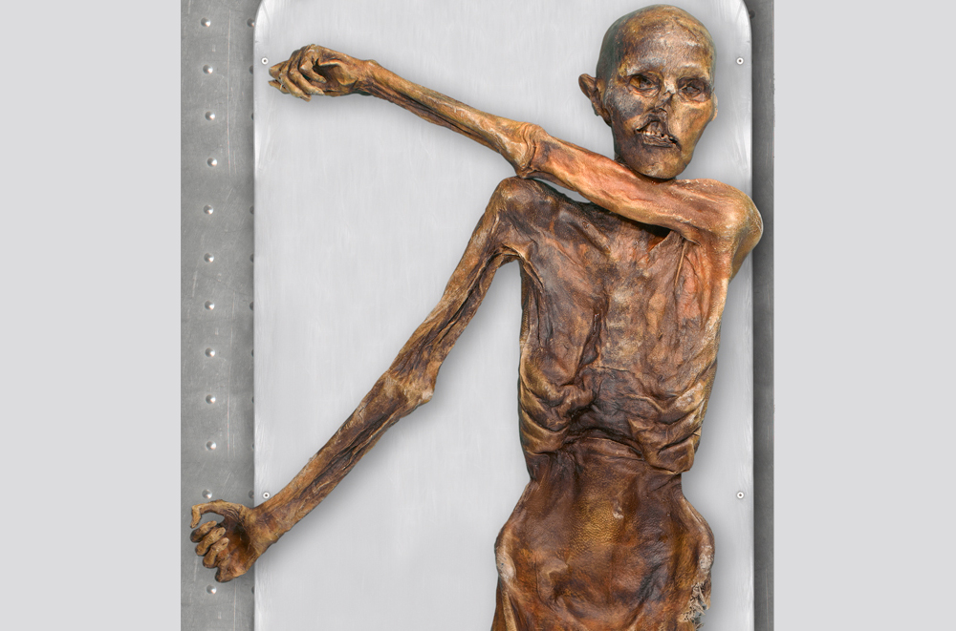
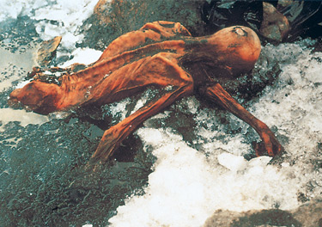
Radiocarbon Dating: The Iceman Cometh
In 1991, hikers discovered a mummified corpse in a rocky hollow high in the Ötztal Alps on Italy's border with Austria. Nicknamed “Ötzi” the iceman, scientists wondered whether this was an ancient human or was this the result of a recent homicide? To determine perhaps which, we use radiocarbon dating. It will turn out that Ötzi” is one of the oldest intact member of the human family.
Radiocarbon dating relies on the fact that the ratio of ${}_{6}^{14}C/{}_{6}^{12}C$has remined mostly constant over the last few thousand years.
http://blogs.discovermagazine.com/d-brief/2013/10/16/living-relatives-of-otzi-the-iceman-mummy-found-in-austria/#.VPr018YsEZI
http://www.iceman.it/en/discovery
Source: National Geographic: http://ngm.nationalgeographic.com/2007/07/iceman/hall-text

Slide 4
Radiocarbon Dating: The Iceman Cometh
Neutrons that stream off the sun (called the solar wind) enter the earth’s upper atmosphere where the neutrons interact with nitrogen. This interaction produces radioactive carbon-14.
The atmospheric carbon-14 quickly oxidizes into radioactive carbon monoxide and then into radioactive carbon dioxide. The radioactive carbon dioxide can enter the oceanic and terrestrial carbon reserves where it is processed in plants as regular carbon dioxide.
To determine the age of Ötzi the iceman, a bone fragment was taken and analyzed by radiocarbon dating. If the bone fragment had a mass of 200g of carbon (due to only ¹²C), how old is Ötzi? Further, the bone fragment was found to have an activity of 26 decays per second of ¹⁴C when it was analyzed and the ratio of $\frac{{}_{6}^{14}C}{{}_{6}^{12}C}=1.3×{10}^{−12}$is found to be roughly constant in time.
As a sidenote, ¹⁴C dating has a limited use. It can date objects to times of approximately 60,000 years. To date older objects we use strontium, thorium, or uranium. What is the activity of ${}_{6}^{14}C$after about 60,000 years?
$${}_{7}^{14}N+{}_{0}^{1}n→{}_{6}^{14}C+{}_{1}^{1}p$$

Slide 5
Dinosaur Bones: The age of Spinosaurus Aegypticus
To date older objects, we need elements with very long half-lives. One such older object is a dinosaur bone. To determine the age of dinosaur bones we use radiometric dating of igneous (previously molten) rocks in layers of earth that were deposited at or around the same time as the dinosaur died. One such technique is known as rubidium-strontium dating. The rubidium isotope ${}_{37}^{87}{Rb}$has a $48.8$-billion-year half-life and ${}_{37}^{87}{Rb}$ decays into strontium, ${}_{38}^{87}{Sr}$.
You want to make an estimate of the age of the dinosaur bone that you found, so you take an igneous rock sample that you dug up in the same area as the dinosaur bone to a geologist. After analysis, the geologist tells you the ratio of strontium to rubidium found in the rock sample today is $\frac{{}_{38}^{87}{Sr}}{{}_{37}^{87}{Rb}}=0.00127$.
In the decay of rubidium to strontium, what is(are) the particle(s) emitted during the decay and what maximum kinetic energy (in keV) that characterizes the decay? (Hints: The spectroscopic rest masses of the parent and daughter are ${}_{37}^{87}{Rb}=86.909187u$and ${}_{38}^{87}{Sr}=86.908884u$ respectively. )
What is the age of the solidified igneous rock and hence an approximate age of the dinosaur bone you found. This age is towards the end of the Cretaceous period (150MYr – 65MYr ago) and the end of the Cretaceous period marked the end of the dinosaurs.

