Slide 1
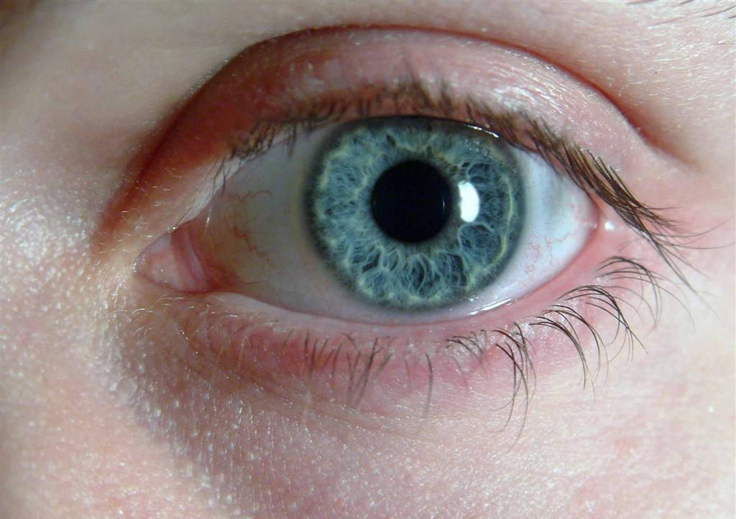
The Human Eye
http://medilinks.blogspot.com/2011/09/seq-paper-of-eye-rawalpindi-medical.html

Slide 2
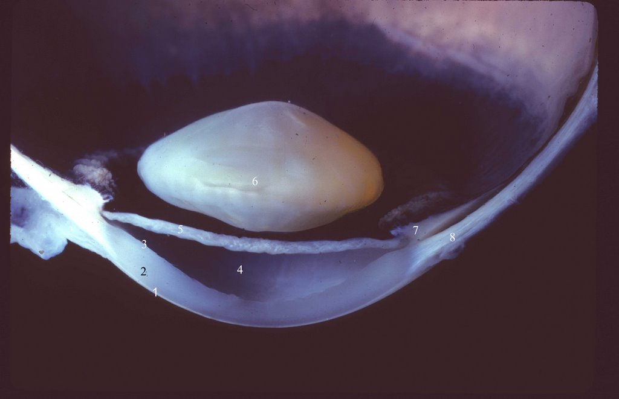
The Human Eye - Structure
http://www.missionforvisionusa.org/anatomy/uploaded_images/GrosASlabMfV-702936.jpg
1. Epithelium (cornea)
2. Stroma (cornea)
3. Descemet's membrane and endothelium (cornea)
4. Anterior chamber
5. Iris
6. Lens
7. ciliary body
8. sclera
Axial image of the human eye showing the major features of the lensing system.

Slide 3
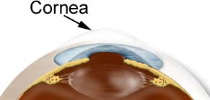
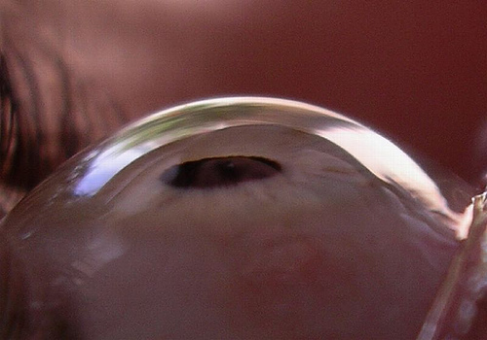
The Human Eye - Cornea
The cornea is the transparent, dome-shaped window covering the front of the eye. It is a powerful refracting surface, providing 2/3 of the eye’s focusing power. Like the crystal on a watch, it gives us a clear window to look through.
There are no blood vessels in the cornea (avascular), and it is normally clear with a shiny surface. The cornea is extremely sensitive - there are more nerve endings in the cornea than anywhere else in the body.
The adult cornea is between $\frac{1}{2} −1$ millimeter thick. The epithelial and endothelial cornea $50 −90μm (0.05 −0.09mm)$ and the stroma $0.5 −0.9mm.$
http://www.stlukeseye.com/anatomy/Cornea.asp
http://www.shorelinevision.com/visiondata/db/UPLOADEDIMAGES/cornea2-20071103-164958.jpg

Slide 4
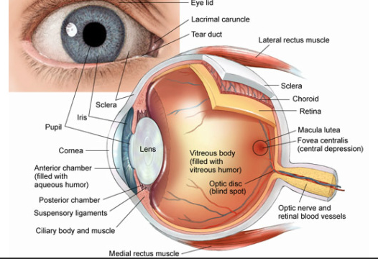
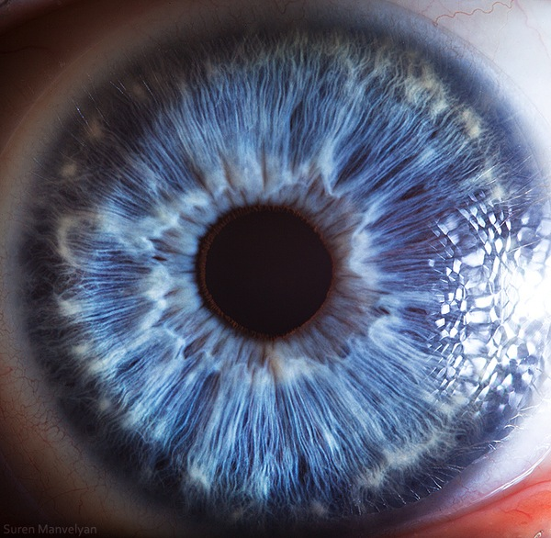
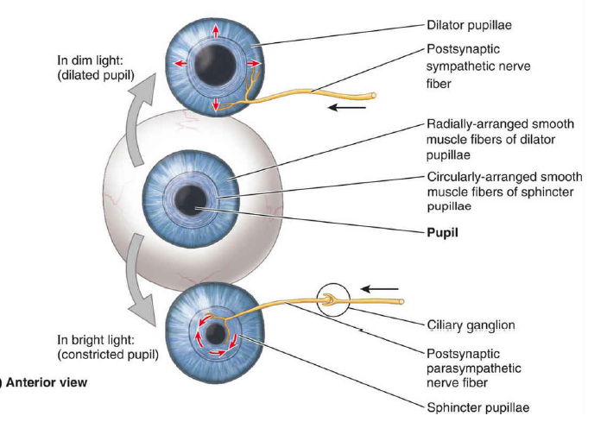
The Human Eye – Iris
The colored part of the eye which helps regulate the amount of light entering the eye through the pupil (black hole).
In bright light, the sphincter contracts, causing the pupil to constrict. The dilator muscle runs radially through the iris, like spokes on a wheel. This muscle dilates the eye in dim lighting.
The iris is flat and divides the front of the eye (anterior chamber) from the back of the eye (posterior chamber). Its color comes from microscopic pigment cells called melanin. The color, texture, and patterns of each person's iris are as unique as a fingerprint.
http://www.pceyeglasses.com/eye-anatomy.html
Clinically Oriented Anatomy, Keith L. Moore, et. al, 8th Ed., Wolters Kluwer, 2018/
https://www.smithsonianmag.com/smart-news/the-science-behind-these-amazing-photographs-of-the-human-eye-118697490/

Slide 5
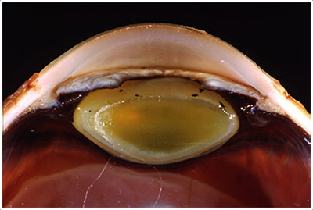
The Human Eye – Lens
The crystalline lens is located just behind the iris. Its purpose is to focus light onto the retina. The nucleus, the innermost part of the lens, is surrounded by softer material called the cortex. The lens is encased in a capsular-like bag and suspended within the eye by tiny delicate fibers called zonules.
In young people, the lens changes shape to adjust for close or distance vision. This is called accommodation. With age, the lens gradually hardens, diminishing the ability to accommodate.
http://www.med.mun.ca/getdoc/bb1b99b8-ccf3-4468-a4f7-330eb74a1317/Example-6.aspx
$$10mm$$
$$3−4mm$$
http://www.pceyeglasses.com/eye-anatomy.html
http://www.missionforvisionusa.org/anatomy/uploaded_images/GrosASlabMfV-702936.jpg

Slide 6
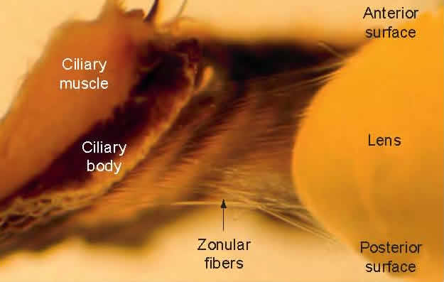
The Human Eye – Lens
An actual photograph of a human eye that has been bisected in the axial plane to show the view of the anterior segment from a posterior perspective (as though you are looking from the retina).
The crystalline lens is suspended by delicate fibers called the zonule. The ciliary body (CB) is composed of about 72 processes that make up the pars plicata and a flat area called the pars plana.
The ora serrata (ora) is the place where the retina joins the ciliary body.
https://www.thehealthscience.com/sites/default/files/a%20partially%20dissected%20human%20eye%20to%20show%20the%20accommodative%20structures.jpg

Slide 7
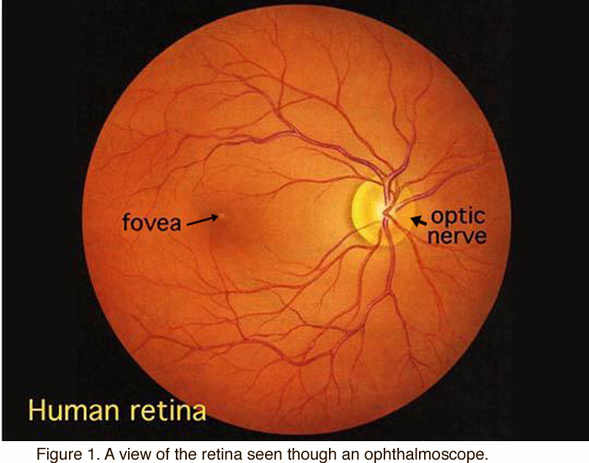
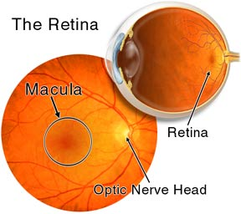
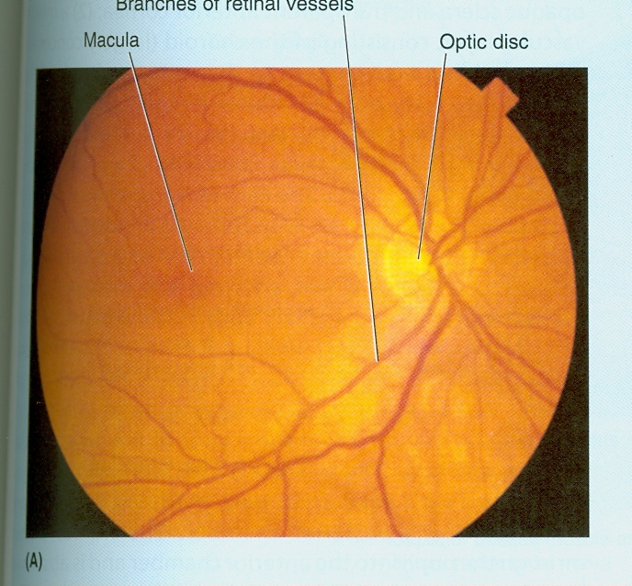
The Human Eye – Retina
The retina is a multi-layered sensory tissue that lines the back of the eye. It contains millions of photoreceptors that capture light rays and converts the light into electrical impulses. These impulses travel along the optic nerve to the brain where they are turned into images.
There are two types of photoreceptors in the retina: rods and cones.
The retina contains approximately 6 million cones, and they are contained in the macula, the portion of the retina responsible for central vision. They are most densely packed within the fovea, the very center portion of the macula. Cones function best in bright light and allow us to appreciate color.
There are approximately 125 million rods. They are spread throughout the peripheral retina and function best in dim lighting. The rods are responsible for peripheral and night vision.
Rods and cones work by total internal reflection.
Superior retinal arteries
(macula)
Inferior retinal arteries
http://www.stlukeseye.com/anatomy/Retina.asp
https://webvision.med.utah.edu/book/part-i-foundations/simple-anatomy-of-the-retina/

Slide 8
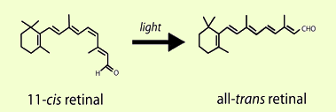
The Human Eye – Retina
The eye contains a molecule called 11-cis-retinal (a photosensitive derivative of vitamin A) that changes shape when struck by light of sufficient energy.
The change in shape triggers a series of events that result in an electrical signal being sent to the brain that results in vision.
http://photobiology.info/Crouch.html
The minimum energy need to change the structure of 11-cis-retinal to all-trans-retinal is about $164 \frac{kJ}{mole of photons}$. What’s the longest wavelength visible to the human eye?

Slide 9
The Human Eye – Refraction Errors
In a nutshell, the cornea aids in the focusing of light to create an image on the retina by means of refraction.
Often, the shape of the cornea and the eye are not perfect and the image on the retina is out-of-focus.
There are three primary types of refractive errors (or imperfections in the focusing power of the eye.)
Myopia – or nearsightedness
Persons with myopia, or nearsightedness, have more difficulty seeing distant objects as clearly as near objects.
Hyperopia - or farsightedness
Persons with farsightedness have more difficulty seeing near objects as clearly as distant objects.
Astigmatism – which is a distortion of the image on the retina caused by irregularities in the cornea or lens of the eye (usually due to the cornea not being spherical, but oval in shape.)

Slide 10
The Human Eye – Myopia
Myopia – or nearsightedness
Persons with myopia, or nearsightedness, have more difficulty seeing distant objects as clearly as near objects
Human Physiology, From Cells to Systems, 6th Ed., Sherwood

Slide 11
The Human Eye – Myopia Correction
Suppose that you have the ocular condition known as myopia, or near-sightedness. This means objects near to your eye are clearly focused on your retina while objects far away are not.
For persons with the near-sightedness, as the object moves away from the lens of your eye, the clear image of that object
1. focuses on a point behind the retina.
2. focuses on a point in front of the retina between your lens and retina.
3. focuses at a point on the exterior side of your eye, that is at a point in front of your face.
4. cannot be determined since the actual object distance and focal length of your eye is unknown.
If an object was placed at 25cm from your eye and a clear image forms on your retina located 2.5cm behind your lens, what is the focal length of your eye?
In a near-sighted eye your lens no longer can change its focal length so that objects located far away cannot be focused clearly on the retina. Objects can be brought into focus on your retina by using a second lens (glasses) in combination with the lens of your eye. Suppose that you want to see clearly an object located 1.5m from your eyes. If your glasses are 1.5cm from your eye, what are the power of the lenses and the type of lens that you would need to correct for myopia?

Slide 12
The Human Eye – Hyperopia
Hyperopia - or farsightedness
Persons with farsightedness have more difficulty seeing near objects as clearly as distant objects.
An associated condition is called presbyopia or the natural moving of the near point of the eye outwards. This is an artifact of aging where the crystalline lens no longer accommodates as it does when you are young.
Human Physiology, From Cells to Systems, 6th Ed., Sherwood

Slide 13
The Human Eye – Hyperopia Correction
Suppose that you have the ocular condition known as hyperopia, or far-sightedness. This means objects far away from your eye are clearly focused on your retina while objects up close are not.
For persons with the far-sightedness, as the object moves towards the lens of your eye, the clear image of that object
1. focuses on a point behind the retina.
2. focuses on a point in front of the retina between your lens and retina.
3. focuses at a point on the exterior side of your eye, that is at a point in front of your face.
4. cannot be determined since the actual object distance and focal length of your eye is unknown.
In a far-sighted eye your lens can no longer change its focal length so that objects located far away can be focused clearly on the retina. Objects can be brought into focus on your retina by using a second lens (glasses) in combination with the lens of your eye. Suppose that you want to see clearly an object located 25cm from your eye. If your glasses are 1.5cm from your eye, what are the power and the type of lens that you would need to correct for hyperopia if you can clearly focus on objects located 75cm and farther from your eyes?

