Slide 1

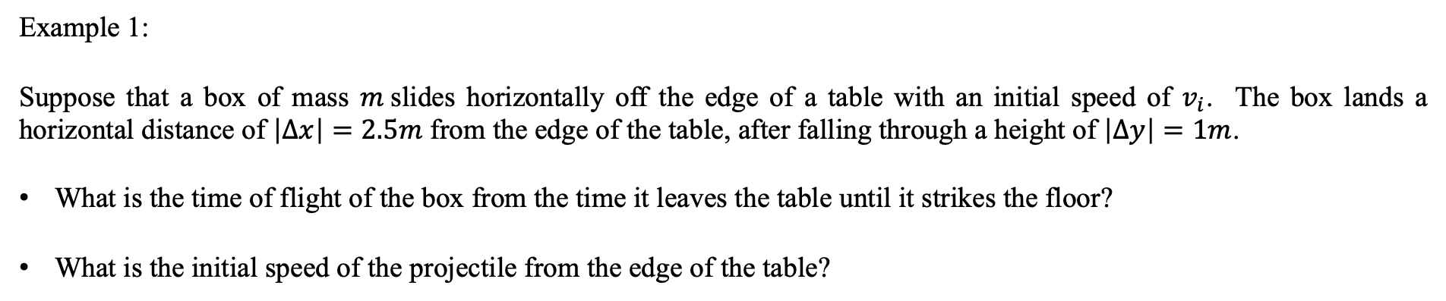



Motion in 2D
- projectile motion
Example 1:
Suppose that a box of mass $m$slides horizontally off the edge of a table with an initial speed of $v_{i}$. The box lands a horizontal distance of $\left|∆x\right|=2.5m$ from the edge of the table, after falling through a height of $\left|∆y\right|=1m$.
What is the time of flight of the box from the time it leaves the table until it strikes the floor?
What is the initial speed of the projectile from the edge of the table?
$$m$$
$$v_{i}$$
$$\left|∆y\right|=1m$$
$\left|∆x\right|=2.5m$

Slide 2
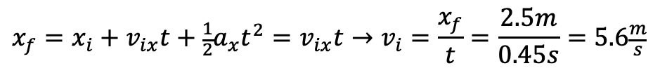
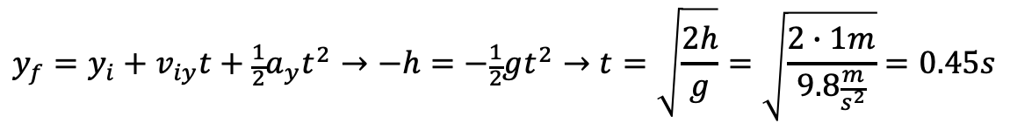
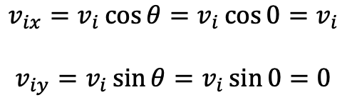
Motion in 2D
- projectile motion
Example 1 Solution:
What is the time of flight of the box from the time it leaves the table until it strikes the floor?
What is the initial speed of the projectile from the edge of the table?
$$\begin{matrix}v_{ix}=v_{i}\cos{θ}=v_{i}\cos{0}=v_{i} \\ \\ v_{iy}=v_{i}\sin{θ}=v_{i}\sin{0}=0\end{matrix}$$
$$y_{f}=y_{i}+v_{iy}t+\frac{1}{2}a_{y}t^{2}→−h=−\frac{1}{2}gt^{2}→t=\sqrt{\frac{2h}{g}}=\sqrt{\frac{2∙1m}{9.8\frac{m}{s^{2}}}}=0.45s$$
$$x_{f}=x_{i}+v_{ix}t+\frac{1}{2}a_{x}t^{2}=v_{ix}t→v_{i}=\frac{x_{f}}{t}=\frac{2.5m}{0.45s}=5.6\frac{m}{s}$$

Slide 3
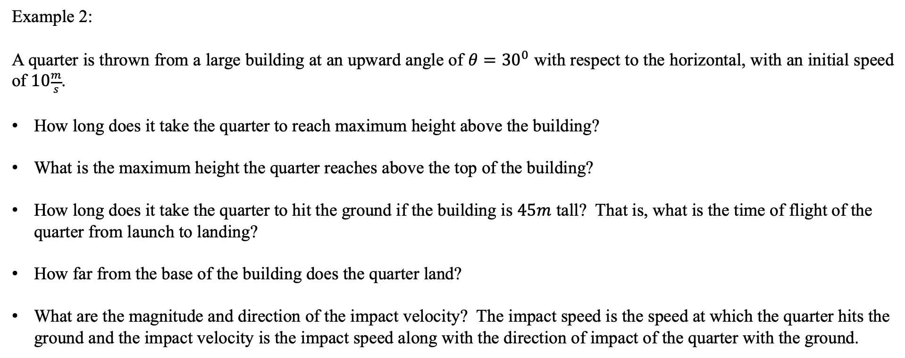
Motion in 2D
- projectile motion
Example 2:
A quarter is thrown from a large building at an upward angle of $θ={30}^{0}$ with respect to the horizontal, with an initial speed of $10\frac{m}{s}$.
How long does it take the quarter to reach maximum height above the building?
What is the maximum height the quarter reaches above the top of the building?
How long does it take the quarter to hit the ground if the building is $45m$ tall? That is, what is the time of flight of the quarter from launch to landing?
How far from the base of the building does the quarter land?
What are the magnitude and direction of the impact velocity? The impact speed is the speed at which the quarter hits the ground and the impact velocity is the impact speed along with the direction of impact of the quarter with the ground.

Slide 4
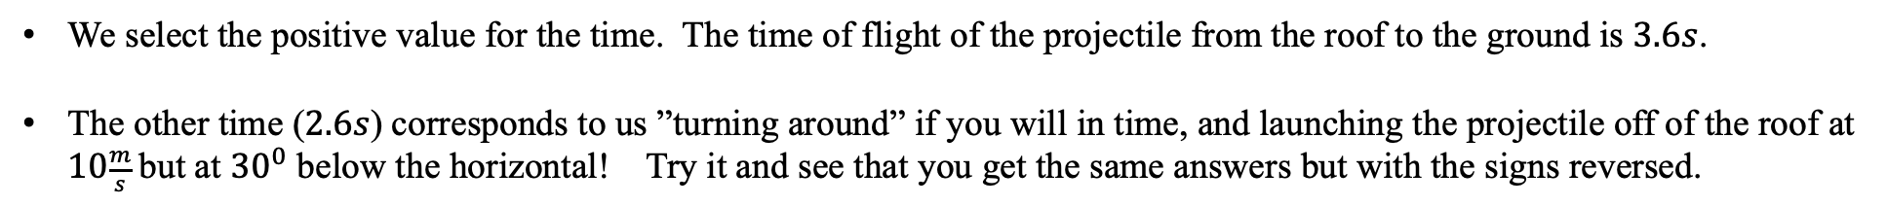
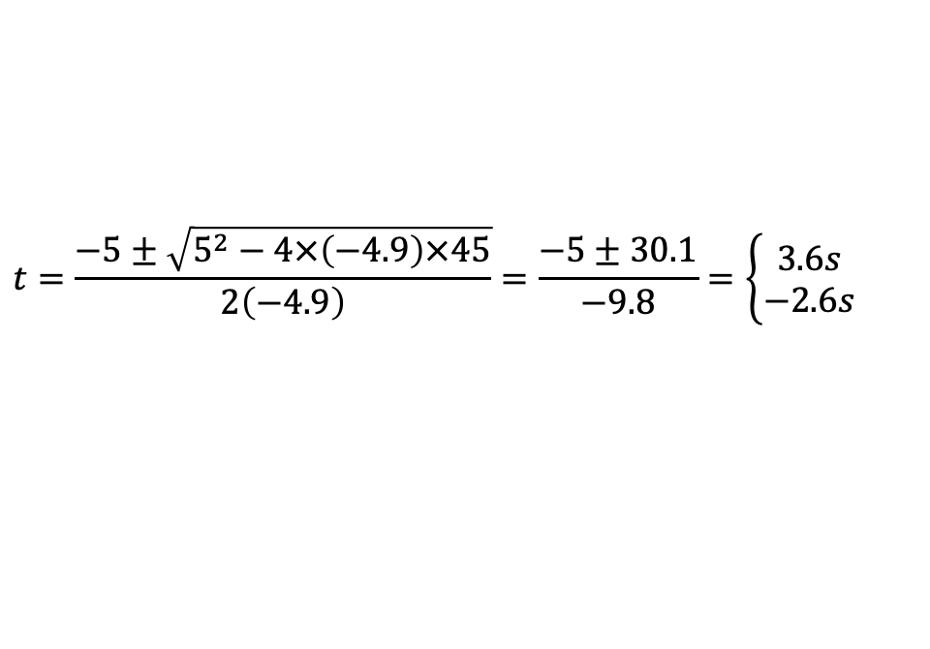

Motion in 2D
- projectile motion
Example 2 solution:
For the solutions below, we will need the horizontal and vertical components of the initial velocity. Let’s calculate them now:
To calculate the time of flight of the quarter from the roof to the ground, we use our vertical trajectory equation of motion.
$$v_{ix}=v_{i}\cos{θ}=10\frac{m}{s}\cos{30}=8.66\frac{m}{s}$$
$$v_{iy}=v_{i}\sin{θ}=10\frac{m}{s}\sin{30}=5.00\frac{m}{s}$$
$$y_{f}=y_{i}+v_{iy}t+\frac{1}{2}a_{y}t^{2}→{0=−y}_{f}+v_{iy}t−\frac{1}{2}gt^{2}=−\left(−45\right)+5t−4.9t^{2}$$
$$t=\frac{−5±\sqrt{5^{2}−4×\left(−4.9\right)×45}}{2\left(−4.9\right)}=\frac{−5±30.1}{−9.8}=\left\{\begin{matrix}3.6s \\ −2.6s\end{matrix}\right.$$
We select the positive value for the time. The time of flight of the projectile from the roof to the ground is $3.6s$.
The other time ($2.6s$) corresponds to us ”turning around” if you will in time, and launching the projectile off of the roof at $10\frac{m}{s}$but at ${30}^{0}$ below the horizontal! Try it and see that you get the same answers but with the signs reversed.

Slide 5
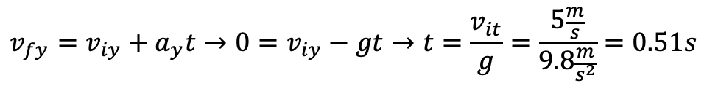
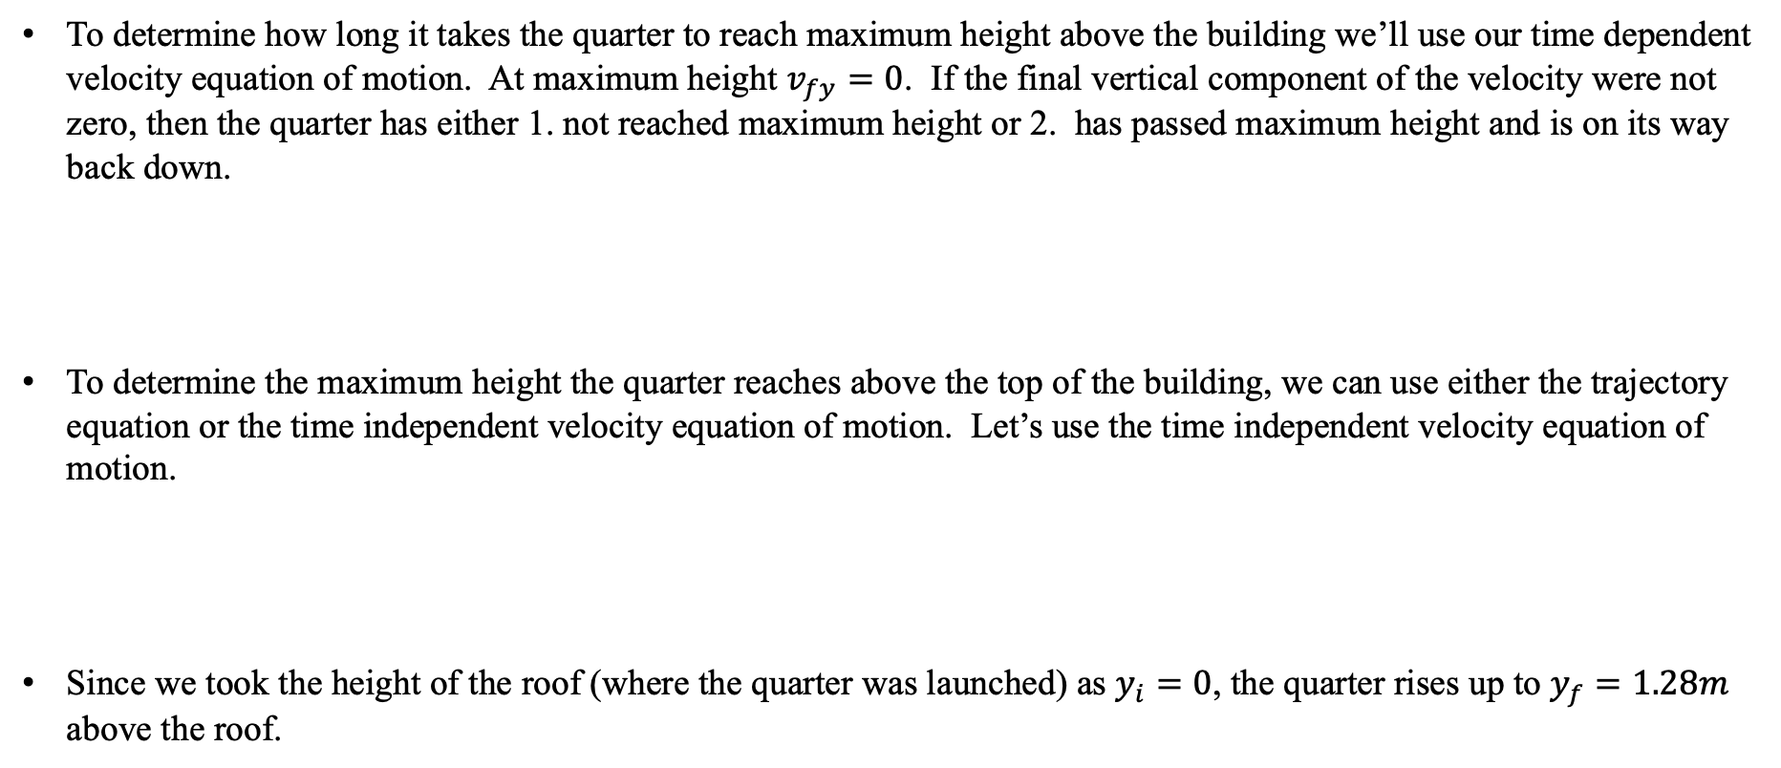
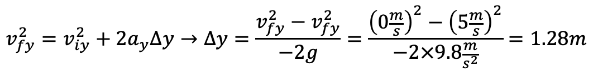
Motion in 2D
- projectile motion
Example 2 solution continued:
To determine how long it takes the quarter to reach maximum height above the building we’ll use our time dependent velocity equation of motion. At maximum height $v_{fy}=0$. If the final vertical component of the velocity were not zero, then the quarter has either 1. not reached maximum height or 2. has passed maximum height and is on its way back down.
To determine the maximum height the quarter reaches above the top of the building, we can use either the trajectory equation or the time independent velocity equation of motion. Let’s use the time independent velocity equation of motion.
Since we took the height of the roof (where the quarter was launched) as $y_{i}=0$, the quarter rises up to $y_{f}=1.28m$ above the roof.
$$v_{fy}=v_{iy}+a_{y}t→0=v_{iy}−gt→t=\frac{v_{it}}{g}=\frac{5\frac{m}{s}}{9.8\frac{m}{s^{2}}}=0.51s$$
$$v_{fy}^{2}=v_{iy}^{2}+2a_{y}∆y→∆y=\frac{v_{fy}^{2}−v_{fy}^{2}}{−2g}=\frac{{\left(0\frac{m}{s}\right)}^{2}−{\left(5\frac{m}{s}\right)}^{2}}{−2×9.8\frac{m}{s^{2}}}=1.28m$$

Slide 6

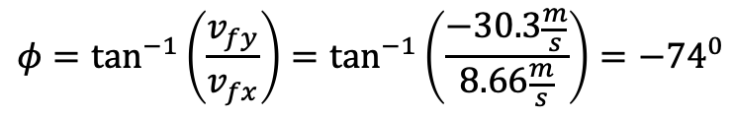
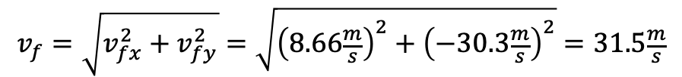
Motion in 2D
- projectile motion
Example 2 solution continued:
The horizontal distance that the quarter lands from the base of the building is determined from the time of flight of the projectile using the horizontal trajectory equation.
Since we know the time of flight of the projectile, we can find the magnitude and direction of the impact velocity. We’ll use the time dependent velocity equations of motion. Note, we can also find this from the time-independent equations of motion, except we’d have to insert the signs for the components of the velocity in the x- and y-directions to determine the vector components.
$$x_{f}=x_{i}+v_{ix}t+\frac{1}{2}a_{x}t^{2}→x_{f}=v_{ix}t=8.66\frac{m}{s}×3.6s=31.2m$$
$$v_{fx}=v_{ix}+a_{x}t→v_{fx}=v_{ix}=8.66\frac{m}{s}$$
$$v_{fy}=v_{iy}+a_{y}t→v_{fy}=v_{iy}−gt=5\frac{m}{s}−9.8\frac{m}{s^{2}}\left(3.6s\right)=−30.3\frac{m}{s}$$
$$v_{f}=\sqrt{v_{fx}^{2}+v_{fy}^{2}}=\sqrt{{\left(8.66\frac{m}{s}\right)}^{2}+{\left(−30.3\frac{m}{s}\right)}^{2}}=31.5\frac{m}{s}$$
$$φ=\tan^{−1}\left(\frac{v_{fy}}{v_{fx}}\right)=\tan^{−1}\left(\frac{−30.3\frac{m}{s}}{8.66\frac{m}{s}}\right)=−{74}^{0}$$
Thus, the impact velocity has a magnitude of $31.5\frac{m}{s} \left(\sim 71\frac{mi}{hr}\right)$and is pointed at ${74}^{0}$below the positive x-axis. By the way, don’t toss anything off of a tall building. At these speeds you could really hurt (or kill) someone.

Slide 7
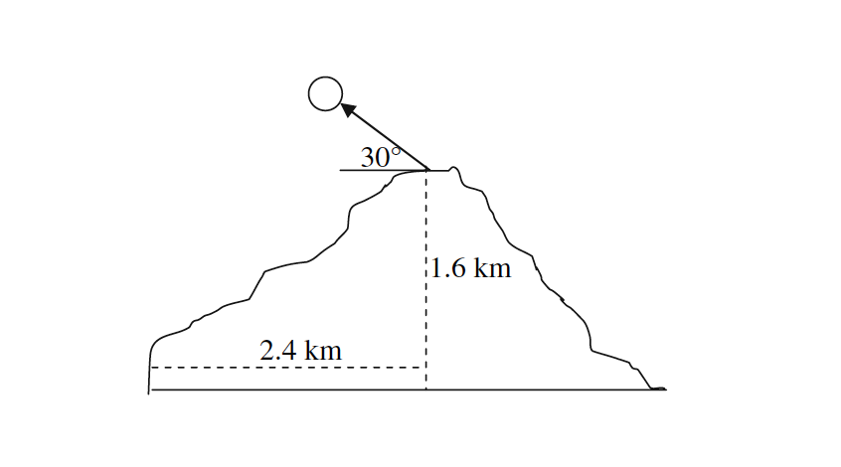
Motion in 2D
- projectile motion
Example 3:
The islands of Hawaii are a beautiful place to live and a great vacation spot, boasting lush tropical forests, pristine beaches, and an active volcano. In 2018 the volcano Kilauea was actively erupting on the big island of Hawaii. Some residents were trying to defend their homes from active lava flows and from lava bombs. In fact, a man made the news in May 2018 after he was hit by a lava bomb trying to save his home. Lava bombs are solid chunks of rock ejected from a volcano. Consider a schematic of a volcano, shown on the right, with a lava bomb being ejected.
With what magnitude of the initial velocity (launch speed), at the top of the volcano, would the lava bomb have to have for the lava bomb to land at the base of the volcano?
What would be the time of flight of this lava bomb from the top of the volcano to its base?
What is the final velocity of the lava bomb, expressed as a magnitude and direction, just before the lava bomb hits the ground at the base? This is the impact velocity.
What is the acceleration of the lava bomb just before it hits the ground at the base?

Slide 8
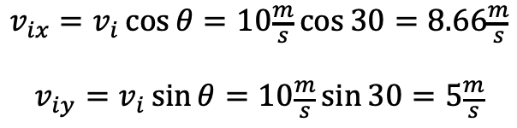

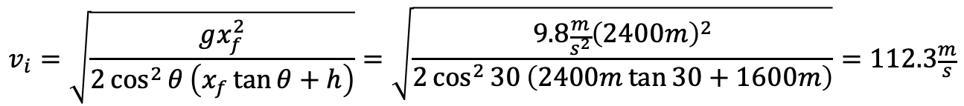
Motion in 2D
- projectile motion
Example 3 Solution:
With what magnitude of the initial velocity (launch speed), at the top of the volcano, would the lava bomb have to have for the lava bomb to land at the base of the volcano?
$$\begin{matrix}v_{ix}=v_{i}\cos{θ}=10\frac{m}{s}\cos{30}=8.66\frac{m}{s} \\ \\ v_{iy}=v_{i}\sin{θ}=10\frac{m}{s}\sin{30}=5\frac{m}{s}\end{matrix}$$
Here we don’t know how long it takes the projectile to get from the top to the base of the volcano because we don’t know the launch speed. But both of the trajectory equations are coupled by time. We’ll eliminate time between the two equations and wrote the vertical position in terms of the horizontal position.
$$x_{f}=x_{i}+v_{ix}t+\frac{1}{2}a_{x}t^{2}=v_{ix}t→t=\frac{x_{f}}{v_{ix}}=\frac{x_{f}}{v_{i}\cos{θ}}$$
$$y_{f}=y_{i}+v_{iy}t+\frac{1}{2}a_{y}t^{2}→y_{f}=v_{i}\sin{θ}\left(\frac{x_{f}}{v_{i}\cos{θ}}\right)−\frac{1}{2}g{\left(\frac{x_{f}}{v_{i}\cos{θ}}\right)}^{2}→−h=x_{f}\tan{θ}−\frac{gx_{f}^{2}}{2v_{i}^{2}\cos^{2}{θ}}$$
$$v_{i}=\sqrt{\frac{gx_{f}^{2}}{2\cos^{2}{θ}\left(x_{f}\tan{θ}+h\right)}}=\sqrt{\frac{9.8\frac{m}{s^{2}}{\left(2400m\right)}^{2}}{2\cos^{2}{30}\left(2400m\tan{30}+1600m\right)}}=112.3\frac{m}{s}$$

Slide 9
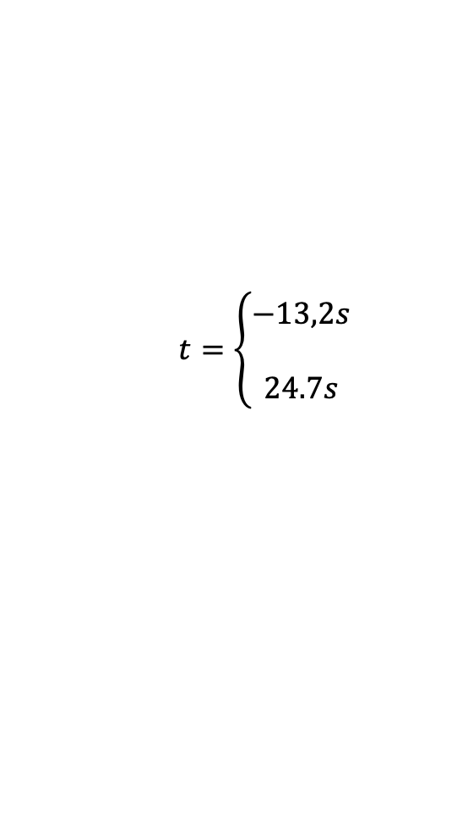
Motion in 2D
- projectile motion
Example 3 Solution:
What would be the time of flight of this lava bomb from the top of the volcano to its base?
$$x_{f}=x_{i}+v_{ix}t+\frac{1}{2}a_{x}t^{2}=v_{ix}t→t=\frac{x_{f}}{v_{ix}}=\frac{x_{f}}{v_{i}\cos{θ}}=\frac{2400m}{112.3\frac{m}{s}\cos{30}}=24.7s$$
Or,
$$y_{f}=y_{i}+v_{iy}t+\frac{1}{2}a_{y}t^{2}→−1600=\left(112.3\sin{30}\right)t−4.9t^{2}→0=4.9t^{2}−56 t−1600=0$$
$$t=\left\{\begin{matrix}−13,2s \\ \\ 24.7s\end{matrix}\right.$$
And we chose the positive time for the time of flight.
What is the acceleration of the lava bomb just before it hits the ground at the base?
The only acceleration that acts (ignoring air resistance) is due to gravity and acts vertically down everywhere throughout the flight of the projectile.

Slide 10

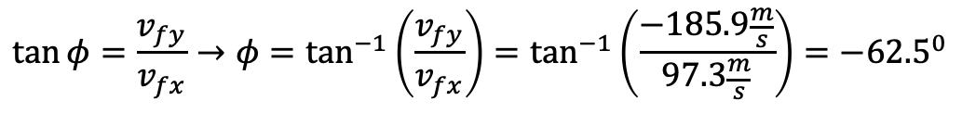
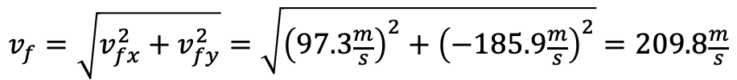
Motion in 2D
- projectile motion
Example 3 Solution:
What is the final velocity of the lava bomb, expressed as a magnitude and direction, just before the lava bomb hits the ground at the base? This is the impact velocity.
$$v_{fx}=v_{ix}+a_{x}t=v_{ix}=v_{i}\cos{θ}=112.3\frac{m}{s}\cos{30}=97.3\frac{m}{s}$$
$$v_{fy}=v_{iy}+a_{y}t=v_{iy}−gt=v_{i}\sin{θ}−gt=112.3\frac{m}{s}\sin{30}−9.8\frac{m}{s^{2}}∙24.7s=−185.9\frac{m}{s}$$
The impact speed:
$$v_{f}=\sqrt{v_{fx}^{2}+v_{fy}^{2}}=\sqrt{{\left(97.3\frac{m}{s}\right)}^{2}+{\left(−185.9\frac{m}{s}\right)}^{2}}=209.8\frac{m}{s}$$
The impact direction:
$$\tan{φ}=\frac{v_{fy}}{v_{fx}}→φ=\tan^{−1}\left(\frac{v_{fy}}{v_{fx}}\right)=\tan^{−1}\left(\frac{−185.9\frac{m}{s}}{97.3\frac{m}{s}}\right)={−62.5}^{0}$$
The angle of impact is ${62.5}^{0}$ below the x-axis.

Slide 11
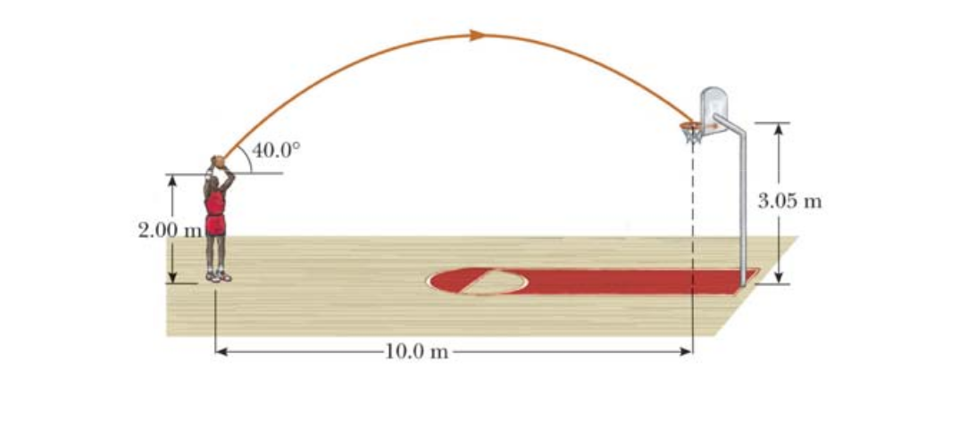
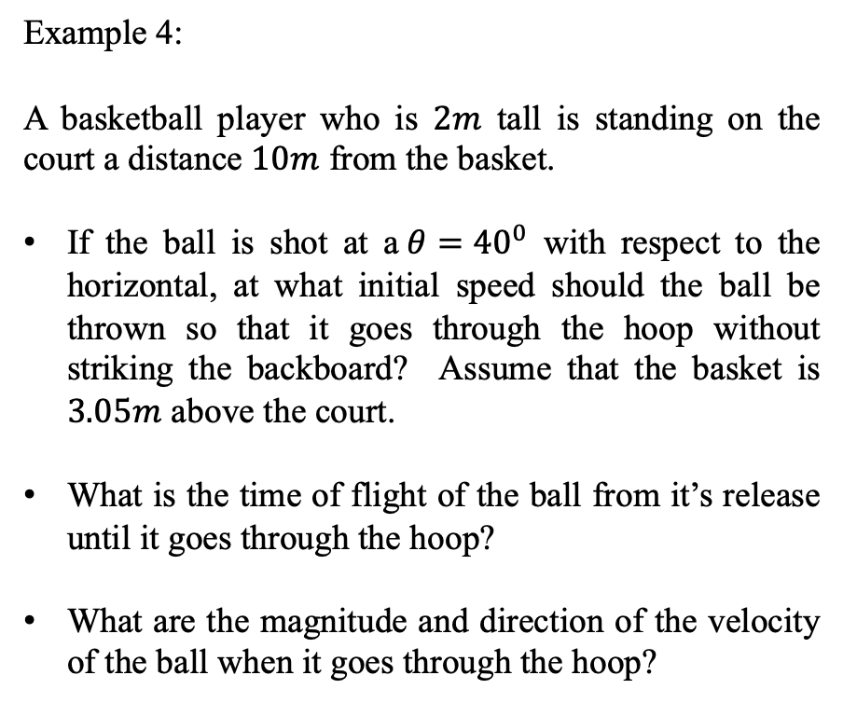
Motion in 2D
- projectile motion
Example 4:
A basketball player who is $2m$ tall is standing on the court a distance $10m$ from the basket.
If the ball is shot at a$θ={40}^{0}$ with respect to the horizontal, at what initial speed should the ball be thrown so that it goes through the hoop without striking the backboard? Assume that the basket is $3.05m$ above the court.
What is the time of flight of the ball from it’s release until it goes through the hoop?
What are the magnitude and direction of the velocity of the ball when it goes through the hoop?

Slide 12

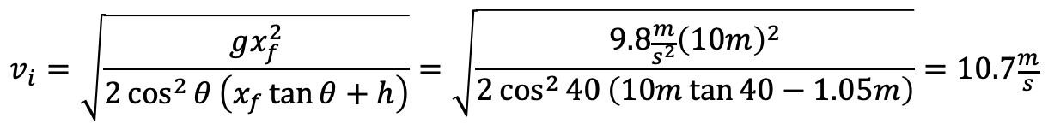
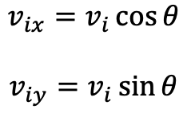
Motion in 2D
- projectile motion
Example 4 Solution:
If the ball is shot at a$θ={40}^{0}$ with respect to the horizontal, at what initial speed should the ball be thrown so that it goes through the hoop without striking the backboard? Assume that the basket is $3.05m$ above the court.
$$\begin{matrix}v_{ix}=v_{i}\cos{θ} \\ \\ v_{iy}=v_{i}\sin{θ}\end{matrix}$$
Here we don’t know how long it takes the basketball to get from the the player to the net because we don’t know the launch speed. But both of the trajectory equations are coupled by time. We’ll eliminate time between the two equations and wrote the vertical position in terms of the horizontal position.
$$x_{f}=x_{i}+v_{ix}t+\frac{1}{2}a_{x}t^{2}=v_{ix}t→t=\frac{x_{f}}{v_{ix}}=\frac{x_{f}}{v_{i}\cos{θ}}$$
$$y_{f}=y_{i}+v_{iy}t+\frac{1}{2}a_{y}t^{2}→y_{f}=v_{i}\sin{θ}\left(\frac{x_{f}}{v_{i}\cos{θ}}\right)−\frac{1}{2}g{\left(\frac{x_{f}}{v_{i}\cos{θ}}\right)}^{2}→h=x_{f}\tan{θ}−\frac{gx_{f}^{2}}{2v_{i}^{2}\cos^{2}{θ}}$$
$$v_{i}=\sqrt{\frac{gx_{f}^{2}}{2\cos^{2}{θ}\left(x_{f}\tan{θ}+h\right)}}=\sqrt{\frac{9.8\frac{m}{s^{2}}{\left(10m\right)}^{2}}{2\cos^{2}{40}\left(10m\tan{40}−1.05m\right)}}=10.7\frac{m}{s}$$

Slide 13
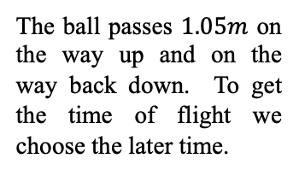
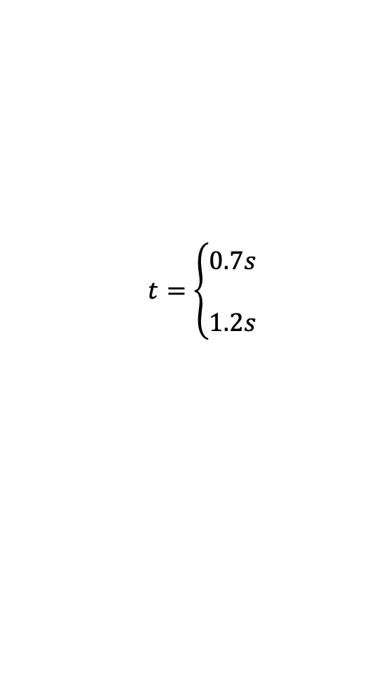
Motion in 2D
- projectile motion
Example 4 Solution:
What is the time of flight of the ball from it’s release until it goes through the hoop?
$$x_{f}=x_{i}+v_{ix}t+\frac{1}{2}a_{x}t^{2}=v_{ix}t→t=\frac{x_{f}}{v_{ix}}=\frac{x_{f}}{v_{i}\cos{θ}}=\frac{10m}{10.7\frac{m}{s}\cos{40}}=1.2s$$
Or,
$$y_{f}=y_{i}+v_{iy}t+\frac{1}{2}a_{y}t^{2}→1.05=\left(10.7\sin{40}\right)t−4.9t^{2}→0=4.9t^{2}−6.9 t+1.05=0$$
The ball passes $1.05m$ on the way up and on the way back down. To get the time of flight we choose the later time.
$$t=\left\{\begin{matrix}0.7s \\ \\ 1.2s\end{matrix}\right.$$

Slide 14

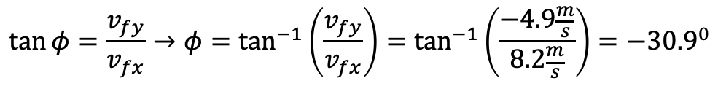
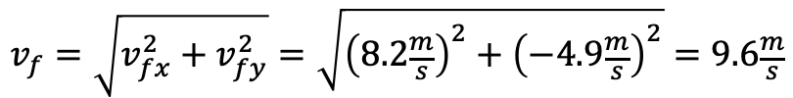
Motion in 2D
- projectile motion
Example 4 Solution:
What are the magnitude and direction of the velocity of the ball when it goes through the hoop?
$$v_{fx}=v_{ix}+a_{x}t=v_{ix}=v_{i}\cos{θ}=10.7\frac{m}{s}\cos{40}=8.2\frac{m}{s}$$
$$v_{fy}=v_{iy}+a_{y}t=v_{iy}−gt=v_{i}\sin{θ}−gt=10.7\frac{m}{s}\sin{40}−9.8\frac{m}{s^{2}}∙1.2s=−4.9\frac{m}{s}$$
The impact speed:
$$v_{f}=\sqrt{v_{fx}^{2}+v_{fy}^{2}}=\sqrt{{\left(8.2\frac{m}{s}\right)}^{2}+{\left(−4.9\frac{m}{s}\right)}^{2}}=9.6\frac{m}{s}$$
The impact direction:
$$\tan{φ}=\frac{v_{fy}}{v_{fx}}→φ=\tan^{−1}\left(\frac{v_{fy}}{v_{fx}}\right)=\tan^{−1}\left(\frac{−4.9\frac{m}{s}}{8.2\frac{m}{s}}\right)={−30.9}^{0}$$
The angle of impact is ${30.9}^{0}$ below the x-axis.

Slide 15
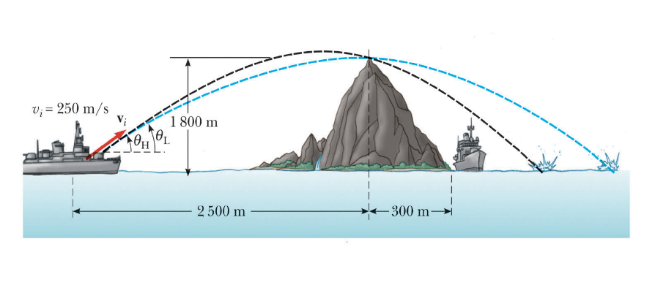
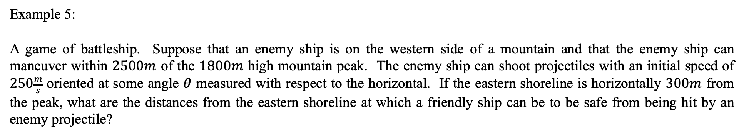
Motion in 2D
- projectile motion
Example 5:
A game of battleship. Suppose that an enemy ship is on the western side of a mountain and that the enemy ship can maneuver within $2500m$ of the $1800m$ high mountain peak. The enemy ship can shoot projectiles with an initial speed of $250\frac{m}{s}$ oriented at some angle $θ$ measured with respect to the horizontal. If the eastern shoreline is horizontally $300m$ from the peak, what are the distances from the eastern shoreline at which a friendly ship can be to be safe from being hit by an enemy projectile?

Slide 16
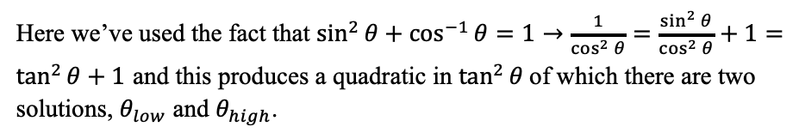
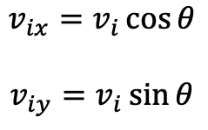

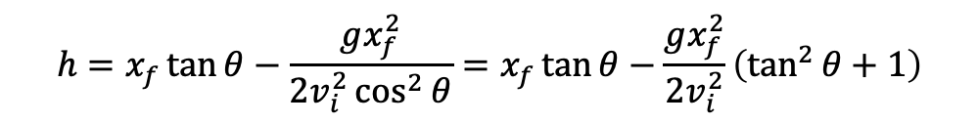
Motion in 2D
- projectile motion
Example 5 Solution:
What are the angles $θ_{low}$ and $θ_{high}$ that we can launch the projectile so that it will clear the mountain?
$$\begin{matrix}v_{ix}=v_{i}\cos{θ} \\ \\ v_{iy}=v_{i}\sin{θ}\end{matrix}$$
Here we don’t know how long it takes the projectile to get from the top to the ship to the top of the mountain because we don’t know the launch angles involved. But both of the trajectory equations are coupled by time. We’ll eliminate time between the two equations and wrote the vertical position in terms of the horizontal position.
$$x_{f}=x_{i}+v_{ix}t+\frac{1}{2}a_{x}t^{2}=v_{ix}t→t=\frac{x_{f}}{v_{ix}}=\frac{x_{f}}{v_{i}\cos{θ}}$$
$$y_{f}=y_{i}+v_{iy}t+\frac{1}{2}a_{y}t^{2}→y_{f}=v_{i}\sin{θ}\left(\frac{x_{f}}{v_{i}\cos{θ}}\right)−\frac{1}{2}g{\left(\frac{x_{f}}{v_{i}\cos{θ}}\right)}^{2}→h=x_{f}\tan{θ}−\frac{gx_{f}^{2}}{2v_{i}^{2}\cos^{2}{θ}}$$
$$h=x_{f}\tan{θ}−\frac{gx_{f}^{2}}{2v_{i}^{2}\cos^{2}{θ}}=x_{f}\tan{θ}−\frac{gx_{f}^{2}}{2v_{i}^{2}}\left(\tan^{2}{θ}+1\right)$$
Here we’ve used the fact that $\sin^{2}{θ}+\cos^{−1}{θ}=1→\frac{1}{\cos^{2}{θ}}=\frac{\sin^{2}{θ}}{\cos^{2}{θ}}+1=\tan^{2}{θ}+1$ and this produces a quadratic in $\tan^{2}{θ}$of which there are two solutions, $θ_{low}$ and $θ_{high}$.
$$→0=\frac{gx_{f}^{2}}{2v_{i}^{2}}\tan^{2}{θ}−x_{f}\tan{θ}+\left(\frac{gx_{f}^{2}}{2v_{i}^{2}}+h\right)$$

Slide 17
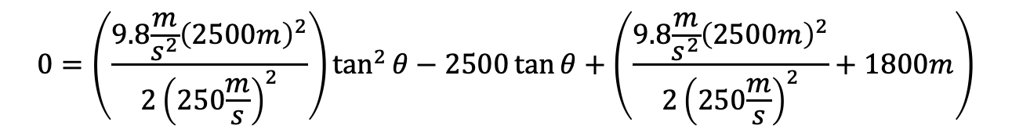

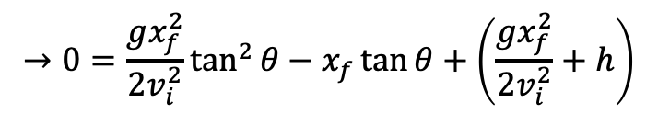

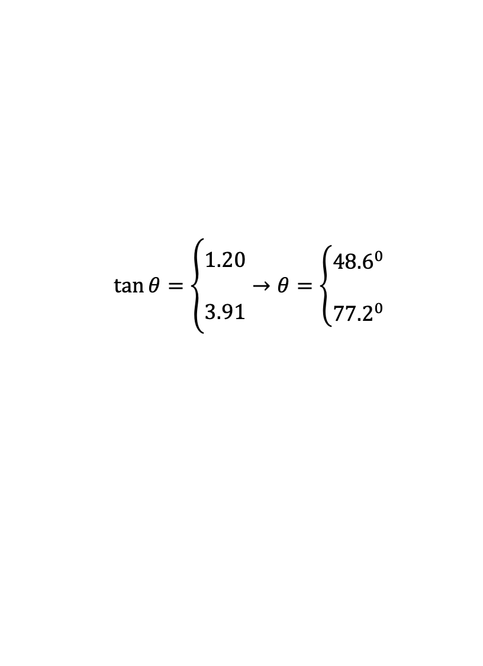
Motion in 2D
- projectile motion
Example 5 Solution:
$$→0=\frac{gx_{f}^{2}}{2v_{i}^{2}}\tan^{2}{θ}−x_{f}\tan{θ}+\left(\frac{gx_{f}^{2}}{2v_{i}^{2}}+h\right)$$
$$0=\left(\frac{9.8\frac{m}{s^{2}}{\left(2500m\right)}^{2}}{2{\left(250\frac{m}{s}\right)}^{2}}\right)\tan^{2}{θ}−2500\tan{θ}+\left(\frac{9.8\frac{m}{s^{2}}{\left(2500m\right)}^{2}}{2{\left(250\frac{m}{s}\right)}^{2}}+1800m\right)$$
$$0=490\tan^{2}{θ}−2500\tan{θ}+2290$$
$$\tan{θ}=\left\{\begin{matrix}1.20 \\ \\ 3.91\end{matrix}→θ=\left\{\begin{matrix}{48.6}^{0} \\ \\ {77.2}^{0}\end{matrix}\right.\right.$$
$$θ_{low}={50.1}^{0}$$
$$θ_{high}={75.7}^{0}$$

Slide 18

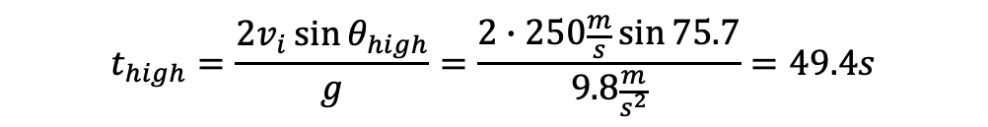

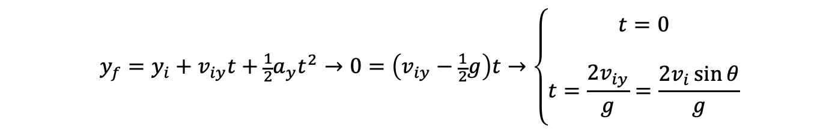

Motion in 2D
- projectile motion
Example 5 Solution:
The time of flight of the projectile at angles $θ_{low}$ and $θ_{high}$ assuming that they start and end at the same height.
$$y_{f}=y_{i}+v_{iy}t+\frac{1}{2}a_{y}t^{2}→0=\left(v_{iy}−\frac{1}{2}g\right)t→\left\{\begin{matrix}t=0 \\ \\ t=\frac{2v_{iy}}{g}=\frac{2v_{i}\sin{θ}}{g}\end{matrix}\right.$$
For $θ_{low}$:
$$t_{low}=\frac{2v_{i}\sin{θ_{low}}}{g}=\frac{2∙250\frac{m}{s}\sin{50.1}}{9.8\frac{m}{s^{2}}}=39.1s$$
For $θ_{high}:$
$$t_{high}=\frac{2v_{i}\sin{θ_{high}}}{g}=\frac{2∙250\frac{m}{s}\sin{75.7}}{9.8\frac{m}{s^{2}}}=49.4s$$

Slide 19


Motion in 2D
- projectile motion
Example 5 Solution:
The horizontal range of the projectile at angles $θ_{low}$ and $θ_{high}$ and where will the ship be safe:
$$x_{f}=x_{i}+v_{ix}t+\frac{1}{2}a_{x}t^{2}=v_{ix}t=\left(v_{i}\cos{θ}\right)t$$
For $θ_{low}$:
$$x_{f,low}=\left(v_{i}\cos{θ_{low}}\right)t_{low}=250\frac{m}{s}∙39.1s\cos{50.1}=6270m$$
For $θ_{high}:$
$$x_{f,high}=\left(v_{i}\cos{θ_{high}}\right)t_{high}=250\frac{m}{s}∙49.4s\cos{75.5}=3092m$$
The ship will be safe if it is at a distance greater than $6270m−2800m=3470m$ from the right shore (the projectile cannot reach farther than this) or at a distance between the shore and $3092m−2800m=292m.$

Slide 20
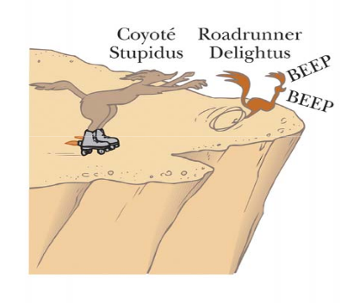
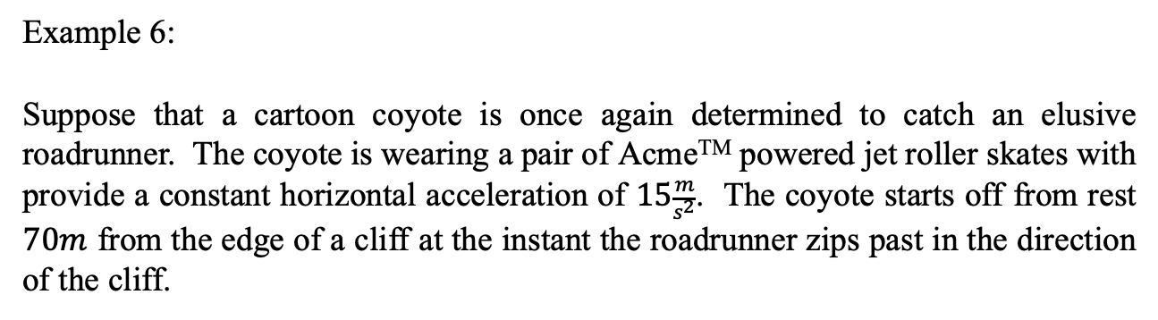
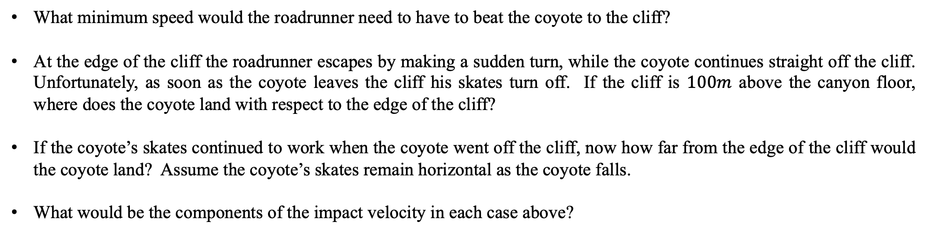
Motion in 2D
- projectile motion
Example 6:
Suppose that a cartoon coyote is once again determined to catch an elusive roadrunner. The coyote is wearing a pair of AcmeTM powered jet roller skates with provide a constant horizontal acceleration of $15\frac{m}{s^{2}}$. The coyote starts off from rest $70m$ from the edge of a cliff at the instant the roadrunner zips past in the direction of the cliff.
What minimum speed would the roadrunner need to have to beat the coyote to the cliff?
At the edge of the cliff the roadrunner escapes by making a sudden turn, while the coyote continues straight off the cliff. Unfortunately, as soon as the coyote leaves the cliff his skates turn off. If the cliff is $100m$ above the canyon floor, where does the coyote land with respect to the edge of the cliff?
If the coyote’s skates continued to work when the coyote went off the cliff, now how far from the edge of the cliff would the coyote land? Assume the coyote’s skates remain horizontal as the coyote falls.
What would be the components of the impact velocity in each case above?

Slide 21
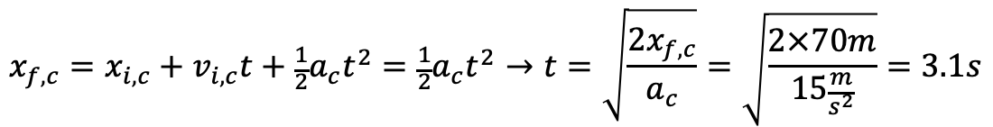
Motion in 2D
- projectile motion
Example 6 solution:
To determine the minimum speed would the roadrunner need to have to beat the coyote to the cliff we write a trajectory equation for the coyote and for the roadrunner.
Then, from the coyote’s motion we can determine how long it takes for the coyote to get to the edge of the cliff.
Using this information, we can determine the roadrunner’s constant speed since they must get to the edge of the cliff at the same time.
$$x_{f,c}=x_{i,c}+v_{i,c}t+\frac{1}{2}a_{c}t^{2}=\frac{1}{2}a_{c}t^{2}→t=\sqrt{\frac{2x_{f,c}}{a_{c}}}=\sqrt{\frac{2×70m}{15\frac{m}{s^{2}}}}=3.1s$$
For the coyote:
For the roadrunner:
$$x_{f,rr}=x_{i,rr}+v_{i,rr}t+\frac{1}{2}a_{rr}t^{2}=v_{i,rr}t→v_{i,rr}=\frac{x_{f,rr}}{t}=\frac{70m}{3.1}=22.9\frac{m}{s}$$

Slide 22
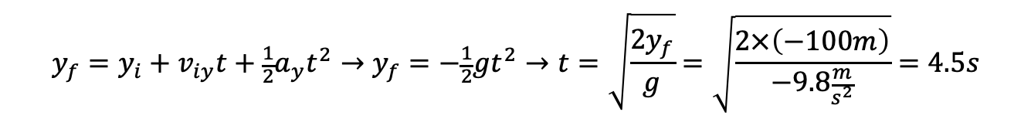

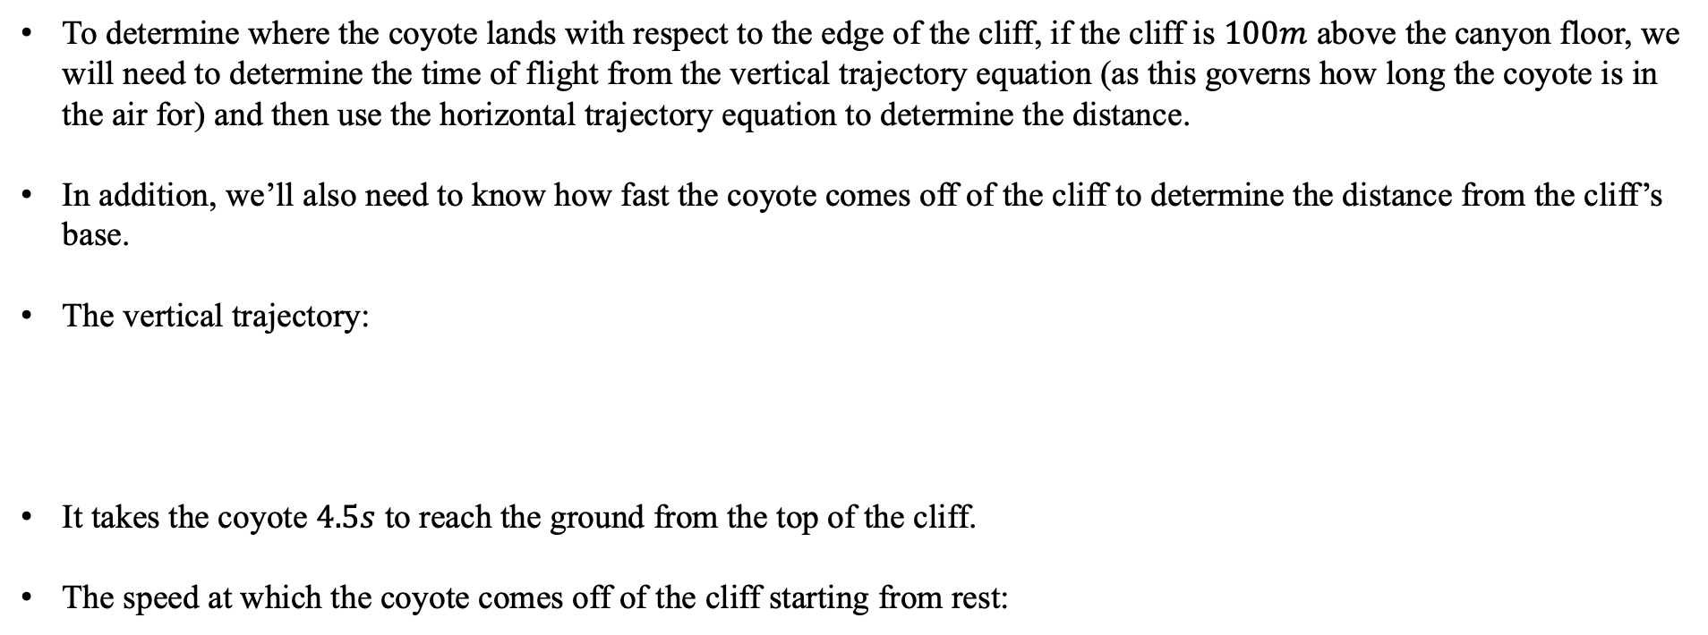



Motion in 2D
- projectile motion
Example 6 solution continued:
To determine where the coyote lands with respect to the edge of the cliff, if the cliff is $100m$ above the canyon floor, we will need to determine the time of flight from the vertical trajectory equation (as this governs how long the coyote is in the air for) and then use the horizontal trajectory equation to determine the distance.
In addition, we’ll also need to know how fast the coyote comes off of the cliff to determine the distance from the cliff’s base.
The vertical trajectory:
It takes the coyote $4.5s$ to reach the ground from the top of the cliff.
The speed at which the coyote comes off of the cliff starting from rest:
$$y_{f}=y_{i}+v_{iy}t+\frac{1}{2}a_{y}t^{2}→y_{f}=−\frac{1}{2}gt^{2}→t=\sqrt{\frac{2y_{f}}{g}}=\sqrt{\frac{2×\left(−100m\right)}{−9.8\frac{m}{s^{2}}}}=4.5s$$
$$0$$
$$0$$
$$0$$
$$v_{fx}=v_{ix}+a_{x}t_{\text{to cliff}}=15\frac{m}{s^{2}}×3.1s=46.5\frac{m}{s}$$

Slide 23


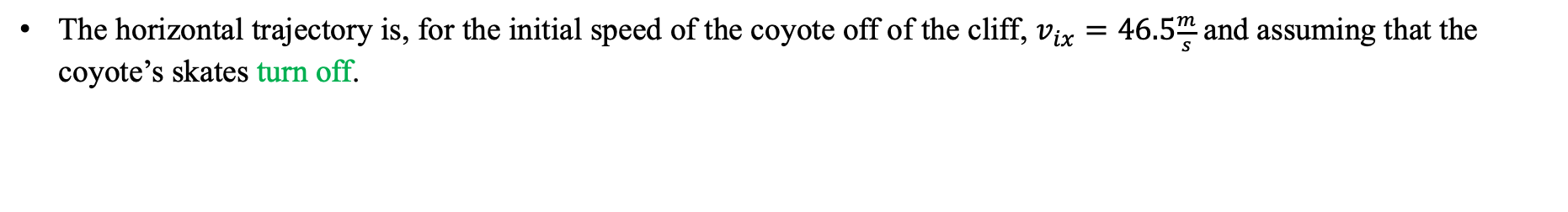





Motion in 2D
- projectile motion
Example 6 solution continued:
The horizontal trajectory is, for the initial speed of the coyote off of the cliff, $v_{ix}=46.5\frac{m}{s}$ and assuming that the coyote’s skates turn off.
$$0$$
$$0$$
$$x_{f}=x_{i}+v_{ix}t+\frac{1}{2}a_{x}t^{2}→x_{f}=v_{ix}t=46.5\frac{m}{s}×4.5s=209.3m$$
The horizontal trajectory is, for the initial speed of the coyote off of the cliff, $v_{ix}=46.5\frac{m}{s}$ and assuming that the coyote’s skate’s acceleration remains horizontal and operational.
$$x_{f}=x_{i}+v_{ix}t+\frac{1}{2}a_{x}t^{2}→x_{f}=v_{ix}t+\frac{1}{2}a_{x}t^{2}=\left(46.5\frac{m}{s}×4.5s\right)+\frac{1}{2}×15\frac{m}{s^{2}}{\left(4.5s\right)}^{2}=361.1m$$
$$0$$
The components of the coyote’s impact velocity in the cases where 1. the skates turned off and 2. remain operational:
Horizontal velocity skates off:
Horizontal velocity skates on:
$$0$$
$$v_{fx}=v_{ix}+a_{x}t=46.5\frac{m}{s}+\left(15\frac{m}{s^{2}}×4.5s\right)=114\frac{m}{s}$$
$$v_{fx}=v_{ix}+a_{x}t=46.5\frac{m}{s}$$
Vertical velocity skates off:
Vertical velocity skates on:
$$0$$
$$0$$
$$v_{fy}=v_{iy}+a_{y}t=−gt=−9.8\frac{m}{s^{2}}×4.5s=44.1\frac{m}{s}$$
$$v_{fy}=v_{iy}+a_{y}t=−gt=−9.8\frac{m}{s^{2}}×4.5s=44.1\frac{m}{s}$$

Slide 24

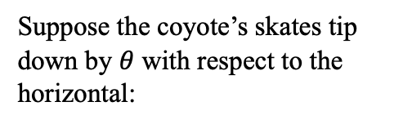


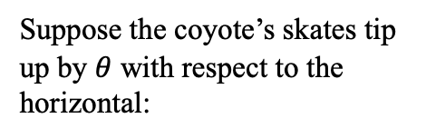








Motion in 2D
- projectile motion
Example 6 solution continued:
As an aside, what if the coyote’s skates remained operational but did not remain horizontal after the coyote comes off of the cliff?
We still can do the problem the same way, but we’d have to calculate the new horizontal and vertical accelerations of the coyote.
$$a_{skate}$$
Suppose the coyote’s skates tip up by $θ$ with respect to the horizontal:
$$a_{x}=a_{skate,x}=a_{skate}\cos{θ}$$
$$θ$$
$$a_{skate,y}$$
$$a_{skate,x}$$
$$a_{y}=a_{skate,x}−g=a_{skate}\sin{θ}−g$$
$$−g$$
Suppose the coyote’s skates tip down by $θ$ with respect to the horizontal:
$$a_{skate,x}$$
$$a_{x}=a_{skate,x}=a_{skate}\cos{θ}$$
$$θ$$
$$−g$$
$$a_{skate,y}$$
$$a_{y}={−a}_{skate,x}−g=−a_{skate}\sin{θ}−g$$
$$a_{skate}$$

Slide 25
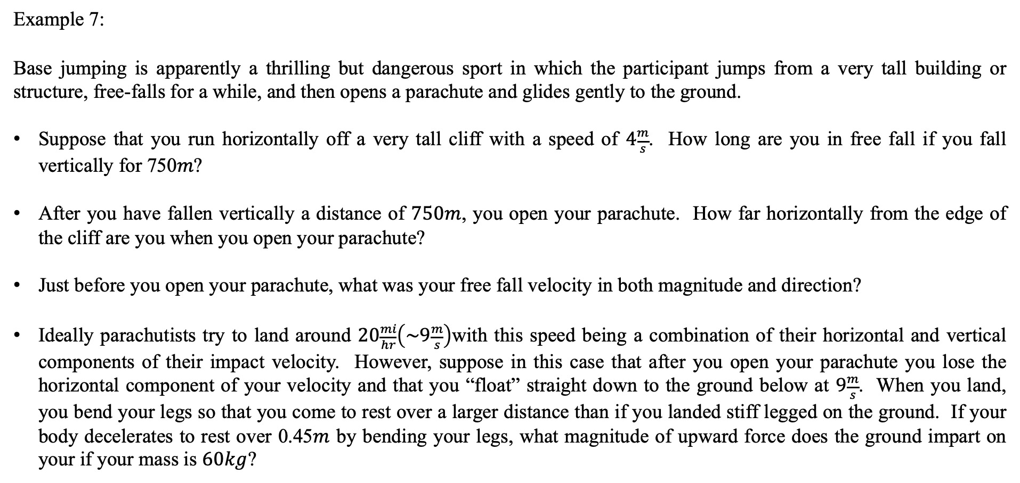
Motion in 2D
- projectile motion
Example 7:
Base jumping is apparently a thrilling but dangerous sport in which the participant jumps from a very tall building or structure, free-falls for a while, and then opens a parachute and glides gently to the ground.
Suppose that you run horizontally off a very tall cliff with a speed of $4\frac{m}{s}$. How long are you in free fall if you fall vertically for 750𝑚?
After you have fallen vertically a distance of $750m$, you open your parachute. How far horizontally from the edge of the cliff are you when you open your parachute?
Just before you open your parachute, what was your free fall velocity in both magnitude and direction?
Ideally parachutists try to land around $20\frac{mi}{hr}\left(\sim 9\frac{m}{s}\right)$with this speed being a combination of their horizontal and vertical components of their impact velocity. However, suppose in this case that after you open your parachute you lose the horizontal component of your velocity and that you “float” straight down to the ground below at $9\frac{m}{s}$. When you land, you bend your legs so that you come to rest over a larger distance than if you landed stiff legged on the ground. If your body decelerates to rest over 0.45$m$ by bending your legs, what magnitude of upward force does the ground impart on your if your mass is $60kg$?

Slide 26

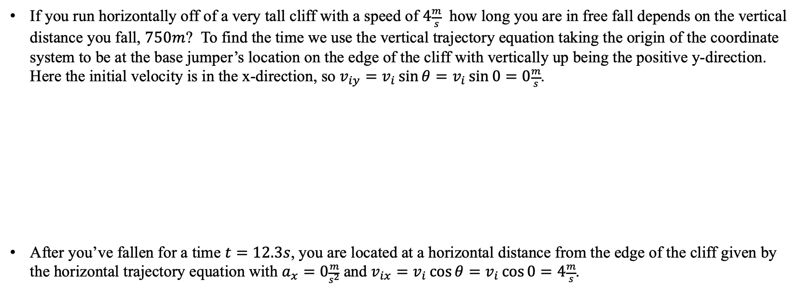
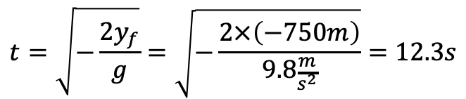
Motion in 2D
- projectile motion
Example 7 solution:
If you run horizontally off of a very tall cliff with a speed of $4\frac{m}{s}$ how long you are in free fall depends on the vertical distance you fall, $750m$? To find the time we use the vertical trajectory equation taking the origin of the coordinate system to be at the base jumper’s location on the edge of the cliff with vertically up being the positive y-direction. Here the initial velocity is in the x-direction, so $v_{iy}=v_{i}\sin{θ}=v_{i}\sin{0}=0\frac{m}{s}$.
After you’ve fallen for a time $t=12.3s$, you are located at a horizontal distance from the edge of the cliff given by the horizontal trajectory equation with $a_{x}=0\frac{m}{s^{2}}$ and $v_{ix}=v_{i}\cos{θ}=v_{i}\cos{0}=4\frac{m}{s}$.
$$y_{f}=y_{i}+v_{iy}t+\frac{1}{2}a_{y}t^{2}→y_{f}=−\frac{1}{2}gt^{2}$$
$$t=\sqrt{−\frac{2y_{f}}{g}}=\sqrt{−\frac{2×\left(−750m\right)}{9.8\frac{m}{s^{2}}}}=12.3s$$
$$x_{f}=x_{i}+v_{ix}t+\frac{1}{2}a_{x}t^{2}→x_{f}=v_{ix}t=4\frac{m}{s}×12.3s=49.5m$$

Slide 27


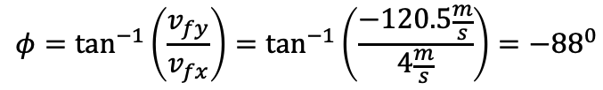

Motion in 2D
- projectile motion
Example 7 solution continued:
To determine your free-fall velocity, in both magnitude and direction just before you open your parachute, we use the time-dependent velocity equations in the horizontal and vertical directions. Then knowing the components of the velocity, we can use the Pythagorean theorem to determine the magnitude of the final velocity and some trigonometry to determine the angle.
Magnitude of the velocity
Time-dependent x-component of velocity
$$v_{f}=\sqrt{v_{fx}^{2}+v_{fy}^{2}}=\sqrt{{\left(4\frac{m}{s}\right)}^{2}+{\left(−120.5\frac{m}{s}\right)}^{2}}=120.6\frac{m}{s}$$
$$v_{fx}=v_{ix}+a_{x}t→v_{fx}=v_{ix}=4\frac{m}{s}$$
Time-dependent y-component of velocity
Direction of the velocity
$$v_{fy}=v_{iy}+a_{y}t=−gt=−9.8\frac{m}{s^{2}}×12.3s=−120.5\frac{m}{s}$$
$$φ=\tan^{−1}\left(\frac{v_{fy}}{v_{fx}}\right)=\tan^{−1}\left(\frac{−120.5\frac{m}{s}}{4\frac{m}{s}}\right)=−{88}^{0}$$
Or ${88}^{0}$below the positive x-axis.

Slide 28
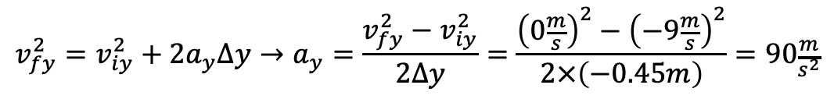
Motion in 2D
- projectile motion
Example 7 solution continued:
The magnitude of upward force does the ground impart on your mass is determined from the acceleration of your body as you slow from your initial speed of $v_{iy}=9\frac{m}{s}$ to $v_{fy}=0\frac{m}{s}$over the given distance $∆y=0.45m$.
Notice the direction of the acceleration is positive which is reasonable since the force from the ground on you should point in the positive y-direction.
$$v_{fy}^{2}=v_{iy}^{2}+2a_{y}∆y→a_{y}=\frac{v_{fy}^{2}−v_{iy}^{2}}{2∆y}=\frac{{\left(0\frac{m}{s}\right)}^{2}−{\left(−9\frac{m}{s}\right)}^{2}}{2×\left(−0.45m\right)}=90\frac{m}{s^{2}}$$
$$F_{ground}=ma_{y}=60kg×90\frac{m}{s^{2}}=5400N$$
This force is very large on you and is due to you decelerating at a very large rate over a very small distance. This force could in fact cause injury. To minimize the force of the ground on you, you should decelerate, if possible, over a much larger distance, which of course is why you bend your legs when you land after jumping off of something.

