Slide 1
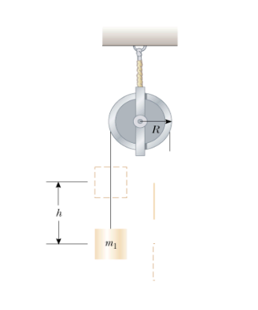
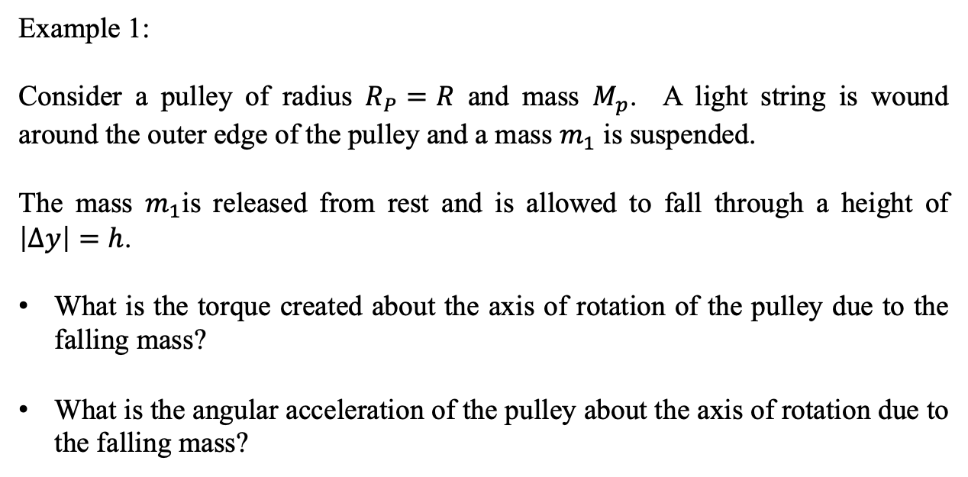

Rotational Dynamics
Example 1:
Consider a pulley of radius $R_{P}=R$ and mass $M_{p}$. A light string is wound around the outer edge of the pulley and a mass $m_{1}$ is suspended.
The mass $m_{1}$is released from rest and is allowed to fall through a height of $\left|∆y\right|=h$.
What is the torque created about the axis of rotation of the pulley due to the falling mass?
What is the angular acceleration of the pulley about the axis of rotation due to the falling mass?
$M_{p}$

Slide 2



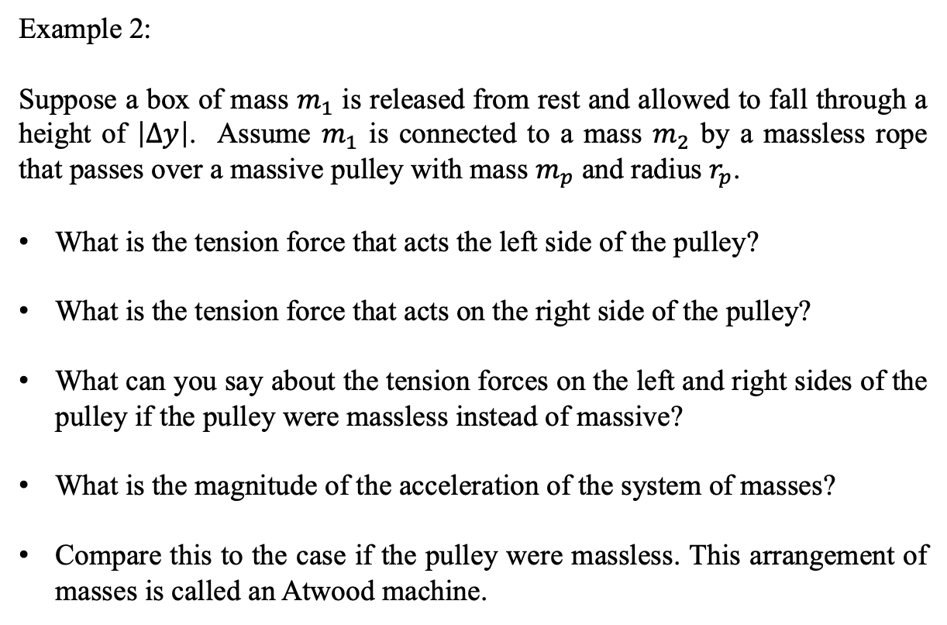



Rotational Dynamics
Example 2:
Suppose a box of mass $m_{1}$ is released from rest and allowed to fall through a height of $\left|∆y\right|$. Assume $m_{1}$ is connected to a mass $m_{2}$ by a massless rope that passes over a massive pulley with mass $m_{p}$ and radius $r_{p}$.
What is the tension force that acts the left side of the pulley?
What is the tension force that acts on the right side of the pulley?
What can you say about the tension forces on the left and right sides of the pulley if the pulley were massless instead of massive?
What is the magnitude of the acceleration of the system of masses?
Compare this to the case if the pulley were massless. This arrangement of masses is called an Atwood machine.
$$r_{p}$$
$m_{p}$
$$m_{1}$$
$$m_{2}$$
$$\left|∆y\right|$$
$$a=\left(\frac{m_{1}−m_{2}}{m_{2}+m_{1}}\right)g$$

Slide 3






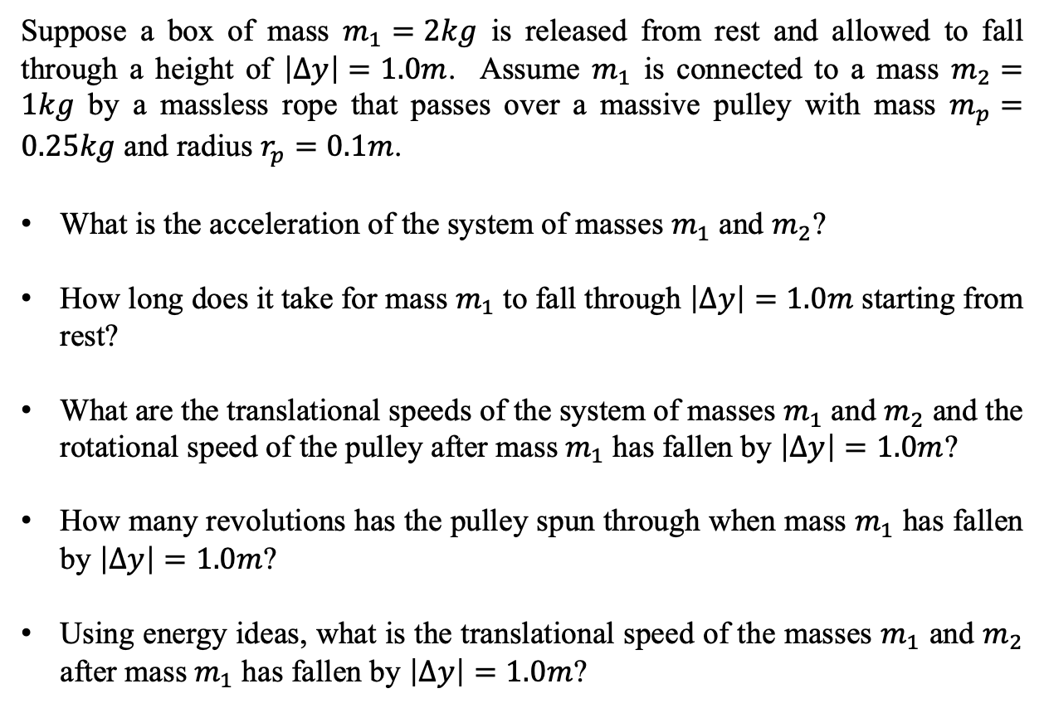









Rotational Dynamics
Example 3:
$$τ_{L}$$
$$τ_{R}$$
Suppose a box of mass $m_{1}=2kg$ is released from rest and allowed to fall through a height of $\left|∆y\right|=1.0m$. Assume $m_{1}$ is connected to a mass $m_{2}=1kg$ by a massless rope that passes over a massive pulley with mass $m_{p}=0.25kg$ and radius $r_{p}=0.1m$.
What is the acceleration of the system of masses $m_{1}$ and $m_{2}$?
How long does it take for mass $m_{1}$ to fall through $\left|∆y\right|=1.0m$ starting from rest?
What are the translational speeds of the system of masses $m_{1}$ and $m_{2}$ and the rotational speed of the pulley after mass $m_{1}$ has fallen by $\left|∆y\right|=1.0m$?
How many revolutions has the pulley spun through when mass $m_{1}$ has fallen by $\left|∆y\right|=1.0m$?
Using energy ideas, what is the translational speed of the masses $m_{1}$ and $m_{2}$ after mass $m_{1}$ has fallen by $\left|∆y\right|=1.0m$?
$$r_{p}$$
$m_{p}$
$${\vec{F}}_{TL}$$
$${\vec{F}}_{TR}$$
$$y$$
$${\vec{F}}_{TL}$$
$$x$$
$$m_{1}$$
$${\vec{F}}_{TR}$$
$${\vec{F}}_{W_{1}}$$
$$m_{2}$$
$$\left|∆y\right|$$
$${\vec{F}}_{W_{2}}$$

Slide 4
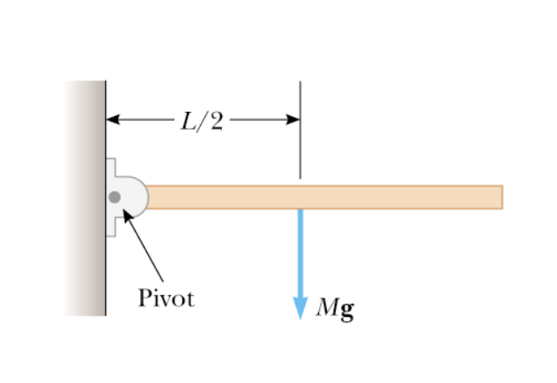
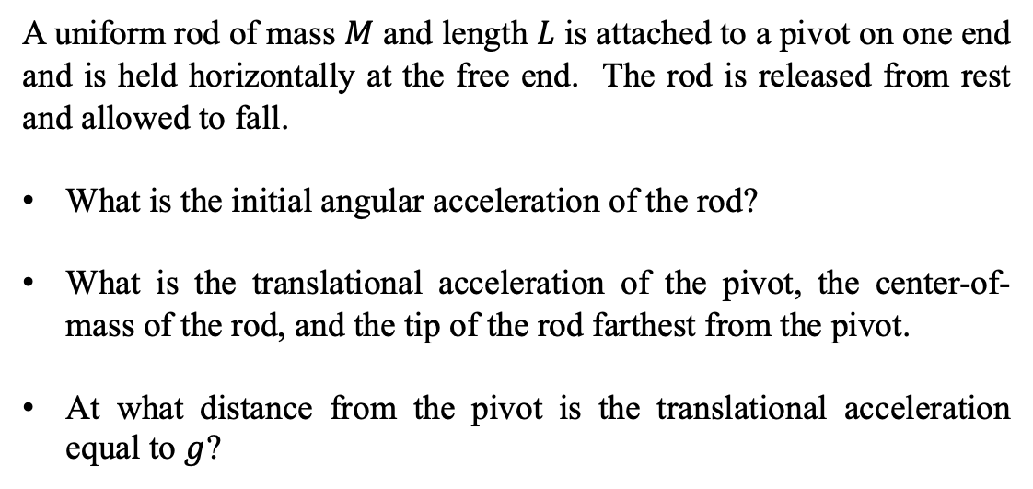
Rotational Dynamics
Example 4:
A uniform rod of mass $M$ and length $L$ is attached to a pivot on one end and is held horizontally at the free end. The rod is released from rest and allowed to fall.
What is the initial angular acceleration of the rod?
What is the translational acceleration of the pivot, the center-of-mass of the rod, and the tip of the rod farthest from the pivot.
At what distance from the pivot is the translational acceleration equal to $g$?

Slide 5

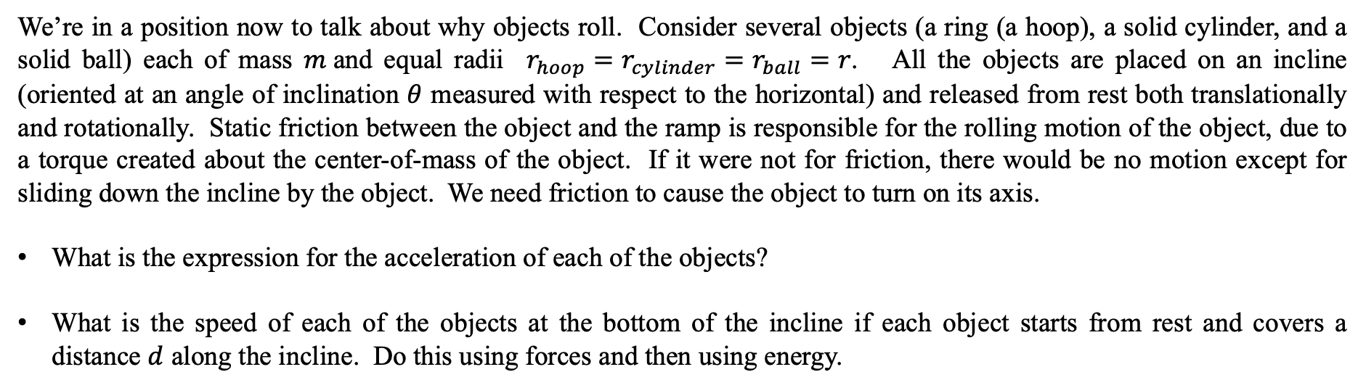



Rotational Dynamics
Example 5:
We’re in a position now to talk about why objects roll. Consider several objects (a ring (a hoop), a solid cylinder, and a solid ball) each of mass $m$and equal radii $r_{hoop}=r_{cylinder}=r_{ball}=r$. All the objects are placed on an incline (oriented at an angle of inclination $θ$ measured with respect to the horizontal) and released from rest both translationally and rotationally. Static friction between the object and the ramp is responsible for the rolling motion of the object, due to a torque created about the center-of-mass of the object. If it were not for friction, there would be no motion except for sliding down the incline by the object. We need friction to cause the object to turn on its axis.
What is the expression for the acceleration of each of the objects?
What is the speed of each of the objects at the bottom of the incline if each object starts from rest and covers a distance $d$ along the incline. Do this using forces and then using energy.
What is the order of arrival of the objects at the bottom of the incline? Which gets there first, second and third? Or do they all get there at the same time?
$$r$$
$$m$$
$$d$$
$$θ$$

Slide 6
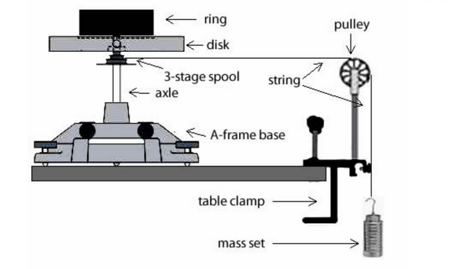


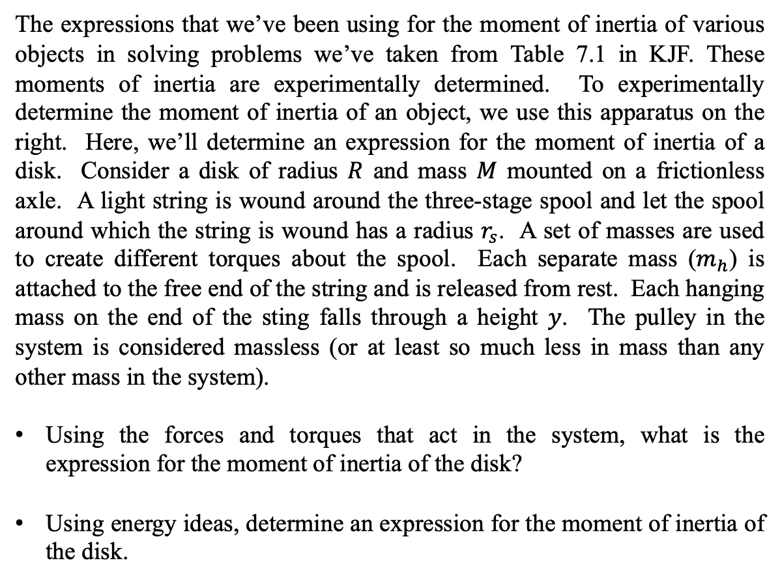



Rotational Dynamics
Example 6:
The expressions that we’ve been using for the moment of inertia of various objects in solving problems we’ve taken from Table 7.1 in KJF. These moments of inertia are experimentally determined. To experimentally determine the moment of inertia of an object, we use this apparatus on the right. Here, we’ll determine an expression for the moment of inertia of a disk. Consider a disk of radius $R$ and mass $M$ mounted on a frictionless axle. A light string is wound around the three-stage spool and let the spool around which the string is wound has a radius $r_{s}$. A set of masses are used to create different torques about the spool. Each separate mass ($m_{h}$) is attached to the free end of the string and is released from rest. Each hanging mass on the end of the sting falls through a height $y$. The pulley in the system is considered massless (or at least so much less in mass than any other mass in the system).
Using the forces and torques that act in the system, what is the expression for the moment of inertia of the disk?
Using energy ideas, determine an expression for the moment of inertia of the disk.
$$M$$
$$R$$
$$r_{s}$$
$$m_{h}$$
https://www.chegg.com/homework-help/questions-and-answers/draw-side-view-equipment-draw-velocity-acceleration-vectors-weight-add-tangential-velocity-q24579747
$$y$$

Slide 7
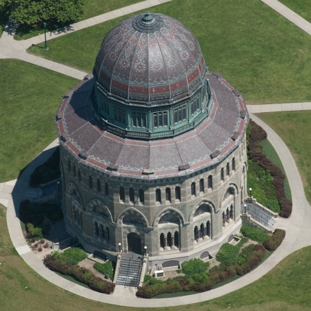
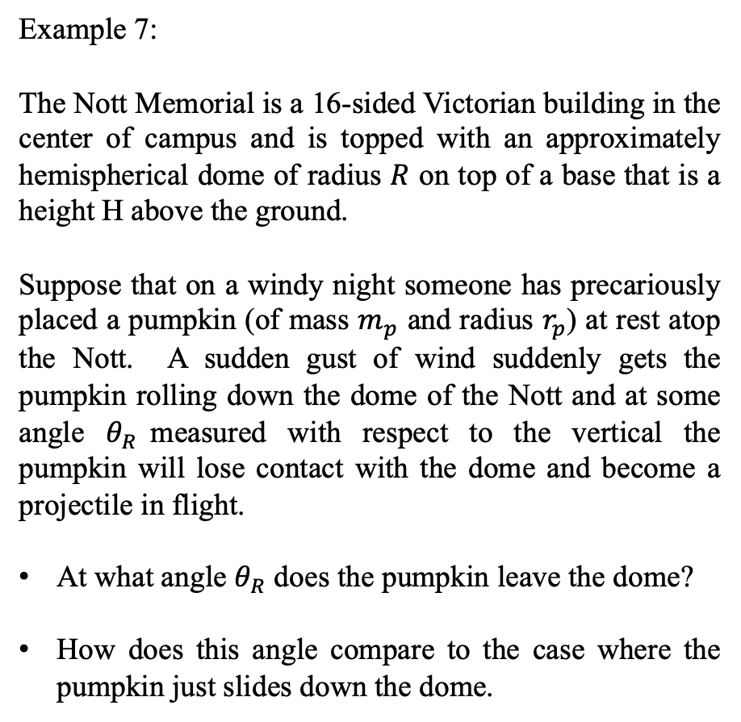
Rotational Dynamics
Example 7:
The Nott Memorial is a 16-sided Victorian building in the center of campus and is topped with an approximately hemispherical dome of radius $R$ on top of a base that is a height H above the ground.
Suppose that on a windy night someone has precariously placed a pumpkin (of mass $m_{p}$ and radius $r_{p}$) at rest atop the Nott. A sudden gust of wind suddenly gets the pumpkin rolling down the dome of the Nott and at some angle $θ_{R}$measured with respect to the vertical the pumpkin will lose contact with the dome and become a projectile in flight.
At what angle $θ_{R}$ does the pumpkin leave the dome?
How does this angle compare to the case where the pumpkin just slides down the dome.
https://commodorebuilders.com/2014/03/24/union-college-nott-memorial/

Slide 8
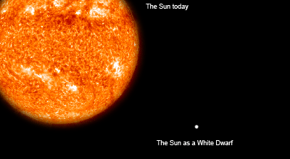
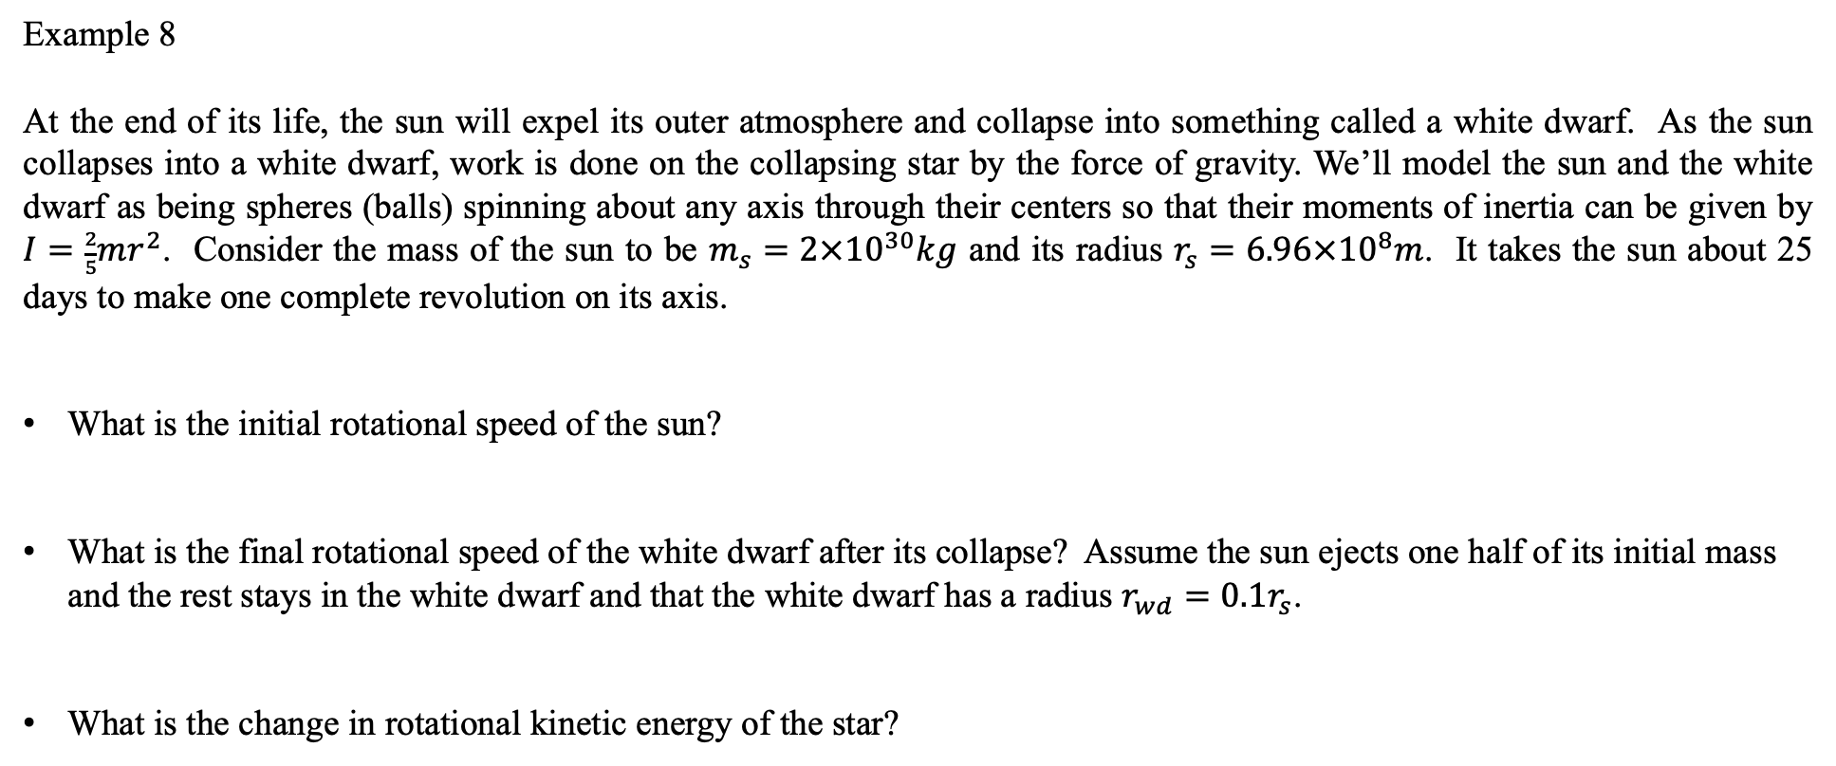
Example 8
At the end of its life, the sun will expel its outer atmosphere and collapse into something called a white dwarf. As the sun collapses into a white dwarf, work is done on the collapsing star by the force of gravity. We’ll model the sun and the white dwarf as being spheres (balls) spinning about any axis through their centers so that their moments of inertia can be given by $I=\frac{2}{5}mr^{2}$. Consider the mass of the sun to be $m_{s}=2×{10}^{30}kg$ and its radius $r_{s}=6.96×{10}^{8}m$. It takes the sun about 25 days to make one complete revolution on its axis.
What is the initial rotational speed of the sun?
What is the final rotational speed of the white dwarf after its collapse? Assume the sun ejects one half of its initial mass and the rest stays in the white dwarf and that the white dwarf has a radius $r_{wd}=0.1r_{s}$.
What is the change in rotational kinetic energy of the star?
How much work was done on the star by gravity?
http://migall.fastmail.fm.user.fm/astronomy/stars_and_nebulae/Star_Life_Cycles/page06_wd.htm

