Slide 1
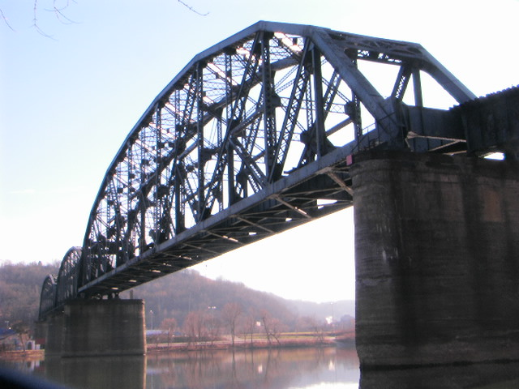
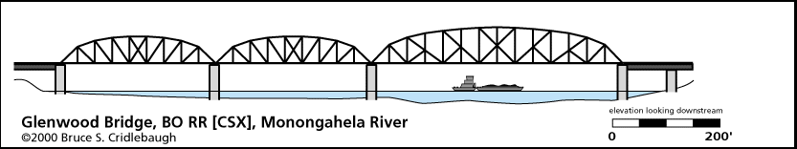

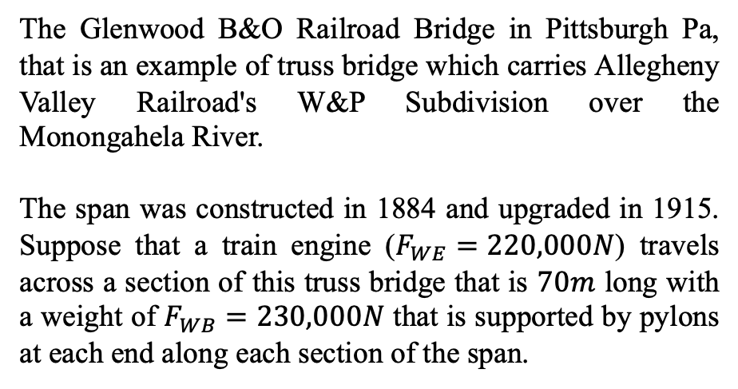



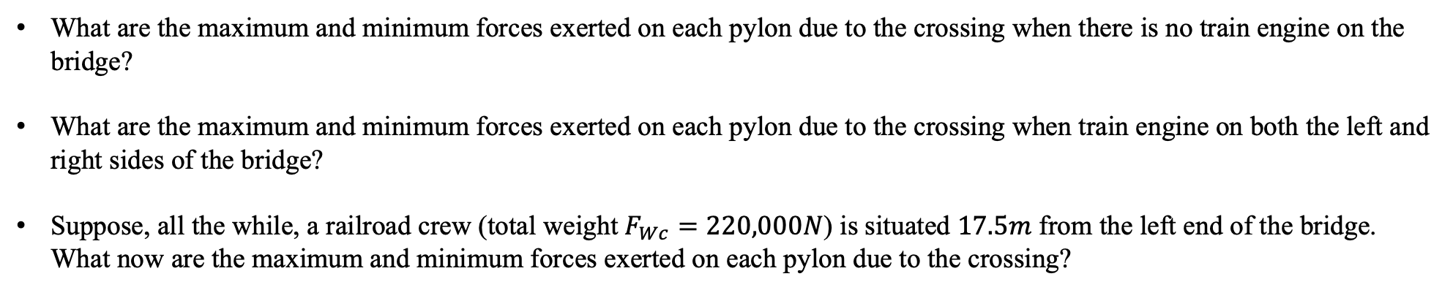

Rotational and Translational Statics
Example 1:
The Glenwood B&O Railroad Bridge in Pittsburgh Pa, that is an example of truss bridge which carries Allegheny Valley Railroad's W&P Subdivision over the Monongahela River.
The span was constructed in 1884 and upgraded in 1915. Suppose that a train engine ($F_{WE}=220,000N$) travels across a section of this truss bridge that is $70m$ long with a weight of $F_{WB}=230,000N$ that is supported by pylons at each end along each section of the span.
$70m$
https://en.wikipedia.org/wiki/Glenwood_B%26O_Railroad_Bridge
$$L$$
$${\vec{F}}_{NL}$$
$${\vec{F}}_{NR}$$
$${\vec{F}}_{WB}$$
http://pghbridges.com/pittsburghE/0590-4472/glenwoodBO.htm
What are the maximum and minimum forces exerted on each pylon due to the crossing when there is no train engine on the bridge?
What are the maximum and minimum forces exerted on each pylon due to the crossing when train engine on both the left and right sides of the bridge?
Suppose, all the while, a railroad crew (total weight $F_{Wc}=220,000N$) is situated $17.5m$ from the left end of the bridge. What now are the maximum and minimum forces exerted on each pylon due to the crossing?

Slide 2
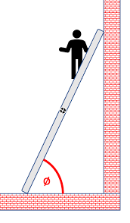
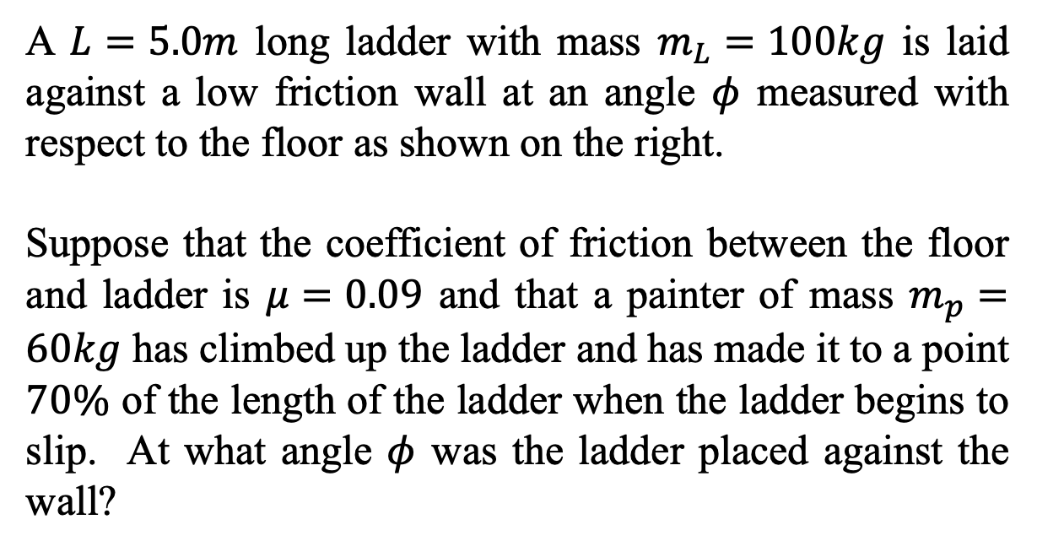
Rotational and Translational Statics
Example 2:
A $L=5.0m$ long ladder with mass $m_{L}=100kg$ is laid against a low friction wall at an angle $φ$ measured with respect to the floor as shown on the right.
Suppose that the coefficient of friction between the floor and ladder is $μ=0.09$ and that a painter of mass $m_{p}=60kg$ has climbed up the ladder and has made it to a point $70\%$ of the length of the ladder when the ladder begins to slip. At what angle $φ$ was the ladder placed against the wall?
https://www.physicsclassroom.com/calcpad/launch/CPRT14

Slide 3


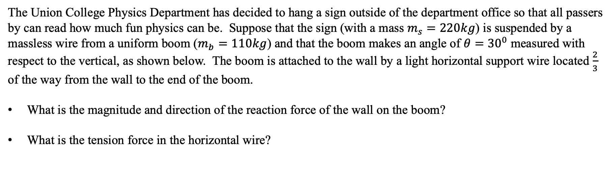
Rotational and Translational Statics
Example 3:
The Union College Physics Department has decided to hang a sign outside of the department office so that all passers by can read how much fun physics can be. Suppose that the sign (with a mass $m_{s}=220kg$) is suspended by a massless wire from a uniform boom ($m_{b}=110kg$) and that the boom makes an angle of $θ={30}^{0}$ measured with respect to the vertical, as shown below. The boom is attached to the wall by a light horizontal support wire located $\frac{2}{3}$ of the way from the wall to the end of the boom.
What is the magnitude and direction of the reaction force of the wall on the boom?
What is the tension force in the horizontal wire?
Physics is Phun!
$$θ$$

Slide 4
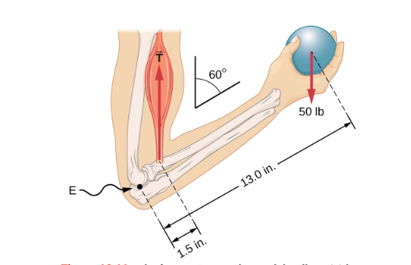
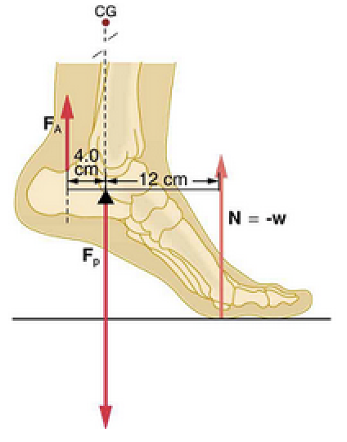
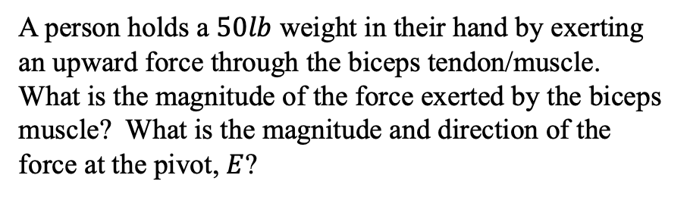



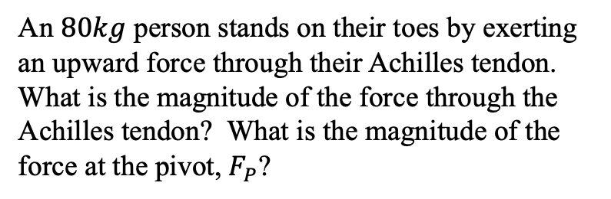
Rotational and Translational Statics
Example 4:
Example 5:
Tibia & Fibula
Talus
Humerus
$$F_{N}$$
$$F_{W,b}=223N$$
Ulna
Radius
$$F_{W,a}=25N$$
A person holds a $50lb$ weight in their hand by exerting an upward force through the biceps tendon/muscle. What is the magnitude of the force exerted by the biceps muscle? What is the magnitude and direction of the force at the pivot, $E$?
An $80kg$ person stands on their toes by exerting an upward force through their Achilles tendon. What is the magnitude of the force through the Achilles tendon? What is the magnitude of the force at the pivot, $F_{P}$?

Slide 5
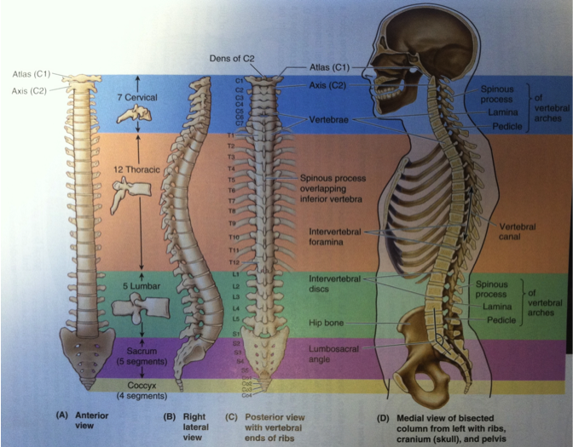
Rotational and Translational Statics
Example 6:
As high as eighty percent of the population at one time or another will suffer from some form of lower back pain, especially during bending and lifting activities.
The stresses, which the mussels apply to the disks located between each of the vertebrae, can be very large and these stresses can, along with degeneration of the structure of the disks produce pain, muscle spasm, and immobilization of the lower back. We’ll specifically look at the lumbo-sacral intersection of the spine as the point at which we bend, to say pick something up when you keep your legs straight.
We’ll look at a specific case of just bending over with your arms hanging vertically to determine how large the reaction force on the lumbo-sacral disk can be in this case in terms of your weight.
lumbo-sacral
intersection
Figure 1: Views of the human spine. Figure from Clinically Oriented Anatomy, by Moore & Dalley.

Slide 6
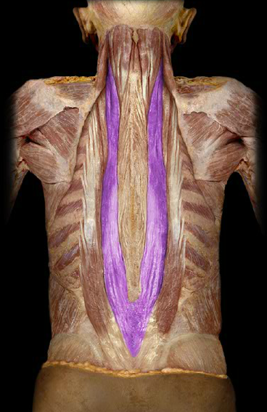
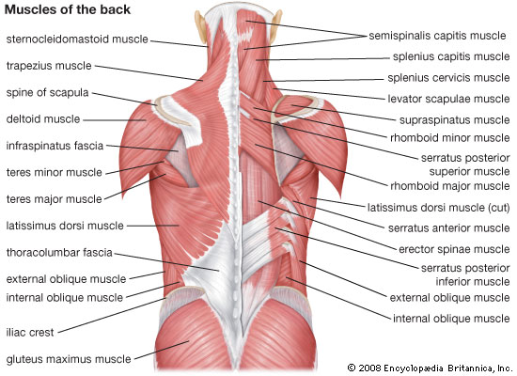
Rotational and Translational Statics
- The Major Muscle Groups and Vertebral Column of the Human Back
Example 6:
Cadaver dissection showing the location of the erector-spinae muscles (stained purple for visualization).
The major muscle groups and muscles of the back are also shown.
The erector-spinae muscles insert at the base of the spine and run the length of your spinal column. These muscles are, in part, responsible for picking you back upright (making your erect) from a prone (or bent over) position.
https://www.studyblue.com/notes/note/n/huaty-1223-study-guide-2011-12-rooney/deck/9730325

Slide 7
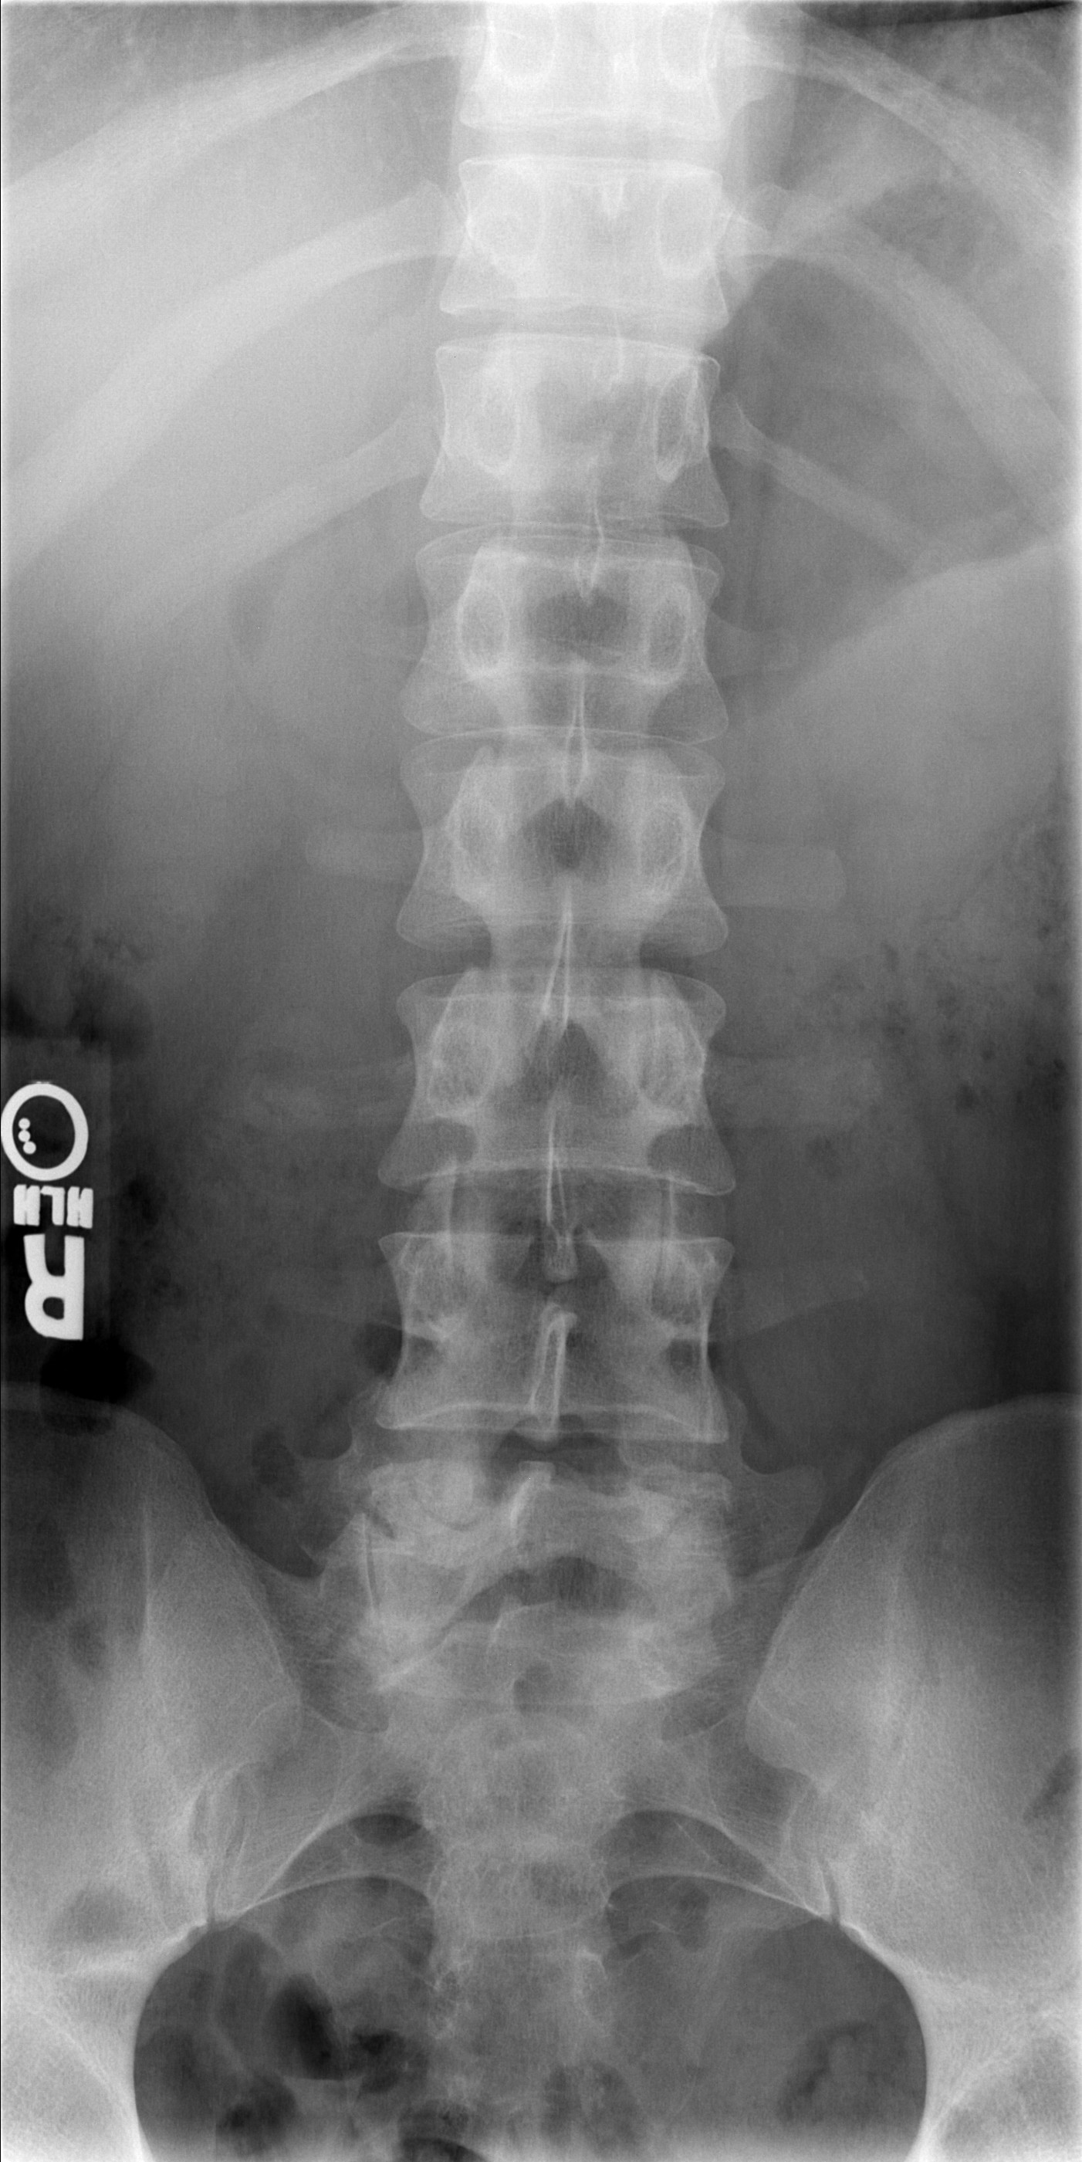
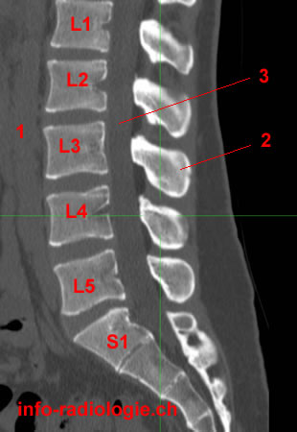
Rotational and Translational Statics
- The Major Muscle Groups and Vertebral Column of the Human Back
Example 6:
Cadaver dissection showing the location of the erector spinae muscles groups on either side of the spine and the vertebra of the spine.
Here it’s been superimposed an x-ray image of the spine onto the back showing the erectors lie just to the side of the spinal column.
The magnetic resonance (MRI) image of the spinal column show the location of interest at the L5/S1 intersection. This is the disk (between the vertebra) that is often ruptured by lifting heavy loads incorrectly.
http://w-radiology.com/ct-lumbar-spine.php
http://medicine.missouri.edu/radiology/iCases/MSK/case1/case01.htm
https://www.studyblue.com/notes/note/n/huaty-1223-study-guide-2011-12-rooney/deck/9730325

Slide 8
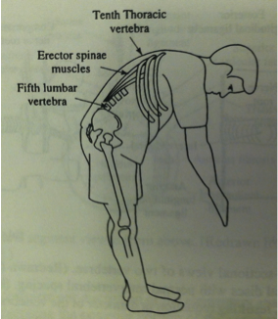


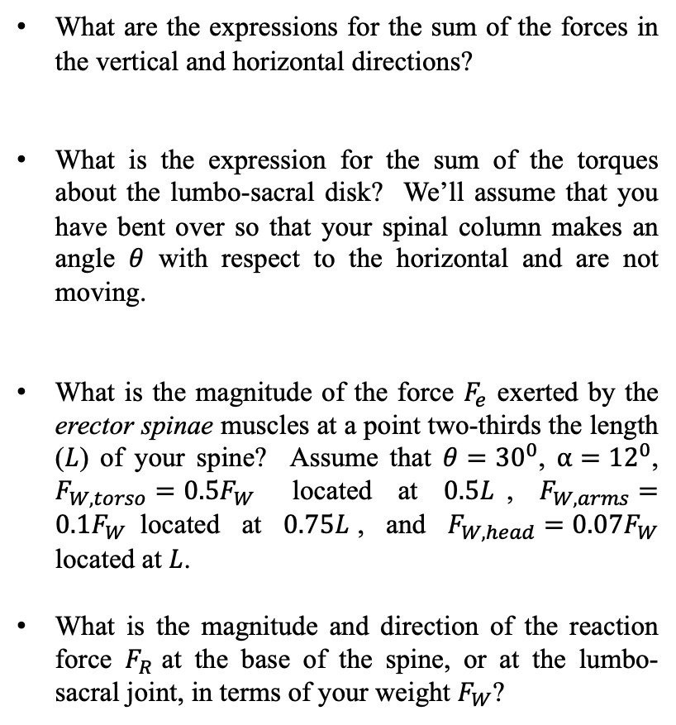






Rotational and Translational Statics
Example 6:
What are the expressions for the sum of the forces in the vertical and horizontal directions?
What is the expression for the sum of the torques about the lumbo-sacral disk? We’ll assume that you have bent over so that your spinal column makes an angle $θ$ with respect to the horizontal and are not moving.
What is the magnitude of the force $F_{e}$ exerted by the erector spinae muscles at a point two-thirds the length ($L$) of your spine? Assume that $θ={30}^{0}$, $α={12}^{0}$, $F_{W,torso}=0.5F_{W}$ located at $0.5L$, $F_{W,arms}=0.1F_{W}$located at $0.75L$, and $F_{W,head}={0.07F}_{W}$ located at $L$.
What is the magnitude and direction of the reaction force $F_{R}$ at the base of the spine, or at the lumbo-sacral joint, in terms of your weight $F_{W}$?
$${\vec{F}}_{R}$$
$${\vec{F}}_{e}$$
$$α$$
$${\vec{F}}_{W,head}$$
$${\vec{F}}_{W,arms}$$
$$φ$$
$$θ$$
Lumbo-sacral disk
$${\vec{F}}_{W,torso}$$
Stick figure drawing of your spinal column showing the various forces that act. The diagram is not to scale
Cartoon illustration of the problem. Drawing from Physics with Illustrative Examples from Medicine and Biology, by Benedek & Villars.

Slide 9
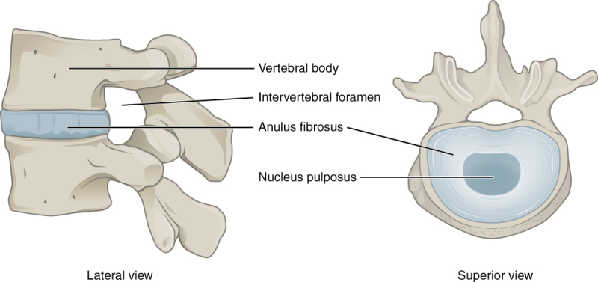

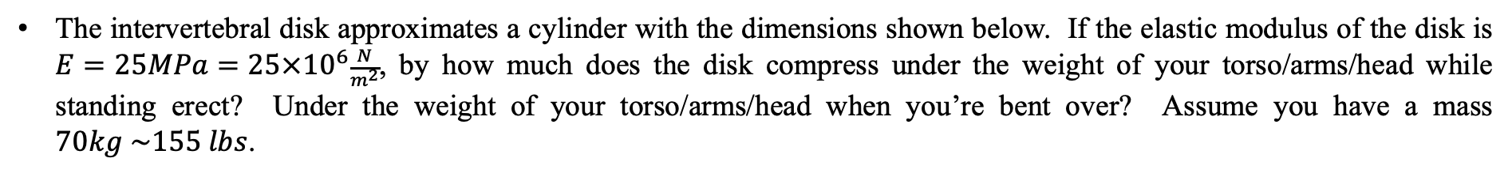

Rotational and Translational Statics
Example 7:
The intervertebral disk approximates a cylinder with the dimensions shown below. If the elastic modulus of the disk is $E=25MPa=25×{10}^{6}\frac{N}{m^{2}}$, by how much does the disk compress under the weight of your torso/arms/head while standing erect? Under the weight of your torso/arms/head when you’re bent over? Assume you have a mass $70kg \sim 155 lbs$.
$$R=2.2cm$$
$$h=7.5mm$$
https://www.ncbi.nlm.nih.gov/books/NBK470583/

