Slide 1
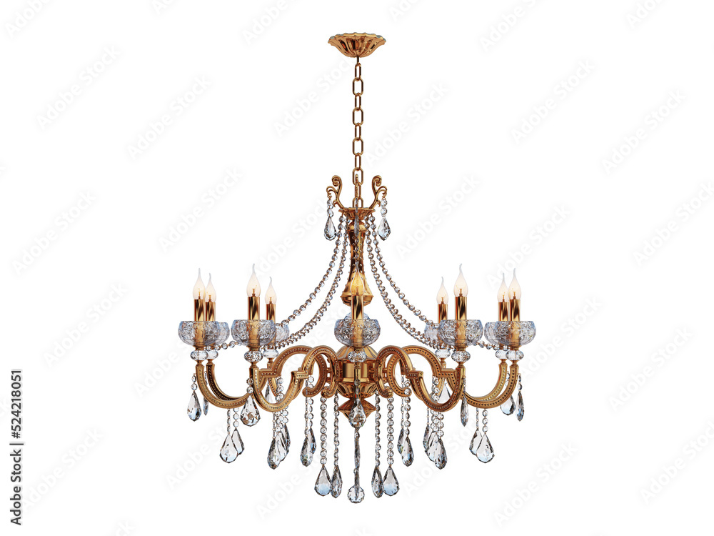

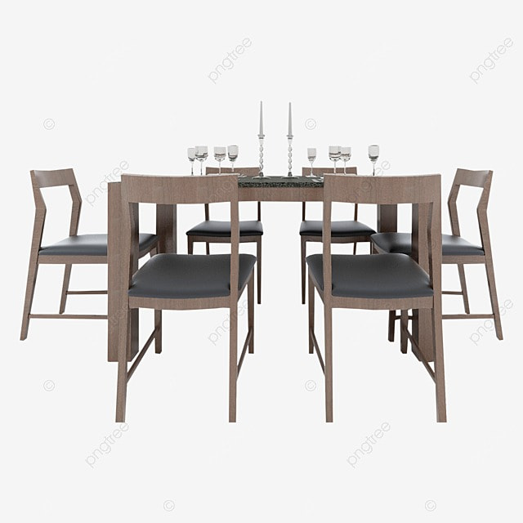
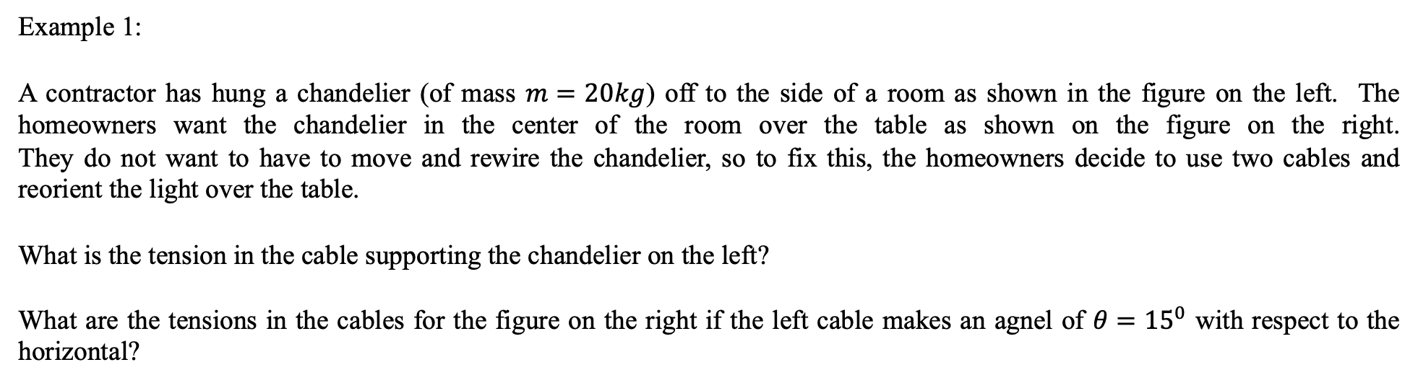
Forces and Newton’s Laws of Motion
- Statics
Example 1:
A contractor has hung a chandelier (of mass $m=20kg$) off to the side of a room as shown in the figure on the left. The homeowners want the chandelier in the center of the room over the table as shown on the figure on the right.
They do not want to have to move and rewire the chandelier, so to fix this, the homeowners decide to use two cables and reorient the light over the table.
What is the tension in the cable supporting the chandelier on the left?
What are the tensions in the cables for the figure on the right if the left cable makes an agnel of $θ={15}^{0}$ with respect to the horizontal?

Slide 2
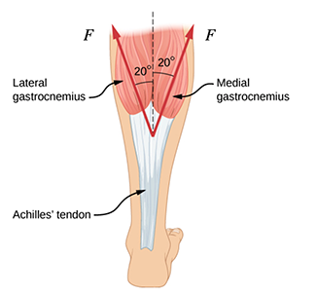
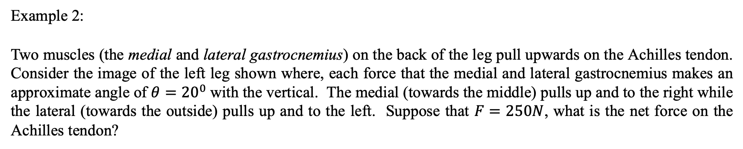
Forces and Newton’s Laws of Motion
- Statics
Example 2:
Two muscles (the medial and lateral gastrocnemius) on the back of the leg pull upwards on the Achilles tendon. Consider the image of the left leg shown where, each force that the medial and lateral gastrocnemius makes an approximate angle of $θ={20}^{0}$with the vertical. The medial (towards the middle) pulls up and to the right while the lateral (towards the outside) pulls up and to the left. Suppose that $F=250N$, what is the net force on the Achilles tendon?

Slide 3
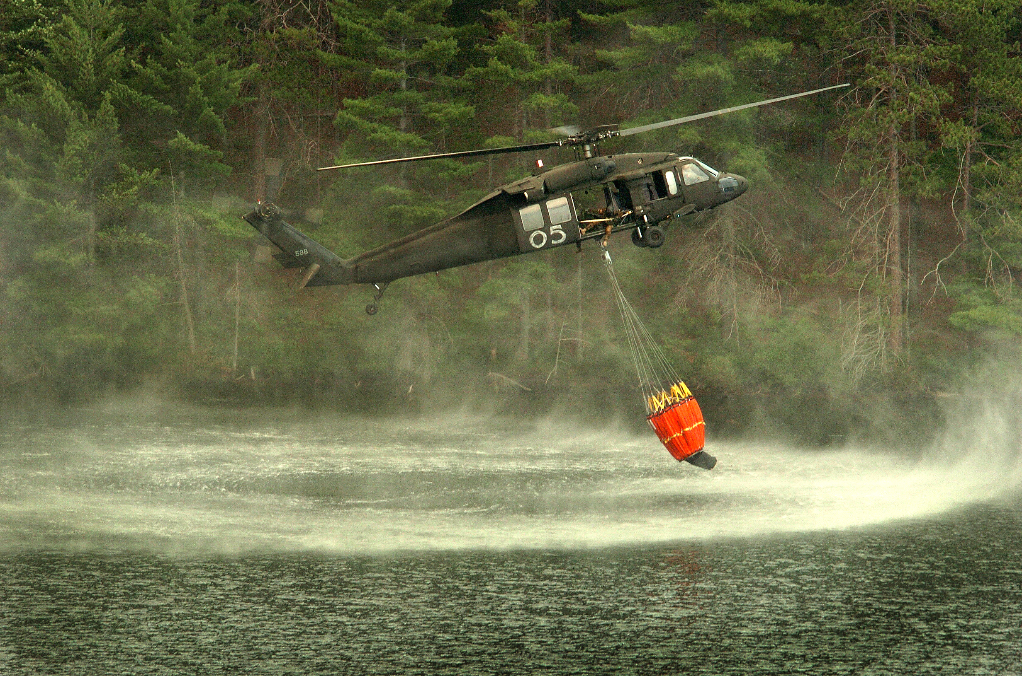
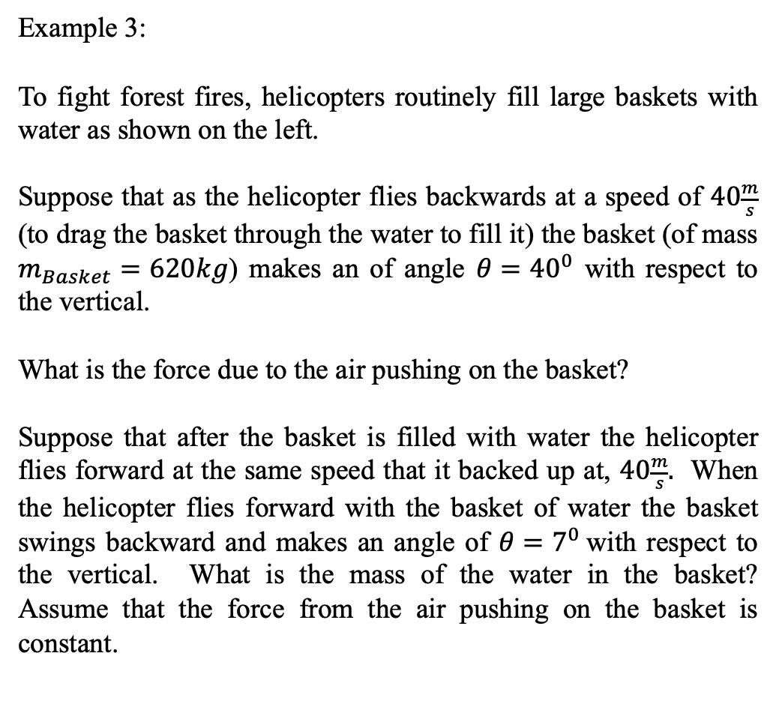
Forces and Newton’s Laws of Motion
- Statics
Example 3:
To fight forest fires, helicopters routinely fill large baskets with water as shown on the left.
Suppose that as the helicopter flies backwards at a speed of $40\frac{m}{s}$ (to drag the basket through the water to fill it) the basket (of mass $m_{Basket}=620kg$) makes an of angle $θ={40}^{0}$ with respect to the vertical.
What is the force due to the air pushing on the basket?
Suppose that after the basket is filled with water the helicopter flies forward at the same speed that it backed up at, $40\frac{m}{s}.$ When the helicopter flies forward with the basket of water the basket swings backward and makes an angle of $θ=7^{0}$with respect to the vertical. What is the mass of the water in the basket? Assume that the force from the air pushing on the basket is constant.
https://en.wikipedia.org/wiki/Helicopter_bucket#/media/File:Michigan_National_Guard_firefighting_bucket.jpg

