Slide 1
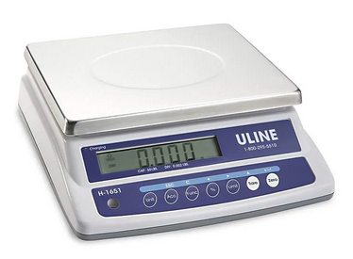
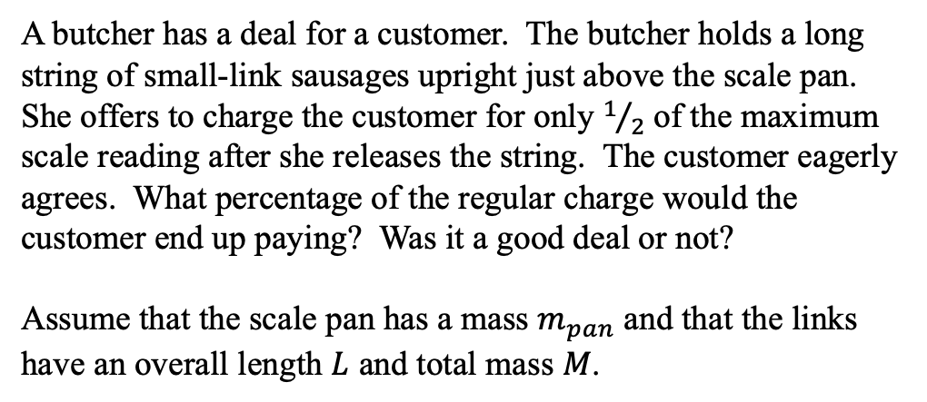
A butcher has a deal for a customer. The butcher holds a long string of small-link sausages upright just above the scale pan. She offers to charge the customer for only $1/2$ of the maximum scale reading after she releases the string. The customer eagerly agrees. What percentage of the regular charge would the customer end up paying? Was it a good deal or not?
Assume that the scale pan has a mass $m_{pan}$ and that the links have an overall length $L$ and total mass $M$.
Scale: https://www.uline.com/Product/Detail/H-1651/Counting-Scales/Uline-Easy-Count-Scale-60-lbs-x-002-lb?pricode=WA9255&gadtype=pla&id=H-1651&gclid=EAIaIQobChMI5Z3G9rzq5wIVBpyzCh3kMQ5HEAQYCCABEgLS5PD_BwE&gclsrc=aw.ds
Sausage: https://www.123rf.com/clipart-vector/sausage.html?sti=nyzkybrty9ezjnrzil|&mediapopup=84404977

