Slide 1
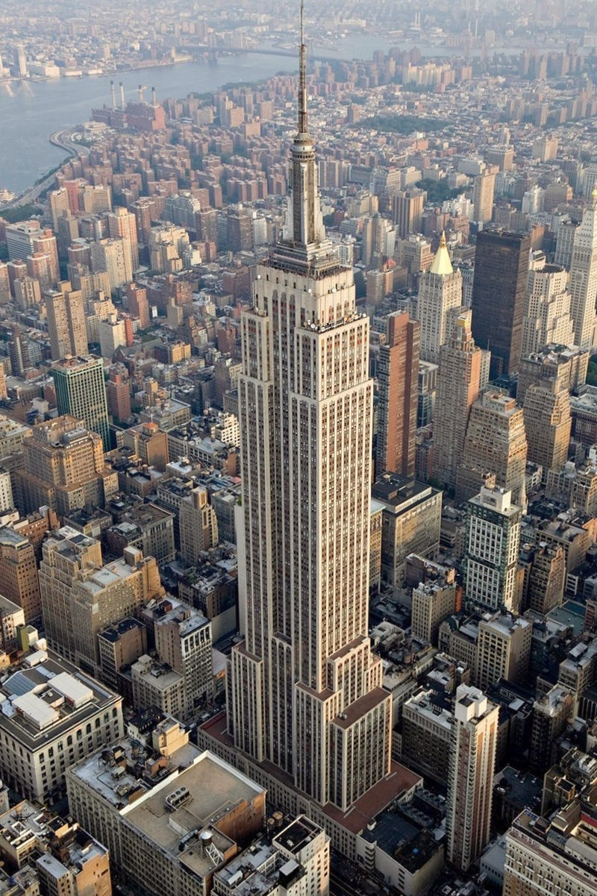
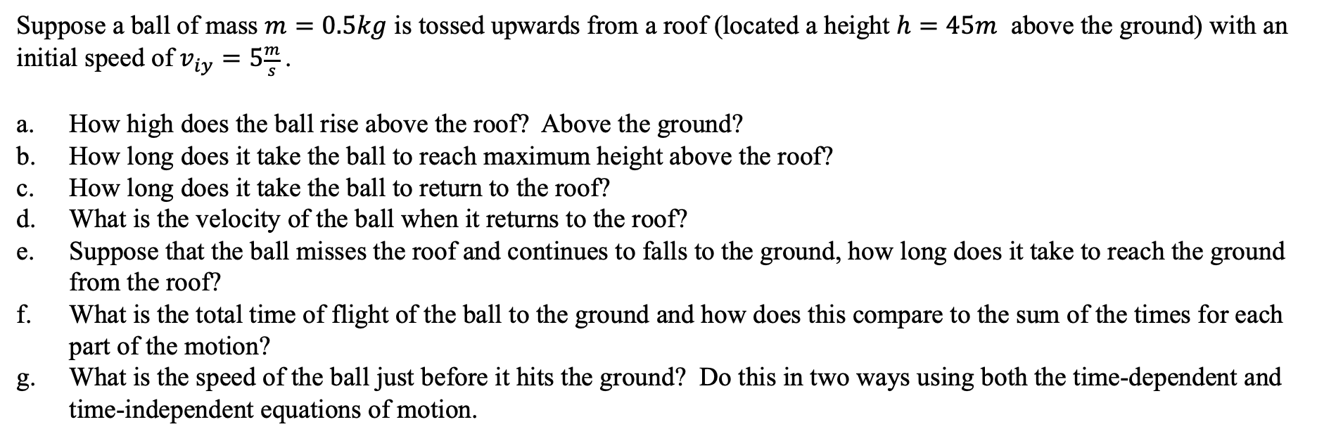
Vertical motion problems with constant acceleration
A coin is dropped from the edge of the Empire State Building $380m (\sim 1280ft)$above the ground.
How long does it take the coin to hit the ground below?
What is the impact speed of the coin with the ground?
https://en.wikipedia.org/wiki/Empire_State_Building
Suppose a ball of mass $m=0.5kg$ is tossed upwards from a roof (located a height $h=45m$ above the ground) with an initial speed of $v_{iy}=5\frac{m}{s}$.
How high does the ball rise above the roof? Above the ground?
How long does it take the ball to reach maximum height above the roof?
How long does it take the ball to return to the roof?
What is the velocity of the ball when it returns to the roof?
Suppose that the ball misses the roof and continues to falls to the ground, how long does it take to reach the ground from the roof?
What is the total time of flight of the ball to the ground and how does this compare to the sum of the times for each part of the motion?
What is the speed of the ball just before it hits the ground? Do this in two ways using both the time-dependent and time-independent equations of motion.

Slide 2
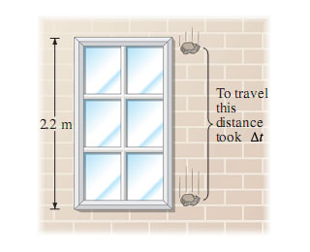
Vertical motion problems with constant acceleration
A rocket rises vertically, from rest, with an acceleration of $3.2\frac{m}{s^{2}}$ until it runs out of fuel at an altitude of $775m$. Assume air resistance is negligible and that the mass of the rocket does not change appreciably as it consumes fuel.
What is the velocity of the rocket when it runs out of fuel?
How long did it take the rocket to run out of fuel?
How high above the ground does the rocket reach?
How long does it take to reach this maximum height above the ground?
From maximum height, how long does it take the rocket to return to the earth?
What is the impact velocity of the rocket with the earth?
What is the total time of flight of the rocket?
A falling stone takes $0.3s$ to travel past a $2.2m$ tall window. From what height above the top of the window did the stone fall?

