Slide 1
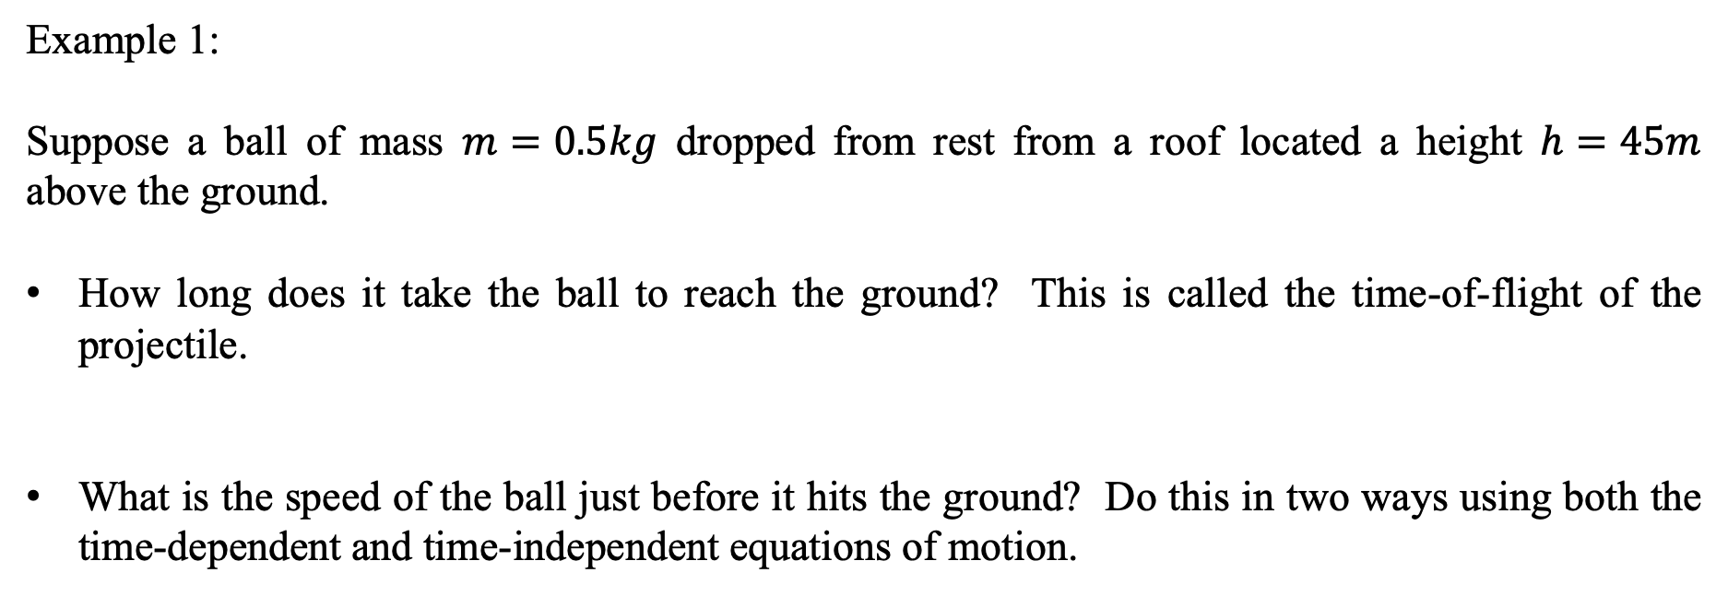
Vertical motion problems with constant acceleration
Example 1:
Suppose a ball of mass $m=0.5kg$ dropped from rest from a roof located a height $h=45m$ above the ground.
How long does it take the ball to reach the ground? This is called the time-of-flight of the projectile.
What is the speed of the ball just before it hits the ground? Do this in two ways using both the time-dependent and time-independent equations of motion.

Slide 2

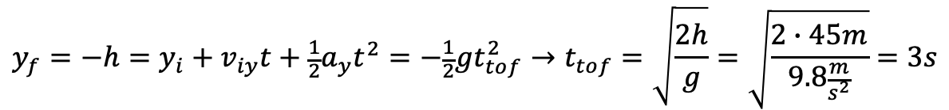
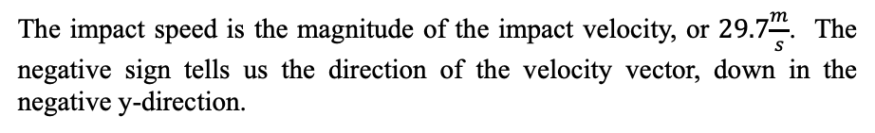
Vertical motion problems with constant acceleration
Example 1 Solution:
How long does it take the ball to reach the ground? This is called the time-of-flight of the projectile.
What is the speed of the ball just before it hits the ground? Do this in two ways using both the time-dependent and time-independent equations of motion.
$$y_{f}=−h=y_{i}+v_{iy}t+\frac{1}{2}a_{y}t^{2}=−\frac{1}{2}gt_{tof}^{2}→t_{tof}=\sqrt{\frac{2h}{g}}=\sqrt{\frac{2∙45m}{9.8\frac{m}{s^{2}}}}=3s$$
$$v_{fy}=v_{iy}+a_{y}t=−gt_{tof}=−9.8\frac{m}{s^{2}}∙3s=−29.7\frac{m}{s}$$
The impact speed is the magnitude of the impact velocity, or $29.7\frac{m}{s}$. The negative sign tells us the direction of the velocity vector, down in the negative y-direction.
Or,
$$v_{fy}^{2}=v_{iy}^{2}+2a_{y}∆y→v_{fy}=\sqrt{2gh}=\sqrt{2∙9.8\frac{m}{s^{2}}∙45m}=29.7\frac{m}{s}$$
The time-independent equation of motion gives us the magnitude directly. If we wanted the velocity, we’d have to put a plus or minus sign with it.

Slide 3
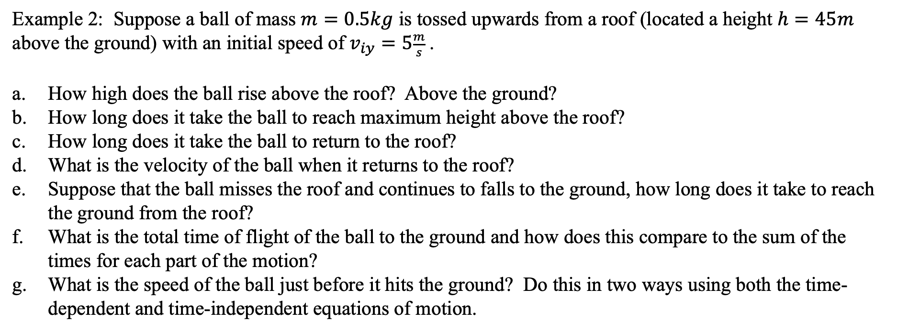
Vertical motion problems with constant acceleration
Example 2: Suppose a ball of mass $m=0.5kg$ is tossed upwards from a roof (located a height $h=45m$ above the ground) with an initial speed of $v_{iy}=5\frac{m}{s}$.
How high does the ball rise above the roof? Above the ground?
How long does it take the ball to reach maximum height above the roof?
How long does it take the ball to return to the roof?
What is the velocity of the ball when it returns to the roof?
Suppose that the ball misses the roof and continues to falls to the ground, how long does it take to reach the ground from the roof?
What is the total time of flight of the ball to the ground and how does this compare to the sum of the times for each part of the motion?
What is the speed of the ball just before it hits the ground? Do this in two ways using both the time-dependent and time-independent equations of motion.

Slide 4
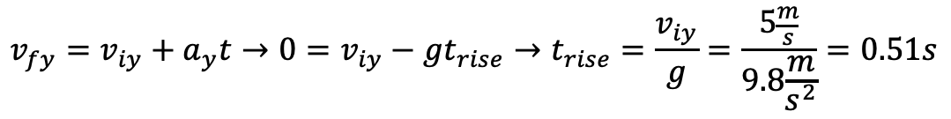
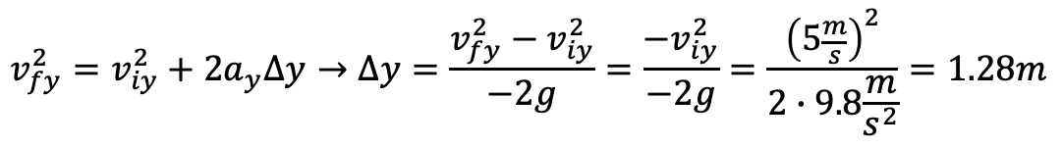
Vertical motion problems with constant acceleration
Example 2 Solution:
How high does the ball rise above the roof? Above the ground?
b. How long does it take the ball to reach maximum height above the roof?
$$v_{fy}^{2}=v_{iy}^{2}+2a_{y}∆y→∆y=\frac{v_{fy}^{2}−v_{iy}^{2}}{−2g}=\frac{−v_{iy}^{2}}{−2g}=\frac{{\left(5\frac{m}{s}\right)}^{2}}{2∙9.8\frac{m}{s^{2}}}=1.28m$$
$$y_{f}=y_{i}+v_{iy}t+\frac{1}{2}a_{y}t^{2}=v_{iy}t−\frac{1}{2}gt^{2}=\left(5\frac{m}{s}∙0.51s\right)−\frac{1}{2}{∙9.8\frac{m}{s^{2}}\left(0.51s\right)}^{2}=1.28m$$
Or we could have done this by using the result to part b.
$$v_{fy}=v_{iy}+a_{y}t→0=v_{iy}−gt_{rise}→t_{rise}=\frac{v_{iy}}{g}=\frac{5\frac{m}{s}}{9.8\frac{m}{s^{2}}}=0.51s$$

Slide 5
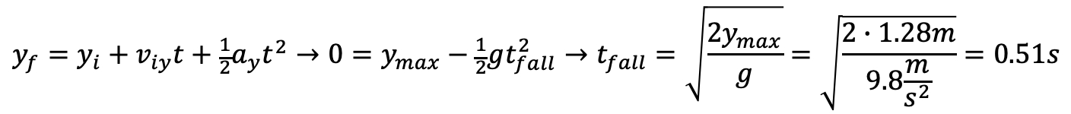
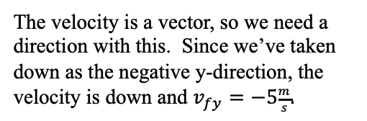
Vertical motion problems with constant acceleration
From the moment the ball comes momentarily to rest at the top. We can think about this as “dropping” the ball from rest from its maximum height taken as $y_{i}=y_{max}$ and ending at the roof $y_{f}=0$.
Example 2 Solution:
c. How long does it take the ball to return to the roof?
d. What is the velocity of the ball when it returns to the roof?
$$y_{f}=y_{i}+v_{iy}t+\frac{1}{2}a_{y}t^{2}→0=y_{max}−\frac{1}{2}gt_{fall}^{2}→t_{fall}=\sqrt{\frac{2y_{max}}{g}}=\sqrt{\frac{2∙1.28m}{9.8\frac{m}{s^{2}}}}=0.51s$$
From the moment the ball comes momentarily to rest at the top. We can think about this as “dropping” the ball from rest from its maximum height taken as $y_{i}=y_{max}$ and ending at the roof $y_{f}=0$.
The velocity is a vector, so we need a direction with this. Since we’ve taken down as the negative y-direction, the velocity is down and $v_{fy}=−5\frac{m}{s}.$
$$v_{fy}^{2}=v_{iy}^{2}+2a_{y}∆y→v_{fy}=\sqrt{−2g∆y}=\sqrt{−2∙9.8\frac{m}{s^{2}}∙\left(0m−1.28m\right)}=5\frac{m}{s}$$
$$v_{fy}=v_{iy}+a_{y}t→v_{fy}=−gt_{fall}=−9.8\frac{m}{s^{2}}∙0.51s=−5\frac{m}{s}$$

Slide 6

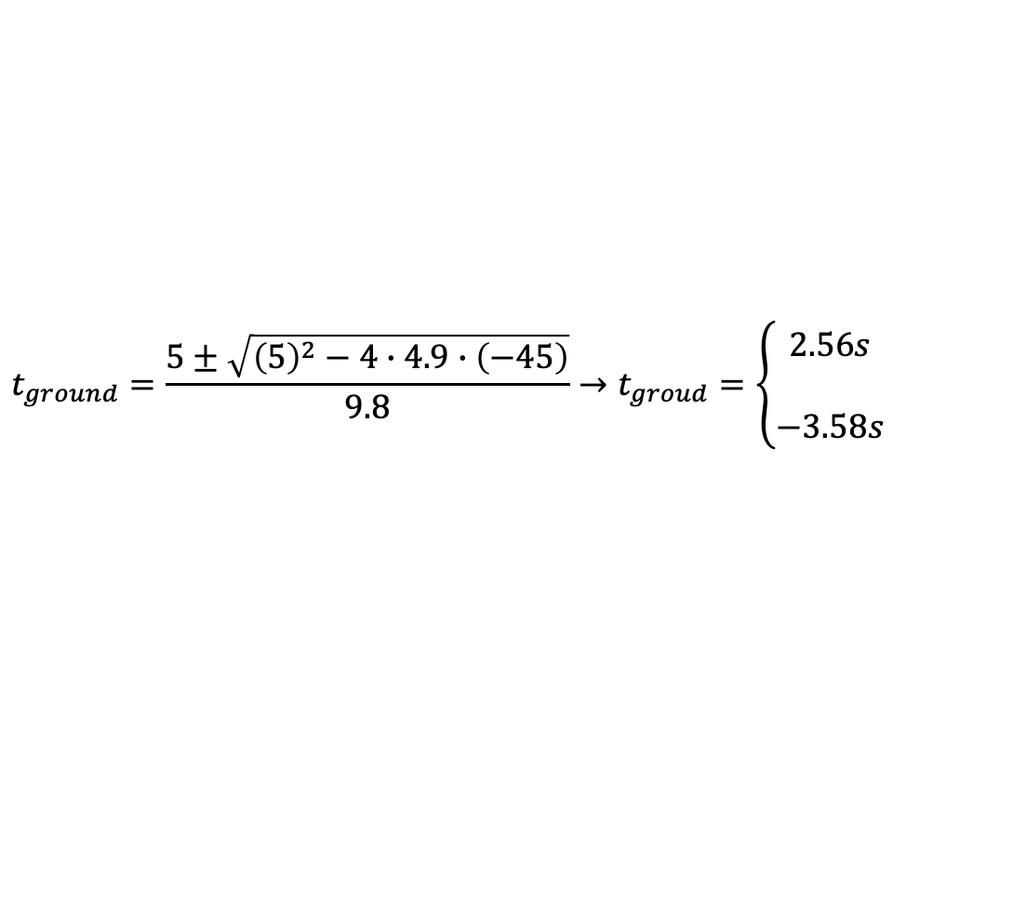
Vertical motion problems with constant acceleration
Example 2 Solution:
e. Suppose that the ball misses the roof and continues to falls to the ground, how long does it take to reach the ground from the roof?
Here we’ll pretend that the ball is thrown down from the roof with an initial velocity $v_{f}=−5\frac{m}{s}$.
$$y_{f}=y_{i}+v_{iy}t+\frac{1}{2}a_{y}t^{2}→−h=v_{iy}t−\frac{1}{2}gt^{2}→−45=−5t−4.9t^{2}→4.9t^{2}+5t−45=0$$
$$t_{ground}=\frac{5±\sqrt{{\left(5\right)}^{2}−4∙4.9∙\left(−45\right)}}{9.8}→t_{groud}=\left\{\begin{matrix}2.56s \\ \\ −3.58s\end{matrix}\right.$$
Here we choose the positive time. The time to the ground for the ball is $2.56s.$

Slide 7


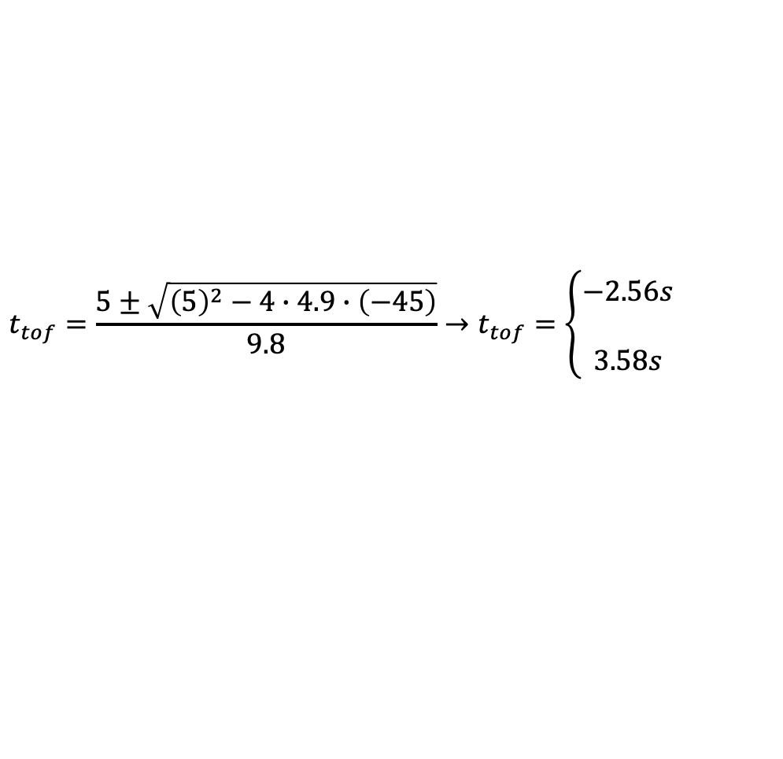
Vertical motion problems with constant acceleration
Example 2 Solution:
f. What is the total time of flight of the ball to the ground and how does this compare to the sum of the times for each part of the motion?
$$y_{f}=y_{i}+v_{iy}t+\frac{1}{2}a_{y}t^{2}→−h=v_{iy}t−\frac{1}{2}gt^{2}→−45=5t−4.9t^{2}→4.9t^{2}−5t−45=0$$
$$t_{tof}=\frac{5±\sqrt{{\left(5\right)}^{2}−4∙4.9∙\left(−45\right)}}{9.8}→t_{tof}=\left\{\begin{matrix}−2.56s \\ \\ 3.58s\end{matrix}\right.$$
Here we choose the positive time. The time-of-flight of the ball is $3.58s.$
$$t_{tof}=t_{rise}+t_{fall}+t_{ground}=0.51s+0.51s+2.56s=3.58s$$
The time of flight is the same as the sum of the individual times of the motion$.$

Slide 8
Vertical motion problems with constant acceleration
Example 2 Solution:
g. What is the speed of the ball just before it hits the ground? Do this in two ways using both the time- dependent and time-independent equations of motion.
$$v_{fy}^{2}=v_{iy}^{2}+2a_{y}∆y→v_{fy}=\sqrt{v_{iy}^{2}−2g∆y}=\sqrt{{\left(5\frac{m}{s}\right)}^{2}−2∙9.8\frac{m}{s^{2}}∙\left(0m−45m\right)}=30.1\frac{m}{s}$$
The velocity is a vector, so we need a direction with this. Since we’ve taken down as the negative y-direction, the velocity is down and $v_{fy}=−30.1\frac{m}{s}.$
$$v_{fy}=v_{iy}+a_{y}t→v_{fy}=v_{iy}−gt_{fall}=5\frac{m}{s}−9.8\frac{m}{s^{2}}∙3.58s=−30.1\frac{m}{s}$$

Slide 9
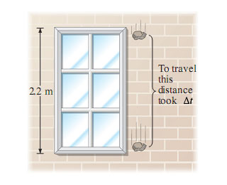
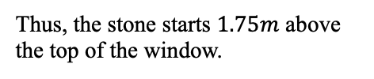
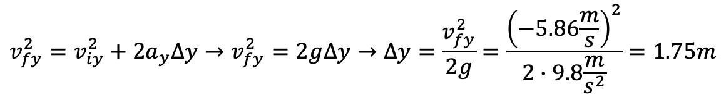
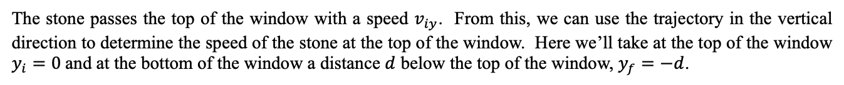
Vertical motion problems with constant acceleration
Example 3: A falling stone takes $0.3s$ to travel past a $2.2m$ tall window. From what height above the top of the window did the stone fall? Assume that the stone was dropped from rest.
Example 3 Solution:
The stone passes the top of the window with a speed $v_{iy}$. From this, we can use the trajectory in the vertical direction to determine the speed of the stone at the top of the window. Here we’ll take at the top of the window $y_{i}=0$and at the bottom of the window a distance $d$ below the top of the window, $y_{f}=−d$.
$$y_{f}=y_{i}+v_{iy}t+\frac{1}{2}a_{y}t^{2}→−d=v_{iy,top}t−\frac{1}{2}gt^{2}→v_{iy}=\frac{\frac{1}{2}gt^{2}−d}{t}=\frac{\frac{1}{2}∙9.8\frac{m}{s^{2}}{\left(0.3\right)}^{2}−2.2}{0.3}=−5.86\frac{m}{s}$$
To determine how far above the top of the window, we can use the time-independent equation of motion and see over what distance we need to accelerate the stone to achieve this downward velocity.
$$v_{fy}^{2}=v_{iy}^{2}+2a_{y}∆y→v_{fy}^{2}=2g∆y→∆y=\frac{v_{fy}^{2}}{2g}=\frac{{\left(−5.86\frac{m}{s}\right)}^{2}}{2∙9.8\frac{m}{s^{2}}}=1.75m$$
Thus, the stone starts $1.75m$ above the top of the window.

Slide 10
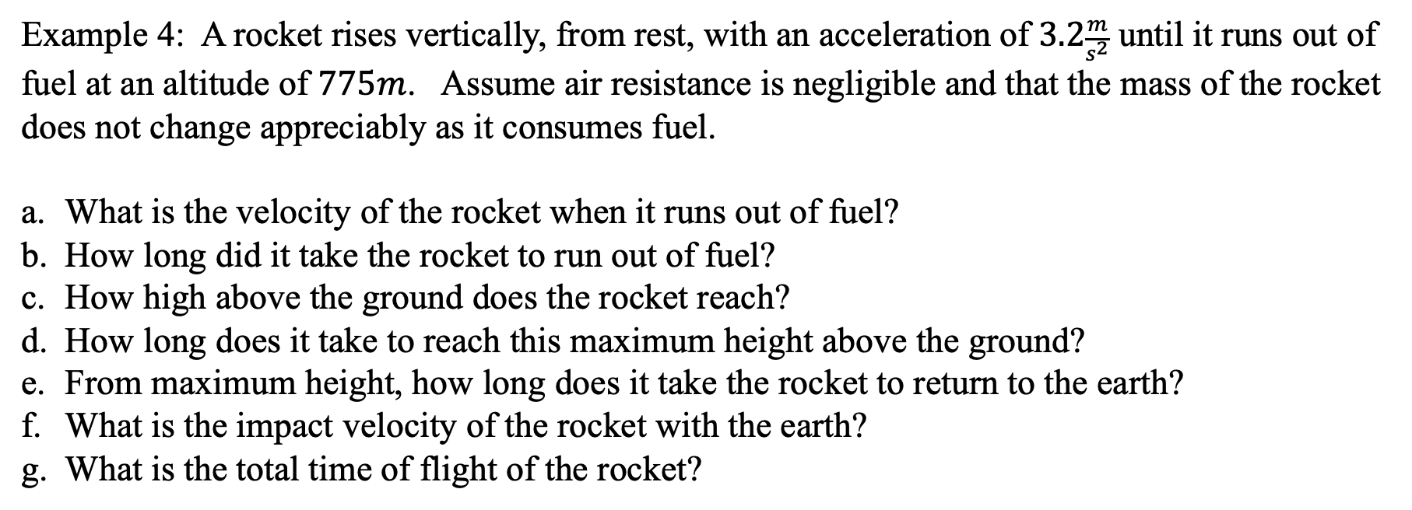
Vertical motion problems with constant acceleration
Example 4: A rocket rises vertically, from rest, with an acceleration of $3.2\frac{m}{s^{2}}$ until it runs out of fuel at an altitude of $775m$. Assume air resistance is negligible and that the mass of the rocket does not change appreciably as it consumes fuel.
What is the velocity of the rocket when it runs out of fuel?
How long did it take the rocket to run out of fuel?
How high above the ground does the rocket reach?
How long does it take to reach this maximum height above the ground?
From maximum height, how long does it take the rocket to return to the earth?
What is the impact velocity of the rocket with the earth?
What is the total time of flight of the rocket?

Slide 11
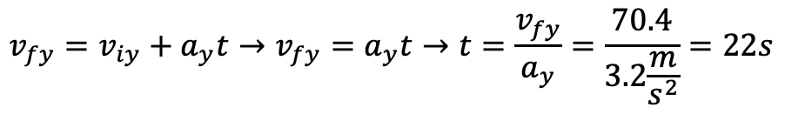
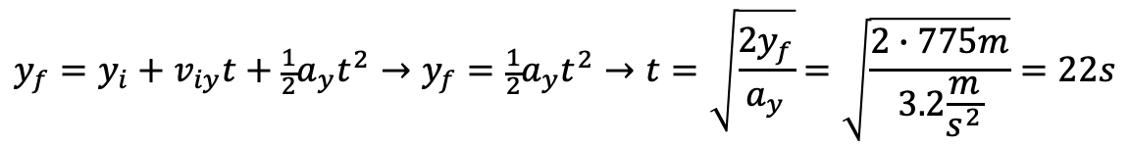
Vertical motion problems with constant acceleration
Example 4 Solution:
What is the velocity of the rocket when it runs out of fuel?
How long did it take the rocket to run out of fuel?
$$v_{fy}^{2}=v_{iy}^{2}+2a_{y}∆y→v_{fy}^{2}=2a_{y}∆y→v_{fy}=\sqrt{2a_{y}∆y}=\sqrt{2∙3.2\frac{m}{s^{2}}∙775m}=70.4\frac{m}{s}$$
$$y_{f}=y_{i}+v_{iy}t+\frac{1}{2}a_{y}t^{2}→y_{f}=\frac{1}{2}a_{y}t^{2}→t=\sqrt{\frac{2y_{f}}{a_{y}}}=\sqrt{\frac{2∙775m}{3.2\frac{m}{s^{2}}}}=22s$$
Or we can use the time-dependent velocity equation and see how long it takes to get to this velocity from rest.
$$v_{fy}=v_{iy}+a_{y}t→v_{fy}=a_{y}t→t=\frac{v_{fy}}{a_{y}}=\frac{70.4}{3.2\frac{m}{s^{2}}}=22s$$

Slide 12
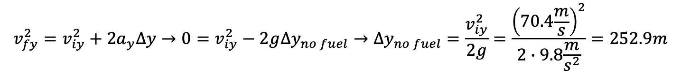
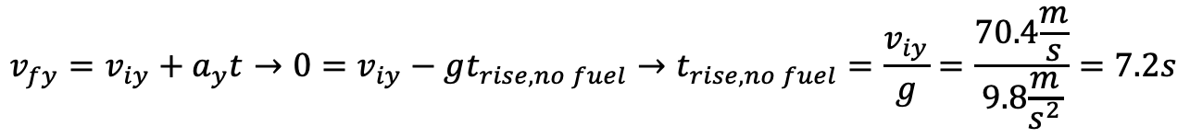
Vertical motion problems with constant acceleration
Example 4 Solution:
c. How high above the ground does the rocket reach?
d. How long does it take to reach this maximum height above the ground?
$$v_{fy}^{2}=v_{iy}^{2}+2a_{y}∆y→0=v_{iy}^{2}−2g∆y_{no fuel}→∆y_{no fuel}=\frac{v_{iy}^{2}}{2g}=\frac{{\left(70.4\frac{m}{s}\right)}^{2}}{2∙9.8\frac{m}{s^{2}}}=252.9m$$
When the rocket uses its fuel, it continues to rise vertically under gravity. It slows from the velocity it had when it ran out of fuel until it stops rising.
$$∆y_{above the gound}=775+∆y_{no fuel}=775m+252.9m=1027.9m$$
$$y_{f}=y_{i}+v_{iy}t+\frac{1}{2}a_{y}t^{2}=775m+\left(70.4\frac{m}{s}∙7.2s\right)−\frac{1}{2}∙{9.8\frac{m}{s^{2}}\left(7.2s\right)}^{2}=1027.9m$$
We could also use the trajectory and the time from part d.
$$v_{fy}=v_{iy}+a_{y}t→0=v_{iy}−gt_{rise,no fuel}→t_{rise,no fuel}=\frac{v_{iy}}{g}=\frac{70.4\frac{m}{s}}{9.8\frac{m}{s^{2}}}=7.2s$$
$$∆t_{from the gound}=∆t_{fuel}+∆t_{rise,no fuel}=22s+7.2s=29.2s$$

Slide 13
Vertical motion problems with constant acceleration
Example 4 Solution:
f. What is the impact velocity of the rocket with the earth?
$$v_{fy}^{2}=v_{iy}^{2}+2a_{y}∆y→v_{fy}=\sqrt{−2g∆y}=\sqrt{−2∙9.8\frac{m}{s^{2}}∙\left(0m−1027.9m\right)}=141.9\frac{m}{s}$$
The velocity is a vector, so we need a direction with this. Since we’ve taken down as the negative y-direction, the velocity is down and $v_{fy}=−141.9\frac{m}{s}.$
We could also see how long it takes the rocket to fall from rest from its maximum height to the ground and then use this time to determine the impact velocity.
$$y_{f}=y_{i}+v_{iy}t+\frac{1}{2}a_{y}t^{2}→−h=−\frac{1}{2}gt_{fall to ground}^{2}→t_{fall to ground}=\sqrt{\frac{2h}{g}}=\sqrt{\frac{2∙1027.9m}{9.8\frac{m}{s^{2}}}}=14.5s$$
$$v_{fy}=v_{iy}+a_{y}t→v_{fy}=−gt_{fall to ground}=−9.8\frac{m}{s^{2}}∙14.5s=−141.9\frac{m}{s}$$

Slide 14
Vertical motion problems with constant acceleration
Example 4 Solution:
g. What is the total time of flight of the rocket?
$$t_{tof}=t_{fuel}+t_{rise no fuel}+t_{fall to ground}=22s+7.2s+14.5s=23.7s$$

