Slide 1
Financial Engineering
Structured Investment Vehicles (SIVs), Mortgage Backed Securities (MBSs), Collateralized Debt Obligations (CDOs) and other devices

Slide 2
Minsky, Leverage
Hyman Minsky
  Financial Instability Hypothesis
  Minsky Moment
Irving Fisher
  Debt Deflation

Slide 3
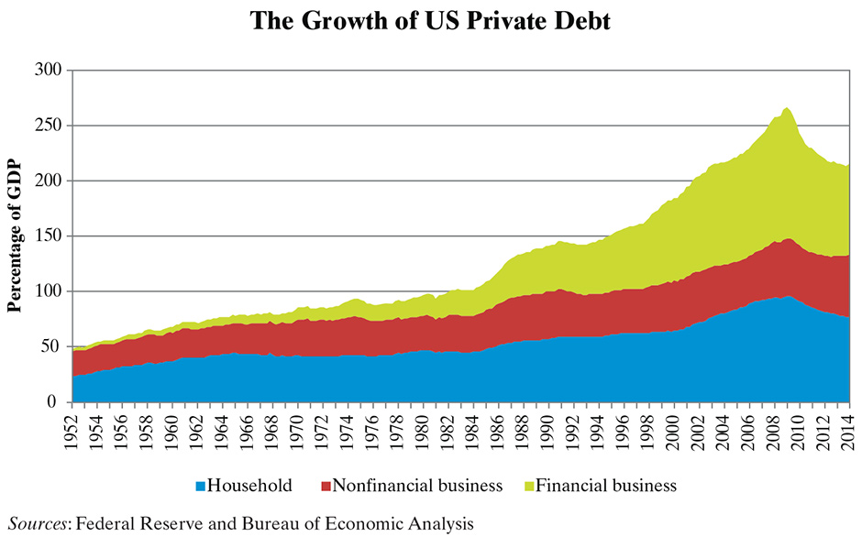
Wolf, Martin, The Shifts and the Shocks: What We’ve Learned—and Have Still to Learn—From the Financial Crisis. Penguin, 2014. Reviewed by Paul Krugman, “Why Weren’t Alarm Bells Ringing?” The New York Review of Books, October 23, 2014, pp. 41-42.

Slide 9
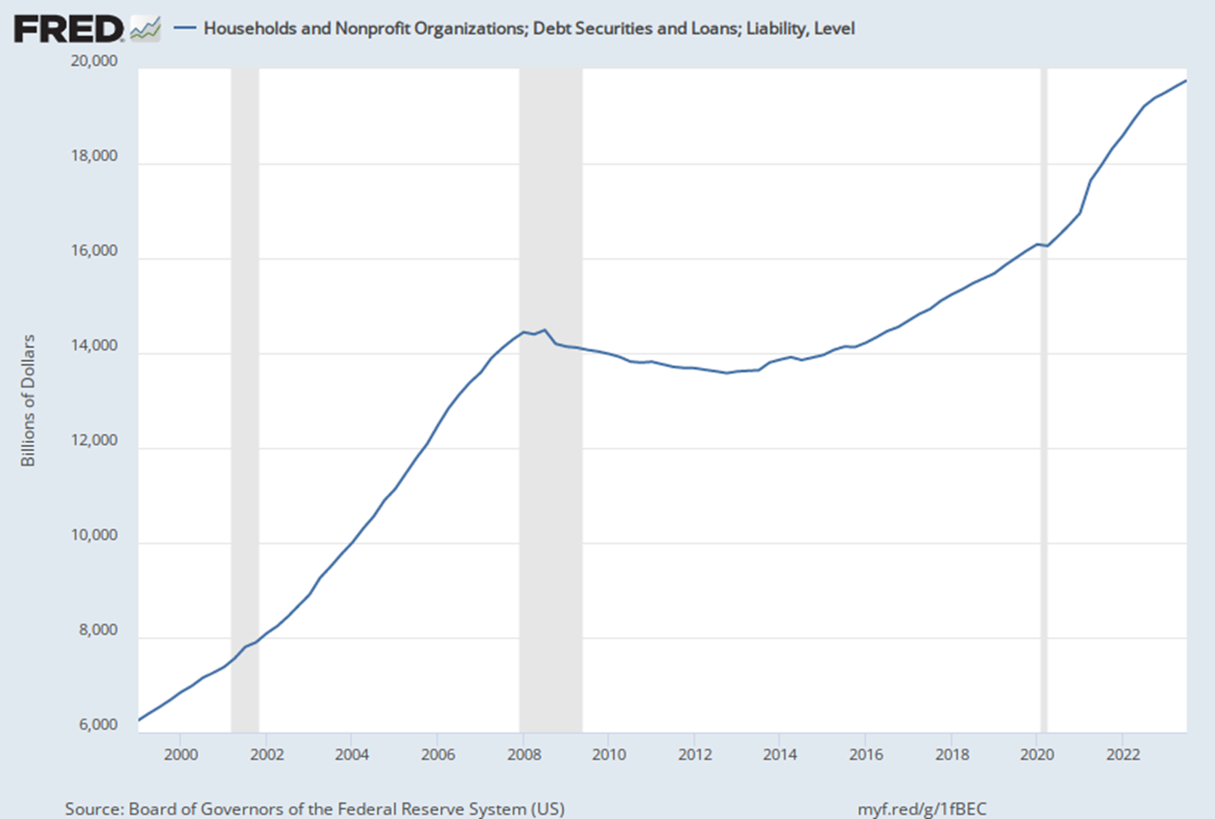

Slide 10
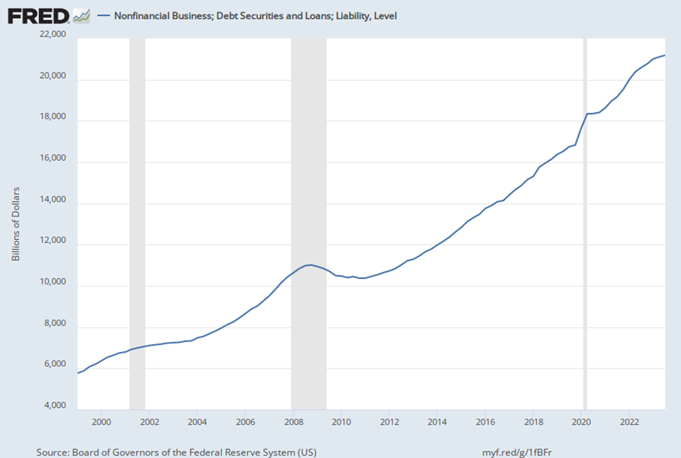

Slide 11
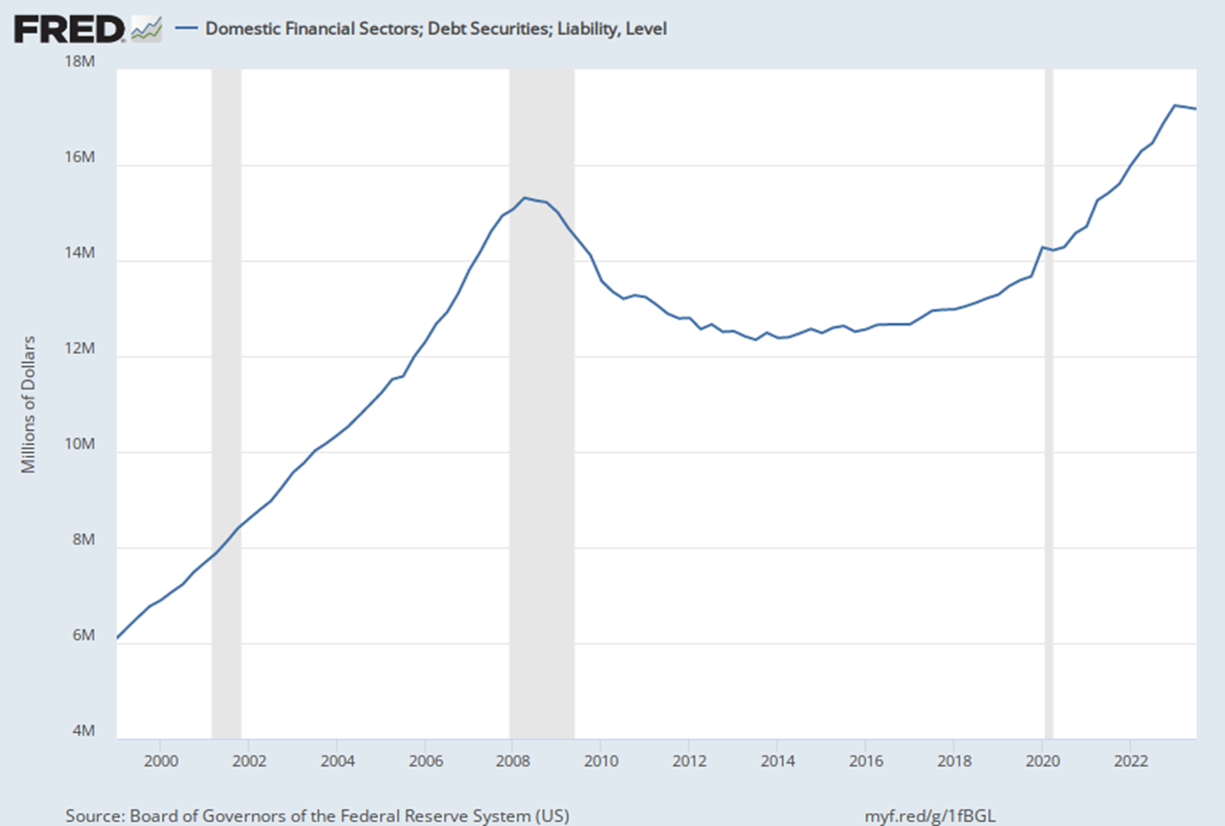

Slide 14

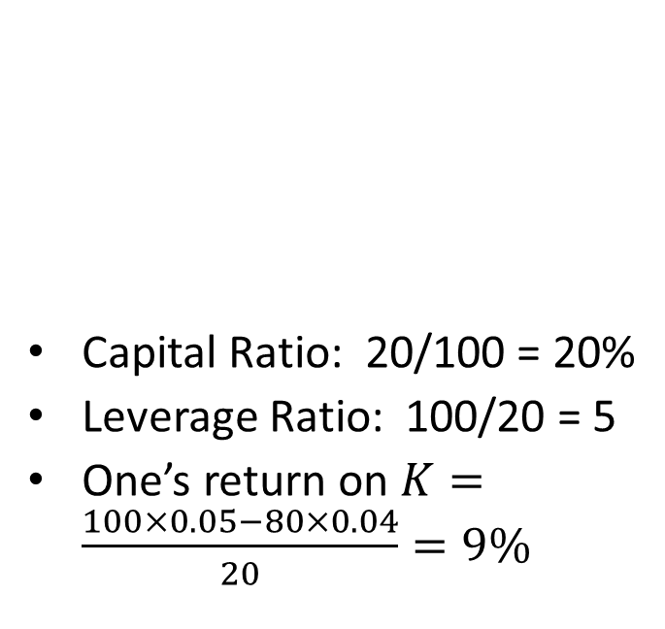
Leverage
Bank One
Bank Two
Capital Ratio: 20/100 = 20%
Leverage Ratio: 100/20 = 5
One’s return on $K=\frac{100×0.05−80×0.04}{20}=9\%$
Capital Ratio: 5/100 = 5%
Leverage Ratio: 100/5 = 20
Two’s return on $K=\frac{100×0.05−95×0.04}{5}=24\%$
Assets | Liabilities
100 | 80
 | 20 NW
Assets | Liabilities
100 | 95
 | 5 NW

Slide 15
Introductory Concepts
Probability
  Two independent events, A and B
  Two non-independent events

Slide 16
Expected value

Slide 17
The Simple Case
Asset characteristics
Price
Probability of default = 10%
≤$900
Rate of Return
11.11%
IOU
$1,000

Slide 18
Key assumption: statistical independence of assets
A Portfolio of Assets
Possible outcomes
Probability of default for each asset = 10%
IOU
$1,000
Outcome | Probability
$2,000 | 81%
$1,000 | 18%
$0 | 1%
IOU
$1,000

Slide 19
Create two new assets (e.g., MBSs) based on the portfolio
Senior tranche
Junior tranche
Probability of default | Price | Rate of return
1% | $990 | 1.01%
19% | $810 | 23.46%
IOU
$1,000
IOU
$1,000

Slide 20
Rating Systems
(simplified)
Moody’s
  Aaa, Aa, A, Baa investment grade
  Ba, B, Caa, Ca, C
Standard & Poor’s
  AAA, AA, A, BBB, BBB- investment grade
  BB+, BB, B, CCC, CC, C, D

Slide 21
Now, assume perfect correlation between the two original IOU’s
Senior tranche
  Had a pr. of default = 1%, now 10%
  Was worth $990, now it’s worth $900
Junior tranche
  Had a pr. of default of 19%, now 10%
  Was worth $810, now it’s worth $900
Thus, risk pricing completely backwards
Prudent investors lost, hedge funds gained

Slide 22
Those who warned about the coming crisis
Raghuram Rajan, Professor, University of Chicago, Booth School of Business
Nouriel Roubini, Professor, NYU Stern School of Business
Paul Krugman, Professor, Princeton University
Dean Baker, Center for Economic Policy and Research
Med Jones, President, International Institute of Management
Peter Schiff, CEO, Euro Pacific Capital, Inc.
Bob Shiller, Professor, Yale University
Byron Dorgan (http://billmoyers.com/segment/byron-dorgan-on-making-banks-play-by-the-rules/ )

Slide 23
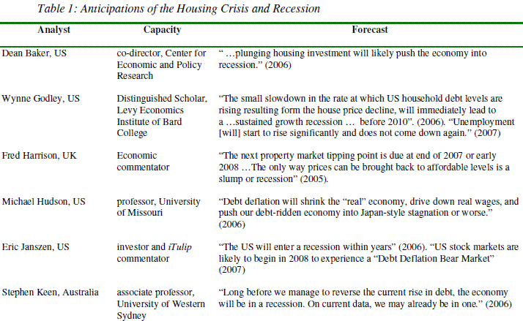

Slide 24
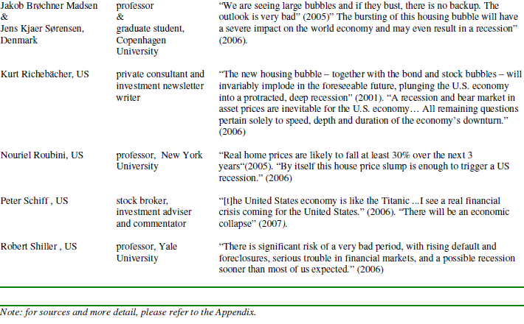
Notes:
Source: http://econintersect.com/wordpress/?p=2648

Slide 25
Human Behavior

Slide 26
Market Fundamentalism
Markets are self-correcting
The best government is a small government
The financial crisis was an accident
Add a few courses on ethics

Slide 27
What to do?
Analogies
  FDA
  NTSB
  Sports
  Hurricanes and other natural disasters
Are markets self regulating?
  Information asymmetry
  Moral hazard

Slide 28
Regulation
Government “size”
  Is “small” good?
  Glass-Steagall

Slide 29
Costs and Benefits of the Financial System [Benjamin Friedman]
In both instances [the dot.com crash and the housing bubble burst], the cost was not just financial losses but wasted real resources.
Moreover, to ask just how efficient a financial system is in allocating capital leads naturally to the question of the price that is paid for such efficiency.
The share of the “finance” sector in total corporate profits rose from 10 percent on average from the 1950s through the 1980s, to 22 percent in the 1990s, and an astonishing 34 percent in the first half of this decade.

Slide 30
Friedman [continued]
Those profits accruing to the financial sector are part of what the economy pays for the mechanism that allocates its investment capital (as well as providing other services, like checking accounts and savings deposits).
The finance industry’s share of US wages and salaries has likewise been rising, from 3 percent in the early 1950s to 7 percent in the current decade.
An important question …is what fraction of the economy’s total returns to productively invested capital is absorbed up front by the financial industry as the costs of allocating that capital.

Slide 31
Friedman [continued]
the Financial Accounting Standards Board … recently changed its rules to allow banks more latitude to claim that assets on their balance sheets are worth more than what anyone is willing to pay for them.

Slide 32
The Robo-Signing Issue
The robo-signing largely involved assignments of mortgage notes to mortgage servicers or trusts representing the investors who put up the loan money. Assignment was necessary to give the trusts legal title to the loans. But assignment was delayed until it was necessary to foreclose on the homes, when it had to be done through the forgery and fraud of robo-signing. Why had it been delayed? Why did the banks not assign the mortgages to the trusts when and as required by law?

Slide 33
Robo-Signing
A working hypothesis, suggested by Martin Andelman: securitized mortgages are the “pawns” used in the pawn shop known as the “repo market.” “Repos” are overnight sales and repurchases of collateral. Yale economist Gary Gorton explains that repos are the “deposit insurance” for the shadow banking system, which is now larger than the conventional banking system and is necessary for the conventional system to operate. The problem is that repos require “sales,” which means the mortgage notes have to remain free to be bought and sold. The mortgages are left unendorsed so they can be used in this repo market.

Slide 34
SPVs and MERS
The shadow banking system evolved in response to the need for large institutional investors to park their money securely and earn some interest. The “special purpose vehicle” (SPV), which acts as the shadow bank, evolved in response to this need.

Slide 35
MERS
The housing shell game was made possible because it was all concealed behind an electronic smokescreen called MERS (an acronym for Mortgage Electronic Registration Systems, Inc.). MERS allowed houses to be shuffled around among multiple, rapidly changing owners while circumventing local recording laws. Title would be recorded in the name of MERS as a place holder for the investors, and MERS would foreclose on behalf of the investors.

Slide 36
Robo-signing (references)
Martin Andelman
http://4closurefraud.org/2010/10/10/mandelman-the-signin-or-pardon-me-mr-banker-but-your-remic-is-showing/
Ellen Brown (primary)
http://www.nationofchange.org/why-all-robo-signing-shedding-light-shadow-banking-system-1327846780
Gary Gorton (more general)
http://online.wsj.com/public/resources/documents/crisisqa0210.pdf

Slide 37
Six Films on the Financial Crisis
Margin Call (2011)
Too Big To Fail (2011)
Inside Job (2010)
Frontline: The Warning (2009)
The Flaw (2010)
Enron: The Smartest Guys in the Room (2005)

Slide 38
Fed Funds Rate (1)

Slide 39
Fed Funds Rate (2)

Slide 40
Legislation
Dodd–Frank Wall Street Reform and Consumer Protection Act (Effective: July 21, 2010)
  Volcker Rule, effectively eliminated January 2020.

Slide 41
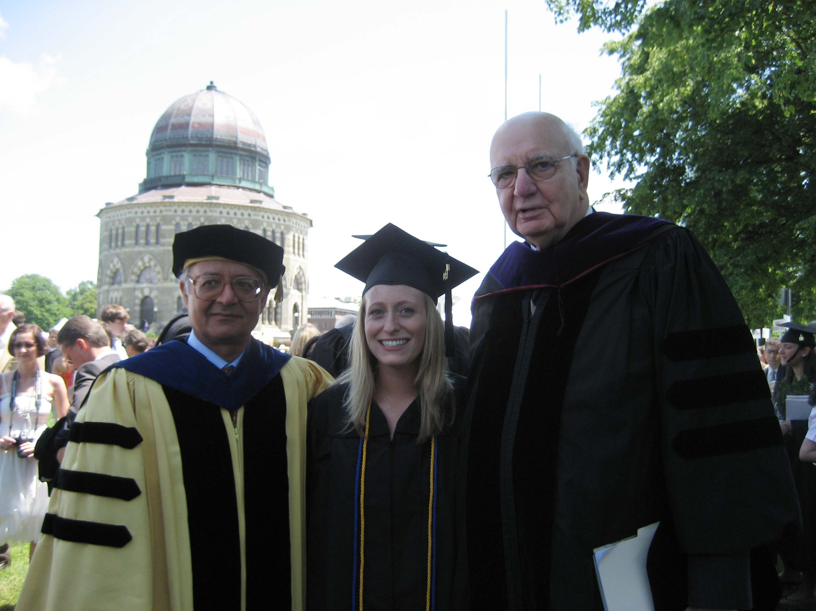

Slide 42
Shelley, Lindsey A., “The High Price of Low Interest Rates: An Empirical Investigation of the Claim that “Too Low”
Interest Rates Contributed to the Current Financial Crisis.” Senior Thesis, Union College, 2008-09

Slide 43
“They should have known …”
Not everyone regards a house as an “investment.”
We do not make this statement about
  Cars [NTSB]
  Medicines [FDA]
  Appliances [Consumer Union]
  Food [Dept. of Agriculture]
  Just about anything

Slide 44
“They should have known …”
Externalities
  Neighborhood level
  Macroeconomic level
  Global level

Slide 45
“They should have known …”
Top financial firms do not believe in this
Too big to fail
Too big to jail
To what purpose?

Slide 46
“People demand much higher standards of evidence for unpopular or unexpected findings than for comfortably familiar findings.”
George Stigler, Nobel Laureate, Economics
Memoirs of an Unregulated Economist
(Chicago, 2003)

