Slide 1
Contemporary Problems in Macroeconomics
Eshragh Motahar
Professor of Economics and Asian Studies

Slide 2
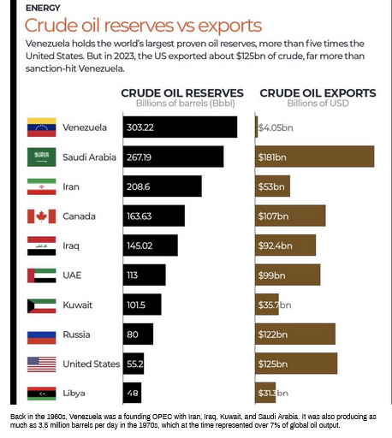

Slide 3
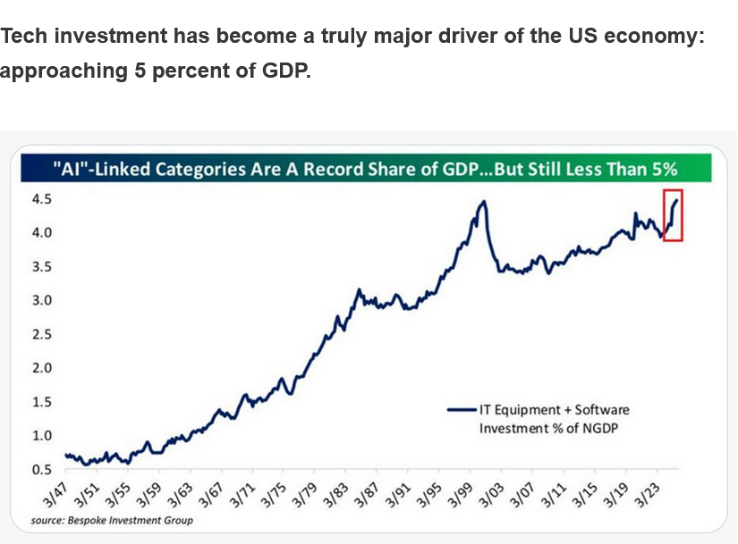

Slide 4


Slide 5
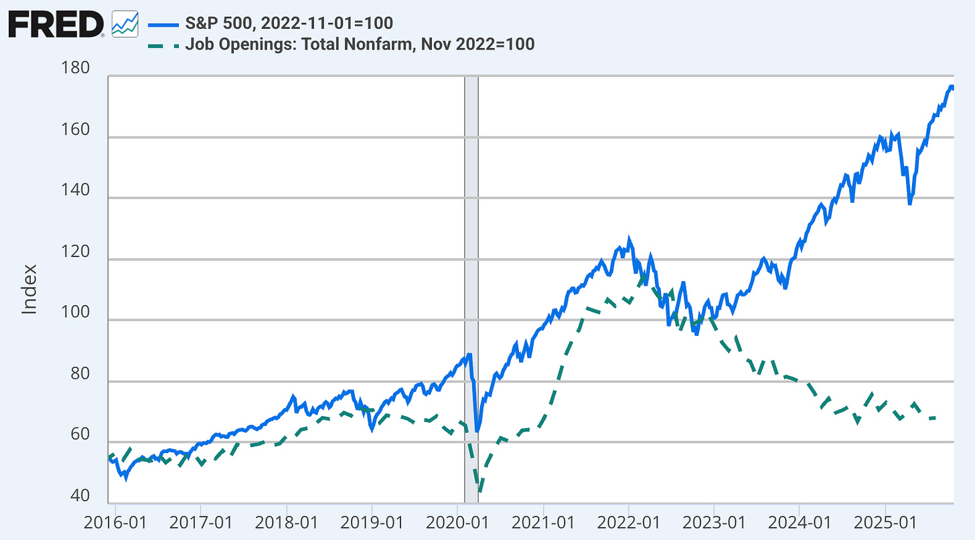

Slide 6
As of September 23, 2025
Unemployment rate: 4.3%
CPI inflation rate: 2.9%
Real GDP growth rate: 3.3%
Federal Funds rate: 4.00-4.25%
30-year mortgage rate (national average): 6.38-6.53%
Ten-year Treasury coupon rate: 4.25%
The Congressional Budget Office (CBO) projected the U.S. budget deficit to be $1.9 trillion in FY 2025.
The total U.S. national debt is over $37.5 trillion as of mid-September 2025.

Slide 7
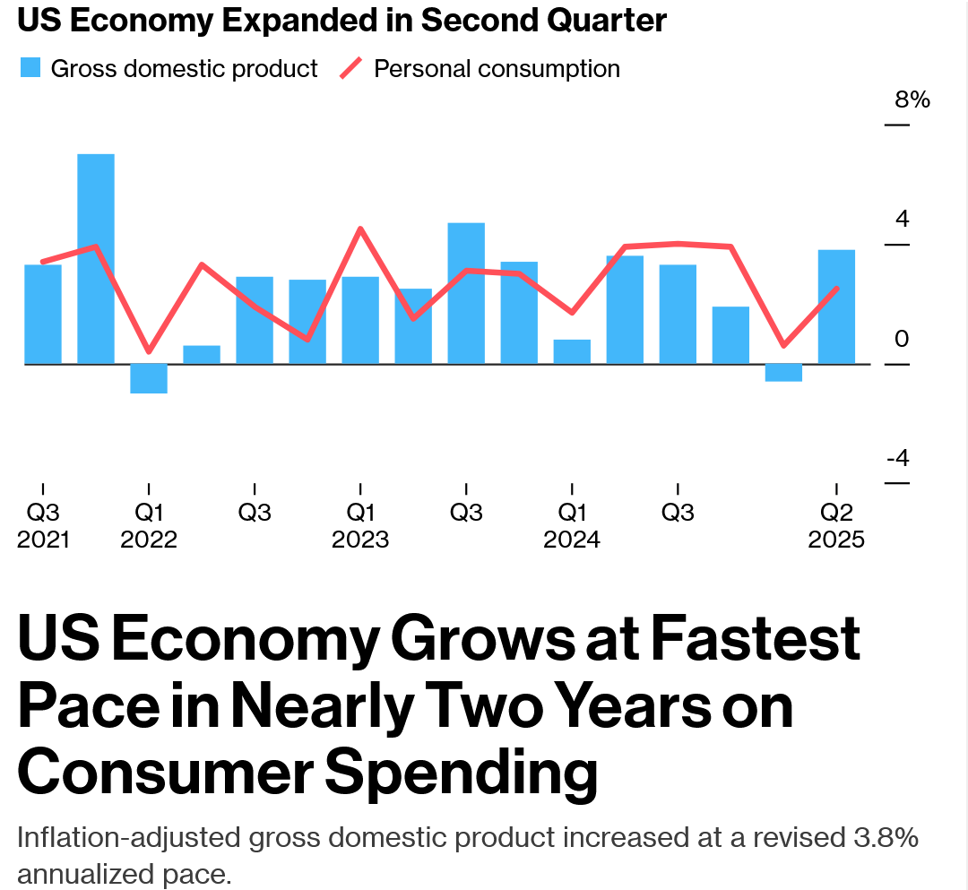
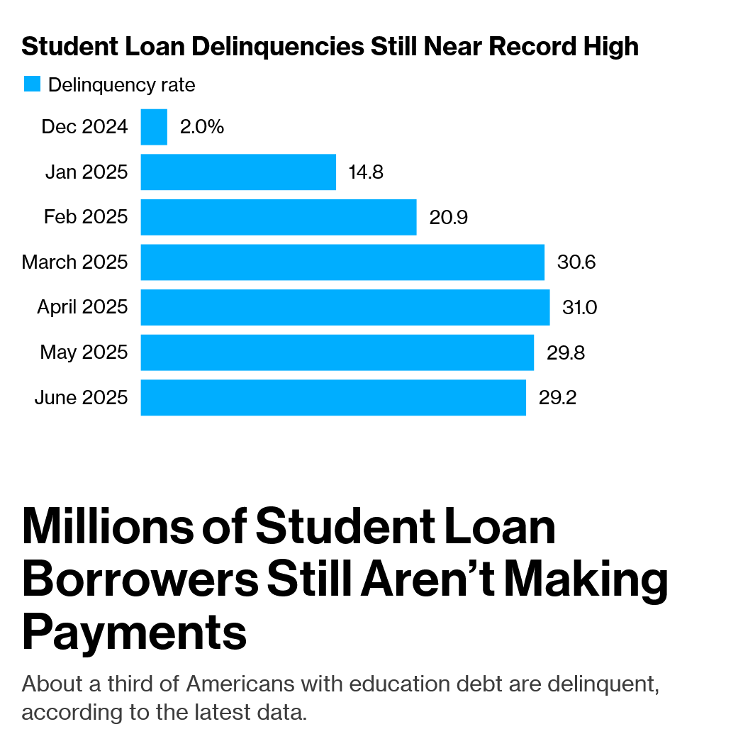
September 25, 2025

Slide 8
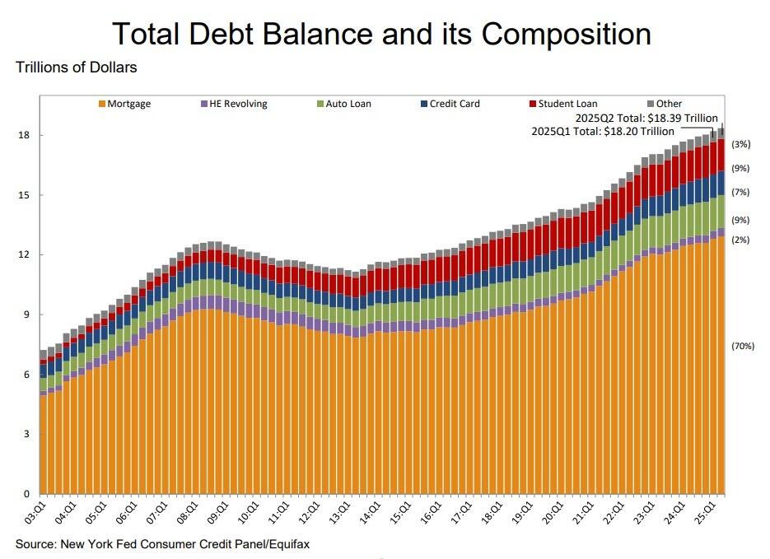
Debt

Slide 9
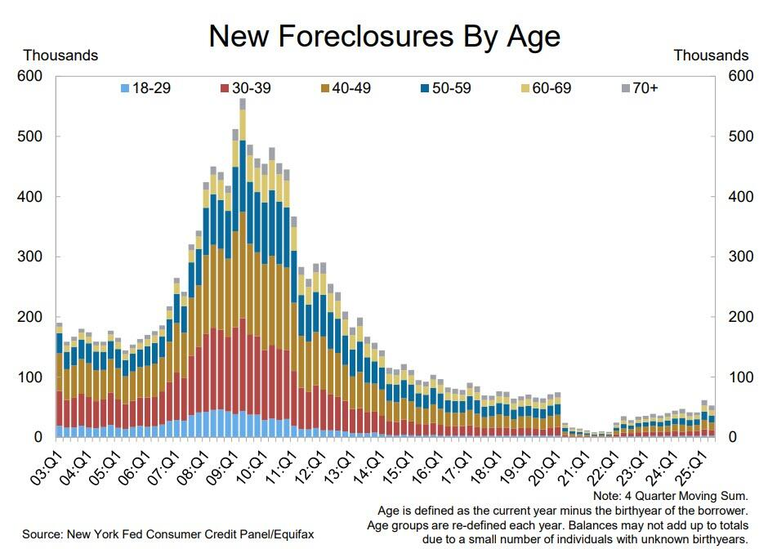

Slide 10
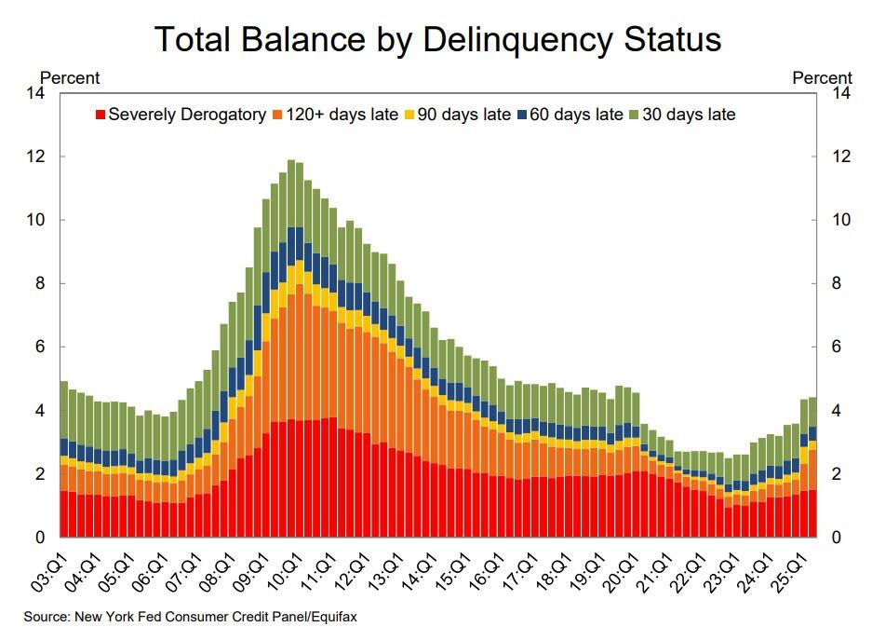

Slide 11
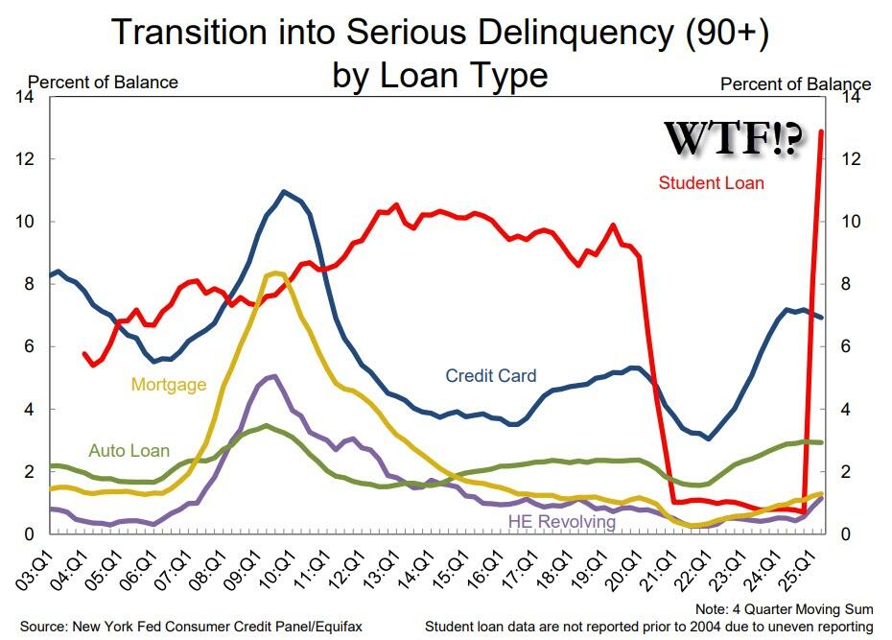

Slide 12
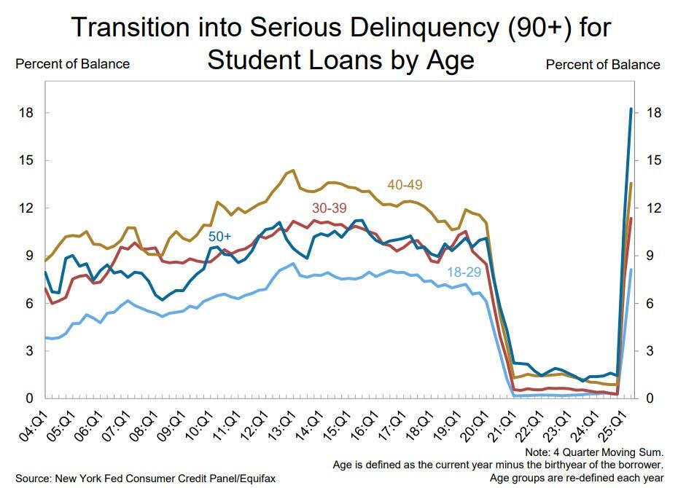

Slide 13
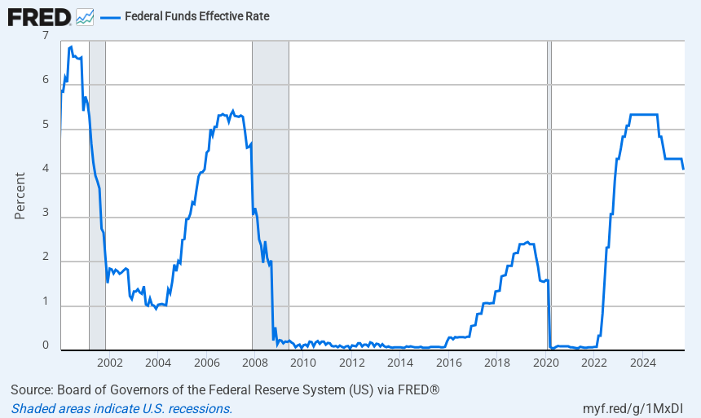

Slide 14
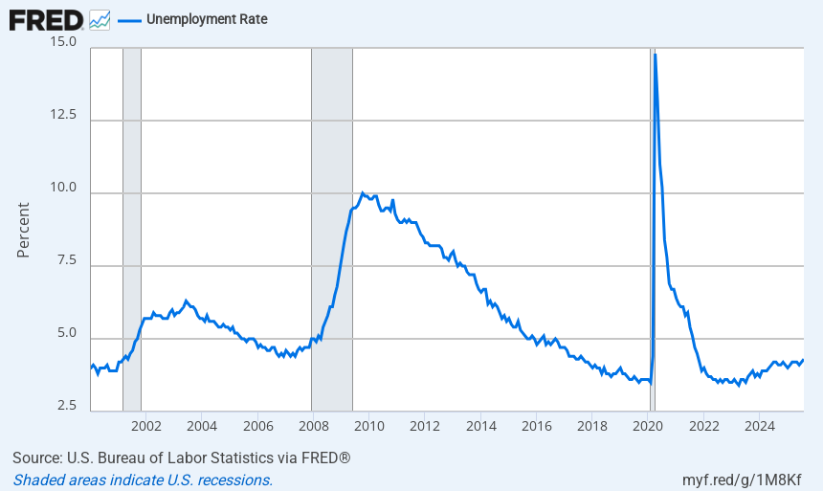

Slide 15
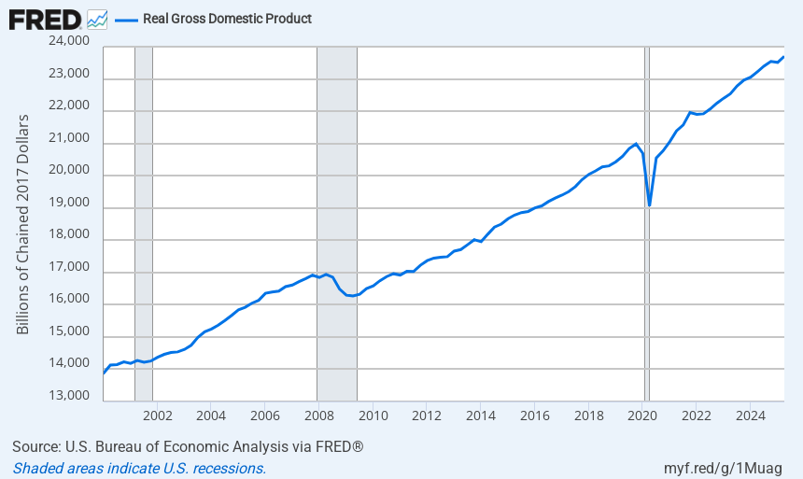

Slide 16
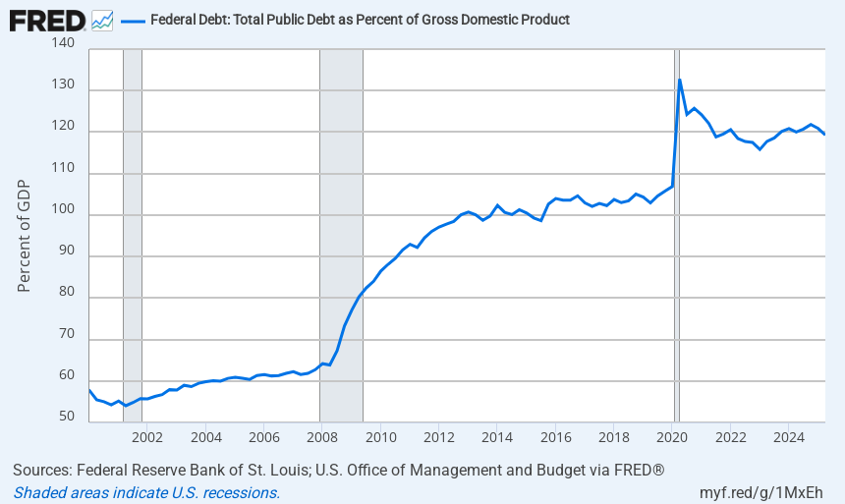

Slide 17
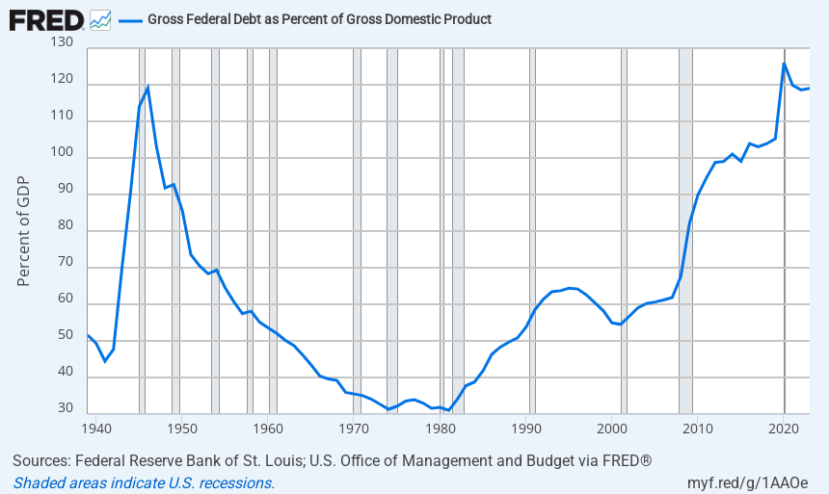

Slide 18
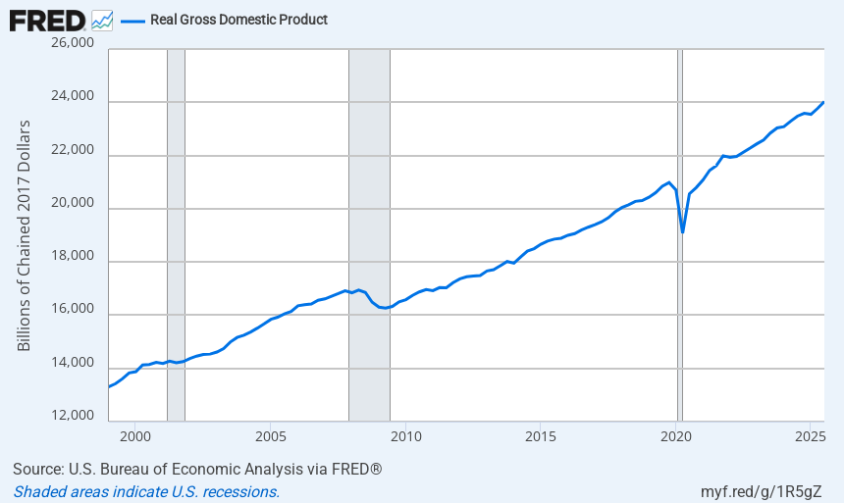

Slide 19


Slide 20
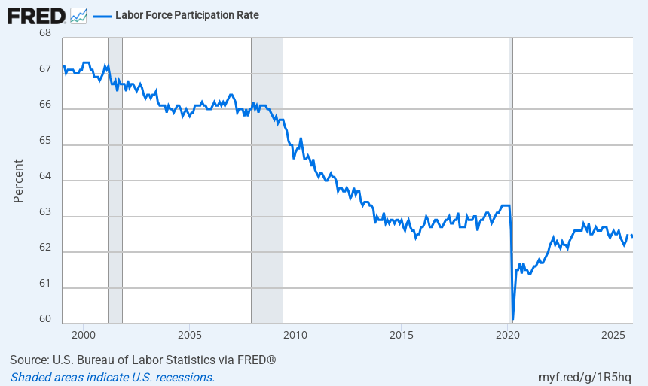

Slide 21
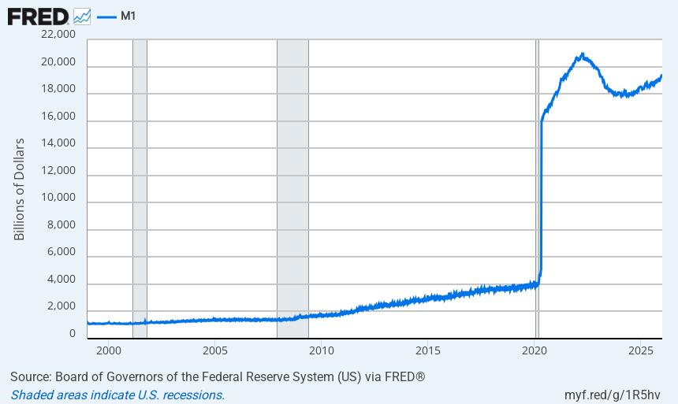

Slide 22
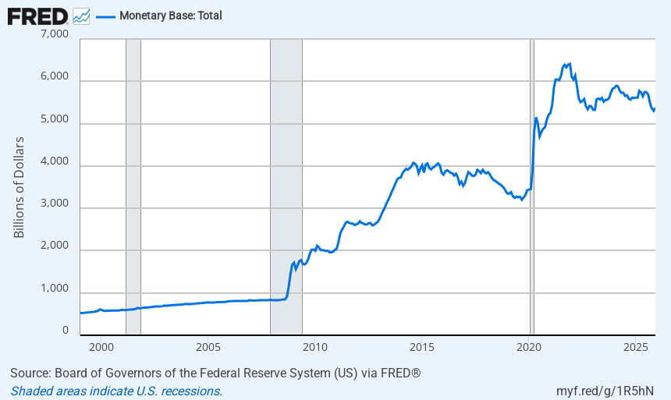

Slide 23
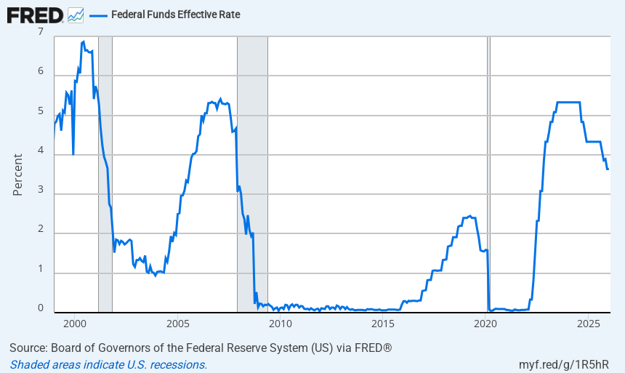

Slide 24
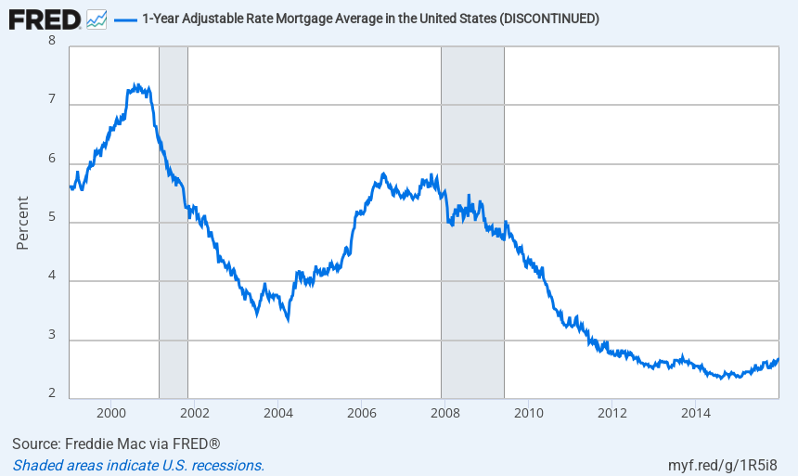

Slide 25
