Slide 1
International Economics
Open-Economy Macroeconomics
Exchange-Rate Determination

Slide 2
Bretton Woods Regime vs. Floating Exchange Rates
Bretton Woods Conference, Mount Washington Hotel, Bretton Woods, New Hampshire, July 1-22, 1944, 44 allied nations
August 15, 1971: U.S. unilaterally terminated the convertibility of the U.S. dollar to gold—the Nixon shock

Slide 3
A Numerical Example
Assume £1 = $4.00
($1= £0.25)
UK ForEx Market
 | EX | IM | net | Inflow | Outflow | net
Case 1 | $100 | $150 | -$50 | $1000 | $950 | +$50
Case 2 | $100 | $150 | -$50 | $1000 | $970 | +$30
 | Supply of $ | Demand for $ | Excess D
Case 1 | $100 + $1000 = $1100 | $150 + $950 = $1100 | 0
Case 2 | $100 + $1000 = $1100 | $150 + $970 = $1120 | +$20

Slide 4
US-UK Exchange Rates
USD per 1 Pound Sterling, 1947.01-2019.05

Slide 5
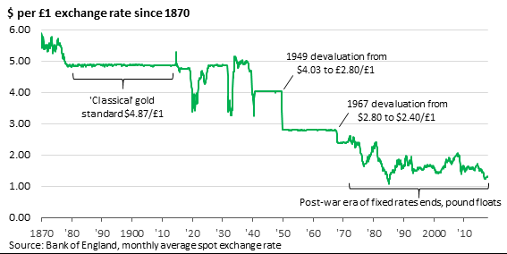

Slide 6
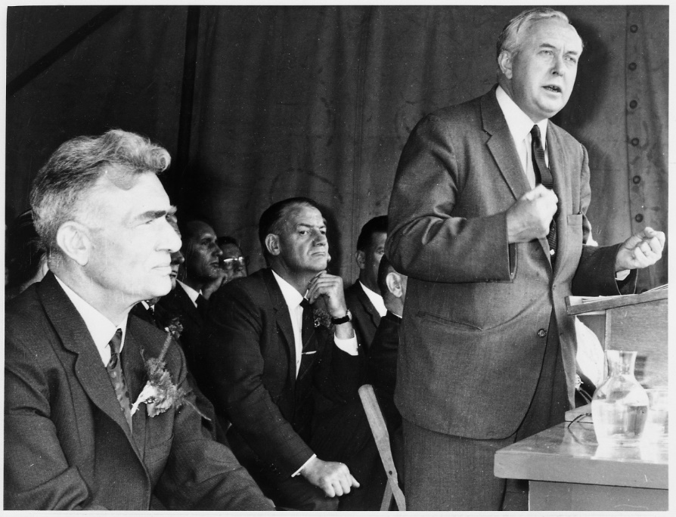

Slide 7
Devaluation of the French Franc
https://www.youtube.com/watch?v=qJVFWbYSIKk

Slide 8
Gold/USD then and now
August 15, 1971:
  $38 per ounce
May 29, 2025:
  $4,430 per ounce

Slide 9
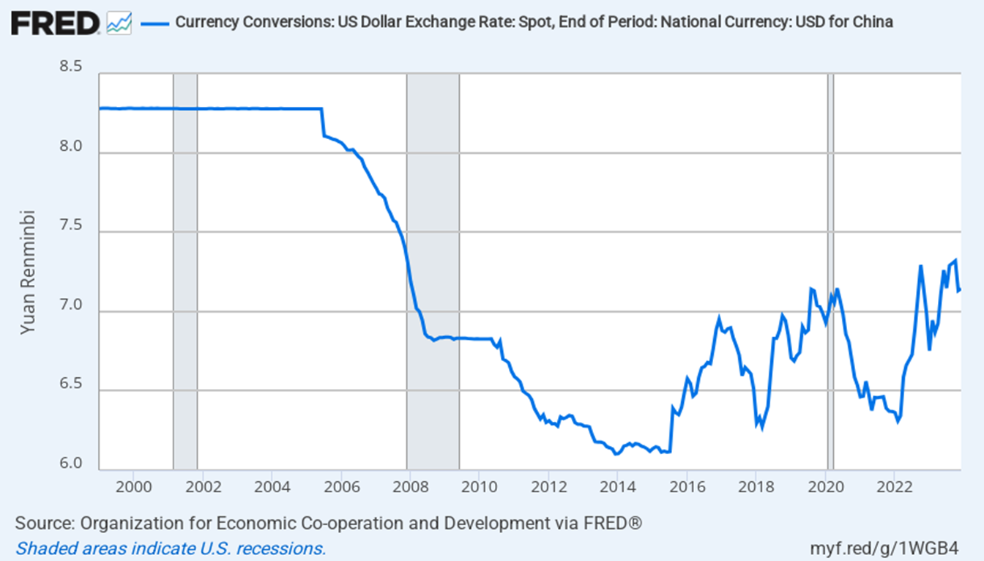
Yuan Renminbi per USD

Slide 10
The China Allegation (cont’d)
http://blogs.wsj.com/chinarealtime/2014/05/02/maybe-chinas-currency-isnt-undervalued-after-all/
http://qz.com/412082/chinas-yuan-is-no-longer-undervalued-says-imf/
http://blogs.wsj.com/chinarealtime/2014/05/13/undervalueovervalue-the-great-yuan-debate-continues/

Slide 11
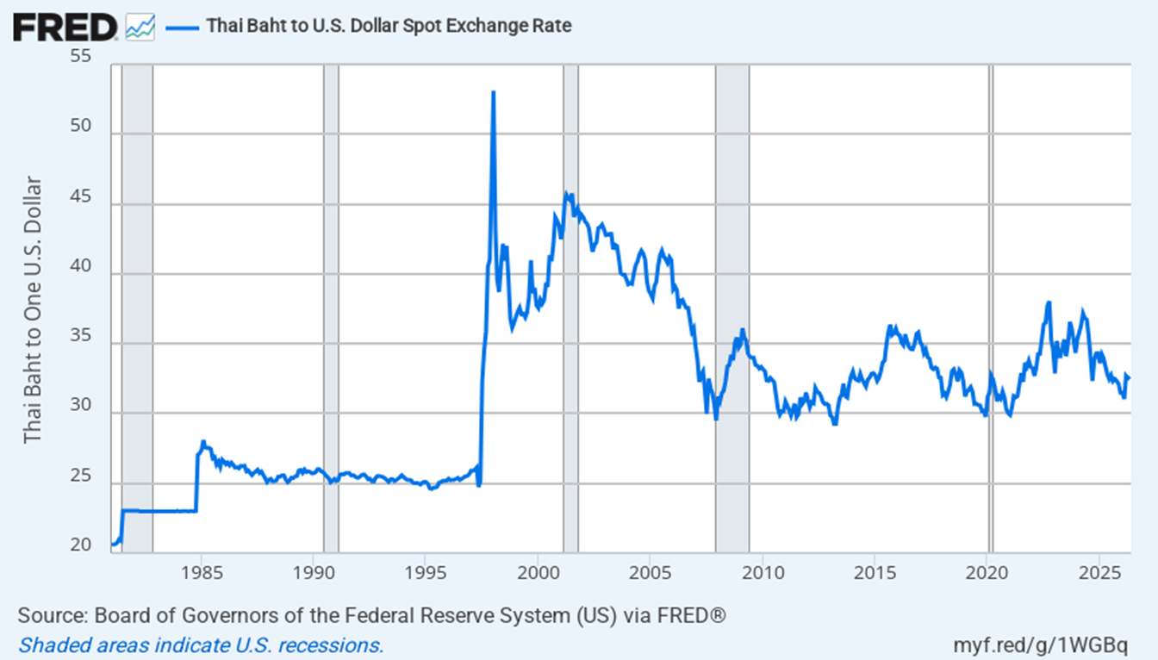
Thai Baht per USD

Slide 12
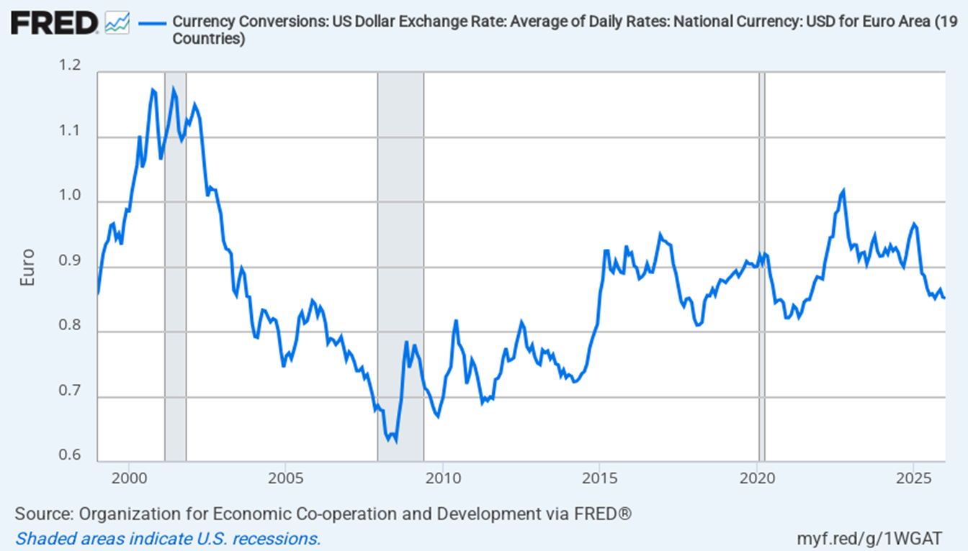
USD per EUR

Slide 13
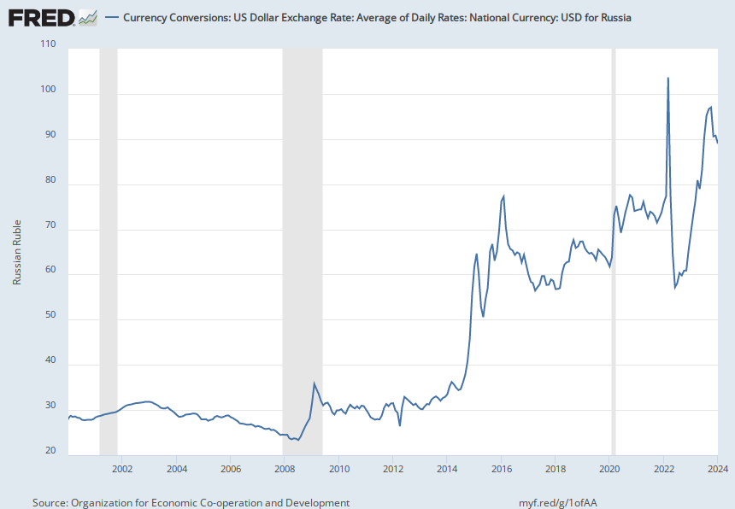
Russian Ruble per USD

Slide 14
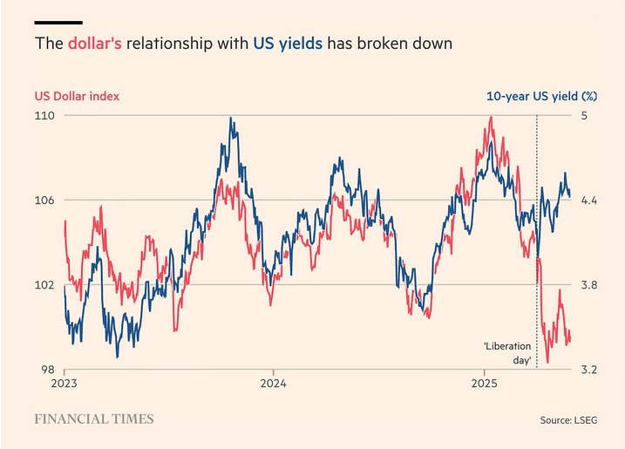
Source: Financial Times, 6/2/2025

Slide 17
Balance of Payments Accounts
The balance of payments accounts are separated into 3 broad accounts:
  current account: accounts for flows of goods and services (imports and exports).
  financial account: accounts for flows of financial assets (financial capital).
  capital account: flows of special categories of assets (capital): typically nonmarket, non-produced, or intangible assets like debt forgiveness, copyrights and trademarks.

Slide 18
BoP
The negative value of the net change in official reserve assets is called the official settlements balance or “balance of payments.”
  It is the sum of the current account, the capital account, the nonreserve portion of the financial account, and the statistical discrepancy.
  A negative official settlements balance may indicate that a country
    is depleting its official international reserve assets, or
    may be incurring large debts to foreign central banks so that the domestic central bank can spend a lot to protect against financial instability.

Slide 19
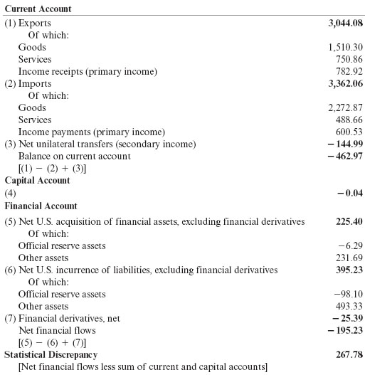
Table 13.2 U.S. Balance of Payments Accounts for 2015 (billions of dollars)
Source: U.S. Department of Commerce, Bureau of Economic Analysis, June 16, 2016, release. Totals may differ from sums because of rounding.

Slide 20
ForEx (FX) Markets (1)
The set of markets where foreign currencies and other assets are exchanged for domestic ones
  Institutions buy and sell deposits of currencies or other assets for investment purposes.
The daily volume of foreign exchange transactions was $9.6 trillion in April 2025
  up from $500 billion in 1989.
Most transactions (89% in April 2025) exchange foreign currencies for U.S. dollars.
http://fxandmm.thomsonreuters.com/market-tools/market-volumes/
http://www.google.com/url?sa=t&rct=j&q=&esrc=s&source=web&cd=1&cad=rja&uact=8&ved=0CC0QFjAA&url=http%3A%2F%2Fwww.bis.org%2Fpubl%2Frpfx13fx.pdf&ei=Ki9nVcrXHuSOsQTx8YKYBA&usg=AFQjCNF-M2Zztx3r5J1yS05M1SaKq7RwhA&bvm=bv.93990622,d.cWc

Slide 21
A subtle but important point: 89% does not mean 89% of global trade or investment is conducted in dollars. It means the dollar acts as the dominant vehicle currency in FX markets. For example, if a trader wants to exchange Thai baht for Mexican pesos, the transaction is often executed as:
Baht → U.S. dollars
U.S. dollars → Pesos
rather than directly exchanging baht for pesos.
This role of the dollar as an intermediary helps explain why its share of FX trading is so much larger than the U.S. share of world GDP or world merchandise trade.

Slide 22
ForEx Markets (2)
The participants:
Commercial banks and other depository institutions: transactions involve buying/selling of deposits in different currencies for investment purposes.
Non-bank financial institutions (mutual funds, hedge funds, securities firms, insurance companies, pension funds) may buy/sell foreign assets for investment.
Non-financial businesses conduct foreign currency transactions to buy/sell goods, services and assets.
Central banks: conduct official international
reserves transactions.

Slide 23
ForEx Markets (3)
Buying and selling in the foreign exchange market are dominated by commercial and investment banks.
  Inter-bank transactions of deposits in foreign currencies occur in amounts $1 million or more
  per transaction.
  Central banks sometimes intervene, but the direct effects of their transactions are small and transitory in many countries.

Slide 24
ForEx Markets (4)
Computer and telecommunications technology transmit information rapidly and have integrated markets.
The integration of financial markets implies that there can be no significant differences in exchange rates across locations.
  Arbitrage: buy at low price and sell at higher price for a profit.
  If the euro were to sell for $1.1 in New York and $1.2 in London, could buy euros in New York (where cheaper) and sell them in London at a profit.

Slide 25
Top 10 Most Traded Currencies
1. US dollar (USD)
2. Euro (EUR)
3. Japanese yen (JPY)
4. Pound sterling (GBP)
5. Australian dollar (AUD)
6. Canadian dollar (CAD)
7. Swiss franc (CHF)
Chinese renminbi (CNY)
Hong Kong dollar (HKD)
New Zealand dollar (NZD)

Slide 26
The Big Mac Index
As of June 4, 2024: 1 USD = 7.24 CNY [Chinese Yuan Renminbi]
http://www.economist.com/content/big-mac-index
The Big Mac PPP of CNY:
  7.24×(1-0.39) = 4.42

Slide 27
ECB’s Policy Stance
http://blogs.wsj.com/briefly/2014/06/04/the-ecbs-negative-deposit-rate-the-short-answer/
http://www.bloomberg.com/news/2014-06-05/draghi-unveils-historic-measures-on-deflation-threat.html

Slide 28
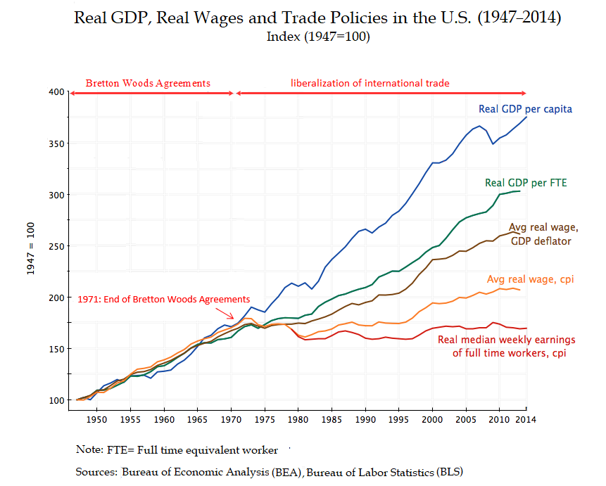

Slide 29
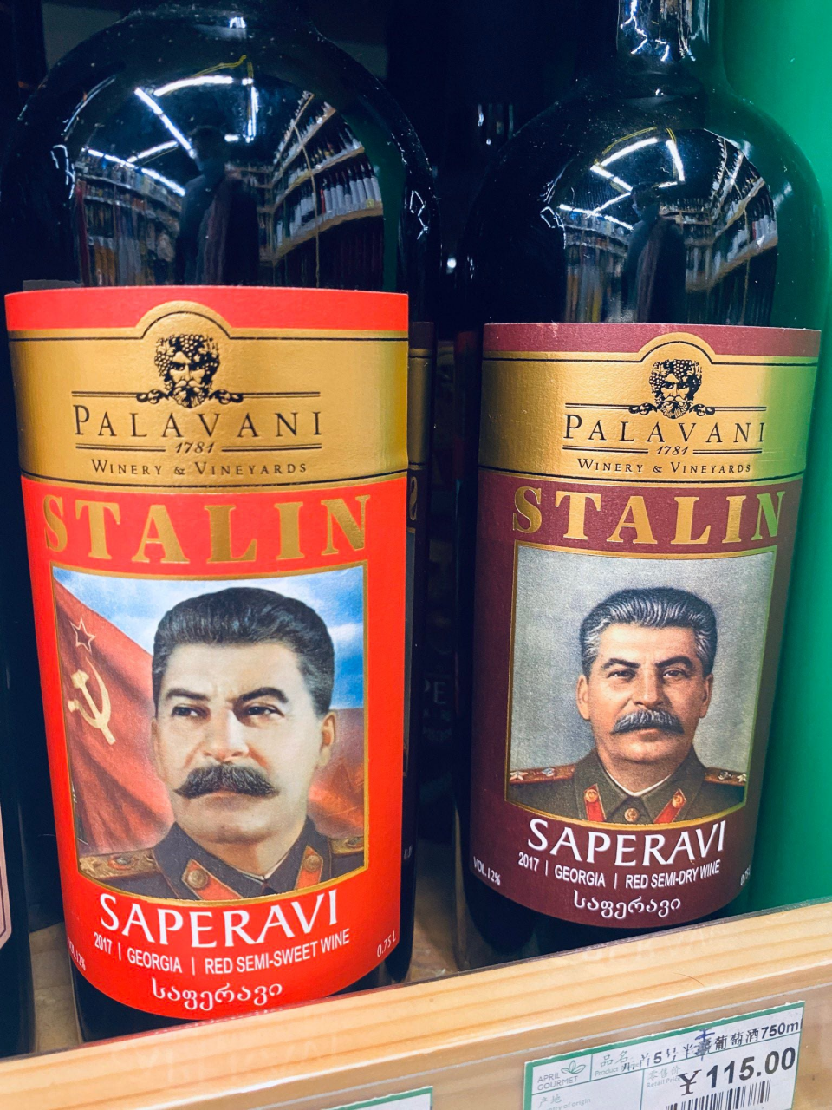

Slide 30
The dry red is, dare I say it, rather rustic, like its namesake. And definitely requires a constitution of steel at 14.5%.

Slide 31
Over the summer, I read a book called “The Industries of the Future” by Alec Ross (former Senior Advisor for Innovation in the State Department and Obama campaigns). While the book as a whole was really interesting, I found one chapter in particular which I thought might give your future macro students a unique view of external economies today, and their potential for the future. Chapter 6 of the book, entitled “Geography of Future Markets”, starts with an in depth look into how external economies have progressed through globalization, and later includes Ross’ argument as to why he believes that further increases in technology will result in individual countries, regions, and cities, handling data analytics and other technological business practices that relate to their particular domain of expertise, rather than exporting those services to silicon valley. While my description may be somewhat lacking, Ross does a great job of explaining the situation and his argument in the book.

Slide 32
On a more anecdotal note, I have recently moved into Hell’s Kitchen, NY and have been experiencing firsthand the external economy of theater production. Not only do I walk past actor’s studios, costume shops, talent agencies, and countless theaters on a daily basis, I have also noticed that the external economy has even permeated peoples’ personal lives, as there are a few churches and synagogues in my area specifically designed for actors! I thought it was really cool to see how the external economy not only affected theater production in the country, but also how it affected seemingly unrelated industries in the area.

Slide 33
Finally, I thought you would be interested in knowing that I have been working directly with macro/international economics in my job. I have recently been assigned to a case in which multiple civil and criminal regulatory agencies are investigation LIBOR manipulation by major international banks. When I was first assigned, I sat down with a few attorneys to discuss the details and every 5 or 10 minutes I would have to stop myself from saying “its alright guys, Prof. Motahar already taught me all this stuff, so this is all really review”.

