Slide 1
Youth and the Civil Rights Movement:
From Freedom Now to Black Power

Slide 2
Youth and the Civil Rights Movement
The Jim Crow System
Youth and Their Relationship to Jim Crow
The Struggle Against Jim Crow
How that Struggle and the Youth Involved in It Changed Over Time: From Freedom Now to Black Power

Slide 3
Class Themes
What the struggle against inequality looks like
How inequality is perpetuated
The effect of inequality and violent resistance to change on youth

Slide 4
The Jim Crow System: Segregation and Rules of Etiquette

Slide 5
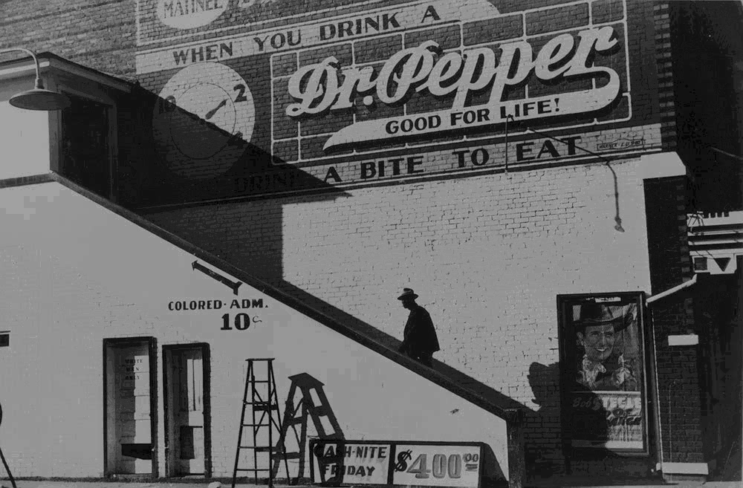

Slide 6
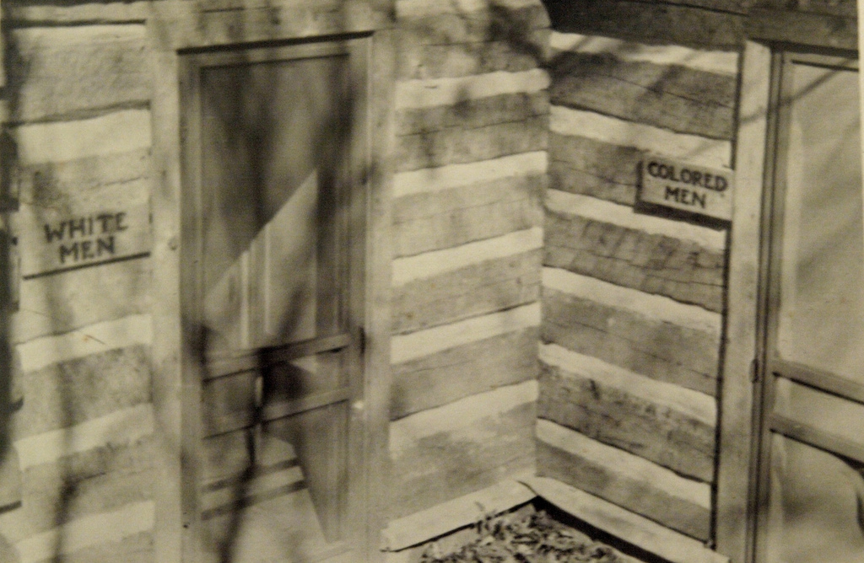

Slide 7
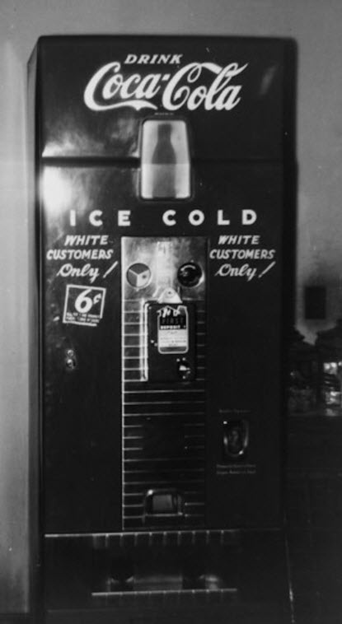

Slide 8
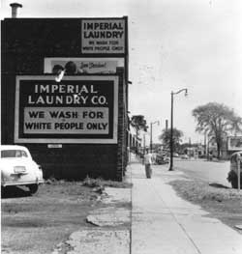

Slide 9
Lynching
As a Method of Control
2. Perpetuating the System (Teaching the Children)

Slide 10
Lynching of Rubin Stacy

Slide 11
The Youth

Slide 12
John Lewis

Slide 13
Diane Nash

Slide 14
Bernard Lafayette

Slide 15
Coming of Age in the 1950s
1954: Brown vs. Board of Education
1955 Lynching of Emmett Till
1955-6 Montgomery Bus Boycott

Slide 16
Introduction to Non-violence
Nashville, 1959

Slide 17
James Lawson at a Workshop
“When you are a child of God… you try thereby to imitate Jesus in the midst of evil. Which means, if someone slaps you on the cheek, you turn the other cheek, which is an act of resistance. It means that you do not only love your neighbor, but you recognize that even the enemy has a spark of God in them, has been made in the image of God and therefore needs to be treated as you, yourself, want to be treated. Jesus is very clear about this.”

Slide 18
Feb. 1, 1960: Greensboro Sit Ins
Notes:
Joseph McNeil, Franklin McCain, Billy Smith, and Clarence Henderson.

Slide 19
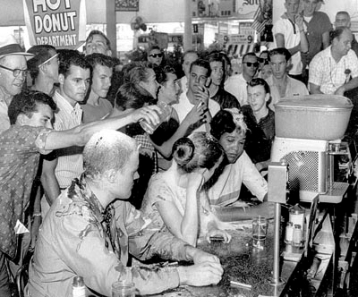

Slide 20
More Youth Join the Movement

Slide 21
Dave Dennis

Slide 22
Stokely Carmichael

Slide 23
April 1960: Ella Baker organized a conference at Shaw University

Slide 24
Student Nonviolent Coordinating Committee

Slide 25
Principles of the Early Movement | Later Movement
Moral Simplicity

Slide 26
Early Movement | Later Movement
Moral Simplicity
High Ideals

Slide 27
Early Movement | Later Movement
Moral Simplicity
High Ideals
Non Violent Tactics

Slide 28
Early Movement | Later Movement
Moral Simplicity
High Ideals
Non Violent Tactics
Working with Whites

Slide 29
Early Movement | Later Movement
Moral Simplicity
High Ideals
Non Violent Tactics
Working with Whites
Working with Liberals

Slide 30
1961 Freedom Rides Congress of Racial Equality (CORE)

Slide 31
Supreme Court Cases
1946 Morgan vs. Virginia
1960 Boynton vs. Virginia

Slide 32
The 1961 CORE Freedom Riders

Slide 33
Freedom Riders in Anniston

Slide 34
Freedom Riders in Birmingham: Charles Person and James Peck

Slide 35
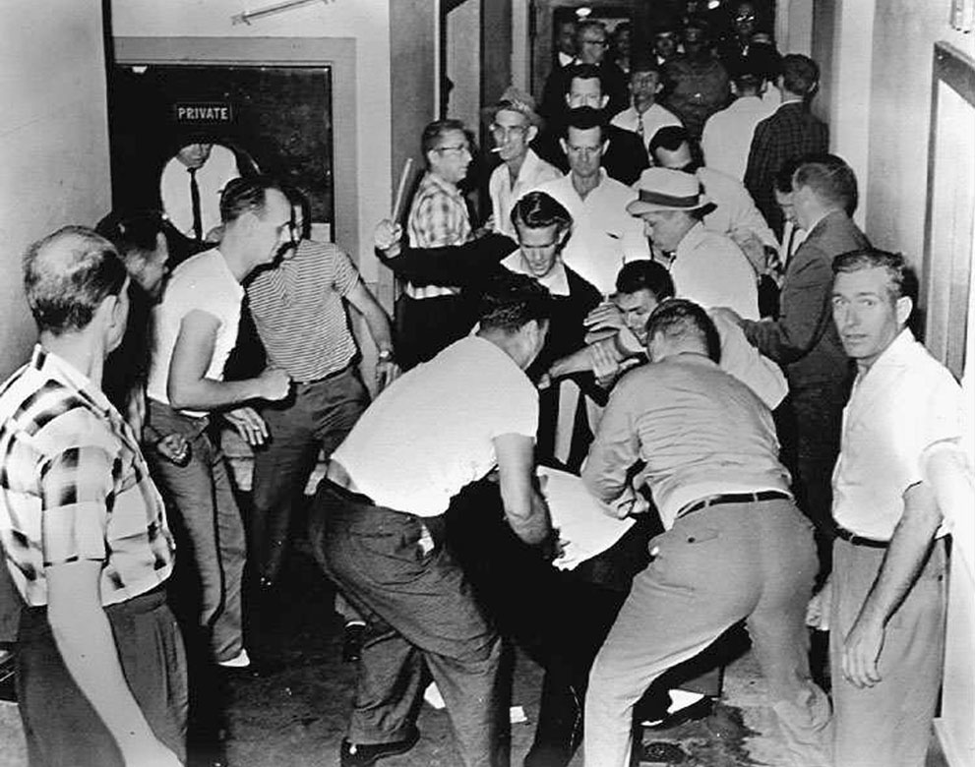

Slide 36
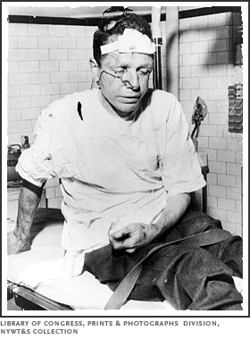

Slide 37
The Kennedy Administration’s International Embarrassment:
Moscow Radio: "Scenes of bloodshed in Montgomery are the worst examples of savagery taking place in a country which has the boldness to declare that its way of life is an example for other people.”

Slide 38
The Freedom Rides Part 2: SNCC

Slide 39
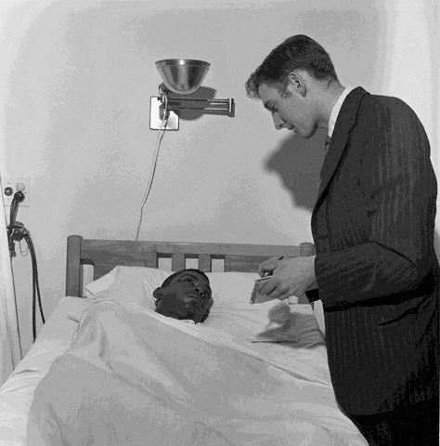
Notes:
William Barbee talks to UPI reporter

Slide 40
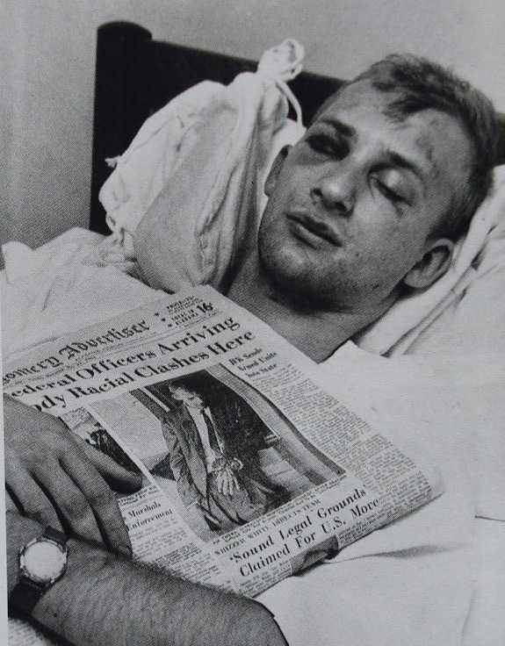

Slide 41
Maximum Security: Parchman Farm
The Federal Government and Compromise with Jim Crow

Slide 42
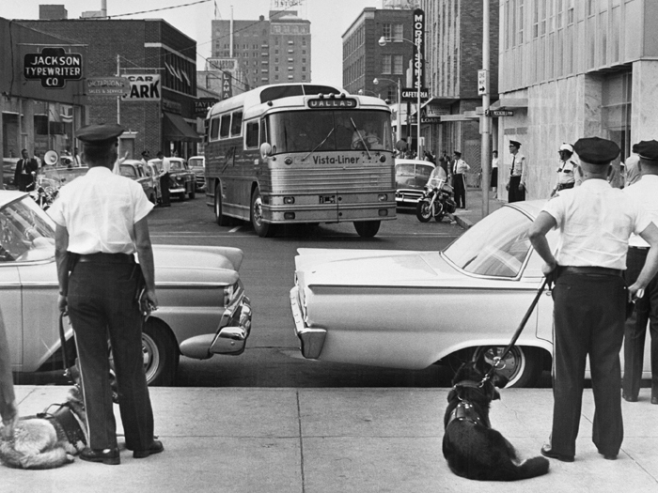

Slide 43
The Freedom Rides, Part 3:
430 People become Freedom Riders and head to Mississippi; 300 sent to Parchman

Slide 44
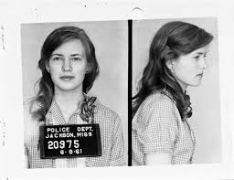

Slide 45
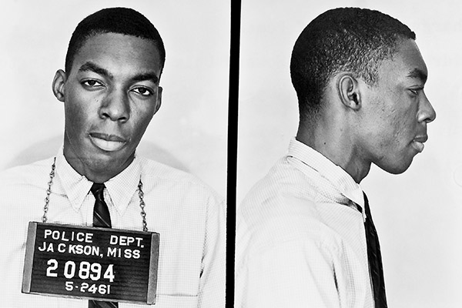

Slide 46
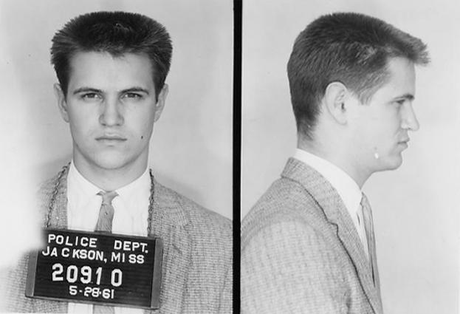

Slide 47
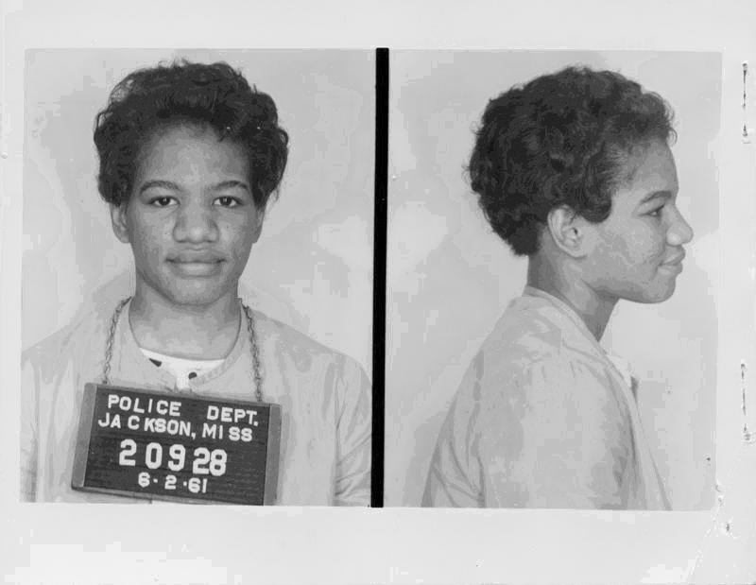

Slide 48
Voter Registration: The Administration Promises Money and Protection

Slide 49
SNCC in Mississippi

Slide 50
Robert Moses

Slide 51
The Murder of Herbert Lee

Slide 52
Violence and its Toll: Birmingham

Slide 53
The Arrest of the Children

Slide 54
Police Dogs

Slide 55
Fire Hoses

Slide 56
The Bombing of the 16th Street Baptist Church

Slide 57
Freedom Summer

Slide 58
Mississippi Freedom Summer
Expand Black Voter Registration
Establish Freedom Schools
Organize an Alternative Integrated State Democratic party

Slide 59
Workshops

Slide 60
Leaving for the South

Slide 61
The Disappearance of Goodman, Chaney, and Schwerner

Slide 62
The Work Goes On: The Freedom Schools

Slide 63
Voter Registration

Slide 64
The Harassment and Violence Continue
During Freedom Summer in Mississippi there were more than
1,000 arrests
80 beatings
35 shootings
35 church burnings
30 bombings

Slide 65
Whites in the National Spotlight

Slide 66
Mississippi Freedom Democratic Party

Slide 67
Dave Dennis’ Eulogy for James Chaney

Slide 68
Early Movement | Later Movement
High Ideals | Cynicism
Moral Simplicity
Non Violent Tactics
Working with Liberals
Working with Whites

Slide 69
Early Movement | Later Movement
High Ideals | Cynicism
Moral Simplicity | More complex
Non Violent Tactics
Working with Liberals
Working with Whites

Slide 70
Early Movement | Later Movement
High Ideals | Cynicism
Moral Simplicity | More complex
Non Violent Tactics | Self-Defense
Working with Liberals
Working with Whites

Slide 71
Early Movement | Later Movement
High Ideals | Cynicism
Moral Simplicity | More complex
Non Violent Tactics | Self-Defense
Working with Liberals | Openly critical of liberals
Working with Whites

Slide 72
Early Movement | Later Movement
High Ideals | Cynicism
Moral Simplicity | More complex
Non Violent Tactics | Self-Defense
Working with Liberals | Openly critical of liberals
Working with Whites | Blacks should organize blacks- whites will be asked to leave

