Slide 1
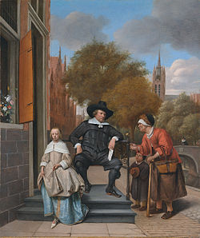
Inequality in Feudal and Early Capitalist Economies,1000-1600
Prof. Steve Sargent 9/14/2015

Slide 2
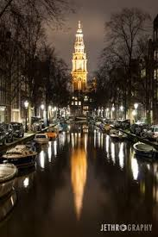
Topics
1000 C.E. Early Feudal Economy
1300 C.E. Late Feudal Economy
1600 C.E. Early Capitalist Economy in the Netherlands

Slide 3
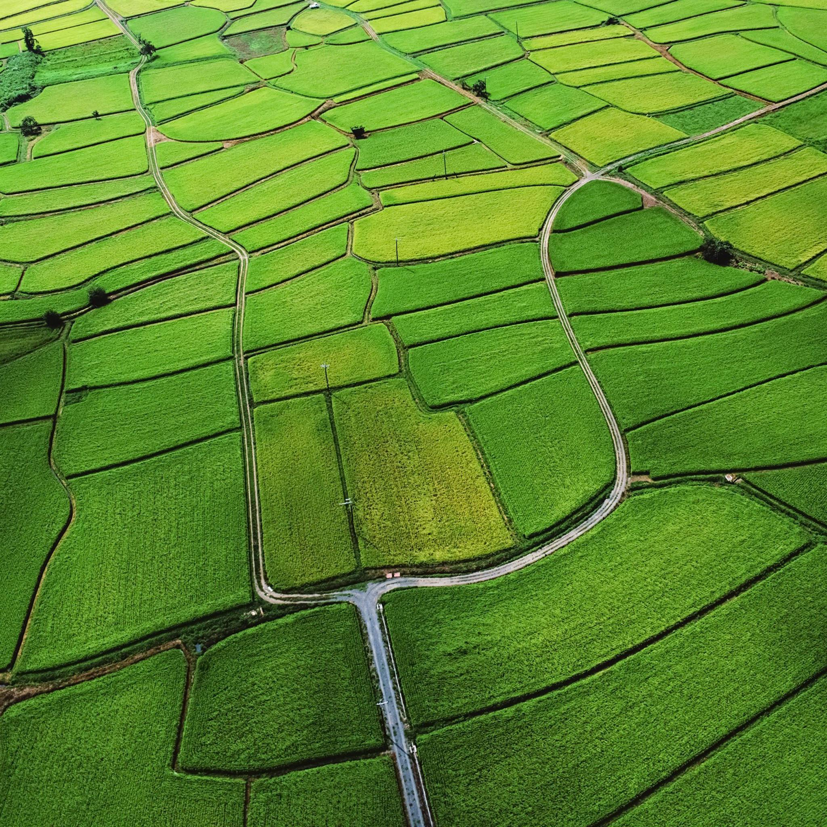
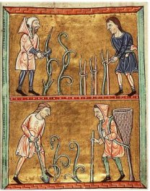
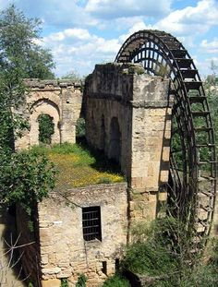
Three Factors of Production”
Land Labor Capital

Slide 4
1000 C.E. Early Feudal Economy: Social Hierarchy
Nobles “those who fight” (free)
Clergy “those who pray” (free)
Serfs “those who labor” (unfree)

Slide 5
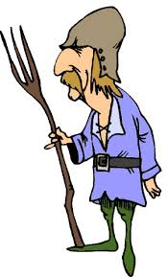
Serfs: Unfree Agricultural Labor
“Bound to the Soil”
-Inherit unfree status from parents
-Owe rents and services to the lord of the manor
-Are NOT slaves
-Have “rights” defined by the “custom of the manor”

Slide 6
The Feudal Economy
Nobles & Clergy “own”
almost all of the land
Gain wealth
by living off
the labor of
unfree serfs
Nobles & Clergy = “ruling class”
Serfs = “semi-coerced labor”

Slide 7
The Result: Inequality

Slide 8
1300 C.E. Late Feudal Economy: Social Hierarchy
Nobles “those who fight” (free)
Clergy “those who pray” (free)
Bourgeoisie (free medieval merchants)
½ Free peasants
½ Serfs

Slide 9
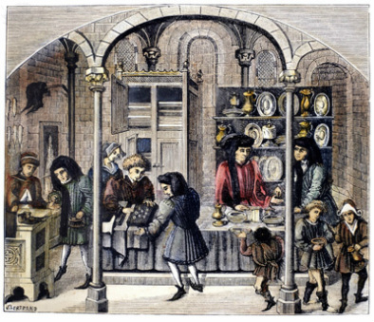
The Bourgeoisie
-Became wealthy
through trade and
commerce
-Took control of the
towns and cities
-Made good their
claims to personal
and collective
freedom

Slide 10
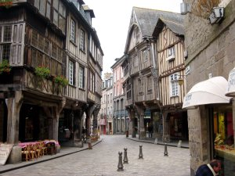
“Stadtluft macht frei”.”
Towns became islands of freedom
All residents were free
Escaped serf free after 1 year + 1 day

Slide 11
Markets fostered freedom
Serfs sold produce for money at markets
Bought their way out of serfdom

Slide 12
Nobles and the Market Economy
Nobles needed money to buy luxury goods (spices, silks, jewelry)
Sought to convert rents and services into cash

Slide 13
Merchants establish banks
Money economy replaces barter economy

Slide 14
Merchants and Guilds
Merchants became wealthy through the manufacture of woolen cloth
Established guilds to create a local monopoly and keep weavers’ wages low

Slide 15
Class Conflict in Florence
Rich guild members vs. poor weavers
1378-82 Ciompi Revolt
in Florence
Guilds finally won & disenfranchised the wool workers.

Slide 16
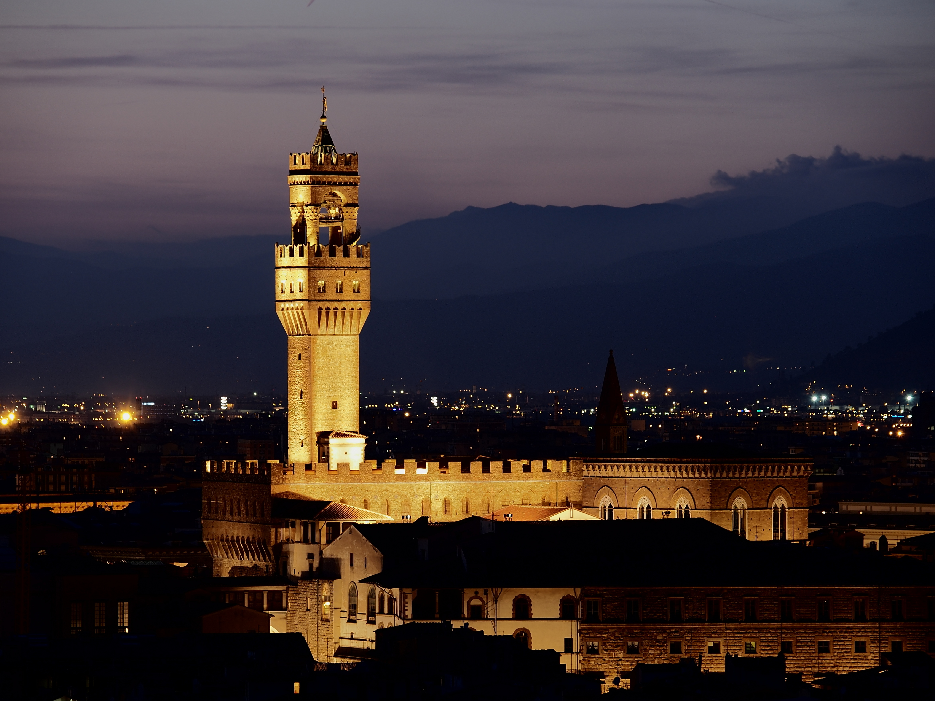
The Result: More Inequality
Medieval merchants
amassed capital (goods,
property, money) &
controlled labor (urban
weavers)
Some serfs gained
freedom
In towns, rich guild
members vs. poor
workers => more
inequality

Slide 17
1600 C.E. Early Capitalist Economy in the Netherlands
Jan de Vries
The First Modern Economy:
Success, Failure, and
Perseverance of the Dutch Economy, 1500-1815 (1997)

Slide 18
The Dutch East India Company
VOC Vereenigde Oost-Indische Compagnie
Chartered 1602, first company to issue stock

Slide 19
“Embarrassment of Riches”
Dutch Golden Age: late 16th to late 17th century
Dominated world trade
Conquered a colonial empire
Largest merchant fleet
County of Holland: wealthiest and most urbanized region in the world

Slide 20
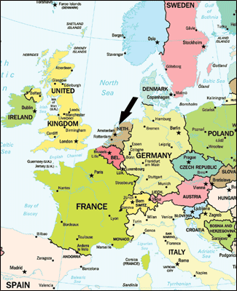
The Dutch Republic, 1581-1795
Slightly less than twice the size of New Jersey

Slide 21
Origins
Low Countries: 17 provinces (modern Belgium, Luxemburg,
and the Netherlands) ruled by Spain
7 provinces revolted and declared independence in 1581

Slide 22
Political Structure
Republic = confederation
of 7 provinces with their own governments
The States General in
The Hague included representatives of each of the seven provinces
Political leader, the Stadtholder, chosen by the provinces (usually the Prince of Orange)

Slide 23
Capitalist Economy
-Trade and commerce
-Banking, Stock market
-Manufacturing
-Agriculture (Tulips)
Capital and labor rather than land and labor
Wealth for the bourgeoisie

Slide 24
When Companies Ruled the World
Chartered joint-stock
companies dominated
trade and commerce
Were granted monopolies
1602 East India Company
1631 West India Company

Slide 25
Dutch Trading Empire
West Indies East Indies

Slide 26
Brazil and the Caribbean
Brazil = sugar
1629 Recife captured
Up to 1650 used
contract labor from
Netherlands
After 1650 imported
slaves from Africa

Slide 27
West Africa
25,000 African slaves transported
between 1635-1650, 3000 per year by
1700, continued into the 19th century

Slide 28
North America
“New Netherland”
1609 Henry Hudson
“New Amsterdam”
1614 (New York)
“Beverwijck”
1624 (Albany)
Schenectady (1661)
"over the pine plains"

Slide 29
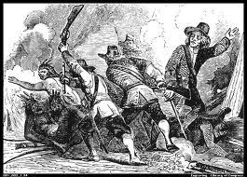
Native Americans
Sold furs to the Dutch
Died of smallpox and other European diseases
90,000 -> 14,000 (1614-50)
Slaughtered by settlers
Never regarded as “fellow human beings”

Slide 30
VOC: Riches of the East
Dominated the East Indies from Batavia
Drove out the Portuguese, English, and Spanish

Slide 31
Spice Trade
Pepper from Sumatra and Java / Cloves from the Molucca Islands (Ternate, Ambon)
Nutmeg and Mace from the Banda Islands

Slide 32
Jan Pieterszoon Coen
-Born 1587, died 1629
-Governor-General of the East Indies 1618
“Trade without war or war without trade cannot be maintained.”
"Despair not, spare your enemies not, for God is with us.”

Slide 33
Monopoly through Violence
1621 Banda Islands invaded
Natives massacred or enslaved
Plantations leased to employees of the VOC
Work done by slaves

Slide 34
Plantation Society: Concubines
Eric Jones, Wives, Slaves, and Concubines: A History of the Female Underclass of Dutch Asia (2010)
“In short, colonialism created a new underclass in Asia, one that had a particularly female cast.”

Slide 35
Netherlands: A World Power
The VOC made the Netherlands a world power until the mid-20th century
A forerunner of modern multinational companies
(Shell, Unilever, Phillips)

Slide 36
The Legacy: Inequality
Violence, slavery, coerced labor, class and ethnic discrimination, concubines, & poverty

