Slide 1
American Slavery and Inequality
Profits of Plantations

Slide 2
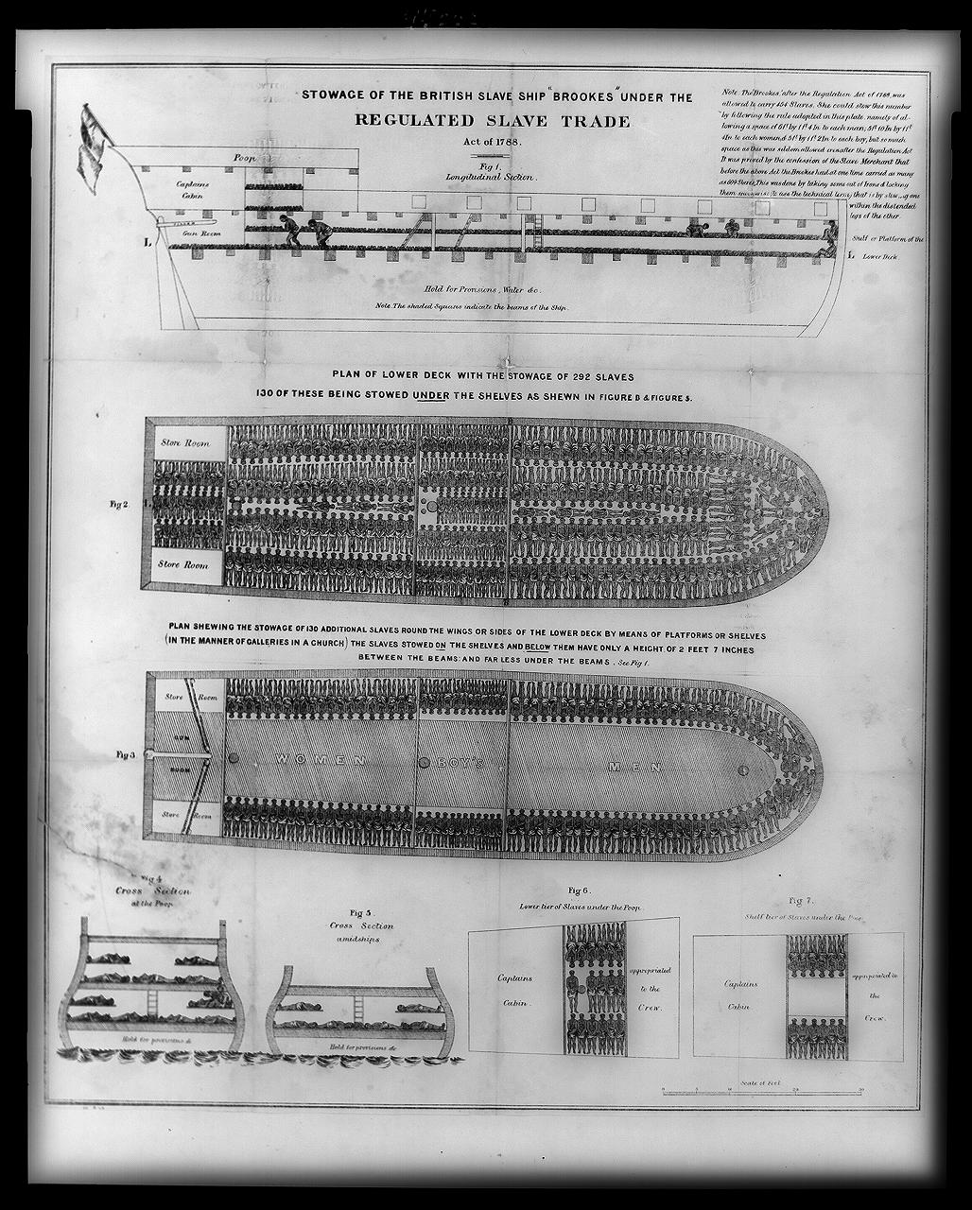

Slide 3
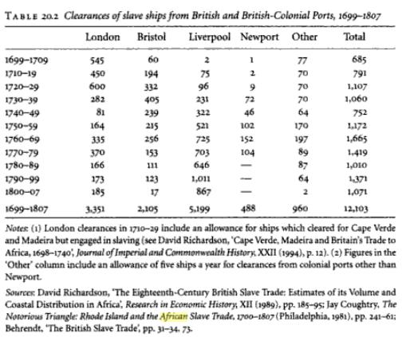

Slide 4
John Rolfe’s January, 1620 Letter
About the latter end of August, a Dutch man of Warr of the burden of about 160 tunes (tons) arrived at Point-Comfort, the Commandors name Capt. Jope, his Pilott for the West Indies one Mr. Marmaduke an Englishman…. He brought not anything but 20, and odd Negroes, wch the Governor and Cape Marchant bought for victualle (food) whereof he was in great need as he pretended at the best and easyest rate they could.

Slide 5
Sept. 17, 1630
Hugh Davis to be soundly whipt before an assembly of negroes & others for abusing himself to the dishonor of God and the shame of Christianity by defiling his body in lying with a negro, wch fault he is to acknowledge next Sabbath day.

Slide 6
July 9, 1640
Whereas Hugh Gwyn hath… brought back from Maryland three servants formerly runaway from the said Gwyn, the court doth therefore order that the said servant shall receive the punishment of whipping and to have thirty stripes apiece; one called Victor, a Dutchman, the other a Scotsman called James Gregory, shall first serve out their times with their master, according to their indentures, and one whole year apiece after the time of their service is expired… and after that service to their said master is expired to serve the colony for three whole years apiece, and the third, being a negro named John Punch shall serve his said master or his assigns for the time of his natural life

Slide 7
Act XII, December 1662
WHEREAS some doubts have arisen whether children got by Englishmen upon a negro woman shall be slave or free, Be it therefore enacted that all children borne in this country shall be held bond or free only according to the condition of the mother…

Slide 8
Act II, September 1667
WHEREAS some doubts have arisen whether children that are slave by birth, and by the charity and piety of their owners made pertakers of the blessed sacrament of baptisme, should by vertue of the baptisme be made free, it is enacted… that conferring baptisme doth not alter the condition of the person as to his bondage or freedom; that diverse masters, freed from this doubt, may more carefully endeavor the propagation of Christianity by permitting… slaves… to be admitted to that sacrament.

Slide 9
Act I, October 1669
WHEREAS the only law in force for the punishment of refractory servants resisting their master, mistress, or overseer cannot be inflicted upon negroes, nor the obstinacy of many of them by other than violent means supprest, Be it enacted… if any slave resist his master… and by the extremity of the correction should chance to die, that his death shall not be [counted as] a felony, but the master… be acquited from molestation, since it cannot be presumed that prepense malice… should induce any man to destroy his own estate.

