Slide 1
Global change and inequality
Prof. Jeff Corbin
Dept of Biology
Union College

Slide 2
Global change
Humans have altered many aspects of Earth’s biology, geology, chemistry on a global scale
Climate change
Land use change
Species extinctions

Slide 3
Global change and inequality
Contribution to global change is not spread evenly across globe…
…while the consequences are not and will not be borne equally

Slide 4
Environmental justice
The fair treatment of all with respect to environmental laws, regulations, and enforcement
Regardless of race, color, country of origin, or income
US Environmental Protection Agency

Slide 5
Environmental justice
The fair treatment of all with respect to environmental laws, regulations, and enforcement
Regardless of race, color, country of origin, or income
Reality: Benefits, and consequences, of activities are not equal

Slide 6
Environmental justice at the local level
We all need landfills, power plants, etc.
But they aren’t in white/wealthy neighborhoods!!

Slide 7
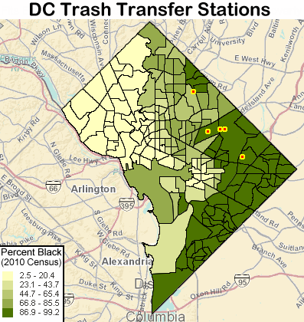
Waste facilities are often in predominantly minority neighborhoods
Source: Energy Justice Network: http://www.energyjustice.net/content/dcs-waste-and-environmental-racism

Slide 8
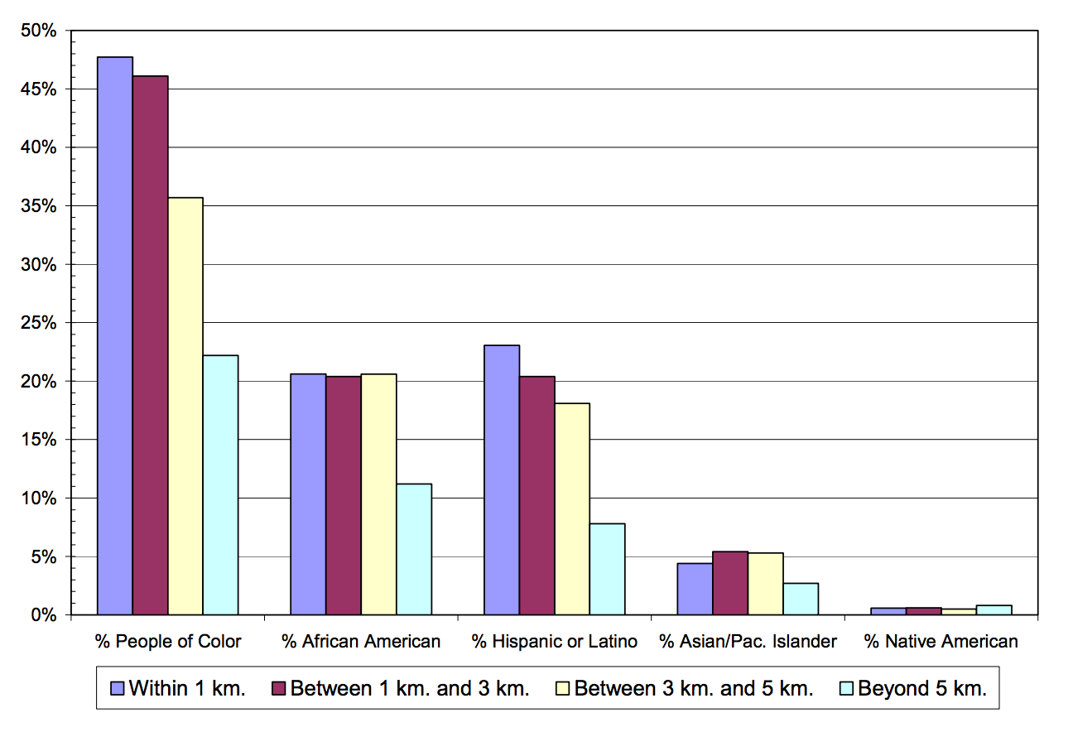
Populations near hazardous waste facilities are disproportionately people of color
Bullard et al. 2007: Toxic Waste and Race at Twenty: 1987-2007. http://www.ejnet.org/ej/twart.pdf

Slide 9
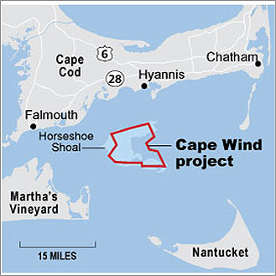
Even clean energy!!
Cape Wind project, off Cape Cod/Nantucket
468 mW of carbon-free electricity
75% of region’s energy
Would replace current
oil and natural gas powered
electricity plant in Sandwich
All good, right?

Slide 10
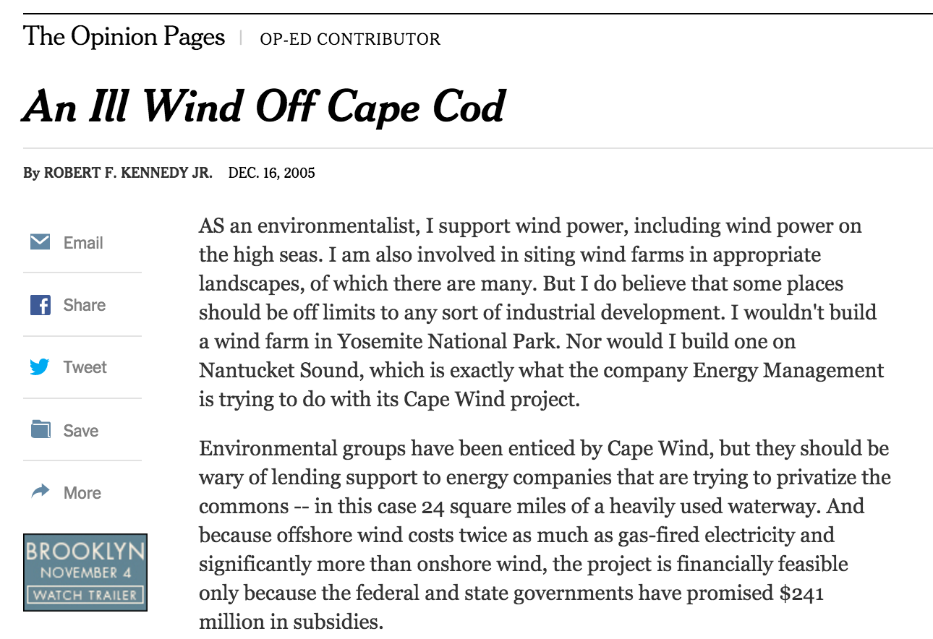
Not In My Back Yard!! (NIMBY)
Opposition based on threat to property values
Kennedy’s
John Kerry
Mitt Romney
against it
81% of MA,
61% of Cape Cod
supports it

Slide 11
Economic drivers of environmental injustice
Environmental damage is often a by-product of industrial activities
“Benefit” of pollution
Producer
Consumer (Cheaper goods)
Costs of pollution
Society
INEQUALITY!!

Slide 12
Imagine a manufacturing facility…
This facility produces widgets, and sells them to buyers. (= market).
Price is set according to the cost to make the widgets, and the demand for the product

Slide 13
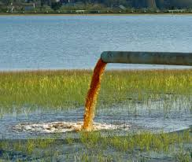
Imagine a manufacturing facility…
BUT, there are chemicals involved in the manufacture, that are expensive to dispose of
So, the company dumps them into the nearby river .→ SAVES $$

Slide 14
Externalities
This pollution is an externality
The price of the widget doesn’t reflect the true cost of production.
The price on the market is not set efficiently
One agent’s actions influence the well-being of another agent without compensation

Slide 15
Externalities
This pollution is an externality
The price of the widget doesn’t reflect the true cost of production.
The price on the market is not set efficiently
One agent’s actions influence the well-being of another agent without compensation
Those who produce the damage do not pay for it (e.g. company)
Those who receive the damage (e.g. local towns) do not receive compensation

Slide 16
Externalities are common in environmental problems
Water and air pollution
Pesticides
Climate change!
“Climate change presents a unique challenge for economics: it represents the greatest example of market failure we have ever seen”
Nicholas Stern, 2006

Slide 17
Climate change in 10 words
It’s real
It’s us
It’s bad
Scientists agree
There’s hope
Anthony Leiserowitz, Yale Project on Climate Change Communication

Slide 18
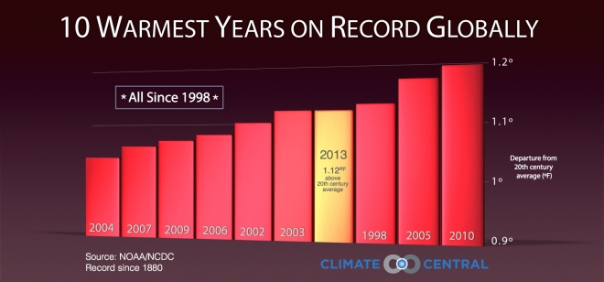
Climate change – It’s real
The Earth is warming
Global temperatures have risen by ~ 1.4 ºF (0.8 ºC) since 1950’s
2014 was the hottest year ever recorded
NASA: http://youtu.be/-ilg75uJZZU
Top 10 hottest years ever have all been since 1998

Slide 19
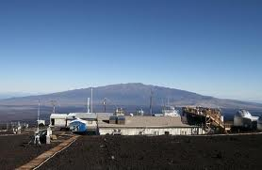
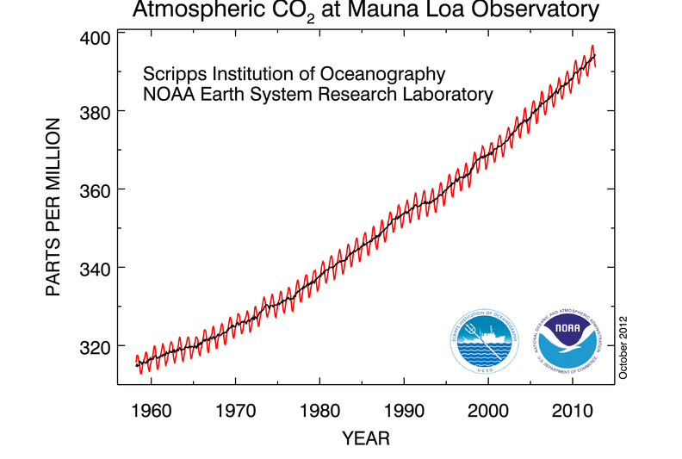
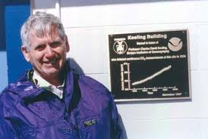
Climate change – It’s us
The cause of this is accumulating carbon in the atmosphere
Charles Keeling

Slide 20
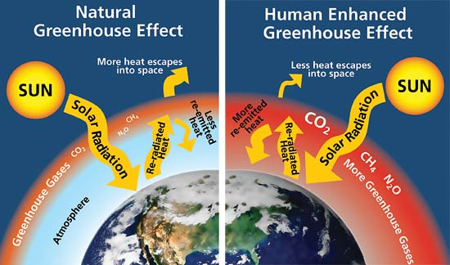
More CO₂ and CH₄ → More Greenhouse effect
This is not in doubt – it is ESTABLISHED PHYSICS

Slide 21
Climate change – It’s us (Summary)
We have been inputting carbon into atmosphere via fossil fuel burning
(And deforestation)
This traps heat in the atmosphere
→ Climate change

Slide 22
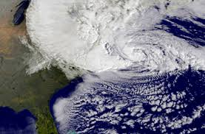
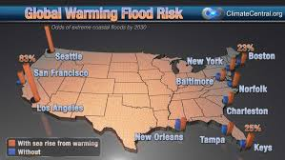
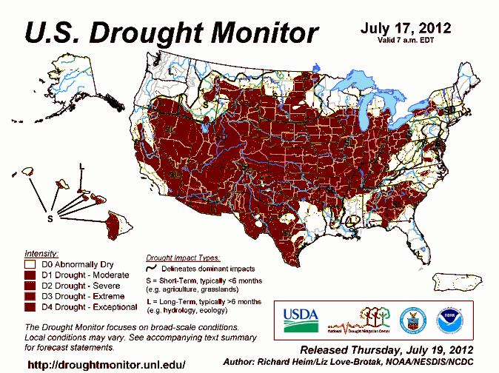
Climate change – It’s bad!!
We are already seeing major impacts
Extreme weather, droughts, coastal inundation

Slide 23
Climate change – It’s bad!!
We are already seeing major impacts
Extreme weather, droughts, coastal inundation
And it is expected to get worse
Threats to current agricultural systems
Temperature extremes, drought, pests

Slide 24
Climate change – It’s bad!!
We are already seeing major impacts
Extreme weather, droughts, coastal inundation
Threats to current agricultural systems
Temperature extremes, drought, pests
Even National Security!!
2014 Pentagon report – Climate change is a “threat multiplier”
Perhaps played a role in Syrian conflict and Arab Spring uprisings (http://journals.ametsoc.org/doi/abs/10.1175/WCAS-D-13-00059.1)

Slide 25
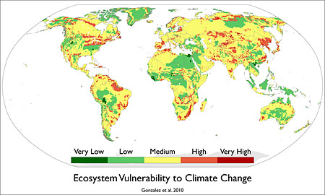
Biological responses to climate change
Ecosystem range shifts
10-50% of globe “high to very high probability”
20% of world’s population lives in such areas, especially in
Asia, N & S
America
Gonzalez et al. 2010. Global Ecol. and Biogeog.

Slide 26
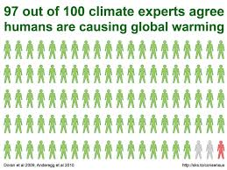
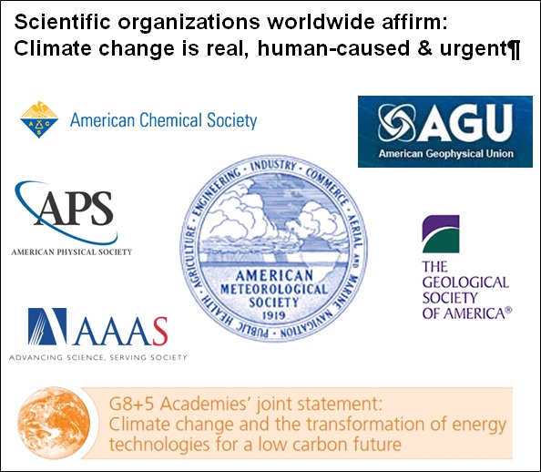
Climate change – Scientists agree
Overwhelming consensus among scientists
Every major scientific organization and national academy

Slide 27
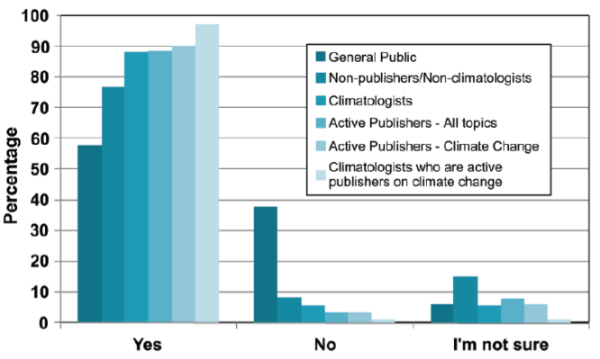
Climate change – Scientists agree
“Do you think human activity is a significant contributing factor in changing mean global temperatures?”
http://tigger.uic.edu/~pdoran/012009_Doran_final.pdf

Slide 28
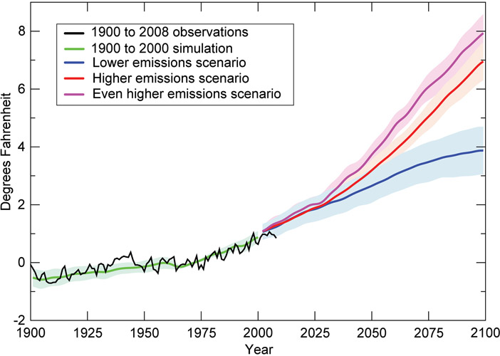
Climate change – There’s hope
The degree of impact depends on our future CO₂ emissions
We should do our best to keep warming < 4 deg F
Source: IPCC

Slide 29
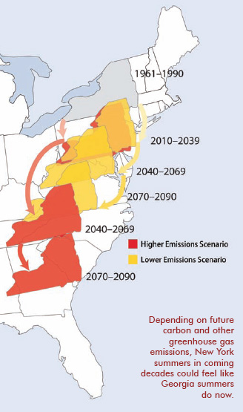
New York’s climate future Virginia? or Georgia?
Source: Union of Concerned Scientists

Slide 30
Climate change – There’s hope
Technology to reduce CO₂ emissions ALREADY EXISTS!!

Slide 31
Climate change – There’s hope
Technology to reduce CO₂ emissions ALREADY EXISTS!!
We must shift to a low-carbon economy as soon as possible
End subsidies for fossil fuel production
Shift to alternative energy
Conservation, conservation, conservation

Slide 32
Climate change in 10 words
It’s real
It’s us
It’s bad
Scientists agree
There’s hope
Anthony Leiserowitz, Yale Project on Climate Change Communication

Slide 33
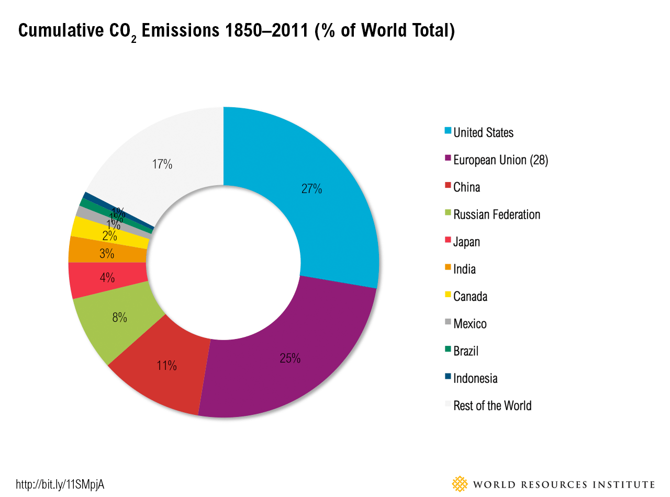
Carbon emissions are not evenly distributed
Developed nations are primary emitters
http://www.wri.org/blog/2014/11/6-graphs-explain-world%E2%80%99s-top-10-emitters

Slide 34
Carbon emissions are not evenly distributed
Developed nations are primary emitters
US, EU, Japan, and Canada have emitted ~60% of the cumulative carbon into the atmosphere

Slide 35
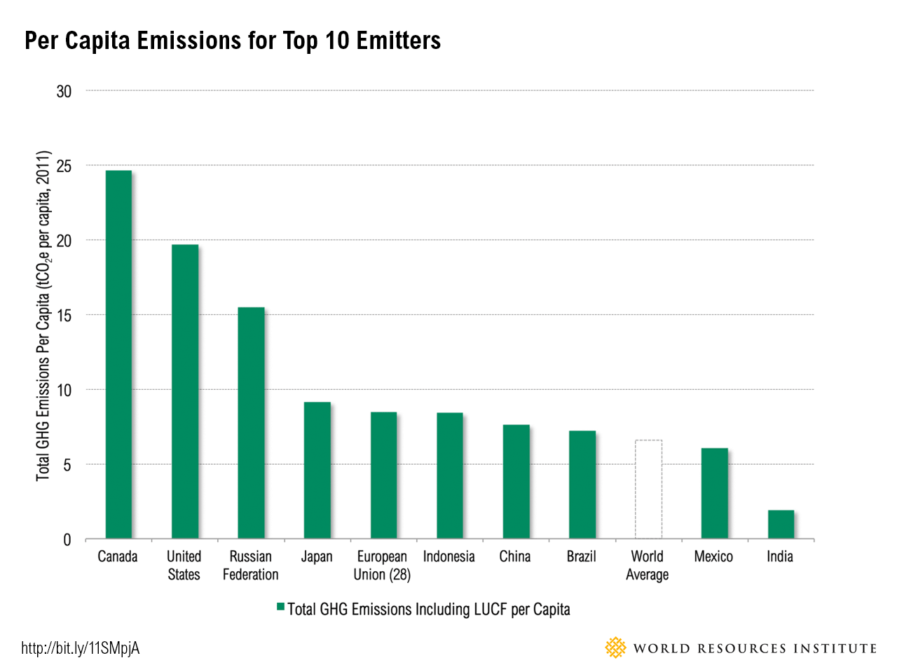
Carbon emissions are not evenly distributed
Developing countries have contributed relatively little
Even large emitters are a product, mostly, of large populations

Slide 36
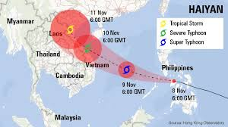
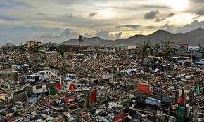
But vulnerability falls onto developing countries
More intense storms
E.g. Typhoon Haiyan (2013) in Philippines and SE Asia
Killed 6300 people in Philippines alone

Slide 37
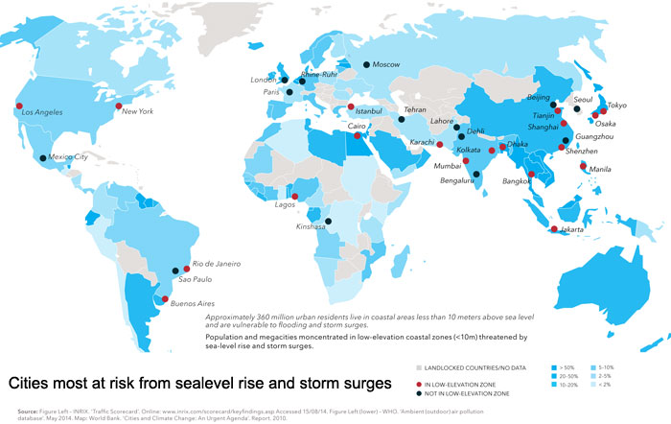
But vulnerability falls onto developing countries
More intense storms
Sea level rise
Source: Sustainable Cities Collective http://www.sustainablecitiescollective.com/david-thorpe/1038231/revealed-greatest-global-business-and-societal-opportunities-sustainability

Slide 38
But vulnerability falls onto developing countries
More intense storms
Sea level rise
World Bank: “As the coastal cities of Africa and Asia expand, many of their poorest residents are being pushed to the edges of livable land and into the most dangerous zones for climate change…These communities are among the most vulnerable to climate change and the least able to marshal the resources to adapt.

Slide 39
What, then, must we do?
The challenges are largely political, not technological or scientific.
Everything from emissions to externalities can be confronted to the benefit of the poor and vulnerable…
…if we have the will.

Slide 40
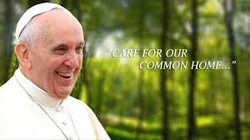
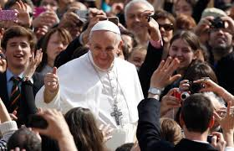
Pope Francis’ Laudato Si
A potential game-changer in the policy debate
Covers wide range of global change issues
Relies on well-established science and economics
Reorients the debate in terms of ethics and inequality

Slide 41
Pope Francis’ Laudato Si
A potential game-changer in the policy debate
Chapter 1, section 49:

Slide 42
The last word…
Your generation didn’t cause climate change and other environmental challenges
But they will be a defining issue of your lifetime

