Slide 1
The Gender Revolution: Stopped, Stalled or in Reverse?
David A. Cotter
Department of Sociology
Union College

Slide 2
analysis of iPUMS Census Data (https://usa.ipums.org/usa/)

Slide 3
analysis of iPUMS Census Data (https://usa.ipums.org/usa/)

Slide 4
analysis of iPUMS Census Data (https://usa.ipums.org/usa/)

Slide 5
analysis of iPUMS Census Data (https://usa.ipums.org/usa/)

Slide 6
The Gender Revolution
Uneven
Asymmetric
Stalled
Motivating Questions:
What caused the “rise of women/gender revolution/grand gender convergence”?
What caused the “stall”?

Slide 7
Women’s Work & Working Women
The first condition for the liberation of the wife is to bring the whole female sex back into public industry.
-Friedrich Engels ([1884] 1942, 66)
It is through gainful employment that woman has traversed most of the distance that separated her from the male; and nothing else can guarantee her liberty in practice. Once she ceases to be a parasite the system based on her dependence crumbles; between her and the universe there is no longer any need for a masculine mediator. -Simone De Beauvoir ([1949] 1989, 679)
The kids are great. But going to work, that's like, hmmmm, that's like another reason to live. Since I went to work I'm more interested in life and life's more interested in me.
Latina store manager and mother of three as quoted by Lillian Rubin (1994, 81)

Slide 11
Falling then Stalling
Documenting Desegregation of Men’s and Women’s Jobs

Slide 12
Occupational Gender Segregation (Blues in B♭)

Slide 17
+.008
PUMS
ACS
Source: “Still Stalled? Diminishing Declines in Desegregation”
David A. Cotter, Joan Hermsen & Reeve Vanneman 2012.
The index of dissimilarity shows the proportion of women or men who would have to change occupations for women/men to be evenly distributed across occupations. 1950 Occupation Codes, n= 179, CLF 25-64
Notes:
The overall trend in segregation shows a decline beginning in the 1960s and continuing through the 1970s and 1980s, with D dropping between four and five points in each decade.
In the 1990s the decline is roughly half that seen in the previous decade.
Then, comparing 2000 to 2007-9 we see little if any change in the last decade -- only a third of a point drop in segregation.

Slide 18
1950 Occupation Codes, n= 179, ECLF 25-64
Notes:
A second way of decomposing desegregation looks at whether changes in segregation are due more to women shifting into formerly male occupations or men moving into formerly female occupations. To assess this we examine the extent of between gender segregation across census years (or ACS years), comparing, for instance, women in 2010 to men in 2000 and men in 2010 to women in 2000.
The period 1970-1990 saw the largest declines in sex segregation (change in D = -5.6 and -4.4). During that period, women’s occupations shifted each decade to look more like where men’s occupations had been (-6.4 and -3.6) – that is, women were entering previously male occupations. But men did not enter previously female occupations; in fact, each of those two decades their occupational distributions shifted slightly away from where women’s had been (+2.9 and +0.9).
In the slower or non-existent changes since 1990, (-1.9 and -0.8) the pattern is quite different. From 1990-2000, women’s occupations shifted only modestly to look like 1990 men’s occupations (-2.0); and from 2000-2009, they shifted back away from where men were in 2000 (+2.1). Men’s occupations, however, did shift slightly each decade towards a more female-like distribution (-2.1 and -1.9). Men’s occupations in 2000 looked more like women’s 1990 occupations than they had ten years earlier. This continued in the first decade of the next century. So, the Times article about men entering women’s occupations, while greatly exaggerated, is not entirely incorrect.
The following slides examine whether the dramatic desegregation and then diminishing declines are observed across different demographic groups.

Slide 19
1950 Occupation Codes, n= 179, CLF 25-64
Notes:
Four things are of note here:
Levels of occupational segregation are now much lower among college graduates than among all other levels of education,
This difference emerged during the gender revolution of the 1960s, 1970s and 1980s
Because segregation proceeded much more quickly among college grads than non-college graduates, though all experienced some integration
Little change has taken place in the 2000s regardless of educational level

Slide 20
Source: “Still Stalled? Diminishing Declines in Desegregation”
David A. Cotter, Joan M. Hermsen & Reeve Vanneman 2012.
The index of dissimilarity shows the proportion of women or men who would have to change occupations for women/men to be evenly distributed across occupations. 1950 Occupation Codes, n= 179, CLF 25-64
Notes:
Four things are of note here:
Levels of occupational segregation are now much lower among college graduates than among all other levels of education,
This difference emerged during the gender revolution of the 1960s, 1970s and 1980s
Because segregation proceeded much more quickly among college grads than non-college graduates
Little change has taken place in the 2000s regardless of educational level

Slide 21
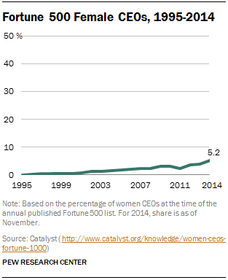

Slide 22
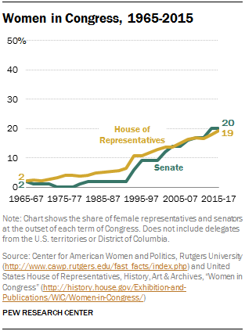

Slide 23
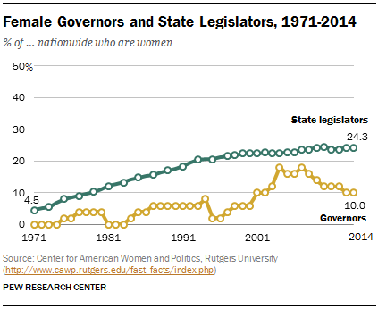

Slide 24
Money Matters
Gender Gap in Earnings

Slide 25
Notes:
Earnings
To some extent changes in both labor force participation and occupational segregation over time are easily observable. We quite literally see more women working today, and working in a wider variety of occupations than in the past. In fact the sight of women in large numbers in previously “male” occupations like police officers and politicians can sometimes mask the persistence of inequality. While perhaps the least directly visible of the three dimensions of work-related gender inequality, differences in men’s and women’s pay may have garnered the most public attention. Each year when the Bureau of Labor Statistics releases results from the March Current Population Survey, a spate of newspaper stories appear on the current state of the “gender gap” in earnings. Sometimes these tell of good news (a narrowing gap) sometimes bad (a widening gap). Cumulatively, as we will see, the last half of a century is good news – but the differences remain and remain large, and the narrowing of the gap between men’s and women’s earnings slowed after the mid 1990s.
Some recent analyses looking at cohort differences (Campbell and Pearlman, 2013) suggest further slowing of the narrowing once accounting for cohorts. That is, most of the change in years after the mid-1990s are because of cohort replacement rather than period effects.

Slide 26
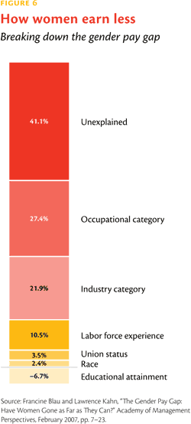

Slide 27
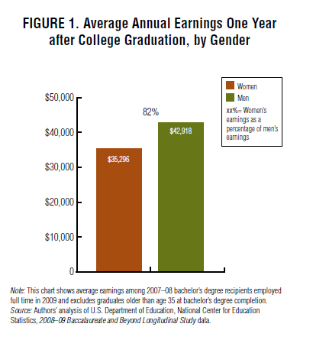
http://www.aauw.org/resource/graduating-to-a-pay-gap/

Slide 28
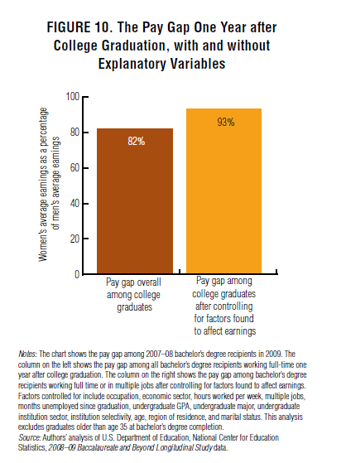
http://www.aauw.org/resource/graduating-to-a-pay-gap/

Slide 29
College Wage Premium Over the Lifecourse by Gender
Source: Brand and Xie. 2010. “Who Benefits Most from College”

Slide 31
The Revolution at Home
Uneven
Asymmetric
Stalled

Slide 32
Source: American Historical Time Use Studies

Slide 33
Source: American Historical Time Use Studies

Slide 34
Source: American Historical Time Use Studies

Slide 35
Source: American Historical Time Use Studies

Slide 36
Source: American Historical Time Use Studies

Slide 37
Source: American Historical Time Use Studies

Slide 38
Source: American Historical Time Use Studies

Slide 39
Comprehending Change I: Levels of Change
Macro
Social Structures
& Institutions
Cultural values and beliefs, ideologies
Objective
Subjective
Individual behaviors
& characteristics
Individual thought, feeling, attitudes &
emotions
Micro

Slide 40
Comprehending Change II: Types of Change
Age effects point to the way that individuals change over the lifecourse:
Changes in response to life events (marriage, kids, etc)
Period effects tell us about historical changes in societies. These can be used to track change over time
Secular vs. Cyclical
Permanent vs. Temorary
Cohort effects attempt to look at the formation of “generations” – groups of people moving through history together and sharing the same formative years, major historical events, etc.
Cohort replacement

Slide 41
Causes of “Mother Goes to Work”
Supply Factors:
What “pushes” women into the labor force?
Demand Factors:
What “pulls” women in to the labor force?

Slide 42
Supply Factors (continued)
Home Economics
Changes in women’s earnings
Changes in men’s earnings
Changes in family income

Slide 43
Source: CPS Historical Tables, https://www.census.gov/hhes/www/income/data/historical/people/2014/p38AR.xls
Notes:
Earnings
To some extent changes in both labor force participation and occupational segregation over time are easily observable. We quite literally see more women working today, and working in a wider variety of occupations than in the past. In fact the sight of women in large numbers in previously “male” occupations like police officers and politicians can sometimes mask the persistence of inequality. While perhaps the least directly visible of the three dimensions of work-related gender inequality, differences in men’s and women’s pay may have garnered the most public attention. Each year when the Bureau of Labor Statistics releases results from the March Current Population Survey, a spate of newspaper stories appear on the current state of the “gender gap” in earnings. Sometimes these tell of good news (a narrowing gap) sometimes bad (a widening gap). Cumulatively, as we will see, the last half of a century is good news – but the differences remain and remain large, and the gap between men’s and women’s earnings widened again in the last half of the 1990s.
Census 2000 Findings
Women still earn less than men. The average woman, age 25-54, who worked full-time year-round in 1999 reported earnings of $28,100. That is only 73% of the $38,700 reported by the average man, age 25-54 (Table 8). The ratio is somewhat better if we estimate hourly wages for all workers by adjusting annual earnings for the reported usual hours worked and the number of weeks worked last year. Women’s average hourly wage, $12.44, is 79% of men’s, $15.72.

Slide 44
Source: CPS Historical Tables, https://www.census.gov/hhes/www/income/data/historical/people/2014/p38AR.xls
Notes:
Earnings
To some extent changes in both labor force participation and occupational segregation over time are easily observable. We quite literally see more women working today, and working in a wider variety of occupations than in the past. In fact the sight of women in large numbers in previously “male” occupations like police officers and politicians can sometimes mask the persistence of inequality. While perhaps the least directly visible of the three dimensions of work-related gender inequality, differences in men’s and women’s pay may have garnered the most public attention. Each year when the Bureau of Labor Statistics releases results from the March Current Population Survey, a spate of newspaper stories appear on the current state of the “gender gap” in earnings. Sometimes these tell of good news (a narrowing gap) sometimes bad (a widening gap). Cumulatively, as we will see, the last half of a century is good news – but the differences remain and remain large, and the gap between men’s and women’s earnings widened again in the last half of the 1990s.
Census 2000 Findings
Women still earn less than men. The average woman, age 25-54, who worked full-time year-round in 1999 reported earnings of $28,100. That is only 73% of the $38,700 reported by the average man, age 25-54 (Table 8). The ratio is somewhat better if we estimate hourly wages for all workers by adjusting annual earnings for the reported usual hours worked and the number of weeks worked last year. Women’s average hourly wage, $12.44, is 79% of men’s, $15.72.

Slide 45
Notes:
Earnings
To some extent changes in both labor force participation and occupational segregation over time are easily observable. We quite literally see more women working today, and working in a wider variety of occupations than in the past. In fact the sight of women in large numbers in previously “male” occupations like police officers and politicians can sometimes mask the persistence of inequality. While perhaps the least directly visible of the three dimensions of work-related gender inequality, differences in men’s and women’s pay may have garnered the most public attention. Each year when the Bureau of Labor Statistics releases results from the March Current Population Survey, a spate of newspaper stories appear on the current state of the “gender gap” in earnings. Sometimes these tell of good news (a narrowing gap) sometimes bad (a widening gap). Cumulatively, as we will see, the last half of a century is good news – but the differences remain and remain large, and the gap between men’s and women’s earnings widened again in the last half of the 1990s.
Census 2000 Findings
Women still earn less than men. The average woman, age 25-54, who worked full-time year-round in 1999 reported earnings of $28,100. That is only 73% of the $38,700 reported by the average man, age 25-54 (Table 8). The ratio is somewhat better if we estimate hourly wages for all workers by adjusting annual earnings for the reported usual hours worked and the number of weeks worked last year. Women’s average hourly wage, $12.44, is 79% of men’s, $15.72.

Slide 46
Source: CPS Historical Tables, https://www.census.gov/hhes/www/income/data/historical/household/2014/h06AR.xls

Slide 47
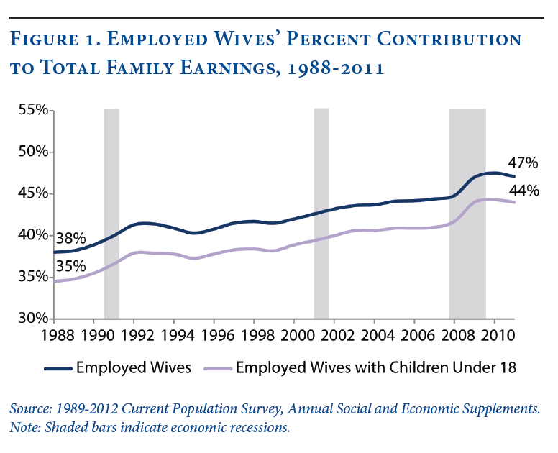

Slide 48
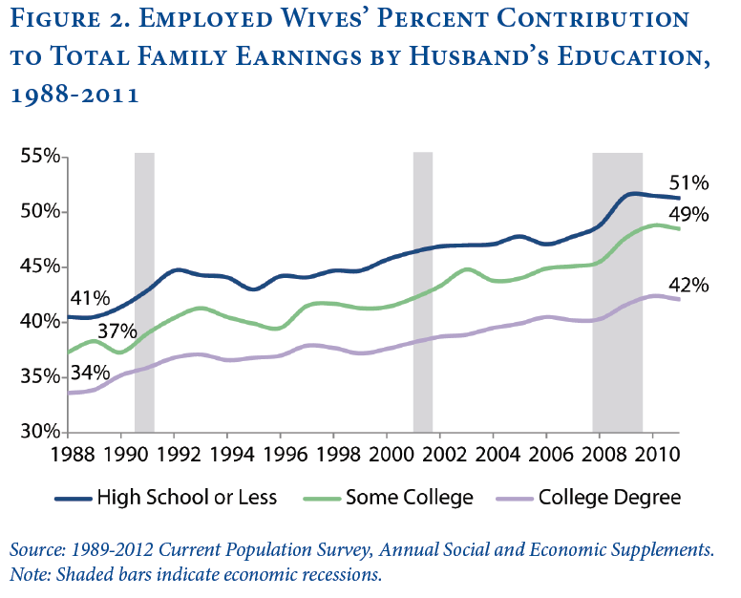

Slide 49
Supply Factors
Normative Shifts
Changes in Women’s Attitudes about Work
Changes in Men’s Attitudes about Women’s Work
Women’s Movement

Slide 50
Shifting Models of Work & Family
Phyllis Moen and Yan Yu. 2000. Effective Work/Life Strategies: Working Couples, Work Conditions, Gender, and Life Quality. Social Problems. 47:291-326.

Slide 51
Changing & Challenging Cultural Conceptions
Egalitarian
Essentialism
Traditionalist
Separate spheres
Gender essentialism
Feminist
Egalitarianism
Gender constructivism

Slide 52
Cotter, Hermsen & Vanneman (2014) “Back on Track?” Council on Contemporary Families

Slide 55
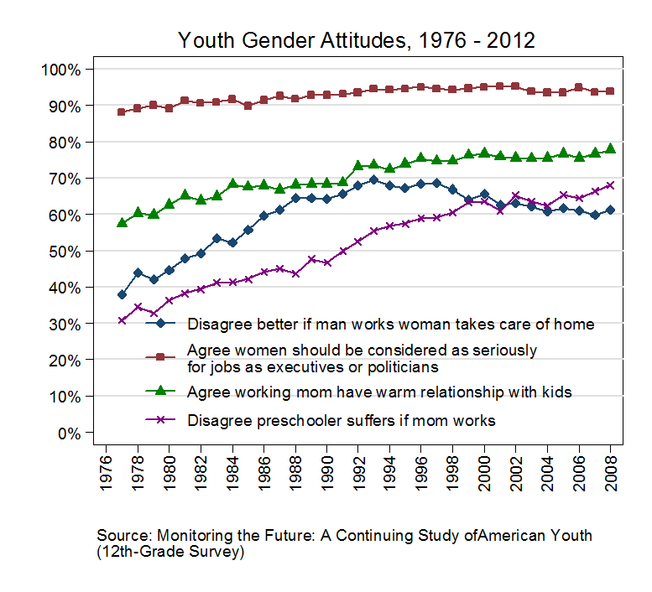
Analysis by Joana Pepin http://thesocietypages.org/girlwpen/2014/08/05/gender-revolution-rebound-youth-edition/

Slide 56
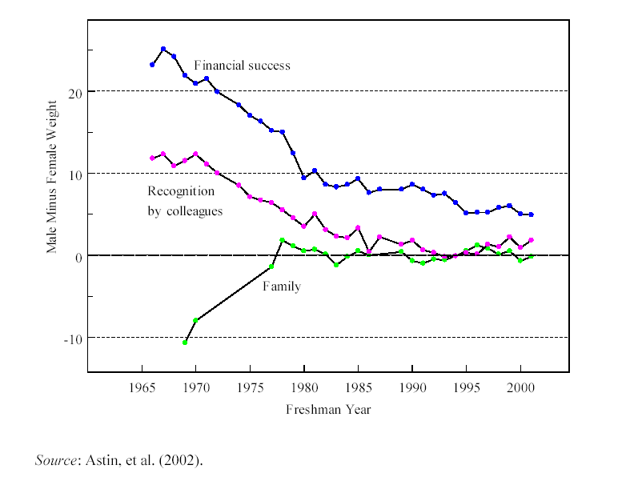

Slide 57
Supply Factors (continued)
Political & Legal Changes
Equal Employment Opportunities Act (1972)
Prohibits discrimination on the basis of race, color, national origin, religion, or sex
Family and Medical Leave Act (1992)
Provides 12 weeks of unpaid leave in a year to attend to new child, sick parent, spouse or child, or to recuperate from personal illness.
Changes in characteristics of women
Increased Education
Decreased Fertility
Increased Experience/Tenure/Attachment

Slide 59
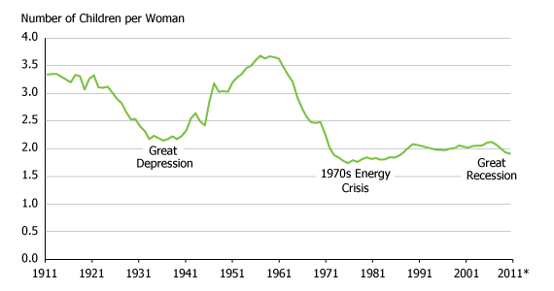
Total Fertility Rate, United States 1911-2011
Source: Population Reference Bureau

Slide 60
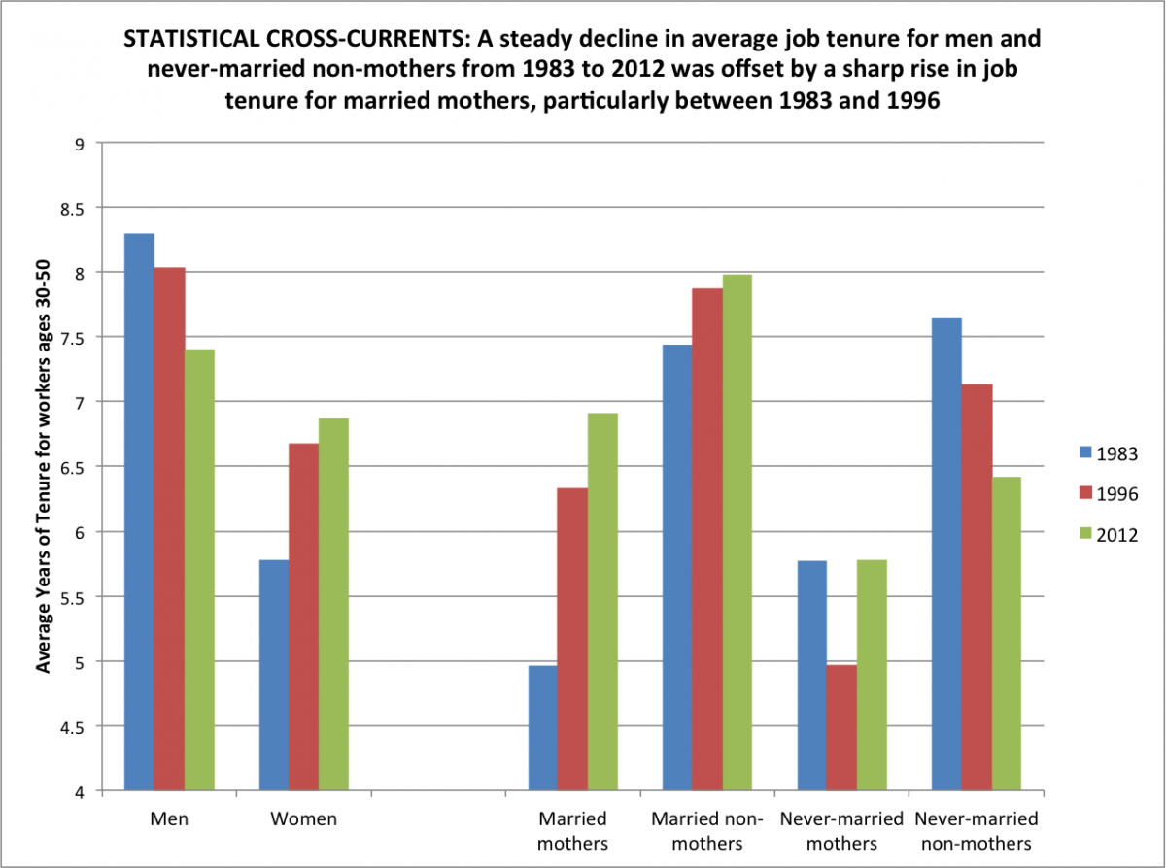
Hollister & Smith (2014) http://www.asanet.org/press/study_untangles_divergent_us_job_patterns.cfm

Slide 61
Demand Factors What “pulls” women into the labor force?
Reduced discrimination by employers
Occupational shifts
Growth of traditionally female occupations
Decline in traditionally male occupations

Slide 62
Forms of Discrimination
Economically Irrational
Myopic
Principled
Economically Rational
Worker-Driven
Consumer-Driven
Statistical
Institutional

Slide 63
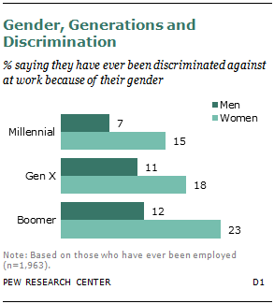

Slide 65
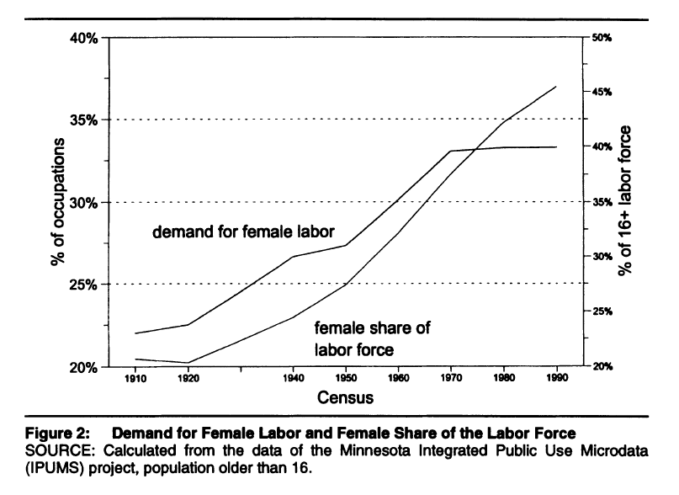
Expected % female based on occupations’ 1950 gender composition
Women as % of workers
Cotter, Hermsen & Vanneman (2001) “Women’s Work and Working Women

Slide 66
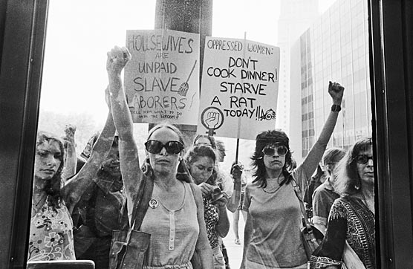
Movements, Moments & Momentum
Women’s Strike for Equality, August 26, 1970

Slide 67
Source: Encyclopedia of Associations data coded by Maeve Williams (UC’16)

Slide 68
http://web.stanford.edu/group/collectiveaction/cgi-bin/drupal/

Slide 69
Use of Women’s Movement Terms in English-Language books, 1900-2008
https://books.google.com/ngrams

Slide 70
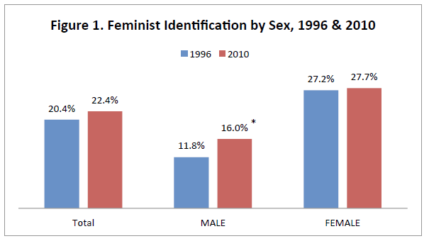
Source: Cotter, Hermsen & Vanneman (2014) “You’ve come a long way, buster”

Slide 71
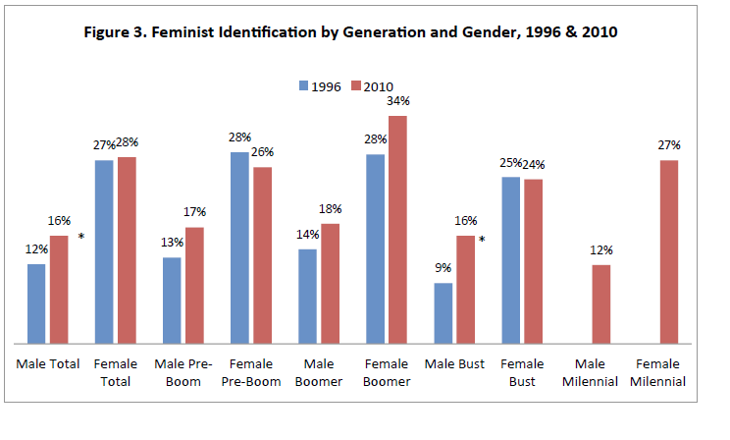
Source: Cotter, Hermsen & Vanneman (2014) “You’ve come a long way, buster”

