Slide 1
Physics 110
Hope to have lots of interaction both in and out of class
I’m almost always available – e-mail, phone, or just come by
If you are sick or expect to miss class, drop me an e-mail
Everyone can do really well but you will need to put in a good and consistent effort
Check out the course web site – bookmark it and use it often – powerpoint slides posted too – HW solutions on Nexus course site – Lab handouts all posted
Help Center will be set up next week Tu/Th 7 – 10 PM
Remember 4th hour of course – I will (and you should) spread out problem solving all week

Slide 2
Is it Really Greek?

Slide 3
Advertisement
http://smarturl.it/AmazonSicily

Slide 4
Chapter 1
An overview of the Structure of Matter
Introduce matter (mass)

Slide 5
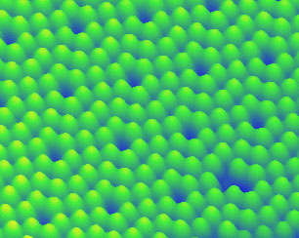
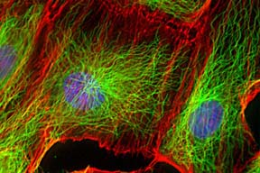
Atoms
Individual silicon atoms
Composition
Size
States of matter
Fluorescence image of human epithelial cells
Red= actin; green = microtubules, blue = DNA

Slide 6
Mass, weight
Mass – kg or amu (dalton) = 1.66 x 10⁻²⁷ kg
Density – mass/volume – intrinsic property
Calculate spacing of atoms from density and atomic weight
All atoms are about the same size!

