Slide 1
Sound
How is sound produced, how does it travel through the air and how do we hear sounds?

Slide 2
Sound II
As the vocal chords vibrate, the air is alternately compressed and rarefied resulting in a longitudinal pressure wave
The speed of sound in air at 20ºC and 1 atm pressure is 343 m/s (about 770 miles/hour)
Frequency, wavelength and intensity are other parameters characterizing sound
Pitch is the audible sensation corresponding to frequency and loudness corresponds to intensity

Slide 3
Intensity of Sound
In one dimension when sound travels along a train rail, for example, it is confined to one dimension traveling along with a “plane wavefront” but may decrease in intensity due to “damping”
In 3- dimensions, however, the “wavefront” is not a plane wave, but a spherical wave and the intensity decreases as the wave travels

Slide 4
Decibel scale
Because sound intensity varies so greatly, we introduce a log scale to measure the sound intensity β with I_{o} = 10⁻¹² W/m²

Slide 5
dB scale
Scale is chosen so that at I = I_{o}, the intensity level is 0 dB, while at the threshold of pain I = 10¹² I_{o}, the intensity level is 120 dB
Intensity (W/m²)
10⁻¹²
10⁻¹⁰
10⁻⁶
10⁻⁵
10⁻¹
1
10
10⁴
Intensity level (dB)
0
20
60
70
110
120
130
160
Sound
Threshold of hearing
Whisper
Normal conversation (at 1 m)
Street traffic in major city
Live rock concert
Threshold of pain
Jet engine (at 30 m)
Rupture of eardrum

Slide 6
Producing Sounds
Production of sound usually involves two requirements: a way to generate mechanical vibrations and a resonant cavity structure to amplify and “shape” the sound
Stringed instruments – e.g. violin:
Fundamental frequency of standing waves is determined by the requirement of nodes at only both fixed ends of the string

Slide 7
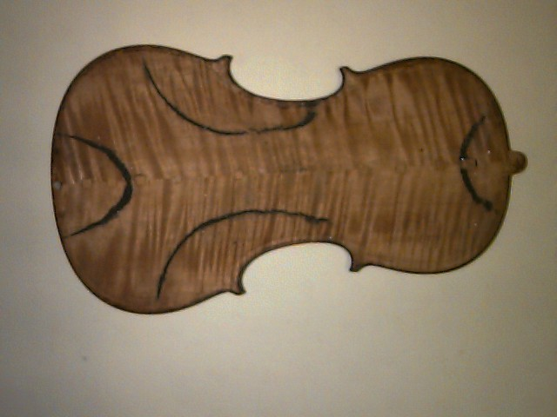
violin
The 4 different strings have different m/L and T is adjusted to get proper pitch
When a string on a violin is played, not only does the string vibrate, so does the entire volume of air within the wooden cavity as well as the wood itself. These vibrations not only help to amplify the sound by more effectively causing the air to vibrate, but also add depth and quality to the sound

Slide 8
Brass/woodwinds
Wind and brass instruments have a resonant tube that amplifies only those frequencies that produce a standing wave pattern.
There are two main configurations that occur in different musical instruments: tubes with two open ends (flute or organ pipe where the blowhole serves as an open end), and tubes with one open and one closed end (trumpet or trombone where the lips act as a closed end.)

Slide 9
Standing waves in a tube
Boundary conditions, are what determine the nature of the standing waves produced
At a closed end, since air is not able to oscillate longitudinally due to the wall, there must be a node of displacement
At the open end, the sound wave is partially reflected and partially transmitted out of the resonant tube. Although it is less obvious, there must be a displacement antinode at the open end
n = odd integer

Slide 10
Ear

Slide 11
Outer Ear
outer ear amplifies sound and protects the delicate tympanic membrane
ear canal serves as a resonator
a tube with one closed and one open end has a fundamental resonant wavelength equal to four times the tube length. If we approximate the ear canal as such a tube, we find that the resonant wavelength is about 10 cm, corresponding to a frequency of 3430 Hz (using the velocity of sound in air as 343 m/s)

Slide 12
Middle Ear
Already discussed hydraulic effect amplification and coupling into fluid of inner ear

Slide 13
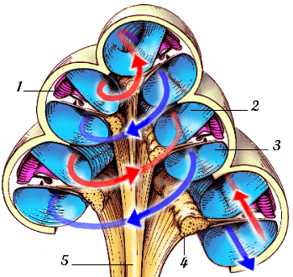
Inner Ear - cochlea
three parallel ducts filled with fluid with total volume about 15 μl, roughly a drop of water

Slide 14
Cochlea - II
“action” occurs between the basilar and tectorial membranes along the length of the cochlea.
There are about 16,000 hair cells in this region, each of which has a hair bundle, composed of about 50 - 100 stereocilia projecting from their apex into the surrounding fluid in precise geometric patterns.
Each stereocilia is a thin (0.2 μm) rigid cylinder composed of cross-linked actin filaments that are arranged to increase uniformly in length from about 4 μm at the stapes end to about 8 μm at the apex end of the cochlea

Slide 15
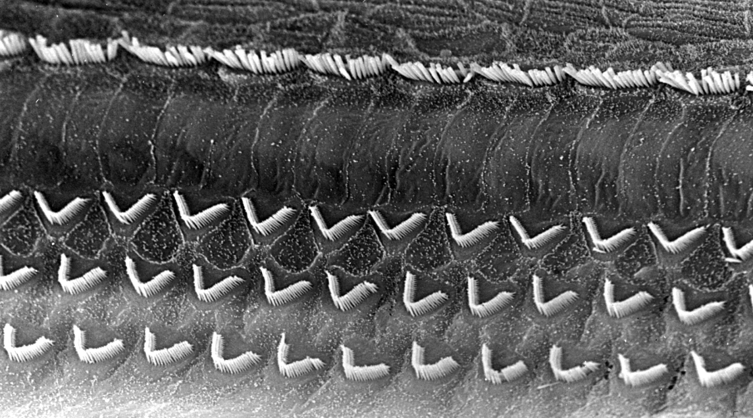
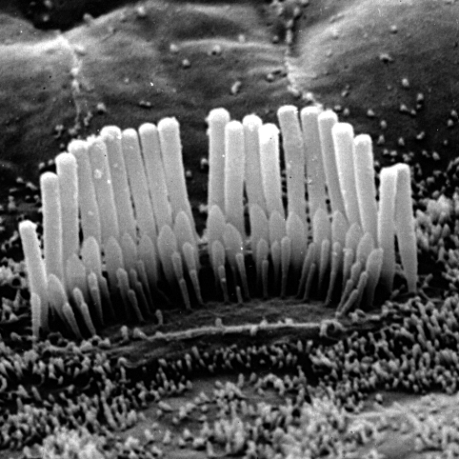
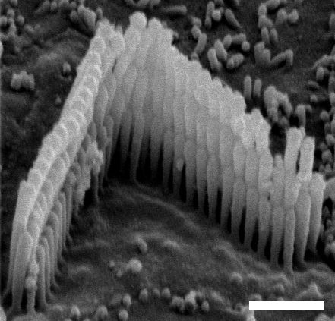
Hair cells - stereocilia
The stereocilia are so rigid that applied forces do not bend them; instead they pivot at their base.
Within a hair bundle, all the stereocilia are inter-connected by filamentous cross-links so that the entire hair bundle moves together.
For this to occur, stereocilia must slide along their neighbors by breaking and reattaching filamentous cross-links in a complex and incompletely understood process. It is thought that this relative sliding mechanism results in ion channels opening and closing along the stereocilia membrane that, in turn, lead to electrical signals propagated down to the hair cell base.
These electrical signals then trigger the release of a chemical neurotransmitter near synaptic junctions leading to nerve cells comprising the auditory nerve

Slide 16
How we hear - summary
Sound waves collected by the outer ear vibrate the tympanic membrane.
In turn, through mechanical vibrations, the stapes sets up traveling waves along the basilar membrane and other structures of the cochlea.
There are actually two types of hair cells, known as inner and outer. The outer hair cells are attached to the tectorial membrane and have efferent (motor) neuron connections so that they do not provide information to the brain, but instead play an active feedback role, taking signals from the brain and modifying the elastic interaction between the basilar and tectorial membranes. Such processes are inherently both extremely complex as well as nonlinear.
The inner hair cells on the organ of Corti are sheared by relative motions of the basilar membrane in the surrounding fluid to produce an electrical change in the stereocilia membrane leading to a series of electrochemical events that culminate in the recognition of sound in the auditory cortex of the brain.

Slide 17
Doppler Effect
Relative motion between source and detector of sound leads to frequency changes
+ for motion toward D; - for motion away from D;
- sign for D approaching,
+ sign for D receding

Slide 18
Doppler Effect II
In general case of both moving observer and detector we have
In the case of light, when the frequency shifts, the color of the light changes. The well-known red shift of starlight in astronomy is due to the fact that stars are rapidly receding from us. Characteristic frequencies of light are emitted by various atomic elements as we will see in Chapter 25. By comparing the frequencies of emitted light from atoms in the laboratory with that emitted from stars, the frequency shifts can be used to determine the recessional velocities of stars using similar equations to those derived below. This is the ultimate source of our knowledge of the extent and age of the universe.

Slide 19
Ultrasound
Sound at frequencies above 20,000 Hz is called ultrasound
Ultrasonic waves traveling in a material undergo several interactions
Some portion of the wave is absorbed as it travels through the material
When an ultrasonic wave reaches a boundary between two different media, some of the wave is reflected back while the rest of the wave is transmitted

Slide 20
Ultrasonic absorption
absorption coefficient α that describes the loss in intensity of the wave as it travels along
The absorption coefficient in human soft tissue depends on the frequency of the ultrasound, increasing with frequency in the MHz range with a typical value of about 12% per cm of distance per MHz

Slide 21
Ultrasound absorption applications
At low intensity levels, the absorbed energy heats the tissue. This interaction is clinically used in diathermy to locally heat tissue
At higher powers a new phenomenon occurs, known as cavitation. At these higher intensity levels the local pressure variation is sufficient to tear apart the medium, forming spherical holes or cavities. Medical applications of cavitation include the disruption of kidney stones or tumors using focused ultrasound

Slide 22
Ultrasound reflections
acoustic impedance, z, a parameter defined as the product of the mass density and the velocity of sound in the medium, z = ρv, determines the fraction of the wave that is reflected. If z₁ and z₂ are the acoustic impedances of the two media at a planar boundary then the fraction of the incident intensity that is reflected back is

Slide 23
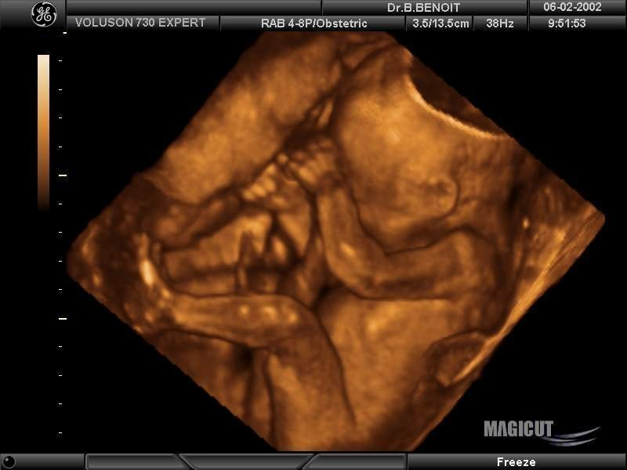
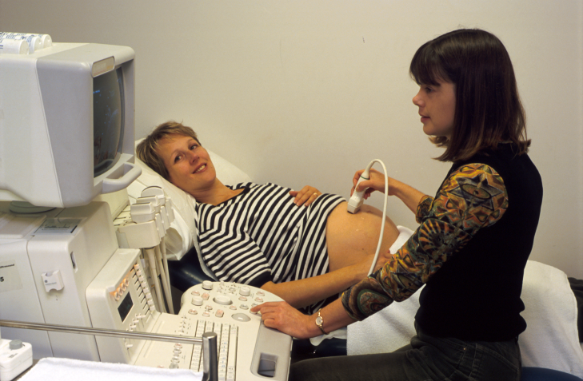
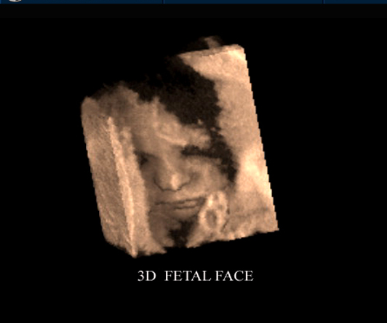
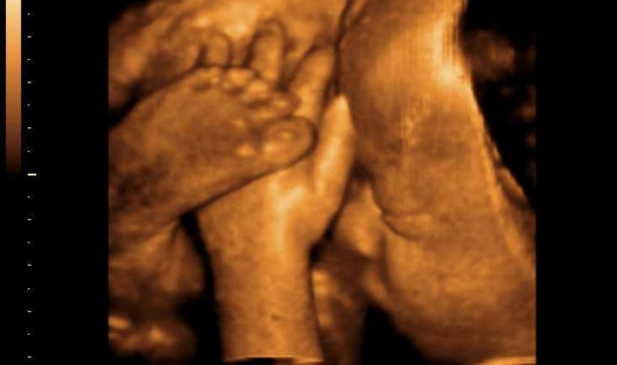
Medical ultrasound
Detected reflections give depth by echo timing – scanning gives images – now to 1 mm in best cases

Slide 24
Doppler ultrasound
Velocity profile obtained from Doppler shifts of ultrasound
Adult kidney

