Slide 1
Chapter 3
Applications of Newton’s Laws in 1 dimension
  Free Fall
  Motion in a Fluid
  Spring motion
  Molecular Dynamics

Slide 2

Free fall
Acceleration = g = 9.8 m/s² = constant
Constant acceleration implies constant force = weight
Be careful when there is air friction – then acceleration is not constant and a terminal velocity results

Slide 3
Constant acceleration Kinematics
If acceleration is constant then the average acceleration = constant (instantaneous acceleration)
Then and
Also → same result
Also, from the v_{x} vs t graph,
the area under the line
gives the displacement so
We can get this result by integrating again also:
v_{x}
Slope=accel
Δt
t

Slide 4
Eliminating Δt from the first two boxed equations we get one more:
  Example problems

Slide 5

Motion in a Viscous Fluid
We’ll discuss the buoyant force (F_{B} in the diagram) later
For now we focus on the friction force, F_{f}
The Reynolds number governs what happens:
where L is the characteristic size of the object, ρ its density, v its speed, and η its viscosity.
For large Reynolds numbers, the flow is turbulent and the frictional force can often be written as ( >> 1)
where A is the effective area and C ~ 1
Notion of effective area – reduce to minimize friction resistance

Slide 6
Terminal velocity
Returning to our falling object:
Soon after release, the object will have zero acceleration and a terminal velocity given by inserting the friction force and setting a = 0:

Slide 7
Small Reynolds number
The other limit is when the Reynolds number is very small – laminar flow – can occur for very small objects or larger viscosities
The frictional force is linear in v and given by ( <<1)
Bacterial motion is governed by this force

Slide 8
Another one-dimensional motion problem - springs
Hooke’s Law

Slide 9
Springs 2
v = dx/dt = -Aω sin(ω t)

Slide 10
Springs 3

Slide 11
Spring Problem
P28 in text: Attached to a spring on a frictionless table top, a 1 kg mass is observed to undergo simple harmonic motion with a period of 2.5 s after stretching the spring. The spring is then held vertically and a 0.2 kg mass is attached.
Find the distance the spring is stretched.
If the spring is then stretched an additional 5 cm and released, find the period of the subsequent motion.
What is the maximum acceleration of the 0.2 kg mass?
What is its maximum velocity?

Slide 12
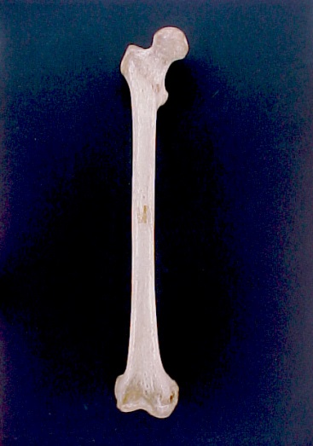
Elasticity of Solids
In linear regime:
strain
stress

Slide 13
Shear /Pressure

Slide 14
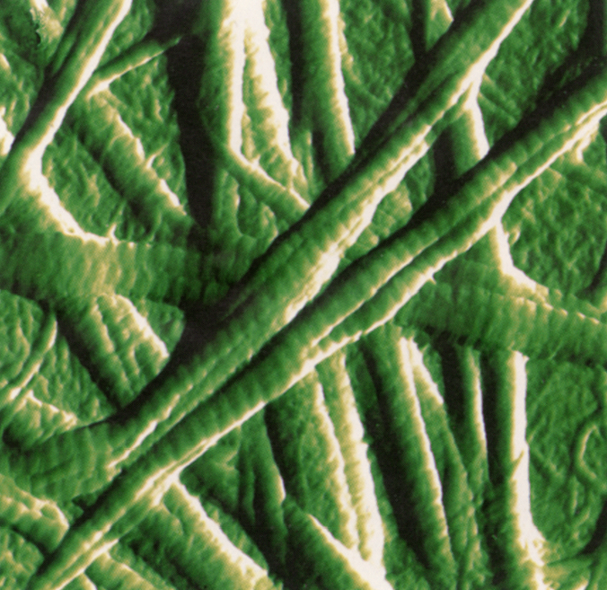

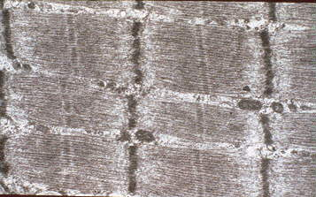
Strength of Biomaterials
Collagen fibers – triple helix
Themes: filament subunits → composites
filaments → fibers → fiber bundle → muscle
Striated muscle -

Slide 15
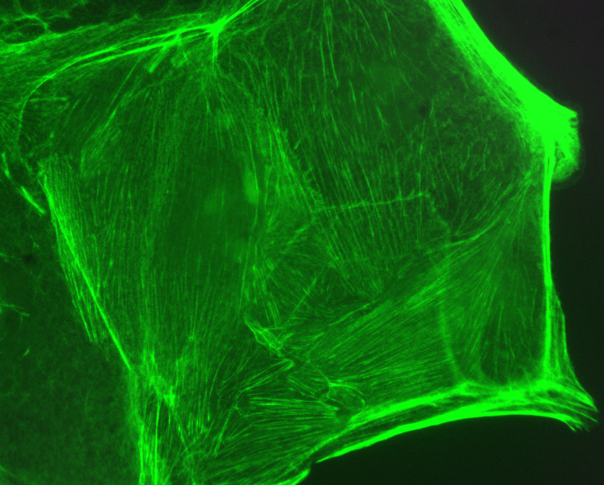
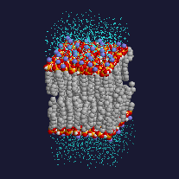
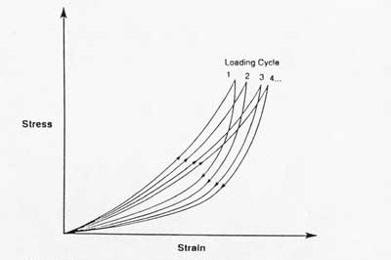
Fluids/Gels
Fluid/Gel systems behave differently
Hysteresis
creep
Stress relaxation

Slide 16
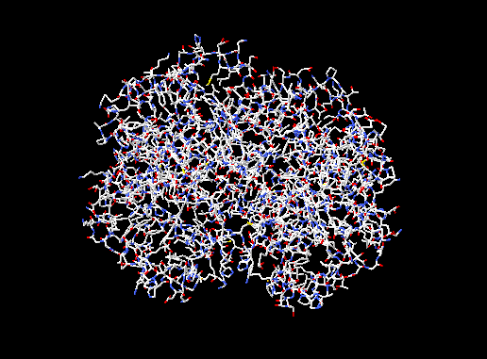
Molecular Dynamics
How do all the atoms of this hemoglobin molecule move around in time?
They undergo random thermal motions, known as diffusion, and each atom responds to all the forces acting on it according to Newton’s laws. The problem is that there are many atoms in hemoglobin and many solvent molecules that collide with them and need to be accounted for.
Early crystal x-ray diffraction structures were pictured to be static – but really the atoms move about quite a bit

Slide 17
Mol. Dynamics 2
In one dimension the acceleration of the i^{th} atom is given by:
From this we know that for a small time step (typically less than 1 ps = 10⁻¹² s)
and
Adding these
While subtracting them gives
So if we know the forces and starting positions, we can iterate and predict the motion of each atom

Slide 18
Mol. Dynamics 3
Molecular dynamics calculations are computer intensive – for each time step (sub – ps) you need to do several calculations for each atom in the molecule.
For a reasonable protein (several 100 amino acids – or thousands of atoms) it takes many hours of supercomputing to map out the motions for nanoseconds
Fast laser dynamic experiments are just starting to actually measure time courses of individual molecule motion in picoseconds
Look at this web site for movies:
http://www.ks.uiuc.edu/Gallery/Movies/

