Slide 1
Vectors
Scalars & vectors
Adding displacement vectors
What about adding other vectors - Vector equality
Order does not matter:

Slide 2
Vector addition I
Graphical vector addition
Vector decomposition
A_{x}=A cos θ
A_{y}=A sin θ
y
A
A_{y}
θ
A_{x}
x

Slide 3
Vector Addition II
Scalar multiplied by a vector:
Analytical vector addition:
C
B
θ_{c}
A

Slide 4
Steps in Component Method of Vector Addition/Subtraction
Make a rough sketch of the vectors, if not given
Find the x-, y- (and z-) components of each vector, if not given order pair notation
Perform the algebraic +/-/or multiplication by a scalar separately to each component, finding the x-, y- (and z) components of the resultant
If needed, combine the components of the resultant, using the Pythagorean theorem and trigonometry, to find the magnitude and direction of the resultant
Example calculation: Given A = (5, 2) and B = (-3, - 5), express C = A + B in terms of a) unit vector notation, and b) magnitude and direction.

Slide 5
Kinematics in 2 (or 3) dimensions I
Position vector:
Velocity vector:
where
Acceleration vector:
where

Slide 6
Kinematics in 2 (or 3) dimensions II
When the object we are interested in is confined to move along a line, position, velocity, and acceleration are all along the same line.
When the object is free to move in space, position, velocity, and acceleration can all point in different directions. This fact makes two- or three-dimensional motion more subtle to deal with.
But, the preceding equations point out a very useful simplification: the x- (respectively, y-, z-) component of velocity only changes due to the x- (respectively, y-, z-) component of acceleration, and the x- (respectively, y-, z-) component of position only changes due to the x- (respectively, y-, z-) component of velocity.

Slide 7
Special Case I – Free fall
If the acceleration = constant, as for example in free fall, then we can generalize two of our equations of motion from the 1-D case:
Example problem: A lacrosse goalie clears the ball by throwing it downfield at a speed of 10 m/s at a 35º angle above the ground.
How long will it be in the air? (assume the ball leaves the goalie’s stick from ground level)
How far will it go before hitting the ground, assuming no one is there to catch it?

Slide 8
Applications of Newton’s Laws
Generalization to 2 or 3 dimensions – no modification for 1st and 3rd laws
Second Law:
Use vector nature of equations to help solve

Slide 9
Example Problem 1
Find acceleration
Find speed at bottom

Slide 10
Problem Solving Strategy
Make a rough sketch of the problem, if there is not already one supplied as part of the problem, and identify the object(s) whose motion is to be studied, if that is not clear.
Identify all the forces acting on the object (and only on that object) by constructing a carefully labeled external force diagram (such a diagram is sometimes known as a free-body diagram)- a crucial step in solving the problem.
From the external force diagram, with a set of chosen coordinate axes, write down the equations of motion, the component Newton’s Second Law equations, being very careful to use appropriate labeling and to write down the x and y components in separate equations.
Once the equations of motion are obtained, solve for the unknowns of the problem, by performing the required algebra.
Whenever possible, check your results in limiting cases or in simplified circumstances.

Slide 11
Example Problem 2
No friction present
For what values of F_{x} does
the 2 kg mass rise?
b) For what values of F_{x} is the
tension in the cord = 0?

Slide 12
Special Case II- Circular Motion
A particle traveling in a circle is accelerating even if its speed is constant
Uniform circular motion
What is the acceleration? Magnitude and direction.

Slide 13
Uniform Circular Motion
With we have two sets of similar triangles so
Or ;but
Direction is toward the center of the circle – centripetal acceleration – perpendicular to
Centripetal force needed to produce this acceleration

Slide 14
Example Problems 3&4
Conical pendulum
Loop-the-loop

Slide 15
Work in 2 or 3 dimensions
The general definition of work when the force is constant is defined as
where θ is the angle between F and x
Why? This picks out the component of F along the motion as that part, and only that part, that can do work.
If he picks up the box and walks
horizontally a distance d at const. v
how much work is done by him and
by the gravitational force?

Slide 16
Example Problem
Problem 27
A 100 kg sled is slid across a smooth ice field by a group of 4 dogs tied to the sled pulling with a 350 N force along a rope at an angle of 20º above the horizontal.
a) If the sled travels at a constant speed, find the drag force on the sled.
b) Find the work done by the dogs after pulling the sled for 1 km.

Slide 17
Friction
Up till now we have ignored ever-present friction forces
Often these are thought of as causing complications, but friction is essential for most types of motion
Without it we would not be able to walk, automobiles would not be able to move, and even machinery would not be able to function

Slide 18
Kinetic Friction 1
Imagine two solid objects sliding relative to each other, such as a block sliding on a table surface.
Friction is the contact force acting parallel to the surface of contact (as contrasted with the normal force which is also a contact force but is directed perpendicular to the contact surface).
It is produced by electromagnetic interactions between the molecules at the contacting surfaces of the two objects.
The frictional force on an object is always directed opposite to its velocity.
It is found that while the frictional force depends on the nature of the material surfaces, surprisingly, it does not depend on the contact area (to a good approximation).
Microscopic surface of copper block

Slide 19
Kinetic Friction 2
The kinetic friction is proportional to the normal force, N, and can be written as
F_{k}= µ_{k}N ,
where µ_{k} is the coefficient of kinetic friction, which depends on the two material surfaces.
Careful with directions here – this is not a vector equation
Empirical, approximate equation; the coefficient of kinetic friction depends on the degree of smoothness of the surfaces, as well as on whether they are wet or lubricated

Slide 20
Example Problem
If θ = 30º and a = g/3 what is the kinetic coefficient of friction?

Slide 21
Static Friction 1
When two objects are in contact, but at rest with respect to each other, there are also molecular bonds that form between contact points.
Just sitting at rest does not result in any net force along a direction parallel to the contact surface; if there were, this force would spontaneously make the object accelerate.
But if we try to push a block with a force directed along the table surface, the molecular bonds supply a frictional force in the opposite direction, opposing the impending motion.
This type of friction is called static friction and arises in response to an applied force which would otherwise result in motion.
As long as there is no motion, the static friction force is always as large as it has to be to cause a net balance of all forces on the block.

Slide 22
Static Friction 2
Maximum static friction force depends solely on the nature of the two surface materials and the normal force but not on the surface area, and is given by
F_{s, max} = µ_{s}N,
where µ_{s} is the coefficient of static friction
In general F_{s} is as large as it needs to be to stop motion until the max is reached, so

Slide 23
Problem 55
Two blocks are attached by a light cord with each block sitting on a different inclined plane as shown.
If the angles of inclination are 30º and 60º, the respective masses are 10 kg and 6 kg, and the coefficients of sliding and static friction are 0.3 and 0.5, do the masses move, and if so in which direction and with what acceleration?

Slide 24
Example 2
In a loop-the-loop roller coaster ride the car of mass m starts from rest at point A at a height H. The loop-the-loop has a height of H/3. Assuming no friction, find: a) the speed of the roller coaster car at point B at the top of the loop-the-loop and b) the speed of the car at point C.

Slide 25
Centrifugation

Slide 26
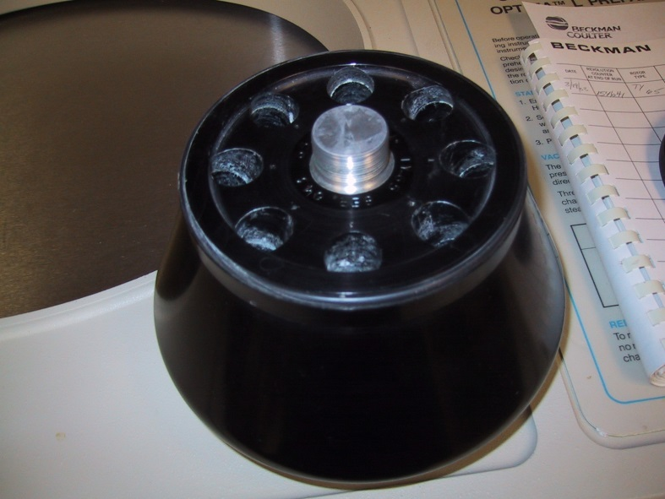
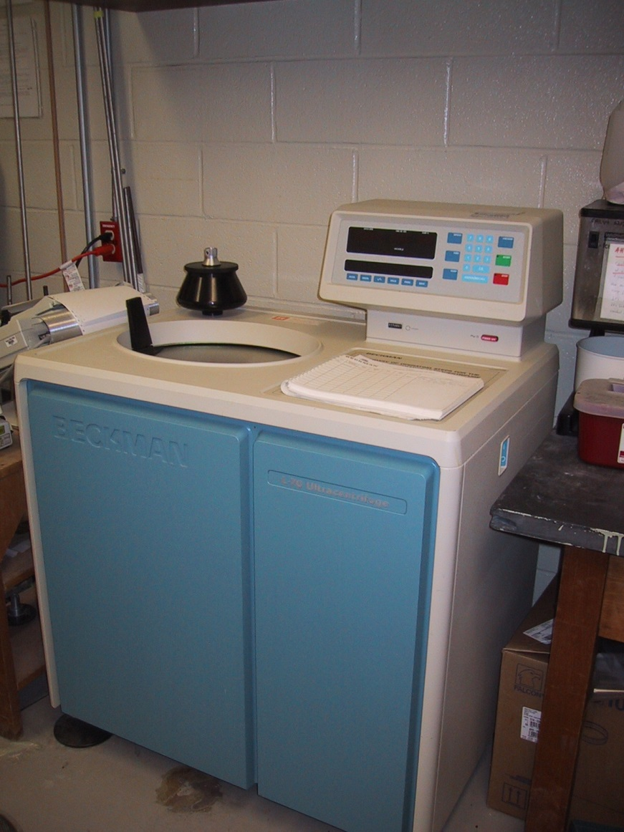

Slide 27
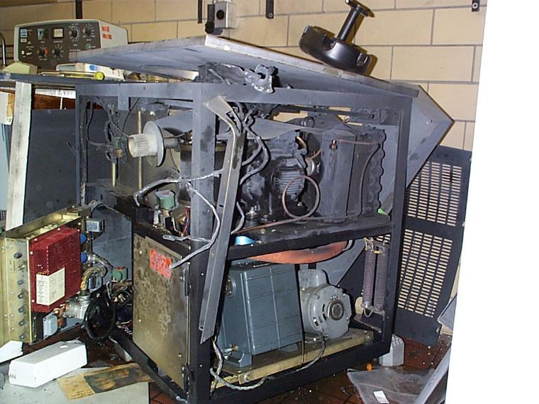
Keep your rotors balanced and spin below rated speed

