Slide 1
Fluids
Gases (compressible) and liquids (incompressible) – density of gases can change dramatically, while that of liquids much less so
Gels, colloids, liquid crystals are all odd-ball states of matter
We’ll stick to ideal fluids (incompressible and no viscosity) in this chapter (9) and expand to viscous fluids in Chapter 10

Slide 2
Pressure in a fluid
Pressure is the normal force/area acting in a fluid – in the absence of external forces a fluid is in equilibrium and the pressure will be uniform in a fluid
The external pressure on a confined fluid increases the pressure uniformly throughout the fluid by the same amount. This is known as Pascal's principle

Slide 3
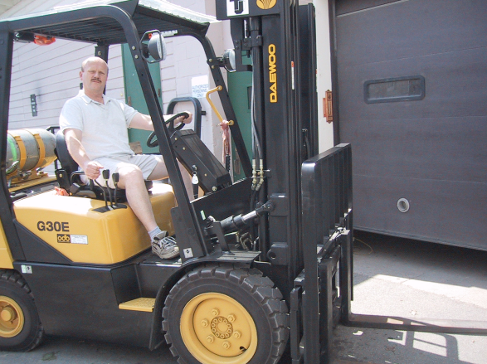
Hydraulic Devices
the applied pressure P = F_{in}/A_{in}
the output force, F_{out}, is determined from
P = F_{in}/A_{in} = F_{out}/A_{out}
So there is an amplification of the output force

Slide 4
Middle Ear Hydraulics
a factor of 20 reduction in the effective area of the footplate of the stapes from that of the malleus
with a roughly constant force acting, the pressure is greatly increased at the stapes – leading to amplification of sound by about 20 x

Slide 5
Problems under Pressure
Ex. 8.2 a) A cylindrical tube filled with blood is held vertically. The tube has a radius and length of 1 cm and 10 cm, respectively. Calculate the pressure at the bottom of the tube.
b) Calculate the pressure exerted on the ground by a 100 kg man standing squarely on his feet, each sole having an area of 200 cm².

Slide 6
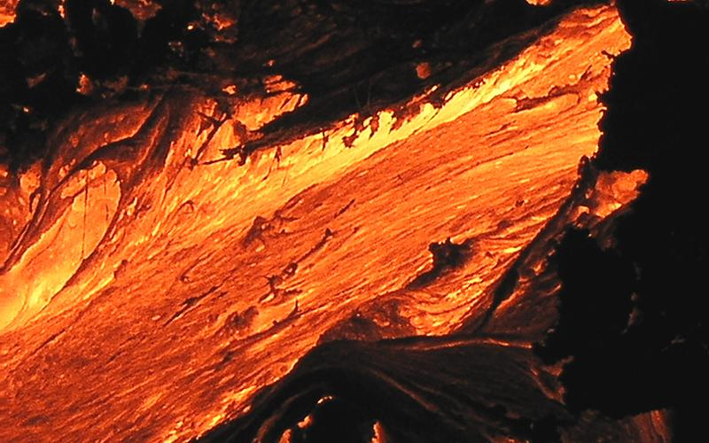
Fluid Flow
Two types of fluid flow: steady flow, or time independent flow, and unsteady flow, or time dependent flow
Steady flow can also be visualized by drawing contour lines, known as streamlines

Slide 7
Laminar vs Turbulent Flow
Laminar = layered flow – used in filtered air in hospitals, for example
Turbulent = random flow – important in blood flow – clotting/heart valves

Slide 8
Conservation Laws and Fluids I
#1 - Conservation of mass
With density ρ, the mass in a cylinder of length vΔt and cross-section area A is
so the volume per unit t is Av and
Continuity Equation:

Slide 9
Conservation of Energy
Work – Energy theorem with Q = Av = constant = volume/time : W_{net} = Δ KE
What kinds of work are done here?

Slide 10
Bernoulli’s Equation I
There is also work done by the pressure forces:
So

Slide 11
Bernoulli’s Equation II
OR
This is the most important equation – it represents conservation of energy
Let’s now look at a bunch of applications of this

Slide 12
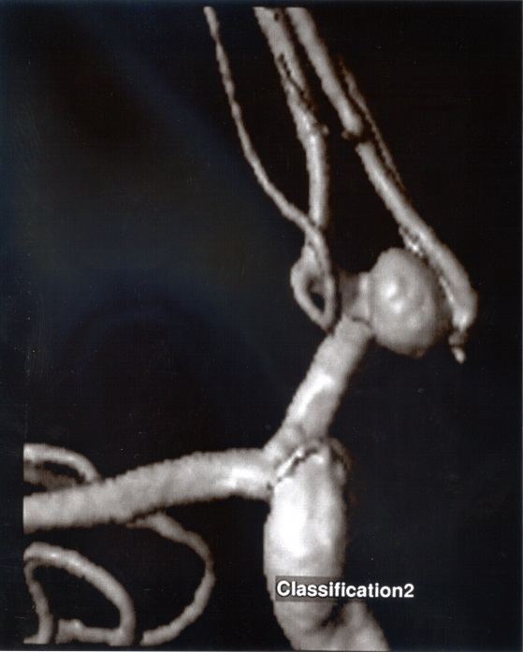
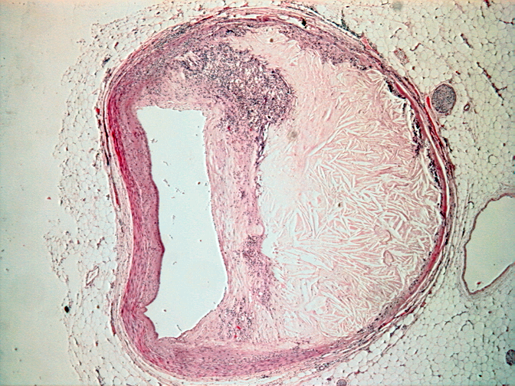
Flow in a tube
If there is no height change then we have
Aneurysm: when the cross-sectional area of the blood vessel increases, the blood velocity decreases (Av = const) – when this occurs, the pressure must increase – dangerous
Atherosclerosis: when the cross-sectional area decreases, the pressure drops causing the heart to work harder – perhaps leading to a cardiac event – TIA or stroke

Slide 13
Blood Flow Problem
Suppose that a catheter is inserted into the aorta, the largest artery of the body, to measure the local blood pressure and velocity (found to be 1.4 x 10⁴ Pa and 0.4 m/s) as well as to view the interior of the artery. If the inside diameter of the aorta is found to be 2 cm and a region of the aorta is found with a deposit due to atherosclerosis where the effective diameter is reduced by 30%, find the blood velocity through the constricted region and the blood pressure change in that region. For this problem assume that blood is an ideal fluid and take its density to be 1060 kg/m³.

Slide 14
Flow under No Pressure Change
When P = constant Bernoulli’s equation becomes
One application is the efflux velocity of a large water tank

Slide 15
Hydrostatics
In the case of statics with no flow, v = 0 and we have
Let’s get this result from first principles: balance of forces on a slab of fluid gives
or
where h = Δy in agreement with the above
These P’s are absolute pressures

Slide 16
Ex. 8.7 Your blood pressure varies not only periodically in time with your heartbeat but also spatially at different heights in the body. This variation is due to differences in the weight of the effective column of blood in your blood vessels as a function of height in the body. Assuming that the average blood pressure at the heart is 13.2 kPa (corresponding to the average of a high and low pressure of 120/80, as it is commonly referred to, or 100 mm Hg- find the blood pressure at foot level (1.3 m below the heart) and at head level (0.5 m above the heart). If a person experiences an upward acceleration, as for example in an airplane during take-off or even in a rapid elevator in a tall building, the increased pressure can drain the blood from the person’s head. What is the minimum acceleration needed for this to occur (take the head to be 25 cm in height)?

Slide 17
Atmospheric Pressure and Gauge Pressure
With one of the pressures referenced to the atmosphere at sea level, the absolute pressure is given by
Since P_{atm} = 1.01 x 10⁵ Pa, this means that the weight of the column of air above a 1 m² cross-sectional area is 10⁵ N – or since P_{atm} = 14.7 pounds/in², the weight of the column of air above 1 in² is 14.7 lb.
ρgh is called the gauge pressure – the difference between absolute and atmospheric P
Can measure pressure as a height of fluid column – P_{atm} → 10 m water or 760 mm Hg

Slide 18
Ex. 8.10 Calculate the height of a column of water or mercury when a long tube closed at the bottom is filled and then inverted into an open container with the same liquid. Based on this result, what is the maximum theoretical length of a functioning straw for sucking water up, ie. above what height would it be impossible to suck water up in such a straw.

Slide 19
Archimede’s Principle
the buoyant force on an object is equal to the weight of the fluid displaced by the object
Ex 8.9 The tallest iceberg ever measured was 168 m above sea level. Assuming it was in the shape of a large cylinder, find its depth below the surface. (Ignore the variation in the density of water or ice with depth or temperature)

