Slide 1
Visible and IR Absorption Spectroscopy
Andrew Rouff and Kyle Chau

Slide 2
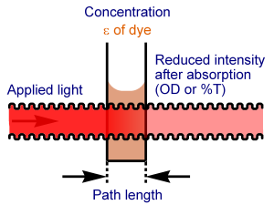
The Basics
wavelength= (λ)
original intensity= Ι_{o}
sample slab thickness= dl
Final intensity= I_{f}
ε’= molar extinction coefficient
-dI= Cε’(λ)Idl

Slide 3
How we get Absorbance
-dΙ= Cε’(λ)Idl
ln(Ι_{o}/Ι_{f})= Cε’(λ)l
log(Ι_{o}/Ι_{f})= Cε’(λ)l= A(λ)
A(λ) is known as absorbance or Optical Density (OD)
When A(λ)= 3….1000=(Ι_{o}/Ι_{f})
When A(λ)= 4….10000= (Ι_{o}/Ι_{f})
Absorbance must be much lower than these to get any usable data

Slide 4
From Energy to Wavelength
UV visible spectrum responds to energies between 100-1000kJ mole⁻¹
frequency range= 2.5e14- 2.5e15
Wavelength range= 1.2e-6m- 1.2e-7m= 120nm-1200nm
E=hf
E= energy
h= planck's constant
f= frequency
c= fλ
c= speed of light

Slide 5
Macromolecules Studied in Water
Water absorbs 170nm wavelength, so measurements must be made above this wavelength
UV is largest change in energy, which is why we use it to measure absorbance. Vibrational and rotational are two small of a change to measure

Slide 6
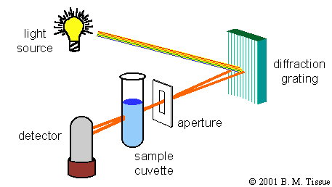
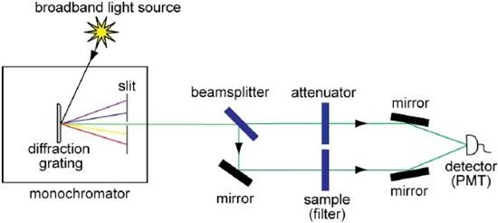
Single Split Beam-Double Split Beam

Slide 7
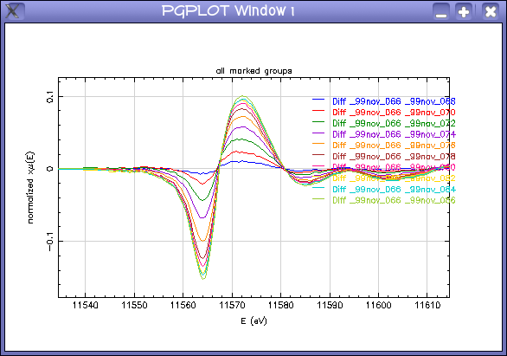
Kinetics and Difference Spectra
Kinetics
A+B→ C
Measuring the absorbance of C vs time gives information about A and B
Difference Spectra
Two absorbance graphs are subtracted from each other

Slide 8
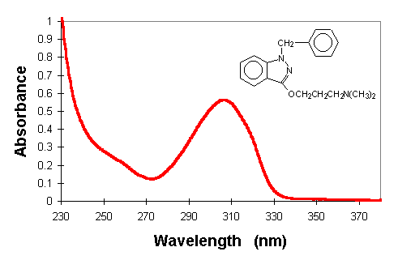
UV Absorption of Proteins
Main absorption areas
peptide group- 170-220nm
Aromatics- 280nm
Prosthetic groups, cofactors, enzymes, etc- vary
Can use Absorbance to calculate concentration (first equation)

Slide 9
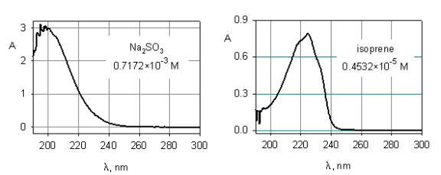
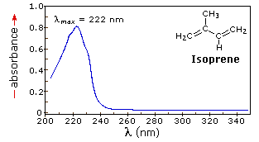
Light Scattering
Has a “tail” because of light scattering
Can either set zero higher up (done here), or graph can simply be fixed to have zero absorbance at end

Slide 10
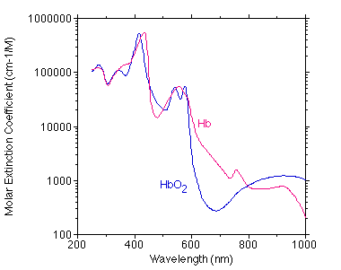
Flash Photolysis
Bond is broken by laser flash
re-binding kinetics are followed through changes in absorption spectrum
Graph shows absorption is higher when bond was broken

Slide 11
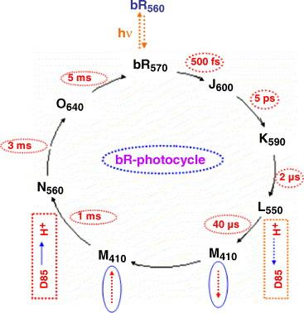
Bacteriorhodopsin
Green light (569nm) initiates cycle
Each letter represents a change in absorbance, and a shape change
M has two shapes with the same absorbance

Slide 12
Bacteriorhodopsin is a light activated Proton Pump
When it is in the dark, retinal configuration is all trans except for one cis configuration (dark adapted state)
When light hits, the cis carbon turns trans, and the photocycle begins (light adapted state)
The “Schiff” base changes configuration as the absorbance increases
L to M shape change causes a loss of a hydrogen
M to N shape change causes a gain of a hydrogen
K shape causes carbon to go back to cis
O shape causes it to go back to trans
This is directly related to how we detect light

Slide 13
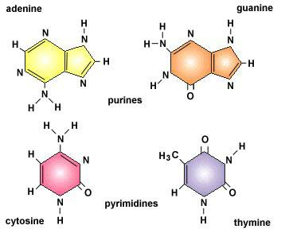
Nucleic Acids
Different absorption peaks than in proteins
Base causes the greatest absorbance- 260-290nm
DNA and protein together in a sample will give at least two distinct absorption peaks

Slide 14
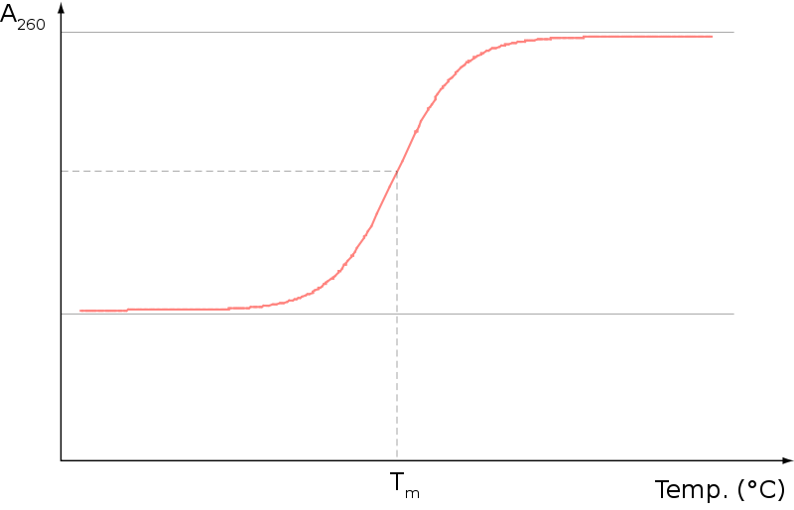
Melted DNA
Extinction coefficient of nucleic acid is smaller than that of free nucleotide
This means that absorbance increases when DNA is melted
Hyperchromic effect- the increase in absorbance upon DNA denaturing

Slide 15
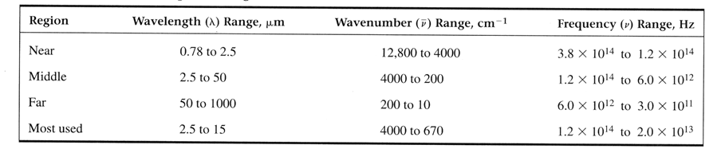
Infrared Absorption Spectroscopy
IR photons have low energy.
The only transitions that have comparable energy differences are molecular vibrations and rotations.
Triggering molecular vibrations through irradiation with infrared light. Provides mostly information about the presence or absence of certain functional groups.

Slide 16
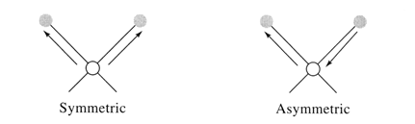
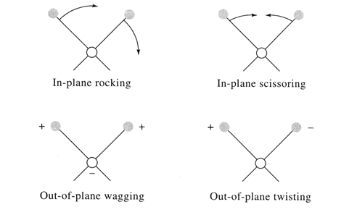
Vibrational Mode
Stretching - the rhythmic movement along a bond axis with a subsequent increase and decrease in bond length.
Bending - a change in bond angle or movement of a group of atoms with respect to the rest of the molecule.

Slide 17
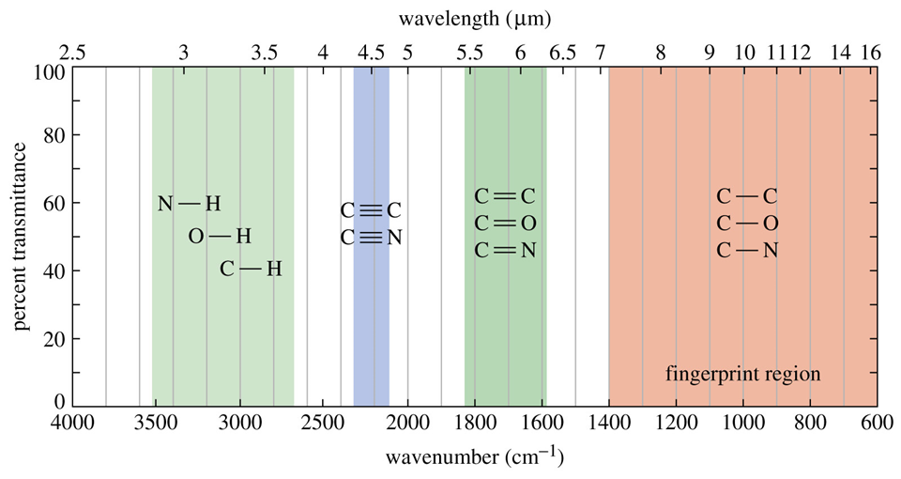
Application
Used to identify organic compounds
Provides information about the types of bonds present
Used to measure the vibrational frequencies of bonds in the molecule
  Each bond has a characteristic frequency

Slide 18
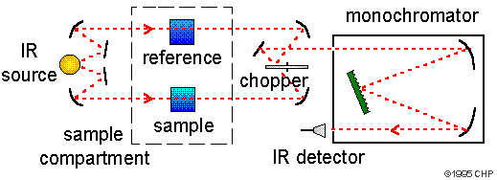
Infrared Spectroscope Schematic

Slide 19
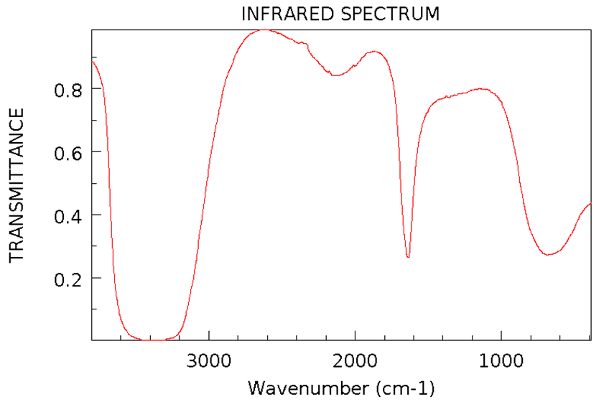
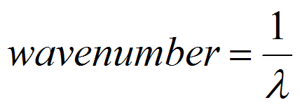
Infrared Spectrum
A plot of % transmittance vs vibrational frequency in wavenumbers.
The higher the wavenumber, the shorter the wavelength.

Slide 20
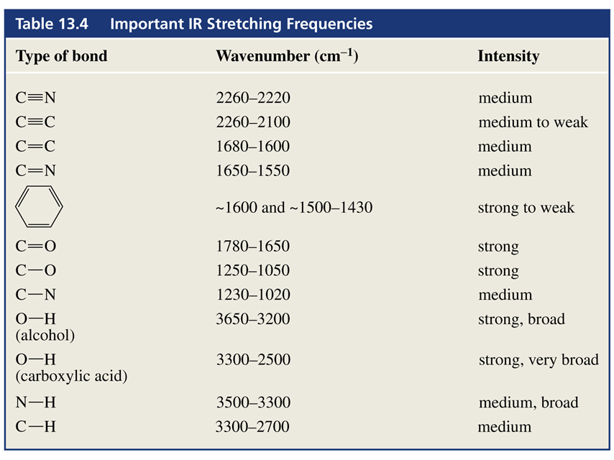

Slide 21
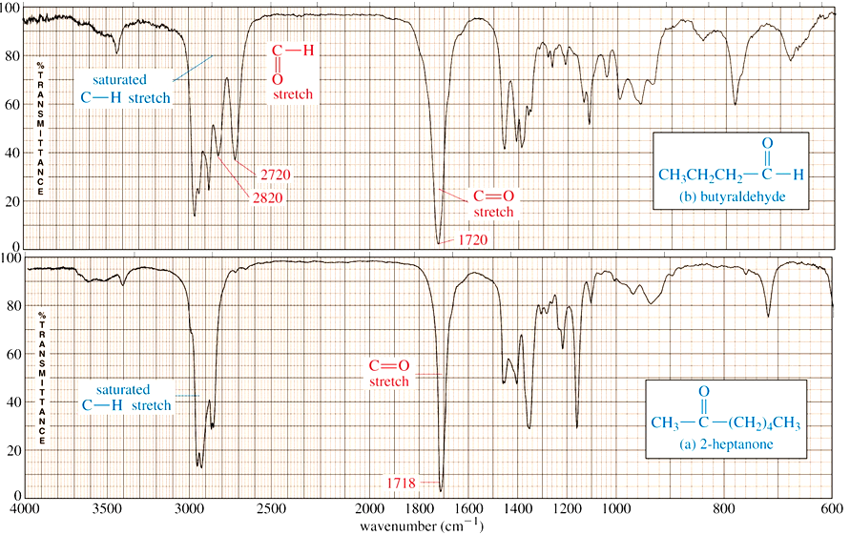

Slide 22
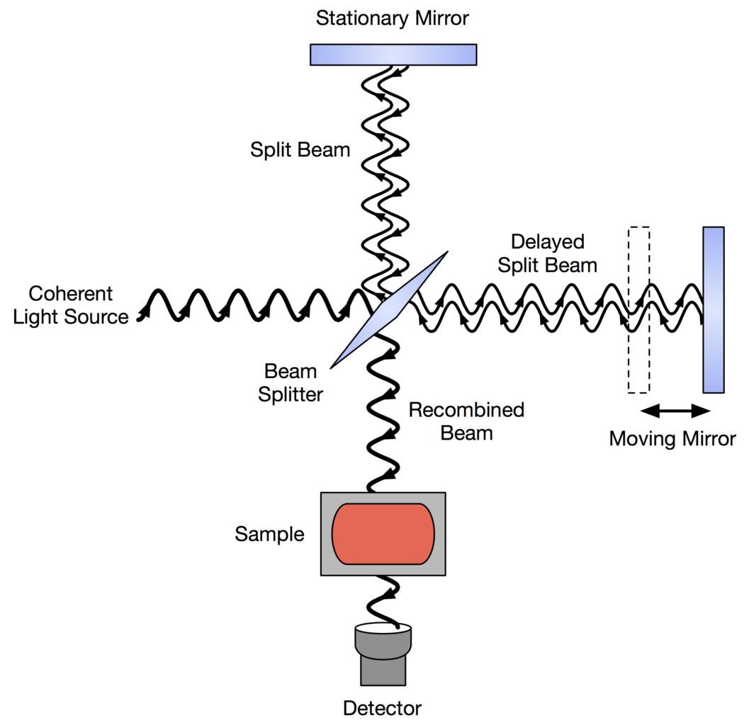
FTIR Spectrophotometers Schematic

Slide 23
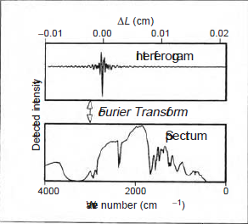
FTIR Spectrophotometers
Uses an interferometer and polychromatic light (all frequencies used at one time, instead of one at a time) to generate an interferogram.

Slide 24
IR Difference Spectrum
IR spectra are very sensitive to structural alteration
  A change in hydrogen bonding distance of 0.002Å shifts the frequency
However, it is very difficult, in practice, to detect small, localised structural changes in a biological macromolecule, by IR spectroscopy.
  All groups in the molecule essentially have IR-active vibrations
  Multitude of overlapping spectral bands

Slide 25
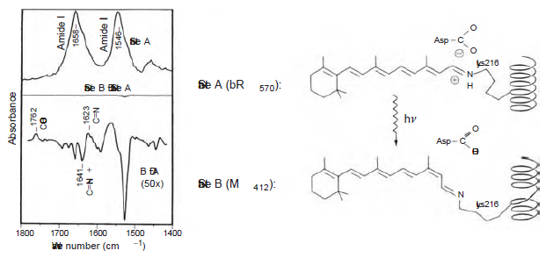
IR Difference Spectrum

Slide 26
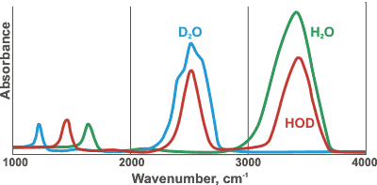
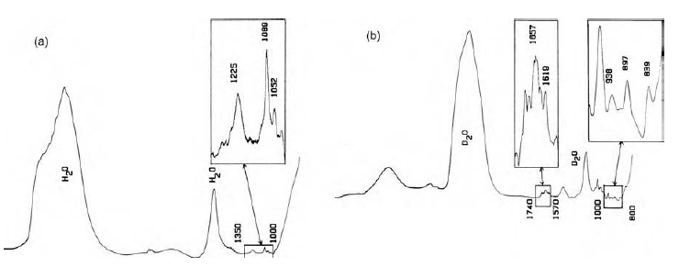
IR Spectroscopy and Water
Water peak at 3000-3700 cm-1

