Slide 1
Fluorescence Microscopy
Chelsea Aitken
Peter Aspinall

Slide 2
Advantages Over Light Microscopy
Resolution of light microscopy limited by Rayleigh Criterion
If two objects cannot be seen as distinct structures, then they may be considered coincident in space
Unable to determine whether there are molecular associations
Fluorescence microscopy can determine the distance between two molecules to 20 – 100 Å

Slide 3
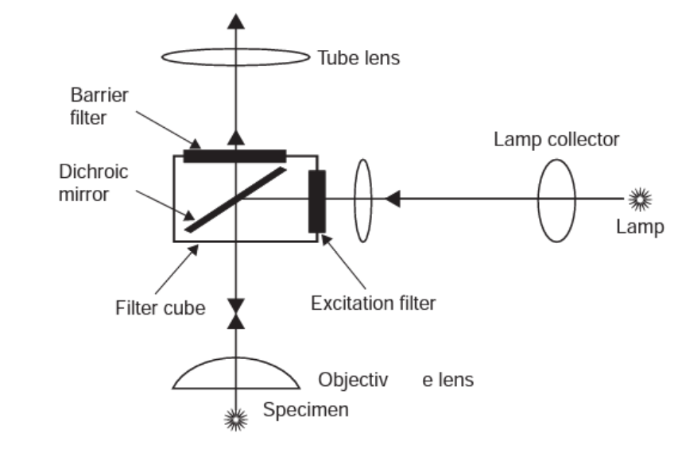
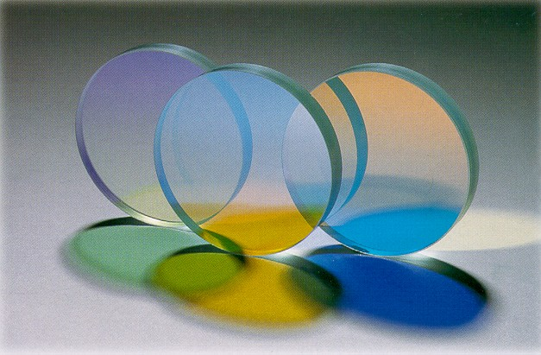
Wide-Field Fluorescence Microscope
Molecule (fluorophore) absorbs a photon and then quickly reemits a lower energy photon
Change in energy allows us to filter out incident light
Uses epi-illumination
Light source goes into a filter cube and is reflected into the sample
Emission returns through same objective and filter cube
Because of its longer wavelength, it passes through the dichroic mirror and is read
http://upload.wikimedia.org/wikipedia/commons/4/49/Dichroic_filters.jpg

Slide 4
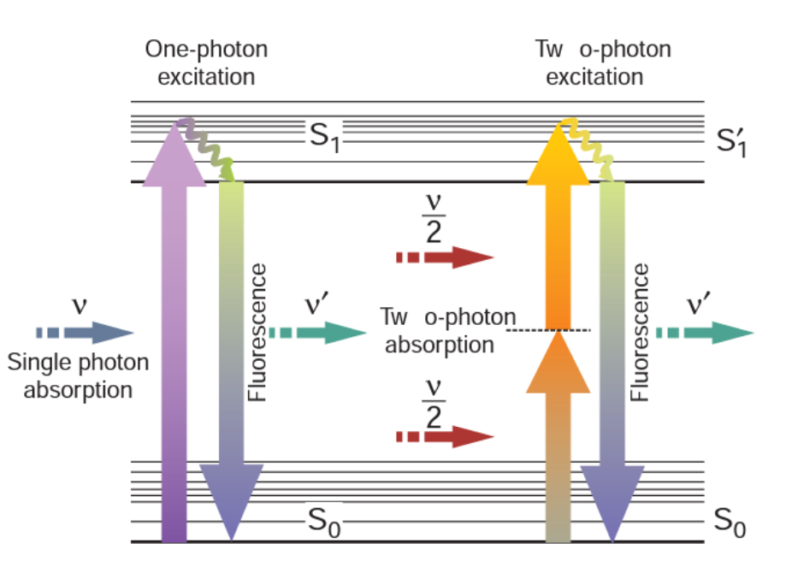
Two-Photon Excited Microscopy
Simultaneous absorption of two photons causing the fluorophore to emit a higher energy (2x) photon
Simultaneous = ~ 10⁻¹⁸ s
However to generate the same number of two-photon events, the laser needs to be ~10⁶ times more powerful than for one-photon events
Use mode-locked (pulsed) lasers
Intensity at peak is great enough to cause two-photon events

Slide 5
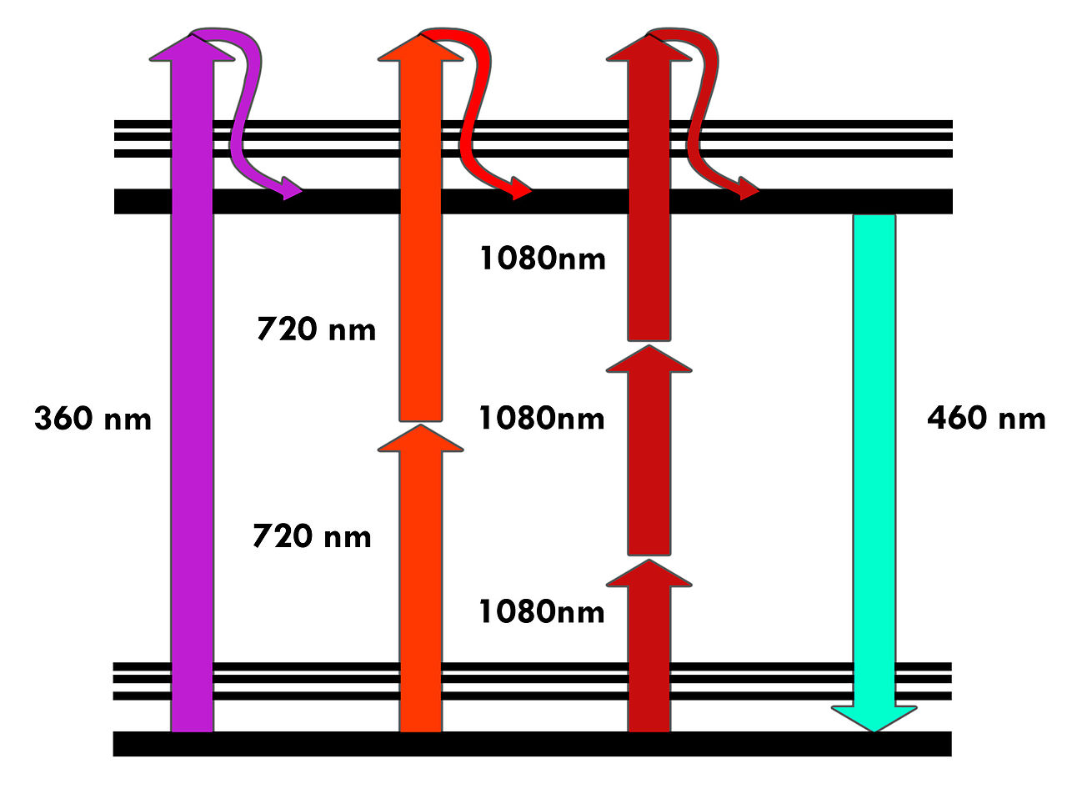
Three-Photon Excited Microscopy
Three-photon events
Photon density needed is only ten times that needed for two-photon events
Useful to excite fluorophores that fluoresce at very short wavelengths (that can be difficult to produce)
http://upload.wikimedia.org/wikipedia/commons/thumb/d/d3/MultiPhotonExcitation-Fig1-doi10.1186slash1475-925X-5-36.JPEG/1280px-MultiPhotonExcitation-Fig1-doi10.1186slash1475-925X-5-36.JPEG

Slide 6
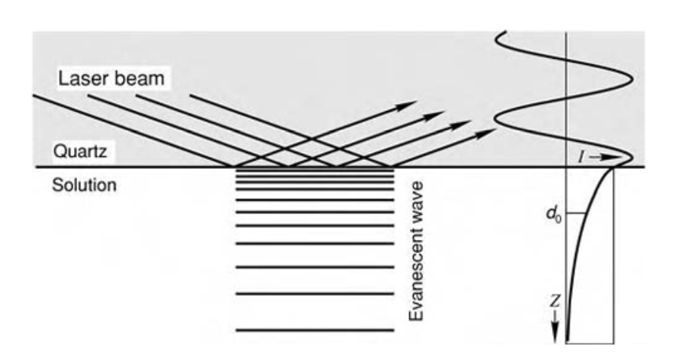
Total Internal Reflectance Fluorescence Microscopy (TIRFM)
Laser is pointed through one medium in contact with the medium of interest
Because of differences in refractive indices the light only reaches a short distance into the solution
$d_{p}=\frac{{λ_{0}}/{n_{2}}}{4π\sqrt{\sin^{2}θ−({n_{2}}/{n_{1}})}}$
Allows us to image cellular binding structures

Slide 7
4Pi-Confocal Microscopy
Uses two objective lens
One to illuminate
One to observe
This doubles the aperture angle making it possible to have an aperture angle of 4pi
Produces clearer more detail images
Can be further improved by combining this setup with standing wave microscopy

Slide 8
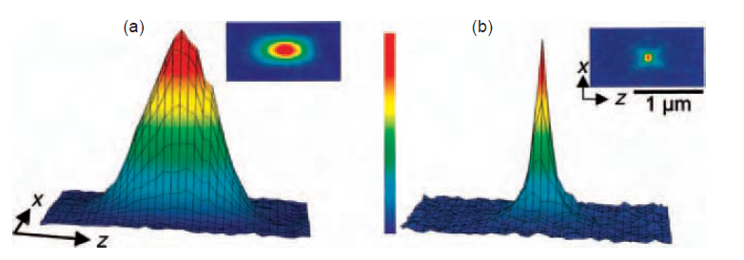
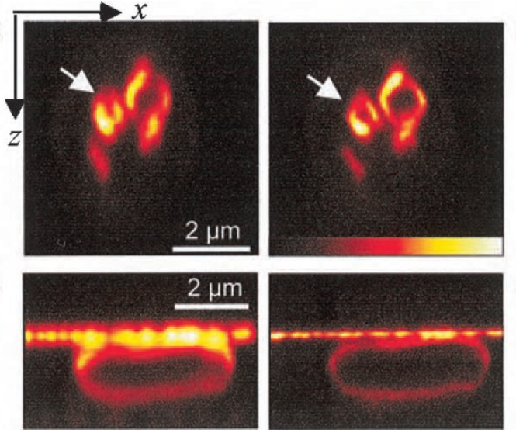
Stimulated Emission Depletion Microscopy (STED)
Fluorophores in a small area are excited by a short pulse of light (200 fs)
Then fluorophores around this area are forced back to ground state by a second longer pulse (40 ps)
This creates a very sharp peak of fluorescence and increases resolution
Notes:
fs = femptosecond (10⁻¹⁵) ps = picosecond (10⁻¹²)

Slide 9
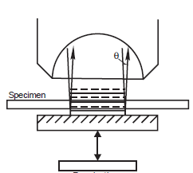
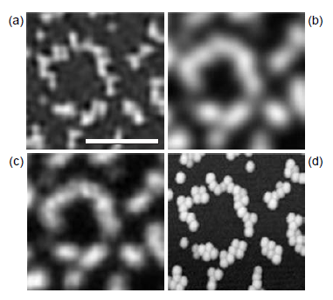
Standing-Wave Illumination Fluorescence Microscopy (SWFM)
Two laser planes cross in the solution and creates an interference pattern
The nodes have spacing:
$∆s=λ/{(2n\cos{θ})}$
Theta (the angle between the two planes) can be varied to reduce the node spacing to $λ/{2n}$
This allows it to have a better resolution than other methods
Notes:
(a) SWFM (b) standard illumination (c) confocal (d) AFM

Slide 10
Fluorescence Resonance Energy Transfer (FRET)
A donor fluorophore is excited and then transfers its energy to an acceptor (if its close enough) through dipole-dipole interactions
Measures molecule interactions efficiency (E_{T})
$E_{T}=\frac{R_{o}^{6} }{R_{o}^{6} +R^{6}}$
R₀ is the distance at which 50% of the energy is transferred
$R_{o}={\left[k^{2}×J(λ)×n^{−4}×Q_{D}\right] }^{1/6}×9.7×100$
k² – relative position of dipoles
J(λ) – integral of the overlap between the acceptor and donor spectra
Q_{D} – quantum yield of the donor
This method can be used as a quantum ruler (solve for R,) since ET can be measured and R₀ can be calculated

Slide 11
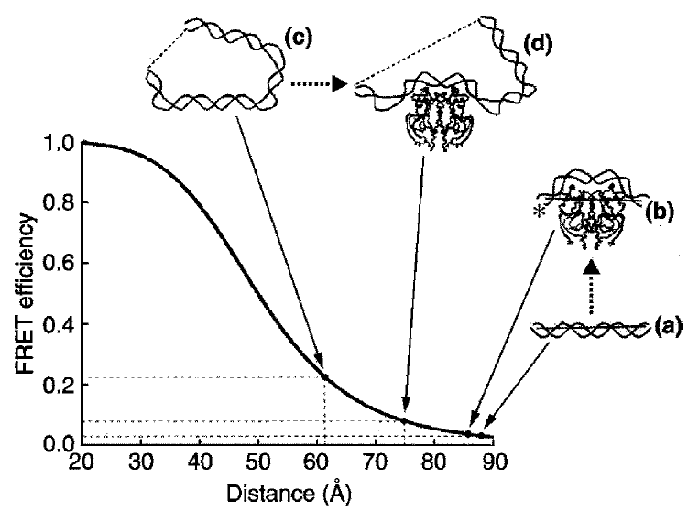
Applications of FRET
Very useful for studying how DNA’s form changes when introduced to certain proteins
Label both ends of DNA and then can measure how the distance changes
Much better at measuring changes in distance than absolute distance
Very good spectroscopic ruler for 20 – 100 Å range
However cannot detect dynamic events

Slide 12
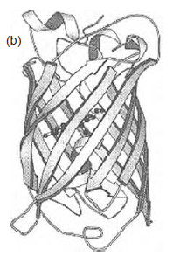
Green Fluorescent Protein (GFP)
Not all molecules fluoresce, so to use fluorescence microscopy they need to be fluorescently labeled
Dye molecules have to bind to specific location and not interfere with the reaction being monitored or the cell in general
Use GFP from Aequoria Victoria (type of jellyfish)

Slide 13
Pros/Cons of GFP
Pros
When expressed is spontaneously fluorescent
Doesn’t interfere with bound protein function
Can target specific organelles
Mutants have varying fluorescent properties
Cons
Limited sensitivity
Very large -> limits resolution
Can undergo color changes from irradiation independent from FRET
Takes hours to fold into its fluorescent shape

Slide 14
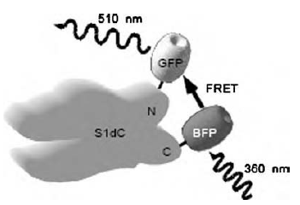
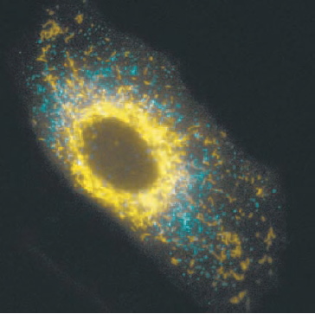
Applications of GFP
Conformational Sensor
Uses FRET between GFP and BFP to measure distance
Position varies as the bound protein undergoes structure changes
Can use reemitted wavelength of light to determine distance
Cellular Reporter
Can image living cells in vitro
Picture uses CFP (cyan) and YFP (yellow)
Can again use FRET principles with two different dyes
Measure conformational changes when two complexes interact

Slide 15
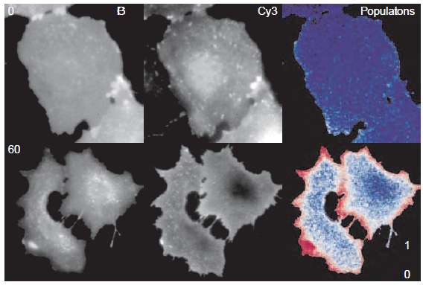
Fluorescence Lifetime Imaging Microscopy (FLI)
Image the fluorescence lifetime of all fluorophores in a sample
Can image live cells this way
Also possible to calculate FRET efficiencies at every pixel:
$E_{T}^{i}=1−\left(\frac{τ_{DA}^{i}}{τ_{D}^{′}}\right)$
Where τ_{D} and τ_{DA} are the donor and acceptor lifetimes respectively
Can use this technique to visualize the locations of GFPs in a living cell in real time
Allows us to see cellular events in real time

Slide 16
Sources
Serdyuk, Igor N., Nathan R. Zaccai, and Joseph Zaccai.Methods in Molecular Biophysics: Structure, Dynamics, Function. New York: Cambridge University Press, 2007. Print.

