Slide 1
Mass Spectrometry
Andrew Rouff and Ben Berger

Slide 2
A Brief History
1897- JJ Thomson recorded first mass-to-charge ratio of electrons
1951- W. Pauli and H. Steinwedel developed first quadrupole mass spectrometer
1959- K. Biemann applies electron ionisation mass spectrometry
1974- B. Mamyrin contributes to time-of-flight mass spectrometry
1988- K. Tanaka develops MALDI, receives Nobel prize in Chemistry

Slide 3
Parts of a Mass Spectrometer
A sample injector
An ionisation chamber
A mass analyser
An ion detector
A data handling facility

Slide 4
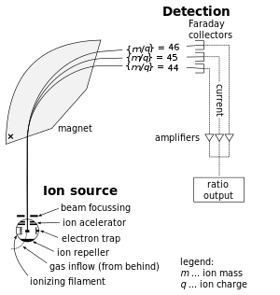
Mass Spec. For Dummies
Cations are produced
Cations are accelerated in instrument
Magnetic field is introduced
Amount of “bend” is measured
The heavier an ion is, the less it will “bend”
Mass/charge ratio is then calculated

Slide 5
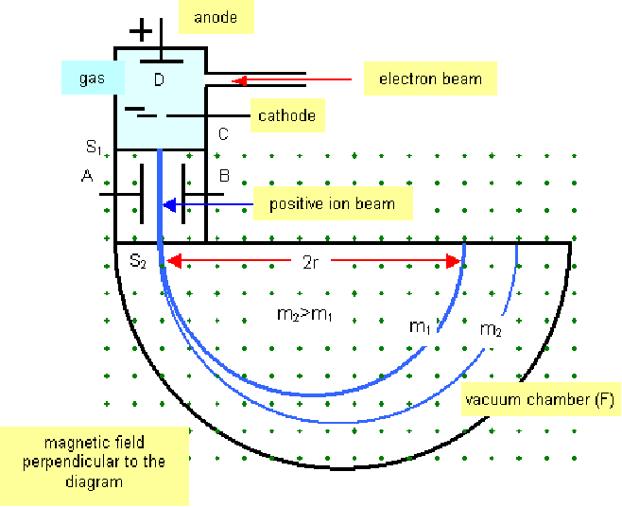
http://www.astarmathsandphysics.com/ib_physics_notes/quantum_and_nuclear_physics/ib_physics_notes_the_mass_spectrometer_html_1107d8b8.gif

Slide 6
The Big Equation
m/z=B²r²/(2V_{acc})
z= charge of ion
m= ion mass
B= magnetic field
r= radius
V_{acc}=potential difference in acceleration region

Slide 7
Mass Resolution
=m/Δm, m= mass, Δm= change in two neighboring masses
The higher to resolution, the better more accurate the readings are
First definition- each adjacent peak contributes 5% of the valley between them
Second definition- mass/width at half point
A resolution of 2000 for the second definition is equal to a resolution of 1000 for the first definition

Slide 8
Molecular Mass Accuracy
The difference between the measured and calculated masses for an ion, displayed as a percent. eg. 1000±.01%
Peak overlap is main reason for bad accuracy

Slide 9
Charging the Ion
Charging is important:
No charge = no lorenz force
There are many ways to do this, including Electron ionisation (EI), Field Ionisation (FI), and Fast Atom Bombardment (FAB), Matrix Assisted Laser Desorption Ionisation (MALDI), and Electrospray Ionisation (ESI)

Slide 10
Electron Ionisation (EI)
Electron energy is generated by a heated filament, set to around 70eV
Gaseous molecule is sent into the energy, causes molecule to lose an electron
Cation is generated from this process
Ions are usually unstable under bombardment

Slide 11
Field Ionisation (FI)
Molecules are introduced in vapor state
High intense electric field is generated, which interacts with molecules
Outer shell electrons are lost, forming cations

Slide 12
Fast Atom Bombardment (FAB)
Argon and/or Xenon are thrown into sample surface at a 8-10 keV
Sample is placed in a glycerol matrix and bombared with Ar or Xe
Disadvantage: requires high concentration of matrix
Advantage: simple and easy to interpret

Slide 13
Matrix Assisted Laser Desorption Ionisation (MALDI)
A useful form of ionisation, more effective than FAB
Laser energy is absorbed by chromophoric matrix, which converts molecules to gas phase
Ionisation occurs between excited matrix molecules and sample molecules
IR laser and UV laser are two most common lasers to use for MALDI, because they can both excite most molecules in the matrix

Slide 14
Electrospray Ionisation (ESI)
Sample is put into tube and shot out in a “spray”
Samples are hit with 1-5kV when it emerges from capillary tube
This creates charged spray like particles
Solvent evaporates before particles go into chamber containing mass analyser
Cations are determined by polarity of voltage applied to capillary
Can create multiply charged ions, which allows large mass molecules to be detected with low m/z ratio
Higher the mass, higher the resolution

Slide 15
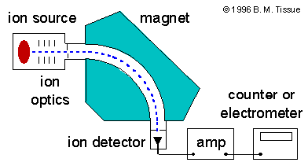
Single Focusing Mass Spectrometer
Only one detector is present
All ions have a constant radius
This is done by changing B in electromagnet analyser, and V in electrostatic analyser
http://figures.boundless.com/511edc7ce4b0c14bf4650299/full/mass-20spectrometer.png

Slide 16
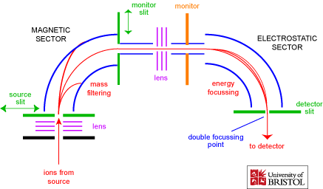
Double Focusing Mass Spectrometer
Both electromagnetic and electrostatic analysers are used
Higher resolution than a single focusing mass spectrometer
http://www.chm.bris.ac.uk/ms/images/sector-schematic.gif

Slide 17
Quadrupole Mass Filter
Consists of four cylindrical rods
Two have a negative direct current voltage and alternating radio frequency voltage
Two have positive direct current voltage and also alternating radio frequency (exact opposite alternating as first two rods)
The purpose is to disallow any ions traveling in a wrong trajectory to be filtered
Only ions with correct radius is kept and measured

Slide 18
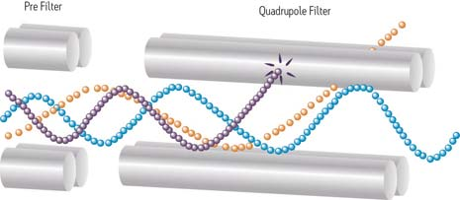
http://www.waters.com/webassets/cms/category/media/other_images/ms_primer_p2_fig1.jpg

Slide 19
Ion Cyclotron Resonance Mass Spectrometry (ICR-MS)
Trapped Ions in magnetic and electric field detected when frequency matches cyclotron frequency
Ions travel in a circle and sit in machine for hours
When you decrease the strength of the magnetic field, the heavier particles will stop traveling in circular paths and will “crash”

Slide 20
Another 2 Big Equations
F=zvB=mv^2/r
|
|
V
ω=v/r=zB/m
Lorenz force due to moving charge through a perpendicular magnetic field
Frequency of rotation

Slide 21
Time of Flight Mass Spectrometer
Bigger ions move slower than smaller ions
Low resolution, but fast speed, high transmission, and unlimited mass range
Uses how long it takes ion to get through instrument to measure m/z
u=√2zV_{acc}/m

Slide 22
Tandem Mass Spectrometry
Two mass spectrometers are used one after the other
The first mass spec. fragments the ions like normal
One ion is chosen and sent into a collision course with the fragments of the other ions
The second mass spec. analyses this ion and these fragments
Allows several generations of ions to be observed

Slide 23
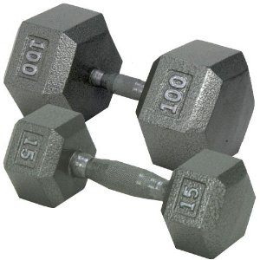
Thank You For Your Time
Mass
Spec

