Slide 1
Mass Spectrometry
Kyle Chau and Andrew Gioe

Slide 2
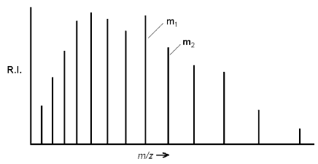
Computation of Molecular Mass
Mass Spectrum is a plot of intensity as a function of mass-charge ratio, m/z.
Mass-charge ratio can be determined through accelerating an ion.
Notes:
Ekin = kinetic energy
Vacc = the potential differences that define the accelerated region
Z = charge
M = mass
V = velocity of the accelerated ion
B = the magnetic field
R = the radius of the trajectory
F = Lorentz force which balance the centrifugal force (perpendicular to both V and B)

Slide 3
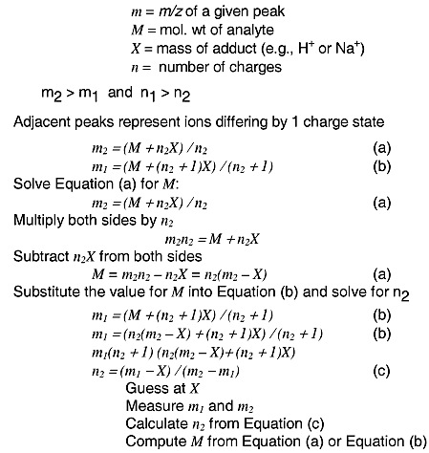
Conti
Introduction to Mass Spectrometry: Instrumentation, Applications, and Strategies for Data Interpretation

Slide 4
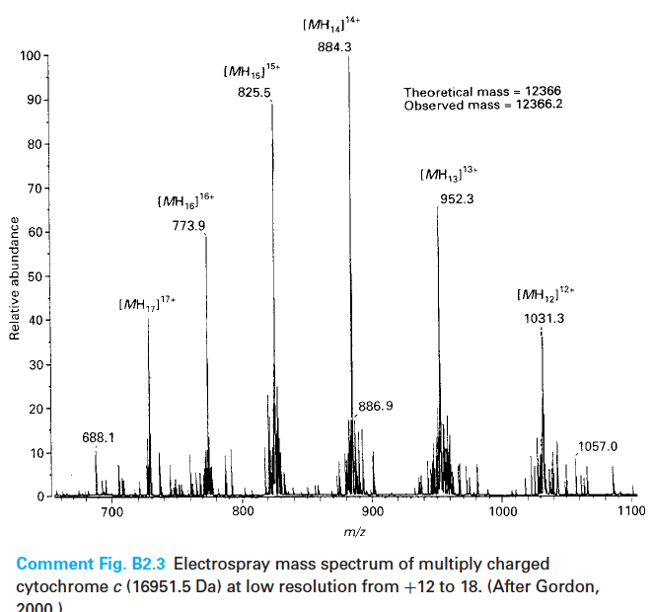
Computation of Molecular Mass (Cont.)

Slide 5
Unfolding of Proteins
Folded and unfolded proteins produce different distributions of charged states in their ESI spectra.
Proteins electro-sprayed form solution conditions that preserve their native conformation tend to have narrow distribution with a low net charge which manifests as MS spectrum with fewer peaks.
Proteins electro-sprayed from denaturing solution produce a broad distribution of charge state
The difference in charge distribution and state is believed to be related to changes in the accessibility of ionisable groups created by pH denaturization.

Slide 6
Multiple Charging Behavior

Slide 7
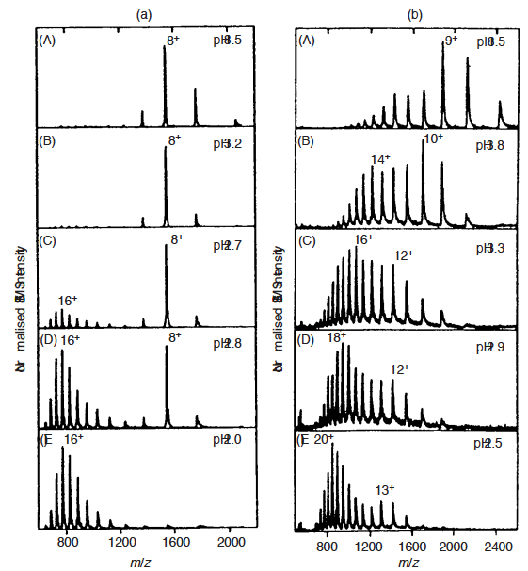
Unfolding of Proteins (cont.) Cytochrome C Myoglobin
Since charge distribution depends on the folded state of a protein. The Novel technique of ‘time resolved ESI’ has been used for studying protein folding.
In Cytochrome C, no conformational intermediates between folded and unfolded states were detected while observation of myoglobin revealed the presence of intermediates during its acid induced denaturation.

Slide 8
The ESI mass spectrum of any protein can be represented by a linear combination of charge-state distributions called ‘basis functions’ which may be approximated by a Gaussian distribution.
The greater the effects pH denaturation, the clearer the manifestation of the bell shaped Gaussian distribution becomes.
Additionally, the more unfolded the protein becomes, the clearer the results of multiple charging in the spectrogram. That is, since the mass of the peptide remains constant during each intermediate folding state, only the charge z of the peptide increases, so the entire spectrogram appears to shift to the left
The intensity changes are represented by a weighting factor which accounts for the relative contribution to the overall charge-state distribution.
In this way an observed ESI mass spectrum can be considered as a sum of the contributions from each protein conformation.
The Cytochrome C/myoglobin comparison gives an excellent illustration of the unique ability of ESI-MS to monitor protein folding intermediates with applications in monitoring suspected protein folding disorders such as Alzheimer’s Disease.

Slide 9
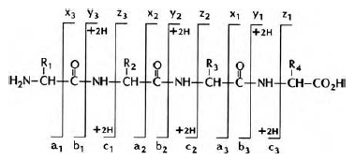
Protein Sequencing
MS-MS approaches combined with enzymatic or chemical degradation to form oligopeptides (< 3 kDa)
ESI-FTMS for degradation
Classical Edman degradation with MS-MS

Slide 10
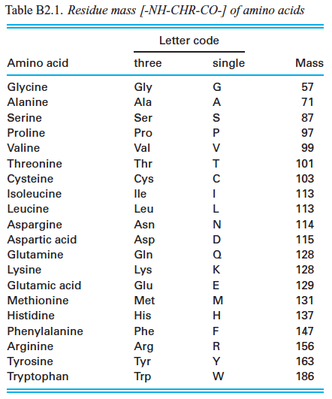
Residue Mass of Amino Acids

Slide 11
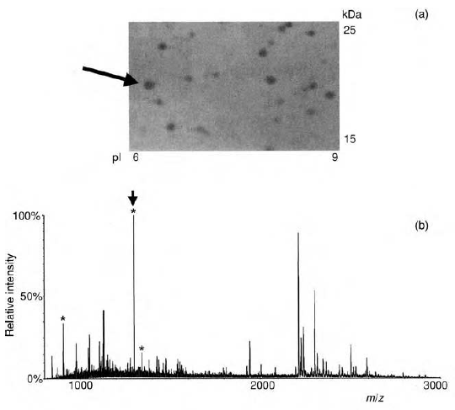
Protein Identification
2-Dimensional Gel Electrophoresis (2DE) separates proteins into 2-D, by the isoelectric point and the size.

Slide 12
Nucleic Acid Analysis
Analysis of nucleic acids by mass spectrometry lags behind proteins because negatively charged nucleic acid have a high affinity for sodium ion greatly reducing ionisation efficiency.
Additionally, the generation of intact molecular ions from oligomers of more than two nucleotides proved to be difficult when using classical ionisation techniques such as electron impact and chemical ionisation due to the high polarity of nucleic acids and the tendency of their molecular ions to fragment.
However, the usage of “soft ionization techniques” such as MALDI-TOF and ESI has allowed for advances in Nucleic Acid Analysis

Slide 13
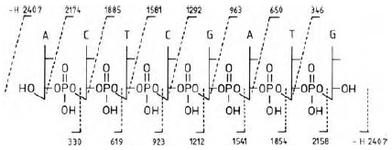
DNA Sequencing

Slide 14
Mass spectrometry may be used to determine DNA sequences through the usage of MALDI-TOF techniques as an alternative to gel electrophoresis techniques.
Instead of doing a size inspection on a gel, the DNA fragments generated by chain-termination sequencing reactions may be compared by mass.
The mass of each nucleotide is different from the others and this difference can be detected by examination of a mass spectrum. After calculation of the analyte’s mass from the m/z ratio, the identity of the nucleotide may be determined from a mass table.
Similarly, indirect DNA sequencing has been attempted by analysis of the Mass Spectrums produced from RNA
Furthermore, single nucleotide mutations in a DNA fragment may be detected easier through examination of a mass spectrum than a gel.

Slide 15
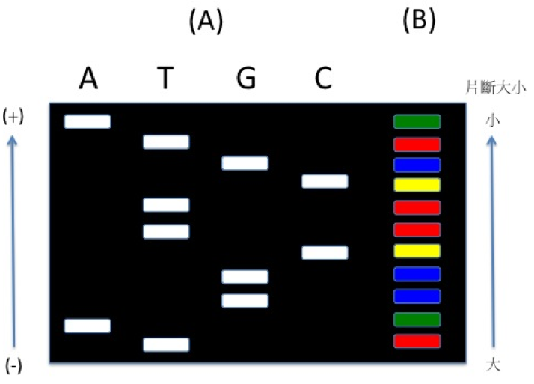
Nucleotide Masses
Nucleotide | Abbreviation | Molecular Mass (Da)
Adenine | A | 135.127099
Thymine | T | 126.113620
Cytosine | C | 111.102282
Guanine | G | 151.126504
Urasil | U | 112.087003

Slide 16
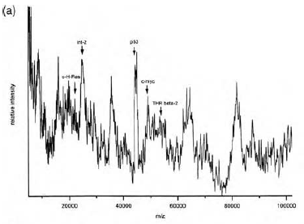
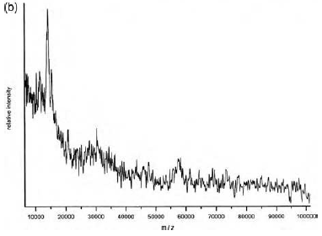
Mass Spectrometry in Medicine
Spectrogram with Abnormal Proteins Expression Spectrogram of Normal Protein Expression

Slide 17
Mass spectrometry has already replaced electrophoresis for analyzing products form routine molecular biological procedures since it allows the sizing of DNA amplified from polymerase chain reaction procedures.
A potential application of MS is for the early detection of certain cancers. MALDI-TOF-MS offers the opportunity to rapidly detect and monitor oncoprotein expression against a background of normal protein activity
An promising application of MS is the analysis of tissue samples for molecular distributions.
Prior to imaging, a tissue section is frozen, sectioned, mounted on a stainless steel plate and coated with a matrix solution. The sample is then dried and introduced into a MALDI-TOF spectrometer which ionizes it and analyzes the ensuing mass spectra. If enough samples are taken a data array of the sampled tissue consisting of 1000-30,000 spots may be created to create a spatial map of the identities of the proteins present in the sample tissue.
The resulting data array may be used to view the spatial distribution of the various proteins that appear in the mass spectrum.
Since certain proteins are known to be present only in particular tissue locations in normal samples, the image may be used to identify the presence of abnormal proteins in the tissue sample.
Potential applications may be aimed at identifying tumor markers in proliferating tissue or identifying the presence of mis-folded proteins such as Tau plaques associated with Alzheimer’s disease.

Slide 18
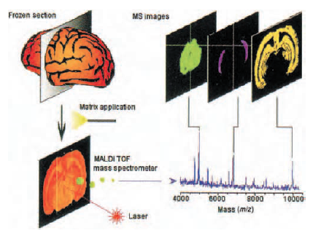
Imaging Mass Spectrometry

Slide 19
