Slide 1
Analytical Ultracentrifugation
Chelsea Aitken
Peter Aspinall

Slide 2
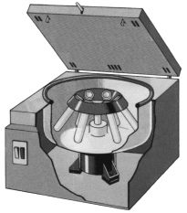
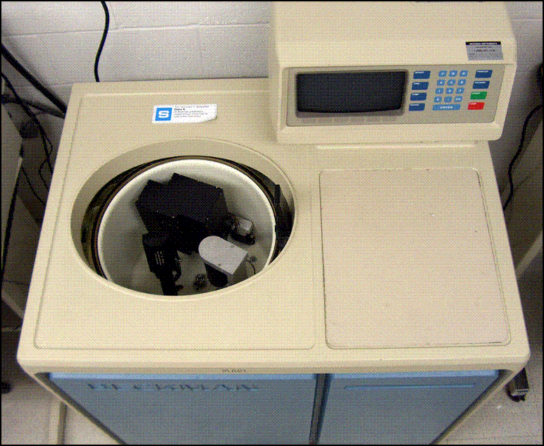
What is an Analytical Centrifuge?
http://1.bp.blogspot.com/-qynUSyJF-_I/UOP29BV1byI/AAAAAAAAAjE/5-kyJoaWL3o/s1600/centrifuge.gif
http://bitc2-preview.sr.unh.edu/TRC/IMAGES/AUC/AUC.gif
What we typically think of as a centrifuge
Used in biological studies to sediment and separate out components
An analytical centrifuge
Detectors are used to monitor the sample as the sedimentation occurs

Slide 3
Rotor
Typically spins at 60,000 revolutions per minute
While the rotor is spinning, 1g has the apparent weight of 250 kg
During rotation a optical receptor records data from the slide each time it passes
There is a set counterweight to keep ensure the centrifuge is never off-balance
http://origin-ars.els-cdn.com/content/image/1-s2.0-S0076687909690108-gr1.jpg

Slide 4
Cells
Cells contain a sample and a control sector
One contains a solution with solvent and analyte and the other just solvent
Sectors are trapezoidal
The walls emanate radially from the center of the rotor
This is to ensure that the particles do not hit the sides of the sectors as they move radially away from the center of the rotor
http://origin-ars.els-cdn.com/content/image/1-s2.0-S0076687909690108-gr1.jpg

Slide 5
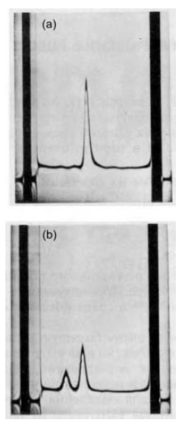
Schlieren Optical System
Light is passed through the cell at a specific point
The concentration at that point is changing due to sedimentation
This results in a varying degree of refraction
This change in radial distance is measured by the displacement of an image on a camera which is then plotted versus time

Slide 6
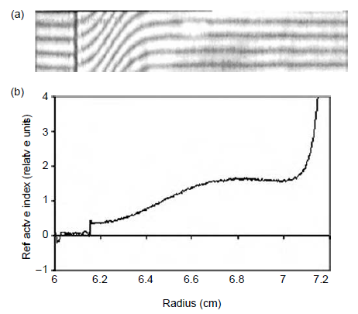
Rayleigh Optical System
Light get passed through the solvent and the sample and the diffraction pattern created is recorded
In order to analyze the data, it is plotted as refraction index versus radius in the cell
You expect to see a greater refractive index at the far end of the cell due to sedimentation
Good for macromolecules that don’t absorb in the UV range
Refractive index (relative units)

Slide 7
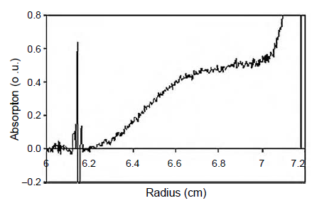
Absorption Optical System
Measuring absorbance versus radius in the cell
The higher the concentration, the stronger the absorbance
Nucleic acids absorb very strongly at ~260 nm and proteins absorb very strongly at ~280 nm
Good for macromolecules that absorb in the UV range
Absorption (o.u.)

Slide 8
The Lamm Equation
$$\frac{δC}{δt}=−\frac{1}{r}\left\{\frac{δ}{δr}\left[ω^{2}r^{2}sC−Dr\frac{δC}{δr}\right]\right\}$$
Equation for the change in concentration over change in time
Used to predict what the boundary shapes will look like

Slide 9
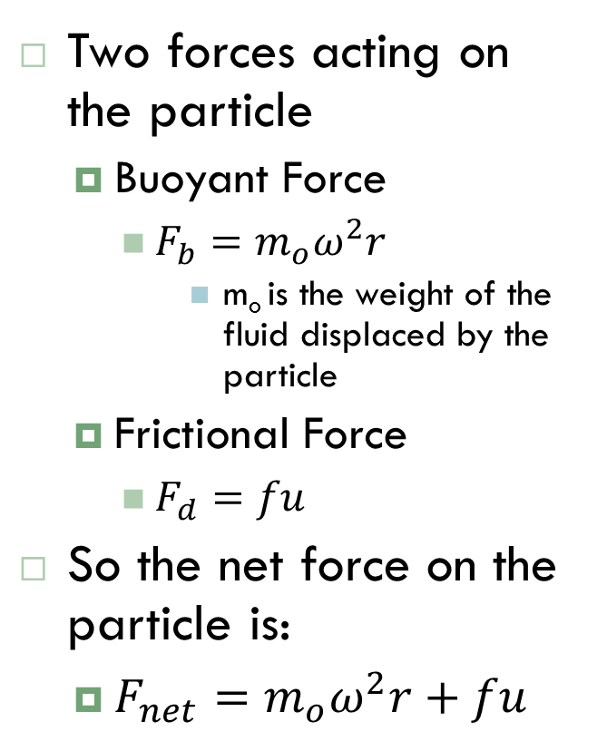
Sedimentation Constant
Two forces acting on the particle
Buoyant Force
$F_{b}=m_{o}ω^{2}r$
m_{o} is the weight of the fluid displaced by the particle
Frictional Force
$F_{d}=fu$
So the net force on the particle is:
$F_{net}=m_{o}ω^{2}r+fu$
$ω$– angular velocity
r – distance from the center of rotation
u – velocity of molecule
m – mass of the particle

Slide 10
Sedimentation Constant
The net force on the particle is equal to the mass times the acceleration which is this case the acceleration is the angular velocity squared times the radius
$F_{net}=ma=mω^{2}r=m_{o}ω^{2}r+fu$
From this we can get:
$\left(m−m_{o}\right)ω^{2}r=fu$
The mass the particle displaces is the volume the particle takes up times the volume of the solution
$m_{o}=V_{particle}ρ_{o}$
The volume of the particle is equal to the mass of the particle times the partial specific volume
$V_{particle}=m\overline{v}$
We can then combine these formulas to find that:
$m_{o}=m\overline{v}ρ_{o}$

Slide 11
Sedimentation Constant
We can then plug this back into our net force equation:
$fu=mω^{2}r−m\overline{v}ρ_{o}ω^{2}r=mω^{2}r(1−\overline{v}ρ_{o}$)
We then place all of the variables that are experimentally known on the left side of the equation, and define this as the sedimentation constant
$s=\frac{u}{ω^{2}r}=\frac{m(1−\overline{v}ρ_{o})}{f}$
Sedimentation constant is in seconds and usually around 10⁻¹³
Often uses Svedberg units (S)
1 S = 10⁻¹³ s

Slide 12
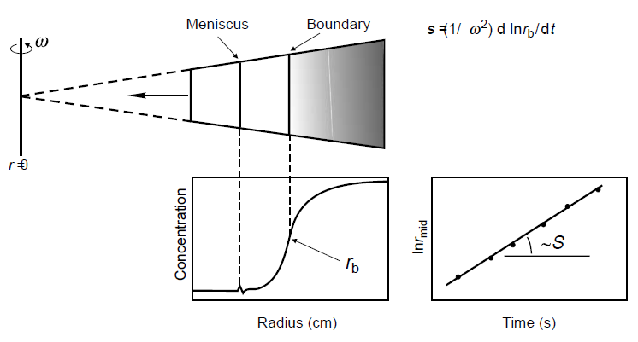
Data Analysis
The velocity of the concentration boundary is the change in its radial distance over the change in time and this velocity is related to the sedimentation constant from our previous definition
$u=\frac{dr_{b}}{dt}=sω^{2}r$
We can then rearrange this formula and take the integral of both sides
$\int{\frac{dr}{r}}=\int{sω^{2}dt}$ $\ln{r}=sω^{2}t$
Using this formula we can solve for the sedimentation constant by plotting the time versus the log of the radial distance of the concentration boundary
The slope of the plot is $sω^{2}$ and since $ω$ is known we can find the sedimentation constant from the plot

Slide 13
Analyzing Heterogeneous Solutions
What happens when the solution has multiple macromolecules in it?
If the solution is spun slowly, the smallest molecules will not sediment out quickly enough (or at all) and will not produce a useful gradient
If the solution is spun very fast, the largest molecules sediment out too fast and will not be able to be observed
To account for this the speed is ratcheted up after a set time step in order to be able to observe a peak for each macromolecule type in the solution

Slide 14
Standardizing Sedimentation Constants
$$s_{20,w}=s_{exp}\frac{1−\overline{v}ρ_{20,w}}{1−\overline{v}ρ_{exp}}\frac{{\text{η}}_{exp}}{{\text{η}}_{20,w}}$$
For biological macromolecules, the sedimentation constants are usually taken in solutions of varying density and viscosity so the sedimentation constant is adjusted to the standard of 20ºC in water

Slide 15
Information taken from:
Serdyuk, Igor N., Nathan R. Zaccai, and Joseph Zaccai.Methods in Molecular Biophysics: Structure, Dynamics, Function. New York: Cambridge University Press, 2007. Print.

