Slide 1
Union College Endowment Performance
Eshragh Motahar
Professor of Economics
September, 2023

Slide 2
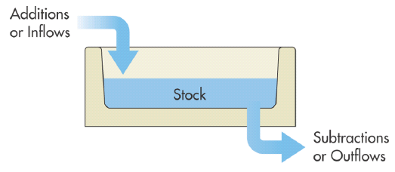

Slide 4
Why should students care?
Tuition
Scholarships
Faculty
Support services (food, bookstore, dorms, ITS, library, etc.)
Causes you believe in
Speakers, events
Additional donations
Reputation

Slide 5
Introduction
Deep in its Fall 2022 Report, the Board of Trustees included the following statement:
“The financial health of the College is strong. Despite a highly challenging investment environment, our endowment is at nearly $502 million.”
Not a word about the fact that the endowment managers lost $97 million in FY2022.

Slide 6
Introduction (continued)
Earlier, on August 11, 2021, the FEC wrote to the general faculty:
“The faculty members on P&P emerged from the meeting confident that the current suite of strategies employed by the Board of Trustees to manage the Endowment are in the best interests of the College”

Slide 7
Short-term Performance
Lower than the widely-used financial markets benchmark, S&P500 Index. (See Table)
FY2021, 12 percentage points lower
FY2022, 4 percentage points lower
Lower than a blend of 70% S&P500, 30% investment grade bonds.
Lower than median rate of return for endowments.
FY2022: Union -15% vs. -8%.
Lower than “peer institutions” (change in endowment)
FY2022: Union -16% vs. median peer -7%
Each one percentage point “lower” means around $5 million lost.

Slide 8
Short-term Performance Union vs. S&P500

Slide 9
Long-term Performance
Worse than S&P500 Index, based on the Gerber-Taylor methodology, for any period (window length) starting from FY2000 on. (See Table.)

Slide 10
Gerber|Taylor Methodology Window length: 5 to 22 years; start with $100 million

Slide 12
Risk
Worse than S&P500 Index, based on the Sharpe Index.

Slide 13
Insulation from “low frequency/severe loss episodes” [quoted from Gerber|Taylor]
The value of the endowment declined by:
$108 million in FY2009
$52 million in FY2016
$97 million in FY2022

Slide 14
Transparency
Data on management and incentive fees discontinued/censored as of FY2021.
No clarity on Cayman Islands investments
around 45% of Union’s endowment is invested there.
The names of the members of the Investment Committee of the Board of Trustees have been censored.
For examples of higher transparency in some peer institutions, see Amherst, here; and Colgate here.

Slide 15
Transparency (continued)
Based on extensive discussions with a senior financial analyst on Wall Street (with 30 years of experience):
“Union's endowment is managed so poorly that doing better would be easy.”
Three characteristics of a good investment strategy are: “simple, transparent, low-fee.” Normally, investments on the Cayman Islands tend to be “complex, non-transparent, high-fee.”
“What are the types of investments for which you need to be on Cayman Islands rather than in the U.S.?”

Slide 16
Accountability/Fiduciary Responsibility
Deep in its Winter 2023 Report, the Board of Trustees includes the following statement:
“During a highly volatile period for investing, the College remains in sound financial health with an endowment at about $500 million.”
Proof by assertion.

Slide 17
Summary
Thus, failure based on all of the following criteria:
Short-term returns
Long-term returns
Risk
Comparison with peer institutions
Protection against “severe loss episodes”
Transparency
Accountability

Slide 18
A Second Opinion (director of investment management services for a major academic institution)
“Overall, I do agree that the data suggests that this endowment has not historically generated performance that a Union College stakeholder should consider acceptable.”
“I think there are very valid questions about the strength of the long-term results and whether returns have been sufficient to compensate for the level of risk in the portfolio.”

Slide 19
A Second Opinion (more clinical!)
“The fact that their Sharpe ratios do not exceed the 70/30 MSCI ACWI benchmark [here] is surprising and, to me, does indicate a relatively poor historical return / risk ratio.”
“[Union has] materially underperformed a 70% S&P 500 / 30% BBG US Aggregate [here] benchmark.”

Slide 20
Sources
All data (Excel files, annual audits, IRS 990 documents), methodology, and workfiles are available upon request. (See also here.)
Extensive bibliography also available, here.

Slide 21
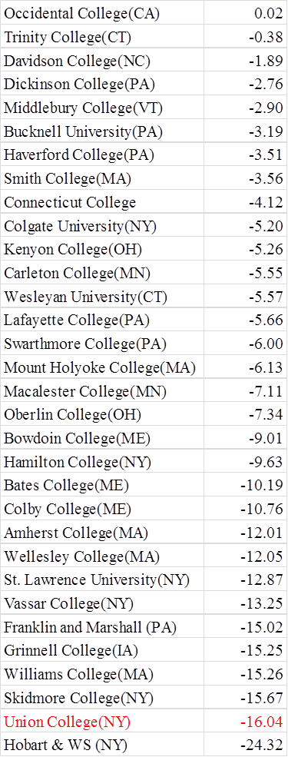
Change in Endowment Market Value from FY21 to FY22, Union’s Peer Institutions

Slide 22
