Slide 1
What’s Happening in Europe? Crisis, Inequality and Structural Constraints from Greece to Norway...and Places In Between
Kristian F. Braekkan
Gustavus Adolphus College
Saint Peter, MN

Slide 2
Challenges associated with studies of global economic inequality….
We often focus on the performance of the “advanced capitalist economies” and treat the world economy as an aggregate of each part
Capitalism is a global system, and it is only at the level of world economy that all of it’s dynamics come into play
Capital does not invest in order to boost GDP, national income, employment, to maintain business spending, or to generate income equality
It invests in order to expand itself via the capture of shares of global surplus value

Slide 3
Surplus Value: the source of profits
The purpose of the capitalist mode of production is to increase surplus value.
Surplus Value (S) = Value of Labor – Labor Power (V)
S/V represents rate of exploitation
Absolute surplus-value: increase surplus value by extending the working day
Relative surplus-value: labor day stays the same, but reduction in necessary labor time
Constant capital (C) reduces labor time
C/V = organic composition of capital

Slide 4
capitalist production = exploitation = unequal exchange
exploitation = our ideologies?

Slide 5
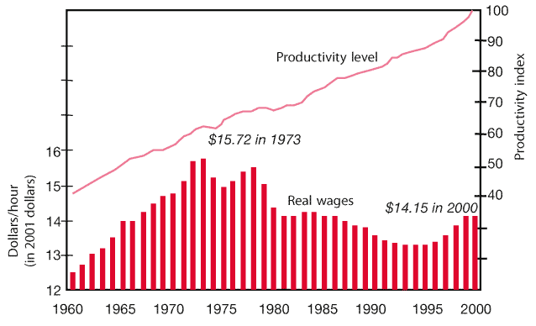
U.S Worker Productivity & Real wages 1960-2000
Source: Pollin, Countours of Descent

Slide 6
Europe: Within and Between Differences

Slide 7
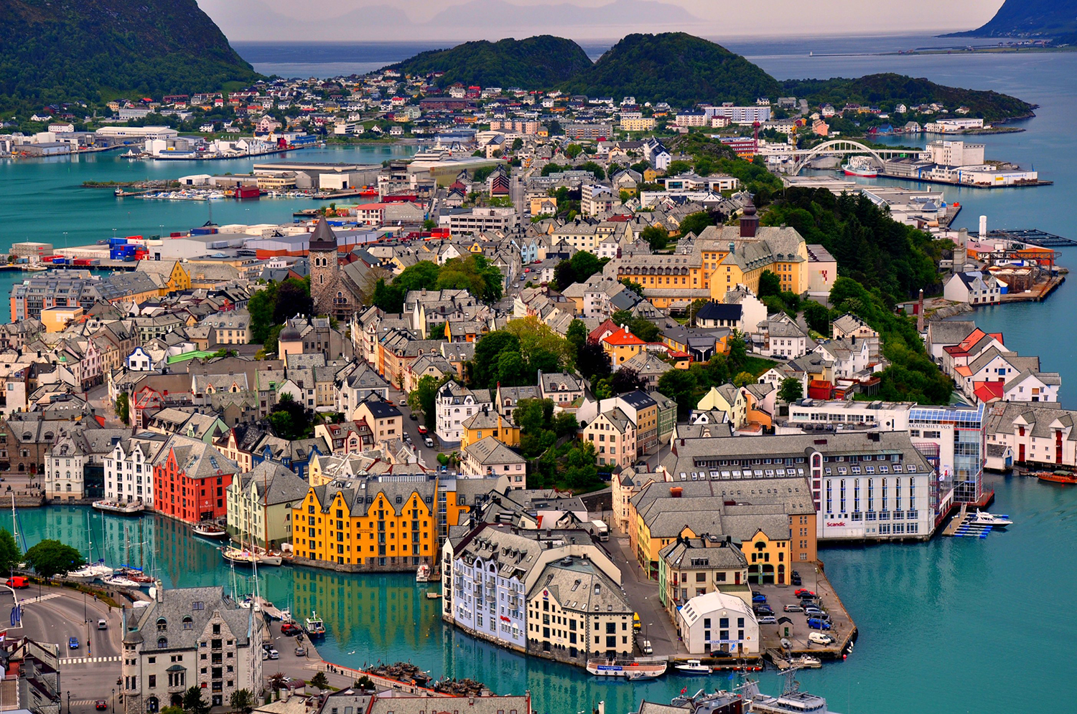
Norway: democratic socialism
Population: 5.1 million
GDP (PPP): $352 billion (421 nominal)
GDP/Capita: $67,445 ($80,749 nominal)
Gini: 22.3 (low)
HDI: 0.944 (highest in the world)
Government surplus < $1,000 billion

Slide 8
How do Norwegians think about “value” in society?
Welfare does not begin and end with production and consumption
It also includes critical human rights such as health, culture, and access to education
High degree of class consciousness:
Important to recognize the relationship between our economic modalities and our ideologies

Slide 9
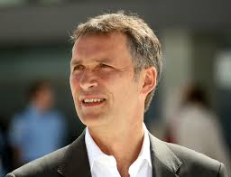
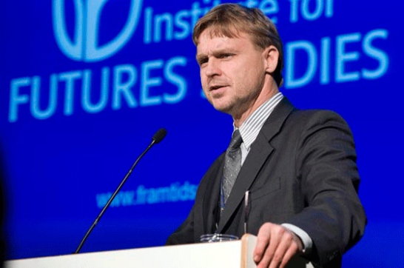
Scandinavian concerns about the market
“Market forces are good servants but terrible masters”
Prime Minister Jens Stoltenberg
“...the Nordic model is about... universalism, generous benefits, social citizenship rights, dual-earner model, active labor market policies, and extensive social services”
Joakim Palme

Slide 10
Lessons from the Norwegian Model
Democratic Socialism/”the slow revolution”
Universal welfare state
Gender equality
Income redistribution
Maternity/Paternity leave
Collective bargaining agreements
Taxation
Health care reforms
Education reforms

Slide 11
Thesis 1: Human capital is by far the most important national resource– not oil and gas
Full coverage of pre-school age 1-6, a common basic education 6 to 16, tertiary education free of charge ensuring that their ability to study is independent of parents’ abilities to pay.
Extremely high labor force participation.
Measures that aim at increasing the human capital, often gives a double dividend by equalizing the income distribution, while at the same time increasing growth.

Slide 12
Thesis 2: The Norwegian welfare model is effective – not only in securing welfare services to the public. It also contributes to labor participation, flexibility and high productivity.
All Norwegians have a statutory right to day care facilities. In addition they are entitled to one year's paid parental leave – divided between the mother and father. As a result, Norway maintains one of the highest fertility rates in Europe, close to 2 per cent compared to the EU average of around 1½.
An active labor market policy is an important tool both to smooth the labor market through business cycles and to ensure that persons on the fringe of the labor market can take part in the labor market. In that context the government put emphasis on including as many as possible in active working life.
A well functioning social security system, including an unemployment scheme, has made the economy less vulnerable to economic shocks because it has supported a flexible labor market and made it easier to carry out downscaling without large social costs and conflicts.

Slide 13
The Health Care System
The government is responsible overall for providing health care to Norway’s population.
Coverage is universal. The nationally managed and financed health system is built on the principle of equal access for all citizens regardless of socioeconomic status, ethnicity, and area of residence.
There is no defined benefits package. In practice, it covers primary care, hospital care, ambulatory care, and outpatient prescription drugs.
All inpatient care in a public hospital, including use of pharmaceuticals, is free of charge for the patients.

Slide 14
How is the health system financed? (OECD, 2012)
Norway has the second-highest per-capita spending on health care among OECD countries (NOK55,560, or USD 6,140).
As a percentage of GDP, Norway spends close to the OECD median (9.3% in 2012).
Public spending on health is financed through general taxation, and accounted for 85.5 percent of total health expenditure in 2013. The central government, counties, and municipalities all collect taxes.

Slide 15
Norway USA (Source: The Commonwealth Fund – London School of Economics)
Percent of population over age 65: 15.3%
Percent of GDP spent on health care: 9.3%
Health care spending/capita: $6,140
Percent of population over age 65: 13.7%
Percent of GDP spent on health care: 16.9%
Health care spending/capita: $8,745

Slide 16
Norway/USA comparison
Out of pocket spending per capita: $0
Hospital spending per capita: $2,132
Number of physicians per 1,000 population: 4.23
Out of pocket spending per capita: $1,045
Hospital spending per capita: $2,811
Number of physicians per 1,000 population: 2.46

Slide 17
Norway/USA comparison
Hospital spending per discharge: $11,363
Obesity (BMI >30): 10%
Hospital spending per discharge: $20,932
Obesity (BMI >30): 35.3%

Slide 18
Adult access to care
Same day appointment when sick: 52%
Two month wait for specialists: 19%
Access barrier due to cost: 0%
Same day appointment when sick: 48%
Two month wait for specialists: 6%
Access barrier due to cost: 37%

Slide 19
OECD health care quality indicators
Diabetes lower extremity amputation rates per 100,000: 8.7
Breast cancer 5 year survival rate: 86.4%
Mortality after admission for acute myocardinal infarction per 100 admissions over age 45: 4.5
Mortality amenable to health care per 100,000: 64
Diabetes lower extremity amputation rates per 100,000: 17.1
Breast cancer 5 year survival rate: 88.7%
Mortality after admission for acute myocardinal infarction per 100 admissions over age 45: 5.5
Mortality amenable to health care per 100,000: 96

Slide 20
Thesis 3: Tripartite cooperation between the social partners (unions and employers) and the Government has a long tradition in Norway and contributes to growth and equality
Wages are set in highly centralized negotiations between a few big unions and employers. Given their size, unions have an incentive to take into account the impact of wage increases on unemployment.
It facilitates an emphasis on common interests and a fairly equal distribution of income. The cooperative quality of the system has been instrumental both in times of crisis and when dealing with long-term structural issues.

Slide 21
Conclusion
Contrary to American conventional wisdom, Norway’s model with comprehensive risk-reducing welfare systems stimulates growth and employment. Despite a rather even income distribution, enrollment in higher education is high, and despite a tax-financed welfare state, labor participation is high, which contributes to high degree of equality and solid economic performance.

Slide 22
Greece and the EU: Neoliberalism
1981: Joined European Communities
2001: Adopted Euro
2001-2008: GDP/Capita almost tripled $12,400 to $31,700
Fall 2009: PASOK government/budget deficit 12.5% of GDP
Spring 2010: Three separate austerity packages/riots/bailout
2011: Two more austerity packages/new property taxes
2012: Two more austerity packages/bailout/new coalition
2013: Two reform bills
January 2015: Syriza wins election
July 2015: Referendum/61% vote against Juncker commission/26% unemployment

Slide 23
Mainstream Explanations of the Crisis in Greece
It’s a Greek Disease
Large and persistent fiscal deficits financed through borrowing
Falling international competitiveness
The EMU is NOT an Optimal Currency Area
Europe exemplifies a situation unfavorable to a common currency
Lower labor mobility [than the United States] and cannot rely on fiscal federalism to smooth out regional economic disturbances
It’s a Combination Problem
National policy errors
Incomplete economic unification of the EMU

Slide 24
IMF
Euro
Members
EFSF
47.9
52.9
34.8
13.6
48.2
10.9
41
Greek
State
1.5
Greek
Banks
51.4
3
Former
Lenders
21.1
2.1
50
Greece has received 224,5 billion euros in loans from the IMF, the other EMU
members and the EFSF.
Sources: Greek Central Bank, EFSF and IMF.
Greek
People

Slide 25
Critical Explanations
Capitalism is crisis prone
The immediate problem is the “financialization” of capitalism
Euro-periphery/euro-core capital movements

Slide 26
My take on the crisis
Inequality is not an undesired outcome but a pre-requisite for perpetual growth under capitalism
Crisis of over-accumulation of capital
Financialization as consequence - not a cause
Imperialist exploitation

Slide 27
Crisis of over-accumulation of capital
Competition yields obsessive accumulation of capital – quest for relative surplus value
Production increases faster than return – lower rates of profits
Recessions free up capital – increased concentration (i.e., inequality)

Slide 28
Accumulation & Imperialist Exploitation: Expansions and Slumps since WWII
Sustained expansion (1948-1973) - “Golden years” of western capitalism
Racial oppression and marginalization (indigenous peoples, African Americans, immigrants of color, undocumented immigrants)
Capital accumulation averaged 4%/year, 5.5% in 1970
World slump (1973-1982) – viewed as recessions
Over-accumulation of capital
Decreasing rates of profit
Sustained expansion (1982-2007)
War on the Global South and labor
Financialization in the 1990s, debt financing, and exploitation
World slump (2007-?)
Domestic and global inequality at all time high
Collapse of Global capitalism?

Slide 29
Profits under capitalism
Profits = s (s/v)
(c +v) = (1 + c/v)
s = surplus value
c = capital
V= variable capital
(s/v) = rate of exploitation
(c/v) = organic composition of capital

Slide 30
Profits under capitalism
Capital needs s to grow faster than v, but that’s only possible with an increase in c, hence denominator has to increase
We can expect surplus value to be in inverse proportion to the organic composition of capital
Profits = s (s/v)
(c +v) = (1 + c/v)
s = surplus value
c = capital
V= variable capital
(s/v) = rate of exploitation
(c/v) = organic composition of capital

Slide 31
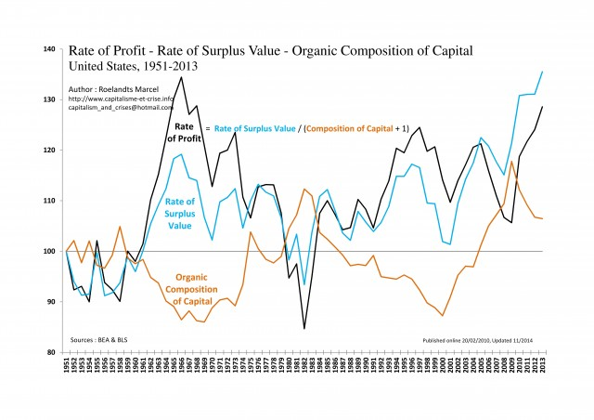

Slide 32
World economy tripled in size between 1982-2007, but…
Mostly due to expansion in Asia, followed by 1997 crisis that was directly tied to over-accumulation
It is not a finance crisis - it is a crisis of capitalism
Marx on the end of capitalism:
“At first glance… the entire crisis presents itself as simply a credit and monetary crisis”
(Capital Vol. 3, p.621)

Slide 33
Thesis 4: The neoliberal agenda has accelerated “primitive accumulation” by exploiting the Global South’s “Reserve Army of Labor” while disciplining workers in the North
Country Monthly Wage as % of U.S. wage
United States 100 – real wages -10% since 1970s
Chile 14.9
Mexico 11.8
China* 4.9
Indonesia 1.9
India 0.8
*109 million manufacturing workers
(G7: 53 million combined)
IMF numbers indicate that more than half of the global labor force of 3 billion people lives in East or South East Asia.
Source: International Labor Organizations, Yearbook of Labor Statistics, 2006

Slide 34
Share of world income received by the richest 20% of the world’s countries relative to the share of the poorest 20%
Global North/South
Source: United Nations Development Program
1820 – 3:1
1870 – 7:1
1913 – 11:1
1960 – 30:1
1990 – 60: 1
1997 – 74:1
2013 – 214:1
North: ¼ population, 4/5 income
South: 3/4 population, 1/5 income

Slide 35
Thesis 5: Capitalist expansion in the neoliberal era delayed the “real” crisis
World Bank figures suggest that 95% of the world economy in the 1970s was tied to the “real economy”, and 5% was considered “speculative”. Twenty years later the numbers were reversed.
1973-1979: $500 billion in new debt (25% per year) - “Volcker shock”
1980-2002: developing economies paid $4.6 trillion in debt payments to the Global North (8x the original loans)
Mexico: minimum wage –40%
80% below poverty line
0.3% control 50% of wealth
Source: Center for Economy Policy

Slide 36
Thesis 6: Neoliberalism has sustained capital’s oppression, but capitalism is the real problem
The capitalist market is a disciplinary system that contributes to alienation and exploitation
It starts with the modern work discipline
Obedience
Industriousness
Financial responsibility
“we are experiencing a statistical recovery, but a human recession” (Larry Summers 2009)
“there is a statistical recovery because of a human recession” (California school teacher 2009)

Slide 37
Domestic Example: Wealth Distribution
America’s 35 largest cities
African American unemployment: 30-35%
African Americans and Latinos 3x more likely to live in poverty than whites
50% of all American children today will at some point live off food stamps
90% of all African American children
Net worth:
African Americans $0.10 per $1.00 of White, Latinos $0.12.
African American women: $100 median net wealth
Latino women: $120 median net wealth
White women: $41,500 median net wealth
Source: Economic Policy Institute

