Slide 1
Inequality Economic and Social Perspectives
Teresa Meade and Eshragh Motahar
Fall 2015

Slide 2
Introduction
What do we mean by inequality?
Is it inevitable?
Historical context
What is new?
Why should we care about it?
Policies

Slide 3
Methodological Issues
“Opinion” vs. evidence-based critical analysis
Correlation vs. causation

Slide 4
Thomas Piketty
Book published in Spring 2014
Capital in the Twenty-First Century
Piketty mania: how an economics lecture became the hottest gig in town
http://www.theguardian.com/books/2014/jun/17/thomas-piketty-lse-capitalism-talk

Slide 6
Pikettymania
A specter is haunting Europe and the U.S.—the specter of plutocracy. In Britain, Deputy Prime Minister Nick Clegg has suggested the moment has arrived to consider a wealth tax. In France, which already has one, plans to ease its bite were recently canceled. Even in the more timid precincts of Washington, you cannot swing a V for Vendetta mask without hitting a think tank panel on inequality. Everyone, it seems, is worried we are shortly headed for a world in which a handful of rich people will own everything, and the rest are forced to rent their air and water from Mark Zuckerberg.
http://www.businessweek.com/printer/articles/204120-pikettys-capital-an-economists-inequality-ideas-are-all-the-rage

Slide 7
The “Piketty Graph”

Slide 8
Graphs
Piketty on the U.S. (in one graph)
http://scalar.usc.edu/works/growing-apart-a-political-history-of-american-inequality/index
Other indicators
[scroll down]

Slide 9
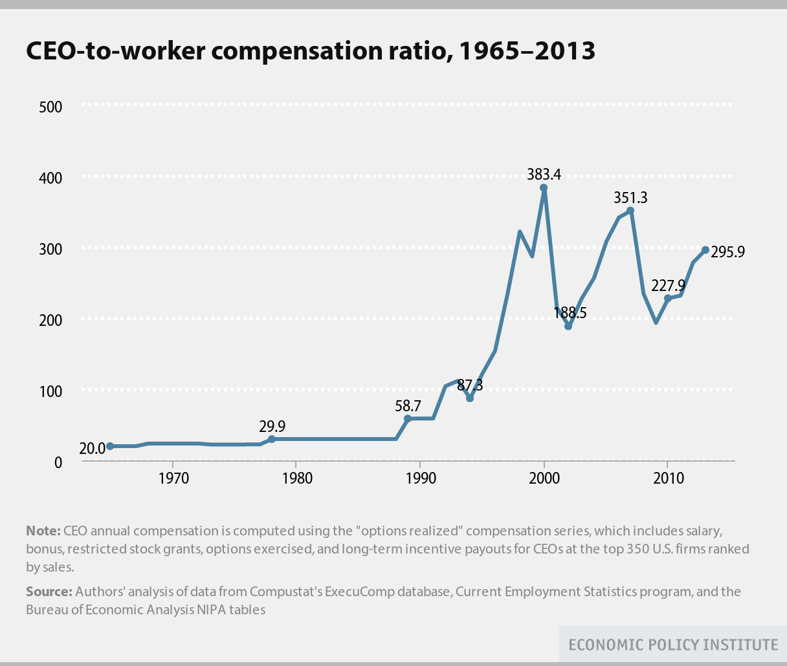

Slide 10
CEO Pay
These U.S. CEOs Make a Lot More Money Than Their Workers
http://www.bloomberg.com/news/articles/2015-08-13/these-ceos-make-the-most-money-compared-with-their-workers
Average CEO pay at the 350 largest U.S. companies by revenue surged 997 percent from 1978 to 2014, while the compensation of non-supervisory employees rose 10.9 percent, according to the Economic Policy Institute, a research group that advocates for workers.

Slide 11
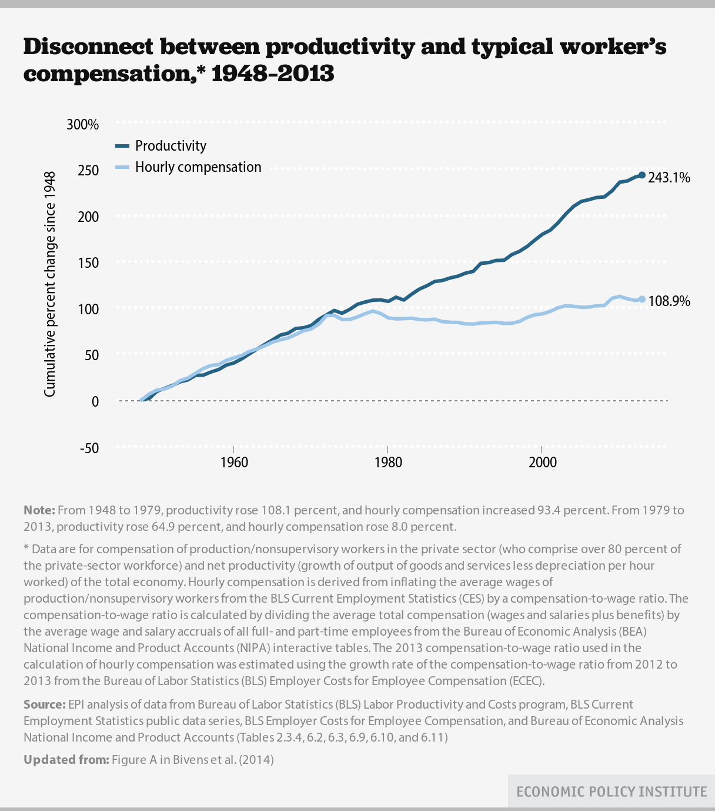

Slide 12
In summary, as of now (in approximate numbers)…
The top 1%
is taking home more than 20% of total income
Owns at least 38% of total wealth
The richest 400 people in the U.S. have more wealth than the bottom 150 million Americans put together
CEOs of large corporations now earn 300 times wages of average workers (vs. 35-40 times in 50s-60s)

Slide 13
Piketty’s Contributions
The truly rich—top 1% [making it “visible”]
Inheritance
“we’re … on a path back to “patrimonial capitalism,” in which the commanding heights of the economy are controlled not by talented individuals but by family dynasties.”
“It’s a work that melds grand historical sweep—when was the last time you heard an economist invoke Jane Austen and Balzac?—with painstaking data analysis.”

Slide 14
Piketty’s Contributions (2)
Income from capital vs. earned income (wages and salaries)
Unequal ownership of assets, not unequal pay, is the prime driver of income disparities
A good diagnosis is important if one is looking for remedies.

Slide 15
Why does it matter?
“Patrimonial capitalism”
Inequality of opportunity
Oligarchy
Lower growth
More unstable economy

Slide 16
Is U.S. becoming an Oligarchy?
“Fewer than four hundred families are responsible for almost half the money raised in the 2016 presidential campaign, a concentration of political donors that is unprecedented in the modern era.”
The New York Times, August, 2015

Slide 17
Scholarly Sources (1)
IMF study finds inequality is damaging to economic growth
International Monetary Fund paper dismisses the argument that redistributing incomes is self-defeating

Slide 18
Scholarly Sources (2)
We use consumption and balance sheet data disaggregated between the top 5% and the bottom 95% of US households by income to show that the bottom 95% went deeply into debt to mitigate the impact of their stagnant incomes on their consumption. We use micro data to calibrate an intrinsic Keynesian growth model and show that over a range of plausible parameter values, the rise in US household income inequality increased enough between the early 1980s and 2000s to cause the entire magnitude of the Great Recession and can explain the slow and prolonged recovery.
* Authors Cynamon: Visiting Scholar at the Federal Reserve Bank of St. Louis Center for Household Financial Stability; Fazzari: Departments of Economics and Sociology at Washington University in St. Louis.

Slide 19
…. and
Income Inequality Hurts Economic Growth
Forbes Magazine

Slide 20
Proposed Policies
Piketty: progressive wealth tax at the global scale, based upon automatic exchange of bank information
Piketty’s critics
Data
Predictions
Policy recommendations

Slide 21
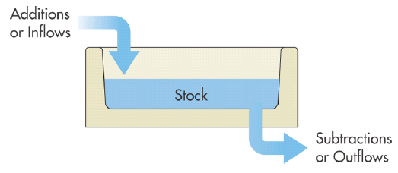
Some Key Concepts
Income (flow)
Wealth (stock)

Slide 22
The T-shirt http://shop.comedycentral.com/The-Colbert-Report-r-g-Tee/M/B00KQ2T9KY.htm

Slide 23
r vs. g
r rate of return on capital
g rate of growth of income
If r > g, then the ratio of capitalist’s wealth to worker’s wage increases at an annual rate of r – g
Thus r > g can be regarded as an “amplification mechanism” for existing inequalities, including labor income inequalities

Slide 24
Appendix: Some additional graphs, tables, etc.
Piketty’s Numerical Estimates
r = 4-5%
g = 1.5
Thus, r – g = 3%

Slide 25
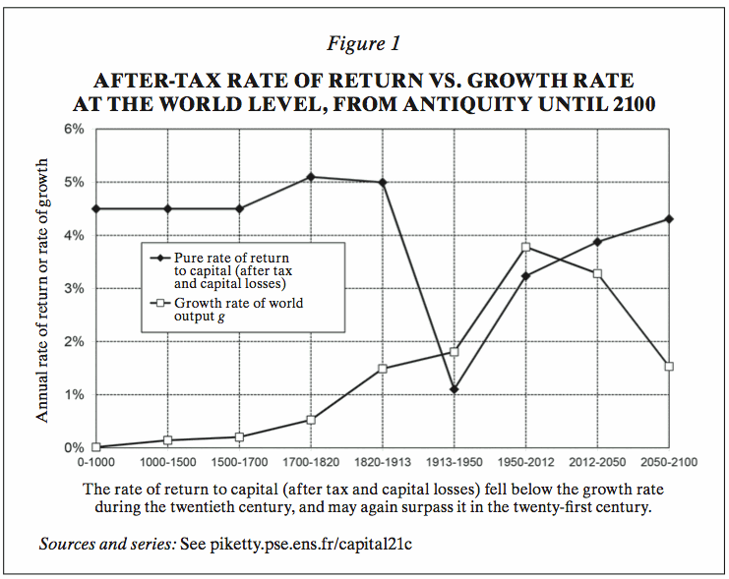

Slide 26
CEO Pay
Money to Burn: How CEO Pay is Accelerating Climate Change
IPS: http://www.ips-dc.org/wp-content/uploads/2015/09/EE2015-Money-To-Burn-Upd.pdf

Slide 27
Marginal Tax Rates

Slide 28
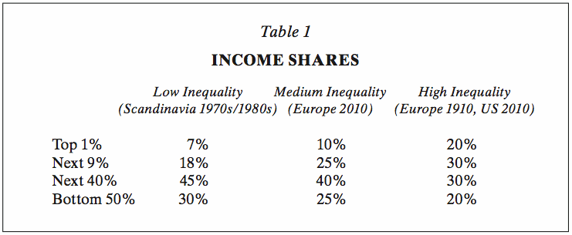

Slide 29
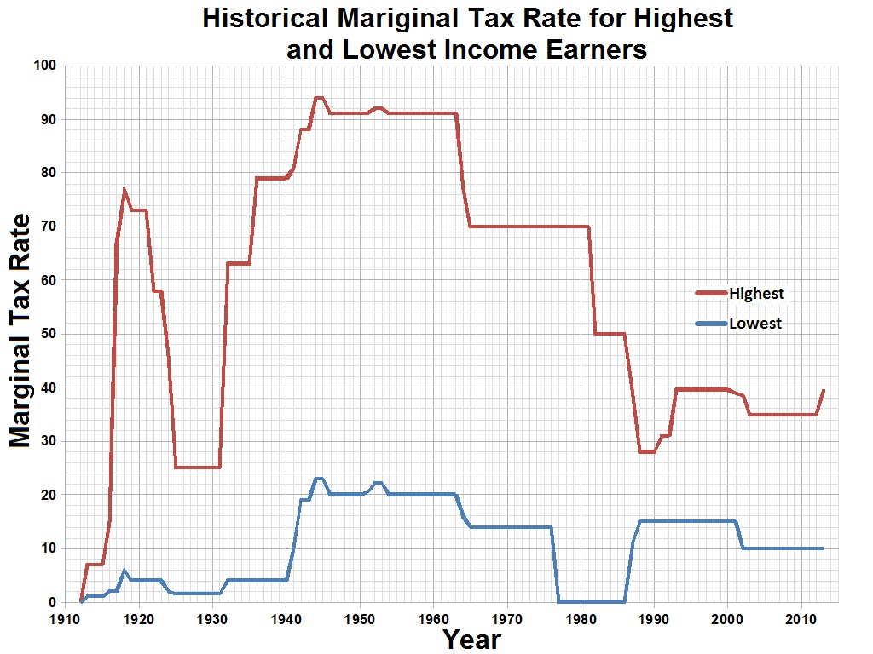

Slide 30
Piketty Graph

Slide 31
Some Relevant Sites
http://topincomes.parisschoolofeconomics.eu/#Graphic:
http://www.gc.cuny.edu/Page-Elements/Academics-Research-Centers-Initiatives/Centers-and-Institutes/Luxembourg-Income-Study-Center
http://inequality.org/
http://scalar.usc.edu/works/growing-apart-a-political-history-of-american-inequality/index

